Slide 1

Measurement of Parity-Violation in Cold Neutron Capture
Mikayel Dabaghyan for the NPDGamma Collaboration
M. Dabaghyan for the NPDGamma Collaboration
The n + p → d + γ Experiment at LANL

Slide 2

Outline
Hadronic Weak Interaction
What…
Why…
How…
Experiment
Hardware and measurements
Analysis and Results
Asymmetry, Errors
Summary and Outlook
Present and Future
M. Dabaghyan for the NPDGamma Collaboration
The n + p → d + γ Experiment at LANL

Slide 3
Why…
Bosons are too heavy
N
N
Study the weak interaction between hadrons
Z⁰ = 91.2 GeV
W± = 80.4 GeV
range - ≤ 2×10³ fm .
π, ρ, ω ≤ 300 MeV.
range - ≤ 1 fm .
?
Explore weak interaction at low energies.
The ΔI = ½ rule: Γ(K_{s}⁰ → π⁰π⁰) » Γ(K⁺ → π⁺π⁰).
Probe strong interaction at low energies.
Z⁰, W±
ρ, ω, π±
N
N
M. Dabaghyan for the NPDGamma Collaboration
The n + p → d + γ Experiment at LANL

Slide 4
Weak Interaction
ν_{μ}
e⁻
ν_{e}
W⁻
Weak processes
μ⁻
μ → e⁻ + υ_{μ} + υ_{e}
n → p + e⁻ + υ_{e}
n + p → n + p
p
u
d
u
e⁻
ν_{e}
W⁻
n
u
d
d
n
d
u
d
u
u
d
p
W⁺
π⁺
p
n
d
u
u
d
u
d
M. Dabaghyan for the NPDGamma Collaboration
The n + p → d + γ Experiment at LANL

Slide 5
Weak Interaction
Weak vs. Strong
N
N
ΔS = 0 : strong
Use Parity!
π±, ρ, ω
PV
PC
N
N
M. Dabaghyan for the NPDGamma Collaboration
The n + p → d + γ Experiment at LANL

Slide 6
Parity Violation
Parity
mirror world
P(x) = - x
P(y) = - y
P(z) = - z
real world
P(s_{n}) = s_{n}
P(k_{γ}) = - k_{γ}
Study the weak interaction between hadrons
Two nucleon system: n + p → d + γ
ΔS = 0, ΔI = 1 channel
M. Dabaghyan for the NPDGamma Collaboration
The n + p → d + γ Experiment at LANL

Slide 7
Why PV in n+p → d+γ ?
n + p excited and ground states
³S₁, I=0
³P₁, I=1
¹P₁, I=0
¹S₀, I=1
³P₀, I=1
E1
M1
E1
E1
E1
E1
M1
E1
E1
Hindered transition
Parity Violation
³S₁, I=0
³P₁, I=1
¹P₁, I=0
M. Dabaghyan for the NPDGamma Collaboration
The n + p → d + γ Experiment at LANL

Slide 8
How…
ϑ
n
p
d
M. Dabaghyan for the NPDGamma Collaboration
The n + p → d + γ Experiment at LANL

Slide 9
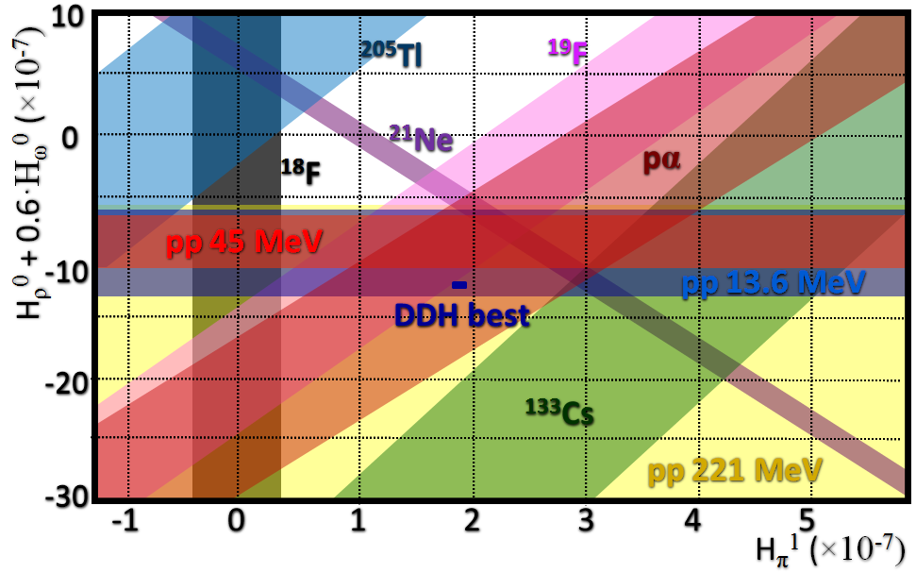
H_{π}¹ so far…
DDH Theoretical
Estimate
n+p→d+γ
Cavaignac et al.
Phys.Lett.B., 67
148, 1977
¹⁸F
Evans et al.; Bini et al.
Phys.Rev.Lett. 55
¹³³Cs
Wood et al.
Science 275, 1753, 1997
Flambaum and Murray
Phys. Rev. C 56, 1641, 1997
Compound Nuclei
Bowman et al. LANL 2002
-2 -1 0 1 2 3 4
H_{π}¹(×10⁻⁶)
H_{π}¹(×10⁻⁶)
DDH:
Goal:
DDH: Desplanques, Donoghue, Holstein, Annals of Physics 124, 1980, 449.
M. Dabaghyan for the NPDGamma Collaboration
The n + p → d + γ Experiment at LANL

Slide 10
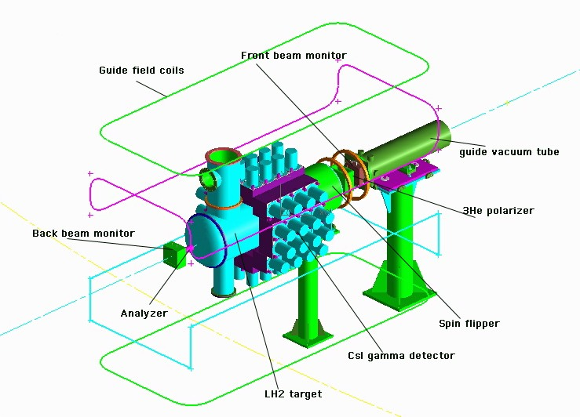
Experiment - Overview
Flight Path
Neutron Guide
Shielding
Holding Field
Beam Monitors
Detector Array
RF Spin Flipper
Polarizer
Analyzer
Hydrogen Target
Compound Targets
M. Dabaghyan for the NPDGamma Collaboration
The n + p → d + γ Experiment at LANL

Slide 11
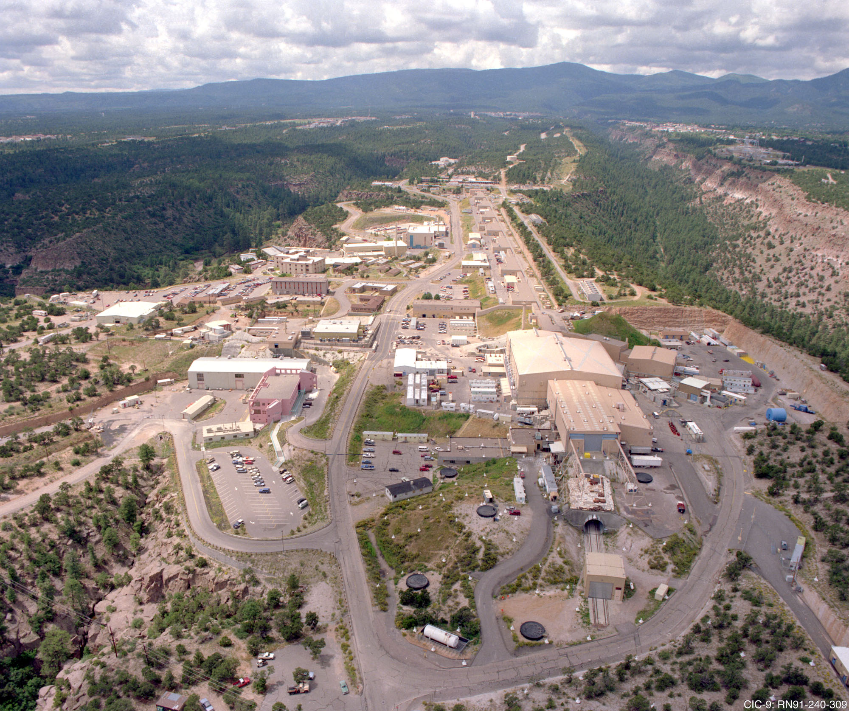
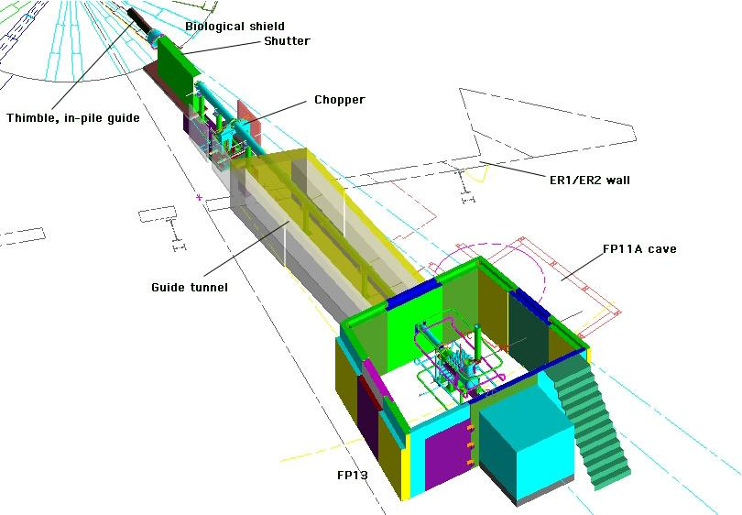
Experiment – Flight Path
Flight – Path
800 MeV Protons from ½ mile linac (~100μA)
Protons hit the W spallation target to produce neutrons
Neutrons are moderated by LH2 to ~100meV
20Hz pulses – 50ms frames – time of flight information
Neutrons are delivered by an ~20m “supermirror” guide
M. Dabaghyan for the NPDGamma Collaboration
The n + p → d + γ Experiment at LANL

Slide 12
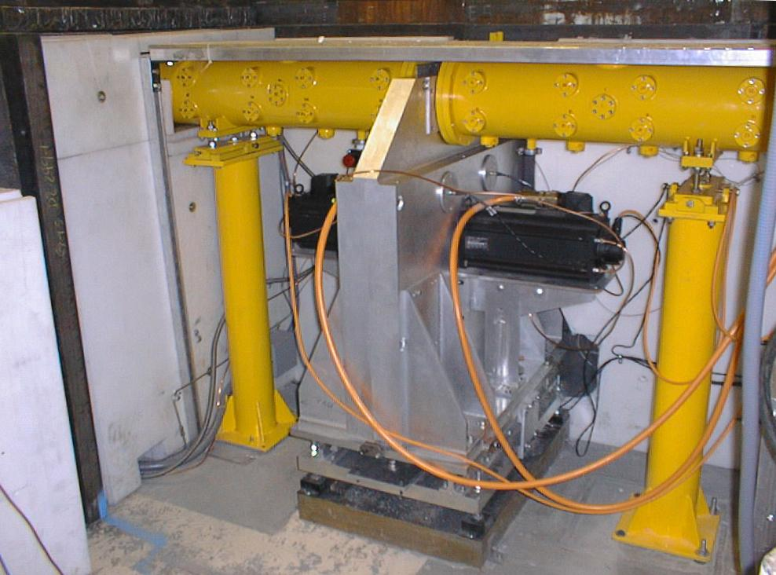
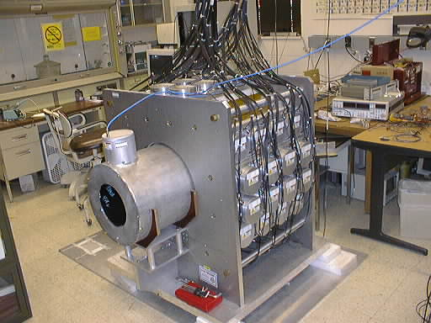
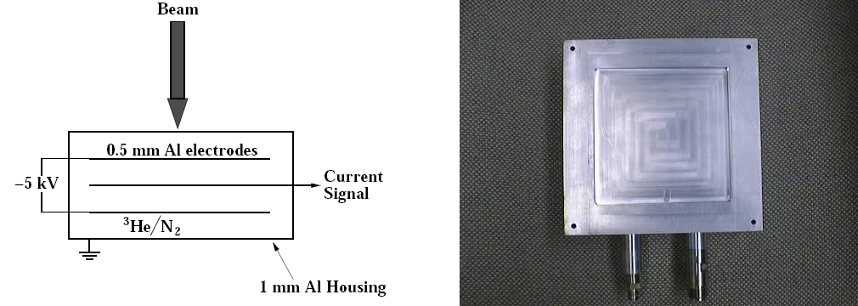
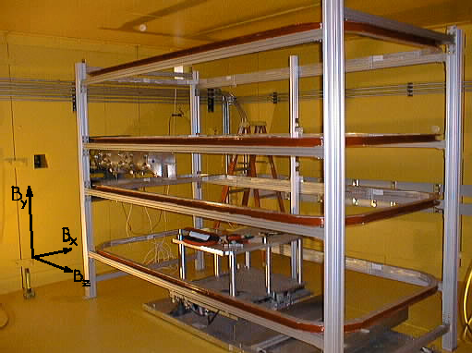
Apparatus
M. Dabaghyan for the NPDGamma Collaboration
The n + p → d + γ Experiment at LANL

Slide 13
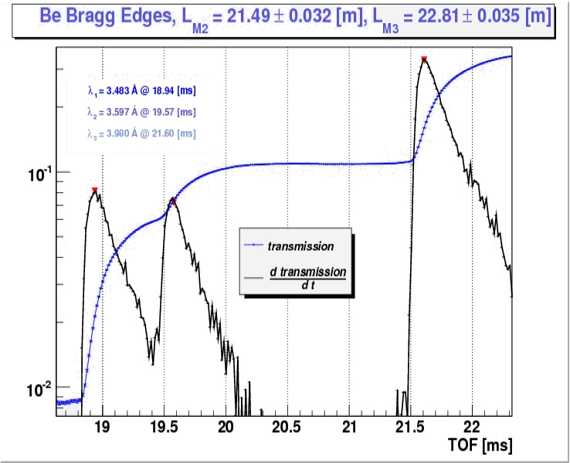
Apparatus – Flight Path Length
Bragg Transmission
L₁
L₂
L₃
Flight Path Length
T_{n}
M. Dabaghyan for the NPDGamma Collaboration
The n + p → d + γ Experiment at LANL

Slide 14
Experiment – γ-ray Detectors
Measure Neutron Flux
3π acceptance
4 rings of 15×15×15 cm³ CsI crystals
VPD: insensitive to magnetic field
High event rate: use current mode
Low-noise preamps: < 0.1 mV RMS
Operate at counting statistics
95% γ’s stopped in crystals
Aligned with B₀ better than 1º
M. Dabaghyan for the NPDGamma Collaboration
The n + p → d + γ Experiment at LANL
Notes:
Rates are about 10¹⁰ γ/s → current mode detection.
Light from CsI(Tl) is detected by 3” vacuum photodiodes which have S20 photocathodes.
vacuum photodiode linearity < 10⁻⁴ and
magnetic field sensitivity < 10⁻⁴/G and < 10⁻⁵/G²
Vacuum photodiode has a gain of 1 → a high-gain low-noise I → V preamplifier is required.
In the current mode detection statistical fluctuations (counting statistics) appear as a shot noise in photodiode current.
RMS of the shot noise current density is i_noise/√f = √(2qI) ~ n_pe√(2·rate) ≈ 5 pA/√Hz per detector.
Sources of noise; Johnson noise in R_{f}, current and voltage noises in the op amp input, and photocathode dark current
If R_{f} = 60 MΩ then the total calculated equivalent noise at the input is 19 fA/√Hz dominated by R_{f}.
Noise value measured from the circuit is about 20 fA/√Hz. → counting statistics/noise ≈ 250.
Counting statistics rules the run time.
To measure beam-off false asymmetry to 0.5 x 10⁻⁸ beam-off time of a few minutes is needed.

Slide 15
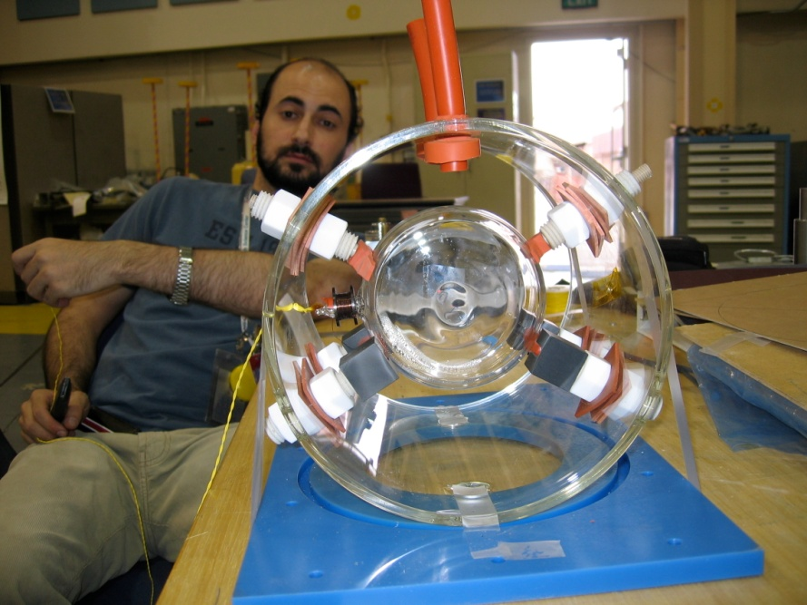
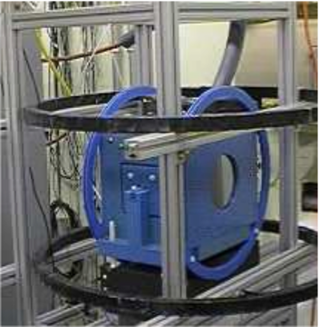
Experiment – Polarizer
Polarized Laser Light
Unpolarized
Neutrons
Polarized
Neutrons
³He cell
Helmholtz Coils
Boo-Boo
12 cm in diameter, 5 cm thick
4.9 atm·cm
Relaxation time of 500 hrs
Typical polarization ~ 55%
M. Dabaghyan for the NPDGamma Collaboration
The n + p → d + γ Experiment at LANL

Slide 16
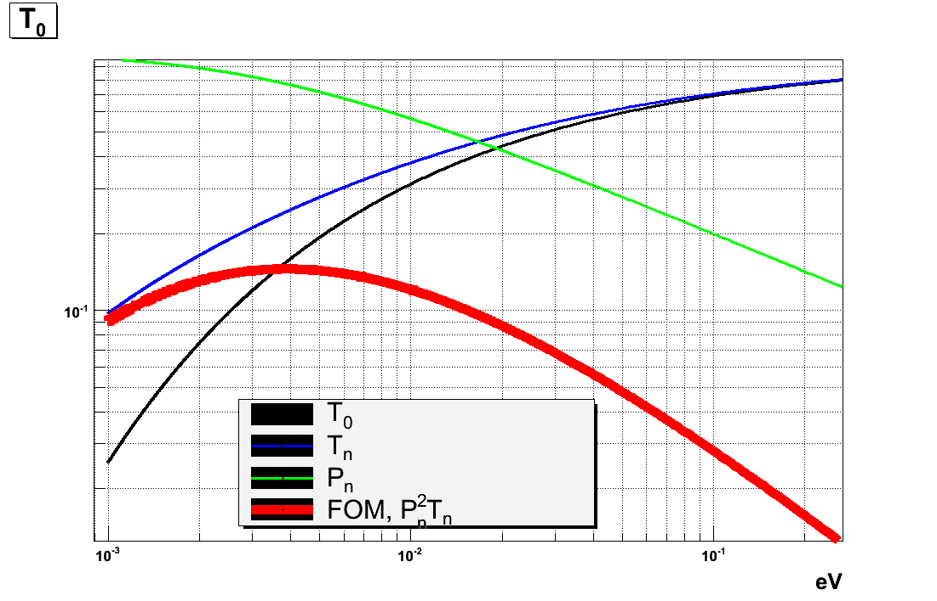
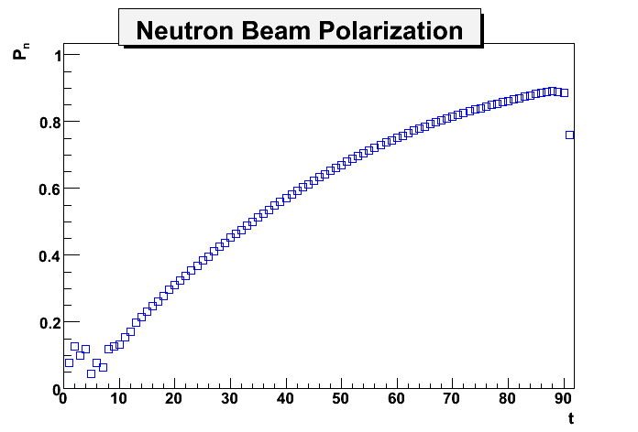
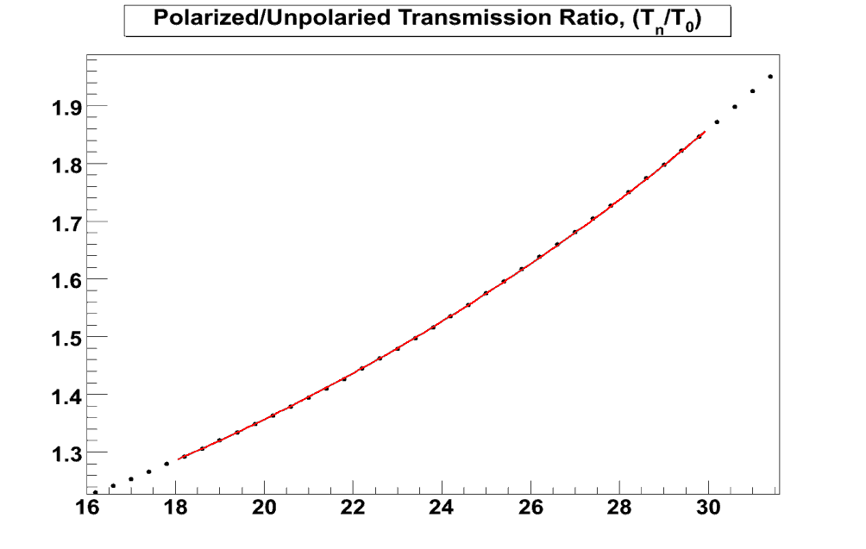
Experiment – Polarizer
³He as a Neutron Spin Filter
- 3 barns
- 5333 barns!
Transmission
n
³He
n
³He
T_{n}/T_{o}
TOF [ms]
M. Dabaghyan for the NPDGamma Collaboration
The n + p → d + γ Experiment at LANL

Slide 17
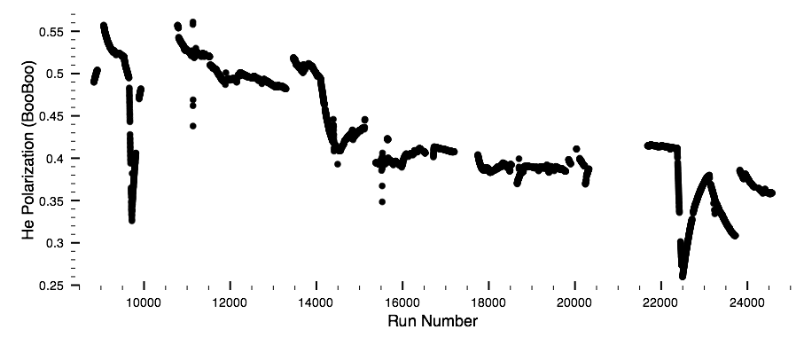
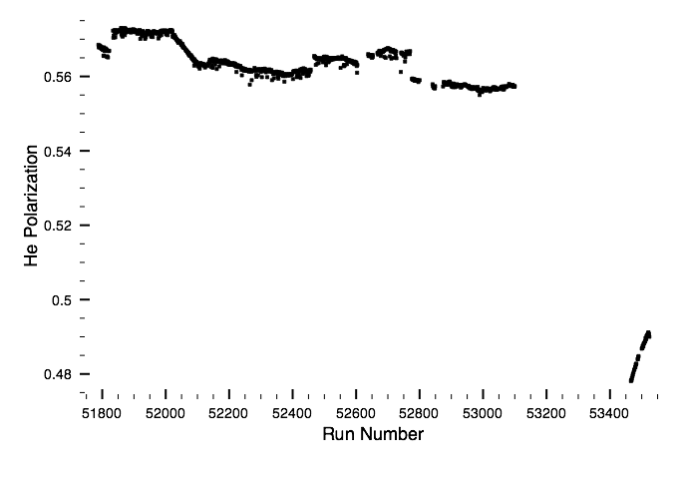
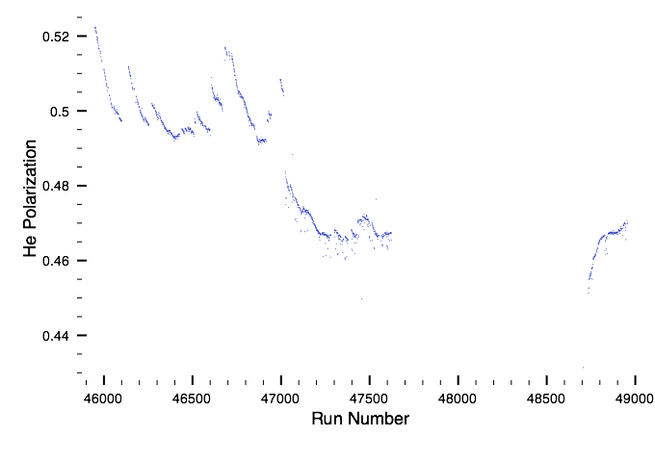
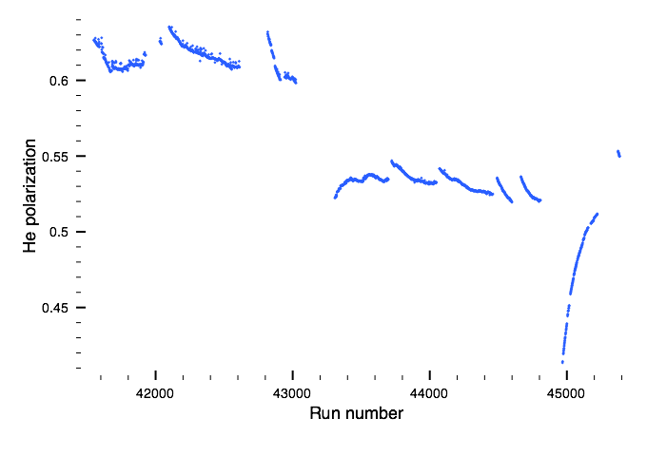
Experiment – Polarizer Performance
M. Dabaghyan for the NPDGamma Collaboration
The n + p → d + γ Experiment at LANL

Slide 18
Experiment – Analyzer
Function
Measure Neutron Beam polarization
Measure RFSF efficiency
Optimize RFSF parameters
M. Dabaghyan for the NPDGamma Collaboration
The n + p → d + γ Experiment at LANL

Slide 19
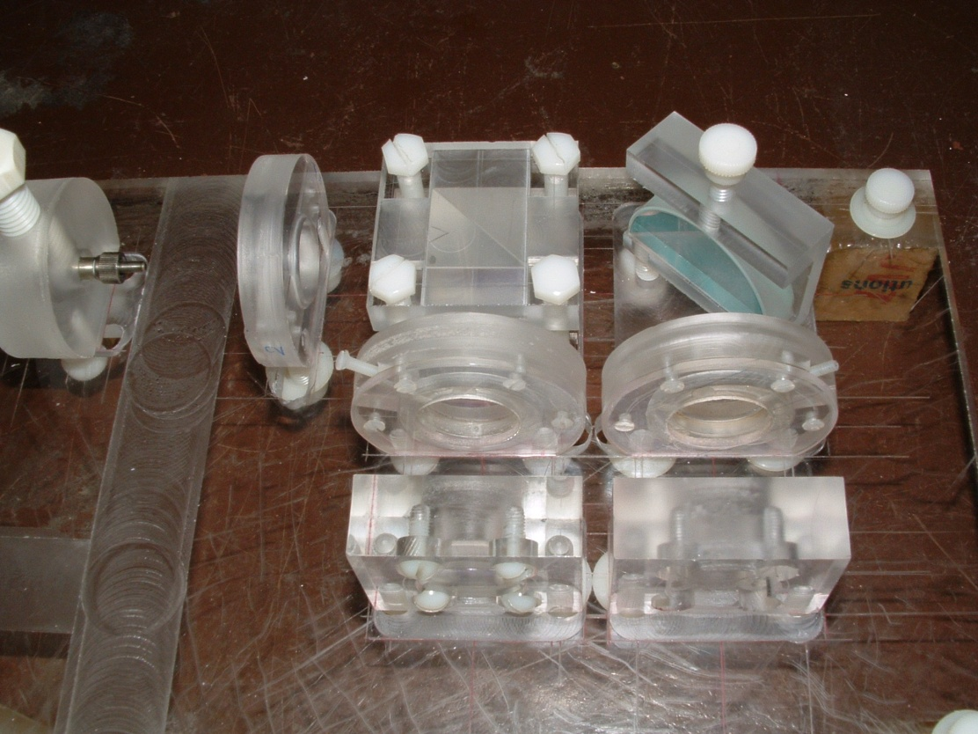
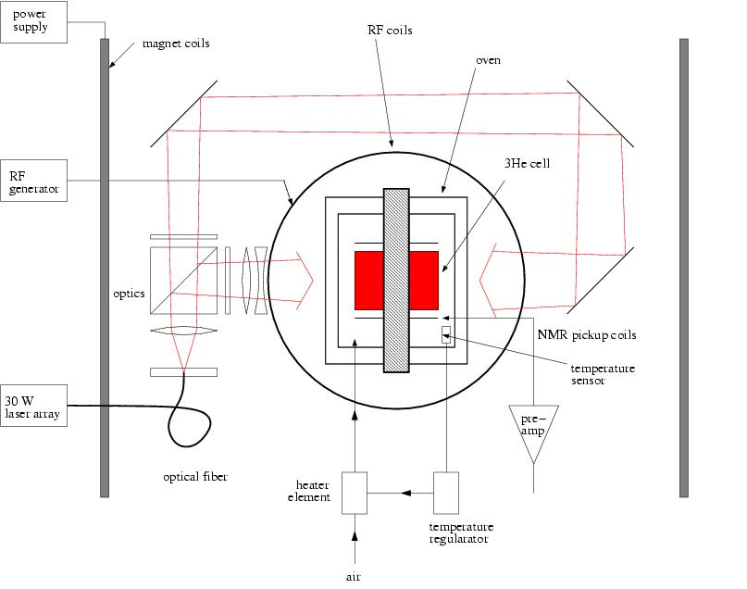
Experiment – Analyzer
Oven
PEEK/glass components
Uniform Temperature (165º C)
Laser Optics
Non-metallic parts
Polarized light from 2 sides
30 W Laser
M. Dabaghyan for the NPDGamma Collaboration
The n + p → d + γ Experiment at LANL

Slide 20
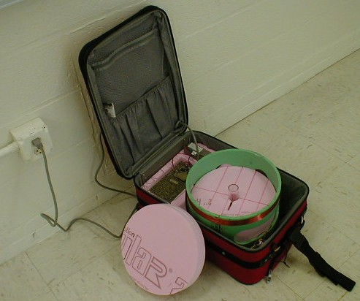
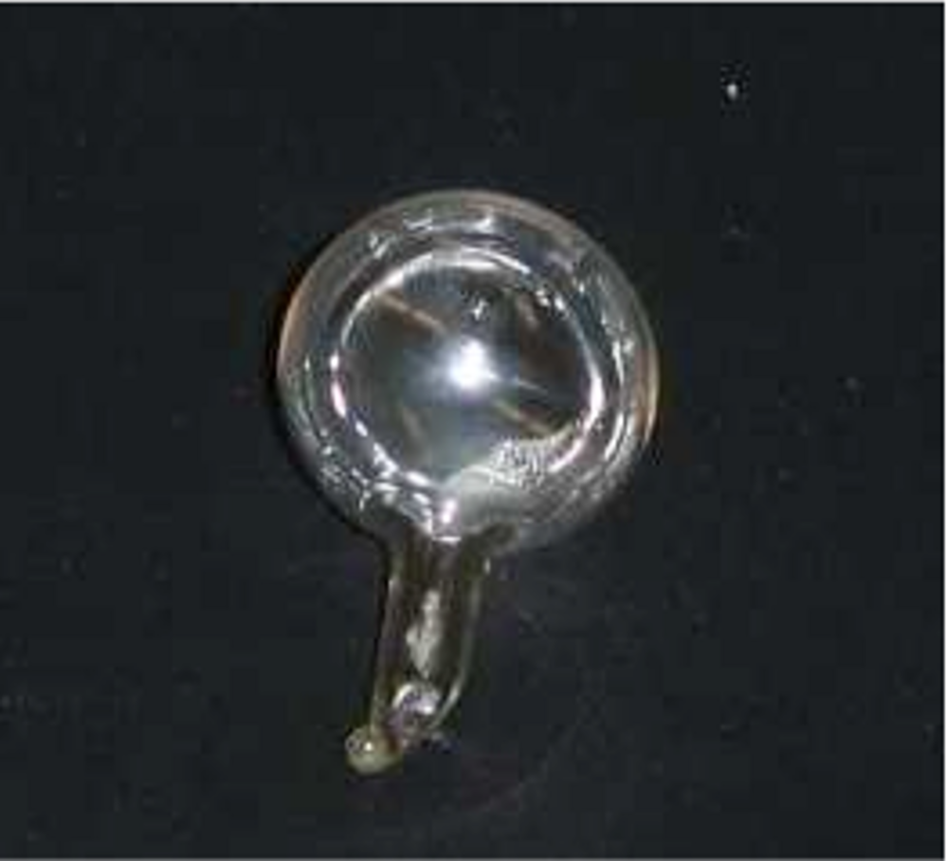
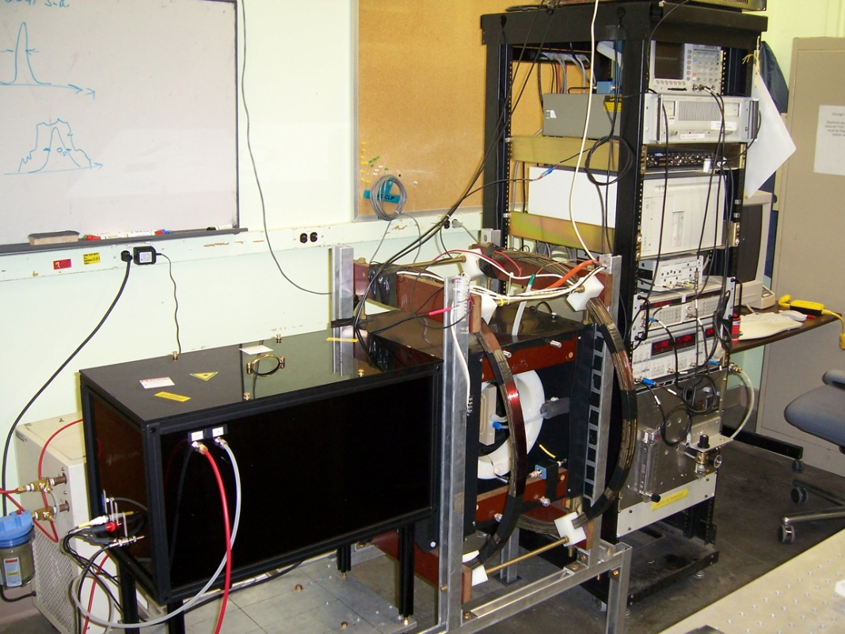
Experiment – Analyzer
Transport Suitcase
TS - 12
2.5 cm in diameter
6.2 atm·cm
Relaxation time of 130 hrs
Helmholtz coils create 12 Gauss field
Running on batteries
Loss of polarization: ~10%/hr
Typical polarization ~ 47%
M. Dabaghyan for the NPDGamma Collaboration
The n + p → d + γ Experiment at LANL

Slide 21
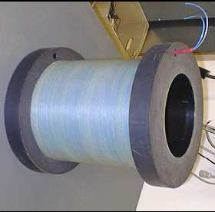
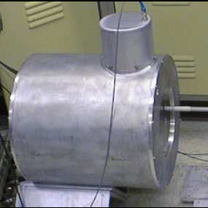
Experiment – RF Neutron Spin Flipper
Resonant Radio Frequency Spin Rotator
Limit systematic effects
2 mm Al housing enough to isolate RF field
20 Hz pulse pattern: ↑↓↓↑↓↑↑↓
M. Dabaghyan for the NPDGamma Collaboration
The n + p → d + γ Experiment at LANL
Notes:
Systematic effects – detector gains etc.

Slide 22
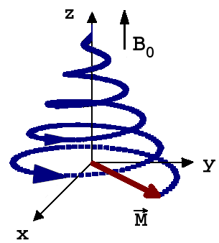
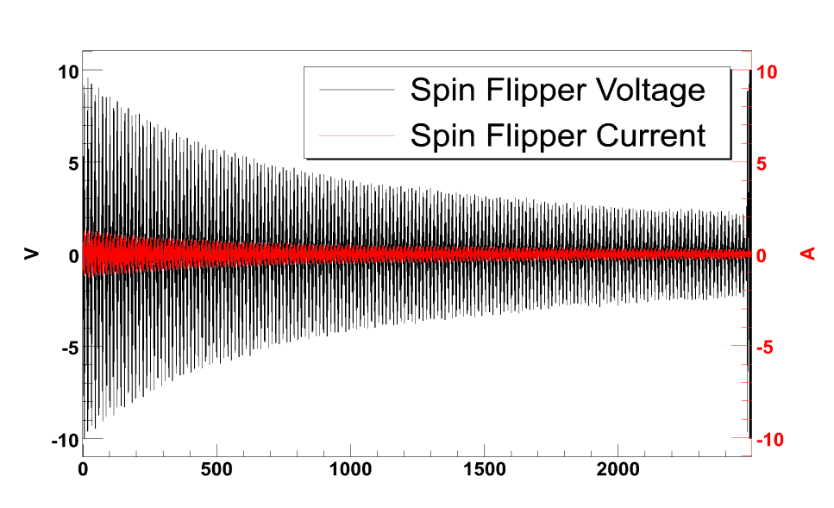
RFSF - NMR
Elements of NMR
Apply resonant ┴ RF field
B₁ =B₁cosωt
Rotate neutron spins by π
α = γB₁Δt
B₁ = πL/dγt_{TOF}
M. Dabaghyan for the NPDGamma Collaboration
The n + p → d + γ Experiment at LANL
Notes:
Systematic effects – detector gains etc.

Slide 23
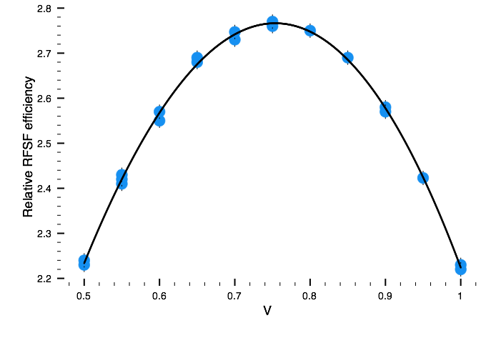
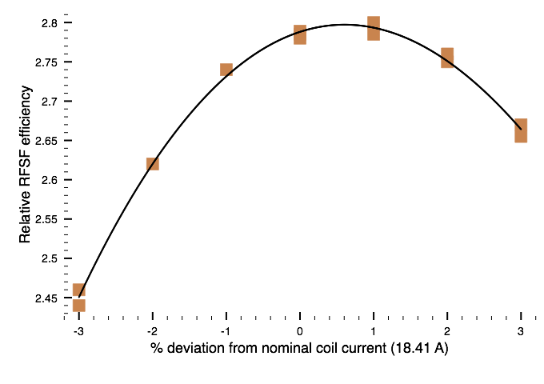
RFSF – Parameter Optimization
RFSF Efficiency Optimization
Optimization is performed using the Analyzer
Normalized population difference between ↑↓
M. Dabaghyan for the NPDGamma Collaboration
The n + p → d + γ Experiment at LANL
Notes:
Systematic effects – detector gains etc.

Slide 24
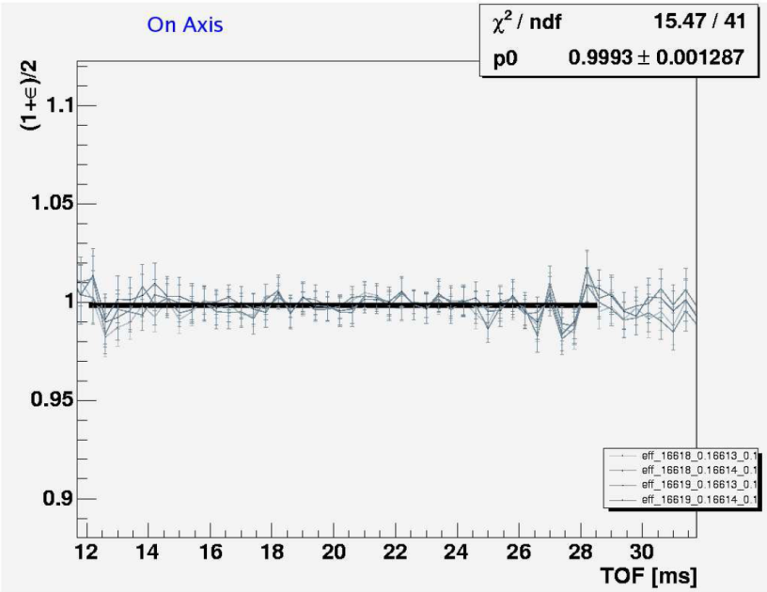
RFSF – Efficiency
RFSF
RFSF
N_{o}=N_{o+}+N_{o-}
Pol
N₁=N₁₊+N₁₋
Off
N₁=N₁₊+N₁₋
Anl
N₂=N₂₊+N₂₋
Off
On
Pol
Anl
N_{o}=N_{o+}+N_{o-}
N₁=N₁₊+N₁₋
RFSF
N₁=N₁₊+N₁₋
N₂=N₂₊+N₂₋
N_{o}=N_{o+}+N_{o-}
Pol
N₁=N₁₊+N₁₋
Off
N₁=N₁₊+N₁₋
Anl
N₂=N₂₊+N₂₋
RFSF
Pol
Anl
RFSF Efficiency Measurement
N_{o}=N_{o+}+N_{o-}
N₁=N₁₊+N₁₋
On
N’₁=N’₁₊+N’₁₋
N’₂=N’₂₊+N’₂₋
NMR Flip – 100%
Compare NMR and RFSF flips
Scan off-axis by moving collimator+analyzer+M3
ε_{on axis} = 99.69 ± 0.12
ε_{1.3” beam left} = 94.06 ± 0.11
ε_{1.3” beam right} = 93.83 ± 0.11
M. Dabaghyan for the NPDGamma Collaboration
The n + p → d + γ Experiment at LANL
Notes:
Systematic effects – detector gains etc.

Slide 25
PV in Compound Nuclei – Not so simple, so why bother?
Reason 1.
Some materials are in the beamline – Al, Cu, In …
Reason 2.
Study PV in nuclear targets – has not been done for this A-range
M. Dabaghyan for the NPDGamma Collaboration
The n + p → d + γ Experiment at LANL

Slide 26
Compound Nuclei – What can be done?
Compound nuclei – complex – impossible to solve analytically. Treat matrix elements as independent random variables
Obtain RMS for directional asymmetry, which is
Estimate A_{γ}^{RMS} using
Using spectroscopic information Γ_{w} could be estimated independently:
M. Dabaghyan for the NPDGamma Collaboration
The n + p → d + γ Experiment at LANL

Slide 27
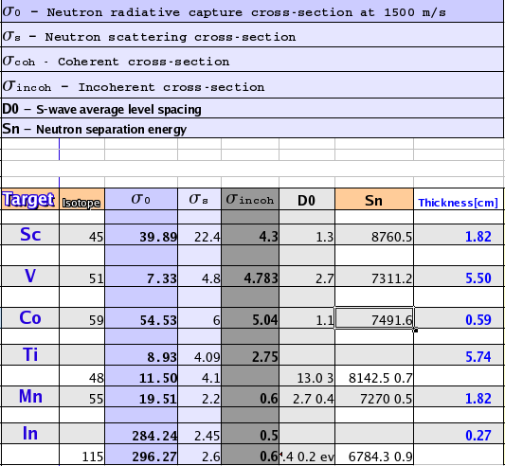
Compound Solid Targets
List of Solid Targets
Al
Mn
Co
Cu
Ti
Cl
In
V
Sc
Selection Criteria
Large capture cross-section
Small scattering cross-section
Small incoherent cross-section
Close level spacing
M. Dabaghyan for the NPDGamma Collaboration
The n + p → d + γ Experiment at LANL

Slide 28
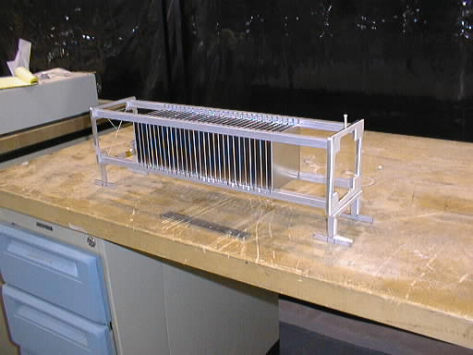
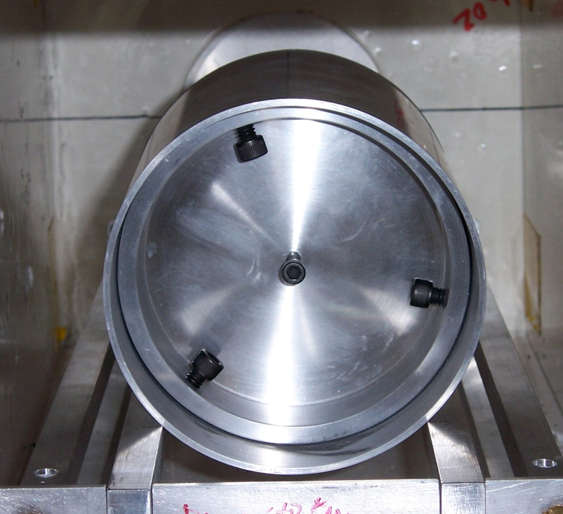
Compound Solid Targets
M. Dabaghyan for the NPDGamma Collaboration
The n + p → d + γ Experiment at LANL

Slide 29
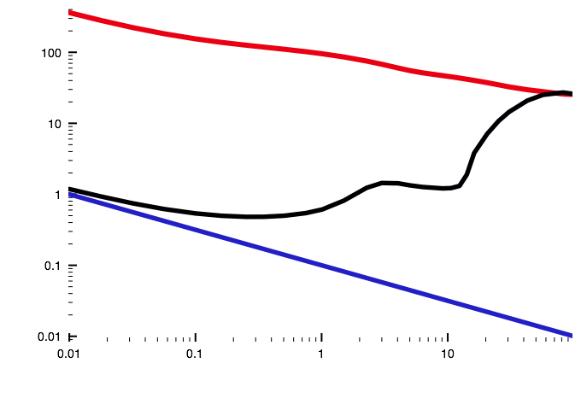
Targets – LH₂
σ_{s}^{ortho}
Cross sections
LH₂ Target
σ_{cap} « σ_{scatt}
Para-H₂: capture and coherent scatter
Ortho-H₂: coherent and incoherent scatter
Aluminum cylinder
Diameter of 26.62 cm
16L of LH₂
kept at ~ 17 K
Cross Section
σ_{s}^{para}
σ_{a}
meV
M. Dabaghyan for the NPDGamma Collaboration
The n + p → d + γ Experiment at LANL
Notes:
Sigmas are given for 2200m/s fast neutrons

Slide 30
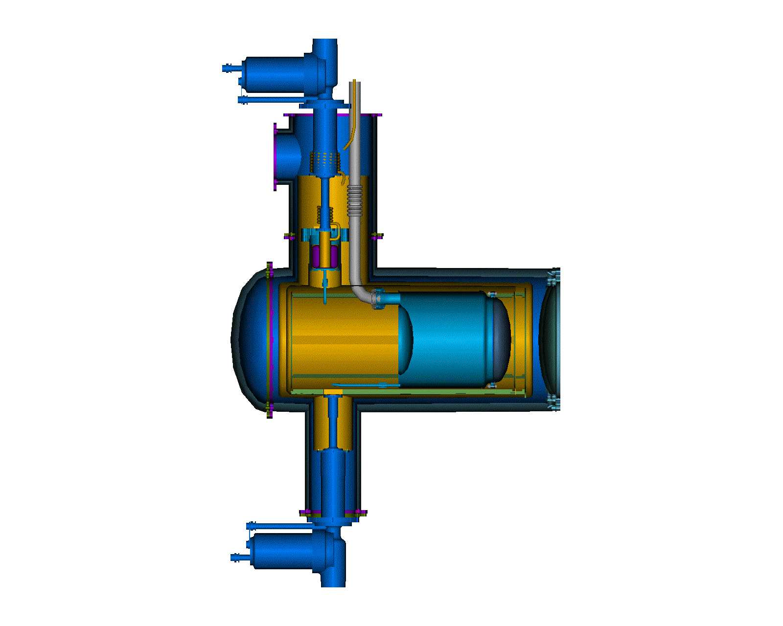
Targets – LH₂
Ortho-to-Para Conversion
OPC #1
Ortho-Para conversion - 1030 hrs
Two FeO₂ OPCs – 112 hrs
LH₂ target
Neutron Beam
OPC #2
M. Dabaghyan for the NPDGamma Collaboration
The n + p → d + γ Experiment at LANL

Slide 31
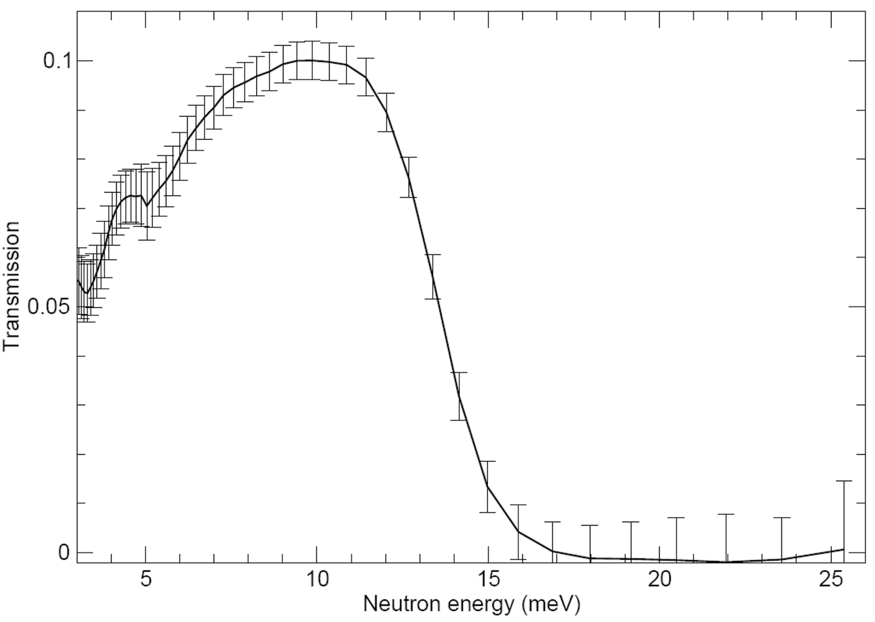
Targets – LH₂
Transmission Through LH₂
Full measurement:
Empty measurement:
Resulting in
LH₂
M2
M3
Para: 99.98%
M. Dabaghyan for the NPDGamma Collaboration
The n + p → d + γ Experiment at LANL
Notes:
Scattering cross section is strongly dependent on fractional concentration of species in LH2, transmission through the target is used to monitor the fractional concentration of para-H

Slide 32
Data Analysis
ϑ
n
p
d
M. Dabaghyan for the NPDGamma Collaboration
The n + p → d + γ Experiment at LANL

Slide 33
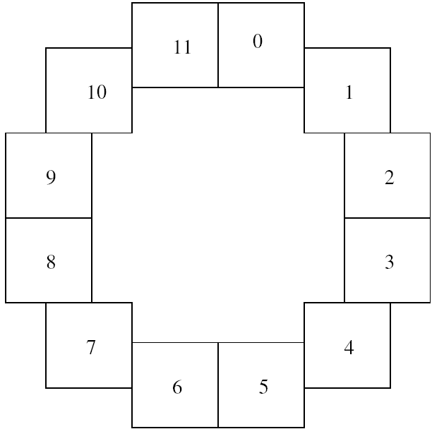
Data Analysis
Raw Asymmetry
U
θ
Physics Asymmetry
D
Sequence Asymmetry
M. Dabaghyan for the NPDGamma Collaboration
The n + p → d + γ Experiment at LANL

Slide 34
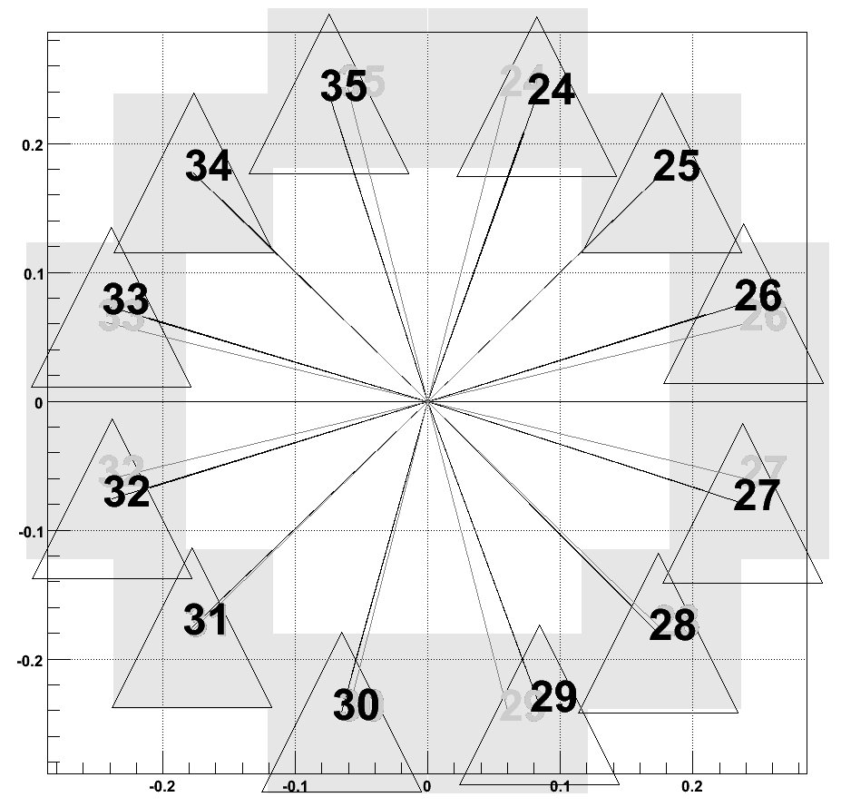
Detector Geometry
Reconstructed Angles
X_{C}
Crystal
R_{C}
Y_{C}
R
X_{C} -R
Source
Table Motion Measurements
M. Dabaghyan for the NPDGamma Collaboration
The n + p → d + γ Experiment at LANL

Slide 35
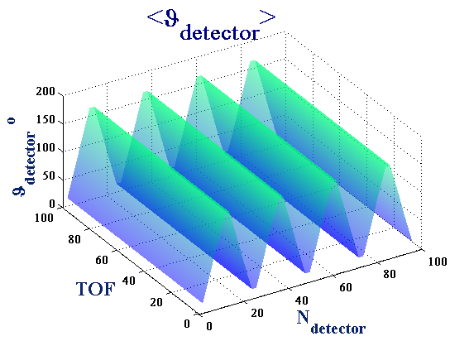
Detector Geometry
Geometry Factors
Ideally cosϑ and sinϑ
Neutron absorption probability
Energy left by a γ in the crystal
Error from Left-Right Mixing into Up-Down
M. Dabaghyan for the NPDGamma Collaboration
The n + p → d + γ Experiment at LANL

Slide 36
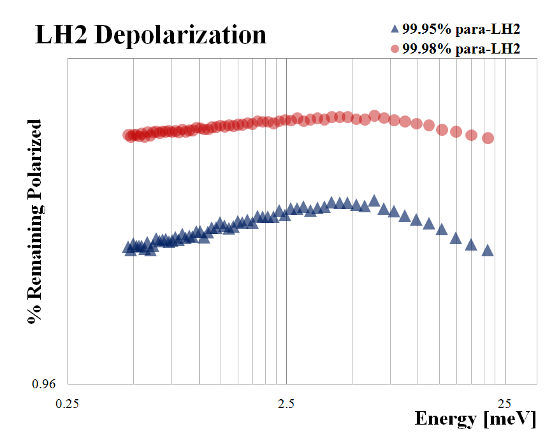
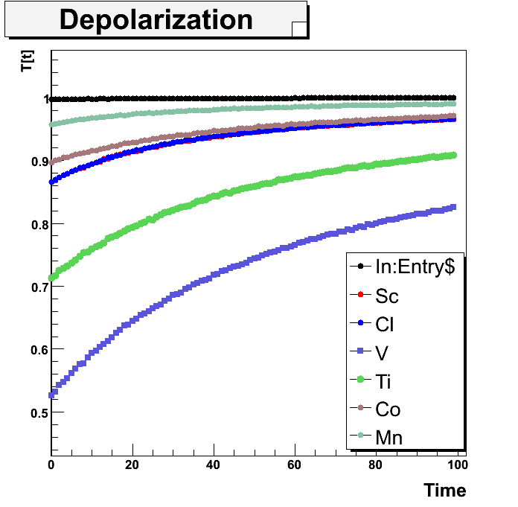
Depolarization in the targets
Neutron Beam Depolarization
M. Dabaghyan for the NPDGamma Collaboration
The n + p → d + γ Experiment at LANL

Slide 37
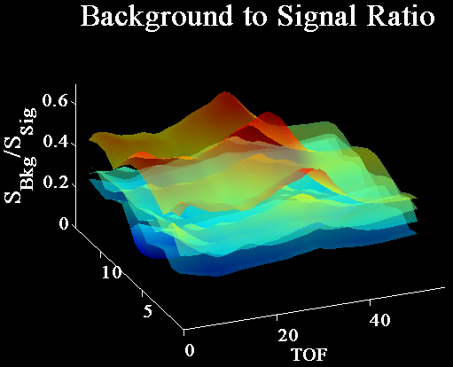
Backgrounds and false asymmetries
Sources of Backgrounds
Electronic pick-up
Activation
Scattered neutrons
Frame overlap
γ’s from spallation
Few percent for solids
More for LH₂
A_{Bkg} = 0
M. Dabaghyan for the NPDGamma Collaboration
The n + p → d + γ Experiment at LANL

Slide 38
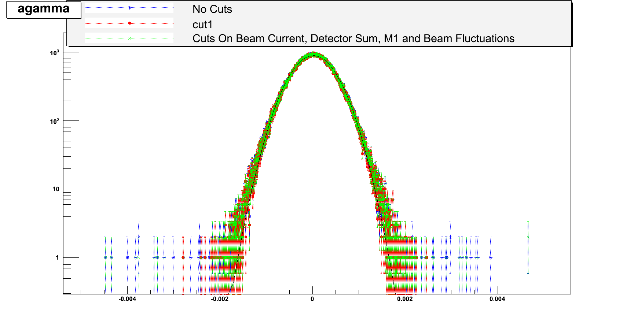
Cuts
Cuts on the Data
Neutron beam current
Detector sums/diff’s
Beam fluctuations
Detector saturation
Valid spin sequences
M. Dabaghyan for the NPDGamma Collaboration
The n + p → d + γ Experiment at LANL

Slide 39
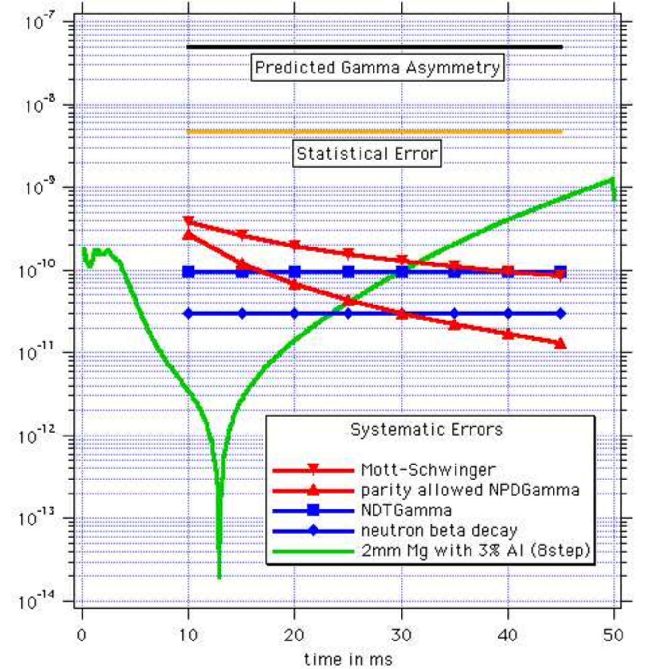
Systematics
Sources
Multiplicative noise
Additive noise
Non-hydrogen target A_{γ}
Mott – Schwinger LR
Stern – Gerlach steering
M. Dabaghyan for the NPDGamma Collaboration
The n + p → d + γ Experiment at LANL

Slide 40
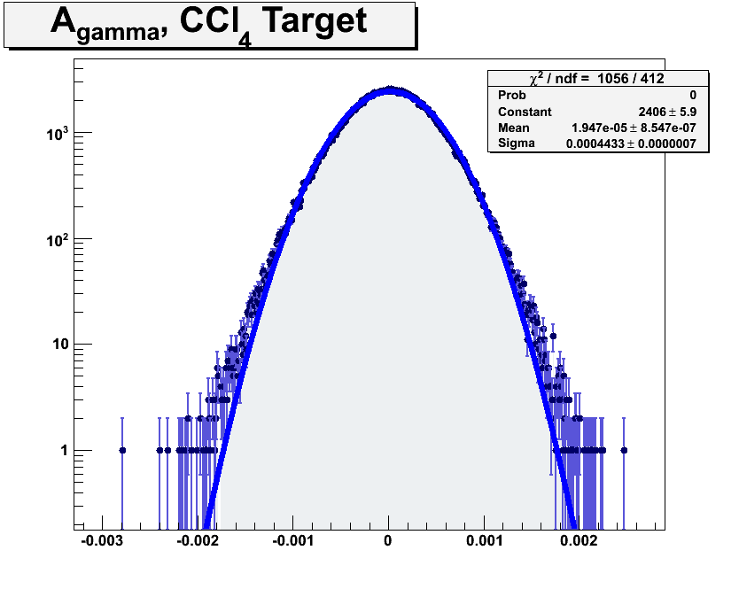
Asymmetry Results - Chlorine
RING
1
RING
4
RING
3
RING
2
Chlorine
Huge known UD asymmetry
Calibrate the experiment
Fit to
A_{γ} = (19.47 ± 2.02)×10⁻⁶
A_{γ}^{UD} = (19.62)×10⁻⁶
A_{γ}^{LR} = (0.087)×10⁻⁶
M. Dabaghyan for the NPDGamma Collaboration
The n + p → d + γ Experiment at LANL

Slide 41
Asymmetry Results - Chlorine
A_{γ}^{UD} = (19.62)×10⁻⁶
A_{γ}^{LR} = (0.087)×10⁻⁶
RING
1
RING
4
RING
3
RING
2
A_{γ} = (19.47 ± 2.02)×10⁻⁶
M. Dabaghyan for the NPDGamma Collaboration
The n + p → d + γ Experiment at LANL

Slide 42
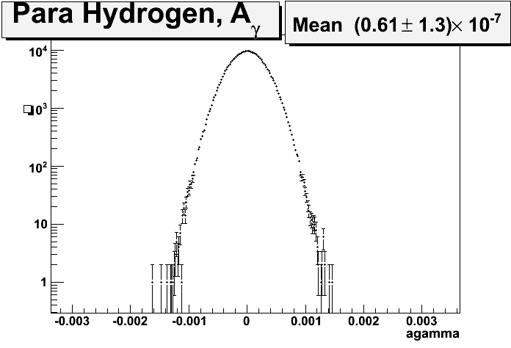
Asymmetry Results - Hydrogen
Hydrogen
RING
1
More statistics
Better knowledge of background
RING
2
RING
4
RING
3
Para-Hydrogen, A_{γ}
A_{γ}^{UD} = (1.7)×10⁻⁷
A_{γ} = (0.95 ± 2.01)×10⁻⁷
A_{γ}^{LR} = (1.1)×10⁻⁷
M. Dabaghyan for the NPDGamma Collaboration
The n + p → d + γ Experiment at LANL

Slide 43
Results – The other targets
Co | 7.7 | 3.5 | 0.7 | 3.6
Cu | -11.9 | 5.8 | 1.1 | 5.9
In | 6.8 | 3 | 0.6 | 3.1
Mn | -5.3 | 7.8 | 0.5 | 7.8
Sc | 7 | 2.8 | 0.7 | 2.9
Ti | -6.5 | 3 | 0.6 | 3.1
V | 1.7 | 6.3 | 0.2 | 6.3
Targets
A_{γ}(×10⁻⁷)
σ_{Aγ,stat}(×10⁻⁷)
σ_{Aγ,syst}(×10⁻⁷)
σ_{Aγ,TOT}(×10⁻⁷)
M. Dabaghyan for the NPDGamma Collaboration
The n + p → d + γ Experiment at LANL

Slide 44
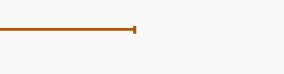
Summary
Cavaignac et al.
Phys.Lett.B., 67
148, 1977
LANL 2006,
Production Phase 1
Preliminary
DDH Theoretical
Estimate
n+p→d+γ
Cavaignac et al.
Phys.Lett.B., 67
148, 1977
A_{γ} = (0.6 ± 1.8)×10⁻⁷
A_{γ} = (0.95 ± 2.01)×10⁻⁷
¹⁸F
Evans et al.; Bini et al.
Phys.Rev.Lett. 55
¹³³Cs
Wood et al., Science 275, 1753, 1997
Flambaum and Murray,
Phys. Rev. C 56, 1641, 1997
H_{π}¹ = (-1.4 ± 4.0)×10⁻⁶
H_{π}¹ = (-2.1 ± 4.5)×10⁻⁶
Compound Nuclei
Bowman et al. LANL 2002
n + p → d + γ
LANL 2006, Preliminary
-4 -2 0 2 4
H_{π}¹(×10⁻⁶)
M. Dabaghyan for the NPDGamma Collaboration
The n + p → d + γ Experiment at LANL

Slide 45
The NPDγ Collaboration
ORNL
LANL
JLAB
University of Michigan
Indiana University
Indiana Univ. Cyclotron
NIST
University of New Hampshire
University of Tennessee
Univ. of California, Berkeley
Univ. of California, Davis
University of Manitoba
University of Arizona
Hamilton College
North Carolina State Univ.
JINR, Dubna, Russia
Univ. of Dayton
KEK, Japan
J.D. Bowman, S. Penttila
S.Wilburn.T.Ito,A. Klein,V.Yuan,A.Salas-Bacci, S.Santra
R.D. Carlini
T.E. Chupp, M. Sharma
M. Leuschner, J. Mei, H. Nann, W.M. Snow, R.C. Gillis
B. Losowki
T.R. Gentile
F.W. Hersman, M. Dabaghyan,H. Zhu,S. Covrig, M.Mason
G.L. Greene, R. Mahurin
S.J. Freedman, B. Lauss
G.S. Mitchell
M.T. Gericke, S. Page, D. Ramsay
L. Barron-Palos, S. Balascuta
G.L. Jones
P-N. Seo
E. Sharapov
T. Smith
T. Ino, Y. Masuda, S. Muto
M. Dabaghyan for the NPDGamma Collaboration
The n + p → d + γ Experiment at LANL

Slide 46
Summary
Completed the third commissioning run of NPDGamma at LANL
Measured Angular Directional Asymmetry A_{γ} in a number of medium-A range nuclei
Completed the first production phase of NPDγ at LANL
Measured the pion coupling constant H
M. Dabaghyan for the NPDGamma Collaboration
The n + p → d + γ Experiment at LANL

Slide 47
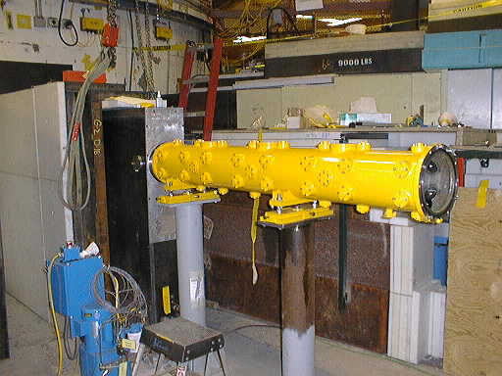
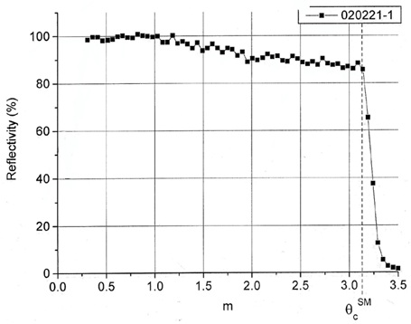
Experiment – Neutron Guide
Specifications
m=3 super-mirror neutron guide
~20 m long, ⁵⁸Ni and ⁴⁷Ti
V ≤ 7 m/s
M. Dabaghyan for the NPDGamma Collaboration
The n + p → d + γ Experiment at LANL

Slide 48
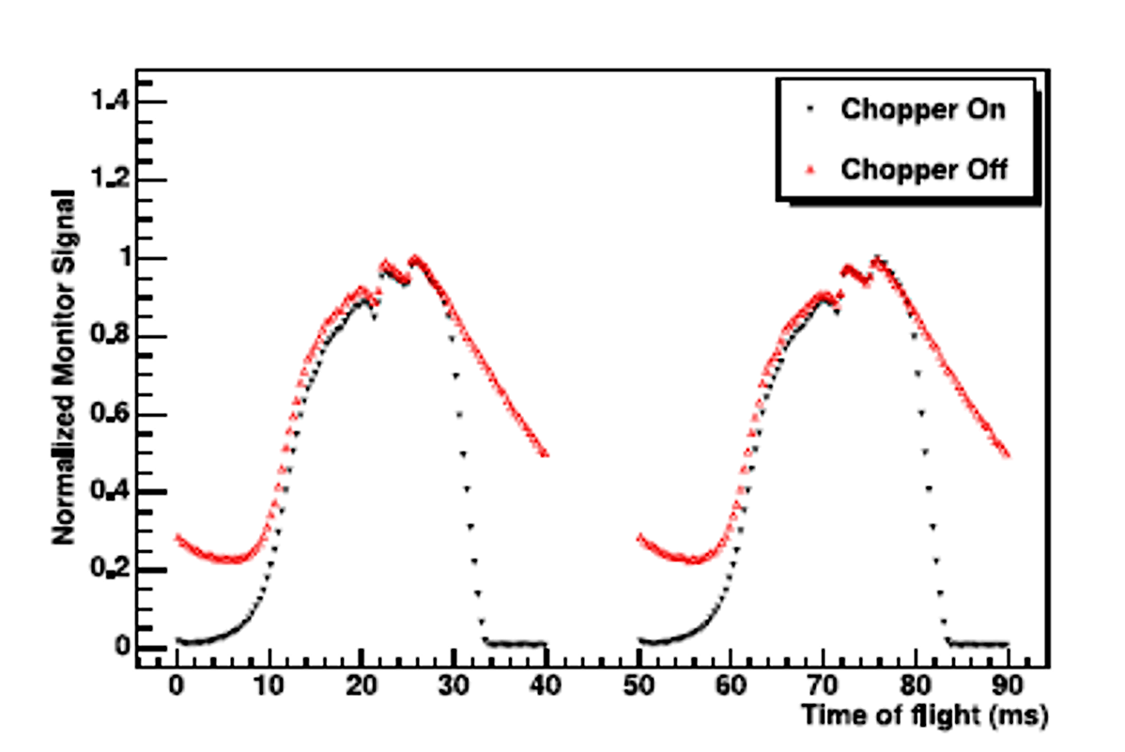


Experiment – Beam Monitors
Measure Neutron Flux
Three parallel plate ion chambers
3 kV bias
M. Dabaghyan for the NPDGamma Collaboration
The n + p → d + γ Experiment at LANL

Slide 49

Flight Path Length Measurement
Flight Path Length
Bragg Transmission
L₁
L₂
L₃
M. Dabaghyan for the NPDGamma Collaboration
The n + p → d + γ Experiment at LANL

Slide 50
Experiment – Frame Overlap Chopper
Specifications
Two independent Gd₂O₃ plated blades rotating at 1200 rpm
Radius = 1024 m, aperture = 1.9 rad
Fully open to fully close in 4 ms
M. Dabaghyan for the NPDGamma Collaboration
The n + p → d + γ Experiment at LANL

Slide 51
Experiment – B-field
Field Parameters
10 G vertical magnetic field
Uniform and stable to 1 mG/cm
Shim coils to minimize stray fields
less than 0.5 mG/cm gradient ||B
Largest gradient measured: dB_{z}/dx = 6mG/cm (0.06%)
M. Dabaghyan for the NPDGamma Collaboration
The n + p → d + γ Experiment at LANL
Notes:
Vertical to 1º

Slide 52
Polarizing the Polarizer
Collisional Mixing
Spin Exchange
-1/2
+1/2
5²P_{1/2}
³He
Rb
σ⁺
50%
50%
Pumping
Rb
³He
-1/2
+1/2
5²S_{1/2}
M. Dabaghyan for the NPDGamma Collaboration
The n + p → d + γ Experiment at LANL

