Slide 1

Explore the QCD Phase Diagram
- Partonic Equation of State at RHIC
Nu Xu Lawrence Berkeley National Laboratory
Many Thanks to the Organizers

Slide 2
Outline
Introduction
- Hydrodynamic approach
- Collectivity vs. local thermalization
2) Recent experimental data
- Transverse momentum distributions
- Partonic collectivity at RHIC
3) Outlook
- Heavy quark measurements
➔ thermalization
- RHIC energy scan
➔ QCD tri-critical point

Slide 3

Physics Goals at RHIC
Identify and study the properties
of the matter (EOS) with partonic
degrees of freedom.
- Explore the QCD phase diagram.
Hydrodynamic
Flow
Collectivity
Local
Thermalization
= ⊗

Slide 4
Pressure, Flow, …
τdσ = dU + pdV
σ– entropy; p – pressure; U – internal energy; V – volume
τ = k_{B}T, thermal energy per dof
In high-energy nuclear collisions, interaction among constituents and density distribution will lead to:
pressure gradient ⇔ collective flow
⇔ number of degrees of freedom (dof)
Equation of State (EOS)
No thermalization is needed – pressure gradient only depends on the density gradient and interactions.
⇒ Space-time-momentum correlations!

Slide 5
Timescales of Expansion Dynamics
microscopic view
vs
macroscopic view
u^{μ}
T
t
scattering rate ν_{ab} ~
expansion rate ∂_{μ} u^{μ}
dilution rate ∂_{τ} s
A macroscopic treatment requires that the
scattering rate is larger than macroscopic rates

Slide 6
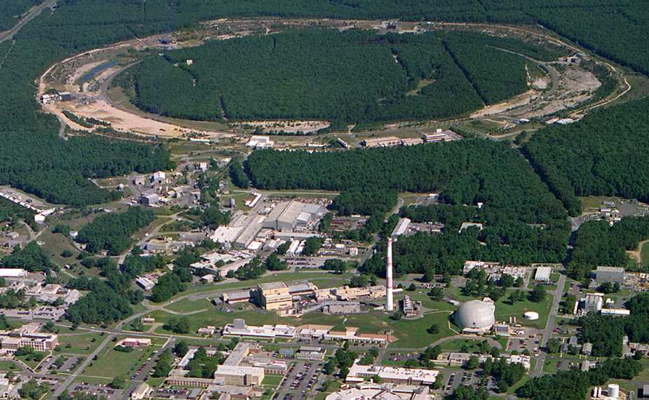
Relativistic Heavy Ion Collider (RHIC) Brookhaven National Laboratory (BNL), Upton, NY
PHOBOS
BRAHMS
RHIC
PHENIX
STAR
- RHIC: The highest energy
heavy-ion collider in the world!
√s_{NN} = 200 - 5 GeV
Au + Au, Cu + Cu, d + Au
- RHIC: The highest energy
polarized proton collider!
√s = 200, 500 GeV
AGS
TANDEMS
Animation M. Lisa

Slide 7
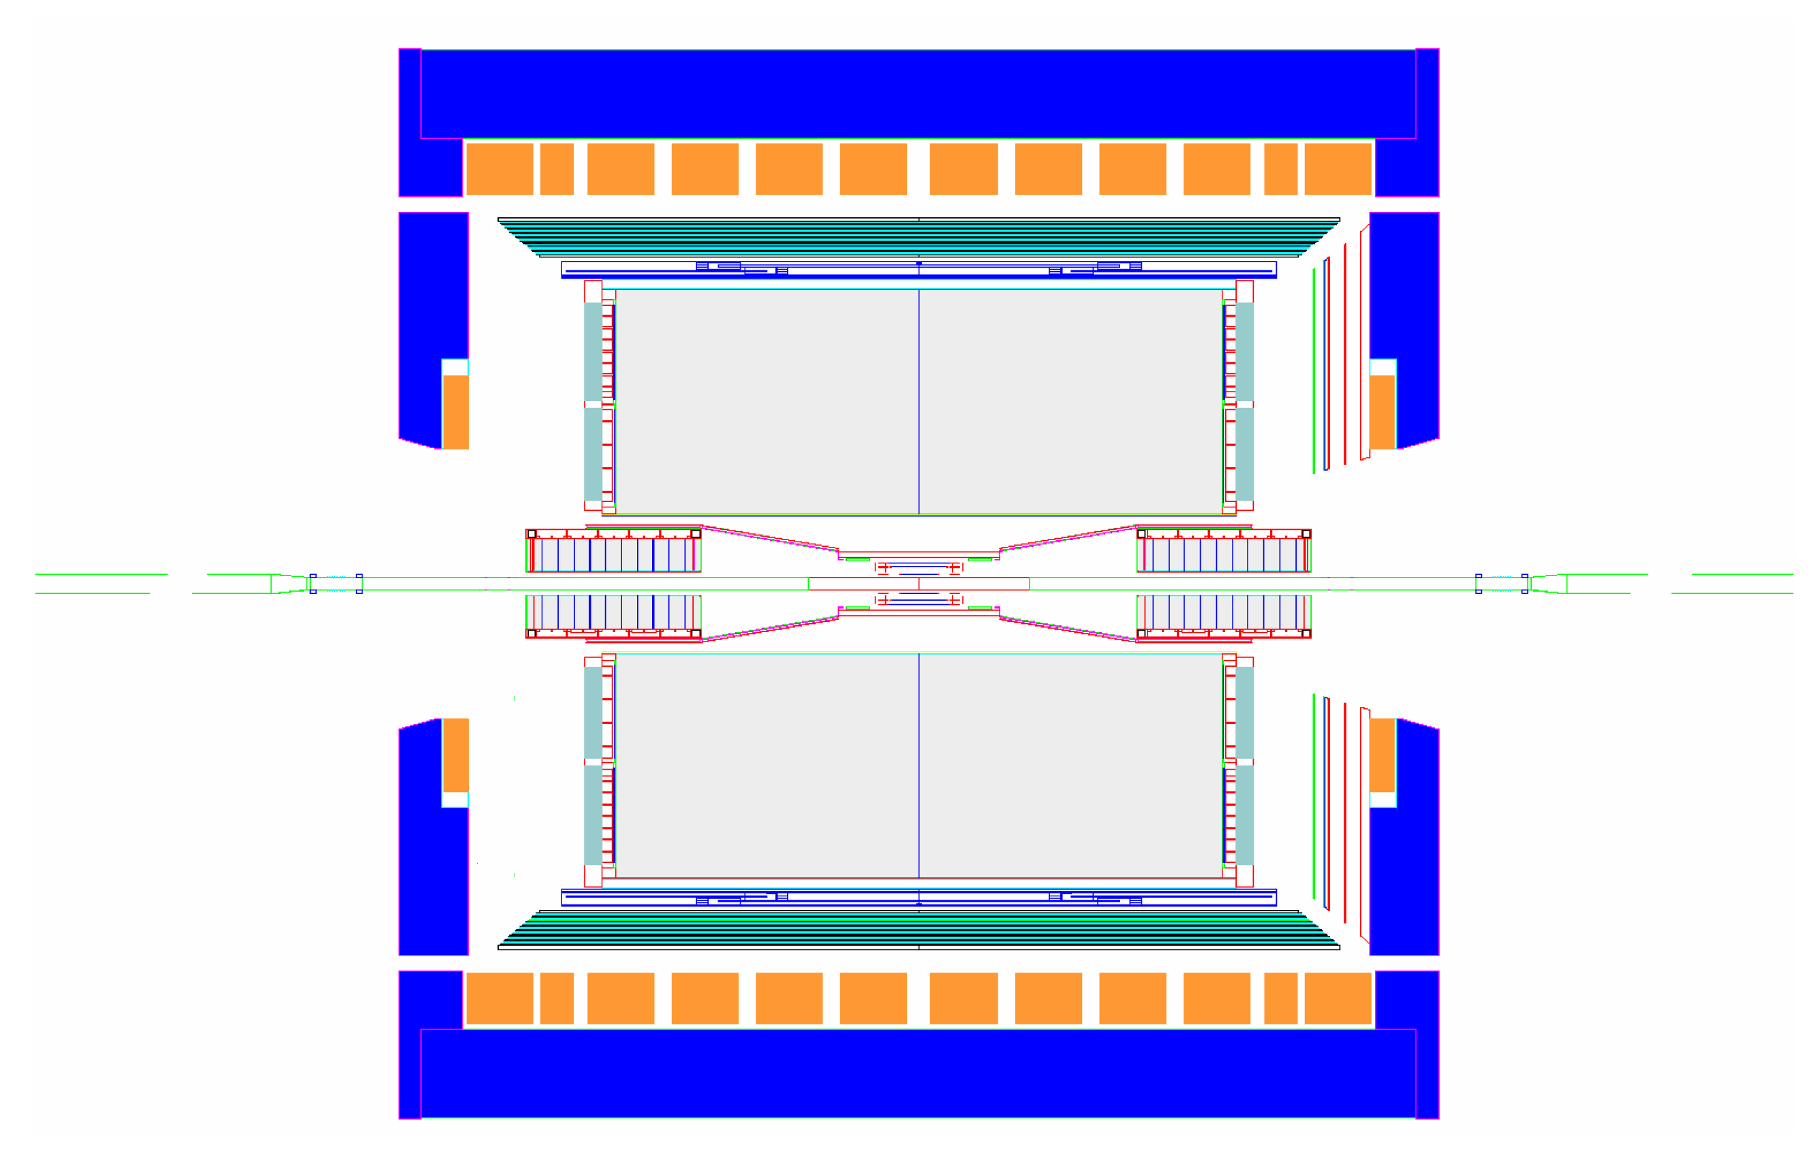
STAR Detector
EMC barrel
MRPC ToF barrel
Ready for run 10
EMC End Cap
RPSD
FMS
FPD
TPC
PMD
Complete
Ongoing
DAQ1000
Ready for run 9
FTPC
Full azimuthal particle identification!
e, π, ρ, K, K*, p, φ, Λ, Δ, Ξ, Ω, D, Λ_{C}, J/ψ …
R&D

Slide 8
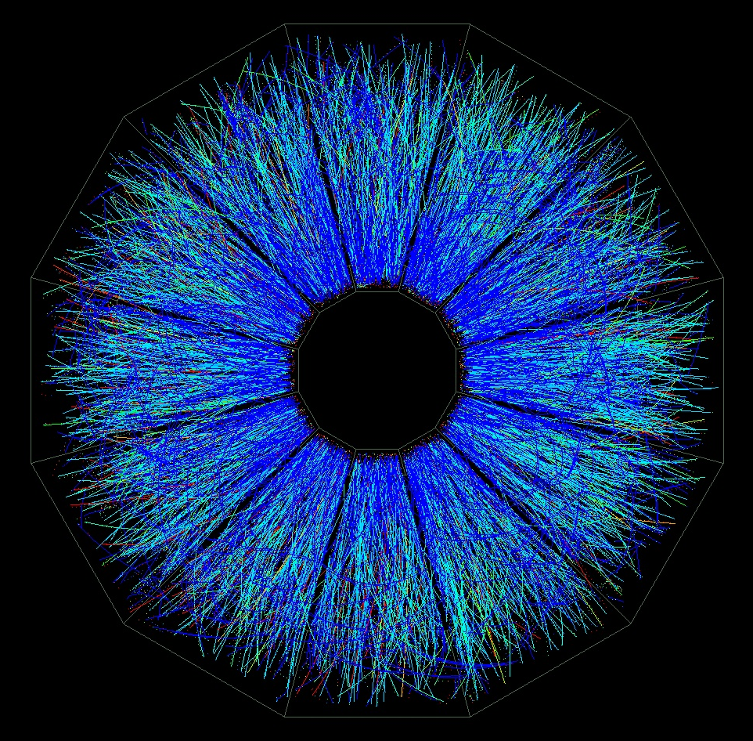
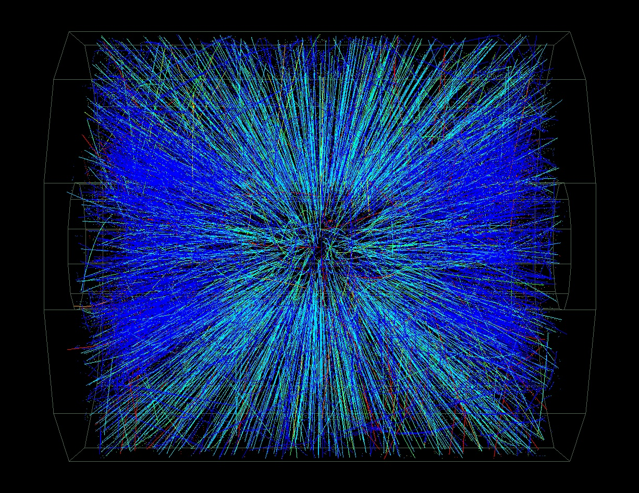
Au + Au Collisions at RHIC
Central Event
STAR
(real-time Level 3)

Slide 9
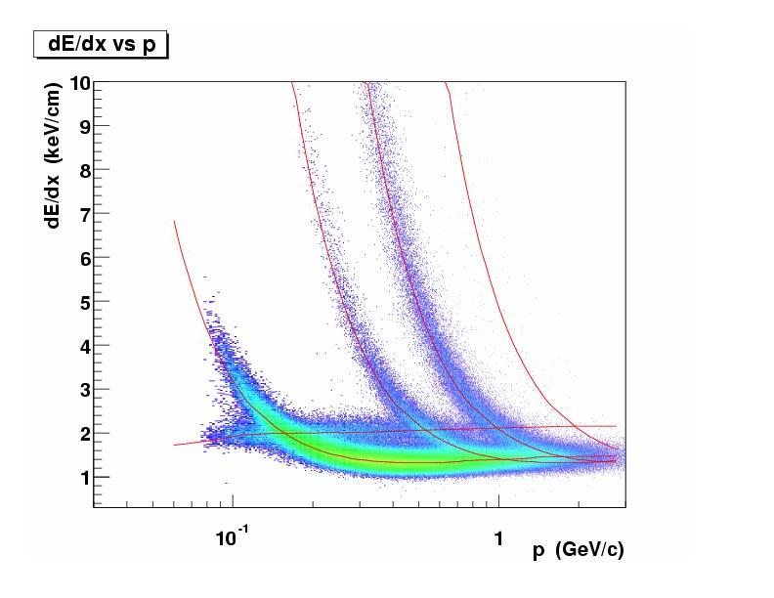
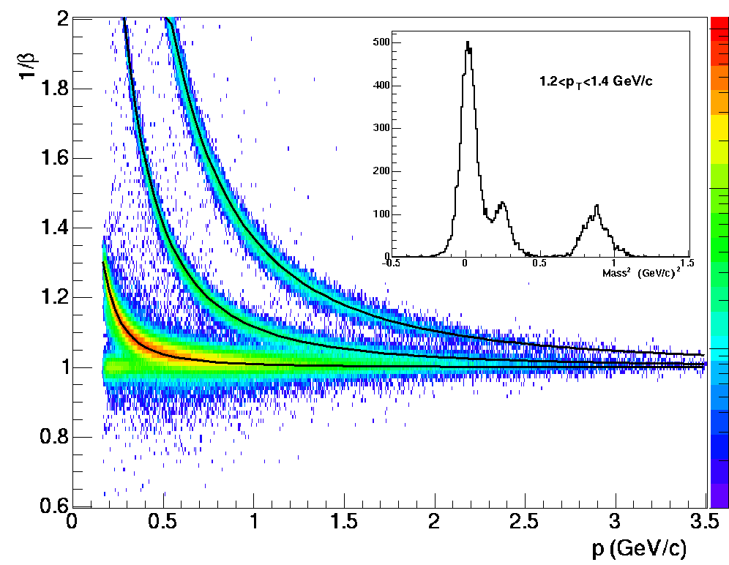
Particle Identification (i)
STAR
kaons
protons
deuterons
pions
electrons
STAR TPC:
1) dE/dx PID up to p ~ 1 GeV/c
|y| < 0.5; p_{T} ~ 1 GeV/c
2) Azimuthal acceptance: ~ 2π
3) Tracking efficiency: ~ 90%, homogenous
STAR MRPC TOF: nucl-ex/0309012
1) Timing resolution: ~ 85 ps
2) PID: π and K ~ 1.9 GeV/c
p and π/K ~ 3 GeV/c
3) Efforts on R&D by ALICE at CERN
Other methods: conversion, EMCal, SVT, Si-μ vertex detector, …

Slide 10
Reconstruction V⁰
Multi-strange particles are
reconstructed via the decay mode :
Ξ ⇒ Λ + π
p + π
Combination of momenta
of the daughter particles
⇒ invariant mass spectra

Slide 11
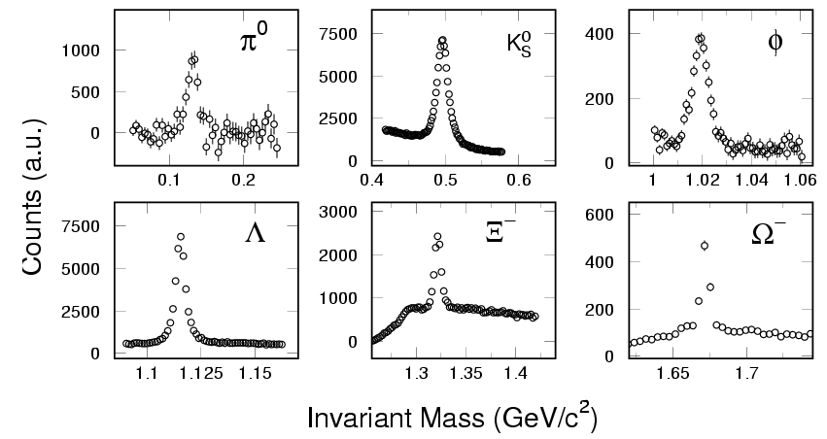
Particle Identification (ii)
Reconstruct particles in full azimuthal acceptance of STAR!

Slide 12
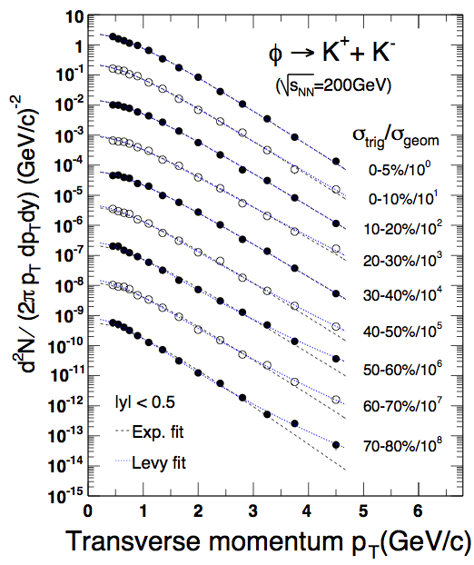
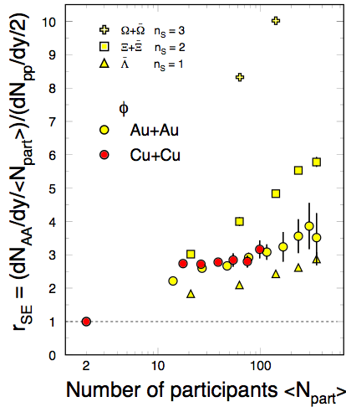
φ-mesons from Au+Au Collisions
STAR: PRL. 98 (2007) 062301
ssbar fusion  φ-meson formation!
STAR: Phys. Lett. B612, 81(2005)
The observed strangeness enhancement is NOT due to the Canonical suppression!
STAR: Preliminary

Slide 13
Transverse Flow Observables
1) Radial flow – integrated over whole history of the evolution
2) Directed flow (v₁) – relatively early
3) Elliptic flow (v₂) – relatively early
- Mass dependent: characteristic of hydrodynamic behavior.

Slide 14
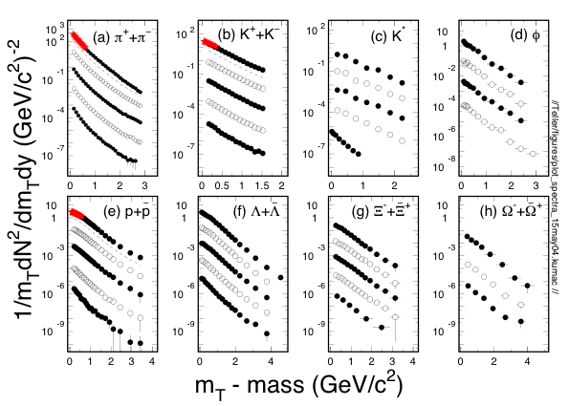
Hadron Spectra from RHIC p+p and Au+Au collisions at 200 GeV
0-5%
ud
ss
more central collisions
uud
sss
Multi-strange hadron spectra are exponential in their shapes.
STAR white papers - Nucl. Phys. A757, 102(2005).

Slide 15
Statistical Model
Assume thermally (constant T_{ch}) and chemically (constant n_{i}) equilibrated system at chemical freeze-out
System composed of non-interacting hadrons and resonances
Given T_{ch} and m 's (+ system size), n_{i}'s can be calculated in a grand canonical ensemble
Obey conservation laws: Baryon Number, Strangeness, Isospin
Short-lived particles and resonances need to be taken into account

Slide 16
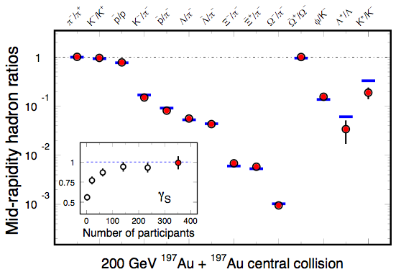
Yields Ratio Results
data
Thermal
model fits
T_{ch} = 163 ± 4 MeV
μ_{B} = 24 ± 4 MeV
In central collisions, thermal model fit well with γ_{S} = 1. The system is thermalized at RHIC.
Short-lived resonances show deviations. There is life after chemical freeze-out. RHIC white papers - 2005, Nucl. Phys. A757, STAR: p102; PHENIX: p184.

Slide 17
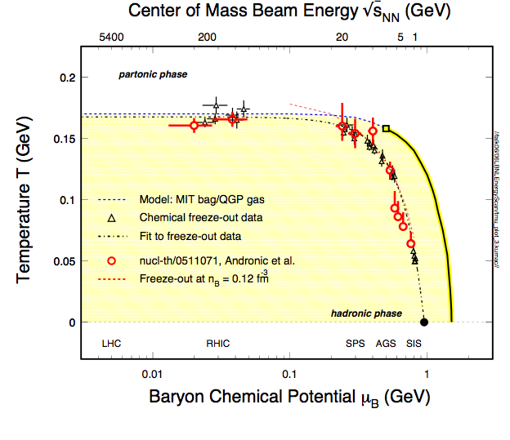
The QCD Phase Diagram
T_{ch} ~ T_{C} (LGT)
at RHIC
*Thermalization
is assumed!
Recent review:
Andronic, et al, NP A772,
167(06)

Slide 18
Thermal Model Fits (Blast-Wave)
Source is assumed to be:
Locally thermal equilibrated
Boosted in radial direction
boosted
E.Schnedermann, J.Sollfrank, and U.Heinz, Phys. Rev. C48, 2462(1993)
random
Extract thermal temperature T_{fo} and velocity parameter ⟨β_{T}⟩
Notes:
At first, I want to show a short explanation of a model to describe the pt distribution.
This model is established to describe particle mass dependence of pt distribution in low pT region.
The source is in local thermal equilibration and it s boosted.
Simply take boltzmann distibution and take enregy term as four momentum with flow effect.
Here we consider transverse direction and then the transverse momentum distribution is described this formula.
The parameters to characterized the system is temperature and flow velocity.

Slide 19
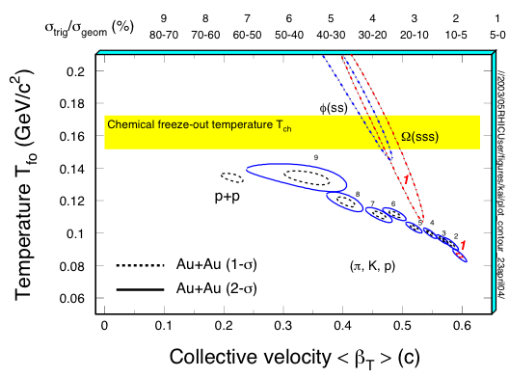
Blast Wave Fits: T_{fo} vs. ⟨β_{Τ}⟩
1) π, K, and p change
smoothly from peripheral
to central collisions.
2) At the most central
collisions, ⟨β_{T}⟩ reaches
0.6c.
3) Multi-strange particles φ,
Ω are found at higher T_{fo}
and lower ⟨β_{T}⟩
⬇ light hadrons move
with higher velocity
compared to strange
hadrons
STAR: NPA715, 458c(03); PRL 92, 112301(04); 92, 182301(04).
200GeV Au + Au collisions

Slide 20
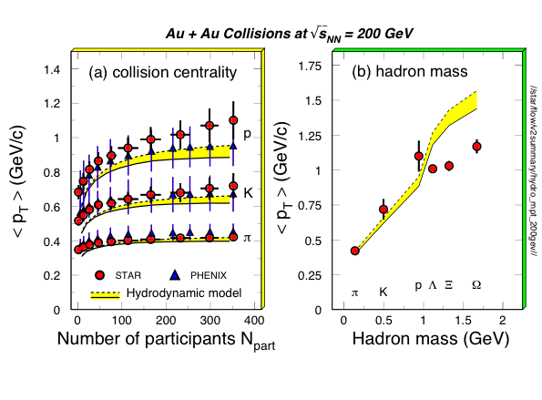
Compare with Model Results
- Hydro model works well for π, K, p, but over-predicts flow for
multi-strange hadrons - partonic flow only?!
- Initial ‘collective kick’ introduced (P. Kolb and R. Rapp, PRC67)

Slide 21
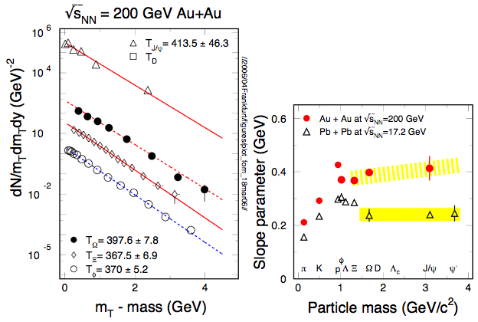
Slope Parameter Systematics
Partonic flow!

Slide 22
Anisotropy Parameter v₂
coordinate-space-anisotropy ⬇ momentum-space-anisotropy
y
p_{y}
x
p_{x}
Initial/final conditions, EoS, degrees of freedom

Slide 23
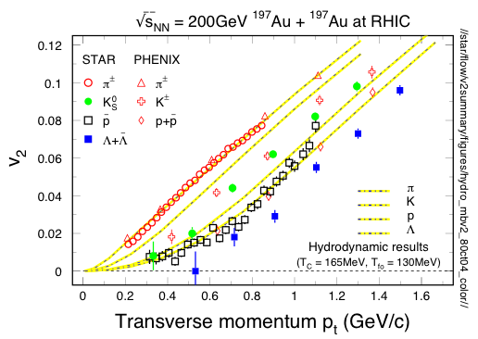
v₂ at Low p_{T} Region
P. Huovinen, private communications, 2004
Minimum bias data!
At low p_{T}, model result fits mass hierarchy well - Collective motion at RHIC
- More work needed to fix the details in the model calculations.

Slide 24
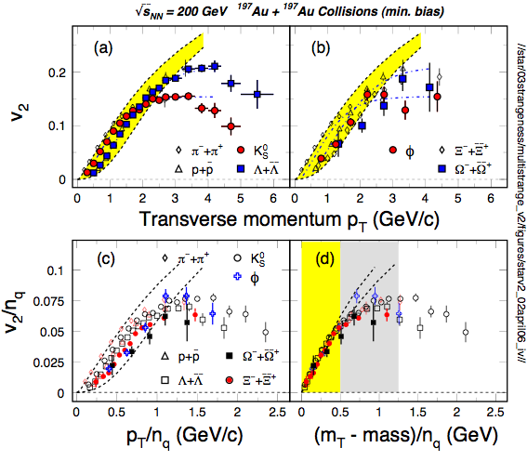
Collectivity, Deconfinement at RHIC
- v₂ of light hadrons and
multi-strange hadrons
- scaling by the number
of quarks
At RHIC:
⬇ N_{q} scaling
novel hadronization
process
Parton flow
De-confinement
PHENIX: PRL91, 182301(03)
STAR: PRL92, 052302(04), 95, 122301(05)
nucl-ex/0405022, QM05
S. Voloshin, NPA715, 379(03)
Models: Greco et al, PRC68, 034904(03)
Chen, Ko, nucl-th/0602025
Nonaka et al. PLB583, 73(04)
X. Dong, et al., Phys. Lett. B597, 328(04).
….
i ii

Slide 25
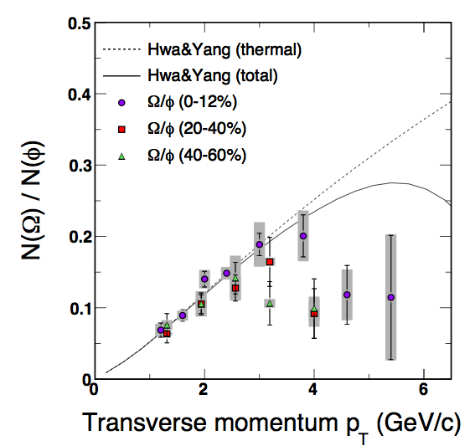
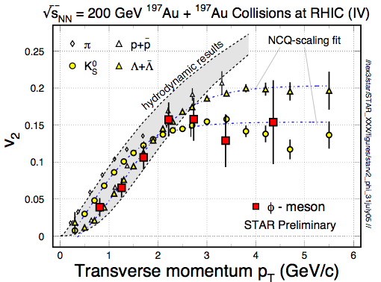
φ -meson Flow: Partonic Flow
“φ-mesons are produced via coalescence of seemingly thermalized quarks in central Au+Au collisions. This observation implies hot and dense matter with partonic collectivity has been formed at RHIC”
STAR: Phys. Rev. Lett. 99 (2007) 112301// * STAR, Duke, TAMU
** OZI rule

Slide 26
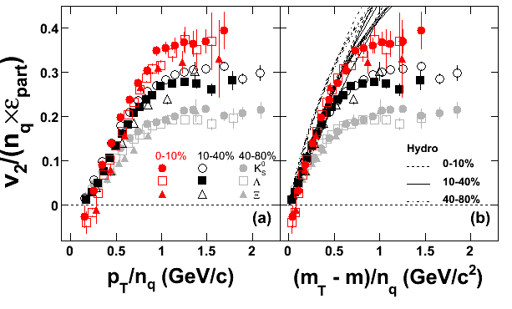
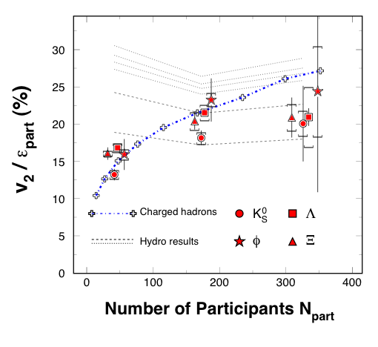
Centrality Dependence
STAR: Phys. Rev. C77, 54901(2008)
200 GeV Au+Au
S. Voloshin, A. Poskanzer, PL B474, 27(00).
D. Teaney, et. al., nucl-th/0110037
Larger v₂/ε_{part} indicates stronger flow in more central collisions.
NO ε_{part} scaling.
The observed n_{q}-scaling does not necessarily mean thermalization.

Slide 27
EoS Parameters at RHIC
In central Au+Au collisions at RHIC
- partonic freeze-out:
*T_{pfo} = 165 ± 10 MeV weak centrality dependence
v_{pfo} ≥ 0.2 (c)
- hadronic freeze-out:
*T_{fo} = 100 ± 5 (MeV) strong centrality dependence
v_{fo} = 0.6 ± 0.05 (c)
Systematic study, understand the centrality dependence
of the EoS parameters
* Thermalization assumed

Slide 28
sQGP and the QCD Phase Diagram
200 GeV Au+Au collisions at RHIC, strongly interacting matter formed:
Jet energy loss: R_{AA}
Strong collectivity: v₀, v₁, v₂
Hadronization via coalescence: n_{q}-scaling
Questions:
Has the thermalization reached, or how large is the η at RHIC?
When (at which energy) does this transition happen?
What does the QCD phase diagram look like?

Slide 29
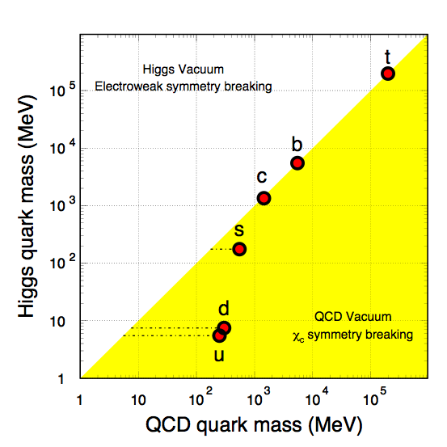
Quark Masses
Higgs mass: electro-weak symmetry breaking. (current quark mass)
QCD mass: Chiral symmetry breaking. (constituent quark mass)
New mass scale compared to the excitation of the system.
Important tool for studying properties of the hot/dense medium at RHIC.
Test pQCD predictions at RHIC.
Total quark mass (MeV)

Slide 30
STAR Detector
MTD
EMC barrel
MRPC ToF barrel
Ready for run 10
EMC End Cap
RPSD
FMS
FPD
TPC
PMD
Complete
Ongoing
DAQ1000
Ready for run 9
HFT
FGT
R&D

Slide 31
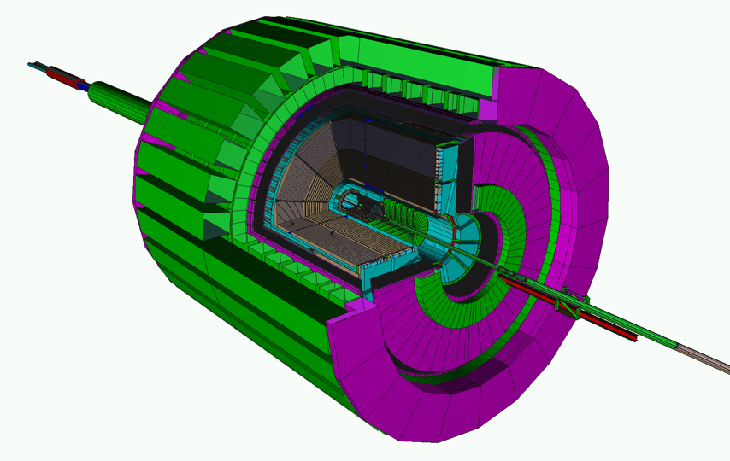
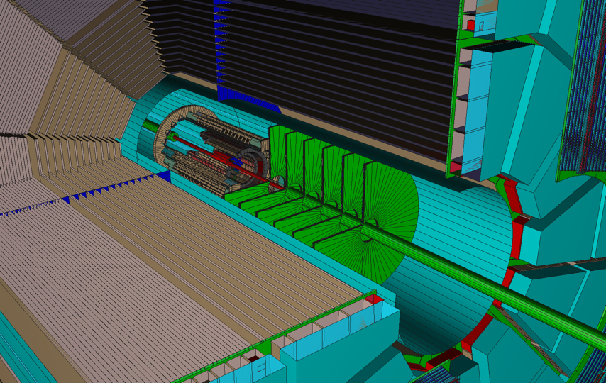
STAR Detectors
EMC+EEMC+FMS
(-1 ≤ η ≤ 4)
TPC
TOF
DAQ1000
HFT
Full azimuthal particle identification!
FGT

Slide 32
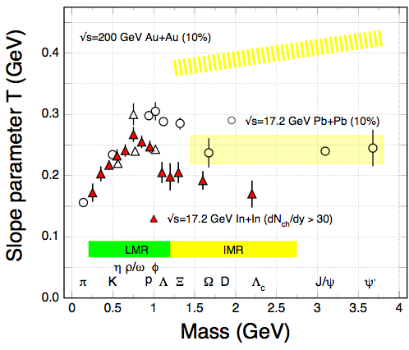
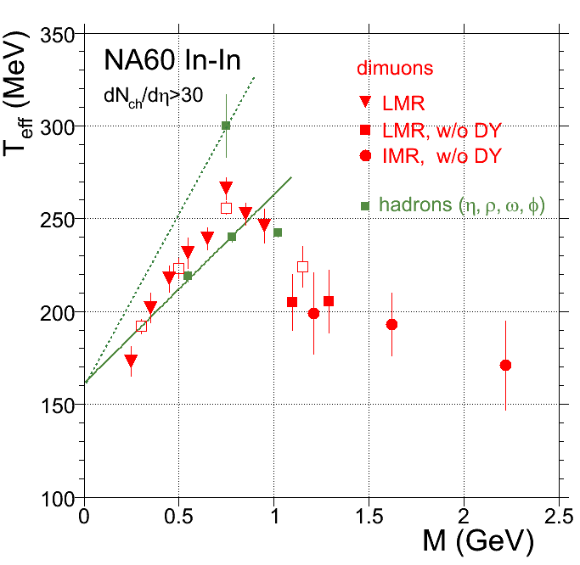
Direct Radiation
Di-leptons allow us to measure the direct radiation from the matter with partonic degrees of freedom, no hadronization!
Low mass region:
ρ, ω, φ ⇒ e⁻e⁺
m_{inv} ⇒ e⁻e⁺
medium effect
Chiral symmetry
- High mass region:
J/ψ ⇒ e⁻e⁺
m_{inv} ⇒ e⁻e⁺
Direct radiation
Expanding partonic matter at RHIC and LHC!
PRL (07)

Slide 33
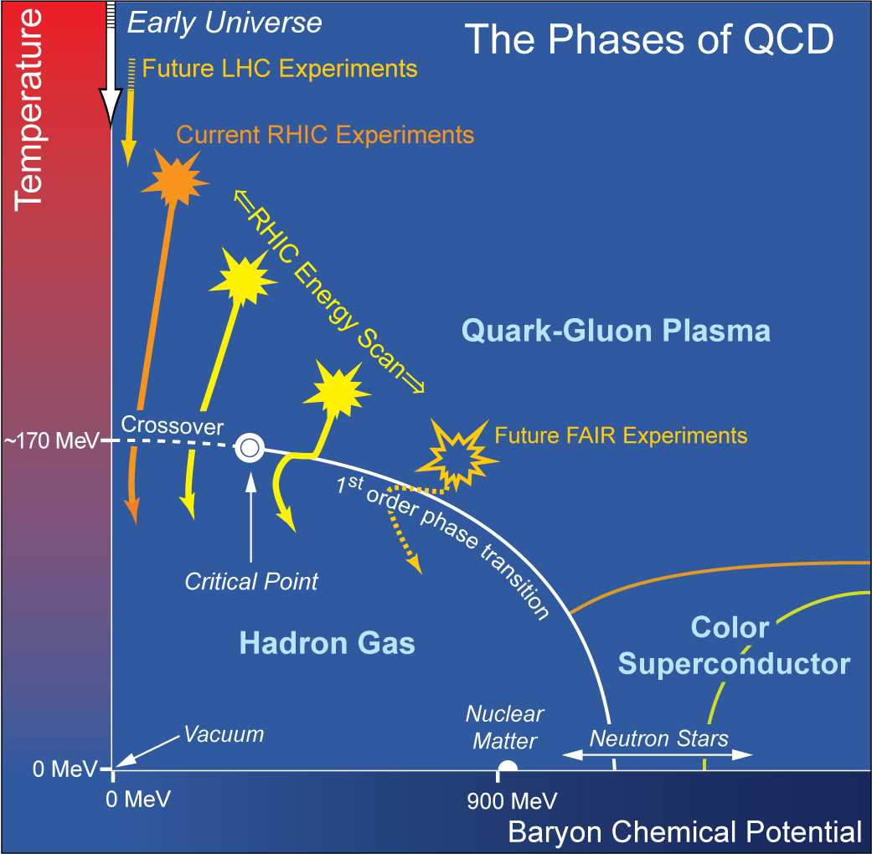
The QCD Critical Point
- LGT prediction on the transition
temperature T_{C} is robust.
- LGT calculation, universality, and
models hinted the existence of
the critical point on the QCD phase
diagram* at finite baryon chemical
potential.
- Experimental evidence for either
the critical point or 1st order
transition is important for our
knowledge of the QCD phase
diagram*.
* Thermalization has been assumed
M. Stephanov, K. Rajagopal, and E. Shuryak, PRL 81, 4816(98)
K. Rajagopal, PR D61, 105017 (00)
http://www.er.doe.gov/np/nsac/docs/Nuclear-Science.Low-Res.pdf

Slide 34
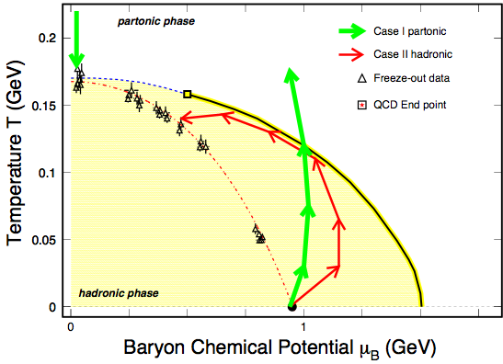
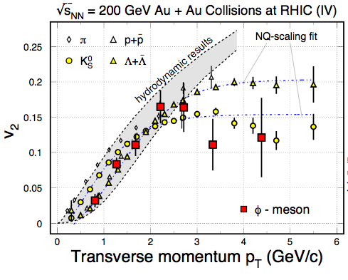
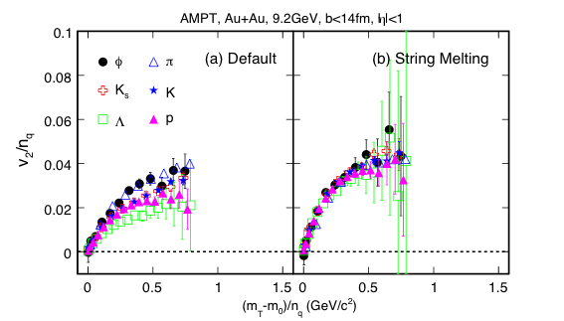
Observable I: Quark Scaling
→
→
m_{φ} ~ m_{p} ~ 1 GeV
ss ⇦ φ not K⁺K⁻ ⇦ φ
σ_{φh} << σ_{pπ, ππ}
In the hadronic case, no number
of quark scaling and the value of
v₂ of φ will be small.

Slide 35
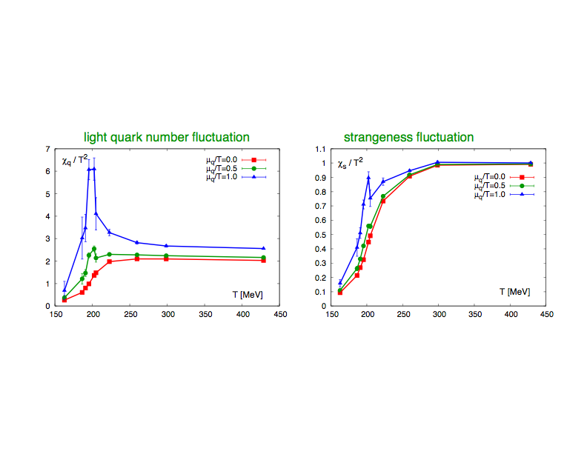
Observable II: χ_{q}, χ_{S}
F. Karsch, 2008.
Event by event:
net-proton Kurtosis K_{p}(E)
two proton correlation functions C₂(E)
ratio of the d/p
ratio of K/p

Slide 36
sQGP and the QCD Phase Diagram
200 GeV Au+Au collisions at RHIC, strongly interacting matter formed:
Jet energy loss: R_{AA}
Strong collectivity: v₀, v₁, v₂
Hadronization via coalescence: n_{q}-scaling
Questions:
Has the thermalization reached, or how large is the η at RHIC?
When (at which energy) does this transition happen?
What does the QCD phase diagram look like?

