Slide 1


(longitudinal) Spin Program at RHIC-PHENIX
K.Aoki for the PHENIX Collaboration
Kyoto Univ. / RIKEN Nishina center
INPC2007 Tokyo, Japan
Notes:
I would like to talk about the longitudinal part of the spin program at RHIC-PHENIX.
Transverse part will be covered by the next speaker.

Slide 2
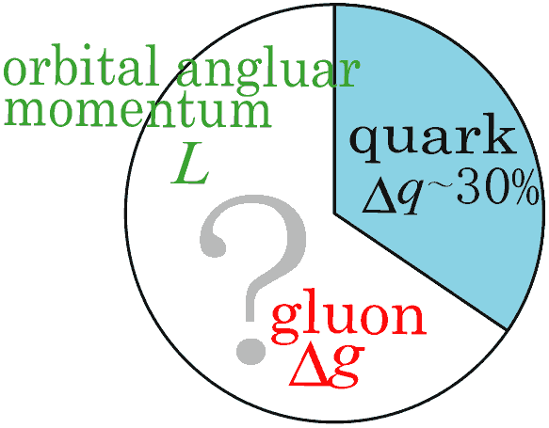
Introduction
Proton has spin ½
Its decomposition still not yet understood well.
Quark spin carries only ~30% of proton spin. – “proton spin puzzle”
The rest should come from gluon spin, and orbital angular momentum of quarks and gluons.
PHENIX longitudinal spin program
Reveal the spin structure of proton, especially Δg (gluon spin contribution to the proton) which still has large uncertaninty.
Through “Double Helicity Asymmetry(A_{LL})” of particle production (such as π⁰) in pol pp collisions
gluons participate in leading order. suitable to probe gluon spin!
RHIC -- the world’s first polarized pp collider

Slide 3
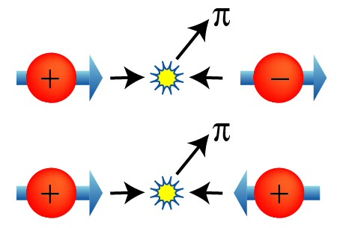
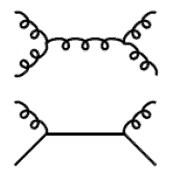
A_{LL} (of π⁰) in pol. pp collisions
Theoretically
σ₊₊=
Proton’s helicity
proton
σ₊₋=
jet
proton
π⁰
Experimentally
These two processes dominates
In our sensitive p_{T} region.
strategy
X-section measurement to confirm pQCD applicability
A_{LL} measurement to extract Δg
N: particle yield
P: polarization of beams
R: Relative Luminosity
Notes:
Here I introduce the variable we measure for dG measurement which is “Double Helicity Asymmetry” ALL. Here I take pi0 as example but it can be calculated for various particles.
ALL is defined as production x-sec asymmetry btw same helicity collisions and opposite helicity collisions. Pi0 is produced by gg,gq and qq scattering. ALL from gg scattering can be written as dg/g in proton times subprocess ALL. Others are similar. We know dq relatively well compared to dG, thus we can access dG by this variable.
Experimentally ALL is calculated as …… . We need N:particle yield (of pi0 in this example), P:Beam polarization, R: Relative Luminosity

Slide 4
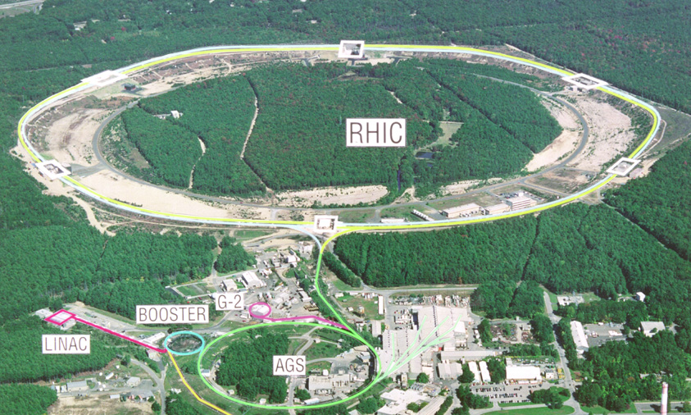
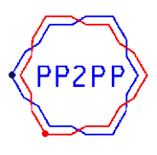






RHIC – the world’s first pol pp collider
Notes:
Here I introduce RHIC, the world’s first polarized pp collider.

Slide 5
RHIC – the world’s first pol pp collider
Longitudinal spin program
Transverse spin program
RUN | √s GeV | FOM = P⁴L 10⁻³pb⁻¹ | Int. Lumi ( pb⁻¹ ) | Pol.
2003 (RUN3) | 200 | 1.9 | 0.35 | 27%
2004 (RUN4) | 200 | 3.1 | 0.12 | 40%
2005 (RUN5) | 200 | 170 | 3.4 | 47%
2006 (RUN6) | 200 | 970 | 7.5 | 60%
 | 62.4 | 5.3 | 0.1 | 48%
2008 (RUN8) |  | 17000 | 70 | 70%
RUN | √s GeV | FOM = P²L 10⁻³pb⁻¹ | Int. Lumi ( pb⁻¹ ) | Pol.
2002(RUN2) | 200 | 3 | 0.15 | 15%
2005(RUN5) | 200 | 33 | 0.15 | 47%
2006 (RUN6) | 200 | 290 | 2.7 | 57%
 | 62.4 | 1 | 0.02 | 48%
Talk by M.Chiu (next speaker)
(plan)
FOM: Figure of Merit

Slide 6
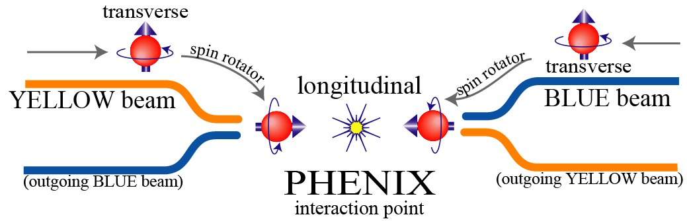
RHIC beam at PHENIX IP
Two independent beams(Blue / Yellow)
Bunch structure (120 bunchs in ~106ns interval )
Transverse→Longitudinal at IP (when we need it)
Spin pattern
Syst. uncertainty from time-dep. of the det. eff. avoided.
BLUE : + + - - ….
Yellow: + - + - ….
We can get all possible
Collision patterns.

Slide 7
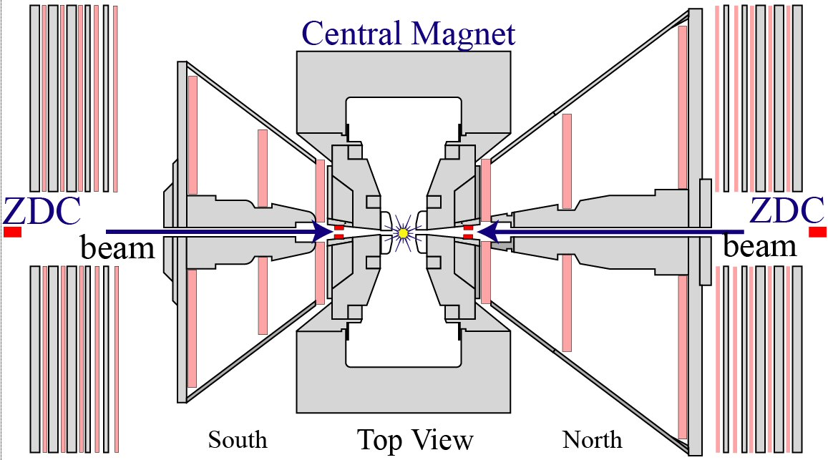
PHENIX global detector
Luminosity Measure
BBC 3.0<|η|<3.9
Quartz Cherenkov det.
ZDC |η|>6.6 (+/- 2.8mrad.)
Hadron Calorimeter
BBC
These two independent lumi. measure
are compared to find out uncertainty
on Relative Lumi.
Local Polarimetry
SMD (+ ZDC).
Scintillator hodoscopes.
Measures transverse component of beam through A_{N} of neutron.
ZDC+SMD ( Local Polarimeter )

Slide 8
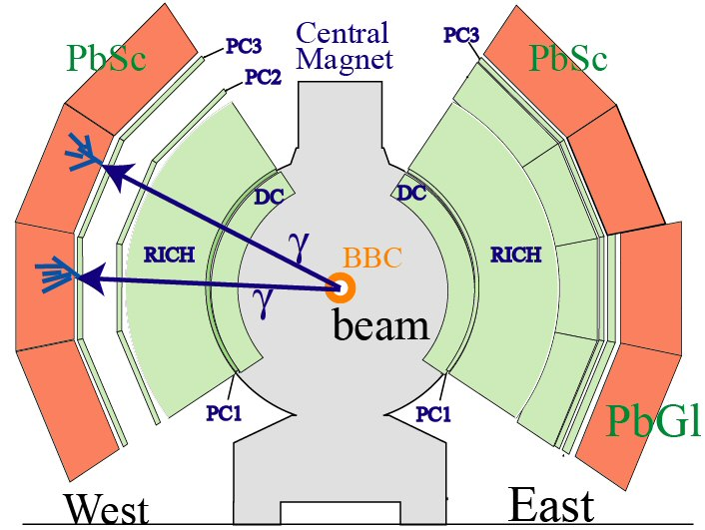
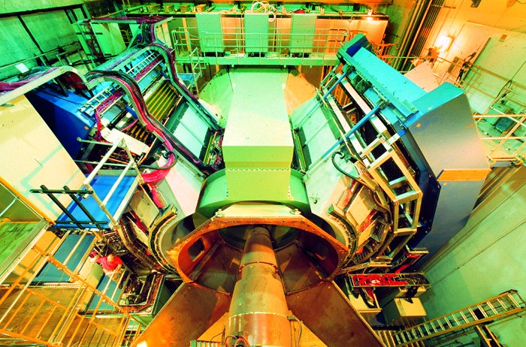
PHENIX Detector
PHENIX has ability to detect various final state particles such as π⁰,π⁺⁻,γ,e⁺⁻ and μ⁺⁻. Here I concentrate on π⁰(or γ) detection.
|η|<0.35, Δφ ~ 2 x 90deg
EMCal(PbSc,PbGl) for γ measurement. π⁰ detected via γγ decay.
High energy photon trigger available
Central Arm
beam

Slide 9
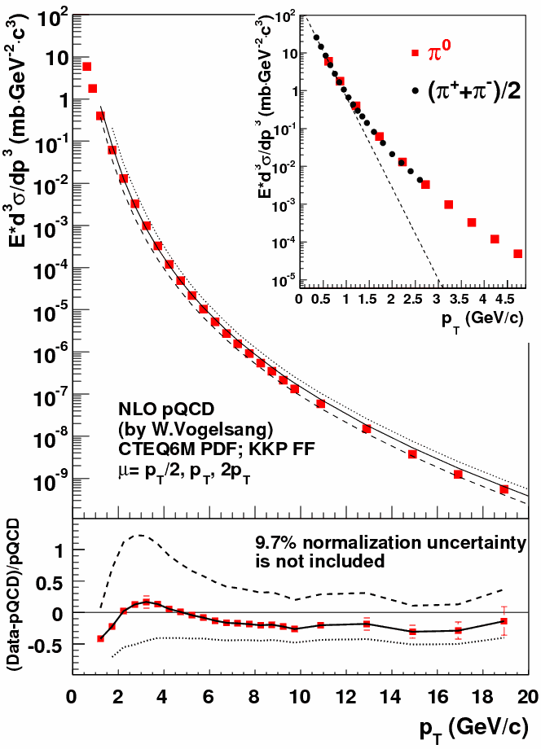
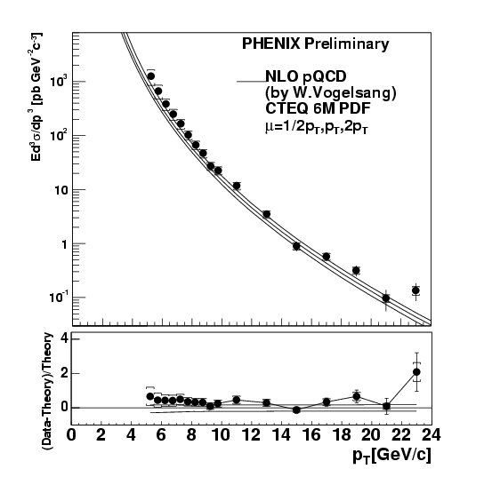


cross section – pQCD applicability
RUN5 200GeV -- π⁰
arXiv:0704.3599 [hep-ex]
RUN5 200GeV – direct γ
pQCD
works

Slide 10
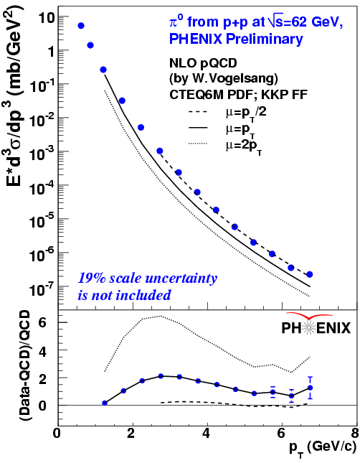
cross section – pQCD applicability
RUN5 200GeV -- π⁰
arXiv:0704.3599 [hep-ex]
RUN6 62.4GeV -- π⁰
pQCD
works

Slide 11
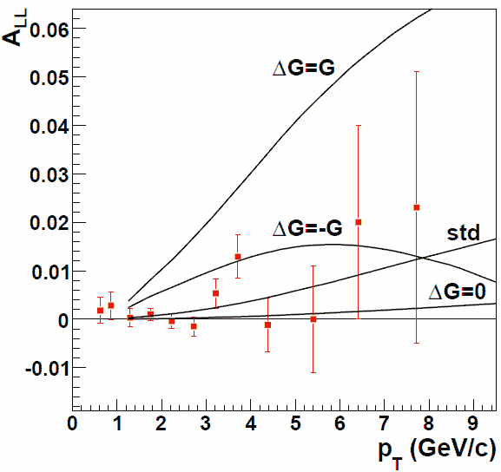
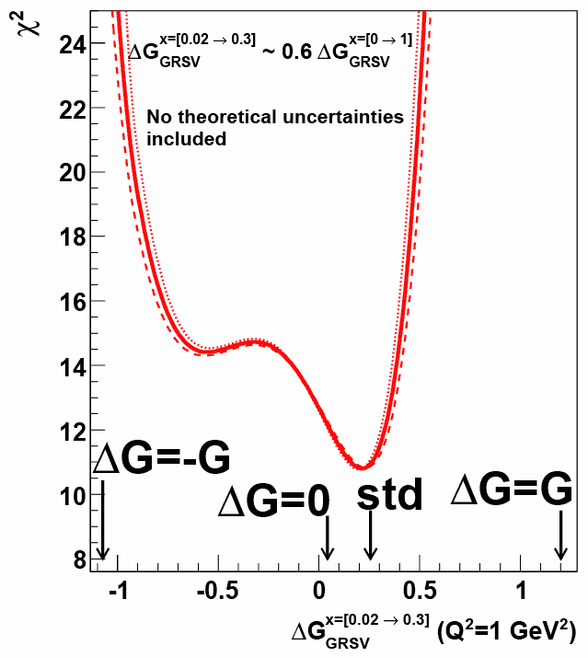
π⁰ A_{LL} at 200GeV
GRSV theory curves
Std: best fit to DIS data.
ΔG=G(x),0,-G(x) are also shown
RUN5 200GeV – π⁰
Submitted to PRL
arXiv:0704.3599 [hep-ex]
ΔG=G(x),-G(x) are excluded.
Dashed / dotted lines
corresponds to +-9.4%
scale uncertainty.
9.4% Scale uncertainty is not included
ΔG [x=0.02→0.3] (Q²=1GeV²)
Notes:
Here the red points are the measured ALL as a function of pT. compared to the four model predictions GRSV. GRSV-std is the best fit to pol DIS data. dG=unpol G(x),dG=0,dG=G(x) are also shown.
dG=G,-G scenarios are ruled out. We extend our model comparison. This plot shows relation btw chi2 and the size of dG. 1st moment of dG from the probed region(x: 0.02-0.3). Our data prefer small dG.
-0.9 ~ 0.5 --- 3sigma
0.07 ~ 0.3 --- 1sigma

Slide 12
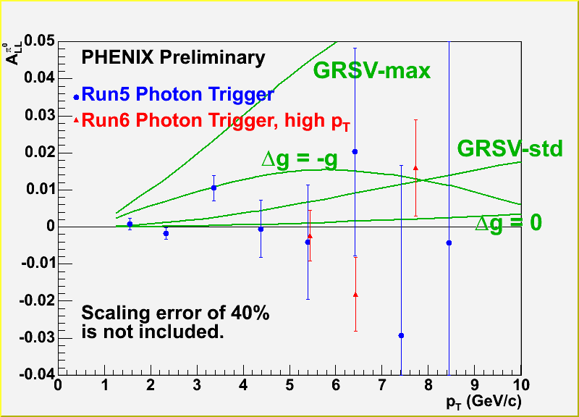
π⁰ A_{LL} at 200GeV RUN6
High p_{T} photon extracted from data virtually online (Lvl.2 filtering) for fast track analysis
Run5 prelm. 1.8pb⁻¹ (pol:47%)
Run6 prelim. (high pT) 7.5pb⁻¹ (pol:60%)
Significant statistical imrpovement in high p_{T}

Slide 13
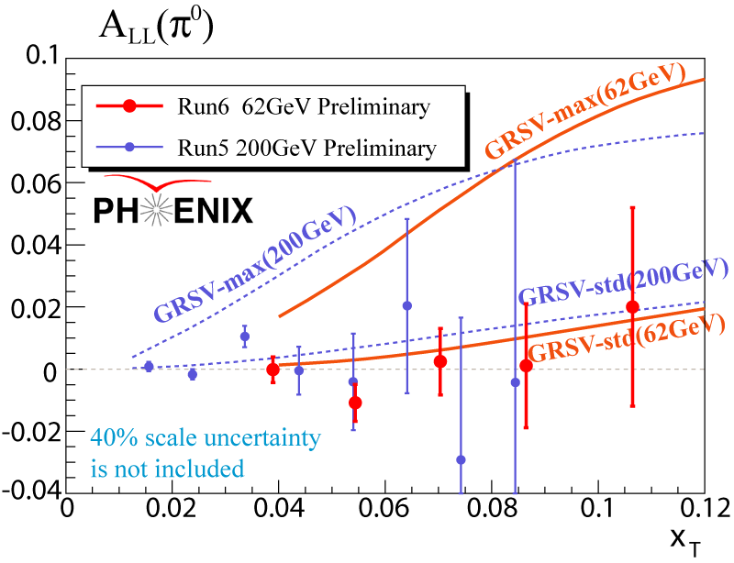
Access higher x with lower energy
Probed x scales with x_{T}
At fixed x_{T}, X-sec is 2 orders of magnitude higher at 62.4GeV than at 200GeV
pol
200GeV prelm. 1.8pb⁻¹ (47%)
62.4GeV prelm. 0.04 pb⁻¹ (48%)
Scaling variable
Significant statistical improvement in high x_{T} even with small int. lumi can be seen.

Slide 14
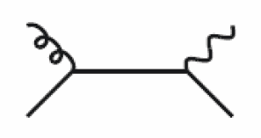
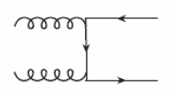
Various channels available at PHENIX to explore gluon pol.
Jet ( or a component of jet )
Direct photon
Heavy Flavor
g
g
π⁰ ,η (◊γγ)
π⁺⁻
jet-like cluster
proton
proton
g
jet
q
jet
proton
π⁰
proton
π⁰
g
γ
γ
proton
q
proton
e⁺⁻
μ⁺⁻
J/ψ (◊e⁺e⁻, μ⁺μ⁻)
e or μ
g
D
‾c
proton
g
c
or ‾cc → J/ψ
proton
Notes:
Various channels are available at PHENIX to explore dG.
For example, jet or a component of jet. Pi0 is one of this. Where gg scat. dominates, dG enters dG*dG which makes ALL insensitive to sign of dG.
The ratio btw gg,qg,qq scat differs with different final state particle like pi0,pi+pi-. And also differs with different pT. Combining these information will give us information on sign of dG.
Thus they are imortant.
Direct g, qg scattering is free from sign problem, and from FF. so clean.
Heavy flavor can be used either open charm, or closed charm.

Slide 15
summary
PHENIX longitudinal spin program is to reveal the spin structure of proton, especially Δg which has a large uncertainty.
PHENIX cross-section measurements are shown. The results confirm pQCD applicability which Δg extraction framework relies on.
PHENIX - A_{LL} π⁰ excludes large |Δg| scenarios.
Statisical improvement expected in the next run.
complementary measurements will be obtained from other channels.
We’ll accumulate 70pb⁻¹(70% pol.) at 200GeV in 2008(RUN8)

Slide 16
Back up slides

Slide 17
Information on the session
Nucleon Structure II
Session Name:D3, Hall Name:G409
No. | Name | Title
1 | M. Strikman (Penn. State Univ.) | High-energy hadron physics at future facilities
2 | J. Peng (UIUC) | Measurement of azimuthal angular distributions of dimuons in p+p and p+d interaction at 800 GeV/C
3 | K. Aoki (Kyoto /RIKEN) | Spin Physics Program at RHIC-PHENIX
4 | M. Chiu (BNL) | Transversely Polarized Proton Spin Measurements in Polarized p+p Collisions with the PHENIX detector
5 | R. Fatemi (MIT) | Recent Measurements of the Inclusive Jet Longitudinal Double Spin Asymmetry at STAR
6 | B. Surrow (MIT) | Longitudinal spin asymmetry and cross section measurement for neutral pion and charged pion production in polarized p+p collisions at RHIC at route s=200GeV
7 | S. Paul (TU-Muenchen) | Study of Hadron Structure with the COMPASS Experiment at CERN

Slide 18
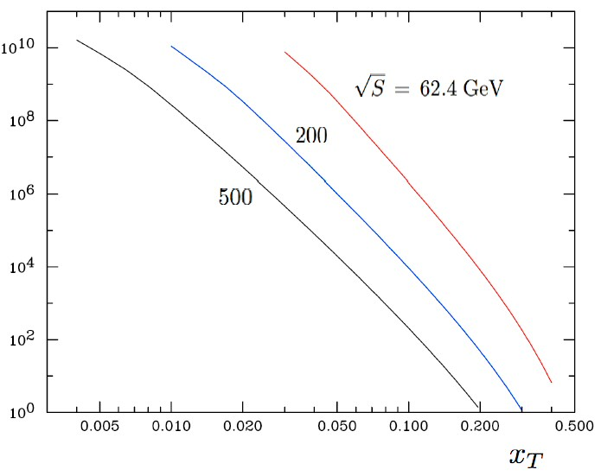
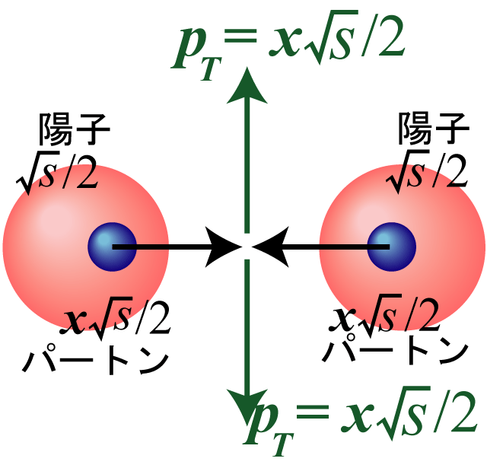
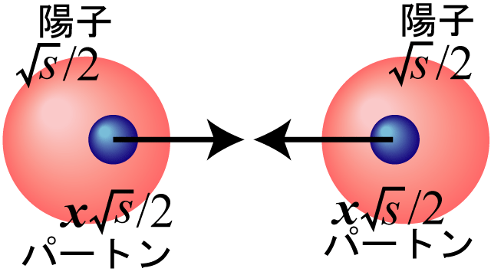
何故 √s = 62.4GeVがうれしいか？
200 GeV
62.4 GeV
スケーリング
変数
500 GeV
[pb/GeV]
測定領域
62.4GeV
200GeV
( 注）下限は、p_{T}>1GeV の要請から
同じ x_{T}で比較して、200 GeVと比べて２桁大きい。
衝突エネルギーを、
全て横に持って行った場合。
高い x_{T} は、高い x を プローブする。
少ない積分輝度で、有意な結果が得られる。

Slide 19
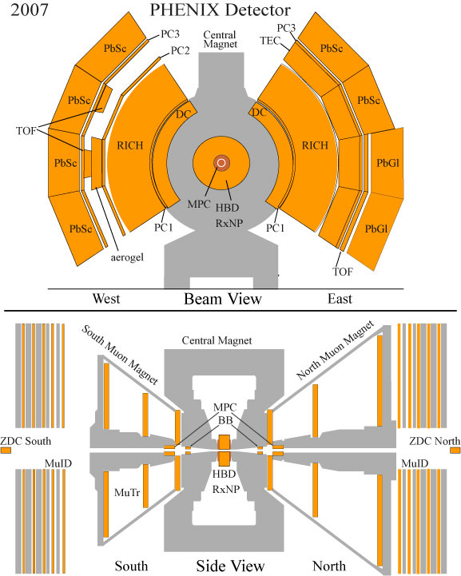
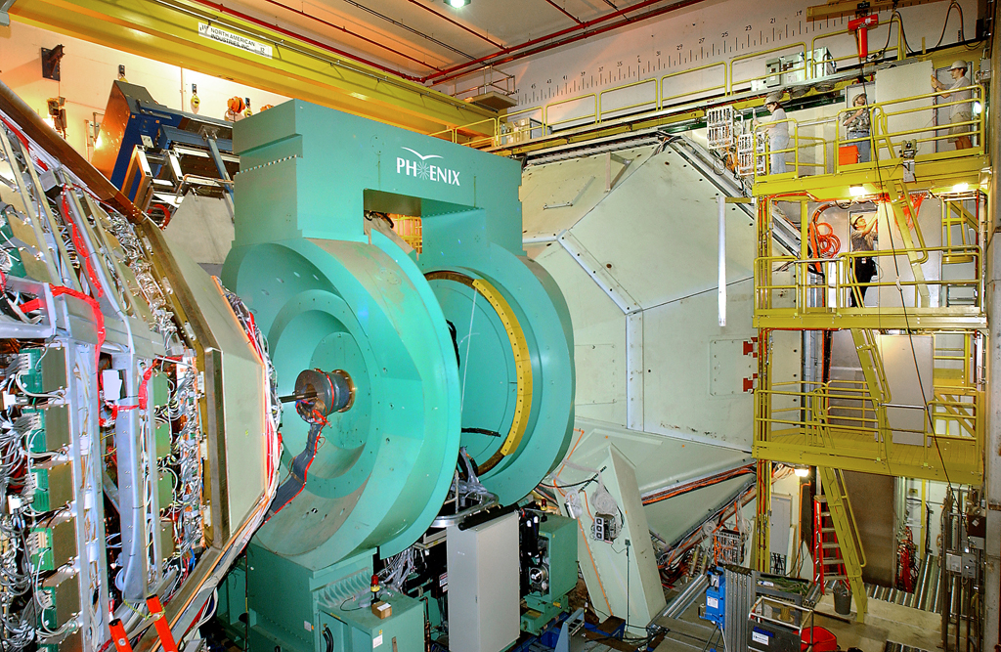
PHENIX Detector – Central Arm

Slide 20
PHENIX: γ detection.(62GeV)
EMCal
Trigger
Acceptance - |η|<0.35 , Δφ=90 x 2
Energy resolution
Position resolution
high energy cluster at EMCal. (~800MeV) w/o BBC
BBC efficiency for π⁰ event(hard scattering) is low (~40%)
π⁰ reconstruction
Minimal photon energy cut
0.1 GeV for PbSc
0.2 GeV for PbGl
Shower profile cut
Energy asymmetry cut
Trigger tile matching. (for higher energy cluster)

Slide 21
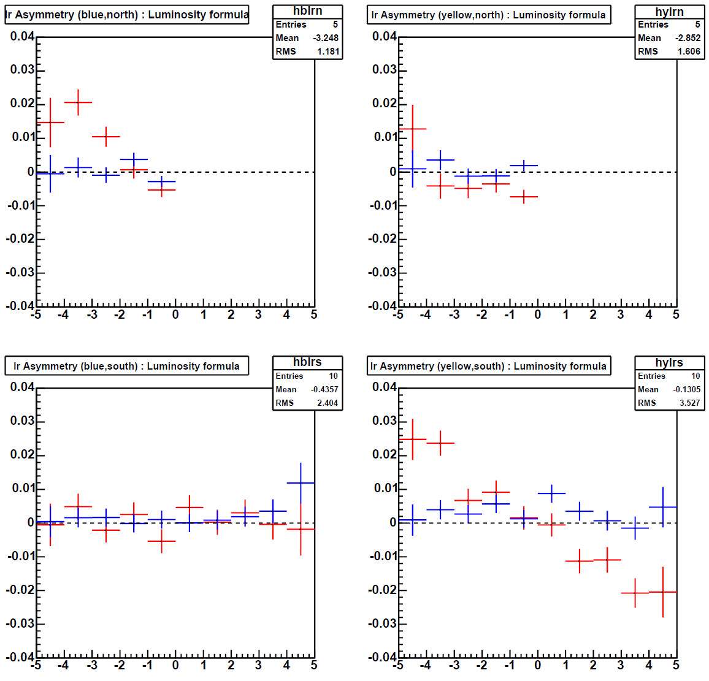
Longitudinality (62.4GeV)
neutron
Longitudinal 100% (-2.2%)
Transverse 21% (1σ uncertainty)
Blue beam
Forward
Blue Beam
Backward
Horiz-position(cm)
Horiz-position(cm)
ZDC detector
What we measure.
What we want.
Yellow Beam
Forward
Yellow Beam
Backward
Red : Rotator OFF
Blue : Rotator ON
Horiz-position(cm)
Horiz-position(cm)

Slide 22
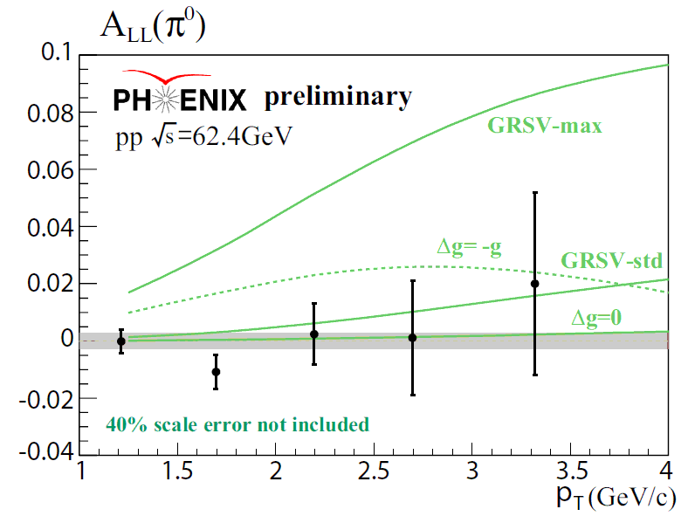
Theory curve by W. Vogelsang

Slide 23
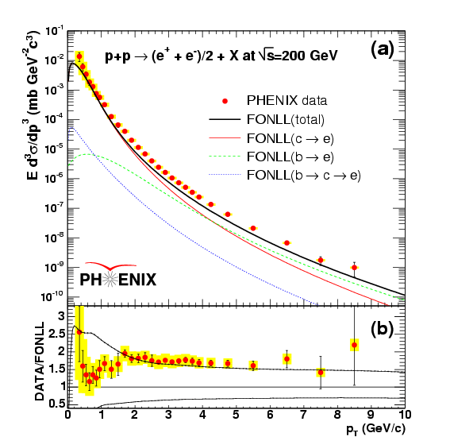
Cross section measurements
Electron
(from Charm, Beauty)
(charm) PRL97 252002: Run5

Slide 24
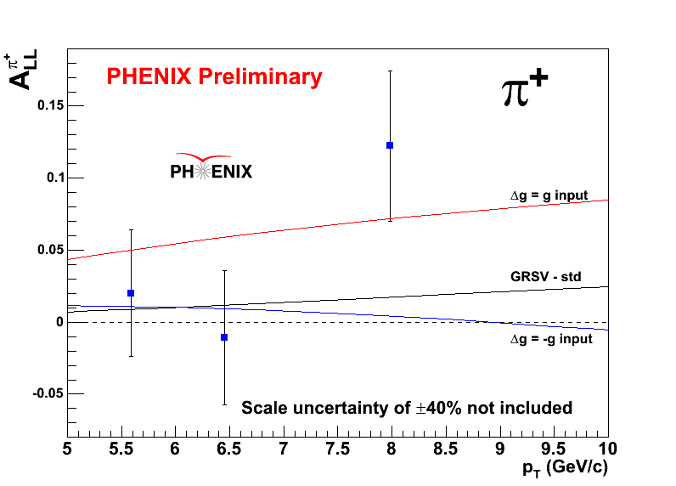

Slide 25
