Slide 1

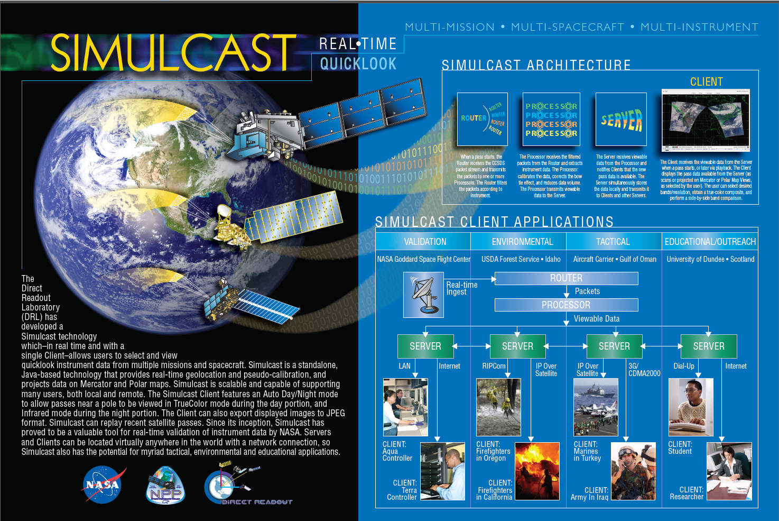
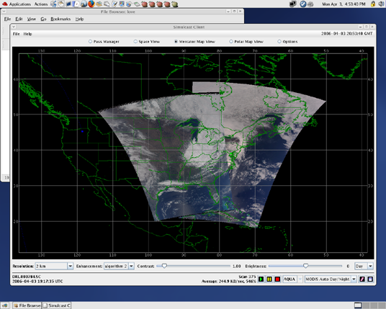
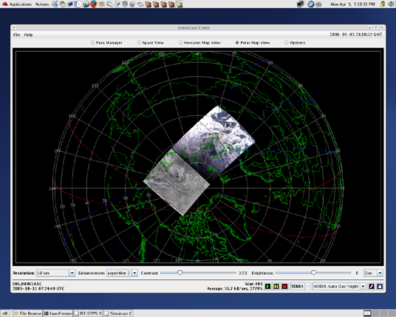
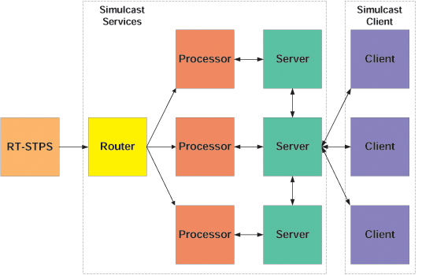
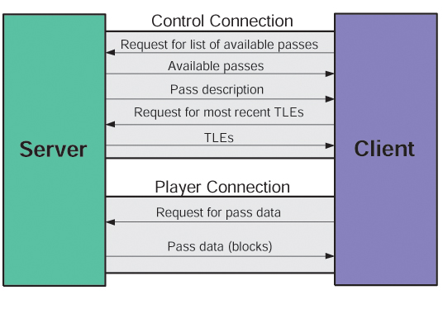

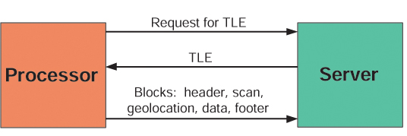
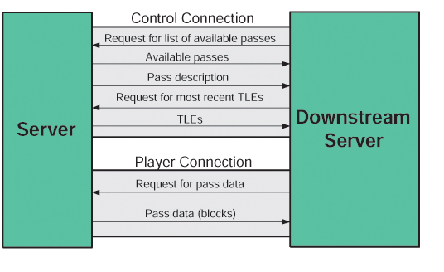
IPOPP Featuring Simulcast
The Direct Readout Laboratory (DRL) has developed a Simulcast technology which—in real time and with a single Client—allows users to select and view quicklook instrument data from multiple missions and spacecraft. Simulcast is a standalone, Java-based technology that provides real-time geolocation and pseudo-calibration, and projects data on Mercator and Polar maps. The Simulcast Client features an Auto Day/Night mode to allow passes near a pole to be viewed in TrueColor mode during the day portion, and Infrared mode during the night portion. The Client can also export displayed images to JPEG format. Simulcast can replay recent satellite passes. Simulcast is scalable and capable of supporting many users, both local and remote. Since its inception, Simulcast has proved to be a valuable tool for real-time validation of instrument data by NASA. Servers and Clients can be located virtually anywhere in the world, so Simulcast also has the potential for myriad tactical, environmental and educational applications.
SYSTEM DESCRIPTION
Simulcast consists of two parts: Services and a Client. Most users will only interface with the Simulcast Client, which actually displays the pass data (as scans or projected on Mercator or Polar Map Views, as selected by the user). Examples of the Mercator and Polar Map Views are depicted below.
Before data can be viewed with the Client, it must first be acquired, routed and processed by Simulcast Services.
Simulcast architecture is depicted on the right.
Mercator Map View
Polar Map View
Simulcast Architecture
Simulcast Services contain a Router, Processor, and Server. The Router is configured to listen on one or more ports for socket connections on which Consultative Committee for Space Data Systems (CCSDS) packets will be received. It expects the connection to be made when a satellite pass begins, and to be disconnected when the pass ends. The source of these socket connections is typically the Real-time Software Telemetry Processing System (RT-STPS). The Router listens on a different port for each satellite (currently Aqua and Terra). As CCSDS packets are received, the Router examines each one and sends the packets desired by a particular Processor via a new socket connection. The Router can support multiple RT-STPS connections to multiple Processors simultaneously. The interface between the Router and the Processor is depicted below.
Interface Between Router and Processor
The Processor is configured to listen for socket connections from a Router. The connection occurs when a satellite pass begins, and is disconnected when the pass ends. The Router first sends a message describing the pass (specifying which satellite), followed by CCSDS packets. The Processor can assume that only those packets of interest will be received. As soon as the Processor receives this connection from the Router, it makes a socket connection to a Server (as specified in the Processor's configuration) and sends a message describing the pass. As packets are received, they are assembled into a complete Earth scan. (For MODIS, the scan consists of all 38 bands at their full resolutions.) When the first scan has been received, the Processor sends a message to the Server requesting the Two Line Element (TLE) closest to the time of the scan for the given satellite. The Server responds with a message containing the TLE, which is used to initialize an SGP4 model and geolocate the scans. The Processor then sends a series of blocks to the Server, starting with a header block containing information about the pass. For each scan, the Processor geolocates the scan, performs a pseudo-calibration, and corrects for the bowtie effect. When the Router disconnects, the Processor sends a footer block to the Server containing a summary of the pass and then disconnects from the Server. The interface between the Processor and the Server is depicted below.
Interface Between Processor and Server
The Server is configured to listen for socket connections from a Processor. When a connection is received, the Server first reads the pass description message, followed by the TLE request message. It responds with a TLE message (from a dynamic database of TLEs it maintains) and then begins reading blocks from the Processor: header, geolocation, data and, finally, the footer block. These blocks are written to a pass file whose format is specific to Simulcast.
The Server is also configured to listen for socket connections from Clients. These connections are of two types: control and player, as depicted below.
Interface Between Server and Client
A Client initially makes a control connection and requests a list of available passes. When new passes begin, a message with a description of the pass is sent to the Client over the control connection. The Client then makes a player connection to the Server when it wants to play a pass for viewing. The Client first sends a message indicating how much of the pass is needed. This message specifies desired bands and resolutions, and whether the geolocated data or the bowtie-corrected data is needed. The Server then begins reading the blocks from the pass file, creates the header, scan, geolocation, and data blocks corresponding to the request, and sends them to the Client over the player connection. This is supported for passes that have already ended (playback) and for passes in real-time (live). The use of a pass file allows rate-buffering for Clients over a slow connection. A Server can also be configured as a Downstream Server in situations where there are many remote Clients, as depicted on the right.
Interface Between Server and Downstream Server
The Simulcast Client is used to view pass data. It first makes a socket connection to the Server and indicates that it is a control connection. A list of the available passes is received and is used to load the Pass Manager screen. The Client requests the most recent TLEs for the satellite and uses them to calculate the orbits shown on the Mercator and Polar Map Views. When the user decides to play a pass (or if auto-play has been enabled and a pass begins), the Client makes a socket connection to the Server and indicates that it is a player connection. A message is sent specifying how much of the pass is desired. The Client then reads the blocks generated by the Server and displays the geolocated instrument data as scans or projected on the Mercator or Polar Map Views.

