Slide 1
SRM Interface Specification
and
Interoperability Testing
Alex Sim
Scientific Data Management Research Group
Computational Research Division
Lawrence Berkeley National Laboratory

Slide 2
Who’s involved…
CERN, European Organization for Nuclear Research, Switzerland
Paolo Badino, Olof Barring, Jean-Philippe Baud, Tony Cass, Flavia Donno, Birger Koblitz, Sophie Lemaitre, Maarten Litmaath, Remi Mollon, Giuseppe Lo Presti, David Smith, Paolo Tedesco
Deutsches Elektronen-Synchrotron, DESY, Hamburg, Germany
Patrick Fuhrmann, Tigran Mkrtchan
Fermi National Accelerator Laboratory, Illinois, USA
Dmitry Litvinsev, Timur Perelmutov, Don Petravick
ICTP/EGRID, Italy
Ezio Corso
INFN/CNAF, Italy
Alberto Forti, Luca Magnoni, Riccardo Zappi
LAL/IN2P3/CNRS, Faculté des Sciences, Orsay Cedex, France
Gilbert Grosdidier
Lawrence Berkeley National Laboratory, California, USA
Junmin Gu, Vijaya Natarajan, Arie Shoshani, Alex Sim
Rutherford Appleton Laboratory, Oxfordshire, England
Shaun De Witt, Jens Jensen, Jiri Menjak
Thomas Jefferson National Accelerator Facility (TJNAF), Virginia, USA
Michael Haddox-Schatz, Bryan Hess, Andy Kowalski, Chip Watson
Notes:
This list does not include anyone in the storage component development and implementations.

Slide 3
What is SRM?
Storage Resource Managers (SRMs) are middleware components
whose function is to provide dynamic space allocation and file management on shared storage components on the Grid
Different implementations for underlying storage systems based on the SRM specification
SRMs in the data grid
Shared storage space allocation & reservation
important for data intensive applications
Get/put files from/into spaces
archived files on mass storage systems
File transfers from/to remote sites, file replication
Negotiate transfer protocols
File and space management with lifetime
support non-blocking (asynchronous) requests
Directory management
Interoperate with other SRMs
Notes:
Brief history will follow after this slide

Slide 4
History
6 year of Storage Resource (SRM) Management activity
Experience with system implementations v.1.x - 2001
MSS: HPSS (LBNL, ORNL, BNL), Enstore (Fermi), JasMINE (Jlab), Castor (CERN), MSS (NCAR), SE (RAL) …
Disk systems: DRM(LBNL), dCache(Fermi), DPM(CERN), jSRM (Jlab), …
SRM v2.1 spec was finalized – 2003
GSM: OGF-BOF at GGF8 - June 2003
SRM v2.2 spec was finalized – May 2006
Last SRM collaboration meeting – Sept. 2006
SRM v3.0 spec being discussed - 2007

Slide 5
SRMs in work
Europe : LCG/EGEE
177+ deployments, managing more than 10PB
116 DPM/SRM
54 dCache/SRM
7 CASTOR/SRM at CERN, CNAF, PIC, RAL, Sinica
StoRM at ICTP/EGRID, INFN/CNAF
US
OSG
dCache/SRM from FNAL
BeStMan/SRM from LBNL
ESG
DRM/SRM, HRM/SRM at LANL, LBNL, LLNL, NCAR, ORNL
Others
JASMine/SRM from TJNAF
L-Store/SRM from Vanderbilt Univ.
DRM/SRM adaptation on Lustre file system at Texas Tech
Notes:
We don’t have a statistics in US like our European colleagues.

Slide 6
Examples for SRMs from LBNL in Production Grids
Earth System Grid
Uses SRM/DRM at multiple sites
Uses SRM/HRM for HPSS
Uses an adaptation of SRM/HRM for NCAR’s MSS
HENP STAR experiment
Uses SRM/DRM on clusters
Uses SRM/HRM for HPSS access at BNL and NERSC
Uses DataMover for production-level robust file streaming
Notes:
A couple examples of SRMs in production grid that LBNL is involved in.
There are more but at least we are familiar with these.

Slide 7
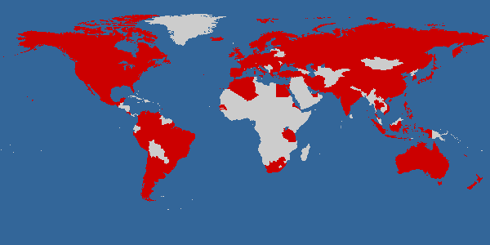
Earth System Grid
Main ESG portal
148.53 TB of data at four locations
965,551 files
Includes the past 7 years of joint DOE/NSF climate modeling experiments
4713 registered users
Downloads to date: 31TB/99,938 files
IPCC AR4 ESG portal
28 TB of data at one location
68,400 files
Model data from 11 countries
Generated by a modeling campaign coordinated by the Intergovernmental Panel on Climate Change (IPCC)
818 registered analysis projects
Downloads to date: 123TB/543,500 files, 300 GB/day on average
Courtesy: http://www.earthsystemgrid.org

Slide 8
Where is SRM in ESG?
LBNL
DISK
HPSS
ANL
GridFTP service
HRM
Storage Resource
Management
RLS
Globus Security infrastructure
GridFTP
server
NCAR
ESG Portal
RLS
ORNL
LLNL
HRM
Storage Resource
Management
DISK
IPCC Portal
User DB
XML
data
catalogs
ESG CA
GridFTP
server
XML data
catalogs
ESG Metadata DB
MyProxy
RLS
DISK
DRM
Storage Resource
Management
OPeNDAP-g
RLS
LAHFS
HPSS
GridFTP server
FTP server
GridFTP
server
HRM
Storage Resource
Management
ISI
LANL
DISK
MCS Metadata Cataloguing Services
RLS
RLS Replica Location Services
MSS
Mass
Torage
System
DRM
Storage Resource
Management
DISK
GridFTP
server
Monitoring Discovery ervices

Slide 9
HENP STAR experiment
In production for over 4 years
Data Replication from BNL to LBNL
1TB/10K files per week on average
Event processing in Grid Collector
STAR analysis framework

Slide 10

DataMover/HRMs in HENP-STAR experiment
for Robust Multi-file replication over WAN
Anywhere
DataMover
(Command-line Interface)
Create
Equivalent
directories
Get list
of files
From directory
RRS
SRM-COPY
(thousands of files)
Catalog Registration
SRM-GET (one file at a time)
LBNL
HRM
(performs writes)
HRM
(performs reads)
BNL
GridFTP GET (pull mode)
Disk
Cache
Disk
Cache
Network transfer
archive files
stage files

Slide 11
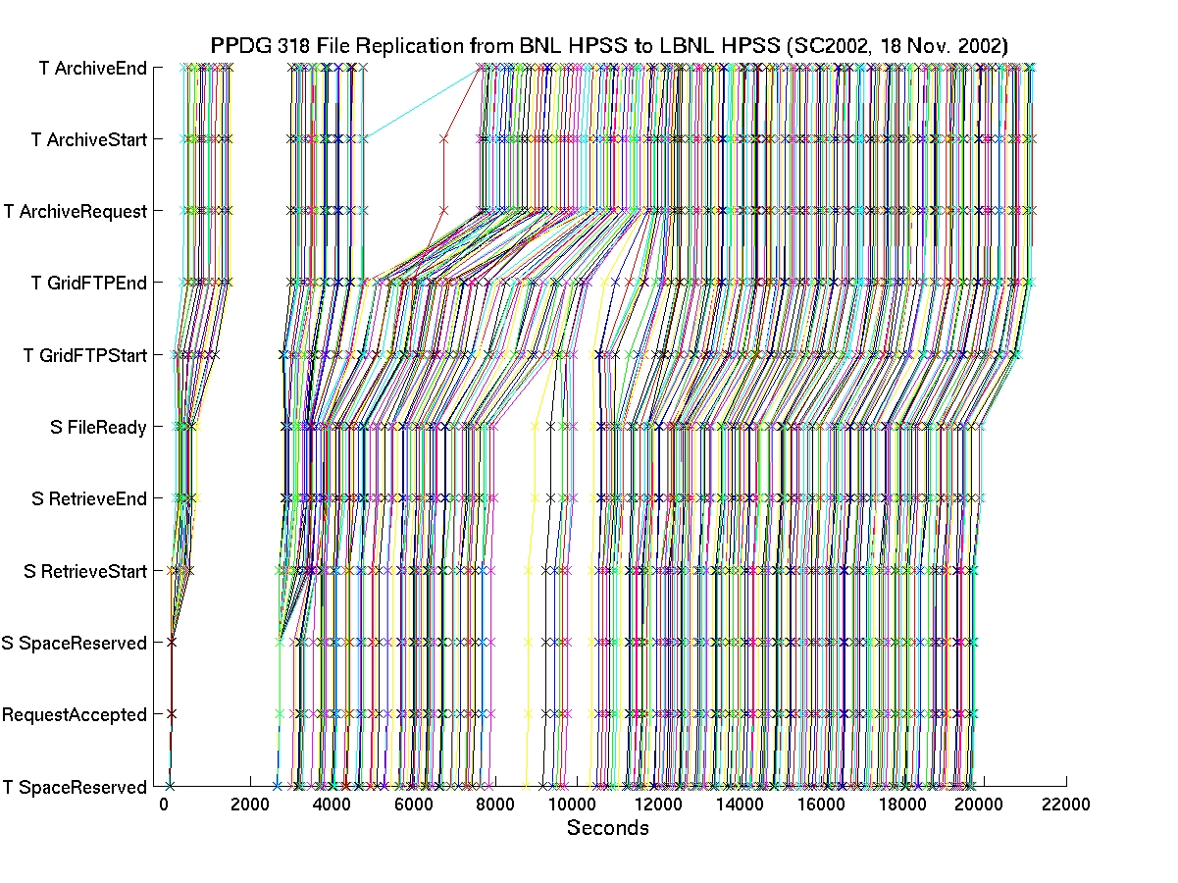
File Tracking Shows Recovery From Transient Failures
Total:
45 GBs

Slide 12
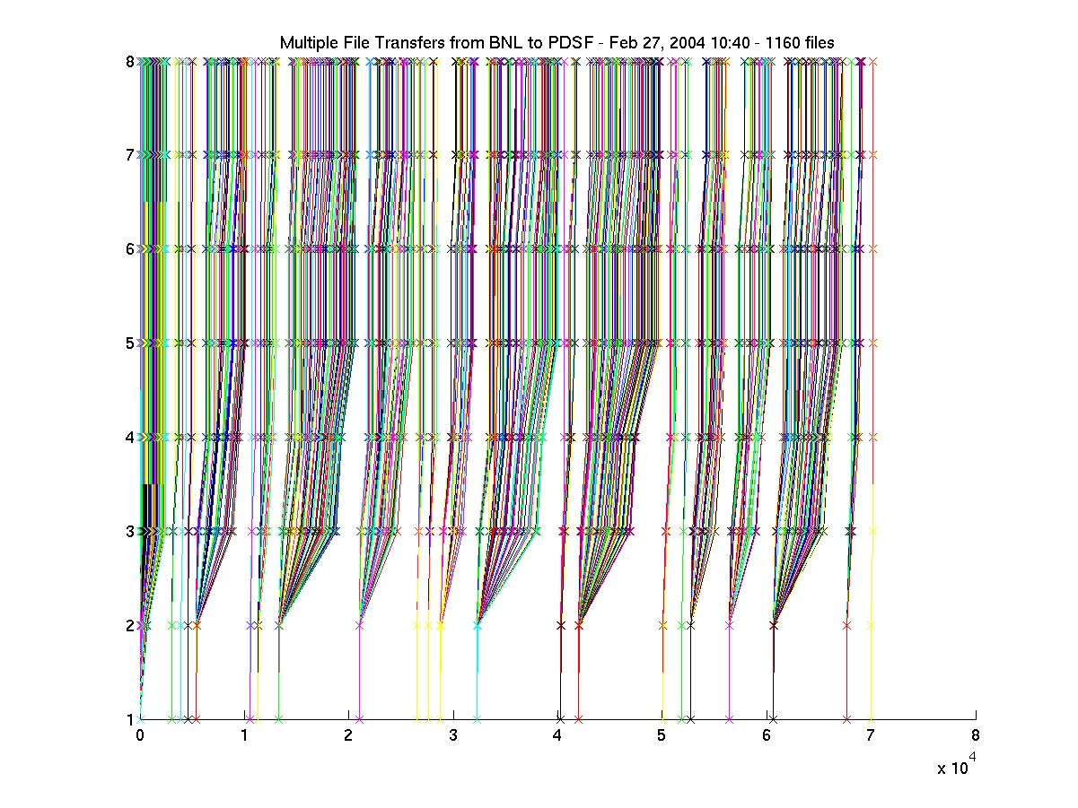
Multi-file Transfer plot from BNL to LBNL (27/02/04)
1 = Request ACCEPTED 2 = File SpaceReserved 3 = Grid FTPStart 4 = Grid FTPEnd 5 = HPSS MIGRATION_REQUEST 6 = HPSS ARCHIVE_START 7 = HPSS ARCHIVED 8 = File Released

Slide 13
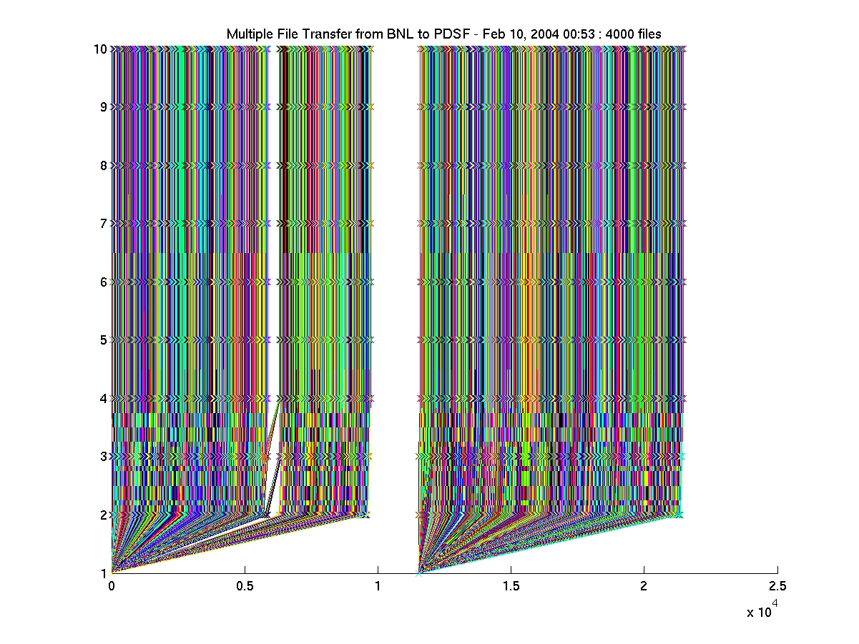
Multi-file Transfer plot from BNL to LBNL (10/02/04)
1 = Request ACCEPTED 2 = File SpaceReserved 3 = Grid FTPStart 4 = Grid FTPEnd 5 = HPSS MIGRATION_REQUEST 6 = HPSS ARCHIVE_START 7 = HPSS ARCHIVED 8 = File Released
9 = File SpaceClaimed 10 = HPSS Archivig_Error
Notes:
Brief summary of SRM v2.2. interface follows

Slide 14
SRM v2.2 Interface
Data transfer functions to get files into SRM spaces from the client's local system or from other remote storage systems, and to retrieve them
srmPrepareToGet, srmPrepareToPut, srmBringOnline, srmCopy
Space management functions to reserve, release, and manage spaces, their types and lifetimes.
srmReserveSpace, srmReleaseSpace, srmUpdateSpace, srmGetSpaceTokens
Lifetime management functions to manage lifetimes of space and files.
srmReleaseFiles, srmPutDone, srmExtendFileLifeTime
Directory management functions to create/remove directories, rename files, remove files and retrieve file information.
srmMkdir, srmRmdir, srmMv, srmRm, srmLs
Request management functions to query status of requests and manage requests
srmStatusOf{Get,Put,Copy,BringOnline}Request, srmGetRequestSummary, srmGetRequestTokens, srmAbortRequest, srmAbortFiles, srmSuspendRequest, srmResumeRequest
Other functions include Discovery and Permission functions
srmPing, srmGetTransferProtocols, srmCheckPermission, srmSetPermission, etc.
Notes:
After that, “then…”

Slide 15
Why do we need testing on SRMs?
Storage Resource Managers (SRMs) are based on a common interface specification.
SRMs can have different implementations for the underlying storage systems.
Compatibility and interoperability need to be tested according to the specification.
5 implementations are currently available for v2.2
CASTOR (CERN, RAL)
dCache (FNAL, DESY)
DPM (CERN)
StoRM (Italy)
BeStMan (LBNL)

Slide 16
How is testing done? (1)
S2 test suite for SRM v2.2 from CERN
Basic functionality, tests based on use cases, and cross-copy tests, as part of the certification process
Supported file access/transfer protocols: rfio, dcap, gsidcap, gsiftp
S2 test cron jobs running 5 times per day.
Results published on a web page
https://twiki.cern.ch/twiki/bin/view/SRMDev
Stress tests simulating many requests and many clients
Available on specific endpoints, running clients on 11 machines
Notes:
Certification process: when a new version of an SRM implementation is released, it is checked against S2. Subset of S2 is integrated into SAM (Site Availability Monitor).
results for 18 SRM v2.2 endpoints

Slide 17
How is testing done? (2)
SRM-Tester from LBNL
Tests conformity of the SRM server interface according to the SRM spec v1.1, and v2.2
Compatibility and interoperability of the SRM servers according to the spec
Supported file transfer protocols: gsiftp, ftp, http and https
Test cron jobs running twice a day.
Results published on a web site
http://datagrid.lbl.gov
Reliability and stress tests simulating many files, many requests and many clients
Available with options, running clients on 8 node cluster
Planning to use OSG grid resources
Java-based SRM-Tester and C-based S2 test suite complement each other in SRM v2.2 testing
Notes:
Results are for 7 SRM v2.2 and 8 SRM v1.1
complement mainly due to the limitations of the programming language. For example, data type checking is more strict in java, whereas SOAP compatibility is more standardized in gSOAP (C-based) than Axis (Java-based).

Slide 18






















Super Computing 2006 Test for SRM v2.2
CASTOR
CASTOR
Disk
LBNL SRM
CERN
SRM
RAL
SRM
dCache
LBNL SRM
FNAL
SRM
DPM
INFN
SRM
mySQL DB
CERN
SRM
WEB
SRM-TESTER
VU
SRM
Notes:
One example of SRM v2.2 testing in last Super Computing.

Slide 19
OGF 17-18 GIN-Data SRM inter-op testing
Client
SRM-TESTER
WEB
Test Storage Sites according to the spec v1.1 and v2.2
SRM
SRM
SRM
SRM
SRM
SRM
SRM
SRM
SRM
GridFTP
HTTP(s)
FTP
services
CERN
LCG
IC.UK
EGEE
UIO
ARC
SDSC
OSG
LBNL
STAR
APAC
SRM
Grid.IT
SRM
FNAL
CMS
VU
SRM
HRM
HRM
HRM
Notes:
One example of SRM testing for v1.1 and v2.2 for OGF

Slide 20
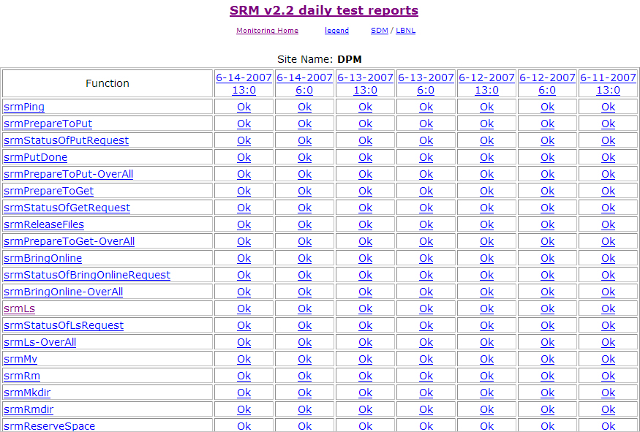
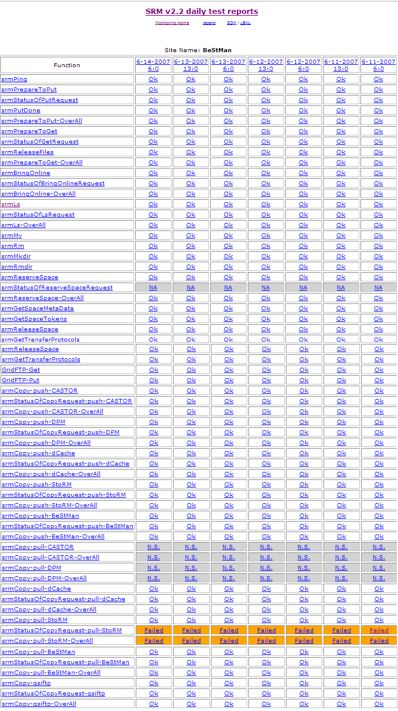
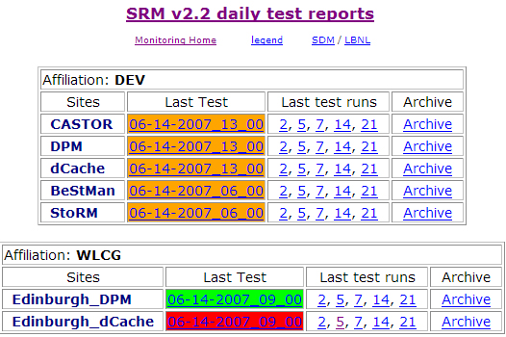
SRM-Tester results SRM v2.2

Slide 21
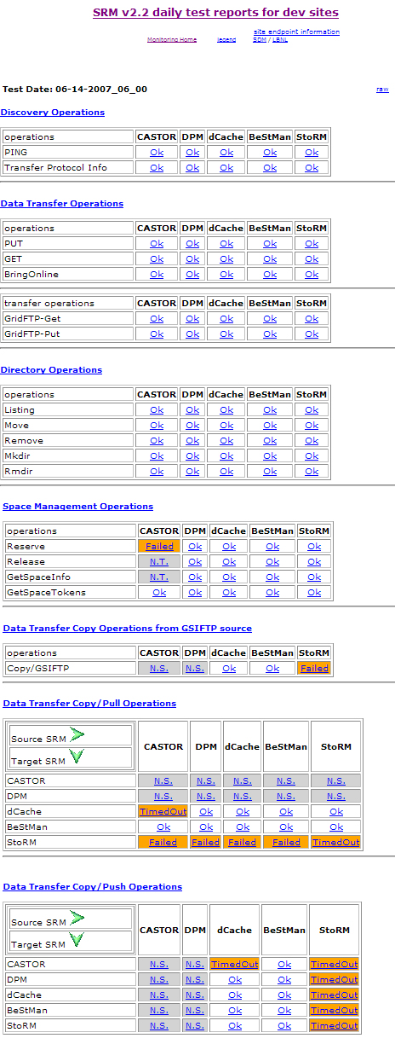
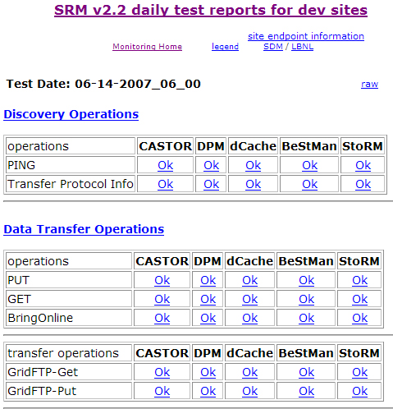
SRM-Tester results SRM v2.2 collective view

Slide 22
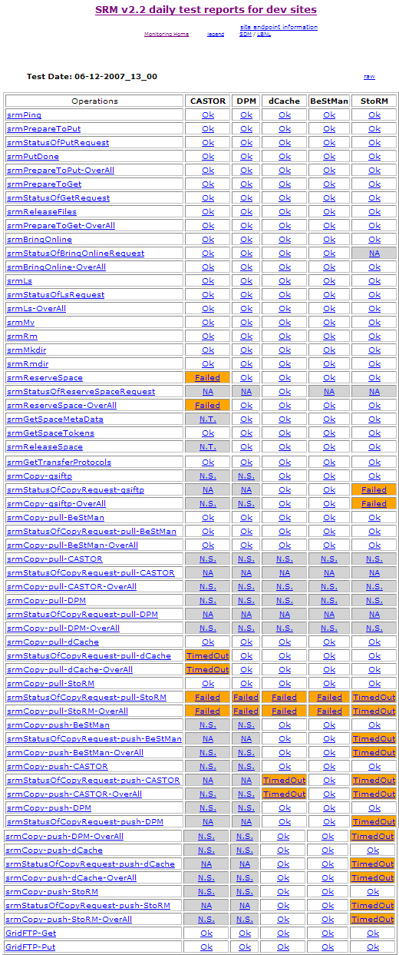
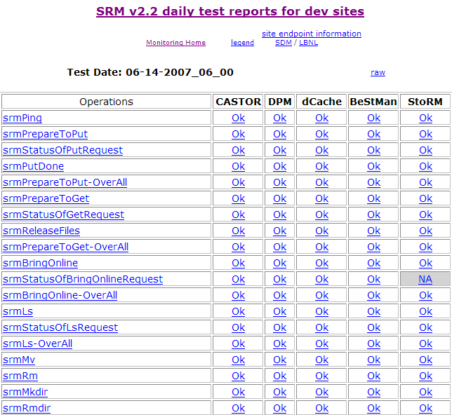
SRM-Tester results SRM v2.2 functional view

Slide 23
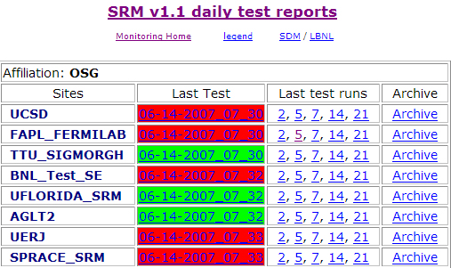
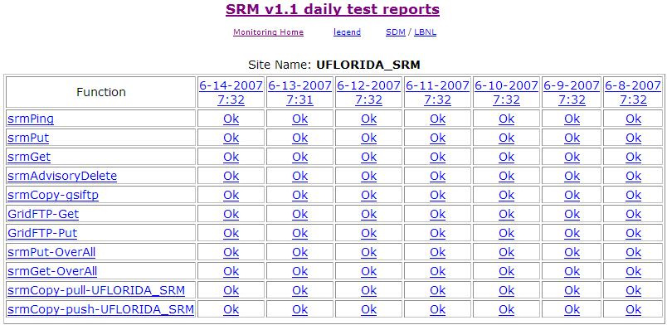
SRM-Tester results SRM v1.1

Slide 24
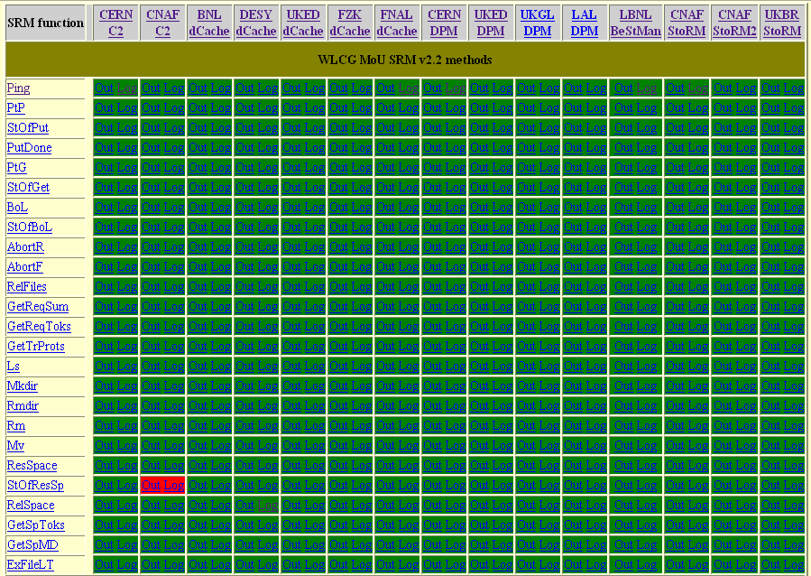
S2 basic tests results
Courtesy: https://twiki.cern.ch/twiki/bin/view/SRMDev

Slide 25
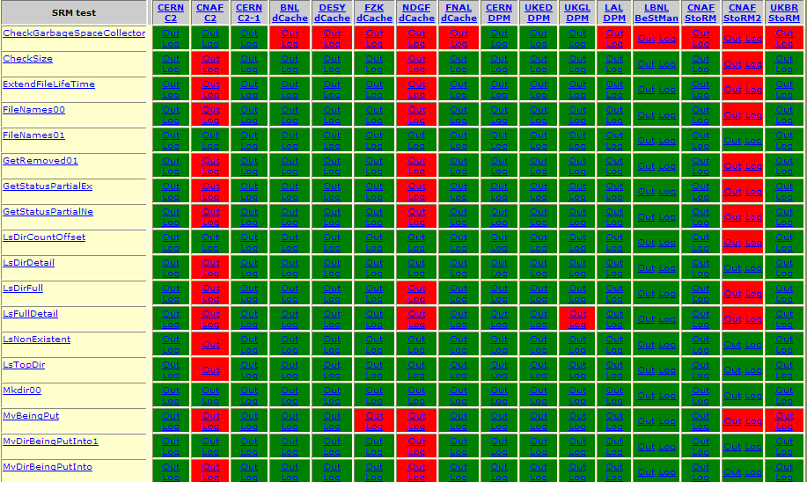
S2 use-case tests results
Courtesy: https://twiki.cern.ch/twiki/bin/view/SRMDev

Slide 26
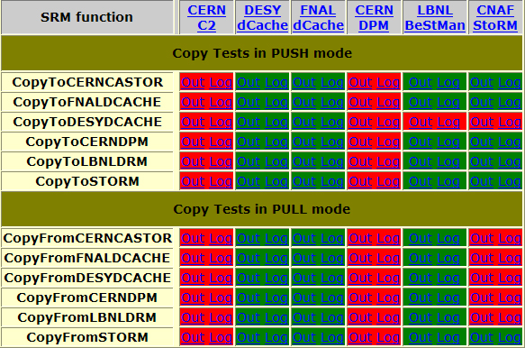
S2 copy case tests
Courtesy: https://twiki.cern.ch/twiki/bin/view/SRMDev

Slide 27
Implementation Status
SRM v1.1
Most deployed SRMs are compliant with the specification
Incompatibility mostly comes from the transfer protocols and the underlying storage configurations, not from interface incompatibility
Information service to advertise capabilities of individual SRMs would help
SRM v2.2
Implementations in pre-production environment
Testing continues…

Slide 28
Summary
Storage Resource Management – essential for Grid
Multiple SRM implementations interoperate based on same specification
Permit special purpose implementations for unique storage systems
Permits interchanging one SRM product by another
SRM implementations exist and in production use
Open Science Grid
LCG/EGEE
Earth System Grid
More coming …
Testing new version implementations in pre-production environment is essential
Notes:
Testing new version implementations in pre-production environment is essential for successful release and deployments.
Detailed testing on new implementations are important.
Deployed implementations in production environment must also be tested for availability and basic functionalities, as well as for reliability and stress testing.

Slide 29
Documents and Support
SRM Collaboration and SRM Specifications
http://sdm.lbl.gov/srm-wg
SRM Test Results
SRM-Tester at LBNL: http://datagrid.lbl.gov
S2 at CERN https://twiki.cern.ch/twiki/bin/view/SRMDev
Contact and support : srm@lbl.gov

