Slide 1





























Uniform Grid Storage Access Scientific Data management Research Group Computational Research Division Lawrence Berkeley National Laboratory
Contact: Alex Sim <ASim@lbl.gov>
Super Computing 2008, Nov. 17-20, 2008 Austin, TX, USA
SRMs
SRM/iRODS-SRB
dCache
institutions
Fermilab
organizations

Slide 2
Abstract
Large scale Grid computing requires dynamic storage allocation and management of large number of files. However, storage systems vary from a single disk to complex mass storage systems. A standard middleware specification, called Storage Resource Management (SRM) has been developed over the last seven years. It provides the functionality for dynamic storage reservation and management of the files in Grid spaces and manages file movement between these spaces. This demo will show the interoperability of different SRM implementations around the world based on the latest SRM specification. It will show the ability to put, get, and copy files between any of these storages systems using the SRM interfaces. In particular, we will demonstrate the ability of analysis program getting and putting files into a variety of remote storage systems using uniform SRM calls. Such analysis programs only need the SRM client to interact with any SRM-based or GridFTP-based servers. Many of these SRM-frontend systems are now used in large Grid projects, including the High Energy Physics Worldwide LHC Computing Grid (WLCG) Project, Open Science Grid (OSG) and the Earth System Grid (ESG) project.

Slide 3
What is SRM?
Storage Resource Managers (SRMs) are middleware components
whose function is to provide dynamic space allocation and file management on shared storage components on the Grid
Different implementations for underlying storage systems based on the SRM specification
SRMs in the data grid
Shared storage space allocation & reservation
important for data intensive applications
Get/put files from/into spaces
archived files on mass storage systems
File transfers from/to remote sites, file replication
Negotiate transfer protocols
File and space management with lifetime
support non-blocking (asynchronous) requests
Directory management
Interoperate with other SRMs
Notes:
Brief history will follow after this slide

Slide 4
Motivation & Requirements (1)
Grid architecture needs to include reservation & scheduling of:
Compute resources
Storage resources
Network resources
Storage Resource Managers (SRMs) role in the data grid architecture
Shared storage resource allocation & scheduling
Specially important for data intensive applications
Often files are archived on a mass storage system (MSS)
Wide area networks – need to minimize transfers by file sharing
Scaling: large collaborations (100’s of nodes, 1000’s of clients) – opportunities for file sharing
File replication and caching may be used
Need to support non-blocking (asynchronous) requests

Slide 5
Motivation & Requirements (2)
Suppose you want to run a job on your local machine
Need to allocate space
Need to bring all input files
Need to ensure correctness of files transferred
Need to monitor and recover from errors
What if files don’t fit space? Need to manage file streaming
Need to remove files to make space for more files
Now, suppose that the machine and storage space is a shared resource
Need to do the above for many users
Need to enforce quotas
Need to ensure fairness of space allocation and scheduling

Slide 6
Motivation & Requirements (3)
Now, suppose you want to do that on a Grid
Need to access a variety of storage systems
mostly remote systems, need to have access permission
Need to have special software to access mass storage systems
Now, suppose you want to run distributed jobs on the Grid
Need to allocate remote spaces
Need to move (stream) files to remote sites
Need to manage file outputs and their movement to destination site(s)

Slide 7
Client and Peer-to-Peer Uniform Interface
...
Client’s site
Uniform SRM
interface
Client
(command line)
client
Client
Program
Disk
Cache
Storage
Resource
Manager
Disk
Cache
network
Storage
Resource
Manager
Storage
Resource
Manager
Storage
Resource
Manager
...
...
...
MSS
Disk
Cache
Disk
Cache
Disk
Cache
Disk
Cache
Disk
Cache
Site 1
Site 2
Site N

Slide 8
Storage Resource Managers: Main concepts
Non-interference with local policies
Advance space reservations
Dynamic space management
Pinning file in spaces
Support abstract concept of a file name: Site URL
Temporary assignment of file names for transfer: Transfer URL
Directory Management and ACLs
Transfer protocol negotiation
Peer to peer request support
Support for asynchronous multi-file requests
Support abort, suspend, and resume operations

Slide 9
SRM v2.2 Interface
Data transfer functions to get files into SRM spaces from the client's local system or from other remote storage systems, and to retrieve them
srmPrepareToGet, srmPrepareToPut, srmBringOnline, srmCopy
Space management functions to reserve, release, and manage spaces, their types and lifetimes.
srmReserveSpace, srmReleaseSpace, srmUpdateSpace, srmGetSpaceTokens
Lifetime management functions to manage lifetimes of space and files.
srmReleaseFiles, srmPutDone, srmExtendFileLifeTime
Directory management functions to create/remove directories, rename files, remove files and retrieve file information.
srmMkdir, srmRmdir, srmMv, srmRm, srmLs
Request management functions to query status of requests and manage requests
srmStatusOf{Get,Put,Copy,BringOnline}Request, srmGetRequestSummary, srmGetRequestTokens, srmAbortRequest, srmAbortFiles, srmSuspendRequest, srmResumeRequest
Other functions include Discovery and Permission functions
srmPing, srmGetTransferProtocols, srmCheckPermission, srmSetPermission, etc.
Notes:
After that, “then…”

Slide 10
Berkeley Storage Manager (BeStMan) LBNL
Java implementation
Designed to work with unix-based disk systems
As well as MSS to stage/archive from/to its own disk (currently HPSS)
Adaptable to other file systems and storages (e.g. NCAR MSS, Hadoop, Lustre, Xrootd)
Uses in-memory database (BerkeleyDB)
Multiple transfer protocols
Space reservation
Directory management (no ACLs)
Can copy files from/to remote SRMs
Can copy entire directory robustly
Large scale data movement of thousands of files
Recovers from transient failures (e.g. MSS maintenance, network down)
Local Policy
Fair request processing
File replacement in disk
Garbage collection

Slide 11
Castor-SRM CERN and Rutherford Appleton Laboratory
CASTOR is the HSM in production at CERN
21 PB on tape, 5 PB on disk, 100M+ files
Support for any TapeN-DiskM storage class
Designed to meet Large Hadron Collider Computing requirements
Maximize throughput from clients to tape (e.g. LHC experiments data taking)
Also deployed at ASGC, CNAF, RAL
C++ Implementation
Reuse of CASTOR software infrastructure
Derived SRM specific classes
Configurable number of thread pools for both front- and back-ends
ORACLE centric
Front and back ends can be distributed on multiple hosts
Slide courtesy: Jan van Eldik
Giuseppe Lo Presti
Shaun De Witt

Slide 12
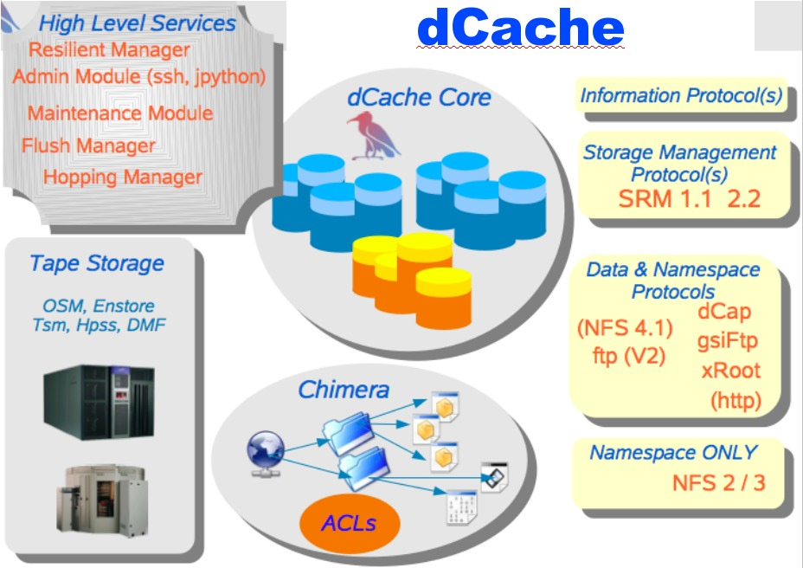
dCache-SRM FNAL, DESY, NDGF
Strict name space and data storage separation
Automatic file replication on based on access patterns
HSM Connectivity (Enstore, OSM, TSM, HPSS, DMF)
Automated HSM migration and restore
Scales to Peta-byte range on 1000’s of disks
Supported protocols:
(gsi/krb)FTP, (gsi/krb)dCap, xRoot, NFS 2/3
Separate IO queues per protocol
Resilient dataset management
Command line and graphical admin interface
Variety of Authorization mechanisms including VOMS
Deployed in a large number of institutions worldwide
SRM 1.1 and SRM 2.2
Dynamic Space Management
Request queuing and scheduling
Load balancing
Robust replication using SrmCopy functionality via SRM, (gsi)FTP and http protocols
Slide courtesy: Timur Perelmutov

Slide 13

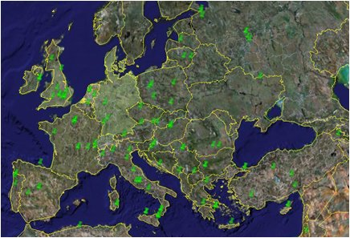
Disk Pool Manager (DPM) CERN
Objective
Provide a reliable, secure and robust storage system
Requirements
Store a few hundreds of TB
Easy to install and to manage
Scalable storage system
Interoperable with other SEs
Production
187 DPM installed
224 supported VOs
Biggest DPM : 200 TB
Expanding to 400 TB
Slide courtesy: Maarten Litmaath
Flavia Donno
Akos Frohner
David Smith
Jean-Philippe Baud

Slide 14
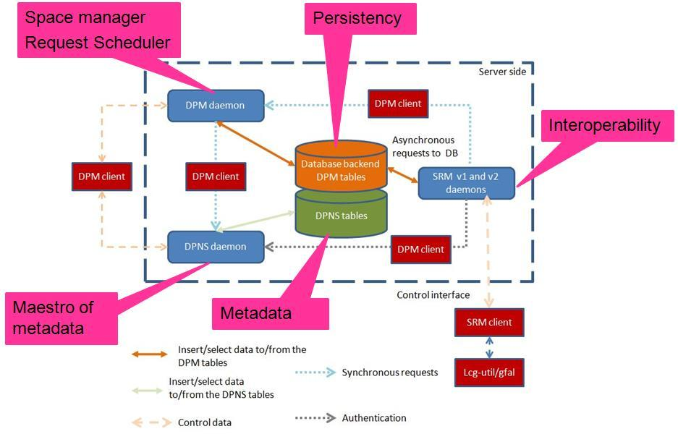
DPM: technical aspects
Manages storage on disks only
Security
GSI for authentication
VOMS for authorization
Standard POSIX permissions + ACLs based on user’s DN and VOMS roles
Virtual ids
Accounts created on the fly
Full SRMv2.2 implementation
Standard disk pool manager capabilities
Garbage collector
Replication of hot files
Transfer protocols
GridFTP (v1 and v2)
Secure RFIO
https
xroot
Works on Linux 32/64 bits, MacOSX and OpenSolaris 10
Supported database backends
MySQL, Postgres, Oracle
Support for IPv6
High availability
All services except DPM daemon can be load balanced
Resilient: all states are kept in the DB at all times

Slide 15
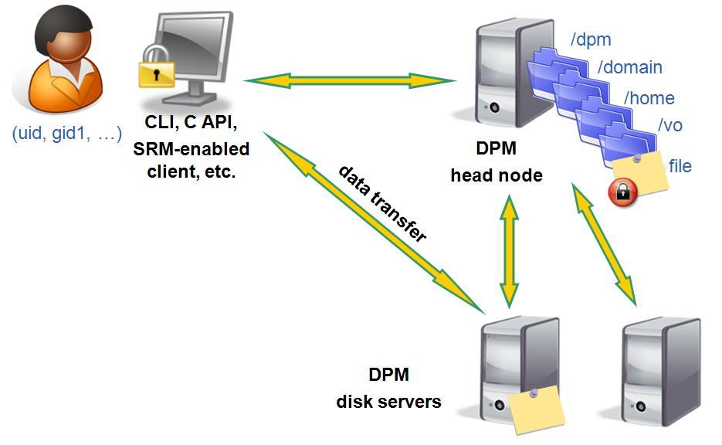
DPM: user’s point of view
DPM Name Server
Namespace, Authorization, file location
Disk Servers
Physical files
Direct data transfer from/to disk server (no bottleneck)
Supports rfio, gridftp, xrootd and http(s)
Supports SRM
SRM-1.1, 2.2 (since April, 2007)
Support DICOM backend for Biomed VOs
Encryption of DICOM files on the fly + local decryption
Use of GFAL and Hydra to get and decrypt the file

Slide 16
Storage Resource Manager (StoRM) INFN/CNAF - ICTP/EGRID
It's designed to leverage the advantages of high performing parallel file systems in Grid.
Different file systems supported through a driver mechanism:
generic POSIX FS
GPFS
Lustre
XFS
It provides the capability to perform local and secure access to storage resources (file:// access protocol + ACLs on data).
StoRM architecture:
Frontends: C/C++ based, expose the SRM interface
Backends: Java based, execute SRM requests.
DB: based on MySQL DBMS, stores requests data and StoRM metadata.
Each component can be replicated and instantiated on a dedicated machine.
Slide courtesy: Luca Magnoni

Slide 17
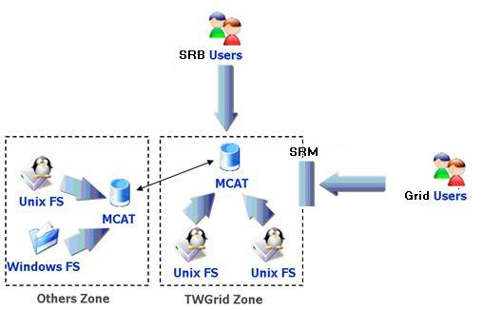
SRM on SRB SINICA – TWGRID/EGEE
SRM as a permanent archival storage system
Finished the parts about authorizing users, web service interface and gridftp deployment, and SRB-DSI, and some functions like directory functions, permission functions, etc.
Currently focusing on the implementation of core (data transfer functions and space management)
Use LFC (with a simulated LFC host) to get SURL and use this SURL to connect to SRM server, then get TURL back
File transfer (gridftp)
User
File transfer (gridftp)
SRM API
Core
Web Service
File
catalog
Data server management
Gridftp/management API
Gridftp/management API
Cache
repository
SRB+DSI
Cache server
(+gridftp server)
SRB/gridftp
Hostname: t-ap20.grid.sinica.edu.tw
Info: SRB server (SRB-DSI installed)
User Interface
Gridftp management commands
Return some information
SURL
TURL
Hostname: fct01.grid.sinica.edu.tw
The end point: httpg://fct01.grid.sinica.edu.tw:8443/axis/services/srm
Info: Cache server (gridftp server) and SRM interface
Slide courtesy: Fu-Ming Tsai
Wei-Lung Ueng

Slide 18










Interoperability in SRM
dCache
CASTOR
dCache
Fermilab
Disk
BeStMan
DPM
Clients
StoRM
SRM/iRODS
SC2008 Demo: Interoperability of 6 SRM implementations at 12 Participating Sites

Slide 19
SRMs Facilitate Analysis Jobs
Job submission
Client
dCache
Worker Nodes
Fermilab
Client Job
Disk
Gate Node
SRM
dCache
Client Job
Disk
Client Job
Disk
Disk
Cache
DISK
CACHE
Client Job
Disk
SRM/iRODS
SC2008 Demo:
Analysis jobs at NERSC/LBNL with 6 SRM implementations at 12 participating sites
dCache

Slide 20
SRMs at work
Europe/Asia/Canada/South America/Australia/Afraca : LCG/EGEE
250+ deployments, managing more than 10PB (as of 11/11/2008)
172 DPM
57 dCache at 45 sites
6 CASTOR at CERN, CNAF, RAL, SINICA, CIEMAT (Madrid), IFIC (Valencia)
22 StoRM (17 Italy, 1 Greece, 1 UK, 1 Portugal, 2 Spain)
SRM layer for SRB, SINICA
US
Estimated at about 50 deployments (as of 11/11/2008)
OSG
dCache from FNAL
BeStMan from LBNL
ESG
BeStMan at LANL, LBNL, LLNL, NCAR, ORNL
Others
JasMINE from TJNAF
BeStMan adaptation on Lustre file system at Texas Tech Univ.
BeStMan adaptation on Hadoop file system at Univ. of Nebraska
Notes:
We don’t have a statistics in US like our European colleagues.

Slide 21
Acknowledgements : SC08 demo contributors
BeStMan
BNL/STAR : Jerome Lauret, Wayne Betts
LBNL : Vijaya Natarajan, Junmin Gu, Arie Shoshani, Alex Sim
NERSC : Shreyas Cholia, Eric Hjort, Doug Olson, Jeff Porter, Andrew Rose, Iwona Sakrejda, Jay Srinivasan
TTU : Alan Sill
UNL : Brian Bockelman, Research Computing Facility at UNL
CASTOR
CERN : Olof Barring, Miguel Coelho, Flavia Donno, Jan van Eldik, Akos Frohner, Rosa Maria Garcia Rioja, Giuseppe Lo Presti, Gavin McCance, Steve Murray, Sebastien Ponce, Ignacio Reguero, Giulia Taurelli, Dennis Waldron
RAL : Shaun De Witt
dCache
CERN : Flavia Donno
DESY : Bjoern Boettscher, Patrick Fuhrmann, Iryna Koslova, David Melkumyan, Paul Millar, Tigran Mkrtchyan, Martin Radicke, Owen Synge, German HGF Support Team, Open Science Grid
FNAL : Andrew Baranovski, Matt Crawford, Ted Hesselroth, Alex Kulyavtsev, Tanya Levshina, Dmitry Litvintsev, Alexander Moibenko, Gene Oleynik, Timur Perelmutov, Vladimir Podstavkov, Neha Sharma
gridPP : Greig Cowan
IN2P3 : Jonathan Schaeffer, Lionel Schwarz
Quattor : Stijn De Weirdt
NDGF : Gerd Behrmann
UCSD : James Letts, Terrence Martin, Abhishek Singh Rana, Frank Wuerthwein
DPM
CERN : Lana Abadie, Jean-Philippe Baud, Akos Frohner, Sophie Lemaitre , Maarten Litmaath , Remi Mollon, David Smith
LAL-Orsay : Gilbert Grosdidier
StoRM
CNAF : Luca Dell'Agnello, Luca Magnoni, Elisabetta Ronchieri , Riccardo Zappi
LHCb : Vincenzo Vagnoni
SRM/iRODS-SRB
SINICA : HsinYen Chen, Ethan Lin, Simon Lin, FuMing Tsai, WeiLong Ueng, Eric Yen
SRB/GridFTP
RAL : Jens Jensen (RAL), Matt Hodges (RAL), Derek Ross (RAL)
Daresbury lab : Roger Downing
In alphabetical order

Slide 22
Summary and Current Status
Storage Resource Management – essential for Grid
OGF Standard GFD.129 (Apr. 15, 2008)
Multiple implementations interoperate
Permit special purpose implementations for unique products
Permits interchanging one SRM product by another
Multiple SRM implementations exist and are in production use
Particle Physics Data Grids
WLCG, EGEE, OSG, …
Earth System Grid
More coming …
Combustion, Fusion applications
Structural biology, medicine

Slide 23
Documents and Support
SRM Collaboration and SRM Specifications
http://sdm.lbl.gov/srm-wg
Developer’s mailing list: srm-devel@fnal.gov
BeStMan (Berkeley Storage Manager) : http://datagrid.lbl.gov/bestman
CASTOR (CERN Advanced STORage manager) : http://www.cern.ch/castor
dCache : http://www.dcache.org
DPM (Disk Pool Manager) : https://twiki.cern.ch/twiki/bin/view/LCG/DpmInformation
StoRM (Storage Resource Manager) : http://storm.forge.cnaf.infn.it
SRM-SRB : http://lists.grid.sinica.edu.tw/apwiki/SRM-SRB
Other info : srm@lbl.gov
SRMs
SRM/iRODS-SRB
dCache
institutions
Fermilab
organizations

