Slide 1

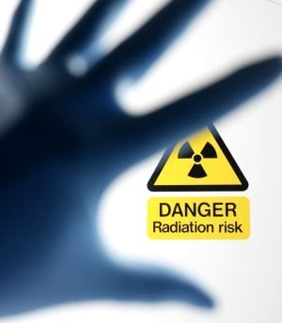
Ancillary Radiation Safety Training

Slide 2
Course Objectives
Recognize the radiation symbol and warning signs or postings
Understand safety rules for working radioactive materials (RAM) laboratories.
Understanding the basic principles of ionizing radiation.
Important point of contacts

Slide 3
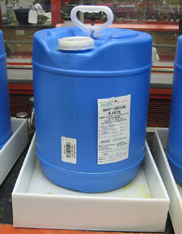
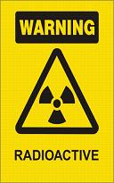
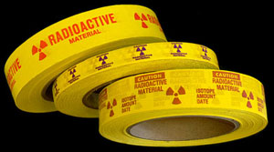
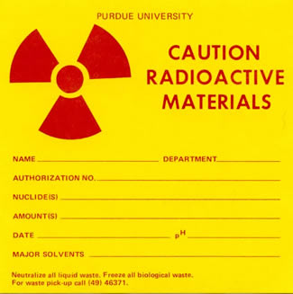
Radiation Warning Signs and Labels
Door posting and label for fume hoods, refrigerators, freezers, and other large equipment used for handling radioactive materials.
Radioactive materials waste container.
Radiation waste labels – attached to each radioactive material waste container.
Radioactive material tape – posted on small lab equipment used for handling radioactive materials.

Slide 4
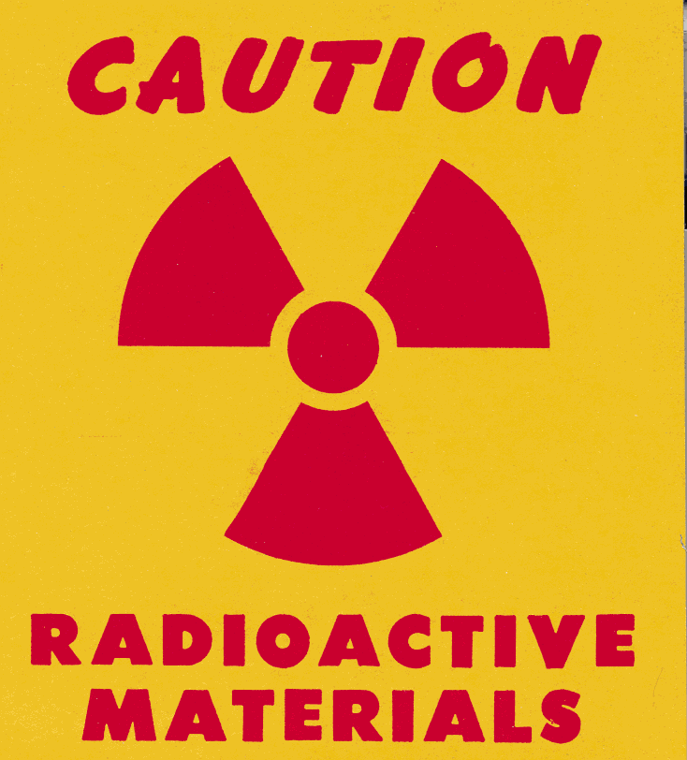
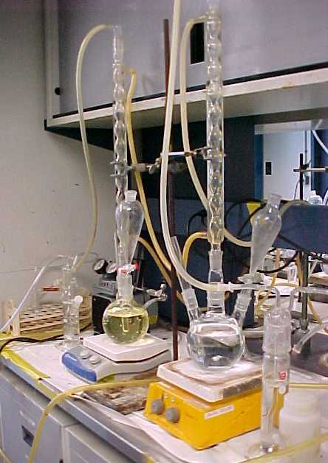
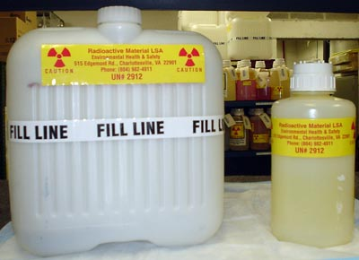
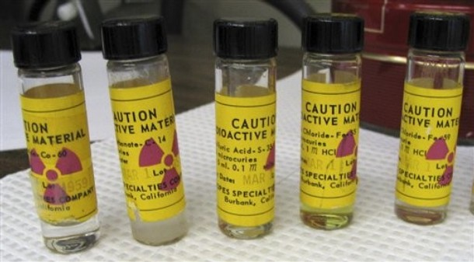
Principle Rule When Working in a Lab with Radioactive Materials
Avoid contact with any objects that are labeled with the radiation sign

Slide 5
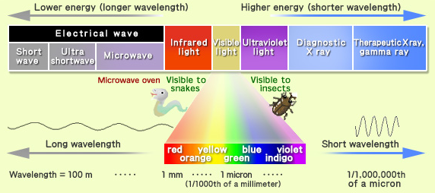
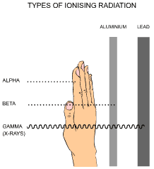
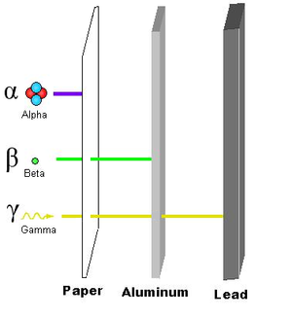
What is Radiation? Radiation is the transfer of energy
Types of Ionizing Radiation

Slide 6
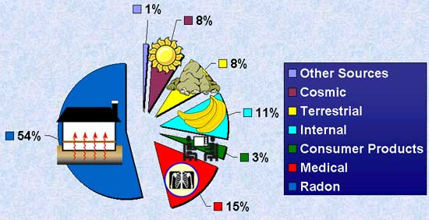
Where is Radiation Found?
Radiation is found all around us and even inside our bodies. It is found in the air, water, ground, building materials, and even some foods.

Slide 7
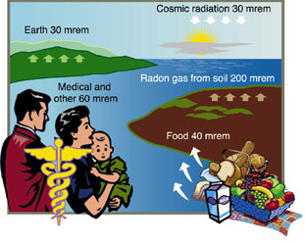
Background and Manufactured Radiation In the U.S. Contributes 250-400 mrems per year
Radioactive material and sources at NOAA facilities do not represent an exposure issue for ancillary staff.

Slide 8

Basic Rules for Working in Laboratories with Radioactive Materials
Before you start work and enter the area, contact the Radiation Safety Officer.
Read all room postings before performing your work.
Announce yourself and purpose for being in the lab.
Contact the Radiation Safety Officer if no one is present in the lab.
Ask lab personnel which areas should be avoided.
DO NOT handle anything labeled with the radioactive sign until you are given clearance to do so from the Radiation Safety Officer.
For assistance contact the Radiation Safety Officer during business hours.

Slide 9
Emergency Procedures for Work-Related Accidents, Injuries and Spills
TYPE OF EMERGENCY | CONTACT
Accidents or spills with injuries that require urgent medical attention | 911
Accident or spills without injuries or with injuries that do not require urgent medical attention (i.e. on site first aid only | DURING NORMAL BUSINESS HOURS: XXX-XXX-XXXX AFTER HOURS, WEEKENDS AND HOLIDAYS: XXX-XXX-XXXX
Important Note: If radioactive material is involved, do not leave the area unless it is unsafe to remain there. Contact the Radiation Safety Officer and wait for assistance to arrive. This will prevent the spread of contamination.

Slide 10
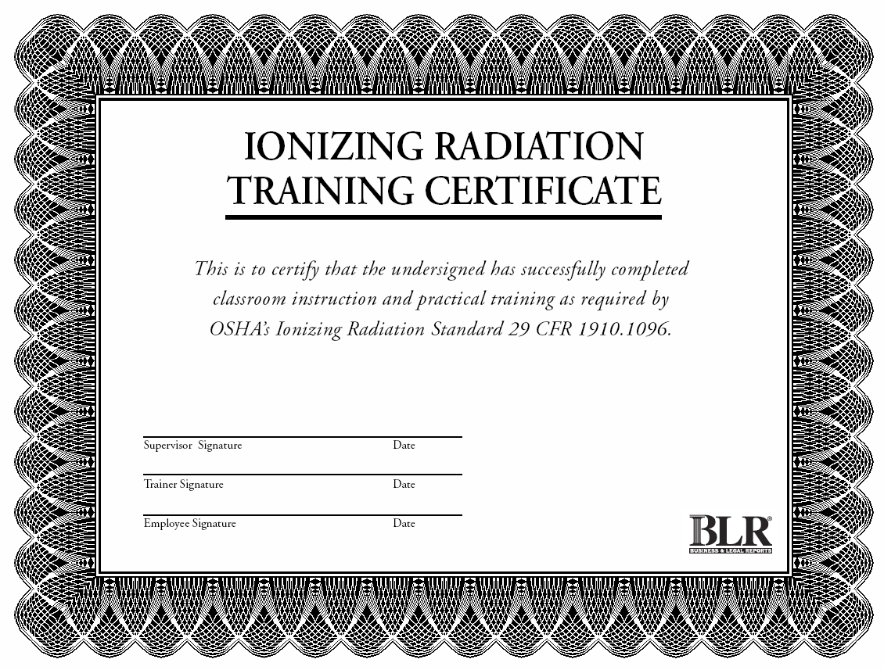
Ancillary Radiation Safety Training Certificate
Points to Remember:
Do not work with, disassemble, or remove placarded equipment unless previously cleared by the Radiation Safety Officer (RSO) or the laboratory staff.
If you are uncertain regarding precautions to follow, ask the laboratory staff or contact the Radiation Safety Officer for appropriate guidelines.

