Slide 1
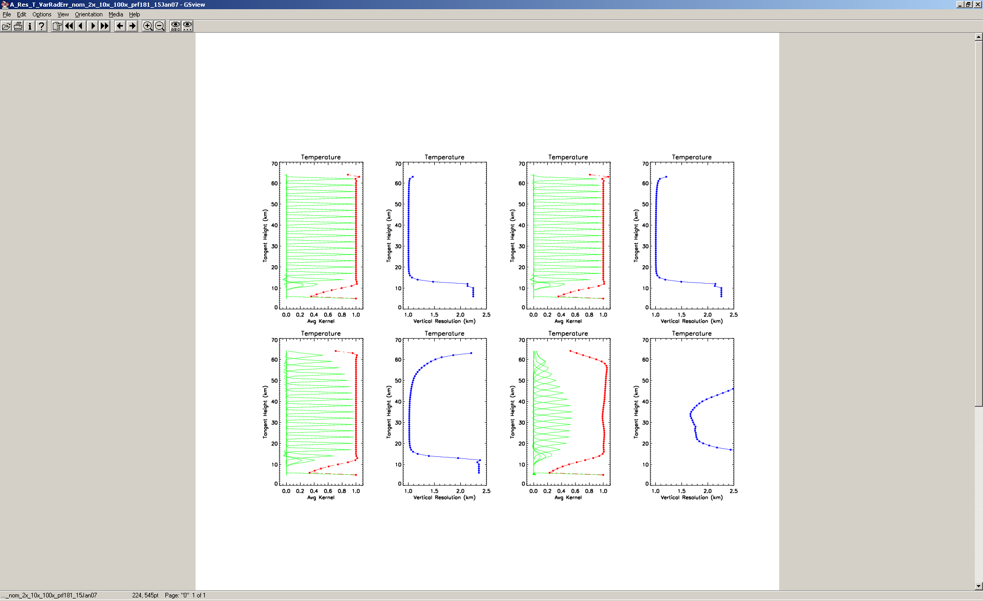
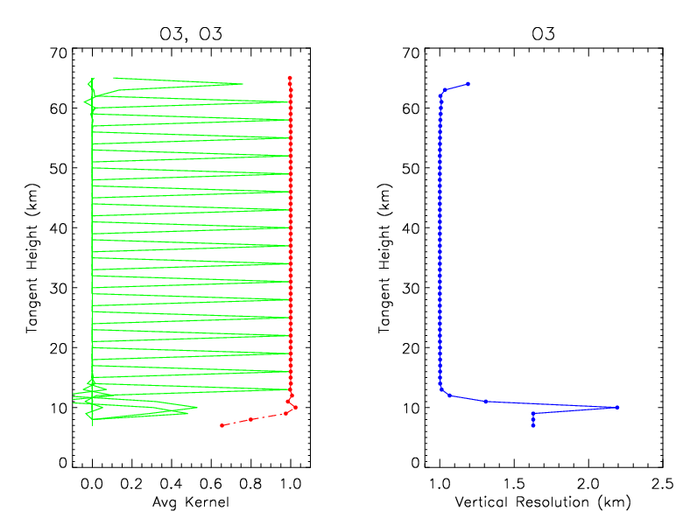
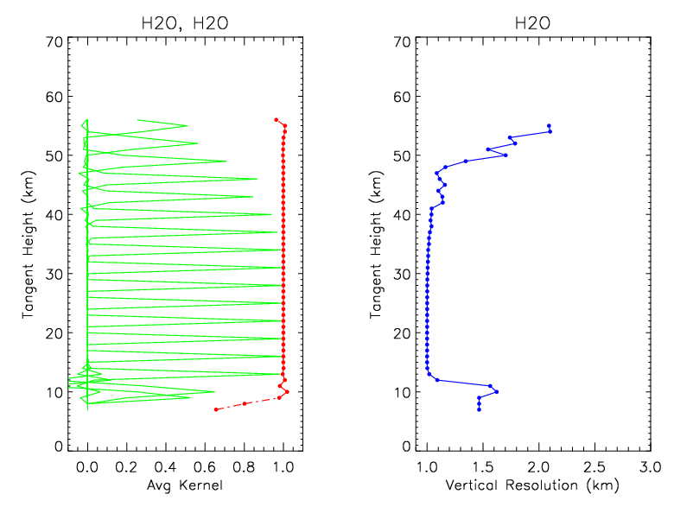
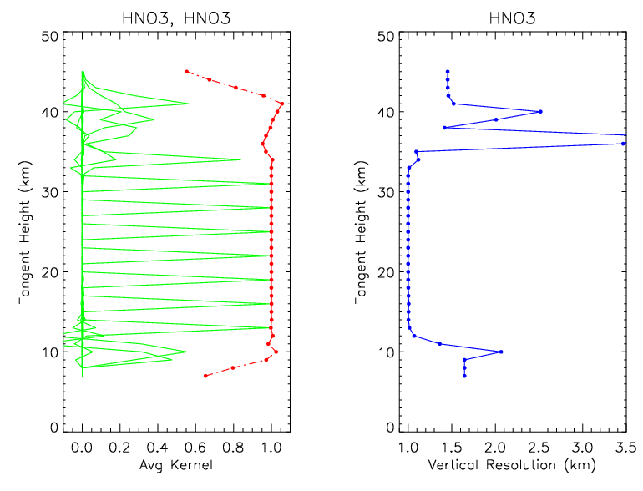
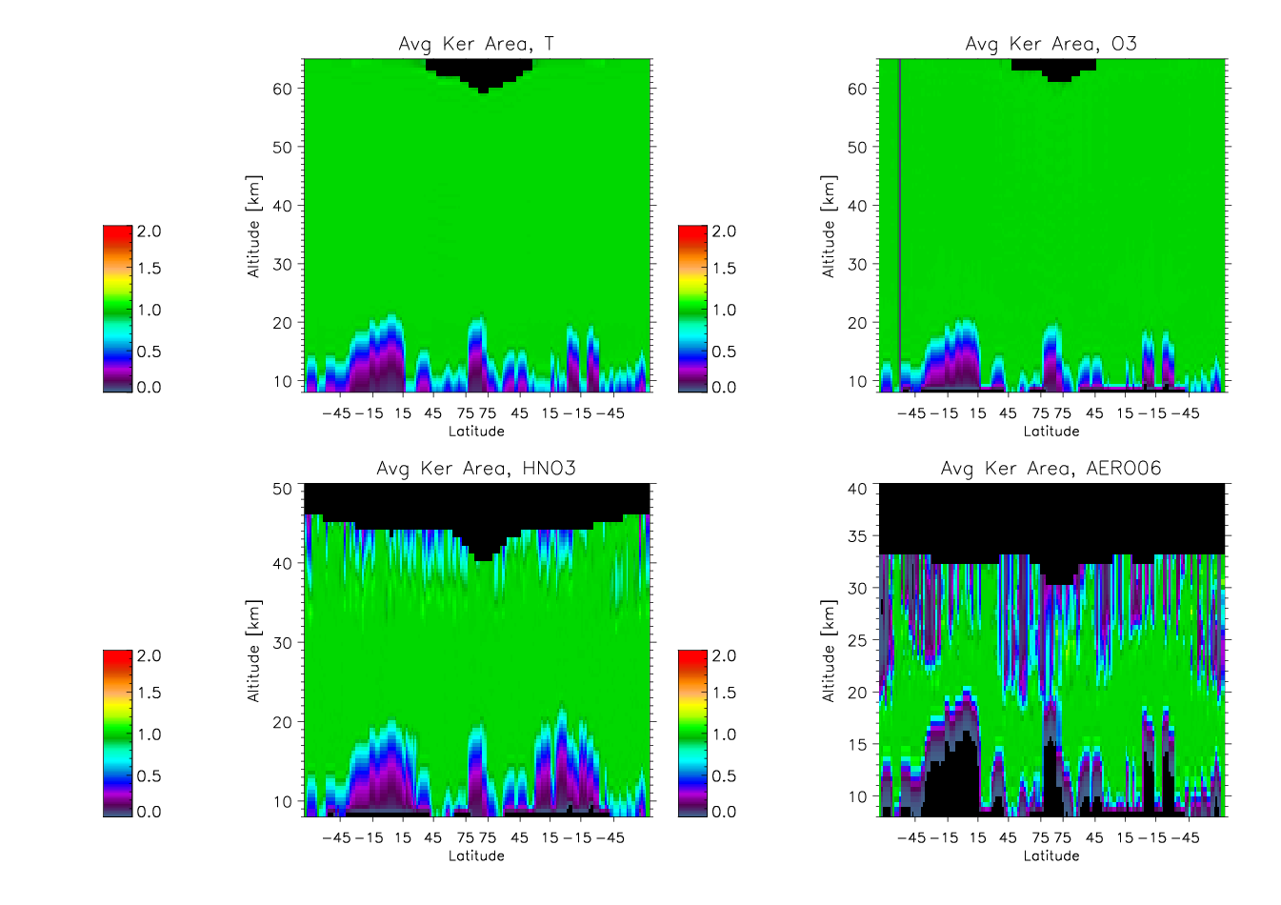
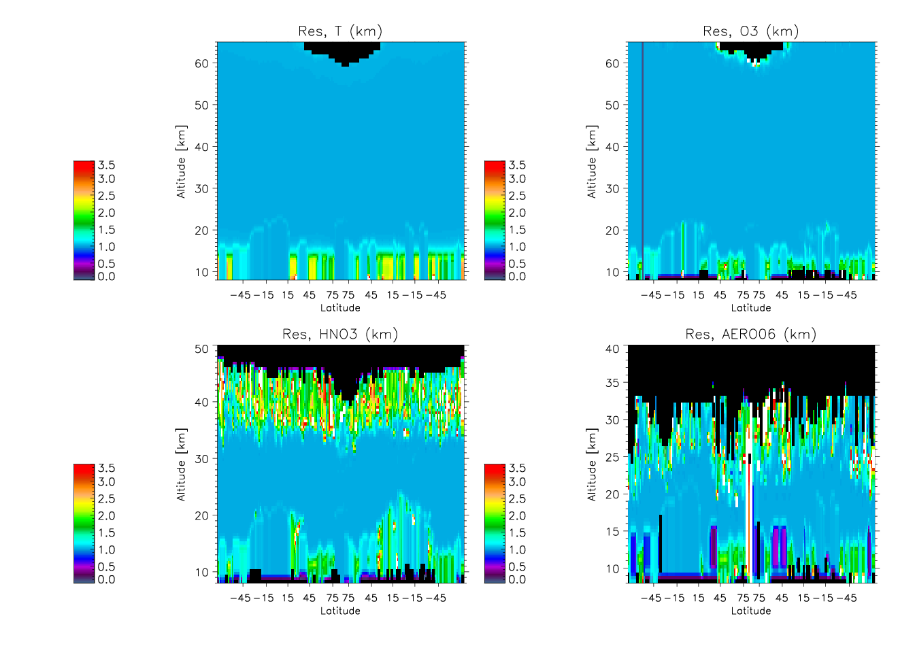
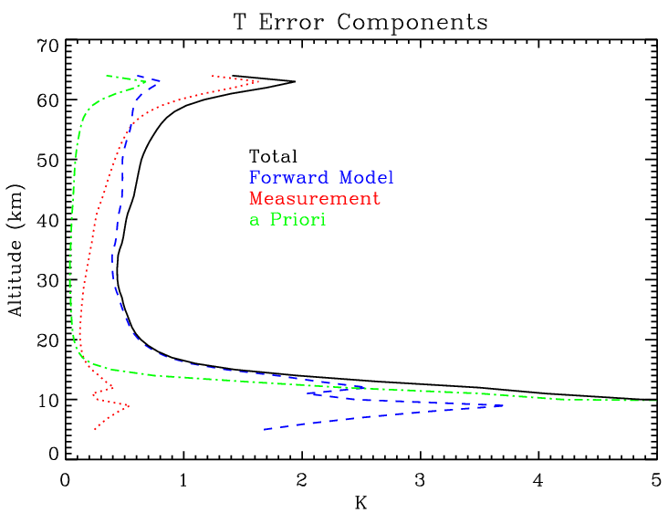
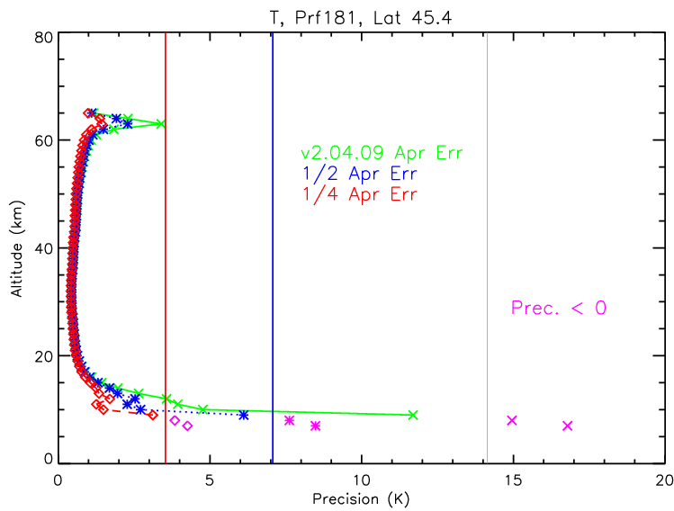
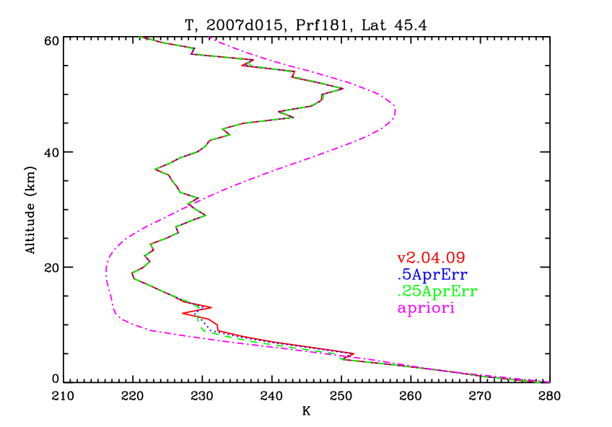
HIRDLS Retrieval Characterization
Rashid Khosravi, J. Gille, J. Barnett, and the HIRDLS Team
Aura STMG, Oct. 27-30, 2008
HIRDLS averaging kernels for T, O₃, and HNO₃ are examined for a mid-latitude NH winter profile. It is shown that for regions of high signal-to-noise ratio the retrievals follow the observed radiances very closely (minimal contribution from a priori) and have very high resolution (~ 1 km). Curtain plots show that HIRDLS retrievals maintain these characteristics for all latitudes throughout an orbit. Temperature error decomposition shows that the total estimated precision, which is very small (0.5-0.8 K) from 16-55 km, increases rapidly in the UTLS region, being dominated by the a priori errors. In future versions, the current temperature a priori data (CIRA) will be replaced with GEOS data to allow better temperature retrievals in cloudy regions as well as in clear regions in the lower troposphere
ABSTRACT
Retrieval Method: Optimal Estimation
Solution: minimize with respect to X (Maximum Likelihood)
Averaging Kernels
response of retrieval to perturbations in true state
retrieval response at levels j to a perturbation at level i
Convergence Criteria
set a tolerance limit; avoids waste of computational time
b) set an optimal limit for number of iterations; avoids stopping
before convergence, and never-converging retrievals
Ideally,
; i.e., response to perturbation is a δ function
Constrains solution to prior knowledge of atmospheric
state weighted by the a priori errors
FWHM of each row = vertical resolution
Evaluates difference between measured and simulated
radiances weighted by the measurement errors
Area of A = fraction of retrieval from observed radiances
In general, vertical resolution degrades and fraction from
a priori increases with higher noise
Averaging Kernels for T, O₃, H₂O, and HNO₃; NH Mid-Latitude Winter, Nominal Measurement Noise (V003)
Kernels (green) are sharply peaked
and very close to 1; i.e., near ideal
Vertical Resolution (blue) ≈ 1
Area of each kernel (red dots) = 0.99; i.e., retrieval is dominated by observed radiances
Sensitivity of Averaging Kernels with Increasing Measurement Noise
The near-Ideal characteristics of the averaging kernels are retained as noise increases
Degradations occur w/ 10x Noise:
vertical resolution decreases (by a small Amount)
2x Noise
10x Noise
This sensitivity study shows that a large increase
In noise is required to degrade the near ideal
characteristics of HIRDLS retrievals
Note that the contribution of a priori to the
retrievals remains minimal for most altitudes
Reason: HIRDLS is a very low noise instrument
Variations of a Priori Contribution and Vertical Resolution with Latitude
Fraction of retrieval from observed radiances (left) remains very close to 1 throughout the orbit.
Similarly, vertical resolution (right)
remains at 1 km.
Cloudy Regions
Error Analysis, Effect of a priori Errors
Negative Precision Threshold
Left Fig. shows total T error and its
components. In UTLS, a priori and
forward model (to lesser extent)
dominate.
Middle Fig. shows that reducing
the a priori errors improves the total
error in UTLS.
Right Fig. shows reducing a priori
errors smoothes T in UTLS (only) a bit.
V003,
+/- 20K
Summary
Some smoothing of the retrieved
temperature profile due to
Decreasing a priori errors
Because of very low noise, HIRDLS averaging kernels show near ideal characteristics: sharply peaked near 1,
high vertical resolution, and minimal contribution from a priori to the retrievals (except in cloudy regions and lower troposphere).These characteristics are maintained for all latitudes throughout an orbit.
In the UTLS region or lower troposphere, a priori contribution to the retrievals increases, and hence the precision
there is dominated by a priori errors, and to a lesser extent by forward model errors. In future versions of HIRDLS
retrievals, GEOS temperature data will be used as a priori, which will allow better retrievals in the UTLS region
with smaller total errors. Also, the forward model errors will be updated, which will further reduce the total errors.

