Slide 1
PHENIX Luminosity
Recorded Luminosity
from PHENIX DAQ scalers, which only count when Run is going
where BBC count are from LL1 trigger system with ±30 cm vertex cut
part of this comes from the DAQ lifetime
which is typically about 90%
 | σ_{BBC} | ε_{BBC}^{MB}
dAu | 2.26 b | 0.88
pp | 42 mb | 0.53
AuAu | 6.847 b | 0.92

Slide 2
Delivered Luminosity
from RHIC scalers, which count whether Run is on or not (usually)
where I try to identify the stable part of all stores by using cuts on very high backgrounds, ZDC rates above mimimal level, and excluding (most) APEX & development time
since I don’t have the CA “physics” signal that is set by the operators by hand, I cannot reliably get the same luminosity that CA gets, in fact in Run8 it came out as follows
and CA counts luminosity during RHIC CNI measurements, when PHENIX see backgrounds that are too large and cannot take data. I estimated this amounted to approximately 10% less delivered luminosity (for pp collisions)
the σ_{ZDC}^{eff} is especially uncertain in pp collisions (and small). It is determined Vernier Scans, but may not be completely stable during the pp run.
 | CA/my Lumi
dAu | 91.7%
pp | 87.8%
 | σ_{ZDC}^{eff}
dAu | 0.52 b
pp | 0.31 mb

Slide 3
Recorded/Delivered Luminosity
obtained by comparing L_{ZDC} to L_{BBC}
this includes ±30 cm vertex cut which can be determined separately using the BBC without a vertex cut, and is about 50%
then the PHENIX efficiency (DAQ , HV, detector up & livetime) is
the main uncertainties are:
σ_{ZDC}^{eff} (see above)
when to count L_{delivered}
e.g. not during polarization measurements
not until collimation done and backgrounds down, etc.
uncertainty in ε_{vertex} due to question of whether BBC without vertex cut includes all collisions that ZDC sees or not
 | ε_{PHENIX} | _{LT}
dAu | 68% | 89%
pp | 62% | 89%

Slide 4
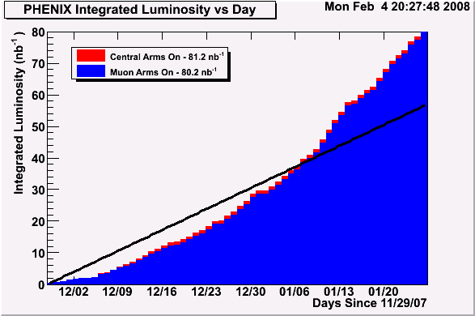
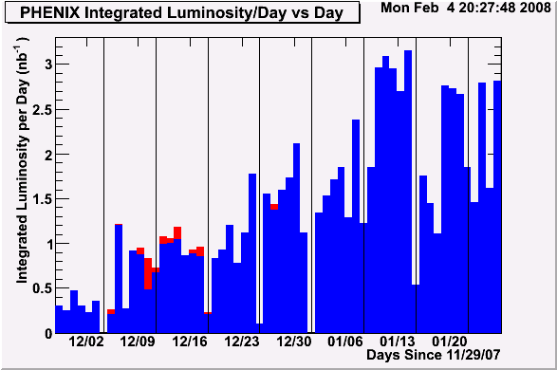
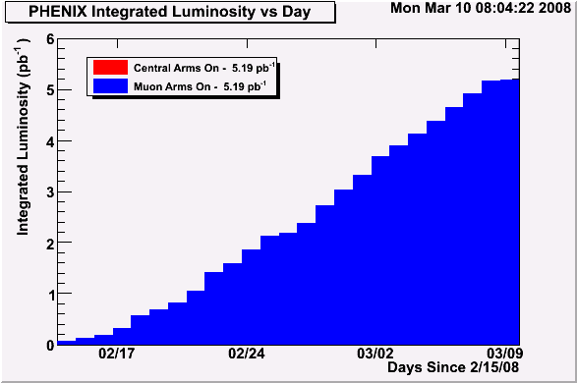
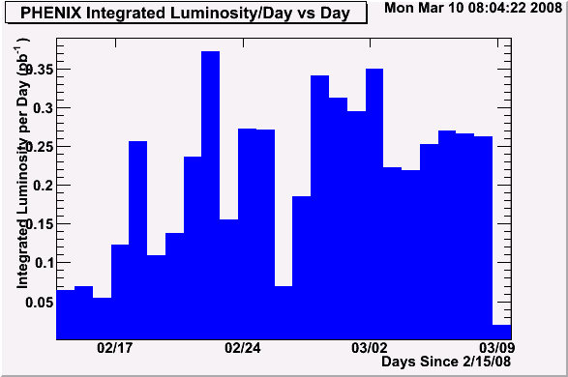
dAu
peaks above 3 nb⁻¹ per day
one day > total Run3 luminosity of 2.7 nb⁻¹
80 nb⁻¹ Run8 dAu:
30x Run3
140% of Run8 goal
160 Billion Evts
pp - almost no progress on luminosity & polarization development towards future
Run | Energy | Long. | Trans.
02 | 200 GeV |  | 0.15 pb⁻¹
03 | 200 GeV | 0.35 pb⁻¹
04 | 200 GeV | 0.12 pb⁻¹
05 | 200 GeV | 3.4 pb⁻¹ | 0.16 pb⁻¹
06 | 200 GeV | 7.5 pb⁻¹ | 2.7 pb⁻¹
06 | 62.4 GeV | 0.08 pb⁻¹ | 0.02 pb⁻¹
08 | 200 GeV |  | 5.2 pb⁻¹
5.2 pb⁻¹ 200 GeV p+p Transverse Vertical luminosity recorded
(1.1 pb⁻¹ FOM)
Peak luminosity per day ~0.37 pb⁻¹

Slide 5
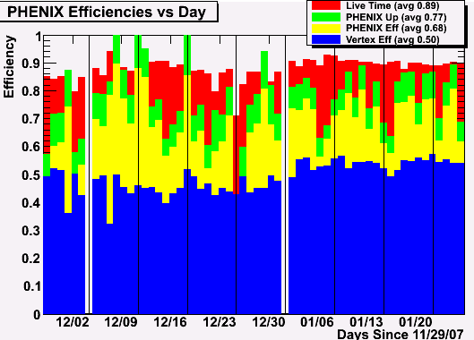
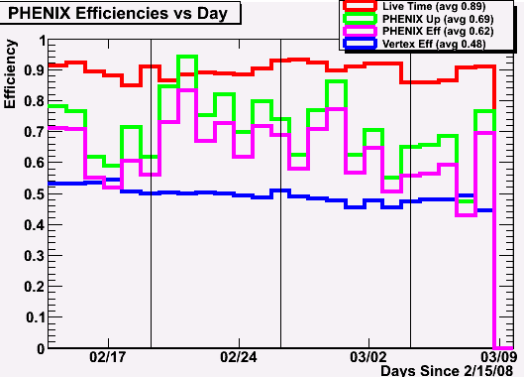
200 GeV d+Au
Live Time – 89%
PHENIX up – 77%
Overall (w/o vertex) – 68%
Vertex eff ~50% in both cases!
will be improved by Stochastic Cooling (SC) & RF advances
but vertex detector upgrades use ±10 cm so even with SC can expect only 38% eff!!
Black vertical lines are markers for Maintenance and/or APEX days
200 GeV p+p
Live Time – 89%
PHENIX up – 69%
Overall (w/o vertex) – 62%
(where 10% correction for loss due to CNI measurements is made)
Notes:
dAu – BBC 88%x2.26b, ZDC 0.52 b; pp – BBC 53%x42mb, ZDC 0.31 mb

Slide 6
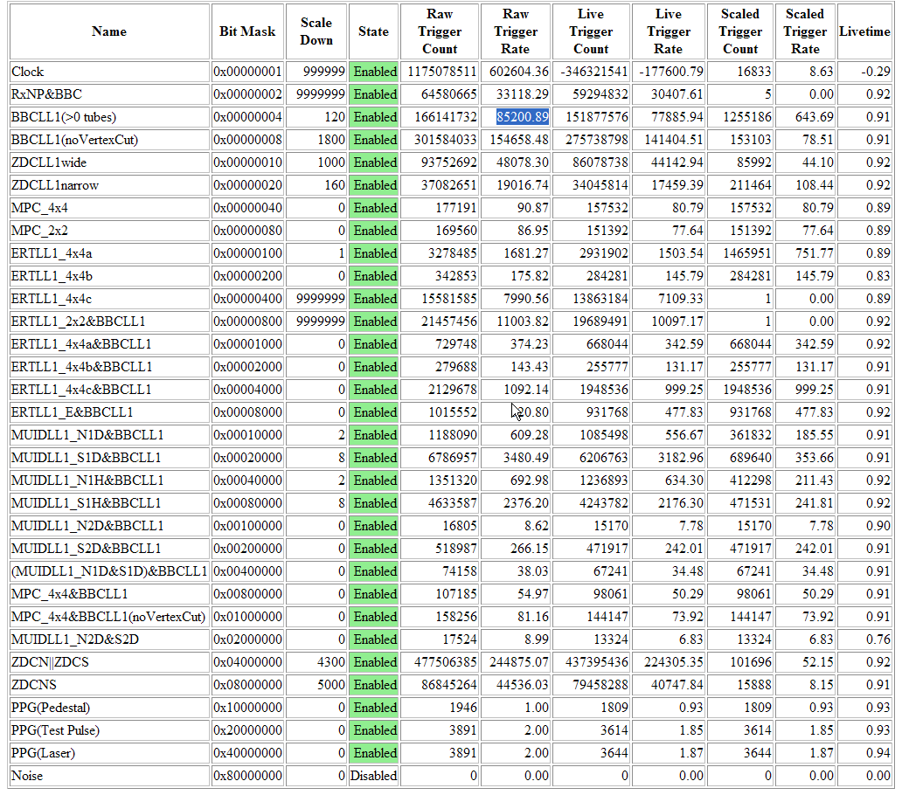
Waste No Rare Triggers – the PHENIX Strategy
Actual trigger setup & rates for one of the hottest Run8 dAu runs
> 90% livetime
85khz MB (BBC_{VtxCut}) rate
MPC Forward
Calorimeter
central-arm
γ,π⁰,π±, etc
thresh:
2.8 GeV
3.5 GeV
2.1 GeV
J/ψ → e⁺e⁻
J/ψ → μ⁺μ⁻
(32 triggers total – some not shown)

