Slide 1
CDE Leadership Group Introduction to ICR Workspace
Mukesh Sharma
12/10/2008

Slide 2
Agenda
What do Standards mean to you?
What is the relationship of UML models and CDEs?
Where to find existing data standards?
Why should ICR WS and VCDE WS work together? (Interoperability!!)
Introduction to CDE Leadership Group
ICR WS to bring forward candidates for standardization
High Impact CDE Identification
Resources
Questions

Slide 3
What do Standards mean to you?
There are Different standards that caBIG uses to enable interoperability
caGrid standards (specified in the caGrid Developer’s Guide on the caGrid wiki)
Vocabulary Standards (common vocabulary-common language)
Data Standards
Datatypes
CDEs
Modeling “best practices”
Using STANDARDS should
Help applications pass caBIG compatibility reviews.
Save software developers time in modeling.
Help domain workspace applications semantically interoperate among themselves and with other caBIG® applications.
We are concentrating on DATA (and Modeling) Standards today

Slide 4

The relationship of UML models and CDEs in caDSR
Comparing Class Diagrams to Data Elements
UML Class
caDSR Data Element
Gene
Gene Symbol java.lang.String
Data Element
- symbol: String
Data Element Concept
Gene Symbol
Gene
Object Class
Symbol
Property
java.lang.String
Value Domain
String
Permissible Values
Notes:
Modified from 1070a UML_Derived_Metadata_Part_1
This slide shows the full decomposition of UML model elements into caDSR Metadata.
The UML Class Gene is mapped to the Object Class of Gene (EVS Concept).
The Class Attribute symbol is mapped to the Property Symbol (EVS Concept).
The Object Class and Property make up the Data Element Concept (DEC) of Gene Symbol.
The class datatype String is mapped to the Representation of string in the Value Domain of java.lang.string. Java.lang.string is an example of a generic Value Domain specifically created for UML models. There is an option in the SIW to select an existing Value Domain for this reason.
The complete Common Data Element is made up of the DEC and VD. In this case the DE is named Gene Symbol java.lang.String.

Slide 5
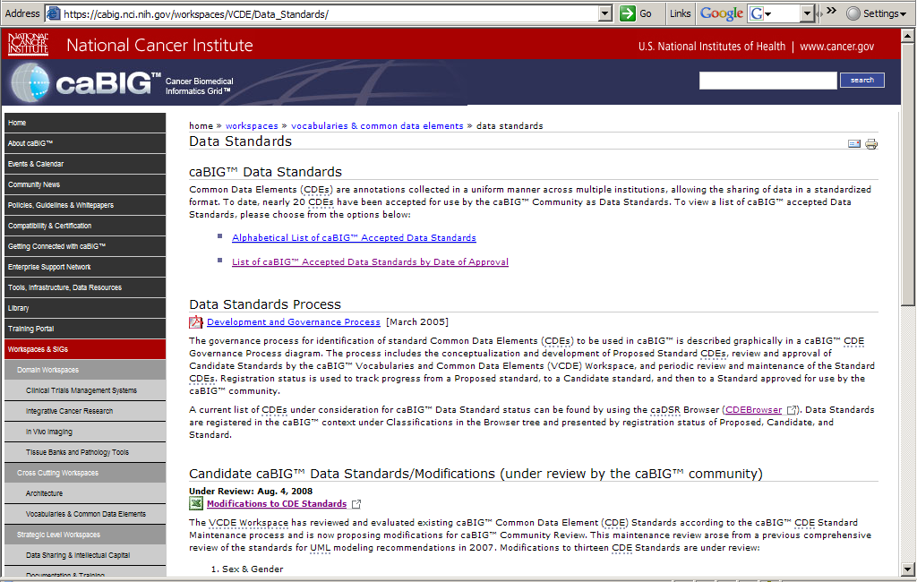
Where to find existing data standards?
caBIG® Site for Data Standards
https://cabig.nci.nih.gov/workspaces/VCDE/Data_Standards/

Slide 6
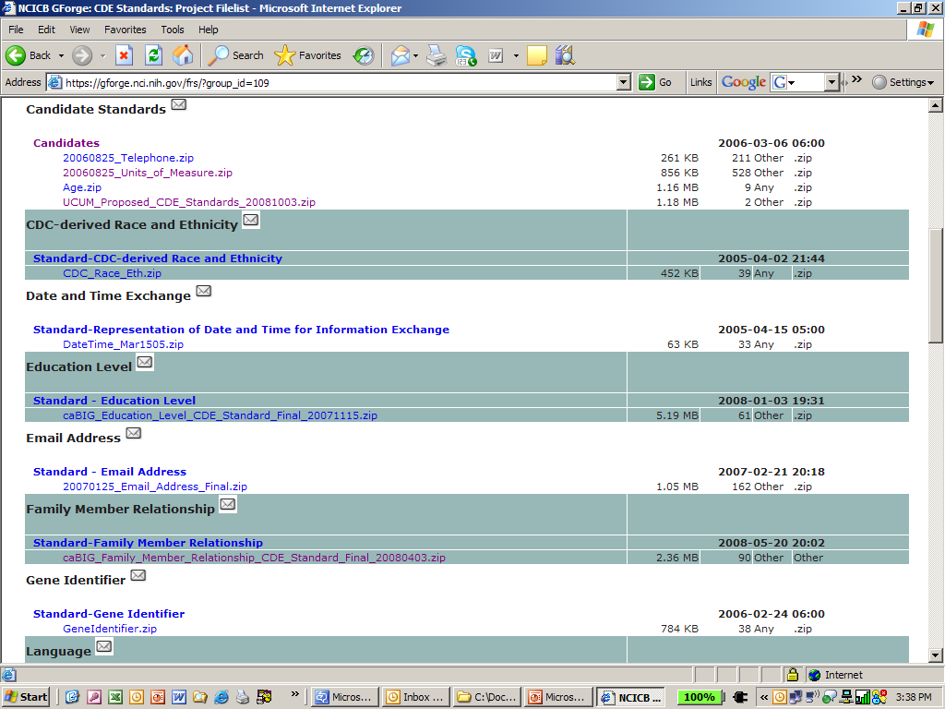
Where to find existing data standards?
GForge site for Data Standards: https://gforge.nci.nih.gov/frs/?group_id=109
Notes:
Briefly go through where these standards are stored. GForge site, caBIG website, caDSR, and CDE Browser.

Slide 7
Why should ICR WS and VCDE WS work together? CDE Reuse and Interoperability
gridPIR and caBIO UML models
CDE: 2223841v3.0
gridPIR
caBIO
CDE: 2342468v1.0
7
https://gforge.nci.nih.gov/frs/download.php/4722/08272008_ICR_Telecon_PIR1.ppt
Notes:
Emphasize the REUSE of CDEs in UML models that leads to interoperability.
From, Presentation name “08272008_ICR_Telecon_PIR1”
Notes: Here is a representation of semantically equivalent Class/attribute pairs.
Show how caGrid Portal (CQL query builder) or applications like caB2B can be used to aggregate this data.
To show a CQL query of data that are aligned (standard CDEs). Can try to aggregate data that are not quite aligned and the difficulty in doing this. Show how many data and analytical services are available, and CDEs that are shared between applications.
Mukesh: For ICR check http://www.cagrid.org/wiki/CaBIG:AnnualMeeting:2008:FederatedQueries:Live_Demo

Slide 8
Why should ICR WS and VCDE WS work together? CDE Reuse and Interoperability
Collect information on the same protein from different resources
caBIO
Genomic Info
Join caBIO and gridPIRand access to more info
gridPIR
Annotations
8
https://gforge.nci.nih.gov/frs/download.php/4722/08272008_ICR_Telecon_PIR1.ppt
Notes:
From, Presentation name “08272008_ICR_Telecon_PIR1”
Notes: Use two differently named attributes to “join”/intersect two different models to gather more information.
Use the services as complementary to each other.

Slide 9
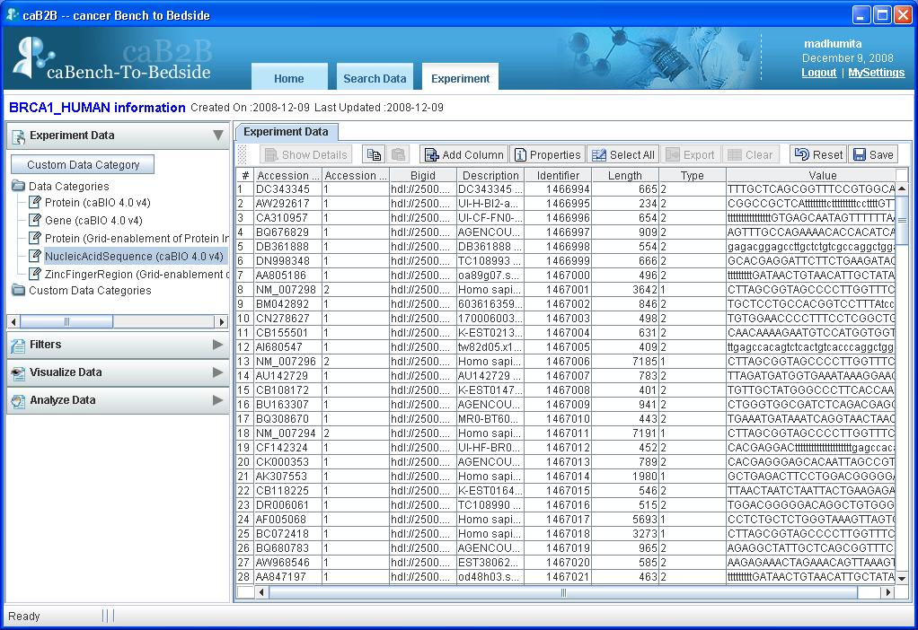
Data aggregation from caBIO and grid PIR
For the protein BRCA1_HUMAN identify the zinc finger region and all the nucleic acid sequence information.
Notes:
Show how caGrid Portal (CQL query builder) or applications like caB2B can be used to aggregate this data.
To show a CQL query of data that are aligned (standard CDEs). Can try to aggregate data that are not quite aligned and the difficulty in doing this. Show how many data and analytical services are available, and CDEs that are shared between applications.
Mukesh: For ICR check http://www.cagrid.org/wiki/CaBIG:AnnualMeeting:2008:FederatedQueries:Live_Demo

Slide 10
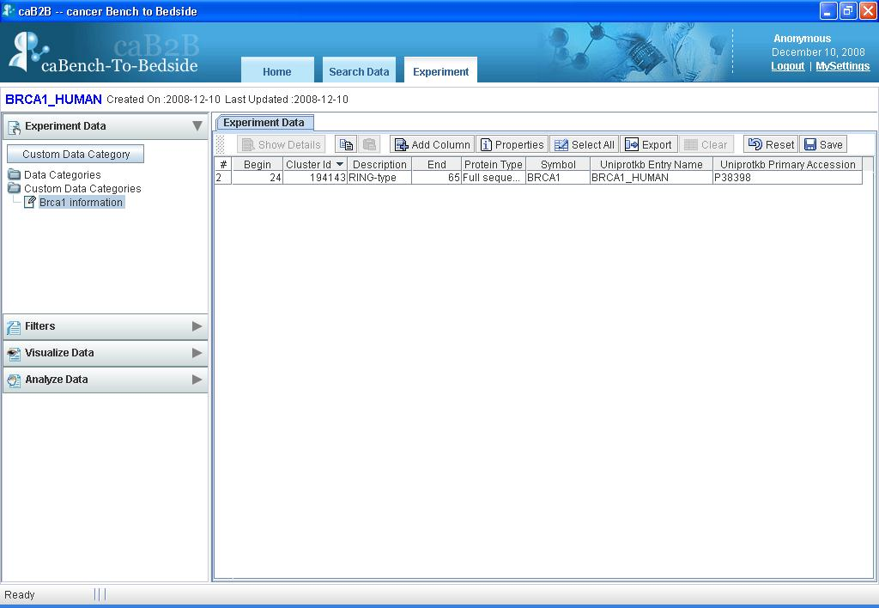
Data aggregation from caBIO and grid PIR
For the protein BRCA1_HUMAN identify the zinc finger region and all the nucleic acid sequence information.
Notes:
Show how caGrid Portal (CQL query builder) or applications like caB2B can be used to aggregate this data.
To show a CQL query of data that are aligned (standard CDEs). Can try to aggregate data that are not quite aligned and the difficulty in doing this. Show how many data and analytical services are available, and CDEs that are shared between applications.
Mukesh: For ICR check http://www.cagrid.org/wiki/CaBIG:AnnualMeeting:2008:FederatedQueries:Live_Demo

Slide 11
CDE Leadership Group Goals
The CDE Leadership Group is an effort within the VCDE Workspace to identify commonly used CDEs to validate as caBIG® standards for reuse.
Goals of the CDE Leadership Group include:
Bring forward reusable CDEs from caBIG® Domain Workspaces
Make reuse of CDEs easier for developers and to ensure that high impact CDEs are brought forward for standard use in caBIG® to achieve semantic interoperability.
Provide VCDE mentors with information on advising developers on CDE reuse.
Notes:
Now that the importance of standards has been shown, let the workspaces know there is a group (CDE Leadership Group) that can help them promote their standards!

Slide 12
We would like ICR WS to help us bring standards forward
DATA STANDARDS (Model objects and attributes and CDEs) identified in ICR Workspace.
Through re-use in ICR WS applications (eg, caArray, caBIO, gridPIR, caFE, GenePattern).
Information Representation WG’s ICR DAM development
Inter and intra workspace and governance collaboration
DATA STANDARDS (Object Models and CDEs) identified by High Impact CDE Identification (effort within the VCDE WS).
Other suggestions from ICR WS?
Notes:
This slide will need to be
Note: (caTissue Suite for TBPT) (AIM/NCIA for IMG) tailored to each workspace.
CTMS Case Report Form Harmonization & Standardization project.

Slide 13
High Impact CDE Identification
CDEs designated as caBIG Standards by the caBIG® Community should be reused.
‘High impact’ CDEs are CDEs that are pervasive through many developer projects and are ‘touch points’ for semantic interoperability.
To permit interoperability, the classes and attributes in the UML models for different applications should be semantically annotated to be the same.
Some examples of high impact CDEs include those where the object class is biospecimen, genes or gene products.
Notes:
Introduce this as the effort within VCDE WS to identify candidate CDEs for standardization (those CDEs having high reuse).
13

Slide 14
High Impact Information for ICR WS (Manual review)
Information Captured | No. Of Models | Information Captured | No. Of Models
Participant | 22 | Genomic Identifier | 7
Protocol | 19 | Metadata | 7
Biospecimen/Specimen | 19 | Participant Sex | 7
Organization/institution | 14 | Species | 6
Address | 12 | Treatment | 6
Person | 12 | Chromosome | 5
Participant Ethnicity | 10 | Disease/Tumor | 5
Diagnosis-histologic, clinical | 8 | Image | 5
Organism | 8 | Participant First Name / Last Name | 5
Patient | 8 | Protein | 5
Gene | 7 | Study | 5
Notes:
POINT Out the CDEs that are applicable to each Domain WS (different ones for each WS, this might be for ICR WS).

Slide 15
high impact CDEs for ICR (Automated approach)
CDE | CDE Public ID | Reused in no. | Standard
Organism Identifier java.lang.Long | 2223783 | 6
Organism Scientific_Name java.lang.String | 2223784 | 5
Organism Common Name java.lang.String | 2223787 | 4
Organism National Center for Biotechnology Information Taxonomy Identifier java.lang.Long | 2342465 | 3
Gene Identifier java.lang.Long | 2223838 | 8
Gene Entrez Gene Genomic Identifier | 2322246 | 5 | Standard
Gene Name java.lang.String | 2223839 | 4
Gene Gene Symbol java.lang.String | 2223841 | 4
Protein UniProtKB Primary Accession Number Genomic Identifier | 2322254 | 3 | Standard
Protein Identifier java.lang.Long | 2223878 | 6
Protein Sequence Identifier java.lang.Long | 2223883 | 3
Protein Alternative Name Identifier java.lang.Long | 2223888 | 3
Biochemical Pathway Identifier java.lang.Long | 2223806 | 3
Scientific Publication PubMed Identifier java.lang.Long | 2224328 | 3
Microarray Identifier java.lang.Long | 2223905 | 3
Other CDEs of interest can be grouped under: Study/Project; Organization; Person/User
Notes:
Reused in # (Basis of CSI names)
Standard: Data Element Registration Status

Slide 16
CDE Data Standards Process
Proposed
Standard
Standard
Review By
VCDE CDE Standard
Review Small Group
Final Approval
From VCDE Workspace
Acceptance by
VCDE Workspace
caBIG®-Wide
Comment Period
CDE Standard
Review Small Group
Address Comments
Notes:
Can be used as an addendum.

Slide 17
Resources
CDE Leadership Group GForge site: https://gforge.nci.nih.gov/docman/?group_id=317
CDE Leadership Working Group, caBIGTM site: https://cabig.nci.nih.gov/workspaces/VCDE/work_groups/cde-leadership-work-group/
Data Standards page on caBIGTM site: https://cabig.nci.nih.gov/workspaces/VCDE/Data_Standards/
Link to VCDE Data Standard Governance Process: https://cabig.nci.nih.gov/workspaces/VCDE/Data_Standards/CDE_Standard_Review_Process_mar2505.pdf
CDE Leadership group representatives and VCDE guide to mentors-
Domain Workspace | CDE leadership Group Representative | Guide to Mentors
CTMS | Lynne Wilkens lynne@crch.hawaii.edu | Bob Freimuth Freimuth.Robert@mayo.edu Sal Mungal salvatore.mungal@duke.edu
ICR | Mukesh Sharma Sharmam@pathology.wustl.edu | Baris Suzek bes23@georgetown.edu
IMG | Mukesh Sharma Sharmam@pathology.wustl.edu | Stuart Turner swturner@ucdavis.edu
TBPT | Lynne Wilkens lynne@crch.hawaii.edu | Lewis Frey Lewis.Frey@hsc.utah.edu

Slide 18
Acknowledgements
CDE Leadership
Brian Davis
Rakesh Nagarajan
Riki Ohira
Dianne Reeves
Daniela Smith
Lynne Wilkens
ICR/IRWG
Robert Freimuth
Elaine Freund
Juli Klemm
Patti Kwong
Li Kramer
Ted Liefeld
Sue Pan
Konrad Rokicki
Grace Stafford
Baris Suzek

Slide 19
Questions?
Notes:
19

