Slide 1
Influence of Height and Angle on Fingerprint Collections
Charles Sheppard

Slide 2
Question by US-VISIT
Given current surface heights, what is the “best” angle?

Slide 3
Heights
Reported Height Frequencies less 6”

Slide 4
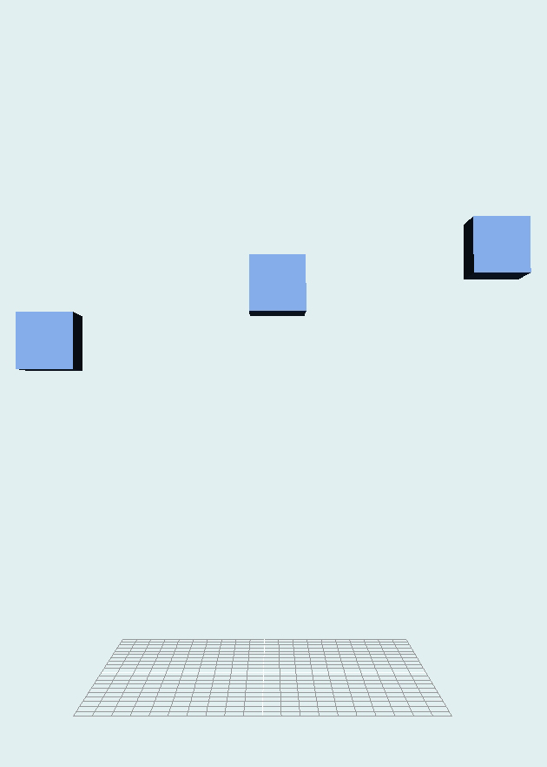
Heights
Choose three heights
39”
45” Practical Midpoint
49”
49”
45”
39”

Slide 5
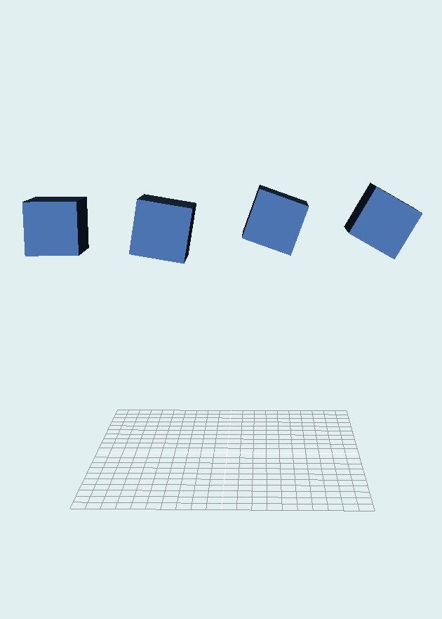
Angles
Selected Range of Angles
Flat
10 °
20 °
30 °
Flat
10°
20°
30°

Slide 6
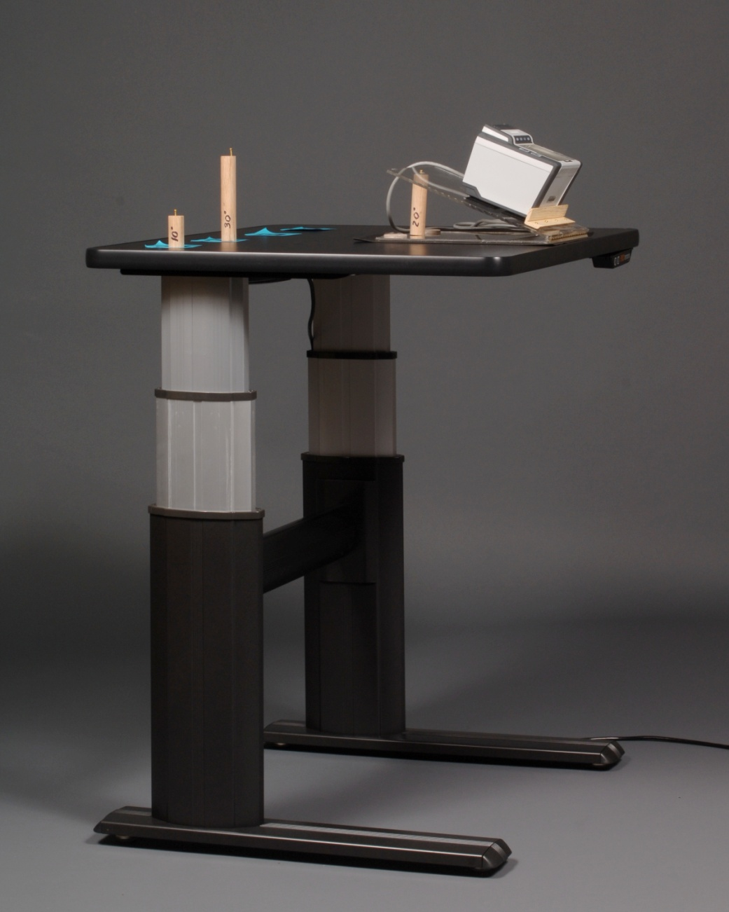
Equipment
Adjustable Table
Angle Adjustment

Slide 7
Data
Height
flat
10°
20°
30°
Right Sequence
Left Sequence
Thumbs
Index
Middle
Ring
Little
Index
Middle
Ring
Little
Right Thumb
Left Thumb
Right Thumb
Left Thumb
12 prints/angle
× 4 angles = 48 prints/height
× 20 people
= 960 prints per height
× 3 heights
= 2,880 prints/scanner
× 2 scanners
= 5,760 total prints
(120 people total)

Slide 8
Question
Given current surface heights, what is the “best” angle?
Best =
Efficient —Timing — Time to complete task
Effective — Quality — How good were the prints
Satisfaction — Comfort — Questionnaire

Slide 9
Demographics

Slide 10
Test population was representative of the user population with respect to:
Age
Height
Gender
Handedness

Slide 11
Efficiency
Timing

Slide 12
Timing
Scanner A
Opportunity (“please place your hand on the scanner”)
Participant presents
Attempt starts
Capture thresholding
System starts capture
System
Attempt
Capture
System ends capture (“Please remove hand from scanner”)
Attempt ends
Participant
Next attempt
(acceptable attempt)
Time

Slide 13
Timing
Scanner B
Opportunity (“please place your hand on the scanner”)
Participant presents
Attempt starts
Capture thresholding
System
Attempt
System ends Attempt (“Please remove hand from scanner”)
Capture
Attempt ends
Participant
Next attempt
(acceptable attempt)
Time

Slide 14
Timing — Median Times per Slap
Scanner A
Neither height nor angle is significant
Notes:
Median as data isn’t normally distributed

Slide 15
Timing — Median Times per Slap
Scanner B
Neither height nor angle is significant

Slide 16
Timing
No significant affect due to angle or height

Slide 17
Effectiveness
Quality

Slide 18
Quality Measures
NIST Fingerprint Imaging Software
Segmentation
Image Quality

Slide 19
Quality Analysis - Angle
Two levels of analysis
Individual finger NFIQ — Medians
Individual finger NFIQ frequencies
No significant affect due to angle

Slide 20
Quality Results - Angle
No significant affect due to angle

Slide 21
Quality Analysis - Height
Two levels of analysis
Individual finger NFIQ — Medians
Individual finger NFIQ frequencies
Significant differences were found across different counter heights, the effect of which appears to be scanner dependent

Slide 22
Quality Analysis – Median NFIQ per Finger
Scanner A
Scanner B
Finger # | Task # | Table Height
2 | 1 | 39”>45”. 45”<49”
3 | 1 | 39”>45
4 | 1 | 39”>45”
5 | 1 | 39”>45”
7 | 3 | 39”>45”
8 | 3 | 39”>49”
9 | 3 | 39”>45”
10 | 3 | +. 39”>45
1 | 2 | 39”>45”. 45”<49”
6 | 4 | -
11 | 5 | -
12 | 5 | -
Finger # | Task # | Table height
2 | 1 | -
3 | 1 | *39”>45”
4 | 1 | 39”<45”. 45”<49”
5 | 1 | -
7 | 3 | -
8 | 3 | -
9 | 3 | -
10 | 3 | 39”<45”. 45”<49”
1 | 2 | 39”>45”. 45”<49”
6 | 4 | -
11 | 5 | -
12 | 5 | _
7
8
9
4
3
2
10
5
6
1
12
11
Notes:
Significance is not consistent across tasks and fingers
The actual significance isn’t important. What is important is the inconsistency between the scanners

Slide 23
Quality Results- Height
Significant differences were found across different counter heights, the effect of which appears to be scanner dependent

Slide 24
US visit quality scoring.
NFIQ 1 or 2
NFIQ 1 or 2 or 3

Slide 25
US visit quality scoring.

Slide 26
satisfaction
Most and Least Comfortable Angle

Slide 27
Most Comfortable Angle
Notes:
Show similar trend between scanners. As the height increased, more people preferred steeper angle

Slide 28
Least Comfortable Angle

Slide 29
satisfaction
Thumb Preference

Slide 30
Thumb Preferences

Slide 31
Observations

Slide 32
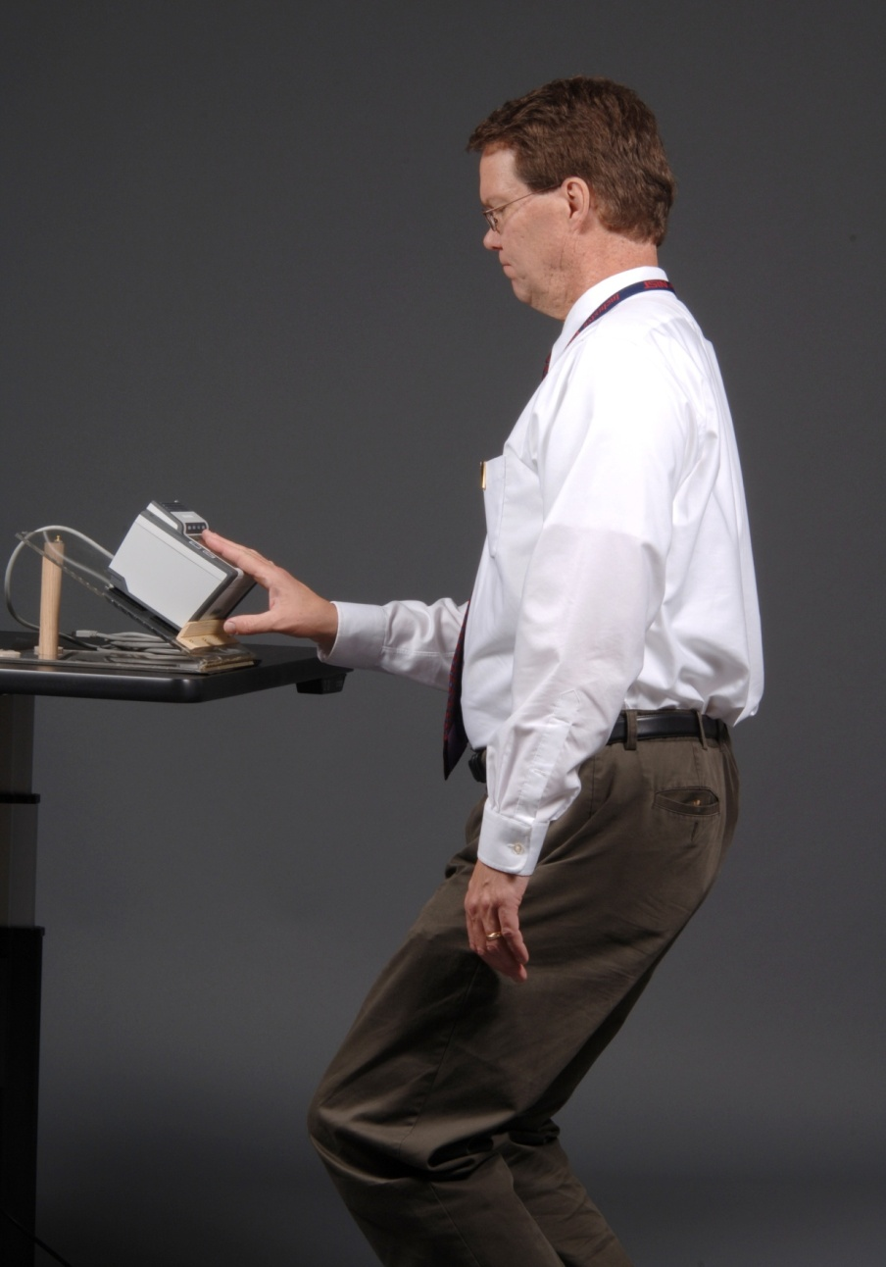
39” 30°
6’6” Individual having to bend knees to position hand comfortably.

Slide 33
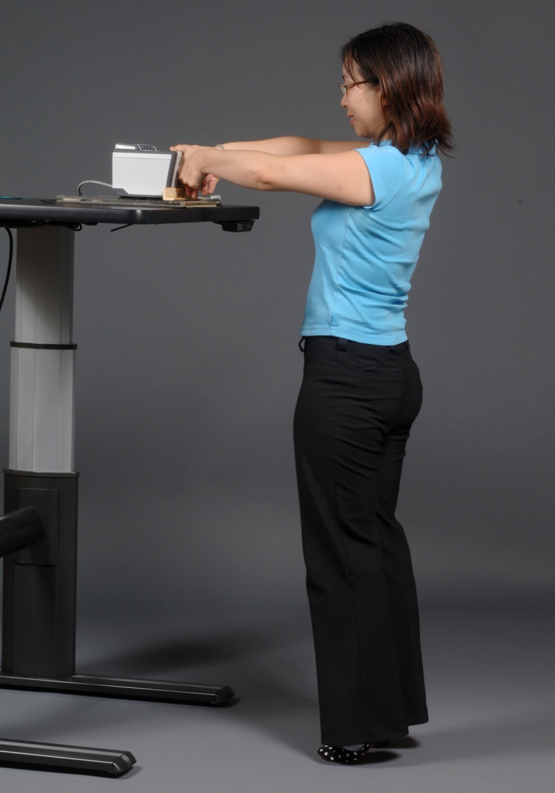
49” 0°
5’2” individual having to stand on toes to reach scanner.

Slide 34
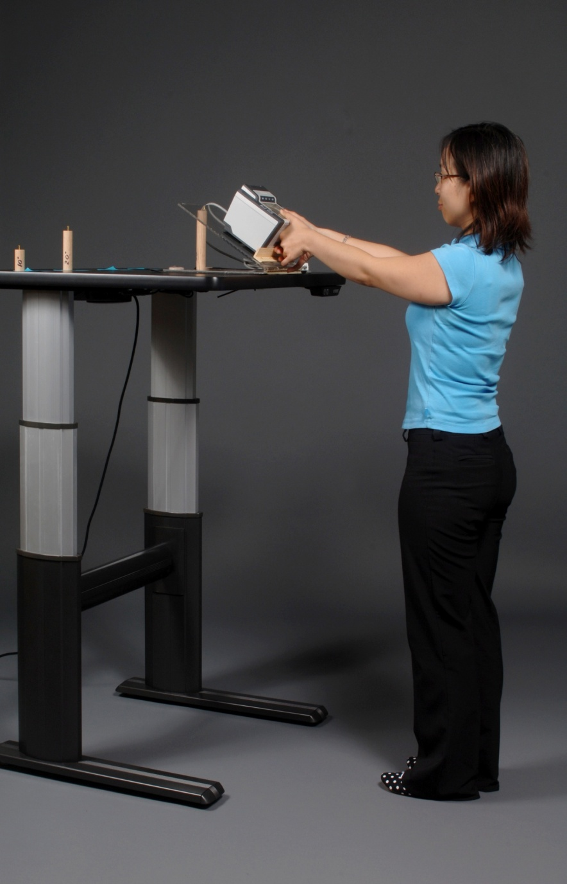
49” 30°
5’2” individual not having to stand on toes to reach scanner.

Slide 35
Conclusions
Angles have no impact on performance
Height does affect quality
Participants when given a choice start with their right hand
Participants preferred 20° and 30° angles as counter height increased
Shorter participants struggled less at the taller counter heights when scanner was angled

