Slide 1



Slide 2
Outline
Experiment and motivation
Results
dN/dy
Stopping
Summary and discussion

Slide 3
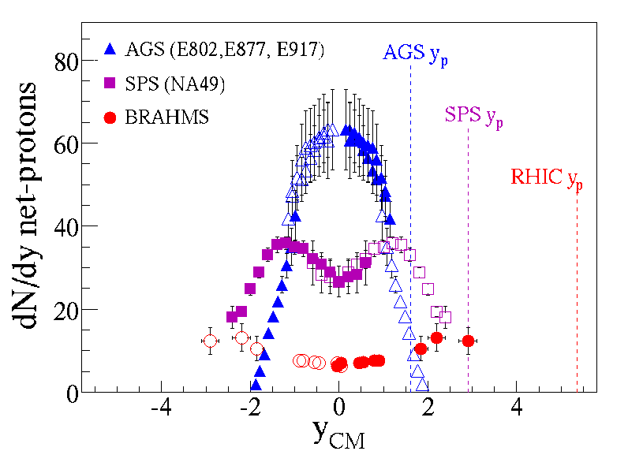
Motivation: reference to understand baryon transport
At RHIC, the mid-rapidity region is almost net-proton free.
Large rapidity loss <δy>=2 in central Au+Au collisions
BRAHMS PRL 93, 102301 (2004)

Slide 4
Collisions systems at 200 GeV
p+p
Minimum bias
d+Au
Minimum bias
Central 0-30%
<N_{part}>=13.6±0.5
Semi-central 30-60%
Peripheral 60-80%
Au+Au
Central 0-5% (PRL93)
<N_{part}>=357±10
Projectile Target
p
p
d
Au
Au
Au

Slide 5
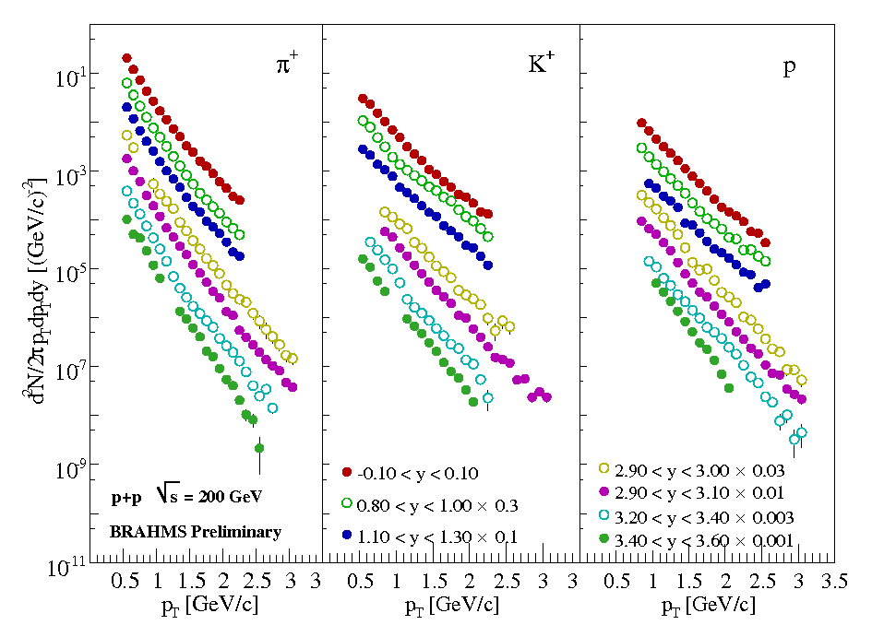
Particle spectra: p+p collisions
Positives in p+p
y=0
y=0
y=0
y=0.9
y=0.9
y=0.9
y=3.5
y=3.5
y=3.5
Spectra are scaled by certain factors for the convenience of display

Slide 6
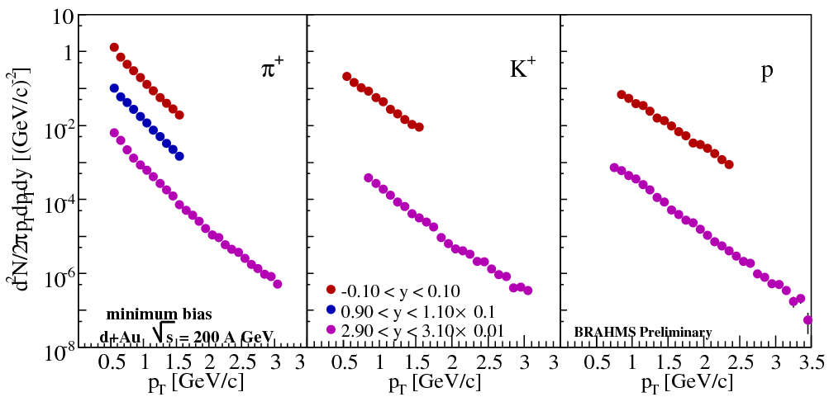
Particle spectra: d+Au collisions
Positives in minimum bias d+Au
y=0
y=0
y=0
y=1.0
y=3.0
y=3.0
y=3.0
Spectra are scaled by certain factors for the convenience of display

Slide 7
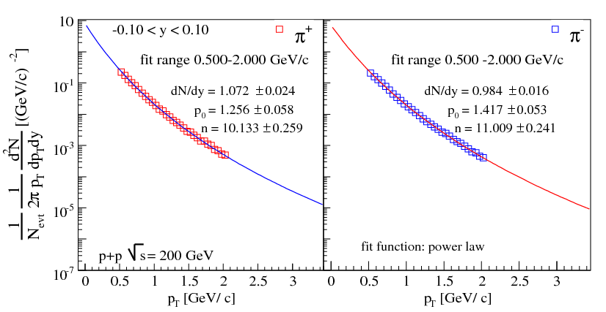
Extract dN/dy from spectra: pion in p+p
y=0, fit by power law

Slide 8
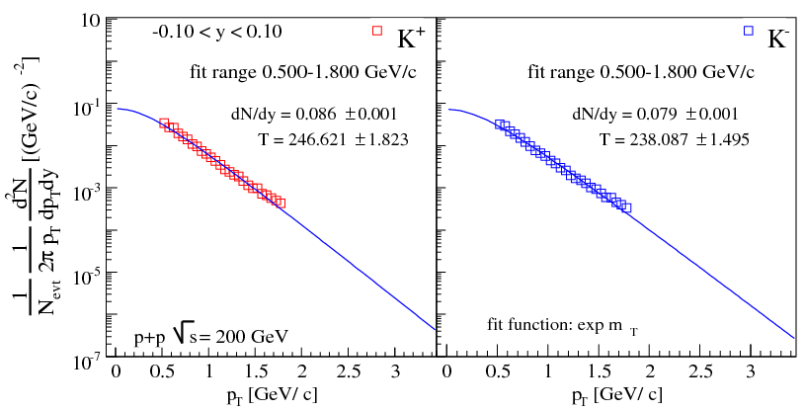
Extract dN/dy from spectra: kaon
y=0, fit by exponential in m_{T}

Slide 9
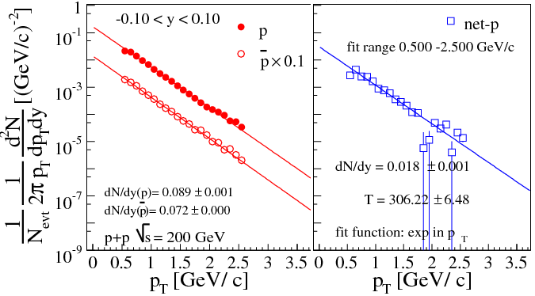
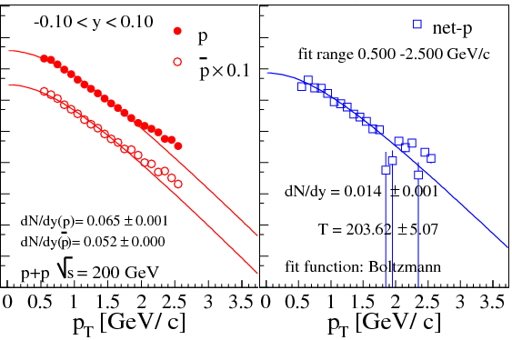
Extract dN/dy from spectra: p, p-bar and net-p
Fit by various functions
Systematic uncertainties are dominated by extrapolation to p_{T}=0
Exponential function in p_{T}
Boltzmann function

Slide 10
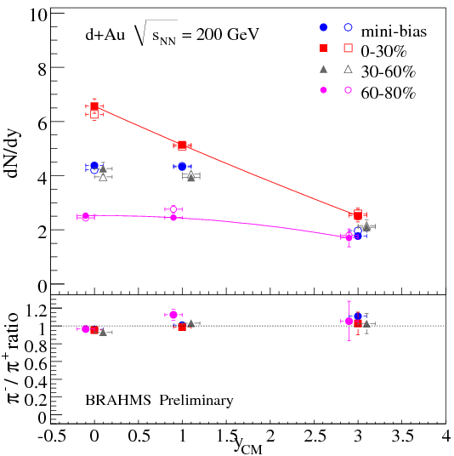
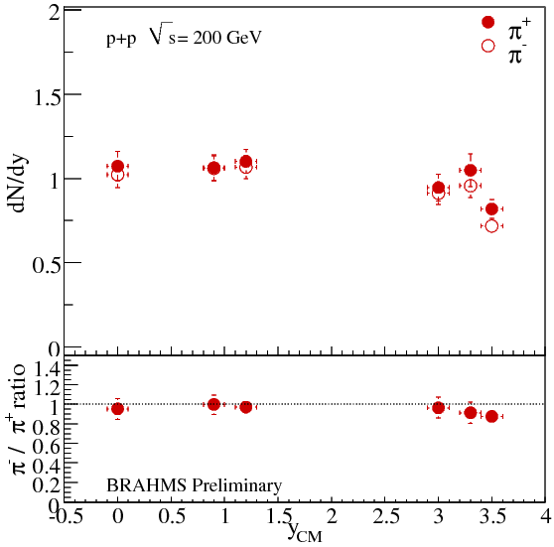
Rapidity density dN/dy: pions
d+Au collisions
p+p collisions
The centrality dependence shows the presence of the Au “target” source as well as the projectile deuteron one at forward rapidity.
The distributions evolves into one similar to p+p in the most peripheral d+Au collisions

Slide 11
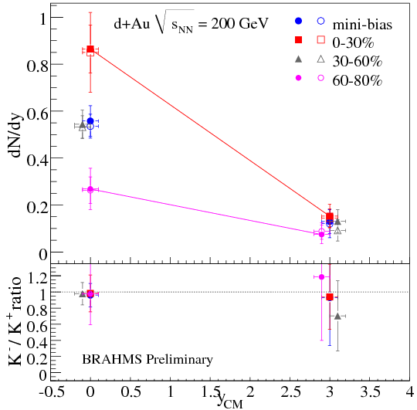
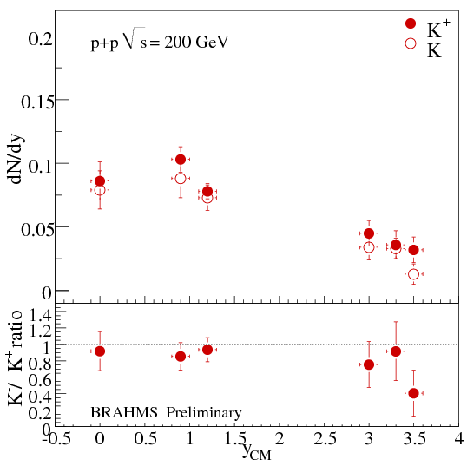
Rapidity density dN/dy: kaons
d+Au collisions
p+p collisions
dN/dy for kaons drastically decreases with increasing rapidity in d+Au
dN/dy for kaons changes slowly in p+p collisions at forward rapidity

Slide 12
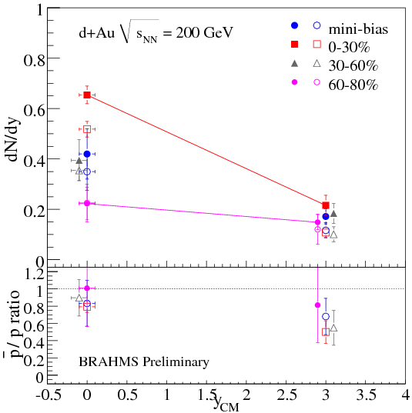
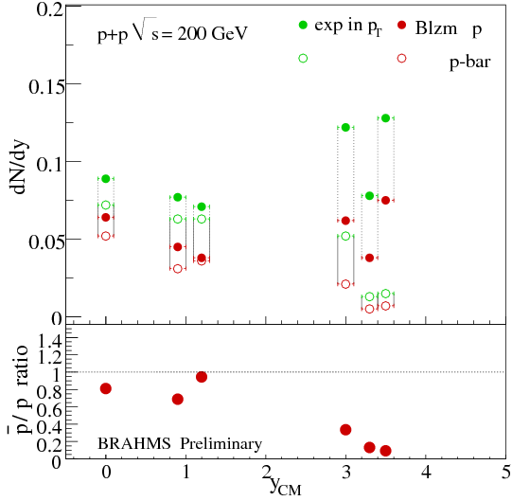
Rapidity density dN/dy: protons
d+Au collisios
p+p collisions
dN/dy for proton (p-bar) drastically decreases at forward rapidity
Much more protons than p-bar in p+p collisions at forward rapidity
the slow decrease trend for proton in the most peripheral d+Au collisions

Slide 13
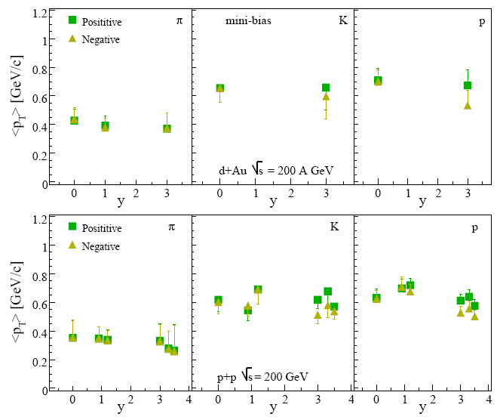
Mean p_{T} of pion, kaon, proton
preliminary
d+Au collisions
preliminary
p+p collisions
no rapidity dependence shown in both systems, and no centrality dependence in d+Au
for heavier particles, <p_{T}> are larger

Slide 14
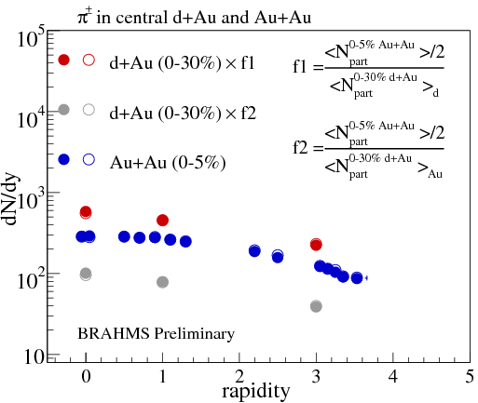
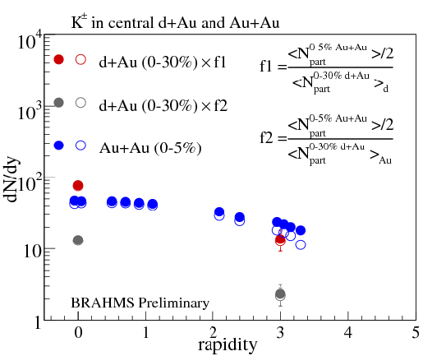
d+Au data: comparing to Au+Au
Pion in central d+Au vs central Au+Au
Kaon in central d+Au vs central Au+Au
<N_{part}^{0-5%Au+Au}>=357±10, Central (0-5%) Au+Au: BRAHMS PRL94(2005)162301
<N_{part}^{0-30%d+Au}>=13.6±0.5, in which <N_{part}^{0-30%d+Au}>_{d}∼2.0, <N_{part}^{0-30%d+Au}>_{Au}∼11.6
<N_{part}^{0-30%d+Au}>_{scale} ~4 could scale pions in central d+Au collisions to dN/dy in central Au+Au collisions

Slide 15
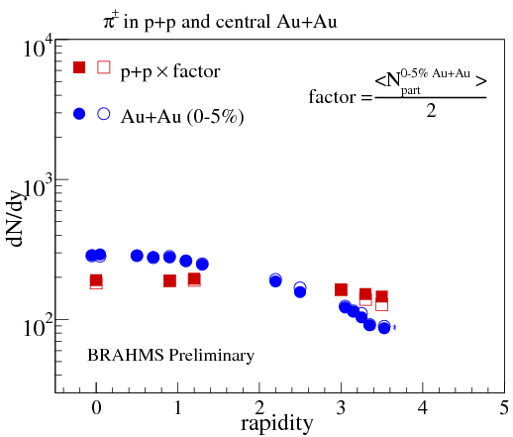
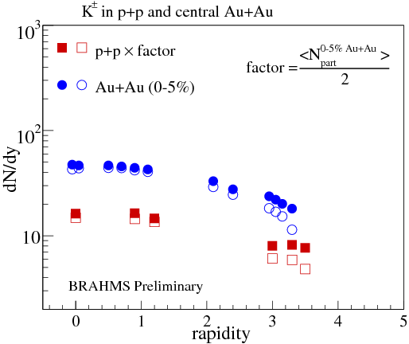
p+p data: comparing to central Au+Au data
Pion in p+p vs central Au+Au
Kaon in p+p vs central Au+Au
No scaling works for pions and kaons in p+p collisions
<N_{part}^{0-5%Au+Au}>=357±10, Central (0-5%) Au+Au: BRAHMS PRL94(2005)162301

Slide 16
Summary on dN/dy
Extraction and systematic uncertainties
large systematic uncertainties dominate by extrapolation to p_{T}=0
Rapidity density for identified hadrons in d+Au and p+p collisions
dN/dy for pions, kaons decrease with increasing rapidity
Centrality dependence shows target nucleus plays a role in particle production at forward rapidity, though not as important as projectile nucleus
comparing to the central (0-5%) Au+Au collisions
Scaling works for pions in central d+Au collisions (if the average number of participants is 4), but not for kaons
Scaling does not work at all in p+p collisions

Slide 17
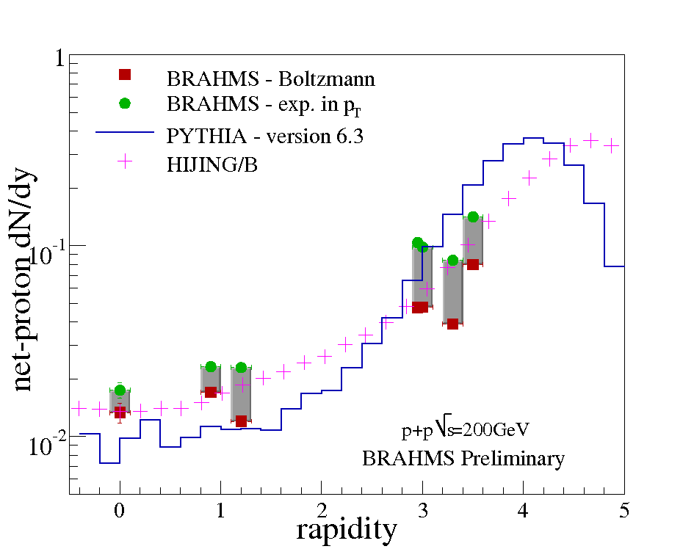
Stopping: net-proton in p+p collisions
comparison to models
More proton at forward rapidity
Experiemental data favors HIJING/B (v1.1) more than PYTHIA model
- version 1.1

Slide 18
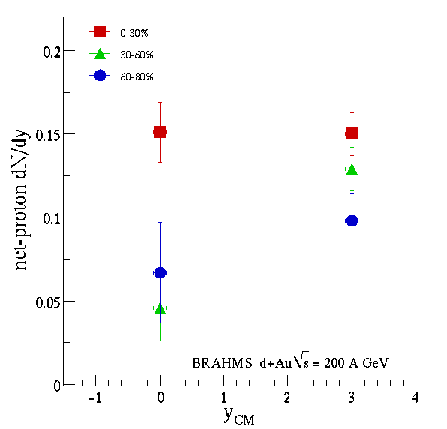
Stopping: net-proton in d+Au collisions
Centrality dependence in d+Au collisions
when dN/dy for net-proton goes from mid-rapidity to forward rapidity:
there is not much difference for net-proton dN/dy in central d+Au collisions (rapidity shifted peak has been flattened )
while net-proton rapidity density increases in semi-cental and pheripheral collisions, which is similar to dN/dy in p+p collisions

Slide 19
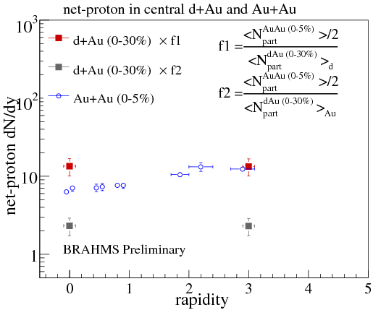
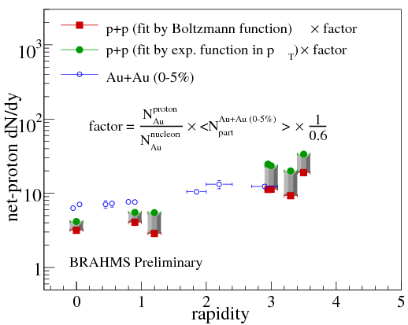
Net-proton: d+Au & p+p vs central Au+Au
p+p vs central Au+Au
Central d+Au vs Au+Au
at mid-rapidity, net-proton mainly comes from both deuteron and gold sides, but at forward rapidity, mainly coming from the deuteron side
at mid-rapidity, more net-proton in central Au+Au collisions, indicates baryon transport from forward rapidity to mid-rapidity
net-proton in central Au+Au <N_{part}^{0-5%Au+Au}>=357±10 ref BRAHMS PRL93(2003)102301
<N_{part}^{0-30%d+Au}>=13.6±0.5, in which <N_{part}^{0-30%d+Au}>_{d}∼2.0, <N_{part}^{0-30%d+Au}>_{Au}∼11.6
isospin correction factor 0.6: ref Proc. 17th Winter Workshop on Nuclear Dynamics (2001) nucl-exp/0106017

Slide 20
Summary and discussion
Rapidity density for identified hadrons in d+Au and p+p collisions are compared with central Au+Au results
Projectile nucleus (Au, d, p) contribute the most to particle production at forward rapidity, There is though a contribution from the target (Au)
Stopping, net-proton in d+Au and p+p collisions
Scaling with number of participants (proton participant when comparing to p+p result) from projectile at forward rapidity works well in both d+Au and p+p systems.
but not well at mid-rapidity, indicating more protons in central Au+Au collisions have been transported from forward rapidity to the mid-rapidity comparing to that in p+p collisions. Even more in central d+Au collisions is seen, suggests that target Au nucleus in the asymmetric system partially get involved in the proton production.

Slide 21
Thank you!

Slide 22
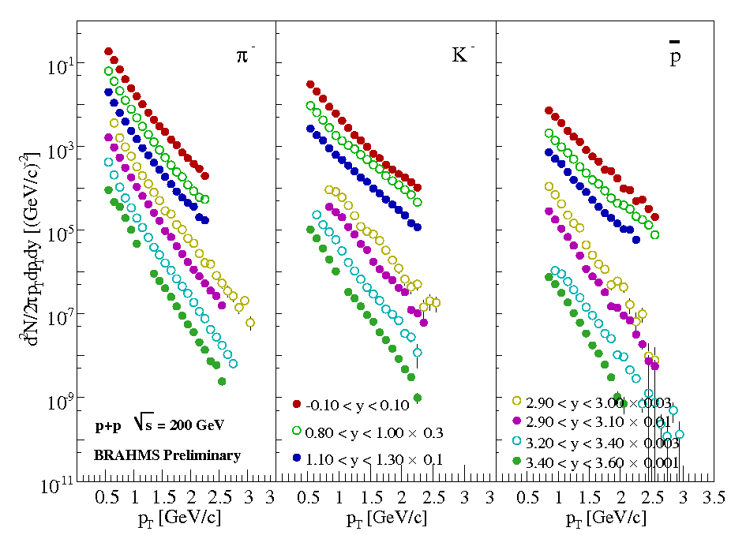
Particle spectra: p+p collisions
Negatives in p+p
y=0
y=0.9
y=0
y=0
y=0.9
y=0.9
y=3.5
y=3.5
y=3.5
Spectra are scaled by certain factors for the convenience of display

Slide 23
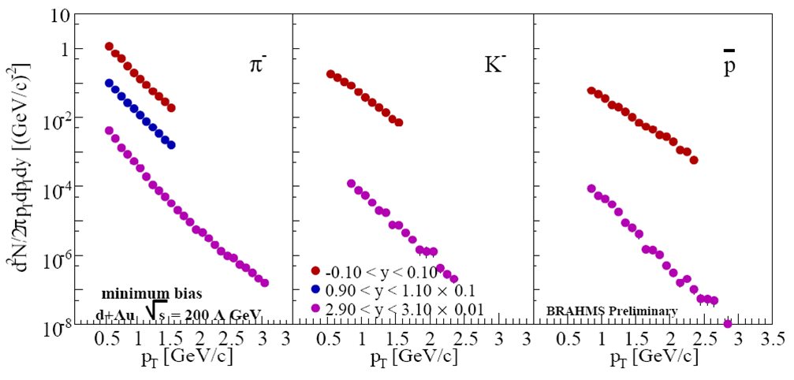
Particle spectra: d+Au collisions
Negatives in minimum bias d+Au
y=0
y=0
y=0
y=1.0
y=3.0
y=3.0
y=3.0
Spectra are scaled by certain factors for the convenience of display

Slide 24
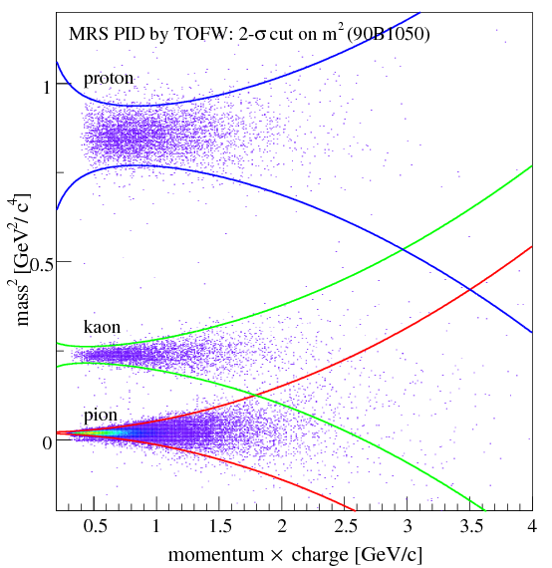
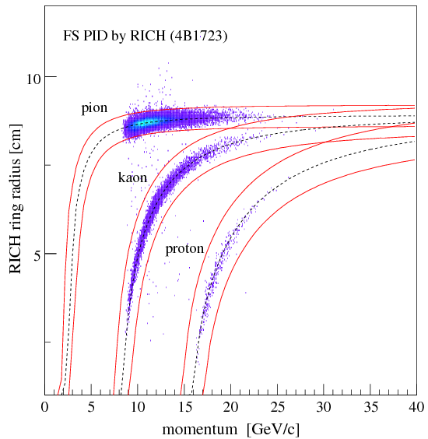
Particle identification: TOFW and RICH
MRS: TOFW
FS: RICH

Slide 25
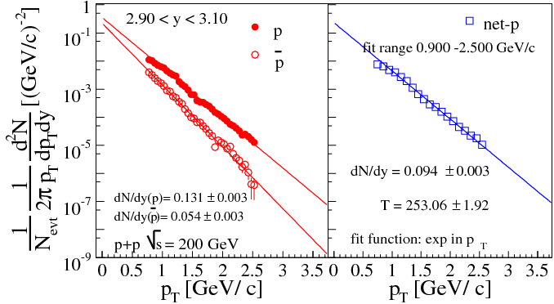
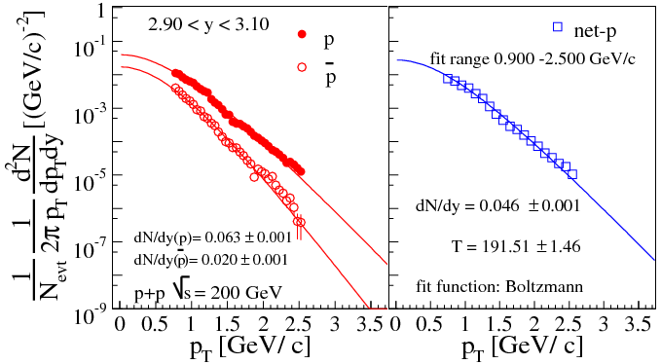
Extract dN/dy from spectra: p, p-bar and net-p
At forward rapidity y=3
Fit functions:
Exponential in p_{T}
Boltzmann function
Large systematic errors result from the extrapolation to p_{T}=0
Exponential function in pT
Boltzmann function

Slide 26
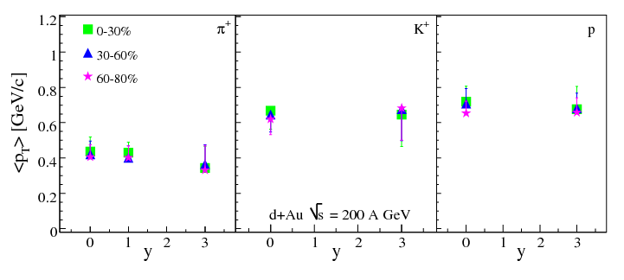
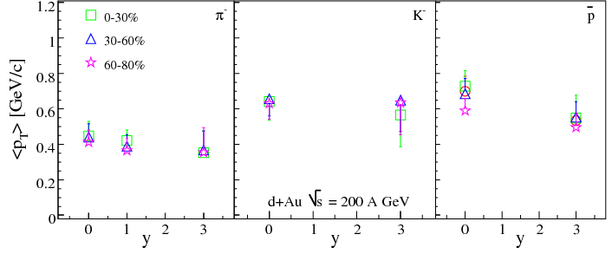
Centrality dependence of <p_{T}>
preliminary
preliminary

Slide 27
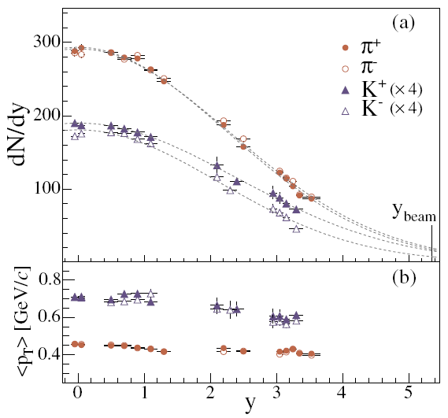
Backup slides: published Au+Au 0-5%

Slide 28
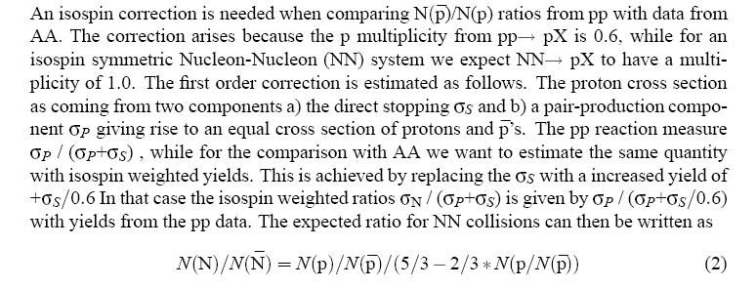
Why 0.6?
Stopping in Relativistic Heavy Ion Reactions - From SIS to RHIC
By F. Videbaek nucl-exp/0106017, Heavy Ion Phys. 15 (2002) 303-313

