Slide 1
AAC Meeting
Design of the MANX experiment
Katsuya Yonehara
Fermilab APC
February 4, 2009

Slide 2
Contents
Project goal
Simulation results
Summary

Slide 3
Goal of this project
Design, engineer, and build a useful device for muon cooling channel studies
Test six-dimensional helical cooling model
Investigate capability and limitation of helical cooling channel

Slide 4
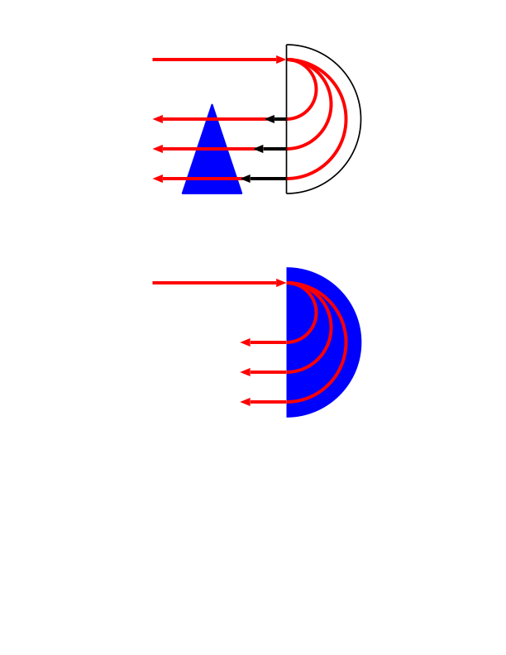
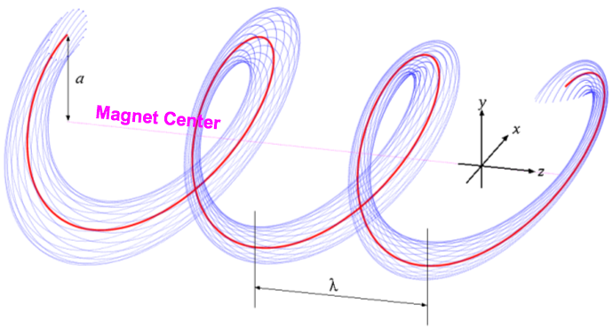
Concept of Helical Cooling Channel (HCC)
Incident Muon Beam
Evacuated
Dipole magnet
Combined function magnet (invisible in this picture) = Pure solenoid + Helical dipole + Helical quadrupole
Red: reference orbit
Blue: beam envelop
Wedge absorber
Incident Muon Beam
H2 gas absorber
in Dipole magnet
Dispersive component makes longer (shorter) path length for higher (lower) momentum particles
→ Continuous emittance exchange
Homogeneous field (no periodic structure) makes minimal resonant losses
This fact makes large phase space acceptance
Emittance exchange

Slide 5
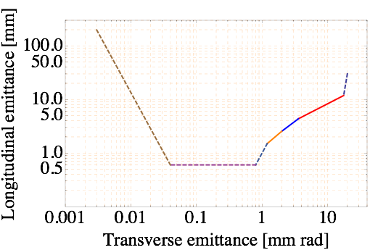
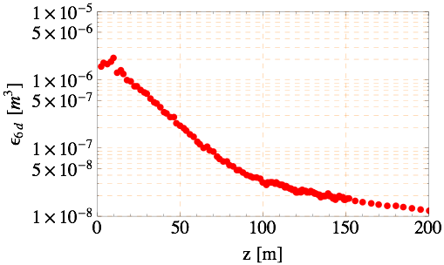
Simulation study of HCC for Muon Collider
400 MHz HCC
λ=1 m, κ=1
Goal for low emittance MC design
Reverse Emittance Exchange (REMEX)
Study II Front-end
200 MHz HCC
λ=2 m, κ=1
800 MHz HCC
λ=0.5 m, κ=1
Pre-cooler
200 MHz HCC
400 MHz HCC
800 MHz HCC
1600 MHz HCC
p=250 MeV/c
Parametric Ionization
Channel (PIC)
6D Phase space evolution in current HCC
Phase space evolution for Muon Collider
(solid line: complete simulation, dashed line: in progress)

Slide 6
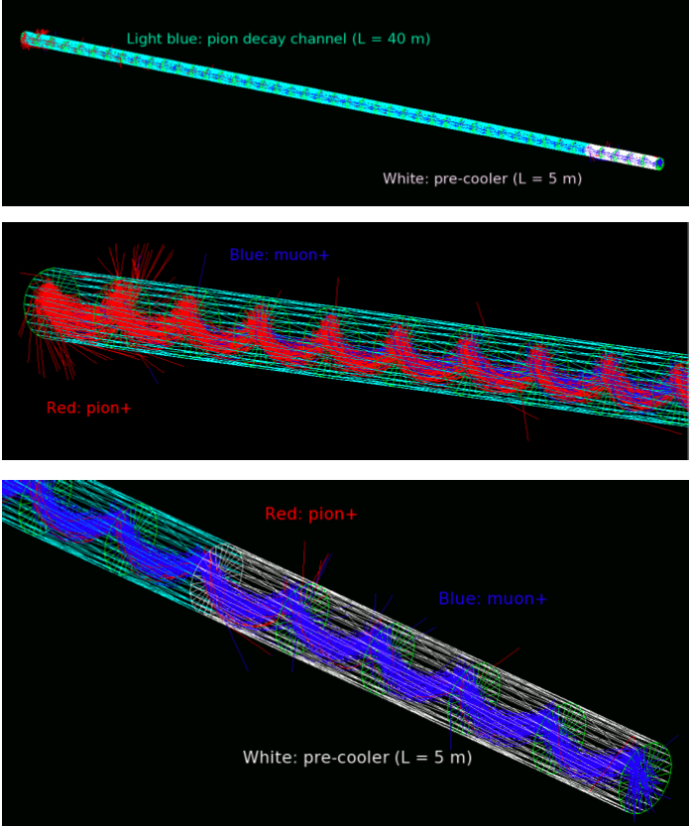
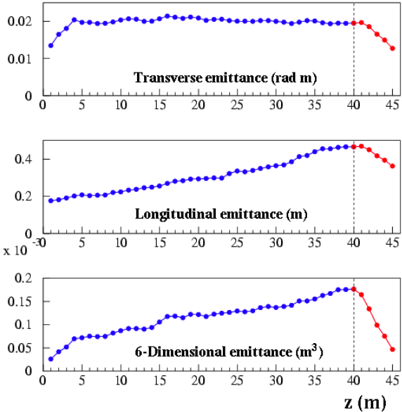
Pre-cooler was the MANX inspiration
MANX: HCC w/o RF structure in magnet
(Discuss MANX channel later)

Slide 7








HCC field parameters
Larmor motion in pure solenoid
Larmor center
Radial equation of motion with helical dipole
HCC magnet center
HCC wave number
a
HCC pitch
Equation of motion for reference particle
Projected motion in
transverse (x-y) plane
Need to introduce proper helical quad (bϕ)’ to stabilize beam phase space

Slide 8
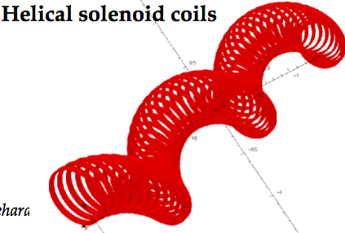



Design of the HCC magnet
Consider continuous RF structure inside HCC
HCC field is generated by helical solenoid (HS)
Field parameters in HS has a geometric restriction
From past HS design study: HS coil radius ~ Helix radius (a)
It makes a lower limit of pill-box type RF frequency
Example: λ = 1 m, κ = 1.0, a = 0.16 m
→ pillbox RF frequency ~ 800 MHz
High freq RF structure destroys the longitudinal phase space stability
Hence, no cooling in high freq RF channel
Furthermore, additional space between coil and RF cell is needed for thermal isolation, pressure barrier, etc
Required minimum gap = 80 mm
br2
Coil-2
B_{φ}
Coil-1
Coil-3
br1
Need to adjust (Bz, b, b’) on red dot (Coil-2 center)
Blue dot and green dot are centers of upstream (Coil-1) and
downstream (Coil-3) HS coils
Coil-1 and Coil-3 generate br1 and br2 on red dot
Br on red dot is zero by sum of br1 and br2 but those generate Bφ
Bz and Bφ are tuned by the location of HS coil
b’ is tuned by bore of the HS coil
→ Optimum HS coil radius for cooling ~ Helix radius (a)
HCC magnet center
Reference orbit

Slide 9
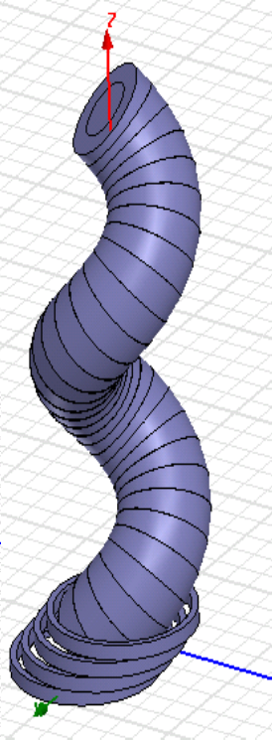
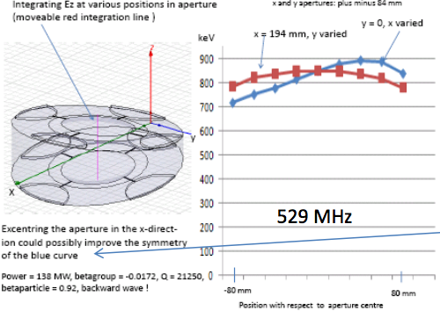
Current progress of RF design
Wedge shape RF cell
Done with Lars Thorndahl. Wedge shape RF is considered
Acceleration field direction follows the helix beam path
Induce traveling wave RF structure, hence there is no
window between RF cells
Asymmetric field structure in radial direction (y-axis in plot)
Requires large RF power
HS coil

Slide 10
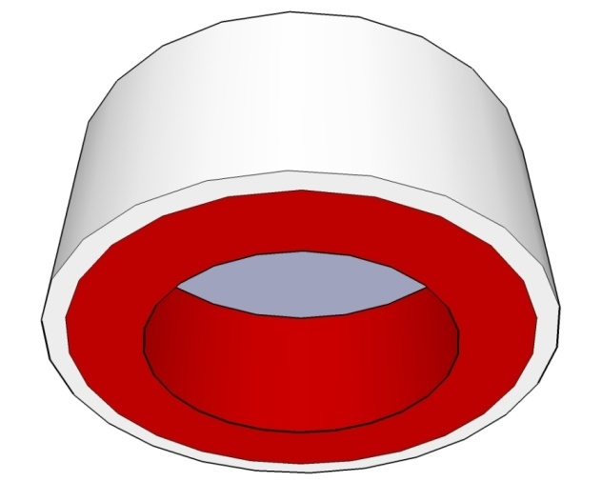
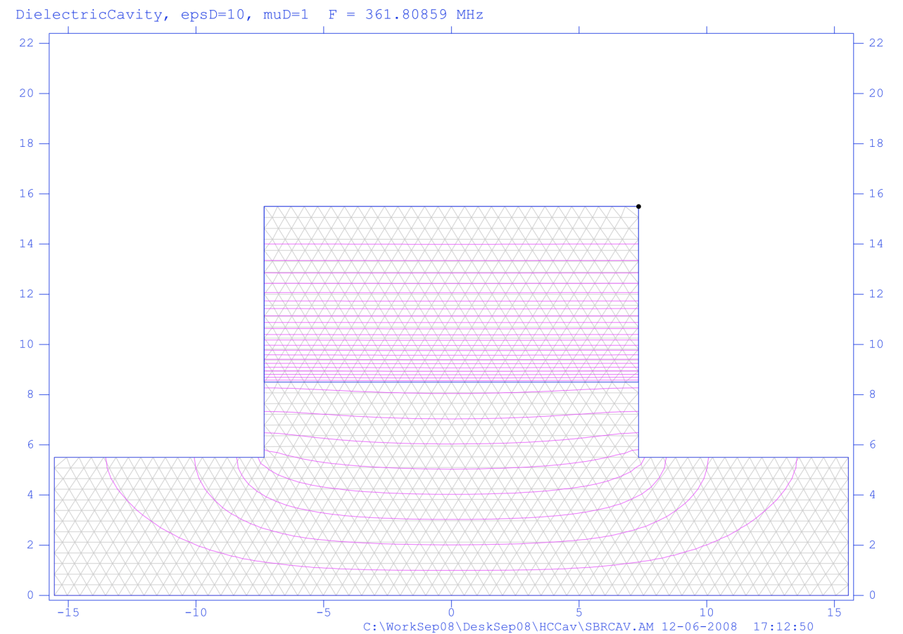
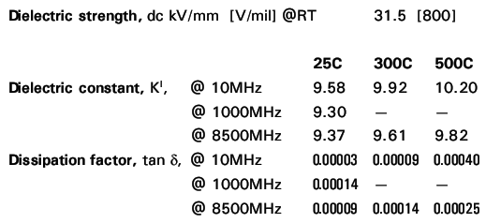
Compact dielectric RF for HCC
ceramics
(dielectric material)
361MHz Cavity
(28.6 cm radius for 400 MHz pillbox cavity)
Cu/Steel
ceramics
Vacuum/H/He
16 cm
Lower frequency RF structure makes larger RF bucket
Reduce transverse size of RF cell by using dielectric material
Gap between RF cell and HS coil is used for power line, thermal
isolation, high pressure wall, etc. (w. Popovic, Moretti, Neubauer)

Slide 11
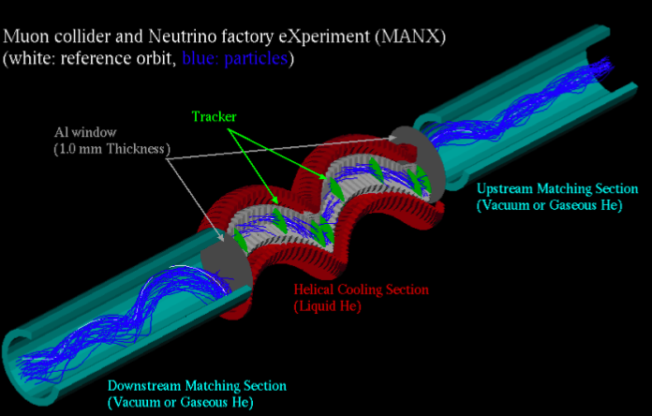
Design MANX

Slide 12
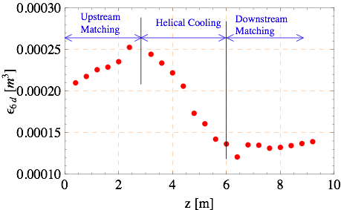
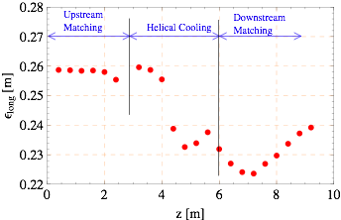
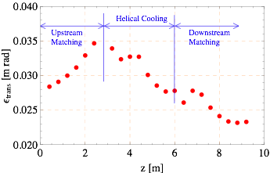
6D Cooling factor: 2
Transverse & Longitudinal Cooling factors: ~1.3

Slide 13
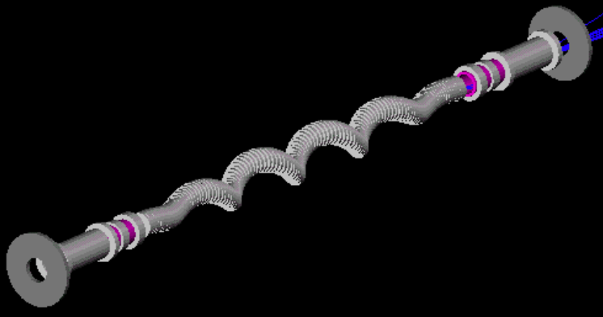
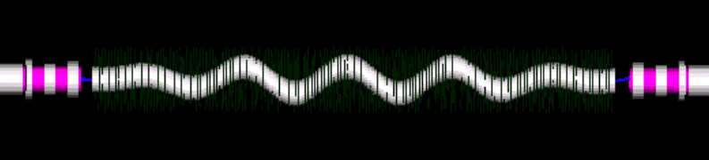
Mount MANX at RAL beamline
Matching section
MANX cooling section
MICE Spectrometer
Matching section
MICE Spectrometer
Matching section
MANX cooling section
Matching section

Slide 14

Key parameters to test HCC theory
Measure six variables
Emittance Exchange is the key parameter in this theory
There is a correlation between scattering angle and energy straggling
Simulation does not involve this correlation
We need to know how much this correlation affects the emittance exchange
s and t are the most sensitive parameters for emittance exchange
We need a very fast ToF counter and tracker system in cooling section to measure s and t precisely
Measurement will be done without cooling material
14

Slide 15

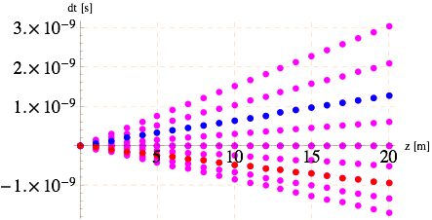
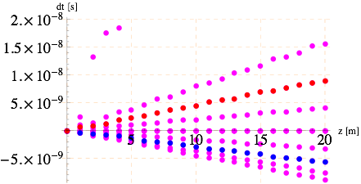
ToF in HCC and pure solenoid
In a pure solenoid channel, ToF of slow (fast) particle takes more (less) time to reach the other end of the channel
This picture is opposite in HCC (opposite phase slip factor)
Phase slip factor can be tuned by adjusting the dispersion
→ Even isochronous condition can be realized in HCC
ToF wrt momentum is directly correlated with path length
no RF, no absorber
No absorber
No angular dist
Blue: Δp = -10 %
Pure solenoid
Red: Δp = +10 %
No absorber
No angular dist around reference orbit
Red: Δp = +10 %
HCC (kappa =1)
Blue: Δp = -10 %

Slide 16
Future Prospect
RF test in MANX channel
It is possible to mount a dielectric RF cell (see slide 10) in the MANX channel
Cu/Steel
Detectors
Cavity + Coil
Cryostat Vessel
ceramics
Vacuum/H/He
Feedthroughs
Power in
Signals out
16

Slide 17
Summary
Design MANX experiment
Show simulations
Discuss how to verify HCC model

