Slide 1
HCC theory
Yaroslav Derbenev, JLab
Rolland P. Johnson, Muons, Inc
Andrei Afanasev, Hampton U/Muons, Inc
Valentin Ivanov, Muons, Inc
+Muons, Inc collaborators
AAC Fermilab, Feb. 04, 2009
Notes:
AAC Fermilab, Febr. 04, 2009

Slide 2
Outline
History
Helical Field in general
Helical orbit
4D conservative helical Hamiltonian
Ionization Cooling (IC) and the linear HCC theory
A new HCC use: Parametric-resonance IC (PIC)
A new HCC use (cntd) : Epicyclic HS for PIC
HCC Conclusions

Slide 3
HCC history
HCC proposed and beam dynamics and 6D IC studied including wedge absorber and precooler with no RF.
Y. Derbenev, 2000, http://www-mucool.fnal.gov/mcnotes/public/ps/muc0108/muc0108.ps.gz
HCC proposed to use for 6D muon cooling with homogeneous absorber, Y. Derbenev, R. Johnson 2002
Derbenev, Johnson, Phys.Rev.ST Accel. Beams 8, 041002 (2005)
Successful simulations, K. Yonehara, since 2004
Helical Solenoid, V. Kashikhin, K. Yonehara et al. WEPD015, EPAC08
MANX proposal and study. R. Johnson et al., since 2006
Epicyclic HCC proposed for PIC, Y. Derbenev et al. since 2008

Slide 4
Helical Cooling Channel
Opposing Radial Forces for particle motion in Solenoid and Helical Dipole Fields:
The equation of particle motion is determined by first expressing the magnetic field in all generality, shown on the next slide, then forming a Hamiltonian which can be solved by moving into frame of the rotating dipole.

Slide 5



Helical Field in general
Compose a helix-invariant system of currents
Representation of magnetic field by mean of a scalar potential :
Helical field:
Expansion of the potential:
Different harmonics can be realized individually or in superposition
Helical dipole :
Helical quadrupole:
Helical sextupole:
Helical octupole:
Notes:
;

Slide 6
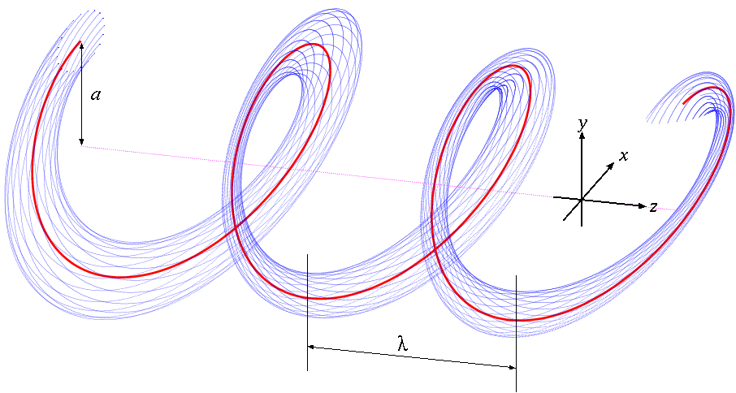
Helical Orbit
The Periodic Orbit is a simple helix
The radial field is zero along the orbit
Orbit radius is a function of particle total momentum
The particle total momentum as function of helix radius is given by:
added for stability and acceptance

Slide 7
Conservative helical dynamics
System appears a 2d conservative in the helical frame
Vector potential is function of only
Hamiltonian in helical frame is conservative (dynamical invariant) :
2d conservatism is an important advantage of helical channel:
Simply solvable periodic orbit
An explicit solvable linear dynamics near periodic orbit
Tunes formulated
Linear stability area of parameters has been formulated. There are no “forbidden” tune bands
No resonance instabilities, hence, acceptance is large

Slide 8
Ionization Cooling and the HCC
6D Ionization Cooling decrements, cooling partitioning, and equilibrium emittances have been formulated.
Note: 1)The quadrupole field is everywhere 2) the solenoid field is necessary for the best beam transport and ionization cooling.
Hamiltonian Solution
Equal cooling decrements
Longitudinal cooling only
~Momentum slip factor
~

Slide 9
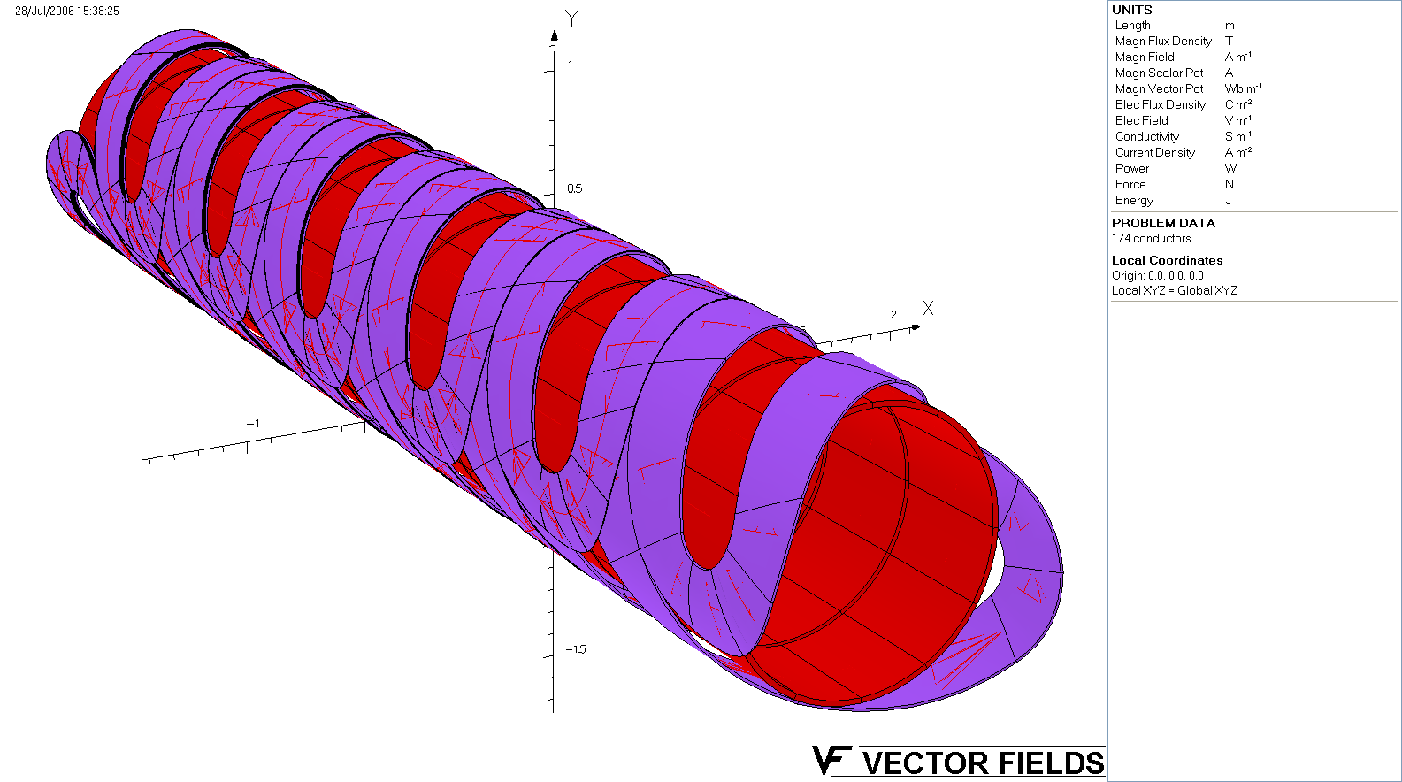
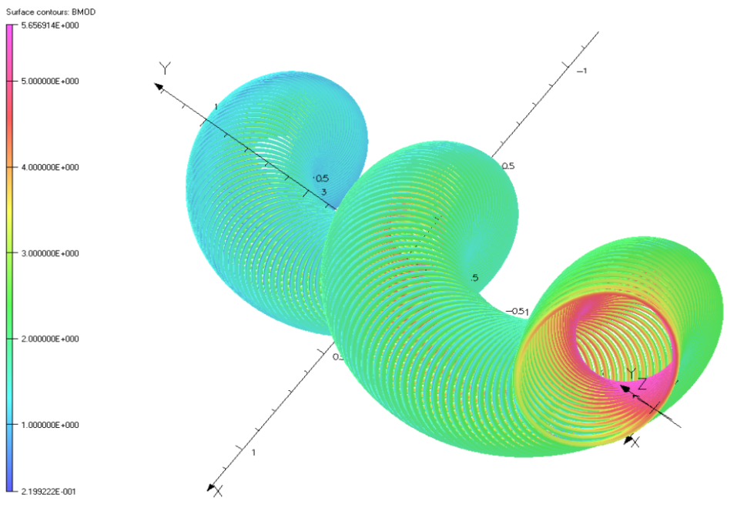
Helical structure design options
SC Helical Magnets
SC “Helical Solenoid”
Can be composed as a super-
position of a few angular helical modes
Composed as a system of short rings, which provide rotating dipole
and quadruple components.
Discussed by Vladimir Kashikhin later.
Notes:
Composed as a system of short rings…,
but, there is rotating dipole and even quadrupole
Mode (and other, if needed)

Slide 10
A New HCC Use: PIC Concept
Muon beam ionization cooling is a key element in designing high-luminosity muon colliders
To reach high luminosity without excessively large muon intensities, it was proposed to combine ionization cooling with techniques using parametric resonance (Derbenev, Johnson, COOL2005 presentation; Advances in Parametric-resonance Ionization Cooling (PIC), ID: 3151 - WEPP149, EPAC08 Proceedings)
A half-integer resonance is induced such that normal elliptical motion of x-x’ phase space becomes hyperbolic at absorber points, with particles moving to smaller x and larger x’
Thin absorbers placed at the focal points of the channel then cool the angular divergence of the beam by the usual ionization cooling mechanism where each absorber is followed by RF cavities

Slide 11
PIC Concept (cont.)
Comparison of particle motion at periodic locations along the beam trajectory in transverse phase space
Ordinary oscilations vs Parametric resonance
Conceptual diagram of a beam cooling channel in which hyperbolic trajectories are generated in transverse phase space by perturbing the beam at the betatron frequency
Absorber plates
Parametric resonance lenses

Slide 12
PIC Challenges and solution
Large beam sizes, angles, fringe field effects
Need to compensate for chromatic and spherical aberrations
Requires regions with large dispersion
Absorbers for ionization cooling have to be located in the region of small dispersion to reduce straggling impact
Suggested solution (Derbenev, LEMC08; Afanasev, Derbenev, Johnson, EPAC08):
Design of an epicyclic HCC characterized by alternating dispersion and beam stability provided by a HCC using a HS with two superimposed periods. The homogeneous
field of the HS accommodates large beam sizes and angles with fewer fringe field effects than earlier designs.

Slide 13
Orbit dispersion in Epicyclic HS
Superimposed helical fields B₁+B₂ with two spatial periods:
B₁≠0, B₂=0 (HS) → B₁≠0, B₂≠0 (Epicyclic HS)
k₁=-k₂=k_{c}/2
p→p+Δp
Constant dispersion
Alternating dispersion function appears !
Change of momentum from nominal shows regions of zero dispersion
and maximum dispersion
Zero dispersion points: near plates (wedges) for 6D ionization cooling
Maximum dispersion and beam size: Correction for aberrations

Slide 14
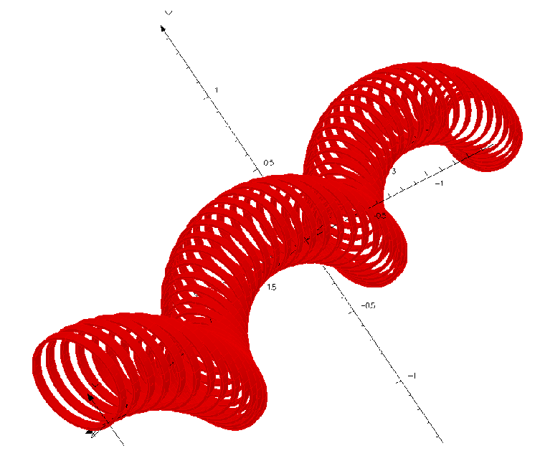

Designing Epicyclic Helical Channel
Solenoid+direct superposition of transverse helical fields, each having a selected spatial period
OR: modify procedure by V. Kashikhin for single- periodic HCC
Magnetic field provided by a sequence of
parallel circular current loops with centers
located on a helix
(Epicyclic) modification:
Circular current loops are centered
along the epitrochoids or hypotrochoids.
The simplest case will be an ellipse
(in transverse plane)
Numerical analysis shows required periodic
structure of magnetic field

Slide 15
Implementing PIC
Plan to develop an epicyclic helical solenoid as part of PIC cooling scheme and for Reverse-Emittance Exchange
Elliptic option looks the simplest
Detailed theory, numerical analysis and simulations are in progress
Afanasev, theory+numerical analysis
Ivanov, G4BL simulations
+
-- Muons, Inc collaborators

Slide 16
HCC Conclusions
Based on results of analytical and simulation studies, we can underline the following features of the HCC:
Easy analysis of field structure, beam dynamics, and cooling processes
Large dynamical aperture, large acceptance
Effective emittance exchange
Optimum cooling partitioning
Possibilities of elegant technical solutions for magnetic structures
Prospects for Parametric-resonance IC and Reverse Emittance Exchange
The numerical simulations of HCC applications are discussed later by Katsuya Yonehara, including the challenges of incorporating RF into HS magnets.
Notes:
Based

