Slide 1

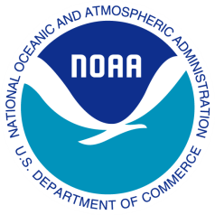
Jane C. Luxton General Counsel National Oceanic and Atmospheric Administration | NOAA
Conference Board EH&S Legal Council September 9, 2008

Slide 2
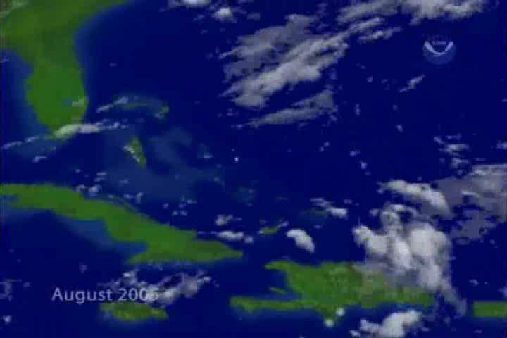
2005 Hurricane Season—Satellite View

Slide 3
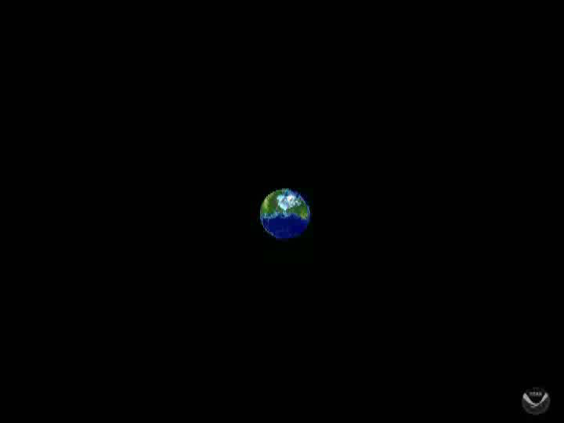
The Global Earth Observation System of Systems By Satellite View

Slide 4


Slide 5


Slide 7
Topics
What is NOAA?
Current GC Priorities at NOAA
What’s Coming?

Slide 8
What is NOAA?

Slide 9

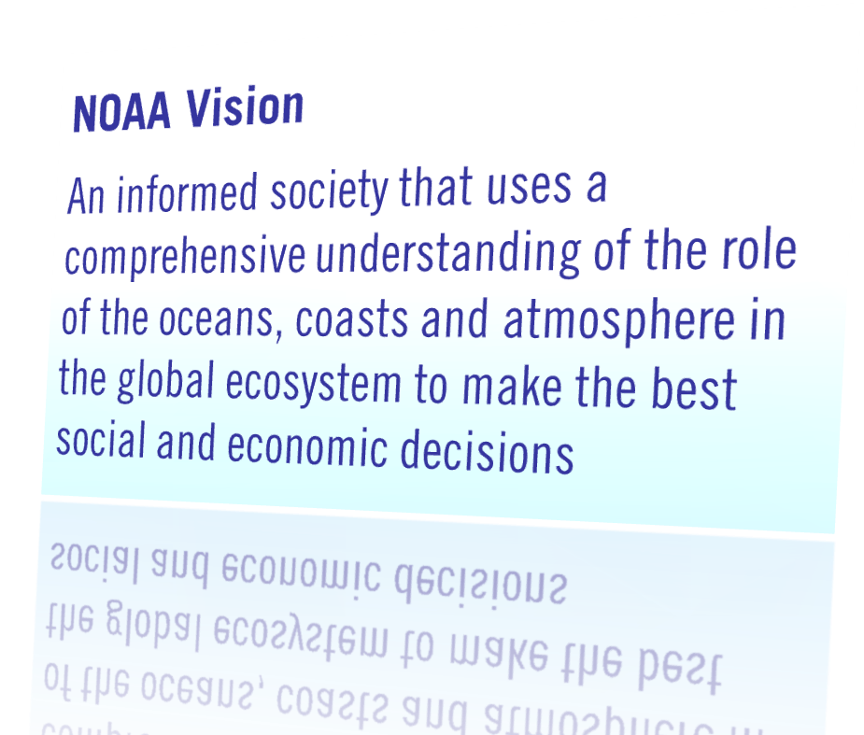
NOAA’s Vision
Notes:
9

Slide 10
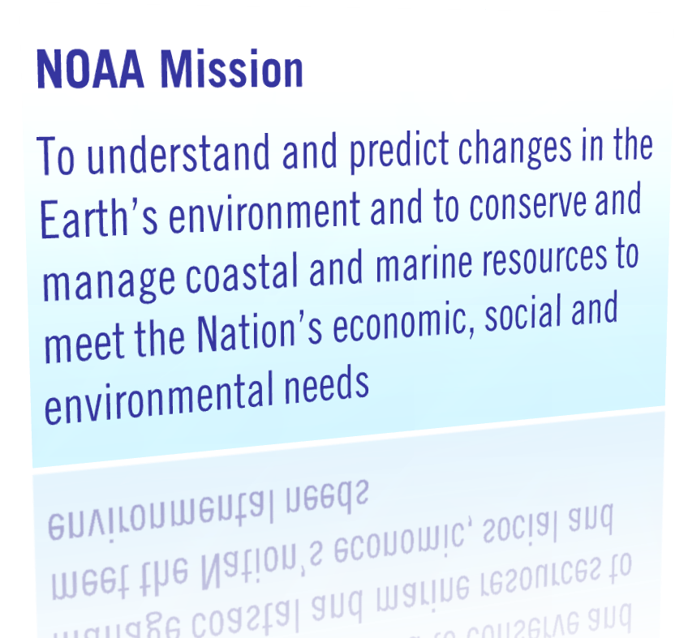
NOAA’s Mission
NOAA functions at the intersection of ocean, climate, and weather science and the application of this knowledge to commercial, societal, and individual decision-making
Notes:
10

Slide 11
Current GC Priorities at NOAA

Slide 12
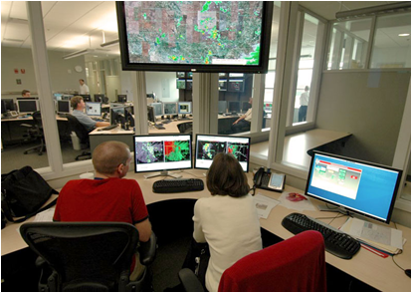
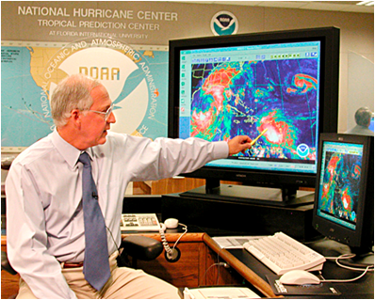
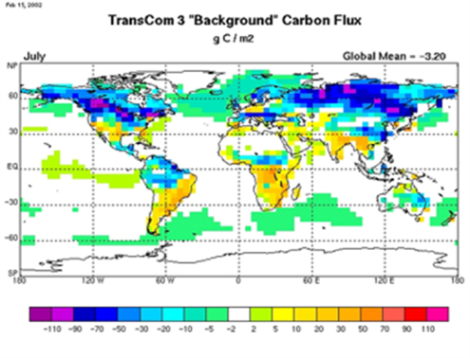
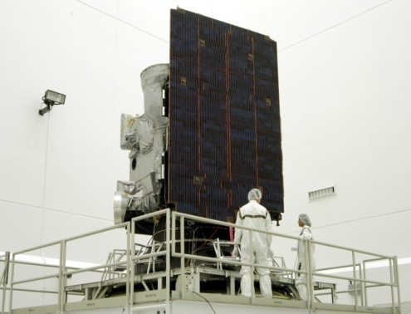
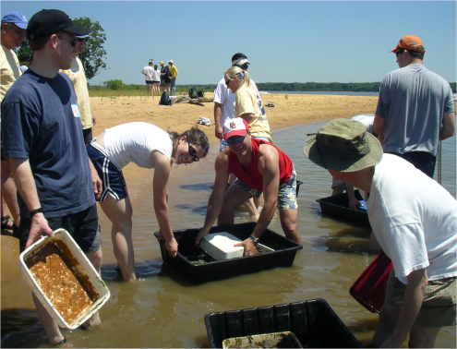
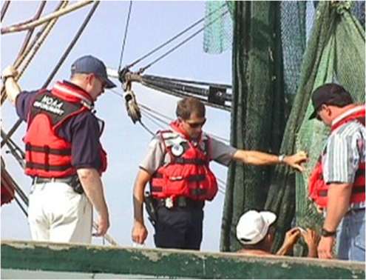
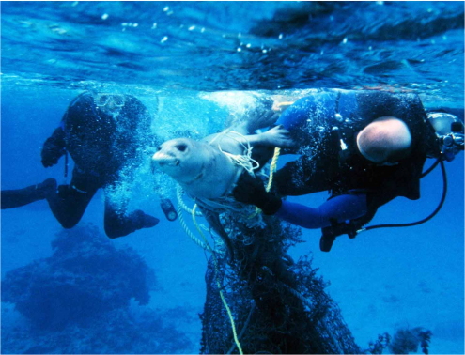
Priorities at NOAA
National Weather Service
National Hurricane Center
National Climatic Data Center
Satellites
Coastal Zone Management
Management of Nation’s Fisheries ($35.1B added to U.S. Economy)
Endangered Species Act
NOAA represents 60% of the Commerce Department’s budget
12,000 Employees
NOAA GC: 130 (108 attorneys)

Slide 13
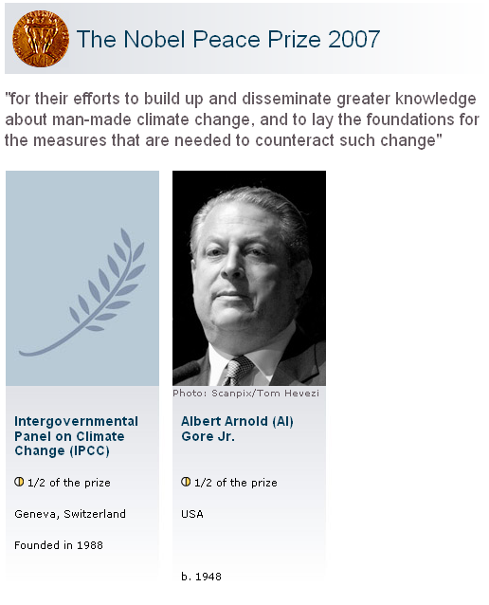
The Nobel Prize in 2007
NOAA IPCC Members
Thomas R. Karl
Dr. David Easterling
Dr. David Fahey
Dr. Isaac Held
Sydney Levitus
Ron Stouffer
Dr. Thomas Peterson
Dr. Venkatachala Ramaswamy
Dr. Susan Solomon
Notes:
13

Slide 14
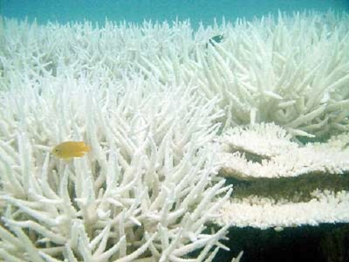
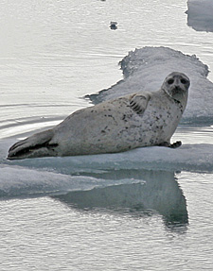
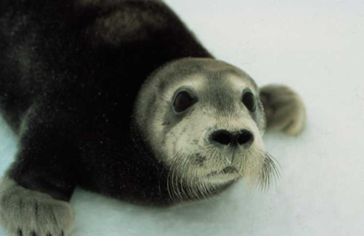
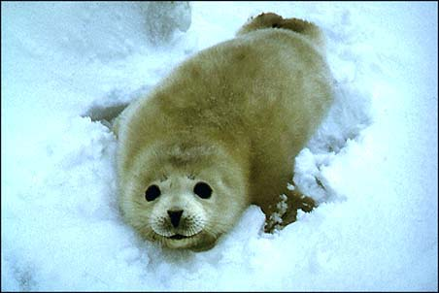
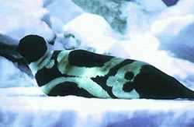
Climate Change ESA Regulations | Corals & Seals
ESA Listings
ESA Consultations
Proposed ESA Regulatory Changes
73 Fed. Reg. 47868 (Aug. 15, 2008) Comment period closes Sept. 15, 2008
Bleached Coral
Spotted Seal
Ringed Seal
Beaded Seal
Ribbon Seal

Slide 15
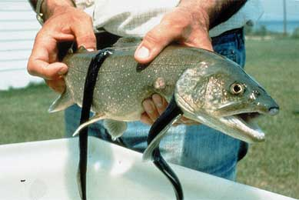
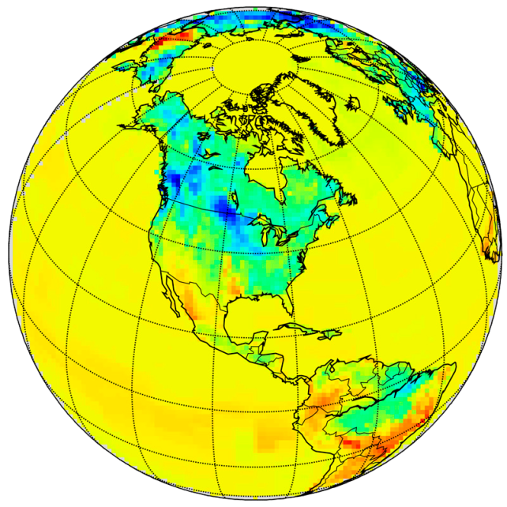
Climate Change Other Potential Implications
Fisheries
Coastal effects
Extensive scientific work
National Climate Service?
Green Sturgeon with lampreys
NOAA’s CarbonTracker

Slide 16
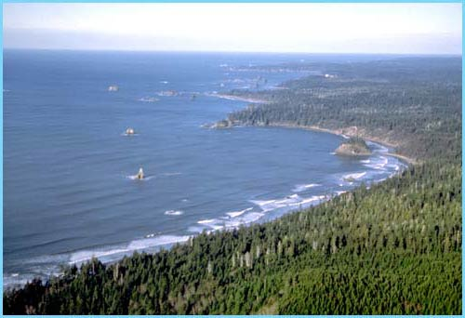
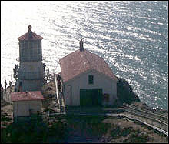
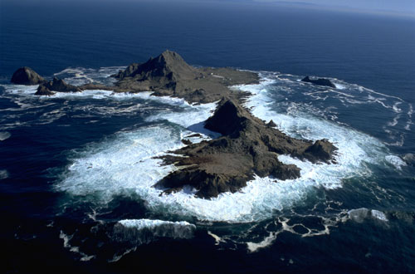
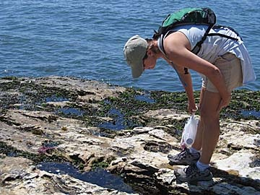
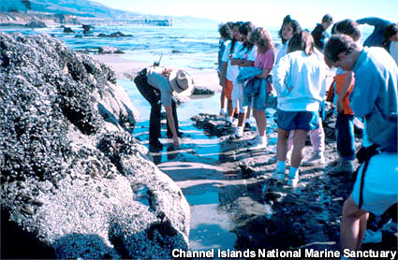
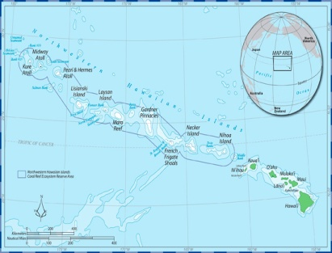
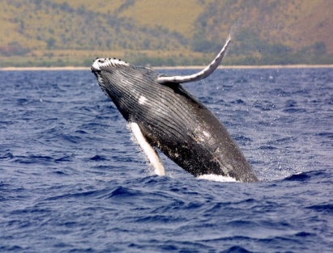

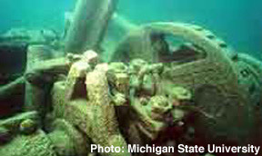
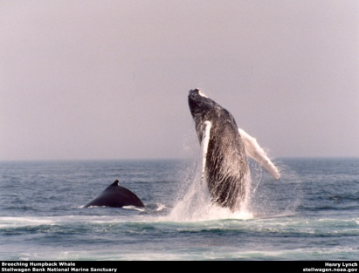
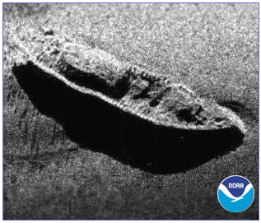
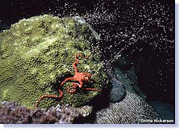
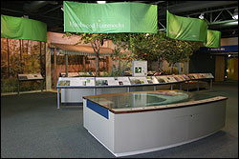
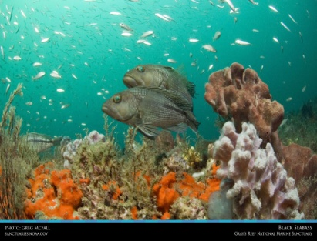
Sanctuaries
Olympic Coast
Cordell Bank
Gulf of the Farallones
Monterey Bay
Channel Islands
Papahānaumokuākea Marine National Monument
Hawaiian Islands Humpback Whale
Fagatele Bay (American Samoa)
Thunder Bay
Stellwagen Bank
Monitor
Flower Garden Banks
Florida Keys
Gray’s Reef

Slide 17
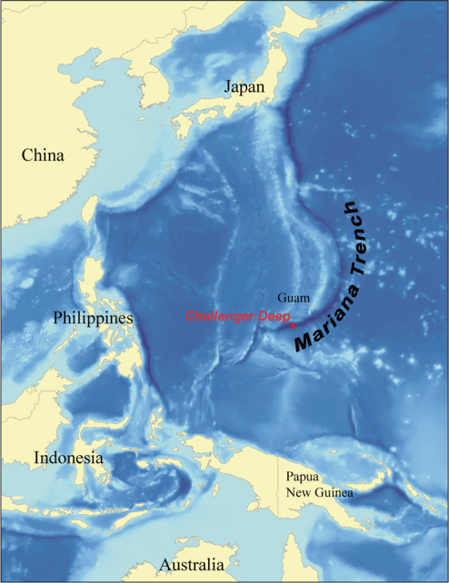
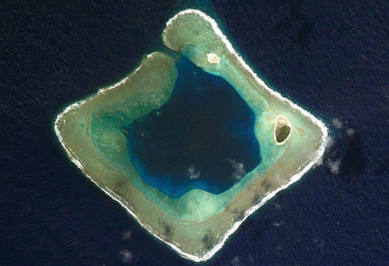
Marine Conservation Areas
August 25, 2008, Presidential memo seeking DOC/NOAA/Interior assessment of 3 Pacific sites for additional protection
Waters surrounding CNMI and Marianas Trench (“Grand Canyon of the Ocean”)
Rose Atoll (American Samoa)
Central Pacific Islands (Johnston Atoll, Howland Island, Baker Island, Jarvis Island, Kingman Reef, Palmyra Atoll, Wake Island )
Recommendation due to President by October 31, 2008
Marianas Trench
Rose Atoll

Slide 18
NOAA Fisheries
Magnuson Stevens Reauthorization Act’s requirements, including ending overfishing by 2010
New market-based approaches
NEPA regulation
Regulation of commercial and recreational fishing throughout the U.S. and participation in international treaty organizations with responsibility for migratory fish and marine mammals
Fishery councils
Western and Central Pacific Fisheries Commission

Slide 19
NOAA Fisheries (contd.)
Marine Mammal Protection Act and Endangered Species Act
Extensive legal involvement, e.g., NRDC v. Winter (Oral argument before Supreme Court Oct. 8, 2008)
Rulemaking, e.g., “Ship Strike” rule
Litigation, e.g., fishery prescriptions at new or relicensed hydropower plants, and vigorous enforcement activity

Slide 20
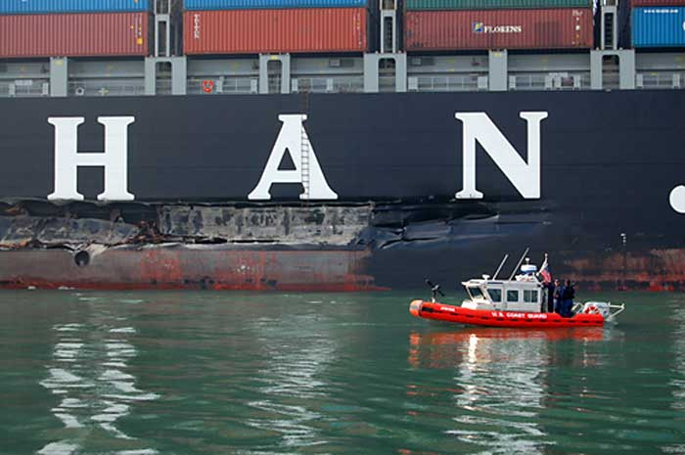
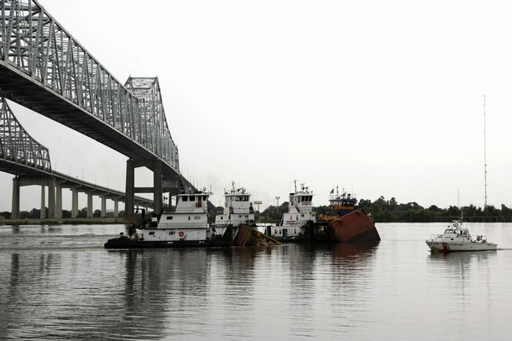
Natural Resource Damages
Oil Spill Response and Damage Recovery
OPA and CERCLA
Exxon VALDEZ [March 4, 1989, 10.8M gallons spilled, over $9B (response = $2.8B)]
COSCO BUSAN [November 7, 2007, 53,000 gallons spilled, $600K in recovery]
Mississippi River Spill [July 23, 2008, more than 400,000 gallons of fuel spilled]
Numerous other recovery and restoration efforts underway
Cosco Busan
Tintomara in New Orleans, July 23, 2008

Slide 21
Coastal Zone Management Act
Consistency Appeal Determinations rendered by Secretary of Commerce
If a state objects to the grant of a federal license or permit that is likely to affect use or resources within the state’s coastal zone, the permit is blocked unless the Secretary overrides the state’s objection
Recent and pending appeals:
Proposed LNG facility in Weaver’s Cove, MA—June 2008, Secretary upheld state’s objection
Proposed LNG facility in Sparrow’s Point, MD—June 2008, Secretary overrode state’s objection
Pending cases include two LNG facilities in Long Island Sound and a proposed toll road in southern CA (hearing scheduled for September 22)

Slide 22
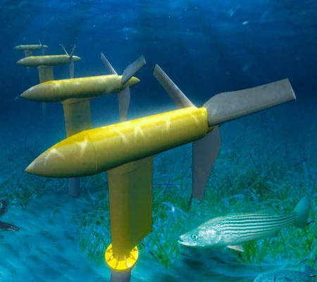
Energy and the NOAA Mission
NOAA plays a significant role in existing and proposed energy projects
Permits for oil and gas exploration and extraction in Arctic regions, Gulf of Mexico, and Outer Continental Shelf (OCS)
FERC licensing
Biological opinions on hydropower projects (effects on salmonid species)
Energy projects, including wave, tidal, and other renewable sources
Direct regulatory authority over Ocean Thermal Energy Conversion (OTEC), 42 U.S.C. §§ 4101 et seq.
Pilot projects underway
Verdant Power's 10-foot-tall turbines will spin in New York’s East River
Photo credit: Verdant Power LLC

Slide 23
How Is NOAA Looking Ahead?

Slide 24
How Is NOAA Looking Ahead?
National Climate Service
Hurricane Forecasting Improvement Project
Satellites, modeling capabilities, other assets
Increasingly sophisticated fishery and marine mammal protection requirements
Expanding energy issues, including renewables, LNG facilities (CZMA appeals), oil spills and response/recovery actions
Legal issues relating to climate change
E.g., Endangered Species Act implications
Enhanced focus on coastal issues

