Slide 1
NOAA Transition Team Briefing
Line Offices

Slide 2
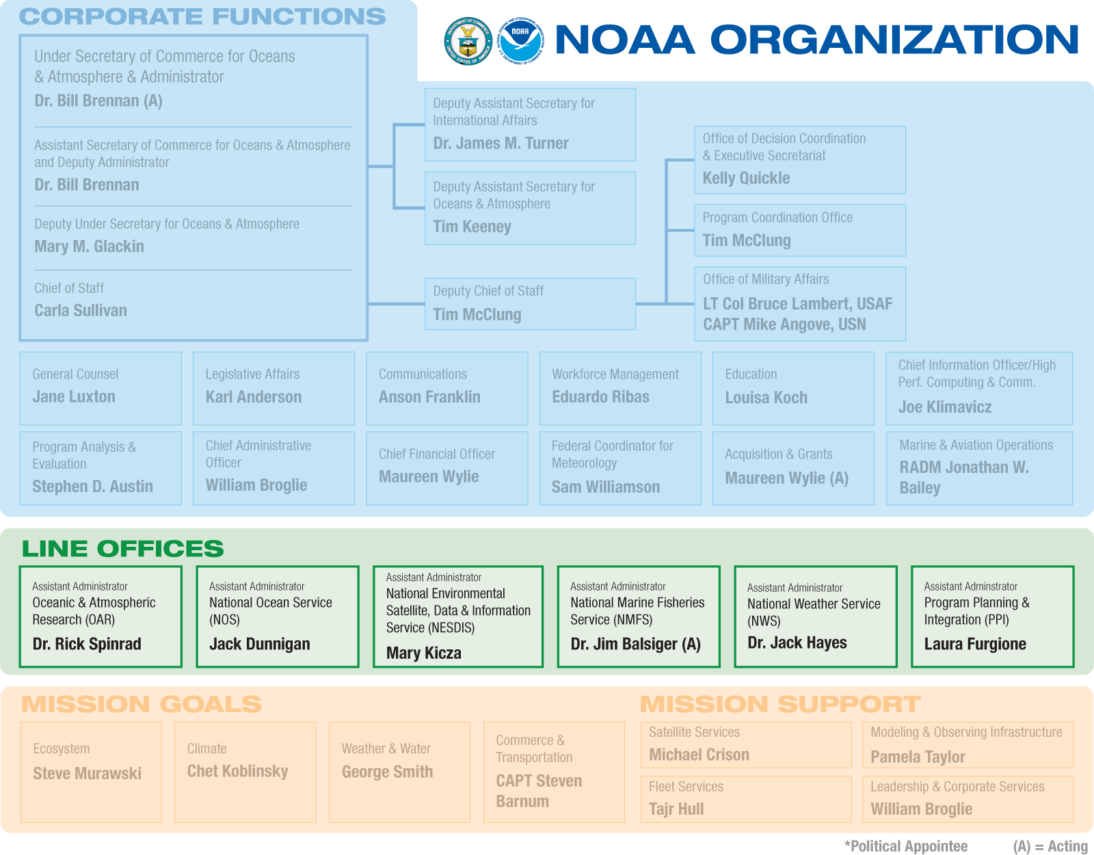
NOAA Organization
Notes:
NOAA is organized around three main components: Operating Branches, Corporate Functions,
and Goals. Operating Branches are the Line Offices and Staff Offices that provide the resources to
execute the programs. Corporate Functions are performed at the headquarters level, and include
NOAA Administration corporate-level offices and support staff (such as the Chief Financial Officer
and Chief Administrative Officer). Goals convert high-level goals and strategies into specific and
actionable programs.
Program managers staff their programs through LO/SOs, which are supported by Corporate
Functions and Regional Teams. They manage the assigned activities derived from the goals and
strategies of the Goal Teams, and are responsible for staffing, managing, communicating and
monitoring programs. If a program crosses multiple LOs, or is sufficiently complex, it may be
designated a matrix program, which requires greater coordination across NOAA.

Slide 3
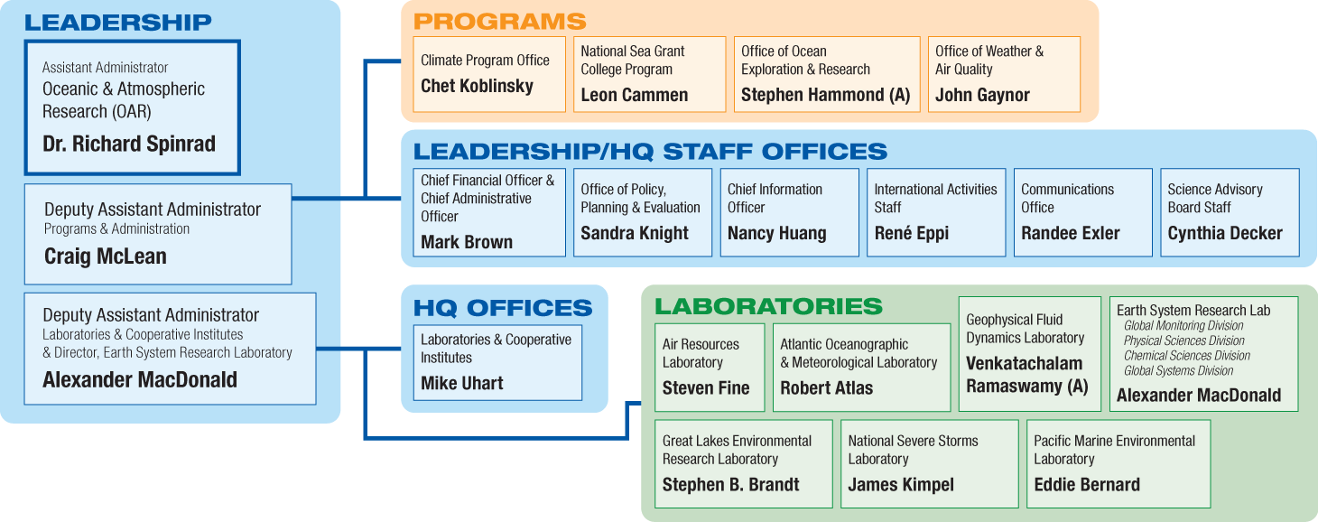
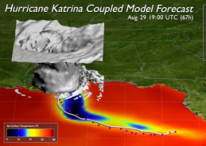
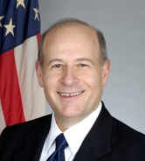
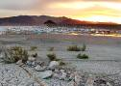
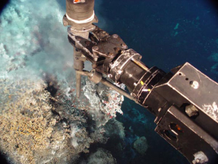
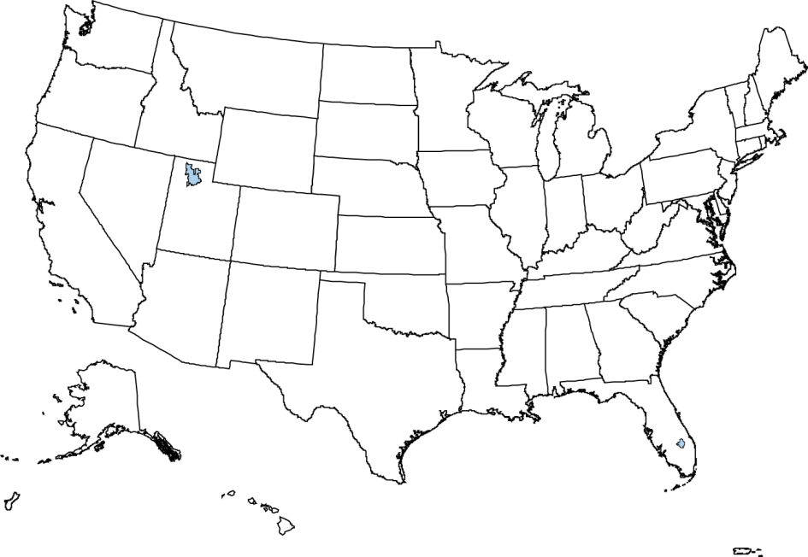

Oceanic & Atmospheric Research
Weather & Air Quality
Climate
Oceans, Coasts & Great Lakes
Mission
To conduct environmental research, provide scientific information and research leadership, and transfer research into products and services to help NOAA meet the evolving economic, social, and environmental needs of the Nation.
Budget:
FY’08 Presidents Request: $368.8M
FY’08 Enacted: $398.1M
FY’09 Presidents Request: $382.6
NOAA Research Serves Society through Science
Improves Predictions from Minutes to Millennia
Improves Quality of Life
Supports Economic Development
Advances Technology
Notes:
Office of Oceanic and Atmospheric Research (OAR) provides the research foundation for
understanding the complex systems that support our planet. Working in partnership with NOAA’s
other organizational units, OAR makes better forecasts, earlier warnings for natural disasters, and
a greater understanding of the Earth possible. OAR’s role is to provide unbiased science to
better manage the environment, nationally and globally. www.oarhq.noaa.gov

Slide 4
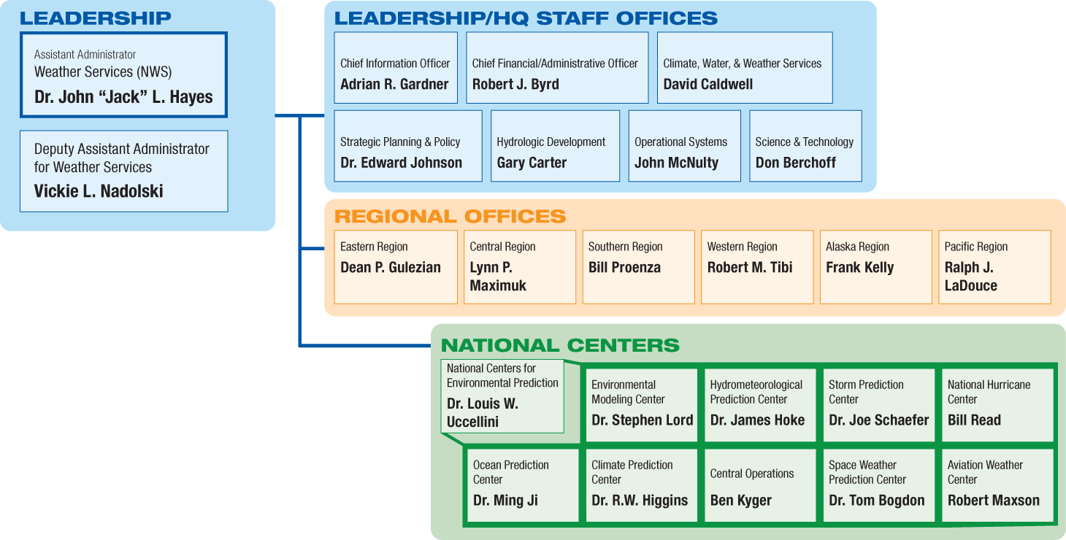
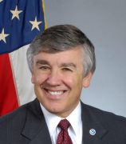
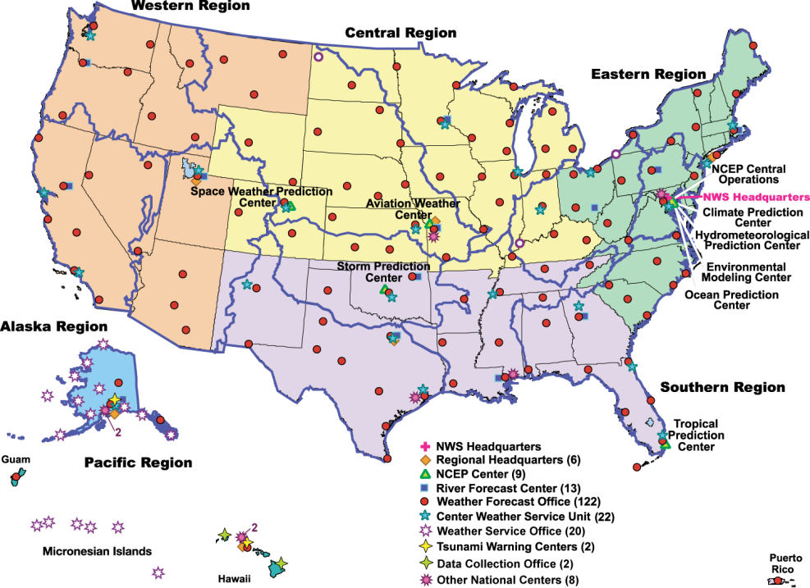
National Weather Service
Observing Systems:
Doppler Weather Radars
Upper Air Observing Sites
Automated Surface Observing Systems
Cooperative Observer Sites
Buoys
Data assimilation, Processing, and Computing:
Super Computing Capacity
Telecommunications
Modeling
Dissemination:
Public source of weather, water and climate data and information
Highest volume of Government data on internet
NOAA All Hazards Transmitters
Mission:
Provide weather, water, and climate forecasts and warnings to protect life and property and enhance the economy
Budget:
FY’08 Presidents Request: $903.5M
FY’08 Enacted: $911.4M
FY’09 Presidents Request: $930.7M
Notes:
NWS provides weather, water, and climate forecasts, warnings, and information for the protection of life and property and enhancement of the national economy.
Using extensive observation networks and computer modeling infrastructure, NWS supports the public; weather and climate enterprise; and local and federal government decision makers on these weather, water, and climate events:
Severe weather – tornadoes, damaging thunderstorm winds, hail
Hurricanes – track, intensity, and storm surge
Floods and flash floods – river levels, urban flooding to major riverine floods
Tsunami – location and impact
Winter weather – snow storms/ice storms
Aviation forecasts – local airports, national air space and international air routes, volcanic ash plume predictions
Marine – offshore forecasts and ocean predictions, including winds and waves
Fire Weather – onsite and national support
Climate forecasts from weeks to years – El Nino/La Nina, drought
Space Weather forecasts – solar flares and resulting electromagnetic and radiation impacts
Air Quality – ozone and particulate guidance
Excessive Heat

Slide 5
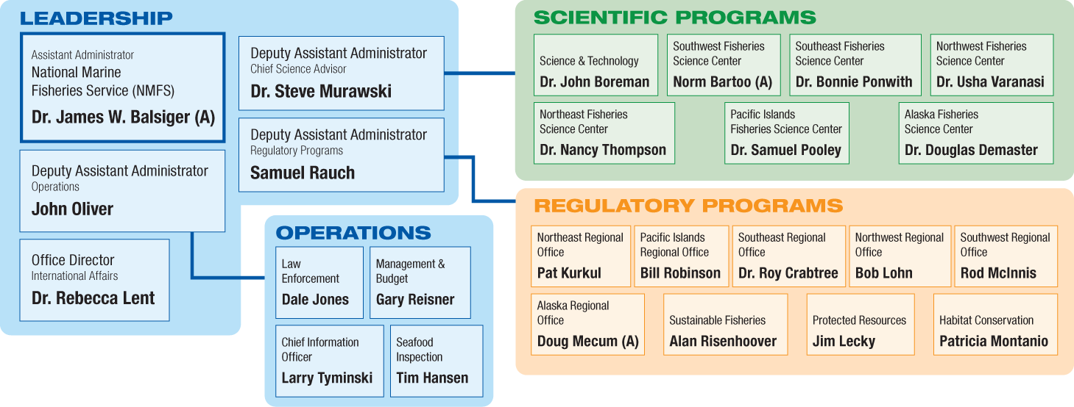
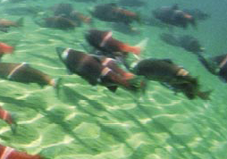
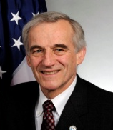
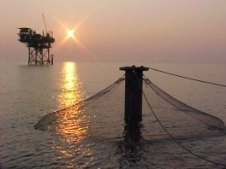
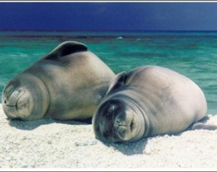
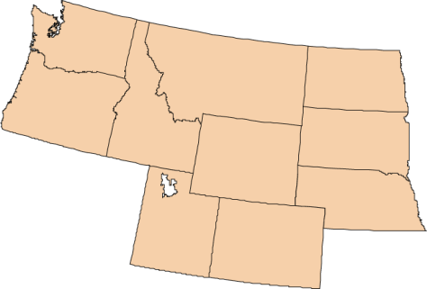
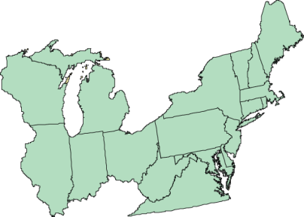
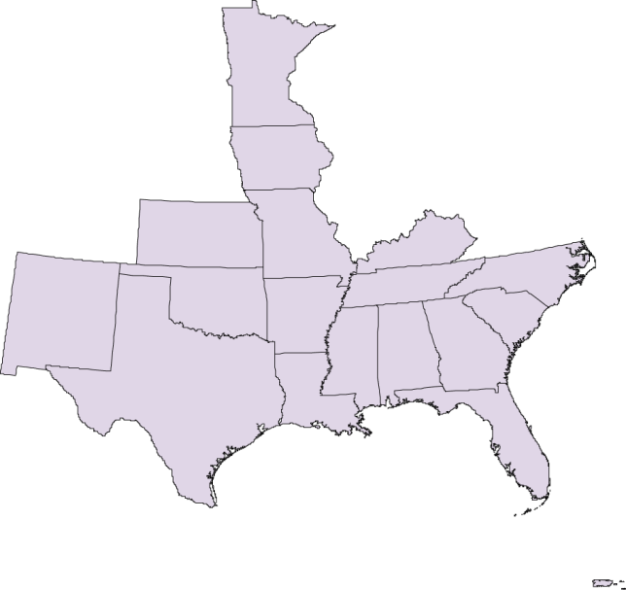
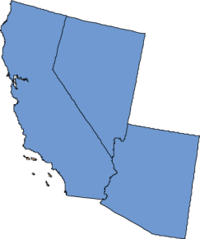
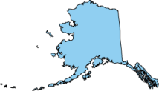

National Marine Fisheries Service
Mission
Stewardship of living marine resources through science-based conservation and management and the promotion of healthy ecosystems.
Budget:
FY’08 Presidents Request: $796.0M
FY’08 Enacted: $829.1M
FY’09 Presidents Request: $782.3M
Manages fish stocks for maximum sustainable economic yield
Protects marine life under the Endangered Species Act and Marine Mammal Protection Act
Performs scientific analysis to support ecosystem approaches to management
Restores and protects habitat
Enforces management measures
Strengthens conservation of living marine resources Internationally
Notes:
Fisheries Science Center (6): carries out a multidisciplinary research strategy including an ecosystem observation system and scientific analysis to support ecosystem approaches to management and restoration of living marine resources (e.g. scientific information for Regional Fisheries Management Councils). Directors oversee a wide range of activities such as resource surveys and stock assessments, fishery monitoring, economic and sociological studies, oceanographic research and monitoring, and critical habitat evaluation.
Science and Technology: The director advocates and ensures sound scientific basis for NOAA Fisheries science programs and resource conservation and management decisions. The Director is responsible for overseeing agency science programs that determine the health of our nation’s fisheries, and serves as the primary interface between NOAA Fisheries scientific activity and NOAA, other agencies, and international organizations.
Office of Sustainable Fisheries
Director of the NOAA Fisheries Service, Office of Sustainable Fisheries provides guidance and oversight to meet the national objectives of the Magnuson Stevens Act, which includes responsibility for Atlantic highly migratory species management. As such, the Director works with Regional Fisheries Management Councils to ensure the regional fishery management plans maintain healthy fisheries, eliminate overfishing and rebuild overfished stocks, and increase long-term economic and social benefits to the nation from living marine resources.
Office of Protected Resources
Director of the NOAA Fisheries Service, Office of Protected Resources provides guidance and oversight for the conservation, protection, and recovery of marine mammals and endangered marine life species under the Endangered Species Act, such as turtles and listed salmon species, and the Marine Mammal Protection Act, for species such as whales and dolphins. This is done in conjunction with Regional Offices, Science Centers, and various partners of the NOAA Fisheries Service.
Office of Habitat Conservation
Director of the NOAA Fisheries Service, Office of Habitat Conservation provides guidance and oversight to the NOAA Fisheries Regional Offices to manage, conserve and enhance habitats for fishery resources, protected species and other living marine resources. Examples of such activities include habitat restoration, dam removal, Federal Energy Regulatory Commission relicensing and protection of essential fish habitat.

Slide 6
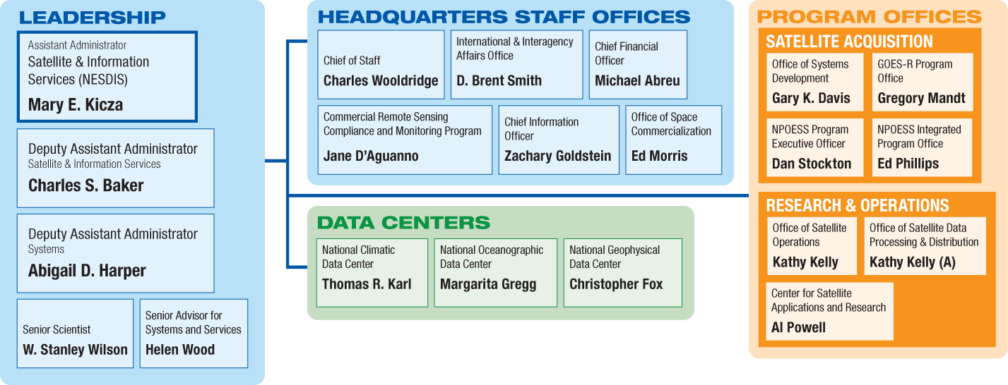
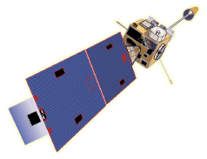
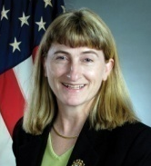
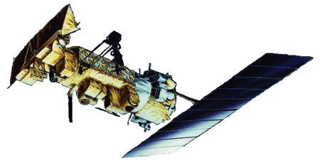
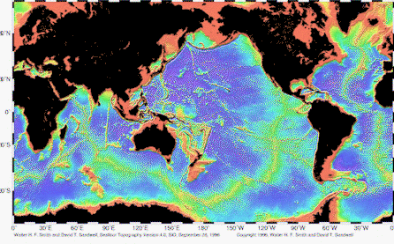
National Environmental Satellite, Data, & Information Service
Budget:
FY’08 Presidents Request: $978.3M
FY’08 Enacted: $955.1M
FY’09 Presidents Request: $1,157.9M
Mission:
NESDIS is dedicated to serving society by providing timely access to global environmental data from satellites and other sources to promote, protect, and enhance the Nation’s economy, security, environment, and quality of life.
To fulfill these responsibilities, NESDIS:
Acquires and manages the Nation’s operational environmental satellites
Provides data and information services to users
Conducts related research
Acquires, archives and provides access to environmental data sets
Notes:
National Environmental Satellite, Data, and Information Service (NESDIS) provides timely
access to global environmental data from satellites and other sources to promote, protect, and
enhance the Nation’s economy, security, environment, and quality of life. To fulfill its
responsibilities, NESDIS acquires and manages the Nation’s operational environmental
satellites, provides data and information services and conducts related
research. www.nesdis.noaa.gov
Number and location of NESDIS facilities is 18, but not all are NESDIS facilities.
Seattle, Washington Boulder and Fort Collins, Colorado La Jolla, California Fairbanks, Alaska Honolulu, Hawaii Madison, Wisconsin Stennis Space Center, Mississippi Miami, Florida Charleston, South Carolina Asheville, North Carolina Wallops, Virginia Narragansett, Rhode Island Silver Spring, Maryland
Suitland, Maryland
Camp Springs, Maryland
College Park, Maryland
Greenbelt, Maryland
Satellite Program:
NPOESS: is a satellite system used to monitor global environmental conditions, and collect and disseminate data related to: weather, atmosphere, oceans, land and near-space environment.
GOES-R: a collaborative effort between NOAA, NASA, DOC and Industry; series of satellites will be comprised of improved spacecraft and instrument technologies, which will result in more timely and accurate weather forecasts, and improve support for the detection and observations of meteorological phenomena that directly affect public safety, protection of property, and ultimately, economic health and development.
Operations: Office supports the launch, activation, and evaluation of new satellites and the in-depth assessment of satellite and ground systems anomalies. It prepares plans and procedures for responding to satellite and ground anomalies, and establishes and coordinates the schedules for satellite operation and data acquisition to meet users' needs.
Information Services:
National Climatic Data Services: provide access and stewardship to the Nation's resource of global climate and weather related data and information, and assess and monitor climate variation and change.
National Oceanographic Data Center: a national repository and dissemination facility for global oceanographic data which acquires and preserves a historical record of the Earth's changing environment to be used for operational applications and ocean climate research. National Geophysical Data Center: provides stewardship, products and services for geophysical data describing the solid earth, marine, and solar-terrestrial environment, as well as earth observations from space. NGDC works closely with contributors of scientific data to prepare documented, reliable data sets

Slide 7
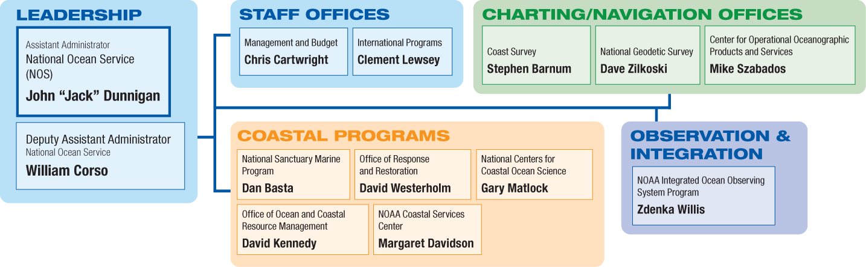
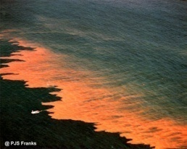
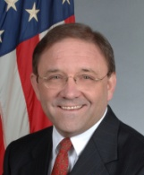
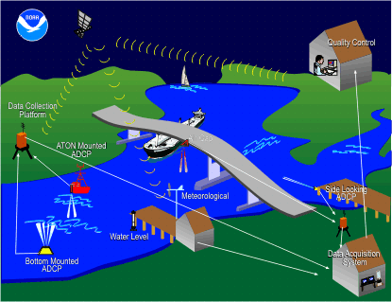
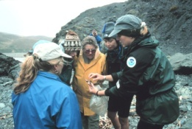
National Ocean Service
Mission
To provide science-based solutions through collaborative partnerships to address evolving economic, environmental, and social pressures on our oceans and coasts
Budget:
FY’08 Presidents Request: $468.5M
FY’08 Enacted: $536.1M
FY’09 Presidents Request: $488.2M
Protects Coastal Communities
Observes Oceans and Coasts
Supports Marine Transportation
Reduces Ocean and Coastal Health Risks
American Samoa
Notes:
National Ocean Service (NOS) keeps ocean and coastal areas safe, healthy, and productive.
The NOS serves America by conserving marine and coastal places for present and future
generations, ensuring safe and efficient maritime transportation, and promoting innovative
science and technology solutions to coastal challenges. www.nos.noaa.gov
The majority of NOS staff are located in Silver Spring, MD. NOS also has concentrations of staff in Charleston, SC (primarily Coastal Services Center), Norfolk, VA (Office of Coast Survey) and Seattle, WA (primarily Office of Response and Restoration).
NOS has some employees co-located with our partners in offices around the country. Examples include State Geodetic Advisors (NGS), Navigation Managers (OCS), and Scientific Support Coordinators (ORR). In addition, NCCOS and the NMSP have a strong presence in specific locations.
The National Centers for Coastal Ocean Science (NCCOS) is comprised of five research centers with facilities in:
Silver Spring, MD (Center for Sponsored Coastal Ocean Research, Center for Coastal Monitoring and Assessment)
Beaufort, NC (Center for Coastal Fisheries and Habitat Research
Charleston, SC (Hollings Marine Lab, Center for Coastal Environmental Health and Biomolecular Research)
Oxford, MD (Center for Coastal Environmental Health and Biomolecular Research)
The National Marine Sanctuary Program includes 13 sanctuaries and 1 national monument:
Channel Islands National Marine Sanctuary (California)
Cordell Bank National Marine Sanctuary (California)
Fagatele Bay National Marine Sanctuary (American Samoa)
Gulf of the Farallones National Marine Sanctuary (California)
Florida Keys National Marine Sanctuary (Florida)
Flower Garden Banks National Marine Sanctuary (Texas/Louisiana)
Gray's Reef National Marine Sanctuary (Georgia)
Hawaiian Islands Humpback Whale National Marine Sanctuary (Hawaii)
Monitor National Marine Sanctuary (North Carolina)
Monterey Bay National Marine Sanctuary (California)
Olympic Coast National Marine Sanctuary (Washington)
Stellwagen Bank National Marine Sanctuary (Massachusetts)
Thunder Bay National Marine Sanctuary (Michigan)
Papahanaumokuakea Marine National Monument (Hawaii)
NOS also provides support for 27 National Estuarine Research Reserves (in 23 states and territories) and coastal management programs in 34 coastal and great lakes states and territories.
Office of Coast Survey
The Office of Coast Survey (OCS) is the nation's nautical chart maker. OCS collects, manages, and compiles the data and information necessary to maintain the national suite of 1,000 nautical charts. In addition, OCS conducts hydrographic surveys that measure water depth and produces coastal maps and vector shoreline series and historic maps and charts. These products support commercial shipping, the fishing industry, U.S. Navy and Coast Guard operations, state and local governments, GIS users, and recreational boaters throughout the United States.
Office of National Geodetic Survey
The National Geodetic Survey (NGS) develops and maintains a national system of positioning data needed for transportation, navigation, and communication systems; land record systems; mapping and charting efforts; and defense operations. NGS also implements a coastal mapping program, which measures precise positions of the shoreline and other features needed for creating accurate nautical charts. It conducts aerial photography surveys near airports in the United States and its territories to locate obstructions and aids to air travel. NGS also develops industry specifications and standards for conducting geodetic surveys; coordinates the development and application of new surveying instrumentation and procedures; and assists state, county, and municipal agencies through a variety of cooperative programs and training workshops.
Center for Operational Oceanographic Products and Services
The Center for Operational Oceanographic Products and Services (CO-OPS) and its predecessors have gathered oceanographic data along our nation’s coasts for over 200 years to protect life, property, and the environment. Serving both the public and other government agencies, CO-OPS is the authoritative source for accurate, reliable, and timely water-level and current measurements that support safe and efficient maritime commerce, sound coastal management, and recreation. The combined efforts, knowledge, and experience of CO-OPS’s technicians, scientists, and engineers working to carry out a central mission has led to the development of a reliable center of expertise for coastal physical oceanography.
National Marine Sanctuary Program
The National Marine Sanctuary Program (NMSP) manages 13 sanctuaries and one marine national monument encompassing more than 150,000 square miles of U.S. ocean and Great Lakes waters. Each sanctuary office maintains on-site field staff that conduct research and monitoring, resource protection, and educational activities.
Office of Response and Restoration
The Office of Response and Restoration (OR&R) works to prevent and mitigate harm to coastal resources. OR&R is the primary NOAA office charged with responding to oil spills, hazardous material releases, and marine debris. OR&R’s experts provide scientific support to the U.S. Coast Guard for spills, and they also coordinate with other agencies during hazardous material releases to ensure protection and restoration of NOAA trust resources. OR&R also coordinates with federal, state, and tribal natural resource trustees to restore damaged coastal resources.
NOAA Coastal Services Center
The NOAA Coastal Services Center engages with state and local organizations to provide skills, tools, and data needed to manage the nation’s coastal resources and communities. Strategic priorities include coastal hazards resilience, coastal and ocean planning, and coastal conservation. The Center’s primary areas of expertise include data and information, geographic information systems, remote sensing, training, and applications of social science.
Office of Ocean and Coastal Resource Management
The Office of Ocean and Coastal Resource Management (OCRM) provides national leadership, strategic direction, and guidance to 34 state and territory coastal programs and 27 estuarine research reserves through its implementation of the Coastal Zone Management Act. The Office administers the Coastal and Estuarine Land Conservation Program (CELCP), established to protect coastal and estuarine lands considered important for their ecological, conservation, or recreational values. OCRM also implements the Coral Reef Conservation Act and Marine Protected Area Executive Order by partnering with federal, state, and local entities to coordinate coral reef conservation efforts and develop an inter-governmental national system of MPAs.
National Centers for Coastal Ocean Science
The National Centers for Coastal Ocean Science (NCCOS) conduct and support research, monitoring, assessment, and technical assistance for managing coastal ecosystems and society's use of them. These activities fit within a framework of five environmental stressors: climate change, extreme natural events, pollution, invasive species, and land and resource use. NCCOS activities are focused in: coral reefs, national marine sanctuaries, estuaries, including national estuarine research reserves, and the coastal oceans.
NOAA Integrated Ocean Observing System Program
The Integrated Ocean Observing System (IOOS) is a multidisciplinary system designed to enhance our ability to collect, deliver, and use ocean information. The goal is to provide continuous data on our open oceans, coastal waters, and Great Lakes in the formats, rates, and scales required by scientists, managers, businesses, governments, and the public to support research and inform decision-making.
The NOAA IOOS Program's mission is to "lead the integration of ocean, coastal, and Great Lakes observing capabilities, in collaboration with Federal and non-Federal partners, to maximize access to data and generation of information products, inform decision making, and promote economic, environmental, and social benefits to our nation and the world."

Slide 8
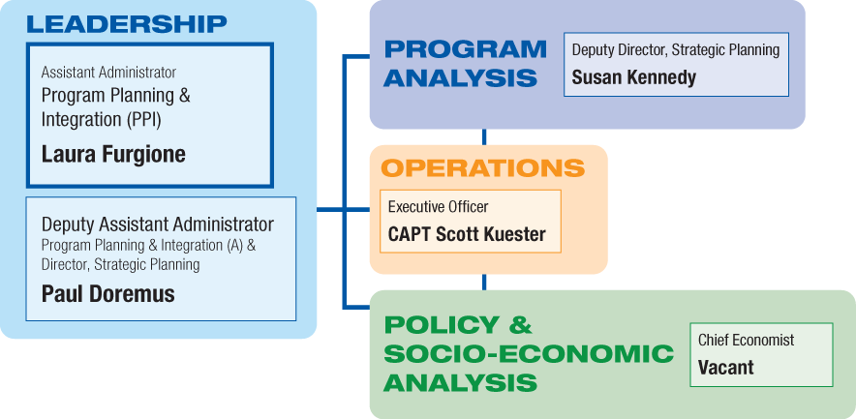
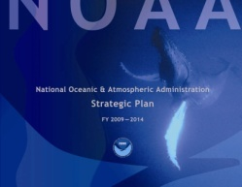
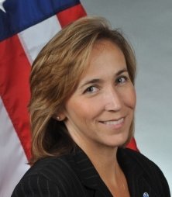
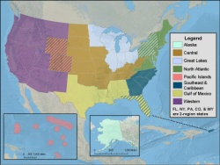
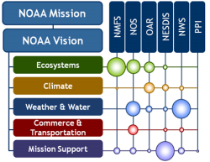
Program Planning & Integration
Budget:
FY’08 Enacted: $2.05M
FY’09 Presidents Request: $2.07M
Mission:
Lead the implementation of NOAA’s Strategic Vision through
Strategic and programmatic planning
Requirements and business case analyses
Knowledge, talent, and resource integration
Environmental policy management
Notes:
Office of Program Planning and Integration (PPI) provides corporate management to
coordinate NOAA’s many lines of service with the Nation’s many needs for environmental
information and stewardship. It ensures that investments and actions are guided by a strategic
plan; are based on sound social and economic analysis; adhere to executive and legislative
science, technology, and environmental policy; and integrate the full breadth of NOAA’s
resources, knowledge, and talent to achieve its mission. www.ppi.noaa.gov

