Slide 1
NOAA Transition Team Briefing
Goal Teams

Slide 2
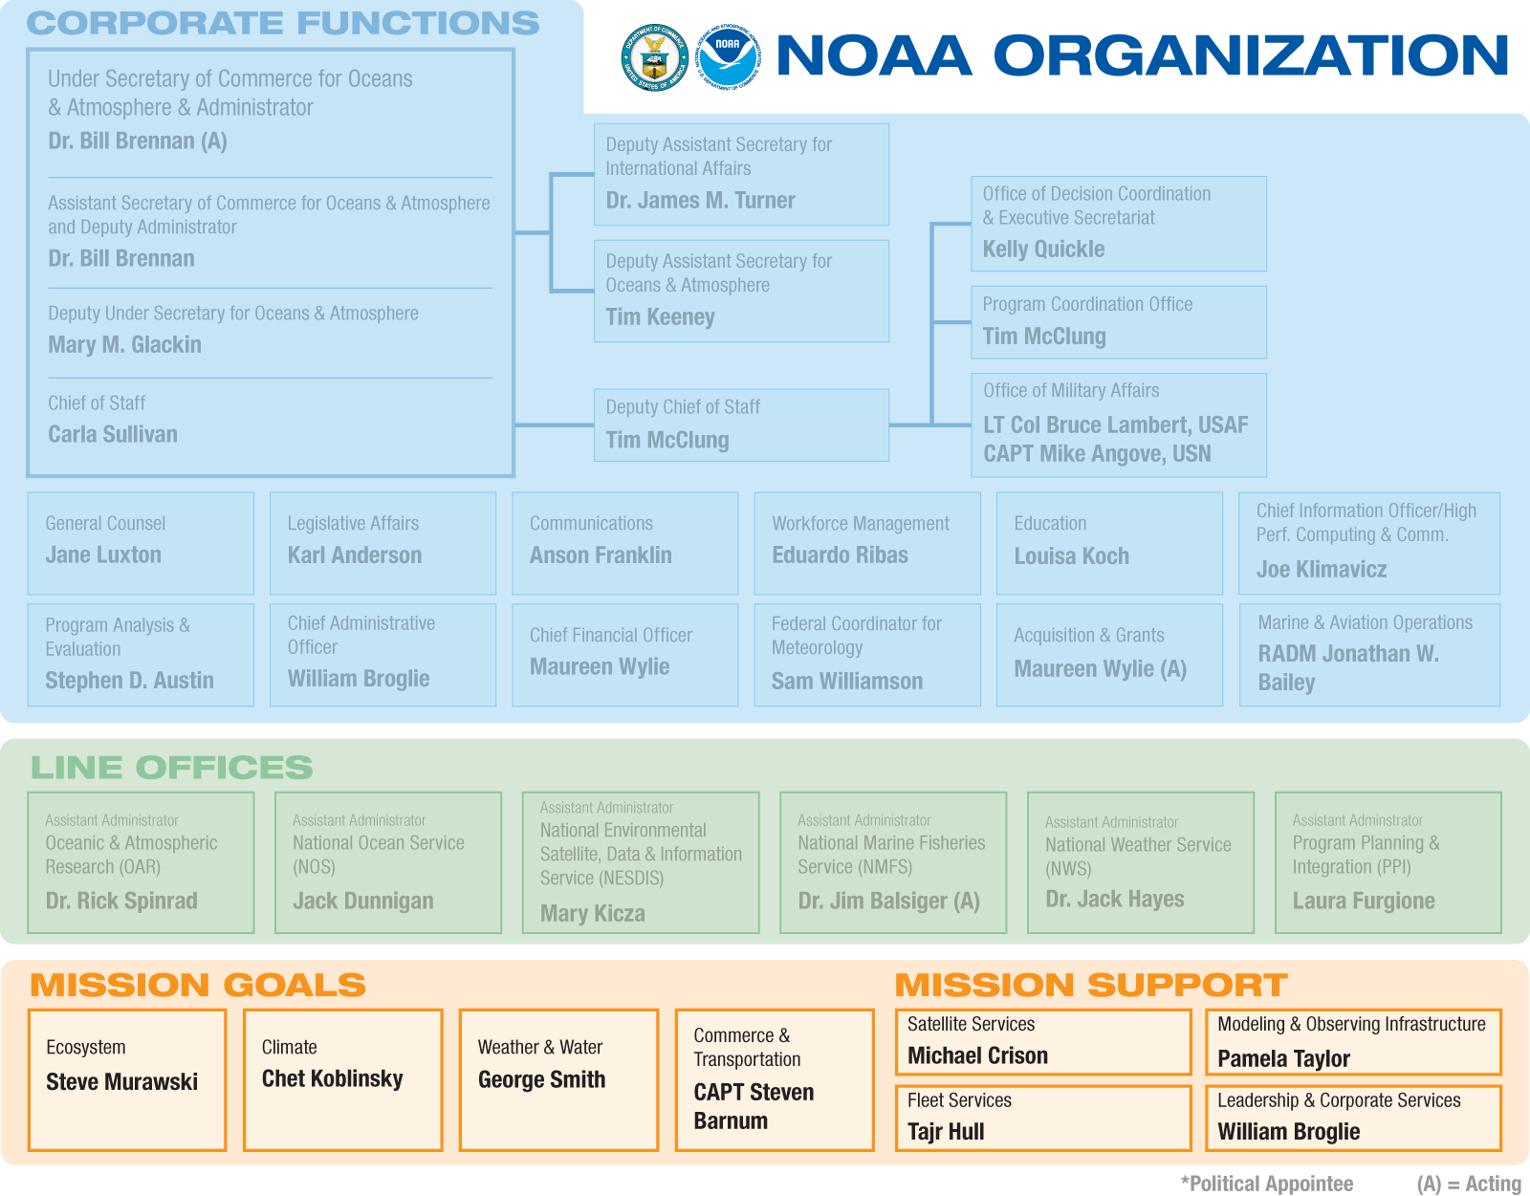
NOAA Organization
Notes:
NOAA is organized around three main components: Operating Branches, Corporate Functions,
and Goals. Operating Branches are the Line Offices and Staff Offices that provide the resources to
execute the programs. Corporate Functions are performed at the headquarters level, and include
NOAA Administration corporate-level offices and support staff (such as the Chief Financial Officer
and Chief Administrative Officer). Goals convert high-level goals and strategies into specific and
actionable programs.
Program managers staff their programs through LO/SOs, which are supported by Corporate
Functions and Regional Teams. They manage the assigned activities derived from the goals and
strategies of the Goal Teams, and are responsible for staffing, managing, communicating and
monitoring programs. If a program crosses multiple LOs, or is sufficiently complex, it may be
designated a matrix program, which requires greater coordination across NOAA.

Slide 3
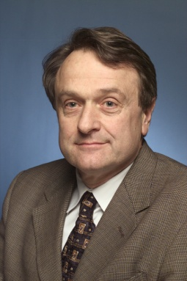
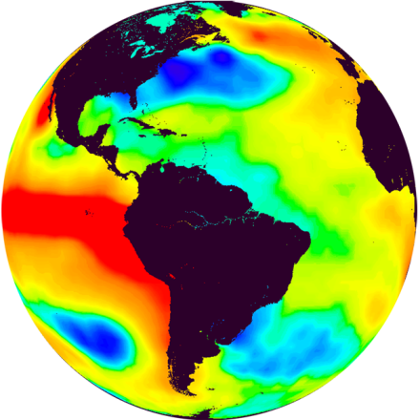

Climate Goal
Goal Lead: Chet Koblinsky
Primary Objectives
Describe and understand the state of the climate system through integrated observations, monitoring, and data management
Understand and predict climate variability and change from weeks to decades to a century
Improve the ability of society to plan for and respond to climate variability and change
Program Structure
Climate Observations and Monitoring – Tom Karl
Climate Research and Modeling – Venkatachalam Ramaswamy
Climate Service Development – Margaret Davidson
Progress to Date
Leadership role on the Intergovernmental Panel on Climate Change
Unveiled a new U.S. Drought Portal that provides comprehensive drought information
Released the 2006 Scientific Assessment of Ozone Depletion.
Launched a new tool, CarbonTracker, to monitor changes in atmospheric carbon dioxide and other greenhouse gases

Slide 4
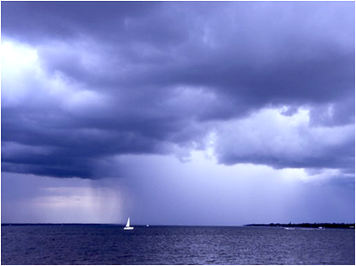
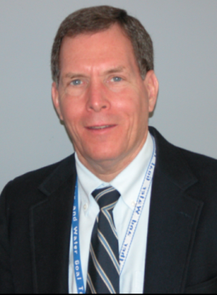
Weather and Water Goal
Goal Lead: George Smith
Primary Objectives
Increase lead-time and accuracy for warnings and forecasts
Improve predictability of hazardous and severe weather and water events
Increase application and accessibility of weather and water information
Increase development, application, and transition of advanced science and technology to operations and services
Program Structure
Air Quality – Jim Meagher
Coast, Estuaries, and Oceans – Keelin Kuipers
Hydrology – Gary Carter
Local Forecasts and Warnings – Aimee Devaris
Science, Technology, and Infusion – Marty Ralph
Space Weather – Tom Bogdan
Tsunami – Therese Pierce
Progress to Date
Expanded its sources of observational data, advanced numerical models, and improved the accuracy of its forecasts and warnings.
Leveraged partnerships in the public, private, and academic sector to respond to society’s evolving needs for forecast services.
Completed a 3-year effort to strengthen the U.S. Tsunami Warning System.
Added 17 broadcast stations to the Weather Radio All Hazards network and upgraded technology at 62 stations.
Made three databases available on the web—Global Historical Tsunami, Significant Earthquake, and Volcano.

Slide 5
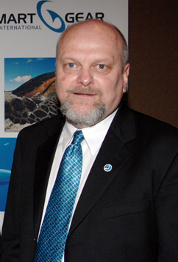
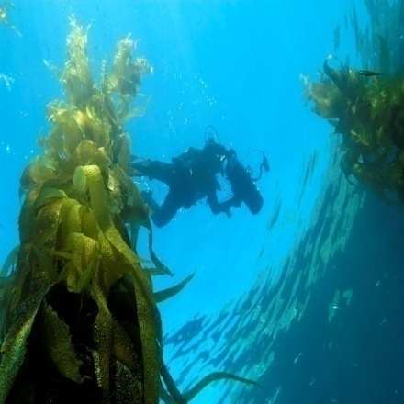
Ecosystem Goal
Goal Lead: Steve Murawski
Primary Objectives
Increase the number of fish stocks managed at sustainable levels
Increase the number of protected species with stable or increasing populations
Improve ecosystem health through conservation and restoration of habitat
Increase environmentally sound aquaculture production
Program Structure
Aquaculture – Michael Rubino
Coastal and Marine Resources – Tim Goodspeed
Coral Reef Conservation – Kacky Andrews
Ecosystem Observations – John Boreman
Ecosystem Research – Leon Cammen
Enforcement – Dale Jones
Fisheries Management – Galen Tromble
Habitat – Pat Montanio
Protected Species – Phil Williams
Progress to Date
National lead for ocean and coastal management
Established the federal portion of the marine reserves and conservation area network within the Channel Islands National Marine Sanctuary
Supported a marine debris cleanup effort in Louisiana revitalizing this shipping channel/significant estuary which is essential to the LA economy.
Completed the first assessment of the status of 207 U.S. Marine Protected Areas (MPAs)

Slide 6
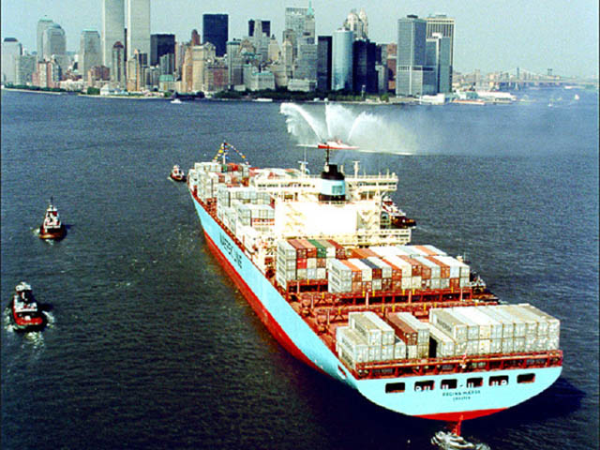
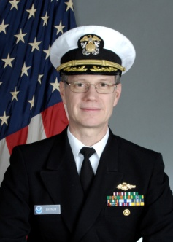
Commerce & Transportation Goal
Goal Lead: CAPT Steve Barnum
Primary Objectives
Support decisions in aviation, marine, and surface navigation
Research, develop, and deploy more accurate and timely information products
Research, develop, and deploy advanced monitoring and observing systems, new models, prediction techniques, and assessments
Support decisions in coastal resource management
Program Structure
Aviation Weather – Kevin Johnston
Emergency Response – William Conner
Geodesy – Doug Brown
Marine Transportation System – Rich Edwing
Marine Weather – Ming Ji
Surface Weather – Jim O’Sullivan
Progress to Date
Rescued 353 people in t2007 in he United States via Search and Rescue Satellite Aided Tracking System
Supported post-hurricane rebuilding and restoration efforts in Louisiana by promoting the integration of observations and providing baseline data.
Installed the PORTS in Mobile, AL ,to reduce the risk of vessel groundings and increase the amount of cargo moved through the port.
Developed a new metric to produce more reliable forecasts of the impact of weather on the National Airspace System.

Slide 7
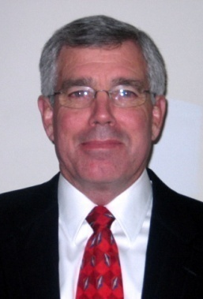
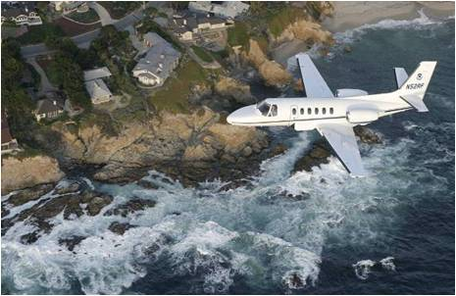
Fleet Services Sub-goal
Goal Lead: Tajr Hull
Primary Objectives
Increase the number of ship operating days and aircraft flight hours that safely, reliably, and successfully meet NOAA’s data collection requirements with high customer satisfaction
Program Structure
Aircraft Replacement – Tajr Hull
Aircraft Services – Tajr Hull (acting)
Fleet Replacement – Tajr Hull
Marine Operations and Maintenance – Tajr Hull (acting)
Progress to Date
Deployed its high-altitude Gulfstream-IV jet from a temporary base in Honolulu, HI, in an effort to improve forecasts released 24 to 96 hours before a winter storm. The jet acquired atmospheric data from severe winter storms originating over the Pacific Ocean that affect the continental United States, Hawaii, and Alaska.
NOAA Fleet Recapitalization Plan released to Congress and the public

Slide 8
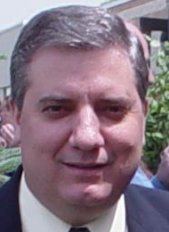
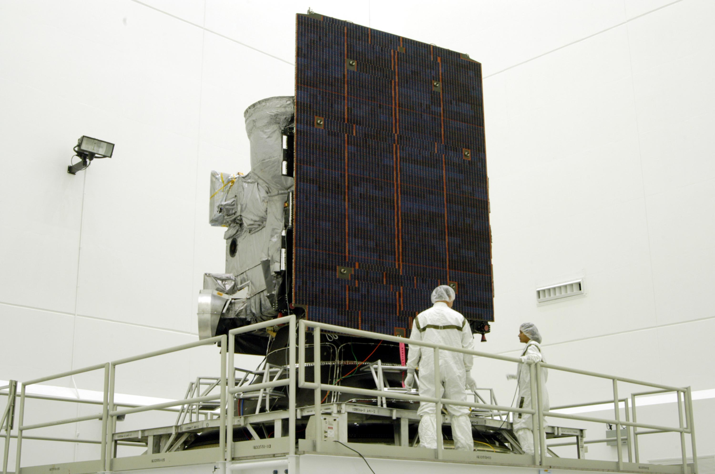
Satellite Sub-goal
Goal Lead: Michael Crison
Primary Objectives
Increase the quantity, quality, and accuracy of satellite data that are processed and distributed within targeted time
Increase government procurements of NOAA-licensed remote sensing systems
Program Structure
Commercial Space Services – Ed Morris
Geostationary Satellite Acquisition – Greg Mandt
Polar Satellite Acquisition – Michael Mignogno
Satellite Services – Kathy Kelly
Progress to Date
Deployed the Advanced Very High Resolution Radiometer onboard the European polar-orbiting satellite. The global data collected are used extensively in NOAA’s weather and climate prediction numerical models.
Repositioned NOAA’s GOES-10 spacecraft for South American users, a move intended to support GEOSS Americas, to improve weather forecasts there and, to lessen the effects of natural disasters in the region.

Slide 9
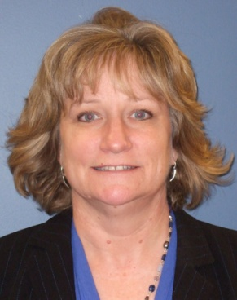
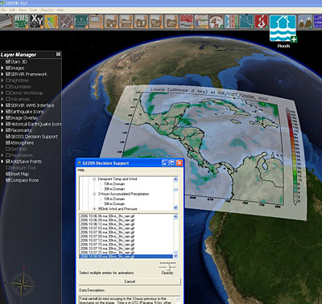
Modeling & Observing Infrastructure Sub-goal
Goal Lead: Pamela Taylor
Primary Objectives
Ensure a strategic, integrated, and balanced observing system investment portfolio for NOAA
Integrate national and regional efforts to optimize ocean observations, data management, and understanding
Provide for capabilities that improve, maintain, and operate models and provide guidance for environmental forecasts at all temporal and spatial scales
Ensure computational infrastructure to sustain NOAA research and operational modeling computational workloads and support NOAA’s data management and stewardship capabilities
Program Structure
Environmental Modeling – Alan Leonardi
IOOS (Integrated Ocean Observing System) – Zdenka Willis
Technology Requirements, Planning, and Integration – Pamela Taylor
Progress to Date
Implemented the Weather Research and Forecast model and North American Ensemble Forecast System to increase lead-time and accuracy for weather forecasts and water warnings.
Published Global Earth Observation Integrated Data Environment (GEO IDE) Concept of Operations, containing standards and protocols for all observation and data management activities.
Developed IOOS Program and Data Integration Framework

Slide 10
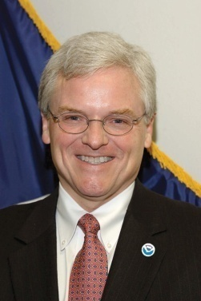
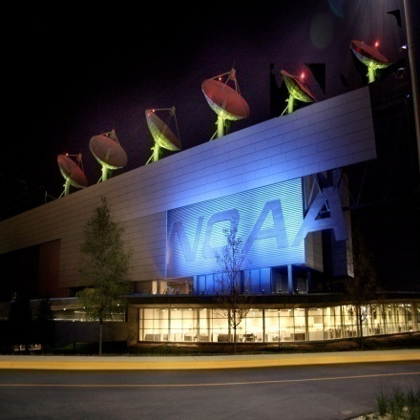
Leadership & Corporate Services Sub-goal
Goal Lead: Bill Broglie
Primary Objectives
Improve collaborative decision-making
Increase internal and external availability, reliability, security, and use of NOAA IT services
Collocate NOAA services and partner facilities
Improve efficiency and performance of support transactions and services
Increase diversity levels and expertise improving NOAA functions
Enhance contribution of NOAA services to all-hazard Homeland Security efforts
Program Structure
Acquisition and Grants – Bob Stockman
Administrative Services – Sandra Manning
Facilities – Roger Natsuhara
Financial Services – Sherry Morrissette
Homeland Security – CAPT Wade Blake
Information Technology Services – Dennis Morgan
Line Office Headquarters – John Potts (acting)
NOAA Headquarters – Christos Michalopoulos
Workforce Management – Barbara Boyd
Progress to Date
Opened a new NOAA Satellite Operations Facility that processes more than 16 billion bytes of environmental satellite data.
Converted three Great Lakes research vessels from petroleum-based fuels and lubricants to bio-based products.
Opened new Ship Operations Facility as first phase of Pacific Regional Center in Hawaii
Opened new marine research facility in Juneau, AK

