Slide 1
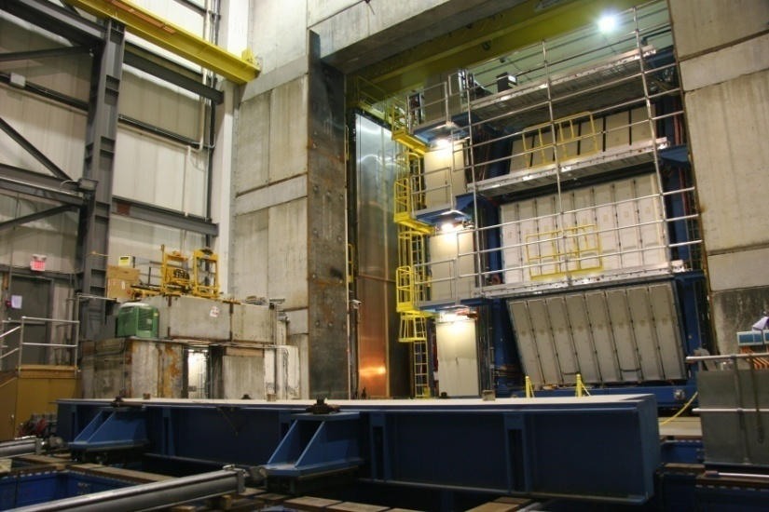
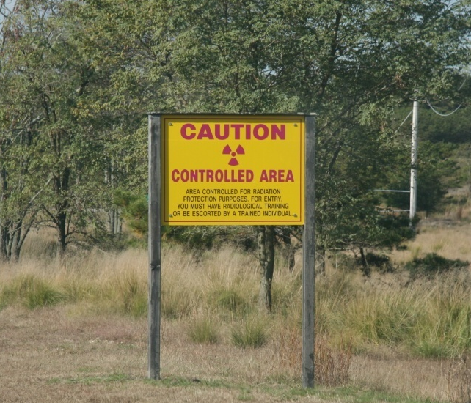
Run8 – Coming sooner than we had thought
Mike Leitch
Run8 Coordinator
November 7th 2007

Slide 2
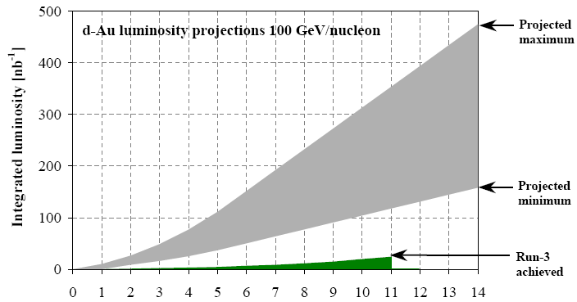
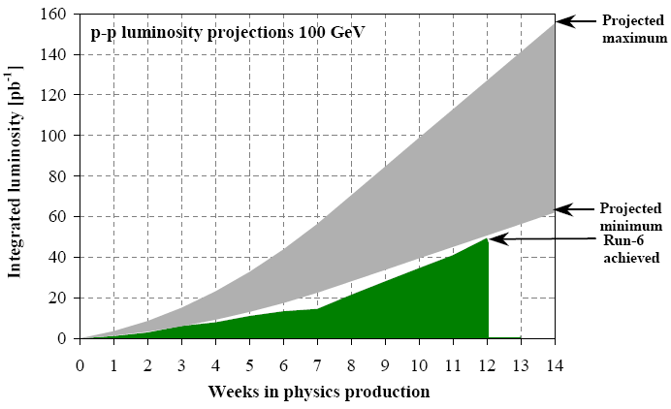
#weeks | Activity
30 | Machine cold
-4 | Cool-down + setup/ramp-up
-3.5 | dAu → pp change
-0.5 | Warm-up
22 | Physics
Expected luminosities for dAu & pp
Species | Weeks | Delivered | Recorded | Goal
dAu | 10 | 100-315 nb⁻¹ | 25-78 nb⁻¹ | 58 nb⁻¹
pp | 12 | 50-125 pb⁻¹ | 13-31 pb⁻¹ | 35 pb⁻¹
Assuming 25% recorded/delivered (48% vtx * 53% up*live)
Run8+9 p+p goal is 71 pb⁻¹

Slide 3
Recorded/Delivered = 0.25 – assumes:
48% vertex efficiency (average seen in Run7)
82% livetime & 64% up time (as seen last two weeks of Run7)
d+Au and p+p collisions not as challenging as Au+Au for PHENIX DAQ, so probably can do better
Also 88% (dAu) & 53% (pp) BBC efficiencies
Details on p+p 35 pb⁻¹ goal:
¾ longitudinal & ¼ transverse polarization
assuming 65% average polarization
FOM goals:
P⁴L_{longitudinal} = 4.7 pb⁻¹
P²L_{transverse} = 3.7 pb⁻¹

Slide 4
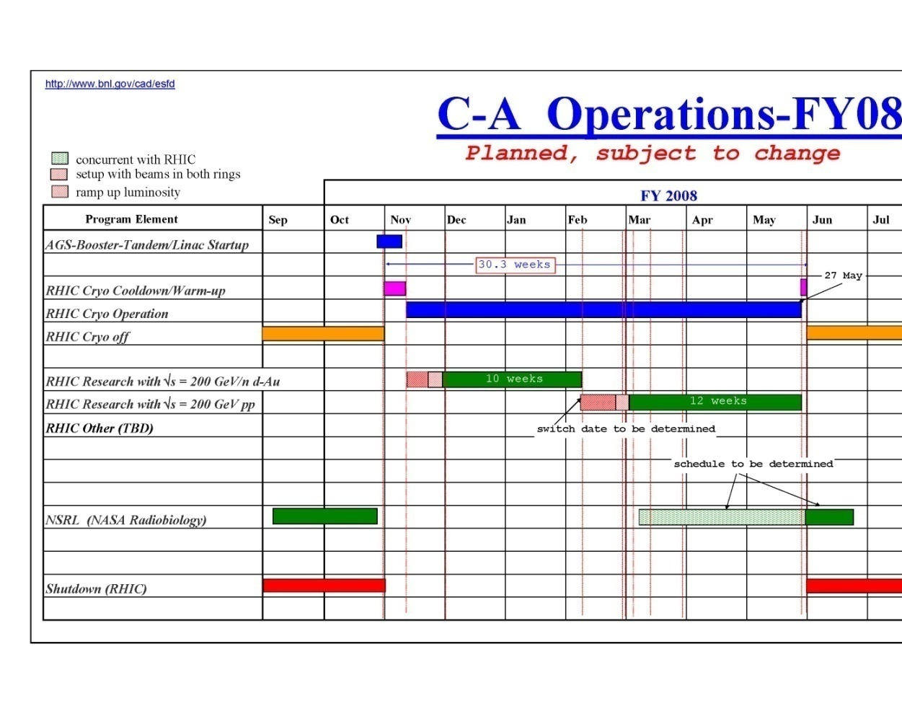
Run8 Schedule
Nov 1st – cool-down
(actually begun several days earlier)
Nov 6th – both rings cold!
Nov 6th - 2-person shifts, flammable gas (?)
Nov 7th - d beam
Nov 12th - Au beam
Nov 22nd – d+Au collisions
Nov 27th - 5-person shifts
Dec 1st – Physics
Feb – switch to p+p
May 27th – end of run

Slide 5
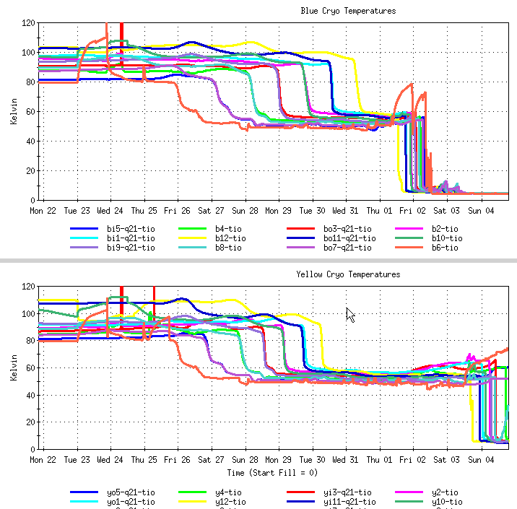
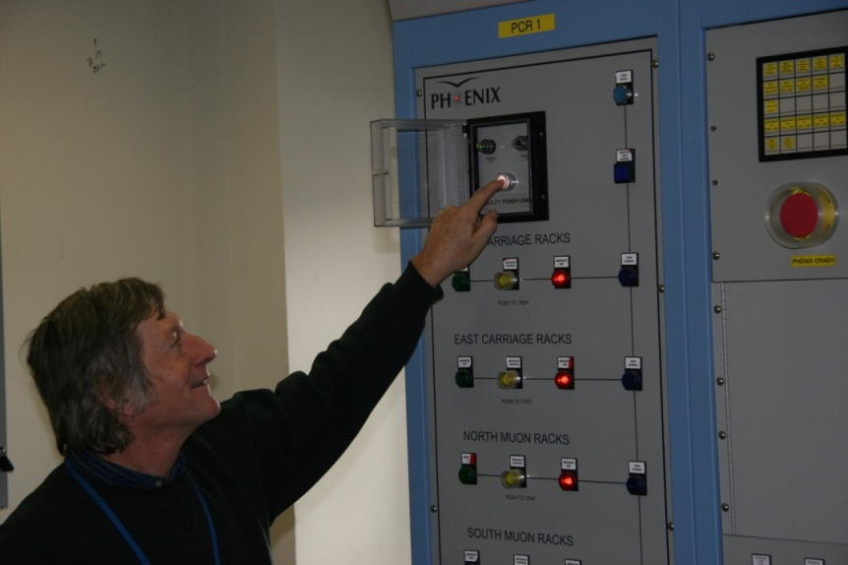
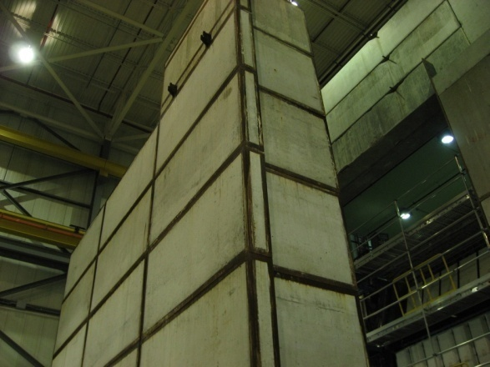
Current Status @ 1008
rings cold
big shielding & plug door in
all PHENIX arms in run position
FCal tested last week
ZDC’s moved 1 cm toward Au beam
HBD not ready…
borrowed UPS online
FPGA test box in this week
Ring will is posted
training required to come to 1008
NO sandals, NO short pants
Sun Nov 4th 9pm

Slide 6
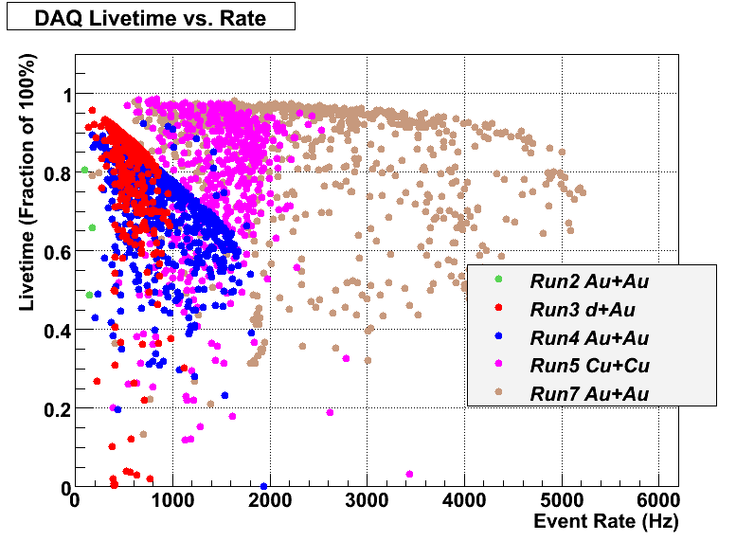
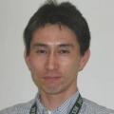
Run8 Plans
planning for 7khz DAQ event rate
need to fix hot DC packets, …
HBD only expected for short test run
will run with ++ (and --?) magnetic field configuration
LVL1 triggers this year - see following slides from Jamie)
LVL2 filtering & fast analysis on 1008 VA machines
need person to run this
subsystem experts NEEDED
Spin Coordinator – Kensuke Okada
Focus organizers – Alan Dion & Astrid Morreale

Slide 7
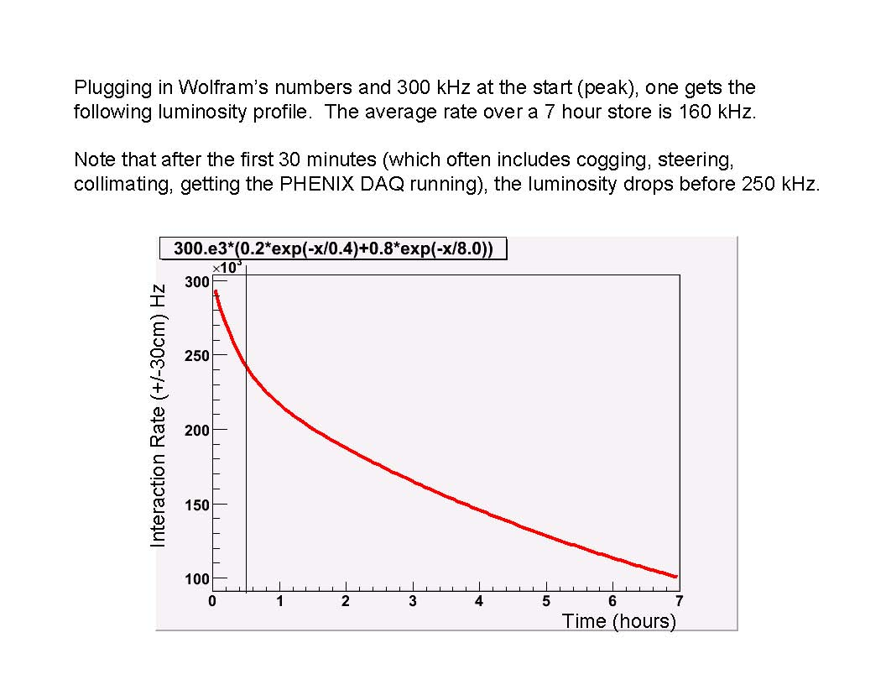

Slide 8
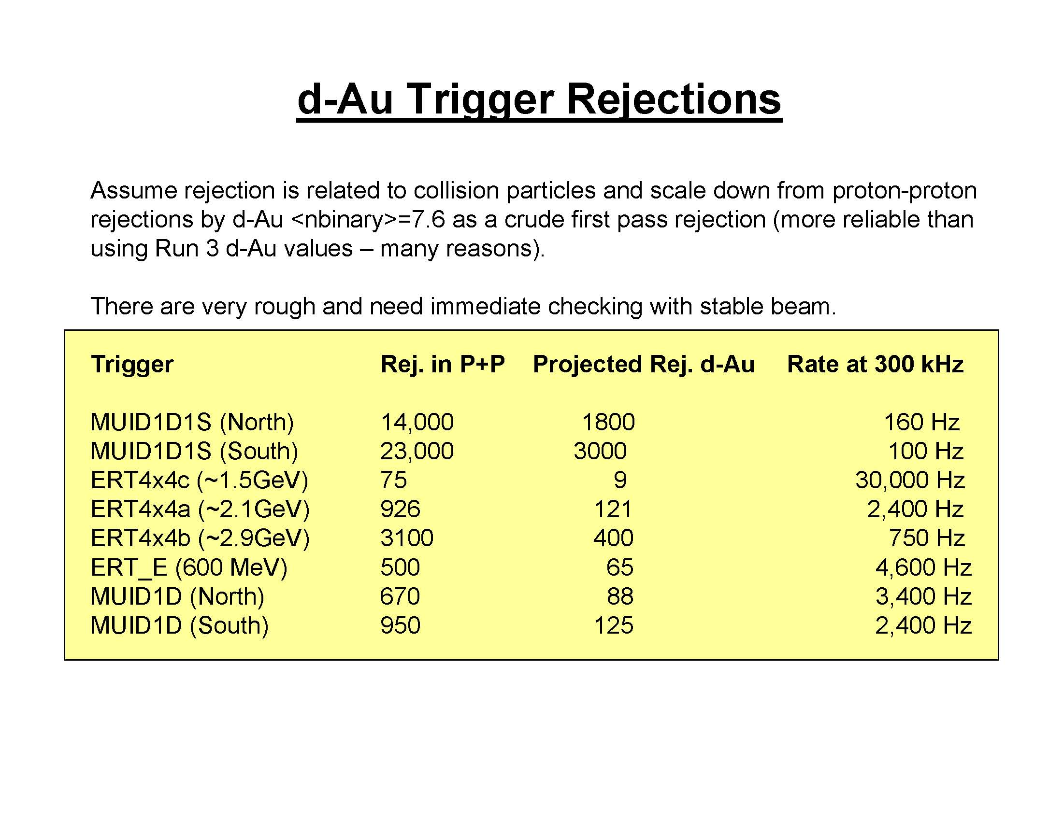

Slide 9
