Slide 1

Strong Local Partnerships: The Key to Success
Mobile County Emergency Management Agency
Walter S. Dickerson, Executive Director
March 6, 2008
IHC – Charleston, South Carolina

Slide 2
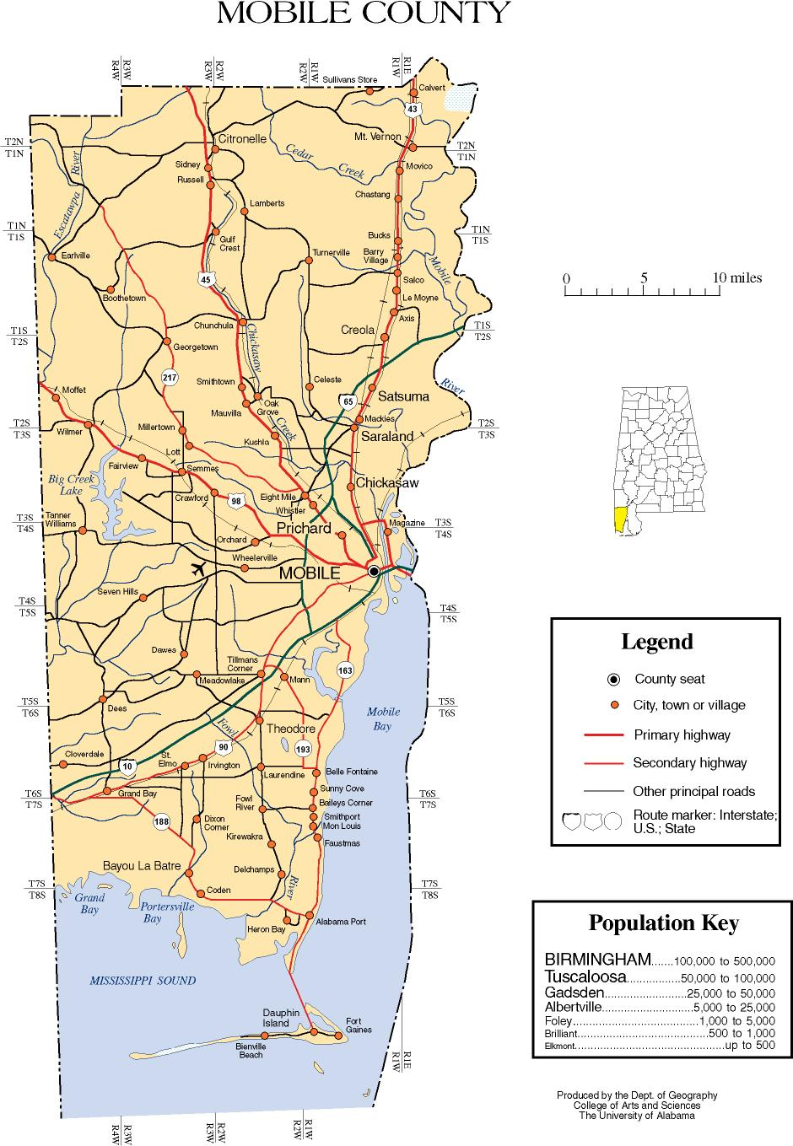
410,000 people inhabiting 1,233 square miles

Slide 3
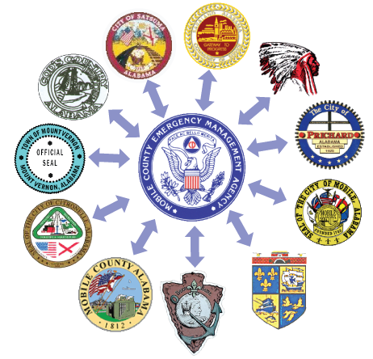


Responsible Jurisdictions and First Responders/Receivers
Fire and Rescue
Public Health
Police
Social Service Agencies
Hazmat
Churches
VOAD
Hospitals, SNFs, ALFs
EMS
USAR
Private Industry
Red Cross
Everyone has a role to play in
Mitigation, Preparedness, Response and Recovery!
Sr. Citizen Advocacy Groups

Slide 4
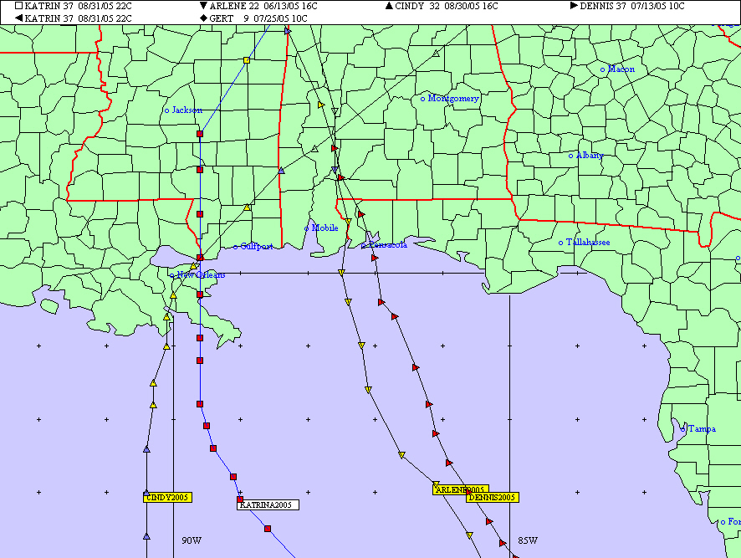

Slide 5
Hurricane Triple Threat to Mobile County
Storm Surge
Greatest potential for loss of life.
A large dome of water, 50 to 100 miles wide
Can range from 4 to 20 feet above normal tide
Widespread Flooding
Generally produce widespread rainfall of 6 to 12 inches.
Heaviest rains occur 6 hours before and 6 hours after landfall.
Large amounts of rain can occur more than 100 miles inland.
High Winds
Winds rapidly increase in strength from the weakest on the outer fringes to the strongest near the eye
As a hurricane moves inland, winds begin to rapidly decrease but can remain above hurricane strength well inland.

Slide 6
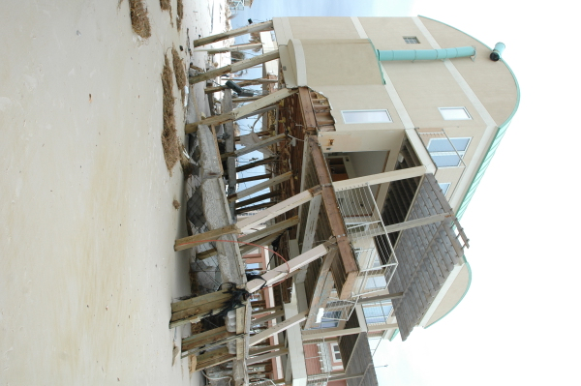

Slide 7
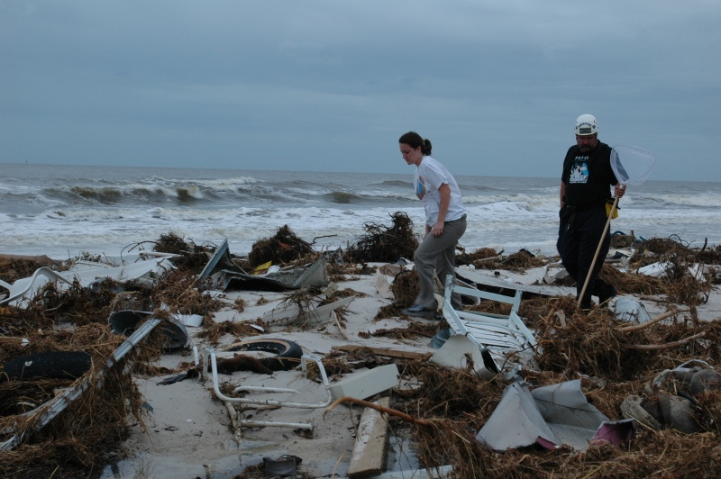

Slide 8
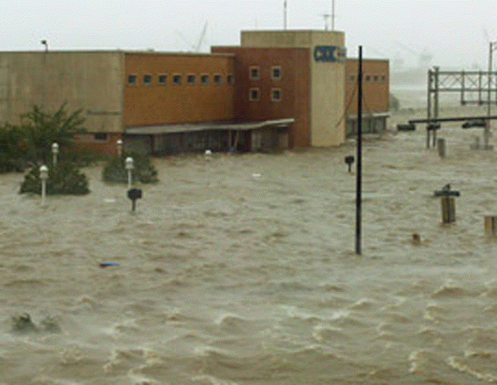
CSX building in Mobile, AL
Hurricane Katrina
Notes:
The Ohio Emergency Management Agency is the central point of coordination within the state for activities to support mitigation, preparedness, response and recovery functions before, during and after a disaster.... All disasters begin locally, however; as the Governor's emergency management organization, we may activate the Ohio Emergency Operations Center to better coordinate the state's response. This center brings together the primary state and federal agencies that will be assisting in the disaster.

Slide 9
Partnerships Early On
As a local Emergency Management Agency, it is critical to establish partnerships with elected officials, other responding agencies, volunteers, and the private sector prior to a disaster.
Please remember that you are not an elected official. Your responsibility is to keep the elected officials informed and to coordinate the necessary resources to restore your area to pre-disaster condition.
By establishing early partnerships, you will save time - you will save money and you will save lives!

Slide 10
Steps to Establish Relationships
Strategically partner with all emergency stakeholders
Think regionally, act locally
Federal, state, local, NGO inclusiveness
Engaged partnership philosophy
Collaboration is the key
Build a ‘culture of preparedness’
Strengthen all relationships/partnerships
Memorandums Of Understanding (MOUs)
Notes:
The integrated planning concept is not new, but the group of participants in the planning process needs to be expanded to include private sector resources that address the functional needs of special needs populations on a day-to-day basis.
Because persons with varying conditions and diagnoses can be served by similar resources, it will be important that agencies that might not have worked together are brought together to address emergency-based functional needs.
This expanded planning effort needs to be led at the local level by County Emergency Management Agencies, Local Emergency Planning Commissions and other entities that have the responsibility for coordinating emergency planning, exercising and training.

Slide 11
Benefits of Collaboration
Strengthening the overall response to the disaster
Elimination of duplication of services
Expanding resource availability
Enhancing problem solving through cross-pollination of ideas

Slide 12
Working Together!
LOCAL
PARTNERSHIP
STATE
FEDERAL
Everyone has a role to play!

Slide 13
What Do Partners Do?
Partners are invaluable during all hazards, but especially when Hurricanes (our biggest threat) affect Mobile County as they assist Emergency Management with:
Help identify/locate/communicate with vulnerable populations
Public Notifications – “getting the word out”
Shelter set-up and administration
Aid and comfort
Rescue efforts
Community coordination in recovery phase

Slide 14
Emergency Management Cycle
Four Phases of Emergency Management
Mitigation
Preparedness
Response
Recovery

Slide 15
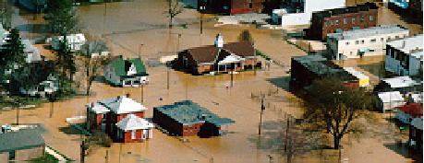
Mitigation
Reduce or eliminate the cost of damage caused by disasters
Minimize the impact on citizens, businesses, and properties

Slide 16
Preparedness
How MCEMA Prepares
Hurricane Season Planning
Update Emergency Operations Plans (EOP)
Update Hurricane Operations Plan (HOP)
Risk and Vulnerability Assessments and Coordination with Partners for Medical/Special Needs Evacuation and Shelter
Emergency Management Assistance Compact (EMAC)
After action evaluations following disasters and exercises
Training & Exercises
Hurricane –specific
EMI – Cat 5 – February 2008
April/May Media Blitz
Coordinate dissemination of information
Drive community to Website for all-hazard preparation
Identifies Special Need Communities, Needs & Partners
Notes:
Planning – Responsible for the state EOP and EOP guidance to local EMA. Provides guidance state and local agencies to continually enhance and standardize the format and content of all state and local plans.
Training - Conduct comprehensive internal and external training to improve the capability to respond and recover
Exercise - Ensure exercises evaluate capabilities of existing plans and procedures
Major Exercise Highlights:
Development of the State of Ohio Terrorism Exercise and Evaluation Manual
Major League Baseball exercise/Cincinnati Reds
(2nd in U.S. – 1st in Ohio)
International Cross Border Exercise/Canada
Participation on national Homeland Security focus groups
2 Master Exercise Practioner certifications
85 Local Emergency Planning Committee exercises (hazardous materials)

Slide 17
Preparedness: Identifying Vulnerable Populations
Your Partners are key in helping you identify and work with ALL Vulnerable Populations:
Hospitals
Nursing Homes
Assisted Living Facilities
Retirement Centers
Psychiatric Institutions
Rehabilitation Centers – Physical and Substance Abuse
Disabled – Physically, Blind, Deaf, other
Orphanages
Mortuaries
Foster Care Families
Single-parent Families
At-home Elderly
At-home Mentally Ill
Foreign/Other Language Populations including ASL
Illegal Aliens
Poor
Without Transportation
Homeless
Prisoners
Pets

Slide 18
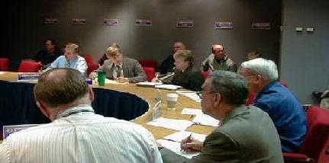
Preparedness
How MCEMA Prepares our Partners
Hurricane Season Planning
Maintain open communication with partner organizations
Meet with partners regularly
Training and Exercises with partner organizations
Involve the citizens, the government and private industry
Implement Warning/Notification Systems
IPAWS
ConnectCTY

Slide 19
Notification Systems
IPAWS – Integrated Public Alert and Warning System
An Interoperable, First Responder Communication, Public Warning, Information Sharing and Coordination System that utilizes a hierarchical Web-based communications system, to enable federal, state and local jurisdictions to immediately disseminate information from the national level, regions, and state levels that include the county, city/tribe or other governmental jurisdictions entirely deployed on the Internet.
ConnectCTY
A fully-hosted, fully managed Application Service Provider (ASP) solution, the Connect-CTY service allows civic leaders to send personalized messages (voice, text and e-mail) to thousands of people in minutes without having to invest in or maintain hardware, software, or additional phone lines.
In the event of local disruptions, such as floods, wildfires, water main breaks or power outages, the ability to provide leadership remains intact, with the capacity to send timely notifications to targeted constituents and staff members using just a telephone.
One, cost-efficient investment allows all key departments to use the Connect-CTY service for just pennies per day

Slide 20
Special Needs Notification
Outreach programs for Special Needs Communities
Established solid communication networks including Information Flowchart for Special Needs
Abrahams Group Outreach
Created Partnerships with volunteer agencies serving all the Special Need groups
IPAWS
ConnectCTY – calls start as early as 96 hours prior to landfall

Slide 21
Special Needs Notification
>400 letters to churches requesting partnership in:
Identifying special needs
Assistance with information dissemination
Evacuations
Aid and comfort including shelter administration
Management of donated goods
Distribution site assistance
Community educational events
Comprehensive MCEMA Website
CERT Teams
Added additional sirens

Slide 22
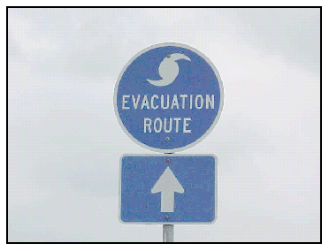
Evacuation Plan
Most people will evacuate themselves
Not all who may want to evacuate have the means to do so
Government and others will provide evacuation assistance

Slide 23
How Mobile County Evacuates
The most common long-term evacuation is in advance of a large Hurricane (typically Cat 3 or higher). Other events may qualify depending on the nature of the threat
Hurricane Emergencies that occur within Mobile County may require evacuation of distinct zones at different times (with a primary focus on Zone I)
Each storm threat will dictate its own combination of levels and types of evacuation to be authorized by government officials
For Categories 1 or 2 storms, either a voluntary full or a mandatory partial, evacuation will be issued
For Categories 3 - 5, only a mandatory full evacuation order will normally be issued

Slide 24
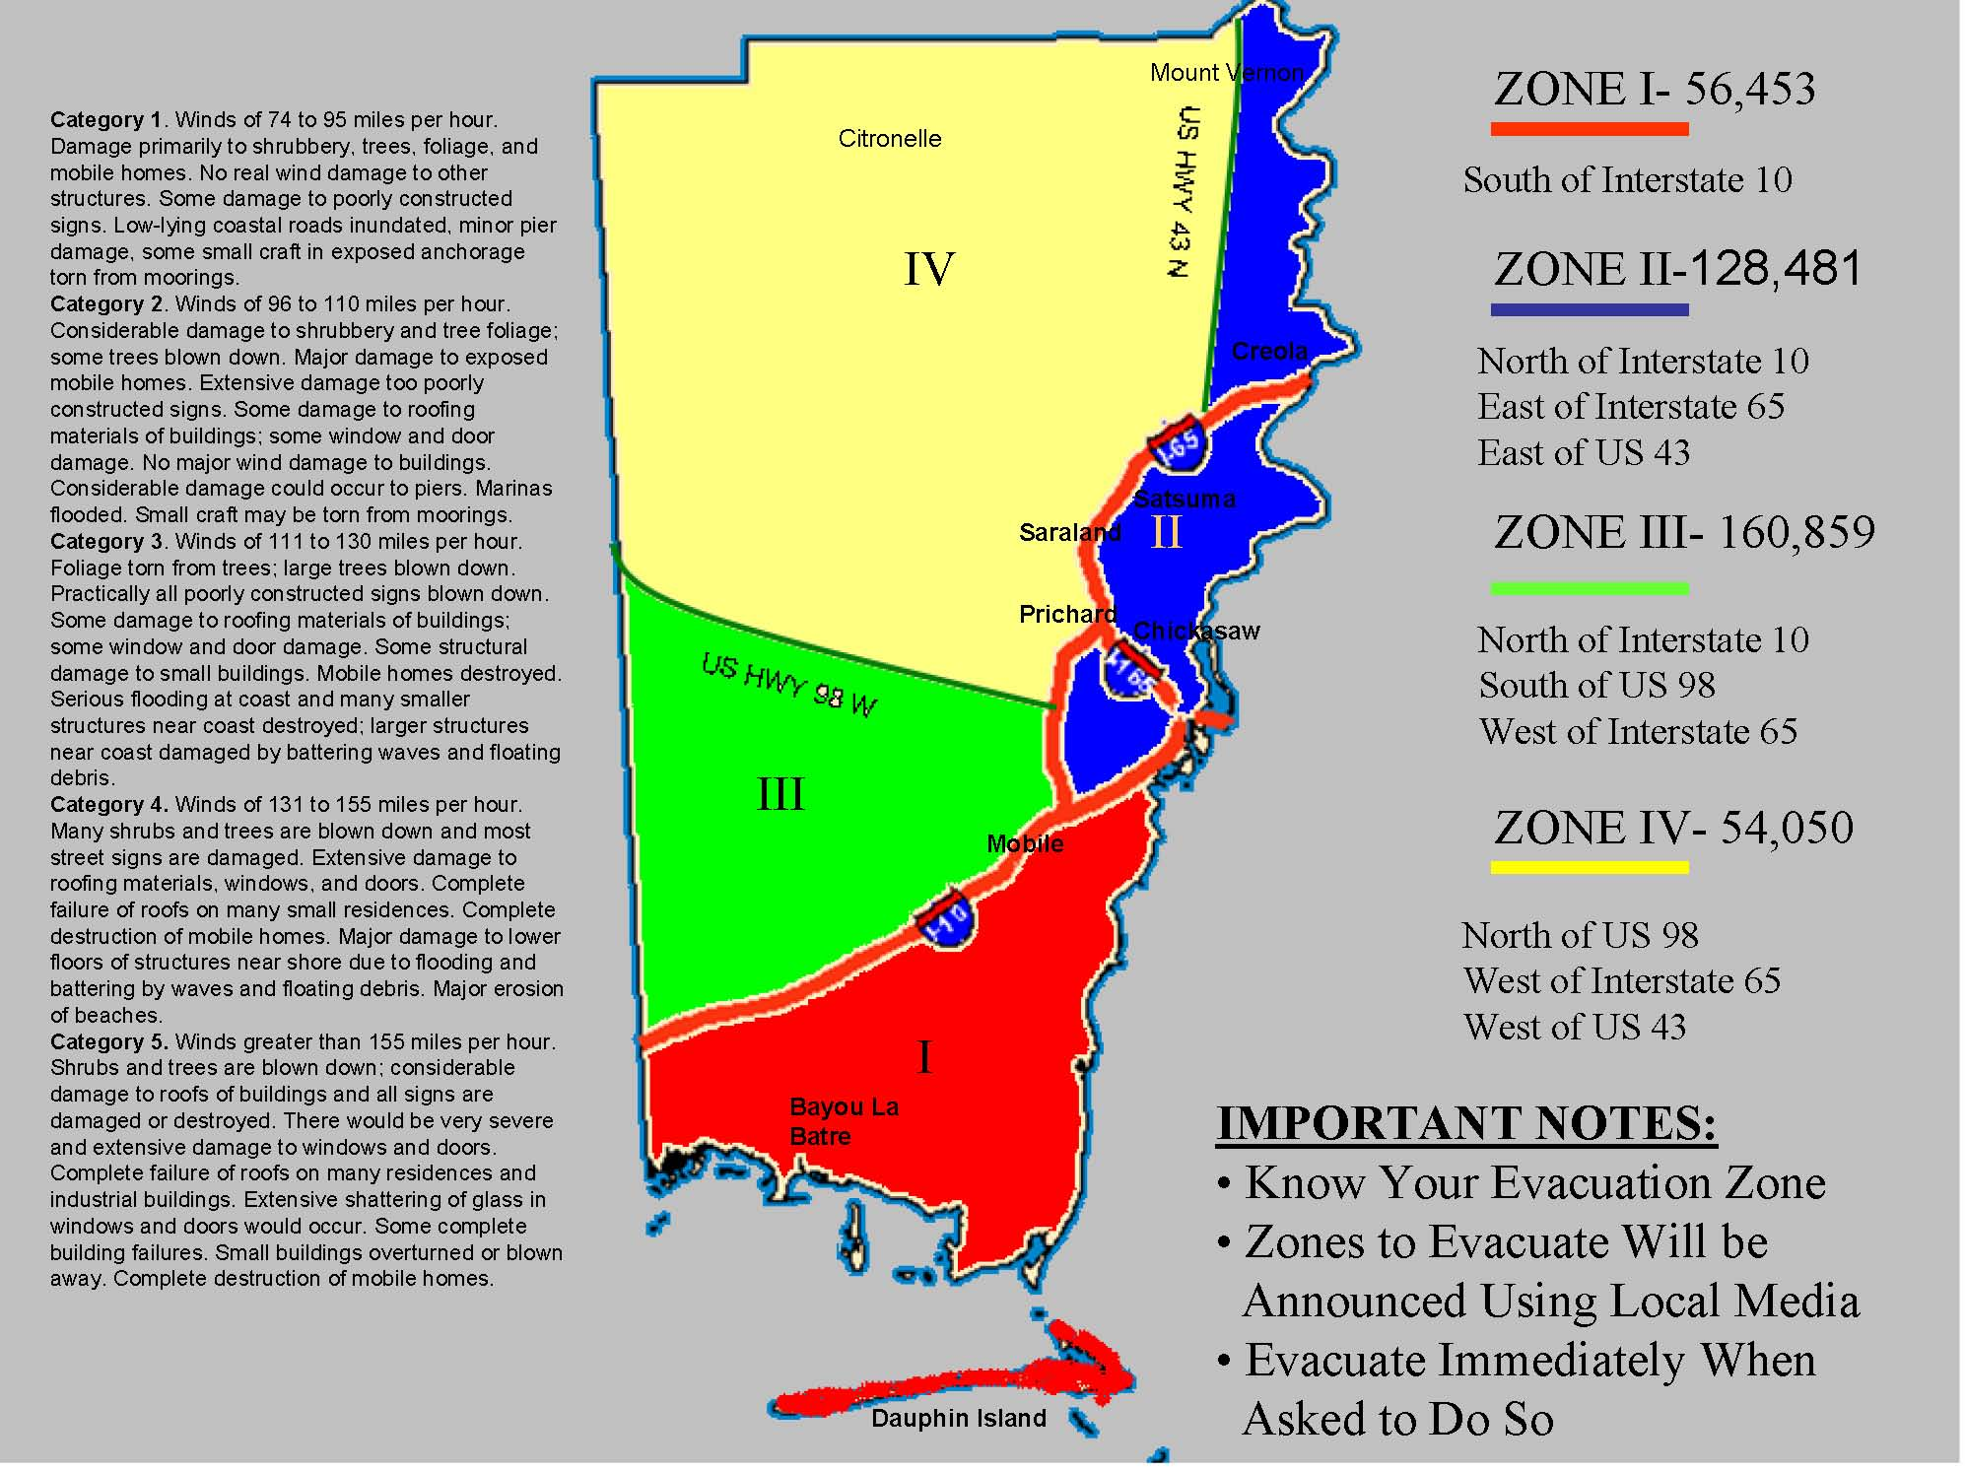

Slide 25
Alabama Contraflow Lane Reversal
During times of evacuation of the Alabama Gulf Coast, the portion of I-65, stretching from Mobile, turns all traffic northbound. Contraflow, in this situation, usually ends in or near Montgomery.
I-65 used contraflow long before Hurricane Ivan devastated the Alabama Gulf Coast region. I-65 is usually in contraflow longer than some other interstates that accommodate more traffic this way because of the large population that lives in Mobile and Baldwin Counties. This region contains less people than other gulf coast regions, but, the Alabama Gulf Coast residents do not have many other major arteries out of the Mobile Area as the larger regions along the coast do.
Most traffic is funneled northward, towards Montgomery, on I-65, US 31, US 45, and US 43.

Slide 26
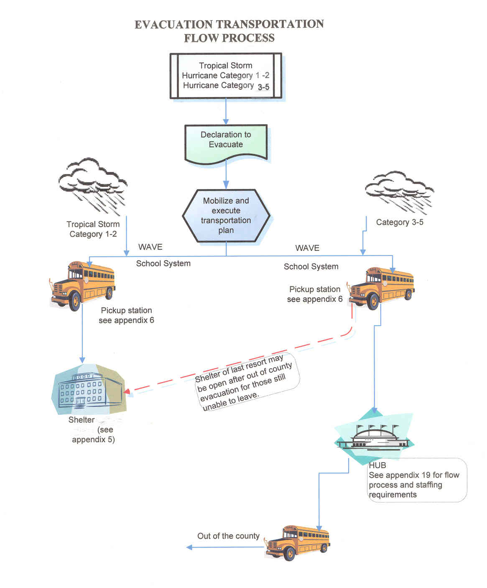

Slide 27
Local Evacuations
From designated pick-up points
To local storm shelters
Buses/Vans
Limited specialty vehicles

Slide 28
Out of County Evacuation
From designated pick-up points
To the HUB
To designated shelters located inland
(Two Year Community Colleges)
Tier 1, Tier 2, Tier 3

Slide 29
Special Needs/Medical Needs Evacuations
Partner Organizations are critical!
Identification
Assistance
Transportation to Medical Needs Shelters is available
Out-of-town evacuation is available if necessary
Institutional Emergency Plans are reviewed annually to ensure process for, and ease of, evacuation (e.g., medical facilities, prisons, etc)
MCEMA Website is full of additional information for preparation for evacuation (see next slide)
Comprehensive Pet Friendly information along evacuation routes are located on website

Slide 30
Special Needs Evacuations – Additional Steps You May Need to Take
Disability/Special Need | Additional Steps
Visually impaired | May be extremely reluctant to leave familiar surroundings when the request for evacuation comes from a stranger. A guide dog could become confused or disoriented in a disaster. People who are blind or partially sighted may have to depend on others to lead them, as well as their dog, to safety during a disaster.
Hearing impaired | May need to make special arrangements to receive warnings.
Mobility impaired | May need special assistance to get to a shelter.
Single working parent | May need help to plan for disasters and emergencies.
Non-English speaking persons | May need assistance planning for and responding to emergencies. Community and cultural groups may be able to help keep people informed.
People without vehicles | May need to make arrangements for transportation.
People with special dietary needs | Should take special precautions to have an adequate emergency food supply.
People with medical conditions | Should know the location and availability of more than one facility if dependent on a dialysis machine or other life-sustaining equipment or treatment.
Dialysis patients | Seek treatment immediately prior to moving to a shelter
People with mental health conditions | May need help responding to emergencies and getting to a shelter.
People with dementia | Should be registered in the Alzheimer’s Association Safe Return Program

Slide 31
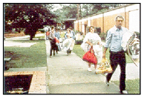
How Mobile County Shelters
Local Storm Shelters including twenty-five (25) standard shelter facilities, three (3) Medical Needs Shelters and (1) Pet Friendly Shelter
In total, we are prepared to shelter up to 27,000
Shelter Partners

Slide 32
Shelter Partners
Alabama College System: Key Partner in Sheltering Operations
The Alabama College System – the state’s two-year college system – partners with the American Red Cross to certify two-year college facilities as Hurricane Evacuation Centers. As a result of the state’s effort, 23 system colleges with 36 certified sites are able to shelter 22,000 people.
In addition, four colleges are in the process of being designated as Red Cross Certified Medical Needs shelters. These special needs shelters will be co-located with college evacuation shelters.
Following careful planning, it was agreed that the college presidents would manage the college facilities and the Red Cross would manage the sheltering and feeding process. A thorough Memorandum Of Understanding (MOU) delineates all responsibilities.

Slide 33
Special Needs Sheltering
All those previously identified as Special Needs, with the exception of Medical Needs and those with pets may go to the regular, local shelters or evacuate/be evacuated do another facility or shelter in the state/region
Medical Needs Shelters are established for certain criteria (next slide)
A Pet-Friendly Shelter is available in Mobile County but has limited space; comprehensive pet evacuation information is on MCEMA website

Slide 34
Medical Needs Shelter
Not bedridden; require minimal or moderate assistance
For example: stable oxygen, nebulizer, or sleep apnea treatment; Foley/supra-pubic catheter; frequent incontinence; Ostomies; mild Dementia without abusive or wandering behavior; mental illness/mental retardation with nonviolent behavior.
Peritoneal Dialysis or IV treatment only if self-administered or family assisted
Must be accompanied by a caregiver
Bring medical supplies and equipment

Slide 35
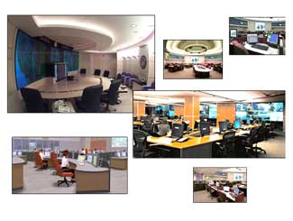
Response
MCEMA - Central point of coordination within the county for response to and recovery from disasters
Activate MCEMA Emergency Operations Center
Coordinate State Resources
Conduct Damage & Needs Assessment
Recommend Actions to the State EMA and Mobile County
Coordinate local Response
Notes:
Responsible for coordination with local, state and federal agencies.
Establish and maintain clear direction and control and operational procedures to ensure effective response

Slide 36
Response Needs for Citizenry
Prioritization of areas to check first
Coordination with First Responders including USAR
Prioritization with Utility companies to restore power/water
Coordination with Partners who know these populations best
Call on community to assist in checking on others
Keep media informed

Slide 37
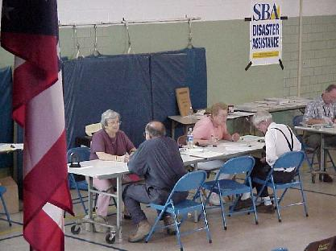
Recovery
Restore governments, systems, and people to pre-disaster levels
Administer local assistance programs
Infrastructure
Individuals & families
Assist with long-term recovery activities

Slide 38
Key Takeaways
Build appropriate relationships BEFORE the disaster…include non-traditional partners
Planning Effort
Process builds relationships
Invite ALL appropriate partners
Training
Exercising
After Action Reviews/Corrective Action Plans
Revise the Plan
Continue the Cycle
Know the plan; Know your role

Slide 39
David Paulison on Partnership
“While emergency management should remain first and foremost a state and local responsibility, the federal government has to be prepared to engage more proactively during the initial stages of a disaster. To do this, we need to enhance partnerships with state and local governments, nongovernmental organizations, and the private sector to identify where the weaknesses exist. The federal government should work with states and municipalities to close capability gaps and improve our combined, integrated response. Katrina has taught us the value of early and unified engagement”.
- David Paulison, Director, FEMA
"Weathering the Next Storm", Washington Post, 08/27/06

Slide 40
Contact Information
Walt Dickerson 251-460-8000
wdickerson@mcema.net
www.mcema.net

