Slide 1
BUILDING A DATA SERVER FOR ECOLOGICAL DATA
Deb Agarwal
BWC technical team
17 September 2007
Hydrolunch

Slide 2
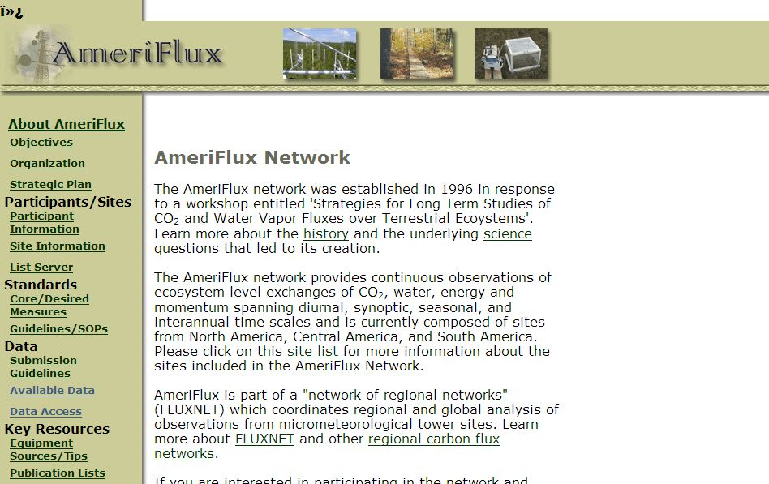

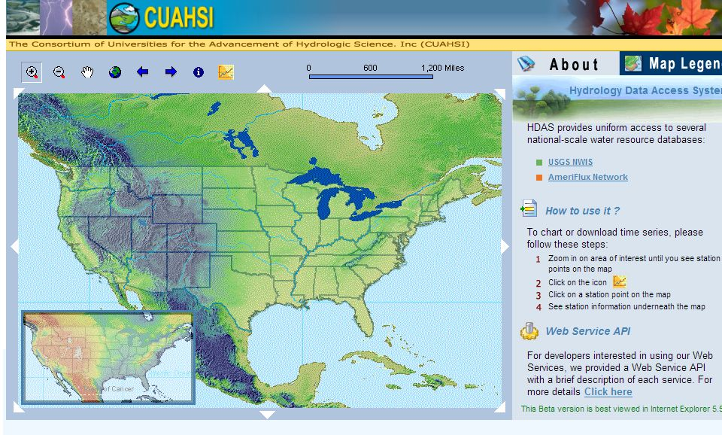
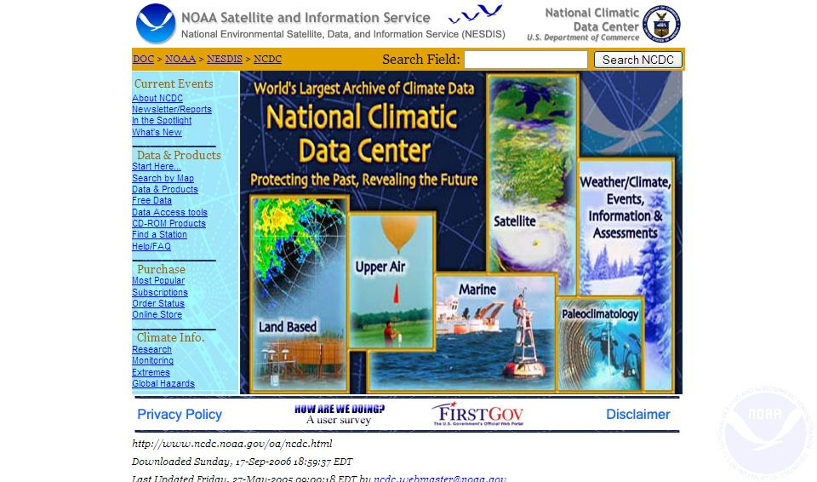
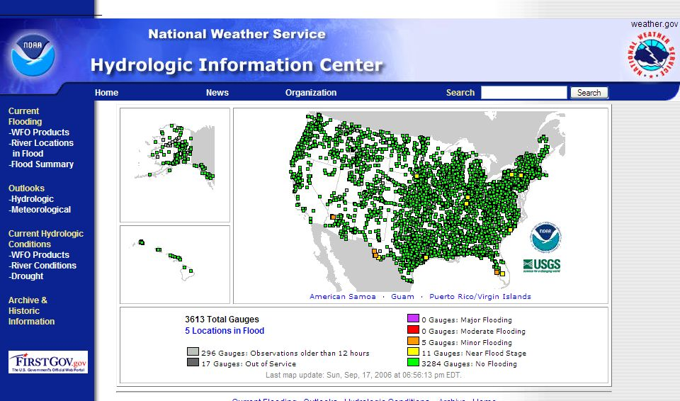
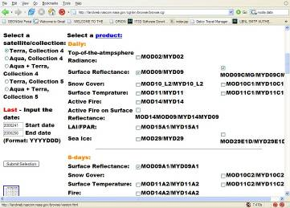
Unprecedented Data Availability

Slide 3
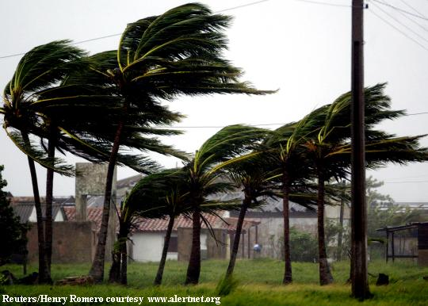
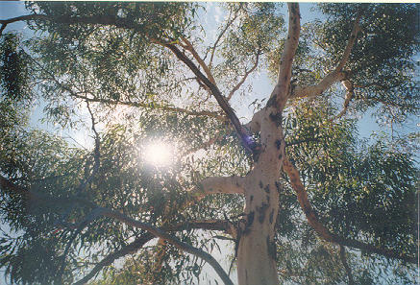
ECOLOGICAL Measurements Are Often Not Simple or Complete
Gaps in the data
Quiet nights
Bird poop
High winds
Batteries die
Rivers flood
Difficult to make measurements
Leaf area index
Wood respiration
Soil respiration
Localized measurements – tower footprint
Local investigator knowledge important
Science goals are not necessarily uniform across the Pis taking measurements

Slide 4
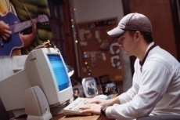

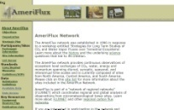


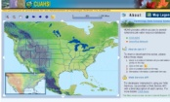


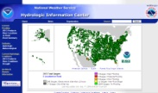




Typical Data Storage Today
Data retrieved by each investigator individually
Data corrections and updates applied
Data are often scattered, across a wide array of locations
Provenance is in the mind of the beholder
“Everybody knows” yet no one is sure
Internet Data
Archives
Large
Models
Local
Measurements
Legacy
Sources

Slide 5

Typical Data Analysis Flow Today
Validate & Quality Check data
Perform Analysis
Identify Data Issues & Retrieve Missing Data
Retrieve Data from Source
Matlab, Excel,
S-Plus, PV-Wave, R, …
Web page, e-mail,
web service, phone,
Student, Post-doc,
Friend, . . .
Notes:
Typically each individual has their own data set that they evolve and refine for their particular calculations

Slide 6
Target Data Analysis Flow
Scientific Data Server
Validate & Quality Check data
Perform Analysis
Identify Data Issues & Obtain Missing Data
Obtain Data from Source
Track versions,
results, and
provenance

Slide 7
Scientific Data Server - Overview
Data Cubes
Databases
Data Ingest
User Interfaces

Slide 8
Database Role
All descriptive metadata and data held in relational databases
Metadata is important too!
Data versioning enables tracking of changes
Data reorganization easy
Allows complex questions to be posed
Data may be exported to flat file, copied to a private MyDb database, directly accessed programmatically, or ?

Slide 9
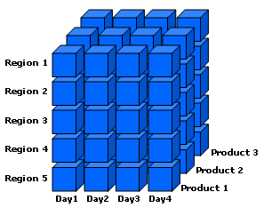
Data Cubes
A data cube is a database specifically designed for data mining
Simple aggregations (sum, min, or max) can be pre-computed for speed
Additional calculations can be computed dynamically or pre-computed
Both operate along dimensions such as time, site, or datumtype
Constructed from a relational database
Client tool integration is evolving
Excel PivotTables allow simple data viewing
More powerful analysis and plotting using Matlab and statistics software

Slide 10
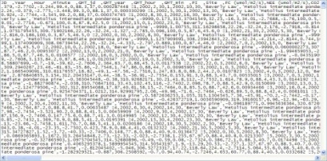
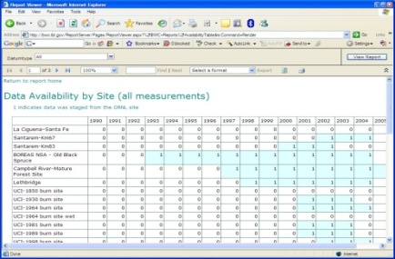
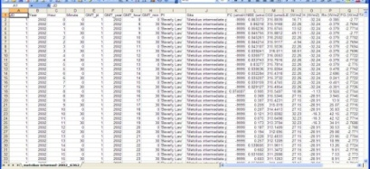
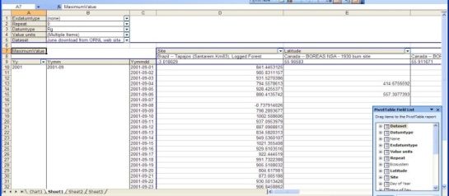
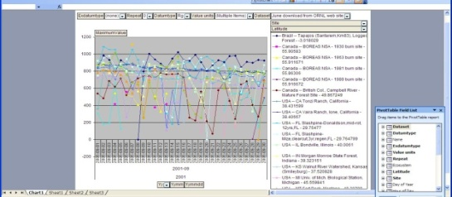
Scientific Data Server – User Interface
CSV Files
Reports, Web Services, Excel Pivot
Table and Pivot Chart
ORNL Ameriflux
Web Site
BWC SQL Server
Database
Data Cube

Slide 11
Browsing For Data Availability Sites Reporting Data Colored by Year

Slide 12
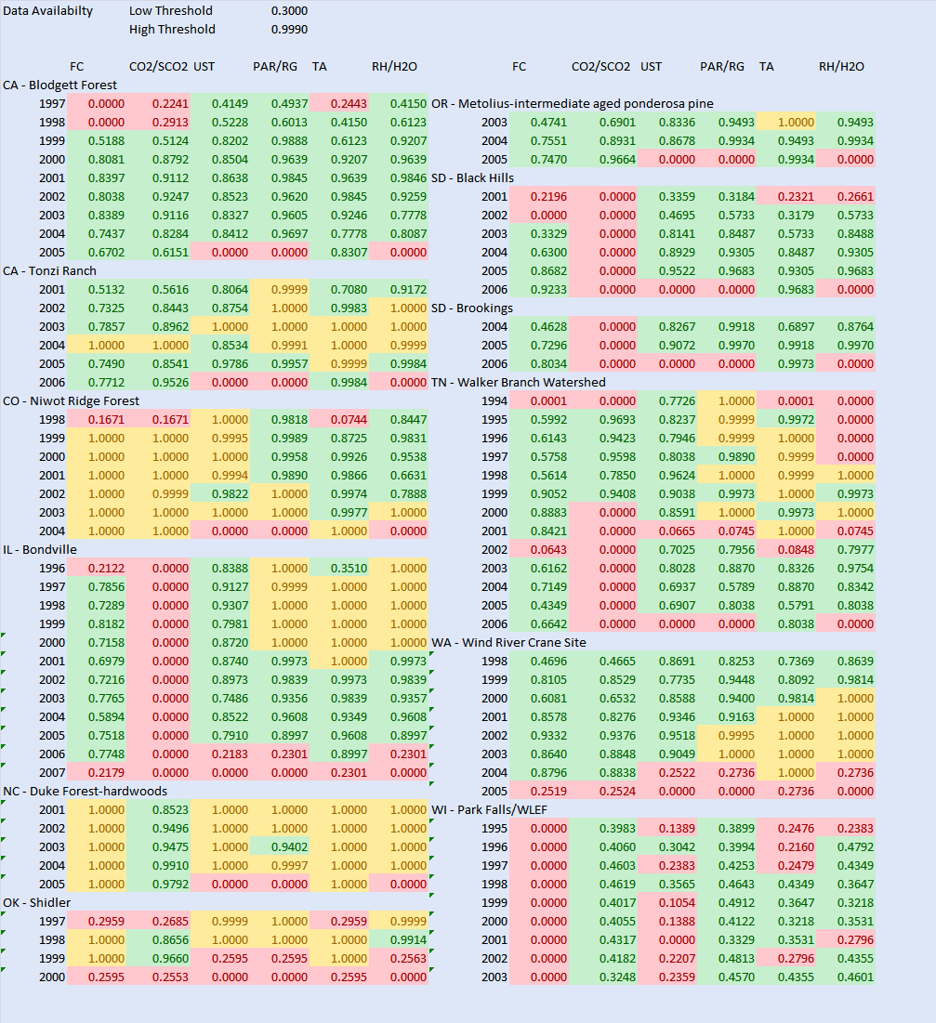
Required variable reporting by site by year
Each row corresponds to one site-year
Each cell corresponds to one site year of (FC, CO2 or SCO2, UST, PAR or Rg, TA, and Rh or H2O).
Color indicates:
Red – likely not enough for processing - % < .3 reported (roughly less than 5K of 17.5K)
Green – likely not enough for processing .3<%<.999
Yellow – may not be good for processing due to gap-filling - % > .999
Red CO2 (second column) can be ignored for cropland/grassland sites
Sites shown are just a sample
Of the 285 site years with good FC, 50 site years are missing one of (UST, PAR/Rg, and TA) and 79 sites have likely gap-filled data.

Slide 13
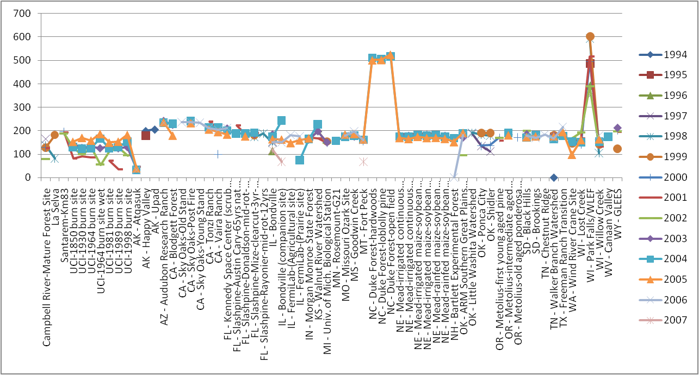
Obviously bad annual averages
Data cube used to browse average yearly Rg values across all site-years
16 additional likely problematic site-years at 5 sites
Notes:
Rg, exdatumtype = none, offset = all (or 0).
Year on column
Site on row

Slide 14
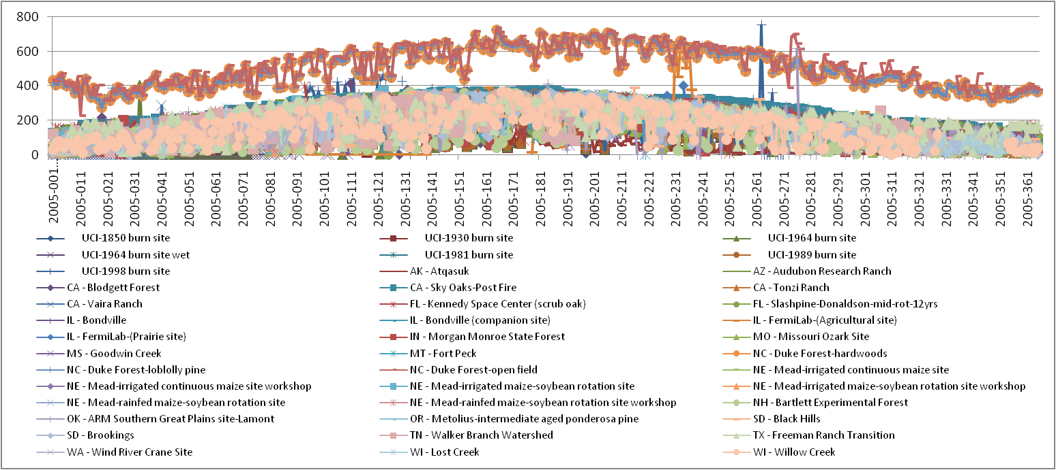
Drill down to consistent (bad) daily values
Data cube used to browse 2005 Rg values shows consistently high reporting (not just a few very large spikes) at Duke Forest sites

Slide 15
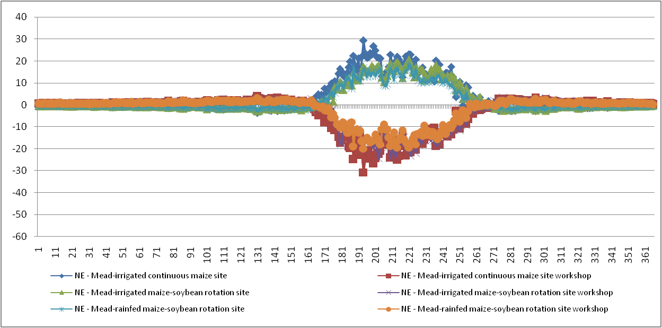
Drill down to Mead sites
Daily average FC at each site shows likely units and/or sign issues
Notes:
Drill down into obvious problem sites
Drill down showing each year….
Mead sites look like sign and/or units problem….

Slide 16
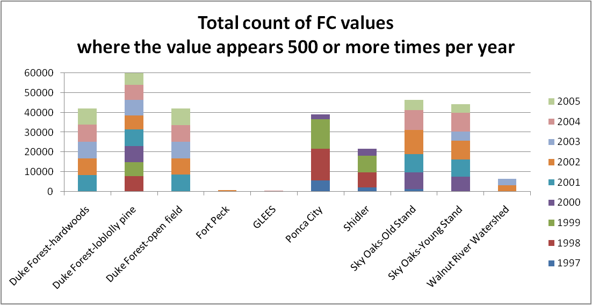
Simple check: the same FC value reported too often
Database query returns count by (site, year, value) where count >= 500
Graph shows sum of (returned counts) by site and year
Sites with high sums likely report very few unique FC values

Slide 17
Project Status
Ameriflux data
~145 million daily values in cube
Advanced calculations and statistics in cube
Methods of providing ½ hourly data access efficiently
Data quality assessment
Collection and incorporation of biological data
Fluxnet data
~210 million daily values in cube
Waiting on gap filling and quality checking operations
Data server, cubes, and reports will likely be the primary repository and access for researchers using the data
Russian River Data
~23 million values in cube
Integration with Matlab and GIS
Additional of data from other sources (fish, sediment size, …)

Slide 18
On-going and Future Challenges
Versioning of data and collection of data provenance
Improved performance of database and cube
Handling of biological data
Advanced plotting capabilities
Integration of collaborative tools
Automation of data ingest, cube building, and report building
MyDB and MyCube capabilities
Integration of workflow capabilities
Data server in a box
Sociological change

Slide 19
Summary
Ameriflux collaboration is adopting the Data Server architecture for the data repository
BWC Data Server will be hosting the Fluxnet dataset which is expected to be the foundation for a broad range of research investigations
Ecological measurements are often “messy”
Applying the Data Server to new domains introduces many additional challenges

Slide 20
Acknowledgements
Berkeley Water Center, University of California, Berkeley, Lawrence Berkeley Laboratory
Jim Hunt
Matt Rodriguez
Robin Weber
Monte Good
Rebecca Leonardson (student)
Carolyn Remick
Susan Hubbard
Yoram Rubin
University of Virginia
Marty Humphrey
Norm Beekwilder
Microsoft
Catharine van Ingen
Jayant Gupchup (student)
Nolan Li (student)
Tony Hey
Dan Fay
Stuart Ozer
SQL product team
Jim Gray
Ameriflux Collaboration
Beverly Law
Tara Stiefl (student)
Youngryel Ryu (postdoc)
Gretchen Miller (student)
Mattias Falk
Tom Boden
Bruce Wilson
Fluxnet Collaboration
Dennis Baldocchi
Rodrigo Vargas (postdoc)
Dario Papale
Markus Reichstein
Bob Cook
Susan Holladay
Dorothea Franks
*Project funded by Microsoft

