Slide 1
NOAA’s Office of International Affairs (OIA)

Slide 2
Summary of Content (in order of appearance)
Vision
Mission
Program Objectives
Budget
Leadership
NOAA’s International Staff
Highest Priority Issues

Slide 3
Premise
NOAA’s scope – oceans and atmosphere – is inherently global, and therefore, international engagement is integral to NOAA’s Mission
“Whether leading world-wide collaboration in integrating global observations, guidingregional activities in managing marine and water resources, or simply collaborating in scientific endeavors, NOAA is a major player in international efforts to meet environmental and ecosystem challenges. Consequently, we recognize the value of our international partners, as we learn from their experiences and benefit by working together on common issues.”
(NOAA Strategic Plan 2006-2011)

Slide 4
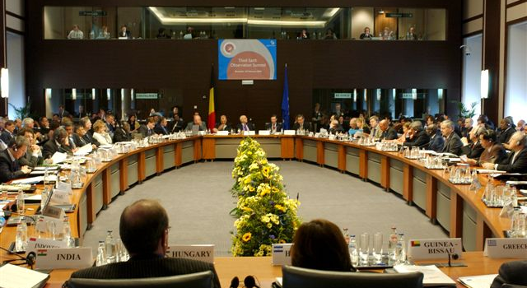
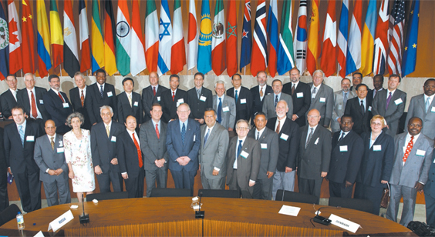
Vision
Serve as Principal advisor to the Under Secretary and Administrator on international policy issues,
Represent NOAA and United States with foreign governments and in international fora
Establish policies, guidelines, and procedures for NOAA’s international programs, and
Provide coordination and support to NOAA’s lines offices
Utilize international collaboration and partnerships to better understand, predict, and take steps to respond to changes in the Earth's environment, conserve and manage coastal and marine resources, protect life and property, and to provide decision makers with reliable and timely scientific information in support of NOAA’s Mission.

Slide 5
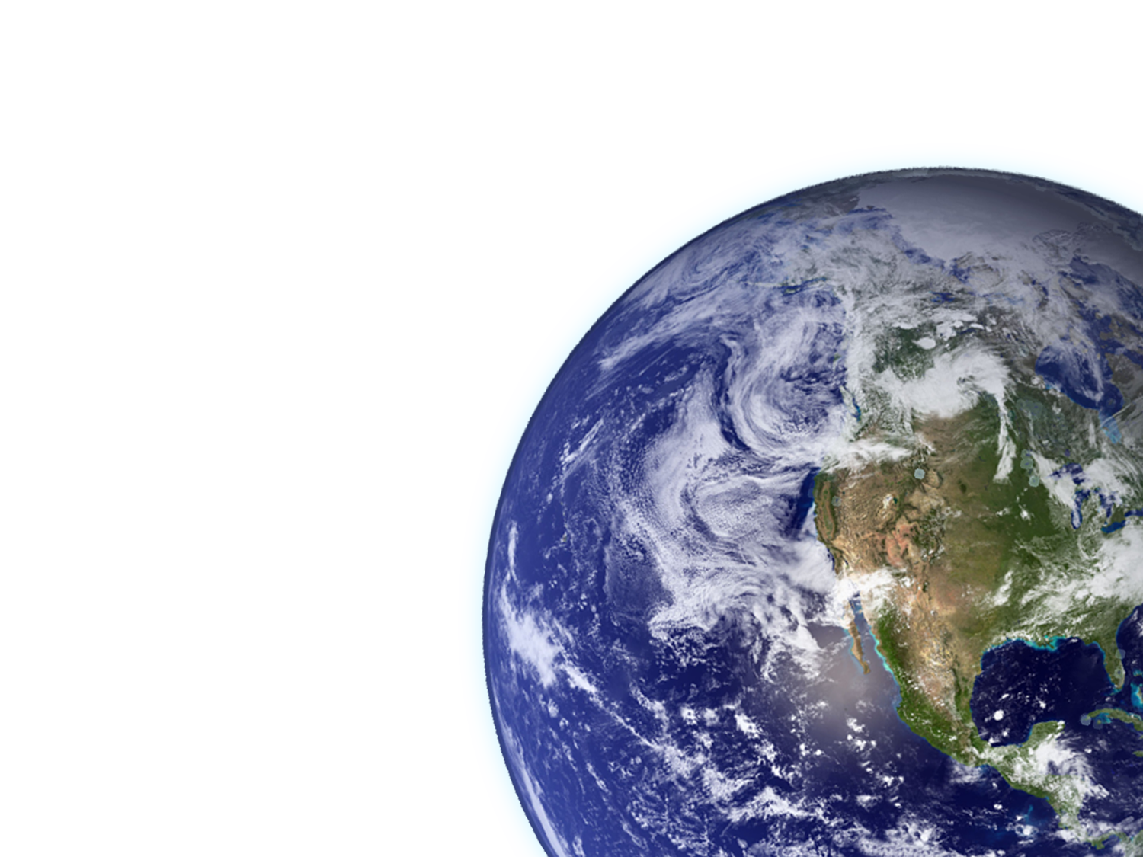
Management Objectives
Leadership, Direction, Management and Support
Objective
Implement a coordinated, cross-NOAA framework, building on LO programs, for effective engagement with the international community in support of NOAA’s mission objectives
End Result
The international community support and partnerships working together toward NOAA’s mission objectives
Policy Development, Representation,
Project Implementation

Slide 6
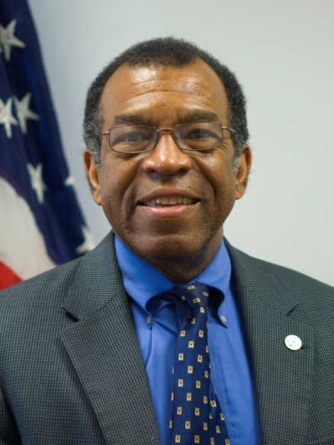
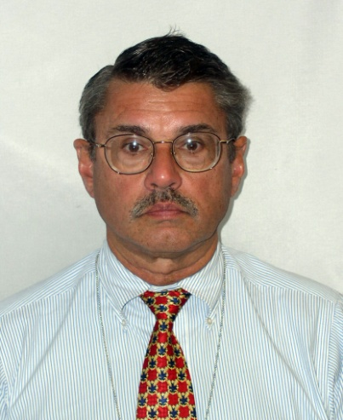
Who We Are: OIA Leadership
Dr. James M. Turner
Deputy Assistant Secretary for International Affairs (Career) and Director, NOAA Office of International Affairs
Thomas L. Laughlin, III
Deputy Director, NOAA Office of International Affairs (Career)

Slide 7
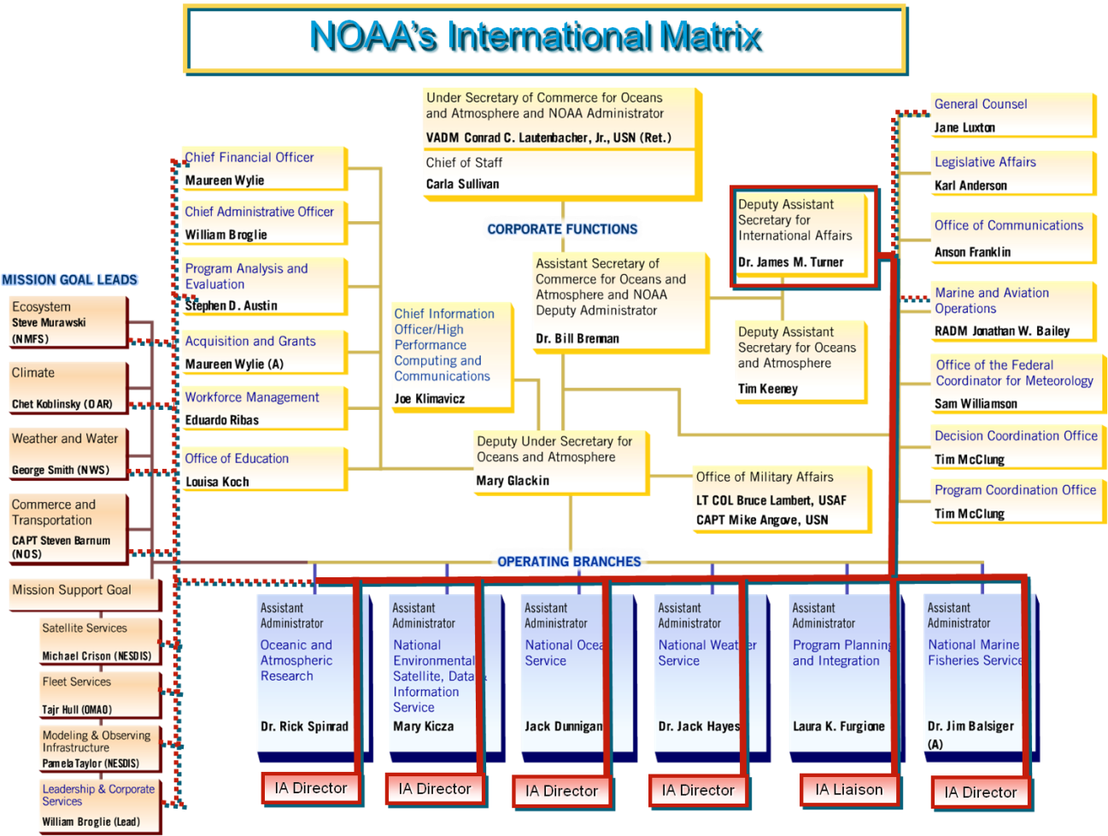
NOAA’s International Staff Resources
The DAS for International Affairs serves as Director of the NOAA Office of International Affairs and directs NOAA’s international program utilizing matrixed relationships with the Line Office international office directors

Slide 8
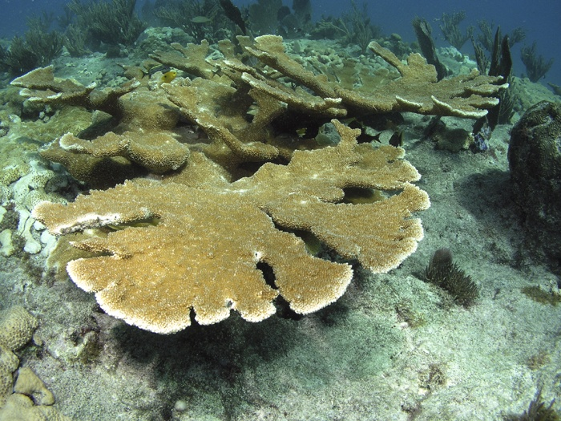
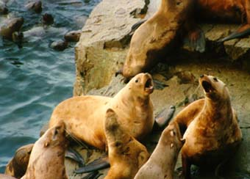
Ecosystems International Issues
Magnuson-Stevens Reauthorization Act’s international obligations
Ecosystem Approaches
Vulnerable Marine Ecosystems
Large Marine Ecosystems (LME)
Marine mammals
Coral Reefs
Protected Areas

Slide 9
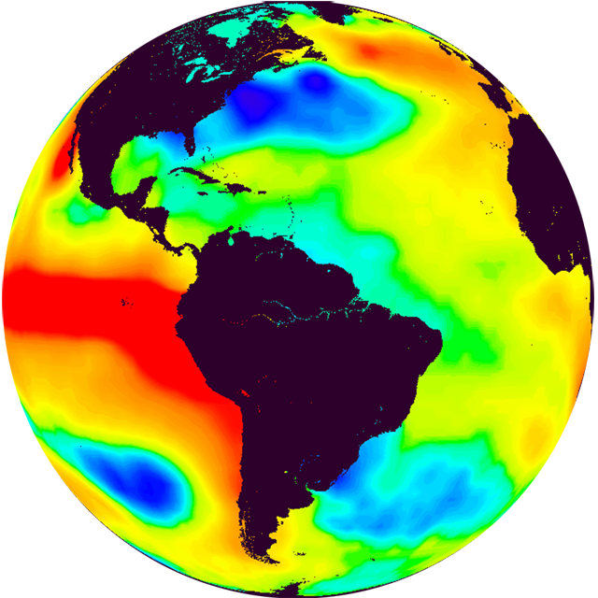
Climate International Issues
UNFramework Convention on Climate Change
Intergovernmental Panel on Climate Change (IPCC)
Observations, data, modeling
Adaptation

Slide 10
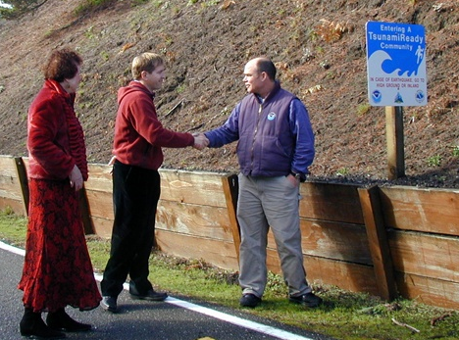
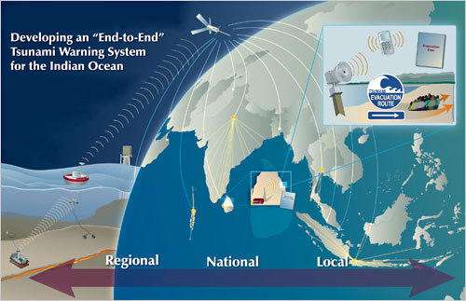
Weather & Water International Issues
Observations, data, modeling
Tsunami follow-on
Natural hazards and warnings
Community resilience

Slide 11
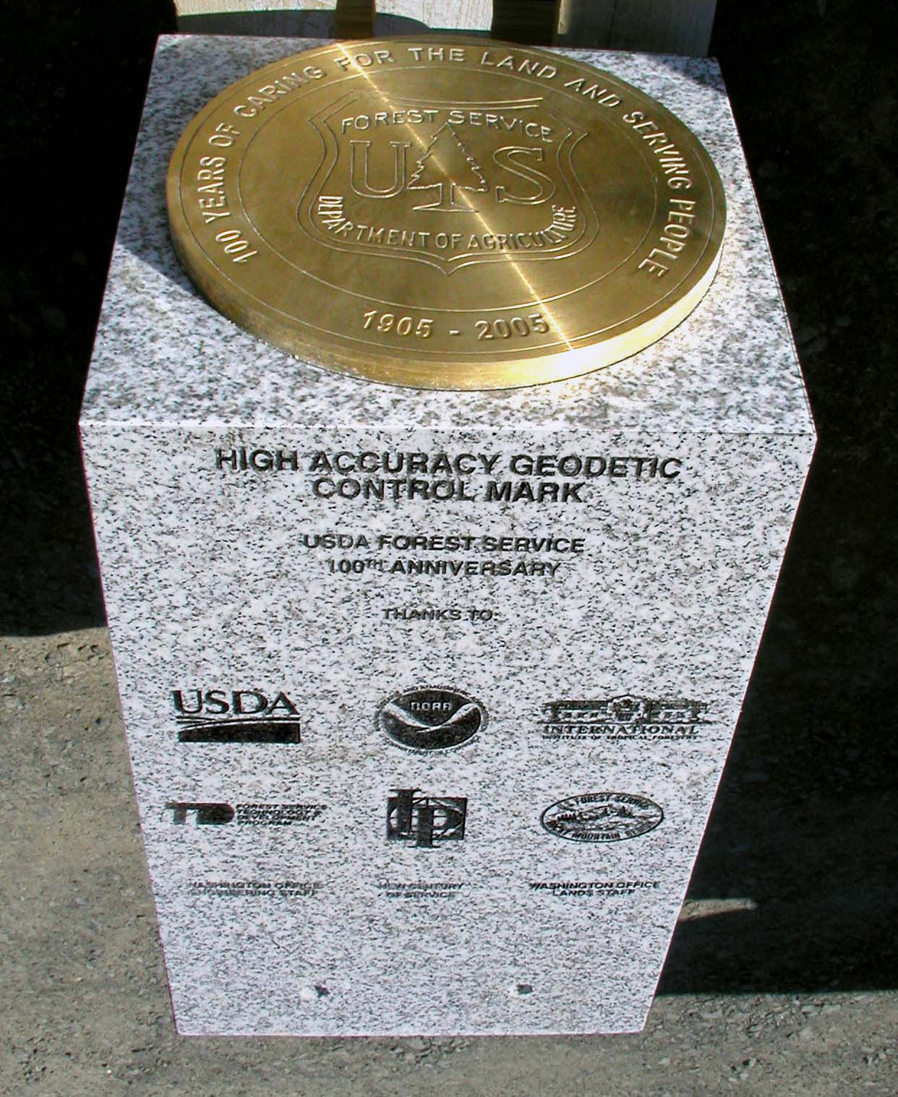
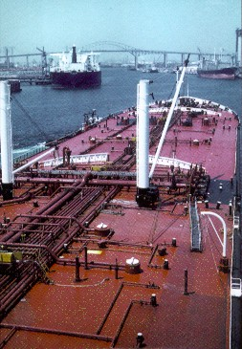
Commerce & Transportation International Issues
Arctic
Charting and Geodesy
Shipping practices

Slide 12
Priority International Issues By Goal Team
Overarching and Mutually Supportive International Priorities
Cross NOAA’s Goals, Lines and Programs
FAO, IWC, ICCAT, ICRI, RFMOs, UNEP, ICES, PICES, UNGA, IMO, Arctic, Antarctic, Bilaterals
International Engagements
MSRA – international obligations
Ecosystem Approaches, VMEs, LME
Marine mammals, Coral Reefs,
Protected Areas, Polar Areas
Earth observations, data, modeling; Oceans;
International Leadership, Environment; Research
Ecosystems
UNFCCC, IPCC
Observations, data, modeling
Adaptation
Cross-Cuts
UNFCCC, IPCC, WMO, IOC, UNEP, GCOS, GOOS, Bilaterals
Climate
Observations, data, modeling
Tsunami follow-on
Natural hazards and warnings
Community resilience
WMO, IOC,GCOS, GOOS, Bilaterals
Weather and Water
Arctic
Charting and Geodesy
Shipping practices
IHO, IMO, London Convention, Bilaterals
Commerce and Transportation

Slide 13
Opportunity and Challenge
“The new Administration has an historic chance to leverage global opportunities in S&T. This could strengthen U.S. global leadership, more effectively meet pressing challenges, and embrace the speed of discovery and innovation. The challenge to the next Administration is to see the world as it is changing and to lead.”
Gerald Hane in Issues in Science and Technology

