Slide 1
Data Cubes for Eco-Science Can One Size Fit All?
Deborah Agarwal (UCB/LBL)
Catharine van Ingen (MSR)
Berkeley Water Center
22 October 2007

Slide 2
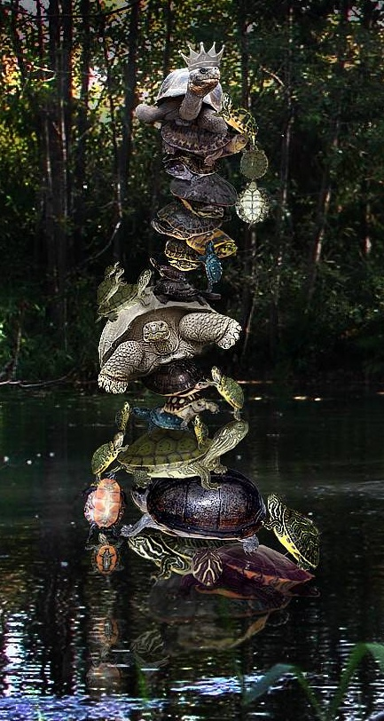
Introduction
Over the past year, we’ve been experimenting using data cubes to support carbon-climate, hydrology, and other eco-scientists
While the science differs, the data sets have much in common
The cube is a useful tool in the data analysis pipeline
Along the way, we’ve wondered how to build toward a “My Cube” service
Empower the scientist to build a custom cube for a specific analysis
http://bwc.berkeley.edu/
http://www.fluxdata.org/

Slide 3
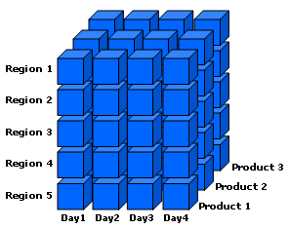
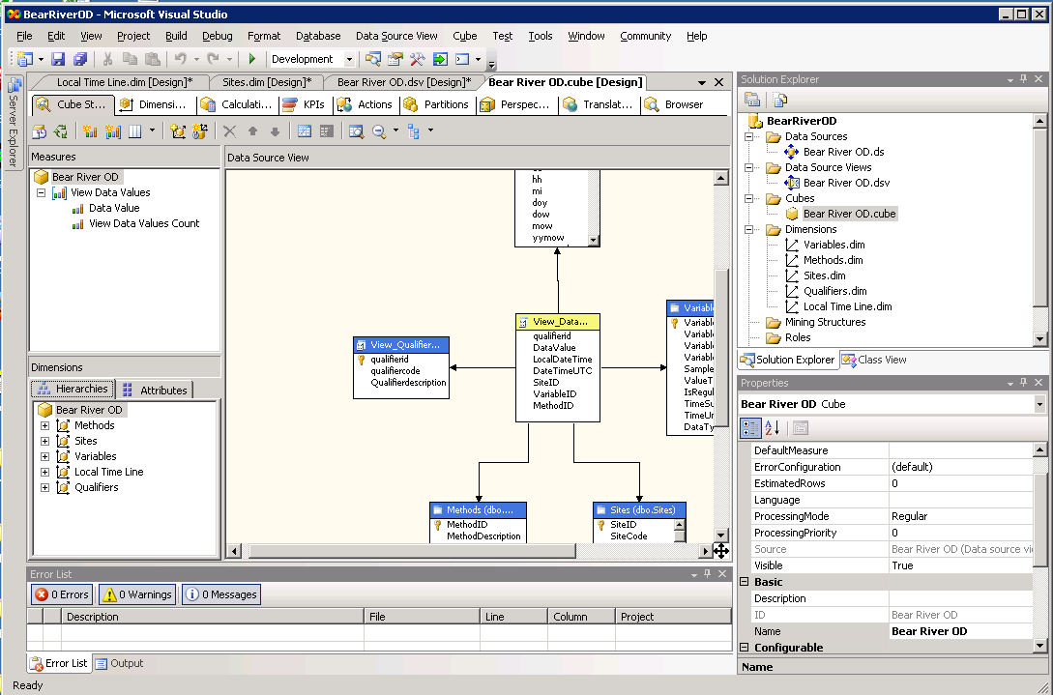
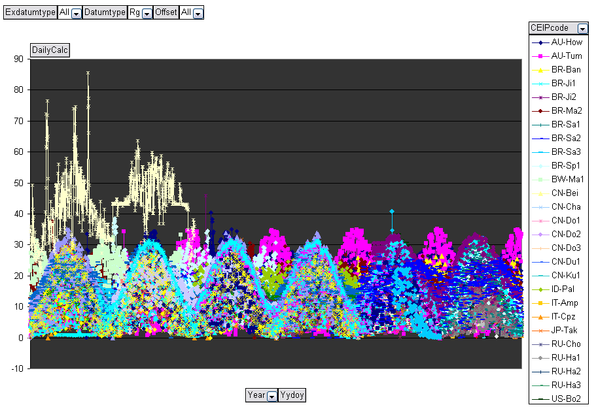
Data Cube Basics
A data cube is a database specifically for data mining (OLAP)
Initially developed for commercial needs like tracking sales of Oreos and milk
Simple aggregations (sum, min, or max) can be pre-computed for speed
Hierarchies for simple filtering with drilldown capability
Additional calculations (median) can be computed dynamically or pre-computed
All operate along dimensions such as time, site, or datumtype
Constructed from a relational database
A specialized query language (MDX) is used
Client tool integration is evolving
Excel PivotTables allow simple data viewing
More powerful analysis and plotting using Matlab and statistics software
Daily Rg 2000-2005 72 sites, 276 site-years

Slide 4
Eco-Science Data
What we start with

Slide 5
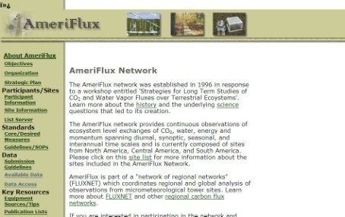
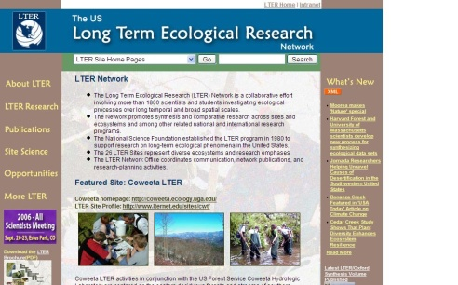
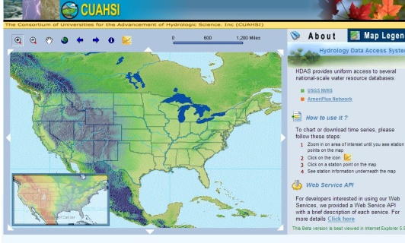
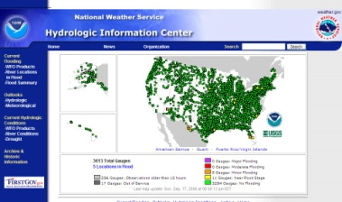
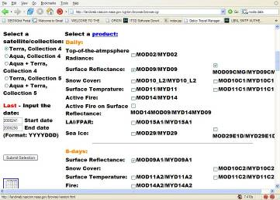
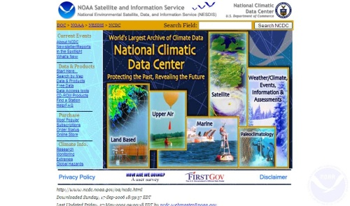
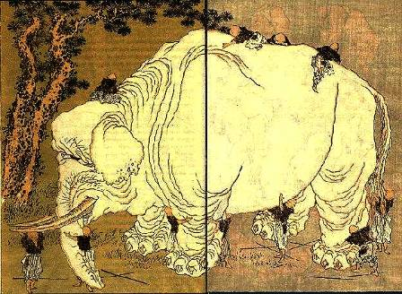
Ecological Data Avalanche/Landslide/Tsunami
The era of remote sensing, cheap ground-based sensors and web service access to agency repositories is here
Extracting and deriving the data needed for the science remains problematic
Specialized knowledge
Finding the right needle in the haystack

Slide 6
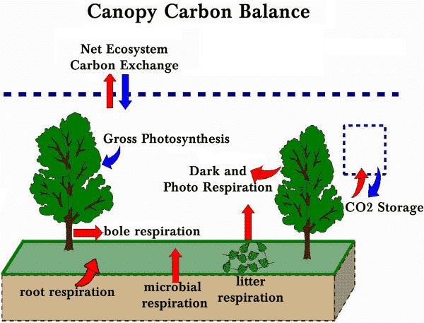
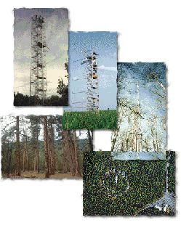
Carbon-Climate Research Overview
What is the role of photosynthesis in global warming?
Measurements of Co2 in the atmosphere show 16-20% less than emissions estimates predict
Do plants absorb more than we expect?
Communal field science – each principle investigator acts independently to prepare and publish data.
496 sites world wide organized into 13 networks plus some unaffiliated sites
AmeriFlux: 149 sites across the Americas
CarboEuropeIP: 129 sites across Europe
Data sharing across investigators just beginning
Level 2 data published to and archived at network repository
Level 3 & 4 data now being produced in cooperation with CarboEuropeIP and served by BWC TCI
Total fluxnet data accumulated to date ~800M individual measurements
http://www.fluxdata.org
http://gaia.agraria.unitus.it/cpz/index3.asp
6
Notes:
10/21/2007 12:06 PM
6
Microsoft Confidential© 2004 Microsoft Corporation. All rights reserved.
This presentation is for informational purposes only. Microsoft makes no warranties, express or implied, in this summary.
Example science questions
Net carbon exchange for the ecosystem
Impact of climate change on the greening of ecosystems
Start of leaf growth
Duration of photosynthesis
Effects of early spring on carbon uptake
Role of ecosystem and latitude on carbon flux
Effect of various pollution sources on carbon in atmosphere and carbon balance
Measurements are not easy to make
Birds poop on automated sensors/instruments
Many manual steps in the field (no sensor will help soon)

Slide 7
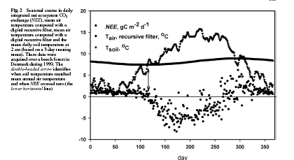
Eco-Science Data
When we say data we mean predominantly time series data
Over some period of time at some time frequency at some spatial location.
May be actual measurement (L0) or derived quantities (L1+)
(Re)calibrations are a way of life.
Various quality assessment algorithms used to mark and/or correct spikes, drifts, etc.
Gaps and errors are a way of life.
Birds poop, batteries die, and sensors fail.
Gap filling algorithms becoming more and more common because a regularly spaced time series is much simpler to analyze
Space and time are fundamental drivers
Versioning is essential
T SOIL
T AIR
Onset of photosynthesis

Slide 8
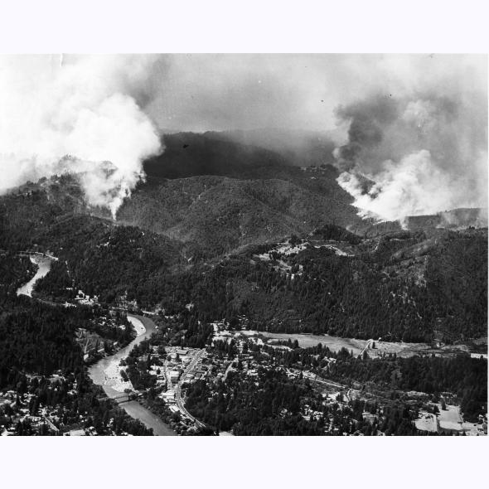
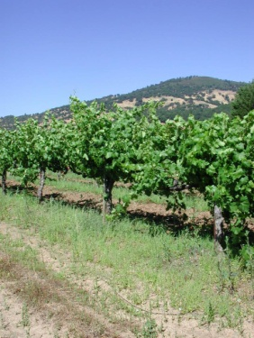
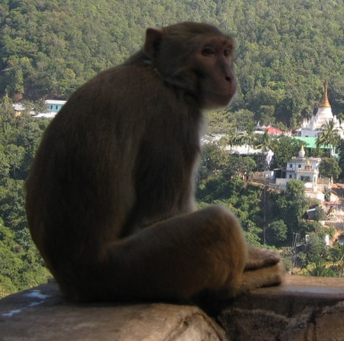
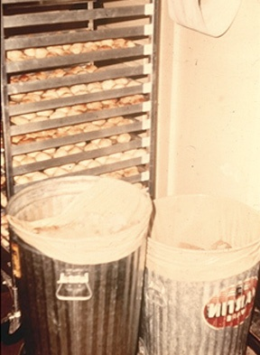
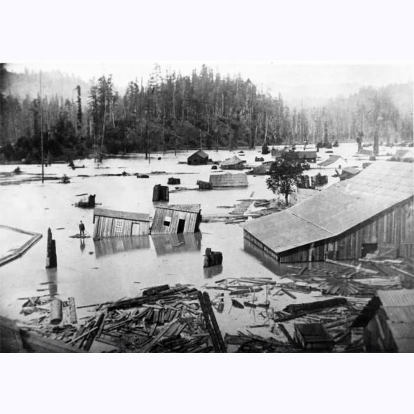
Eco-Science Ancillary Data
When we say ancillary data, we mean non-time series data
May be ‘constant’ such as latitude or longitude
May be measured intermittently such as LAI (leaf cross-sectional area) or sediment grain size distribution
May be a range and estimated time
May be a disturbance such as a fire, harvest, or flood
May be derived from the data such as flood
Not metadata such as instrument type, derivation algorithm, etc.
Usage pattern is key
Constant location attributes or aliases
Time series data (by interpolating or “gap filling” irregular samples
Time filters (short periods before or after an event or sampled variable)
Time benders (“since <event>” including the deconvolution of closely spaced events a fire

Slide 9
Eco-Science Analyses
Why use a datacube?

Slide 10
The Data Pipeline
Data Gathering | Discovery and Browsing | Science Exploration | Domain specific analyses | Scientific Output
“Raw” data includes sensor output, data downloaded from agency or collaboration web sites, papers (especially for ancillary data | “Raw” data browsing for discovery (do I have enough data in the right places?), cleaning (does the data look obviously wrong?), and light weight science via browsing | “Science variables” and data summaries for early science exploration and hypothesis testing. Similar to discovery and browsing, but with science variables computed via gap filling, units conversions, or simple equation. | “Science variables” combined with models, other specialized code, or statistics for deep science understanding. | Scientific results via packages such as MatLab or R2. Special rendering package such as ArcGIS. Paper preparation.

Slide 11
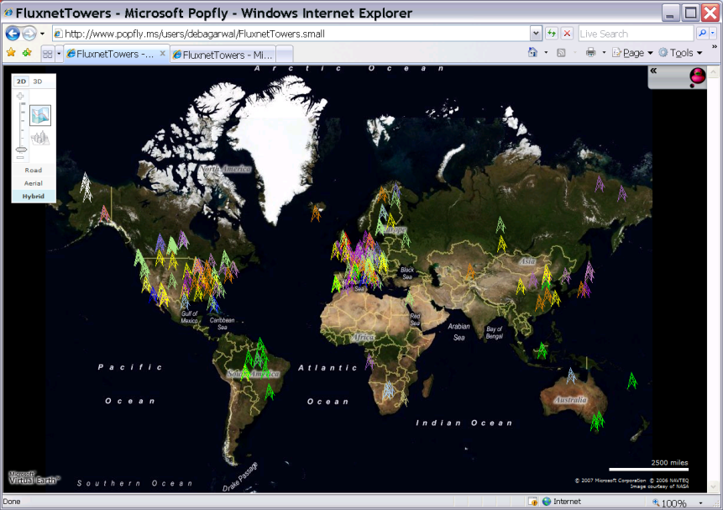
Browsing for Data Availability
Summary data products (yearly min/max/avg) almost trivially
Simple mashups and data cubes aid discovery of available data
Simple Excel graphics show cross-site comparisons and availability filtered by one variable or another
Notes:
Above is mashup of http://www.fluxdata.org/ Follow the dataset information link.

Slide 12
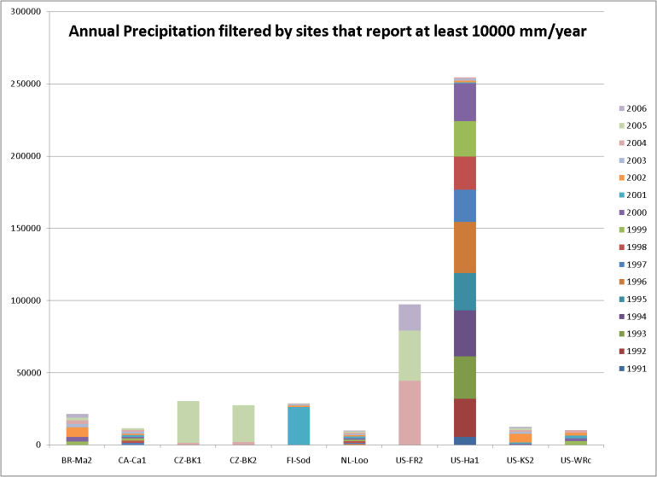
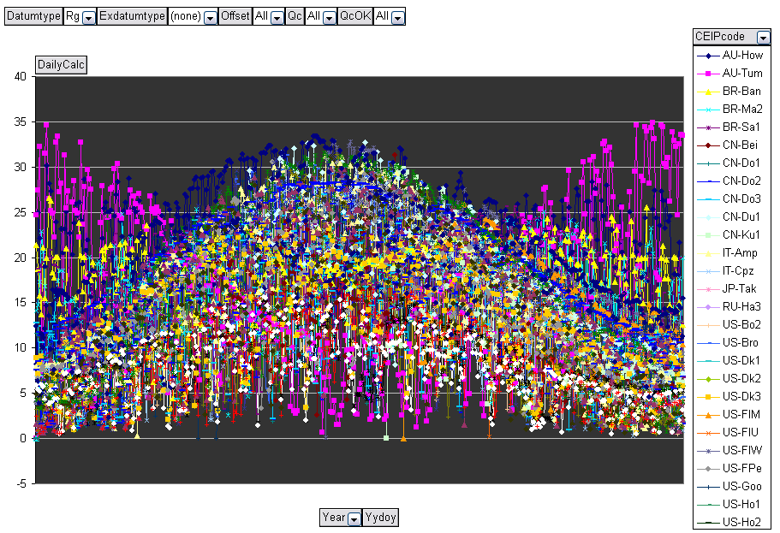
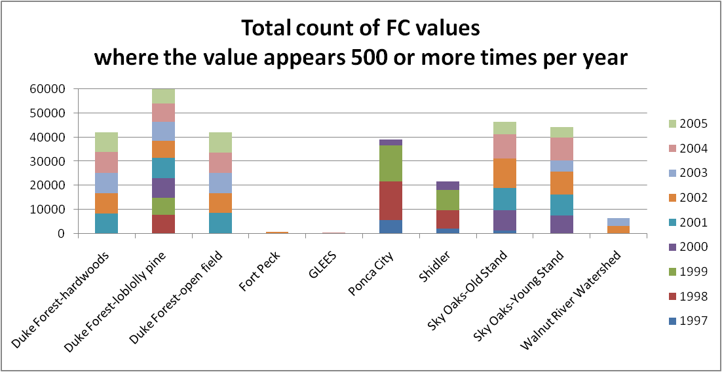
Browsing for Data Quality
Data cleaning never ends
Existing practice of running scripts on specific site years often misses the big picture
Corrections to calibration
Notes:
Upper graph shows error processing sites with daily rather than half-hourly precipitation
Lower graph shows error in time axis reporting (navy series)
Left lower graph shows bad instrumentation – data is too “discrete” or quantized. Shouldn’t have so many common data values.

Slide 13
Eco-Science Datacubes
Building our datacube family

Slide 14
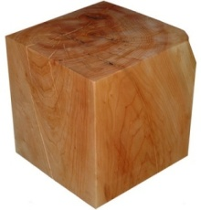
Cube Dimensions
We’ve been building cubes with 5 dimensions
What: variables
When: time, time, time
Where: (x, y, z) location or attribute where (x,y) is the site location and (z) is the vertical elevation at the site.
Which: versioning and other collections
How: gap filling and other data quality assessments
When: time
Which: version
How: quality
What: variables
Where: location
Driven by the nature of the data – space and time are fundamental drivers for all earth sciences.

Slide 15
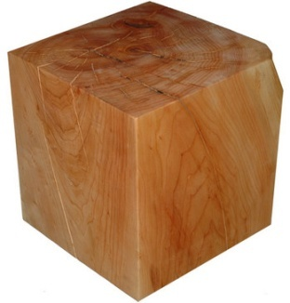
Cube Measures
We’ve been including a few computed members in addition to the usual count, sum, minimum and maximum
hasDataRatio: fraction of data actually present across time and/or variables
DailyCalc: average, sum or maximum depending on variable and includes units conversion
YearlyCalc: similar to DailyCalc
RMS or sigma: standard deviation or variance for fast error or spread viewing
Driven by the nature of the analyses – gaps, errors, conversions, and scientific variable derivations are facts of life for earth science data.

Slide 16
What: variables and measures
Core variables or datumtypes | Non-core or extended datumtypes | Ancillary data treated as time-series data or filters. Note that the gap filling or interpolation algorithm is likely domain-specific.
Daily and yearly value calculation, data counts, min/max values | Hierarchies to solve very large namespace navigation. Note that most science cannot leverage cube aggregations here. | Special calculation such as potential evapotranspiration or bedload sediment transport.

Slide 17
When: handling time
Core time hierarchies. Includes simple calendar, water year, MODIS week. | “tunable” time filters such as morning, afternoon, night, winter; each defined by a start/stop at a hierarchical level. | Time period definition determined by time-series variable (eg. PAR-day determined by photosynthetic activity)
Selectable hierarchy top and bottom: decade, year, month, day |  | Time folding based on data value (eg. after a rain) or ancillary data value (eg. after a fire).
“time is not just another axis”

Slide 18
Where: handling location
Site (location) presented by friendly name and selectable constant site ancillary data such as latitude band or vegetationtype. | Selectable site hierarchies for simple navigation (ala variable) or aggregation (eg. state or HUC). | Site selection determined by time-series variable (eg. minimum temperature) or non-constant ancillary variable (eg. above a soil nitrogen threshold).
No offset. Either one vertical location or aggregated over the vertical. | Geo-spatial calculations | Vertical profiles

Slide 19
Which: versions and subsets
No version (dataset chosen when cube is built). | Selectable site hierarchies for simple navigation (ala variable) or aggregation (eg state or HUC). | Datasets used to include/exclude location subsets, datumtype subsets, or the same data at different processing levels or measurement granularity (eg USGS daily vs 15 minute stream flow).

Slide 20
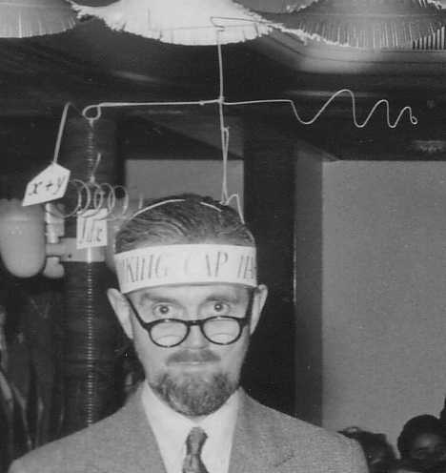
How: quality
Ignore any quality metric | Simple statistics, gap-filling, spike detection, level delta and drift checks. | ??????
 | Quality dimension to allow visualization and filtering
This is clearly where we’ll be spending more time!

Slide 21
How Does This Fit in the Scientific Process?
Data Gathering | Discover y and Browsing | Science Exploration | Domain specific analyses | Outputs
Automation of data ingest. As standards emerge, sensor data acquisition and ingest will become easier. | Data cube. Should be reasonably straight forward to generalize. (Data mining could be interesting here) | Data cube calculated dimensions/ aggregations. Some conversions are simple. Some exploration is just browsing with different variables. | My calculation/ My cube/My database. “Special purpose – may be hard to do given the base database/ datacube technologies. (Workflow technologies might help here) | Interfaces to commercial products and shareware. Should be reasonably straight forward to generalize. (Web services and Collaborative tools help here)

Slide 22
Acknowledgements
Berkeley Water Center, University of California, Berkeley, Lawrence Berkeley Laboratory
Jim Hunt
Deb Agarwal
Robin Weber
Monte Good
Rebecca Leonardson (student)
Matt Rodriguez
Carolyn Remick
Susan Hubbard
University of Virginia
Marty Humphrey
Norm Beekwilder
Microsoft
Catharine van Ingen
Jayant Gupchup (student)
Savas Parastidis
Andy Sterland
Nolan Li (student)
Tony Hey
Dan Fay
Jing De Jong-Chen
Stuart Ozer
SQL product team
Jim Gray
Ameriflux Collaboration
Beverly Law
Youngryel Ryu (postdoc)
Tara Stiefl (student)
Gretchen Miller (student)
Mattias Falk
Tom Boden
Bruce Wilson
Fluxnet Collaboration
Dennis Baldocchi
Rodrigo Vargas (postdoc)
Dario Papale
Markus Reichstein
Bob Cook
Susan Holladay
Dorothea Frank
The saga continues at http://bwc.berkeley.edu and http://www.fluxdata.org

