Slide 1
PHENIX Central arm physics with √s=500GeV (polarized) pp collisions
Kensuke Okada for PHENIX
RIKEN-BNL Research Center
JPS September 23, 2008
(The presentation was performed with the Japanese version.)

Slide 2
RHIC spin program
⎯RHIC
The polarized proton proton collider
The maximum collision energy is 500GeV
⎯3 programs
Longitudinal spin program
Transverse spin program
W boson program
√s=500GeV program
It’s about started!
What’s the W boson program? →

Slide 3
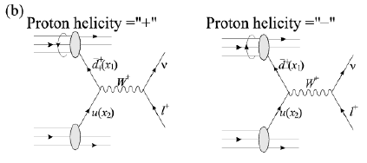
(anti-) quark components of proton spin
⎯Measurements before RHIC
Semi Deep Inelastic Scattering (SDIS)
We rely (anti-) quark fragmentation models
⎯RHIC W-boson program
W-bozon production violates the parity
d-bar+u →W+
u-bar+d →W-
d-bar, u-bar is always
positive helicity
proton
W+ A_{L}: Longitudinal single spin asymmetry
Information of d-bar in the proton
d-bar

Slide 4
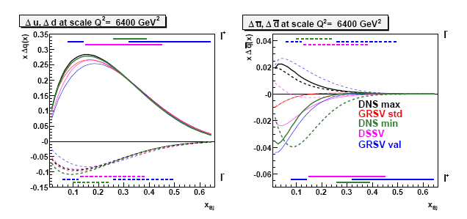

The current knowledge
It’s important to know how W is produced for the x-dependence
But it isn’t so easy.

Slide 5
How to detect W
⎯PHENIX detector
Good for detecting electrons (central arm) and muons (muon arm).
(However) It doesn’t have the 4pi coverage.
○ Leptonic decay mode
× Mass reconstruction
At the central arm
e+
e+
d-bar
u
W+
Center of mass frame
Experimental frame
W-
u-bar
d
e-
e-

Slide 6
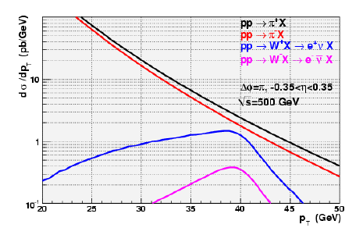
W->e in the central arm
pT distribution
of electrons from W
More e+ than e-
Explained in the previous slide
A special feature
from the 2-body decay
Jacobean peak
M_W/2

Slide 7
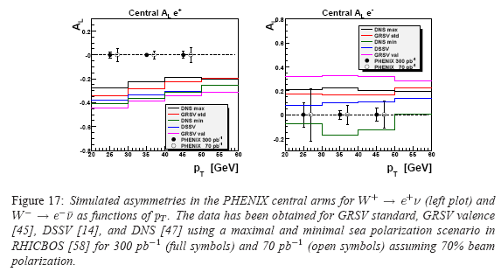
Asymmetry expected
300/pb
70/pb
-0.4
Estimation for the near future
3 weeks physics (preparation is about 5 weeks)
7.5/pb * 3 = 22.5/pb
The first non-zero
asymmetry from the PHENXI
central arm is expected!
420e+,
70e-
dA_L=0.07 (with 50% pol)
Notes:
数字要チェック
はじめの勢いが大分衰えてきていますが、まだ実際の測定について述べていません。

Slide 8
W→e at the central arm
Data acquisition ： EMCal trigger
Charge separation of high energy particle : magnetic field, track reconstruction
Backgrounds
π0 →2γ → conversion electron :
photon has the half energy on average (*0.26) & material before DC (*~3%)
π+- → hadronic interaction
Notes:
HBD how much?

Slide 9
Charge identification
W+ or W-
The basic algorithm in PHENIX (with no inner tracking)
Drift
chamber
vtx
Δx
B field
α
For 40GeV charged particles
Magnetic field option-1 (++ field) : α=2.4 [mrad]
option-2 (+- field): α=1.7 [mrad]
DC resolution
Δα=0.5[mrad]
vs
It looks feasible
But Δx is very small (3mm in the option-2),
it’s important to determine the vertex position
The momentum resolution is very bad at this momentum.

Slide 10
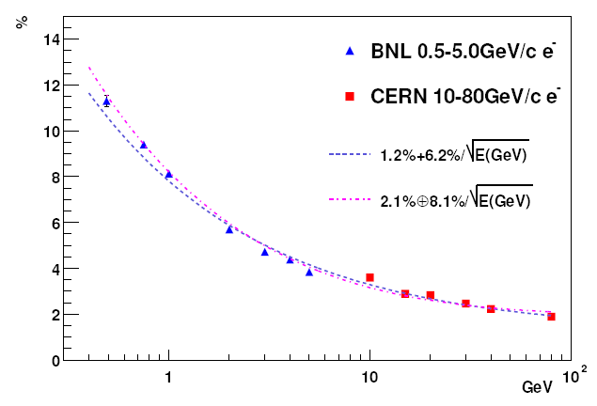
EMCal energy resolution
Energy resolution
Test beam
(PbSc)
PEHNIX data ~6%⊕8%/sqrt(E)
6%
2.1 %
40GeV
It’s better for the momentum measurement than using the DC
An additional merit : rejection of charged pion contribution
Notes:
Rejection in Japanese?

Slide 11
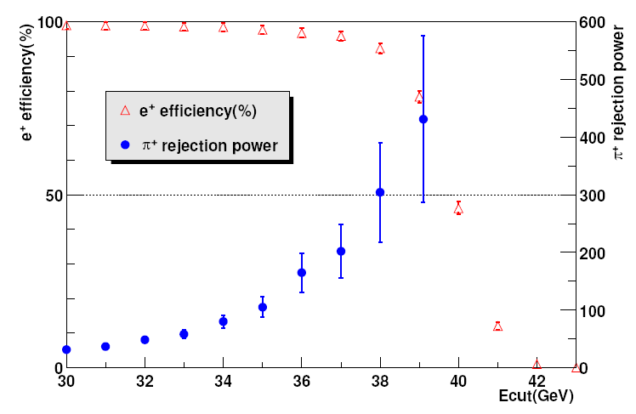
Rejection of charged pions
40GeV pi+, e+
Test beam result
& MC
40GeV charged pions
The rejection power is about 30
With Edep>30GeV.
It looks OK for W+ > e+

Slide 12
Additional rejection
― EMCal response
E_dep measurement : ~30
E/p : we can’t expect much because of bad resolution.
cluster shape cut : at most factor 2?
― Isolation cut (study is in progress)
From the direct photon analysis (sqrt(s)=200GeV), pi0 photons are rejected
by a factor 2 with an isolation cut.
Estimation with PYTHIA : in progress
―TEC/TRD
Ideal with Xenon gas
The acceptance will be limited, but it can be used for the reference

Slide 13
Preparation
For Run9
The dynamic range of the EMCal needs to be changed (Currently ~20GeV max)
Based on the current calibration, it’s relatively easy.
There are some bad regions. Hope to fix them at this time.
Vertex position
Do we need to calibrate fill by fill?
Can it be done with physics runs?
Software and analysis method
Maintenances of GEANT based MC
reliability of hadronic shower?

Slide 14
Summary
One of RHIC spin programs : Measurement of (anti-) quark components of proton
spin with W production.
High energy electron in the PHENIX central arm.
W+ is more than W-.
Trigger OK
Charge discrimination OK ( important to know the vertex)
Background rejection
BG from neutral pions: >100
BG from charged pions: >30 →enough for W+
For Run9
About 3 weeks of 500GeV run? (The priority is in 200GeV run)
7.5/pb (recorded)* 3 = 22.5/pb
δA_{L}=0.07 (with 50% pol) for ~0.4 in W+→e+
It is the first step to confirm the non-zero asymmetry.

Slide 15
Backup

Slide 16
PHENIX algorithm
DC
vertex
α
It is ideal if the magnetic field is localized at the end.

Slide 17
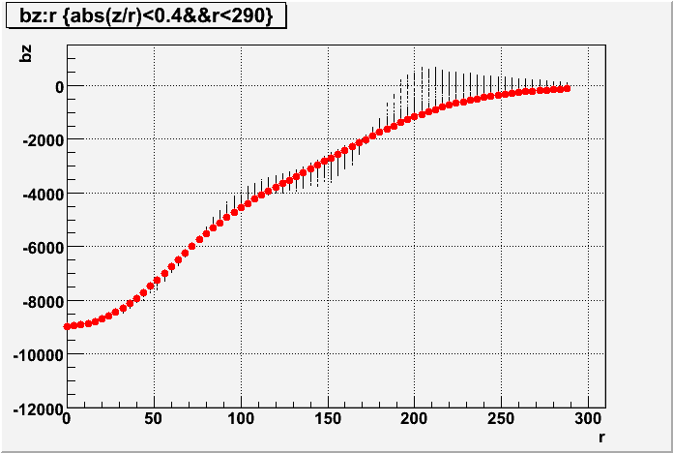
W->e charge identification
++ field
Field map (from Sim3D++.root)
gauss
Red points
z=0,phi=0
cm

Slide 18
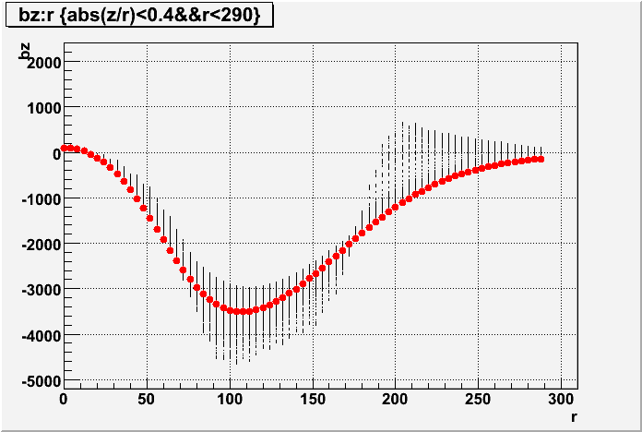
+- field
Field map (from Sim3D+-.root)

Slide 19
Magnetic field integral
…..
…..
Δx
θ
40GeV charged particle
++ field : θ=7.73[mrad], Δx=0.0117[m], l=2.2m → α=2.4 [mrad]
+- field : θ=3.24[mrad], Δx=0.00331[m], l=2.2m → α=1.7 [mrad]
From DC resolution (~0.5mrad), the +- field is feasible (3σ effect).
Here it assumed ultimate vertex position resolution.
How precise can we determine the position?
The beam size itself is σ~0.3mm from the vernier scan.

