Slide 1
Berkeley Storage Manager (BeStMan)
Alex Sim
Scientific Data Management Research Group
Computational Research Division
Lawrence Berkeley National Laboratory

Slide 2
Berkeley Storage Manager
BeStMan
Full implementation of SRM v2.2
But not ACLs - srmSetPermission
For UNIX-like disk based file system
Mass Storage support
Currently, for HPSS and NCAR-MSS
Plug-in capability for easy customization for underlying MSS
E.g. SRM/L-Store

Slide 3
BeStMan Features
Multiple disk partition support
Default space management for files with lifetime
Allocation of space, garbage collection
Space reservation management
Support for multiple file transfer servers
E.g. configure for 5 GridFTP servers
Per-user (not per-request) request management
Multi-file/directory per request
Incoming and outgoing file transfer queue management
Easy adaptability to Unix-based file systems
API for customization for local mass storage systems
Simple installation and easy maintenance

Slide 4
Who is it for?
Sites where maintenance needs to be minimal
Main use is for disks with unix-based file systems
Can be customized for MSS as well
In OSG, mostlikely sites are tier2/tier3

Slide 5
LBNL SRM effort (external to OSG)
SRM v1.1
DRM for UNIX-like disk based file system
HRM for HPSS and NCAR-MSS
SRM v2.2
BeStMan
For UNIX-like disk based file system
For HPSS and NCAR-MSS
BeStMan-Gateway
Skeleton SRM for local implementation
SRM-Xrootd: using BeStMan-Gateway for Xrootd – in progress
Xrootd-SRM: using BeStMan in Xrootd nodes – in progress
SRM layer for SRB (iRODS) – consulting with Sinica - in progress
SRM-Client-2
SRM-Tester-2
Notes:
We don’t have a statistics in US like our European colleagues.

Slide 6






















Interoperability with other SRM v2.2
dCache
CASTOR
Disk
BeStMan
DPM
mySQL DB
xrootd
BNL
SLAC
LBNL
Client
User/application
SRB (iRODS)
SDSC
SINICA
LBNL
EGEE
Notes:
One example of SRM v2.2 testing in last Super Computing.

Slide 7
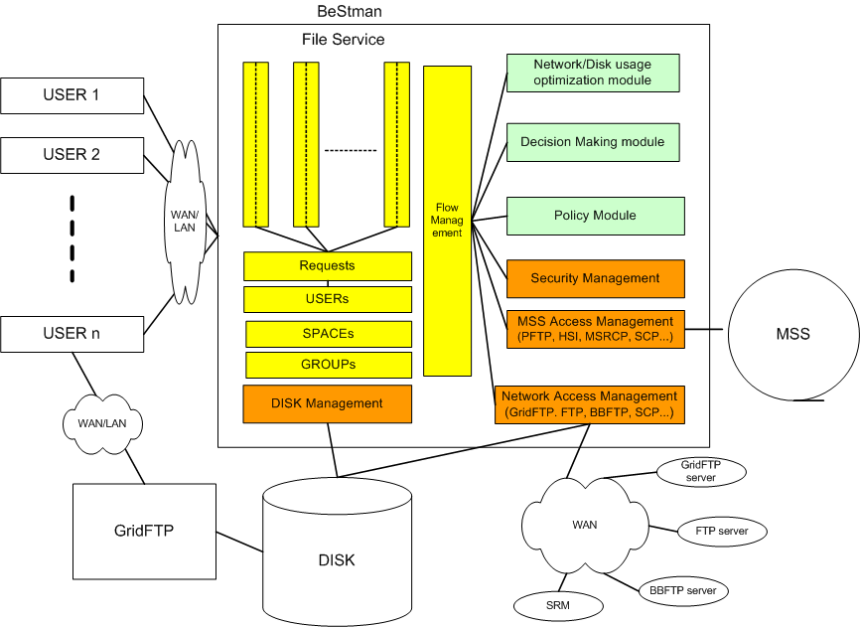
BeStMan design

Slide 8
Some Production Use Cases
STAR experiment
Uses DRM for analysis
Uses HRMs for production-level file replications
HPSS access at BNL and NERSC/LBNL
Currently, extensive testing with BeStMan
Earth System Grid
Uses DRMs and HRMs at multiple sites
Uses an adapted HRM for NCAR’s MSS
Plans to update to BeStMan, SRM v2.2
Notes:
A couple examples of SRMs in production grid that LBNL is involved in.
There are more but at least we are familiar with these.

Slide 9
STAR experiment
Data Replication from BNL to LBNL
1TB/10K files per week on average
In production for over 4 years
Event processing in Grid Collector
Prototype uses SRMs and FastBit indexing embedded in STAR framework
STAR analysis framework
Job driven data movement
Use BeStMan to bring files into local disk from a remote file repository
Execute jobs that access “staged in” files in local disk
Job creates an output file on local disk
Job uses BeStMan to moves the output file from local storage to remote archival location
SRM cleans up local disk when transfer complete
Can use any other SRMs implementing v2.2

Slide 10

STAR Analysis scenario (1)
Client
Job submission
Remote sites
A site
SRMs
Worker Nodes
Client Job
Gate Node
Disk
GridFTP server
Disk
Client Job
BeStMan
Disk
Disk
Client Job
Disk
BeStMan
Disk
Disk
Disk
Cache
DISK
CACHE
Client Job
BeStMan
Disk
Disk
Disk
Cache
Cache

Slide 11
STAR Analysis scenario (2) (dynamic SRM instantiation)
SRM Job submission
Client
Client Job submission
Remote sites
A site
SRMs
Worker Nodes
Client Job
Gate Node
Disk
GridFTP server
Disk
Client Job
BeStMan
Disk
Disk
Client Job
Disk
BeStMan
Disk
Disk
Disk
Cache
DISK
CACHE
Client Job
BeStMan
Disk
Disk
Disk
Cache
Cache

Slide 12
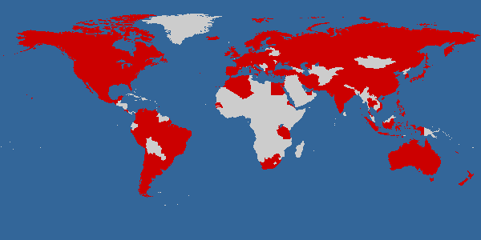
Earth System Grid
Main ESG portal
148.53 TB of data at four locations (NCAR, LBNL, ORNL, LANL)
965,551 files
Includes the past 7 years of joint DOE/NSF climate modeling experiments
4713 registered users
Downloads to date: 31TB/99,938 files
IPCC AR4 ESG portal
28 TB of data at one location
68,400 files
Model data from 11 countries
Generated by a modeling campaign coordinated by the Intergovernmental Panel on Climate Change (IPCC)
818 registered analysis projects
Downloads to date: 123TB/543,500 files, 300 GB/day on average
Courtesy: http://www.earthsystemgrid.org

Slide 13
SRMs in ESG
Client
Files Selection
And Request
HRM
@ LBNL
download
Disk
Disk
Cache
HRM
@ NCAR
Cache
Portal
DRM
@ LANL
Disk
Disk
Cache
Cache
DRM
@ LLNL
Disk
Disk
Disk
Cache
Cache
Cache
DISK
CACHE
NCAR
MSS
HRM
@ ORNL
Disk
Disk
Cache
Cache

Slide 14
SRM works in concert with other Grid components in ESG
LBNL
DISK
HPSS
ANL
GridFTP service
HRM
Storage Resource
Management
RLS
Globus Security infrastructure
GridFTP
server
NCAR
ESG Portal
RLS
ORNL
LLNL
HRM
Storage Resource
Management
DISK
IPCC Portal
User DB
XML
data
catalogs
ESG CA
GridFTP
server
XML data
catalogs
ESG Metadata DB
MyProxy
RLS
DISK
DRM
Storage Resource
Management
OPeNDAP-g
RLS
LAHFS
HPSS
GridFTP server
FTP server
GridFTP
server
HRM
Storage Resource
Management
ISI
LANL
DISK
MCS Metadata Cataloguing Services
RLS
RLS Replica Location Services
MSS
Mass
Torage
System
DRM
Storage Resource
Management
DISK
GridFTP
server
Monitoring Discovery ervices

Slide 15
Summary
BeStMan is an implementation of SRM v2.2.
Used in projects
STAR project
Earth System Grid
Plans for Combustion, Fusion applications
Interoperates with other SRM v2.2 implementations
Open Science Grid
WLCG/EGEE
…
Simple installation and easy maintenance
Notes:
Testing new version implementations in pre-production environment is essential for successful release and deployments.
Detailed testing on new implementations are important.
Deployed implementations in production environment must also be tested for availability and basic functionalities, as well as for reliability and stress testing.

Slide 16
Documents and Support
BeStMan
http://datagrid.lbl.gov/bestman
Downloadable through VDT
SRM Collaboration and SRM Specifications
http://sdm.lbl.gov/srm-wg
Contact and support : srm@lbl.gov

