Slide 1
Grid, Storage and SRM
Jan. 29-31, 2008

Slide 2
Introduction

Slide 3
Storage and Grid
Grid applications need to reserve and schedule
Compute resources
Network resources
Storage resources
Furthermore, they need
Monitor progress status
Release resource usage when done
For storage resources, they need
To put/get files into/from storage spaces
Unlike compute/network resources, storage resources are not available when jobs are done
files in spaces need to be managed as well
Shared, removed, or garbage collected

Slide 4
Motivation & Requirements (1)
Suppose you want to run a job on your local machine
Need to allocate space
Need to bring all input files
Need to ensure correctness of files transferred
Need to monitor and recover from errors
What if files don’t fit space?
Need to manage file streaming
Need to remove files to make space for more files

Slide 5
Motivation & Requirements (2)
Now, suppose that the machine and storage space is a shared resource
Need to do the above for many users
Need to enforce quotas
Need to ensure fairness of space allocation and scheduling

Slide 6
Motivation & Requirements (3)
Now, suppose you want to run a job on a Grid
Need to access a variety of storage systems
mostly remote systems, need to have access permission
Need to have special software to access mass storage systems

Slide 7
Motivation & Requirements (4)
Now, suppose you want to run distributed jobs on the Grid
Need to allocate remote spaces
Need to move files to remote sites
Need to manage file outputs and their movement to destination sites

Slide 8
Storage Resource Managers

Slide 9
What is SRM?
Storage Resource Managers (SRMs) are middleware components
whose function is to provide
dynamic space allocation
file management
on shared storage resources on the Grid
Different implementations for underlying storage systems are based on the same SRM specification
Notes:
Brief history will follow after this slide

Slide 10
SRMs role in grid
SRMs role in the data grid architecture
Shared storage space allocation & reservation
important for data intensive applications
Get/put files from/into spaces
archived files on mass storage systems
File transfers from/to remote sites, file replication
Negotiate transfer protocols
File and space management with lifetime
support non-blocking (asynchronous) requests
Directory management
Interoperate with other SRMs
Notes:
Brief history will follow after this slide

Slide 11
Client and Peer-to-Peer Uniform Interface
...
Client’s site
Uniform SRM
interface
Client
(command line)
client
Client
Program
Disk
Cache
Storage
Resource
Manager
Disk
Cache
network
Storage
Resource
Manager
Storage
Resource
Manager
Storage
Resource
Manager
...
...
...
MSS
Disk
Cache
Disk
Cache
Disk
Cache
Disk
Cache
Disk
Cache
Site 1
Site 2
Site N

Slide 12
History
7 year of Storage Resource Management (SRM) activity
Experience with system implementations v.1.1 (basic SRM) – 2001
MSS: Castor (CERN), dCache (FNAL, DESY), HPSS (LBNL, ORNL, BNL), JasMINE (Jlab), MSS (NCAR)
Disk systems: dCache (FNAL), DPM (CERN), DRM (LBNL)
SRM v2.0 spec – 2003
SRM v2.2 – enhancements introduced after WLCG (the World-wide LHC Computing Grid) adopted SRM standard
Several implementations of v2.2
Extensive compatibility and interoperability testing
MSS: Castor (CERN, RAL), dCache/{Enstore,TSM,OSM,HPSS} (FNAL, DESY), HPSS (LBNL), JasMINE (Jlab), SRB (SINICA, SDSC)
Disk systems: BeStMan (LBNL), dCache (FNAL, DESY), DPM (CERN), StoRM (INFN/CNAF, ICTP/EGRID)
Open Grid Forum (OGF)
Grid Storage Management (GSM-WG) at GGF8, June 2003
SRM collaboration F2F meeting – Sept. 2006
SRM v2.2 spec on OGF recommendation track – Dec. 2007

Slide 13
Who’s involved…
CERN, European Organization for Nuclear Research, Switzerland
Deutsches Elektronen-Synchrotron, DESY, Hamburg, Germany
Fermi National Accelerator Laboratory, Illinois, USA
ICTP/EGRID, Italy
INFN/CNAF, Italy
Lawrence Berkeley National Laboratory, California, USA
Rutherford Appleton Laboratory, Oxfordshire, England
Thomas Jefferson National Accelerator Facility, Virginia, USA
Notes:
This list does not include anyone in the storage component development and implementations.

Slide 14
SRM : Concepts

Slide 15
SRM: Main concepts
Space reservations
Dynamic space management
Pinning file in spaces
Support abstract concept of a file name: Site URL
Temporary assignment of file names for transfer: Transfer URL
Directory management and authorization
Transfer protocol negotiation
Support for peer to peer request
Support for asynchronous multi-file requests
Support abort, suspend, and resume operations
Non-interference with local policies

Slide 16
Site URL and Transfer URL
Provide: Site URL (SURL)
URL known externally – e.g. in Replica Catalogs
e.g. srm://ibm.cnaf.infn.it:8444/dteam/test.10193
Get back: Transfer URL (TURL)
Path can be different from SURL – SRM internal mapping
Protocol chosen by SRM based on request protocol preference
e.g. gsiftp://ibm139.cnaf.infn.it:2811//gpfs/sto1/dteam/test.10193
One SURL can have many TURLs
Files can be replicated in multiple storage components
Files may be in near-line and/or on-line storage
In a light-weight SRM (a single file system on disk)
SURL may be the same as TURL except protocol
File sharing is possible
Same physical file, but many requests
Needs to be managed by SRM implementation

Slide 17
Transfer protocol negotiation
Negotiation
Client provides an ordered list of preferred transfer protocols
SRM returns first protocol from the list it supports
Example
Client provided protocols list: bbftp, gridftp, ftp
SRM returns: gridftp
Advantages
Easy to introduce new protocols
User controls which transfer protocol to use
How is it returned?
The protocol of the Transfer URL (TURL)
Example: bbftp://dm.berkeley.edu//temp/run11/File678.txt

Slide 18
Types of storage and spaces
Access latency
On-line
Storage where files are moved to before their use
Near-line
Requires latency before files can be accessed
Retention quality
Custodial (High quality)
Output (Middle quality)
Replica (Low Quality)
Spaces can be reserved in these storage components
Spaces can be reserved for a lifetime
Space reference handle is returned to client – space token
Total space of each type are subject to local SRM policy and/or VO policies
Assignment of files to spaces
Files can be assigned to any space, provided that their lifetime is shorter than the remaining lifetime of the space

Slide 19
Managing spaces
Default spaces
Files can be put into an SRM without explicit reservation
Default spaces are not visible to client
Files already in the SRM can be moved to other spaces
By srmChangeSpaceForFiles
Files already in the SRM can be pinned in spaces
By requesting specific files (srmPrepareToGet)
By pre-loading them into online space (srmBringOnline)
Updating space
Resize for more space or release unused space
Extend or shorten the lifetime of a space
Releasing files from space by a user
Release all files that user brought into the space whose lifetime has not expired
Move permanent and durable files to near-line storage if supported
Release space that was used by user

Slide 20
Space reservation
Negotiation
Client asks for space: Guaranteed_C, MaxDesired
SRM return: Guaranteed_S <= Guaranteed_C, best effort <= MaxDesired
Types of spaces
Specified during srmReserveSpace
Access Latency (Online, Nearline)
Retention Policy (Replica, Output, Custodial)
Subject to limits per client (SRM or VO policies)
Default: implementation and configuration specific
Lifetime
Negotiated: Lifetime_C requested
SRM return: Lifetime_S <= Lifetime_C
Reference handle
SRM returns space reference handle (space token)
Client can assign Description
User can use srmGetSpaceTokens to recover handles on basis of ownership

Slide 21
Directory management
Usual unix semantics
srmLs, srmMkdir, srmMv, srmRm, srmRmdir
A single directory for all spaces
No directories for each file type
File assignment to spaces is virtual
Access control services
Support owner/group/world permission
ACLs supported – can have one owner, but multiple user and group access permissions
Can only be assigned by owner
When file is requested from a remote site, SRM should check permission with source site

Slide 22
Advanced concepts
Composite Storage Element
Made of multiple Storage Components
e.g. component 1: online-replica component 2: nearline-custodial (with online disk cache)
e.g. component1: online-custodial component 2: nearline-custodial (with online disk cache)
srmBringOnline can be used to temporarily bring data to the online component for fast access
When a file is put into a composite space, SRM may have (temporary) copies on any of the components.
Primary Replica
When a file is first put into an SRM, that copy is considered as the primary replica
A primary replica can be assigned a lifetime
The SURL lifetime is the lifetime of the primary replica
When other replicas are made, their lifetime cannot exceed the primary replica lifetime
Lifetime of a primary replica can only be extended by an SURL owner.

Slide 23
SRM v2.2 Interface
Data transfer functions to get files into SRM spaces from the client's local system or from other remote storage systems, and to retrieve them
srmPrepareToGet, srmPrepareToPut, srmBringOnline, srmCopy
Space management functions to reserve, release, and manage spaces, their types and lifetimes.
srmReserveSpace, srmReleaseSpace, srmUpdateSpace, srmGetSpaceTokens
Lifetime management functions to manage lifetimes of space and files.
srmReleaseFiles, srmPutDone, srmExtendFileLifeTime
Directory management functions to create/remove directories, rename files, remove files and retrieve file information.
srmMkdir, srmRmdir, srmMv, srmRm, srmLs
Request management functions to query status of requests and manage requests
srmStatusOf{Get,Put,Copy,BringOnline}Request, srmGetRequestSummary, srmGetRequestTokens, srmAbortRequest, srmAbortFiles, srmSuspendRequest, srmResumeRequest
Other functions include Discovery and Permission functions
srmPing, srmGetTransferProtocols, srmCheckPermission, srmSetPermission, etc.
Notes:
After that, “then…”

Slide 24
SRM implementations

Slide 25
Berkeley Storage Manager (BeStMan) LBNL
Java implementation
Designed to work with unix-based disk systems
As well as MSS to stage/archive from/to its own disk (currently HPSS)
Adaptable to other file systems and storages (e.g. NCAR MSS, VU L-Store, TTU Lustre, NERSC GFS)
Uses in-memory database (BerkeleyDB)
Local Policy
Fair request processing
File replacement in disk
Garbage collection
Multiple transfer protocols
Space reservation
Directory management (no ACLs)
Can copy files from/to remote SRMs or GridFTP Servers
Can copy entire directory recursively
Large scale data movement of thousands of files
Recovers from transient failures (e.g. MSS maintenance, network down)

Slide 26
Castor-SRM CERN and Rutherford Appleton Laboratory
CASTOR is the HSM in production at CERN
Support for multiple tape robots
Support for Disk-only storage recently added
Designed to meet Large Hadron Collider Computing requirements
Maximize throughput from clients to tape (e.g. LHC experiments data taking)
C++ Implementation
Reuse of CASTOR software infrastructure
Derived SRM specific classes
Configurable number of thread pools for both front- and back-ends
ORACLE centric
Front and back ends can be distributed on multiple hosts

Slide 27
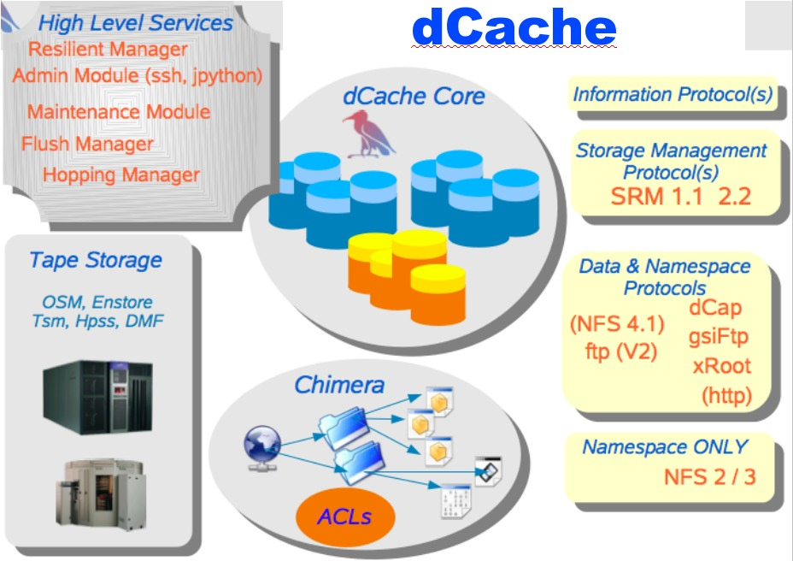
dCache-SRM FNAL and DESY
Strict name space and data storage separation
Automatic file replication based on access patterns
HSM Connectivity (Enstore, OSM, TSM, HPSS, DMF)
Automated HSM migration and restore
Scales to Peta-byte range on 1000’s of disks
Supported protocols:
(gsi/krb)FTP, (gsi/krb)dCap, xRoot, NFS 2/3
Separate I/O queues per protocol
Resilient dataset management
Command line and graphical admin interface
Variety of Authorization mechanisms including VOMS
Deployed in a large number of institutions worldwide
Support SRM 1.1 and SRM 2.2
Dynamic Space Management
Request queuing and scheduling
Load balancing
Robust replication using srmCopy functionality via SRM, (gsi)FTP and http protocols

Slide 28
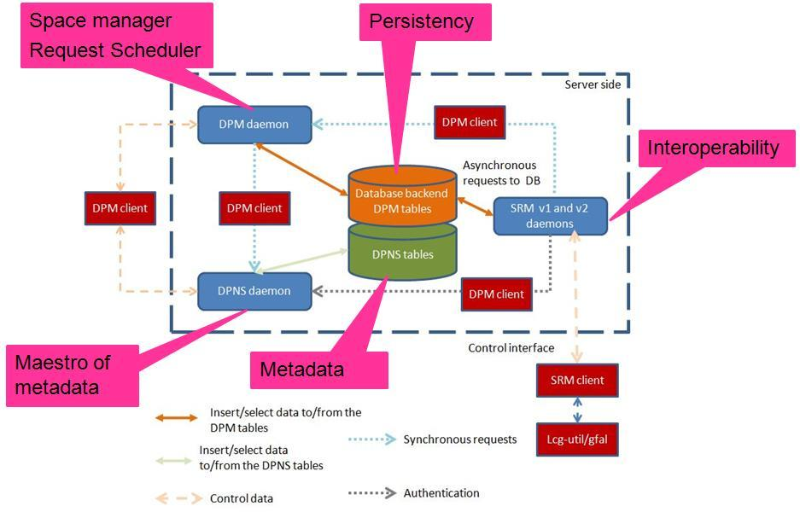
Disk Pool Manager (DPM) CERN
Provide a reliable, secure and robust storage system
Manages storage on disks only
Security
GSI for authentication
VOMS for authorization
Standard POSIX permissions + ACLs based on user’s DN and VOMS roles
Virtual ids
Accounts created on the fly
Full SRMv2.2 implementation
Standard disk pool manager capabilities
Garbage collector
Replication of hot files
Transfer protocols
GridFTP (v1 and v2)
Secure RFIO
https
Xroot
Works on Linux 32/64 bits machines
Direct data transfer from/to disk server (no bottleneck)
Support DICOM backend
Requirement from Biomed VO
Storage of encrypted files in DPM on the fly + local decryption
Use of GFAL/srm to get TURLs and decrypt the file
Supported database backends
MySQL
Oracle
High availability
All servers can be load balanced (except the DPM one)
Resilient: all states are kept in the DB at all times

Slide 29
Storage Resource Manager (StoRM) INFN/CNAF - ICTP/EGRID
It's designed to leverage the advantages of high performing parallel file systems in Grid.
Different file systems supported through a driver mechanism:
generic POSIX FS
GPFS
Lustre
XFS
It provides the capability to perform local and secure access to storage resources (file:// access protocol + ACLs on data).
StoRM architecture:
Frontends: C/C++ based, expose the SRM interface
Backends: Java based, execute SRM requests.
DB: based on MySQL DBMS, stores requests data and StoRM metadata.
Each component can be replicated and instantiated on a dedicated machine.

Slide 30
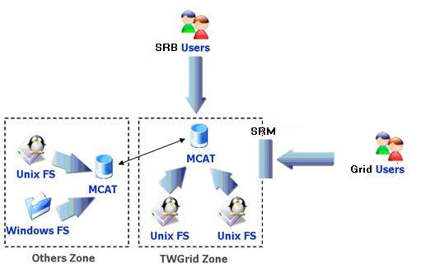
SRM on SRB SINICA – TWGRID/EGEE
SRM as a permanent archival storage system
Finished the parts about authorizing users, web service interface and gridftp deployment, and SRB-DSI, and some functions like directory functions, permission functions, etc.
Currently focusing on the implementation of core (data transfer functions and space management)
Use LFC (with a simulated LFC host) to get SURL and use this SURL to connect to SRM server, then get TURL back
File transfer (gridftp)
User
File transfer (gridftp)
SRM API
Core
Web Service
File
catalog
Data server management
Gridftp/management API
Gridftp/management API
Cache
repository
SRB+DSI
Cache server
(+gridftp server)
SRB/gridftp
Hostname: t-ap20.grid.sinica.edu.tw
Info: SRB server (SRB-DSI installed)
User Interface
Gridftp management commands
Return some information
SURL
TURL
Hostname: fct01.grid.sinica.edu.tw
The end point: httpg://fct01.grid.sinica.edu.tw:8443/axis/services/srm
Info: Cache server (gridftp server) and SRM interface

Slide 31






















Interoperability in SRM v2.2
dCache
CASTOR
Disk
BeStMan
DPM
xrootd
BNL
SLAC
LBNL
Client
User/application
SRB (iRODS)
SDSC
SINICA
LBNL
EGEE
Notes:
One example of SRM v2.2 testing in last Super Computing.

Slide 32
SRMs at work
Europe : LCG/EGEE
191+ deployments, managing more than 10PB
129 DPM/SRM
54 dCache/SRM
7 CASTOR/SRM at CERN, CNAF, PIC, RAL, SINICA
StoRM at ICTP/EGRID, INFN/CNAF
SRM layer for SRB, SINICA
US
Estimated at about 30 deployments
OSG
BeStMan/SRM from LBNL
dCache/SRM from FNAL
ESG
DRM/SRM, HRM/SRM at LANL, LBNL, LLNL, NCAR, ORNL
Others
BeStMan/SRM adaptation on Lustre file system at Texas Tech
BeStMan-Xrootd adaptation at SLAC
JasMINE/SRM from TJNAF
L-Store/SRM from Vanderbilt Univ.
Notes:
We don’t have a statistics in US like our European colleagues.

Slide 33
Examples of SRM usage in real production Grid projects

Slide 34
HENP STAR experiment
Data Replication from BNL to LBNL
1TB/10K files per week on average
In production for over 4 years
Event processing in Grid Collector
Prototype uses SRMs and FastBit indexing embedded in STAR framework
STAR analysis framework
Job driven data movement
Use BeStMan/SRM to bring files into local disk from a remote file repository
Execute jobs that access “staged in” files in local disk
Job creates an output file on local disk
Job uses BeStMan/SRM to moves the output file from local storage to remote archival location
SRM cleans up local disk when transfer complete
Can use any other SRMs implementing v2.2

Slide 35
Data Replication in STAR
Anywhere
SRM-COPY
client command
Recovers from
file transfer failures
Allocate space on disk
Recovers from
staging failures
Make equivalent
Directory
srmCopy
(files/directories)
Recovers from
archiving failures
BNL
BROWSE
LBNL
SRM/BeStMan
GET (one file at a time)
SRM/BeStMan
(performs writes)
(performs reads)
GridFTP GET (pull mode)
RELEASE
Disk
Cache
Disk
Cache
Network transfer
archive files
stage files

Slide 36
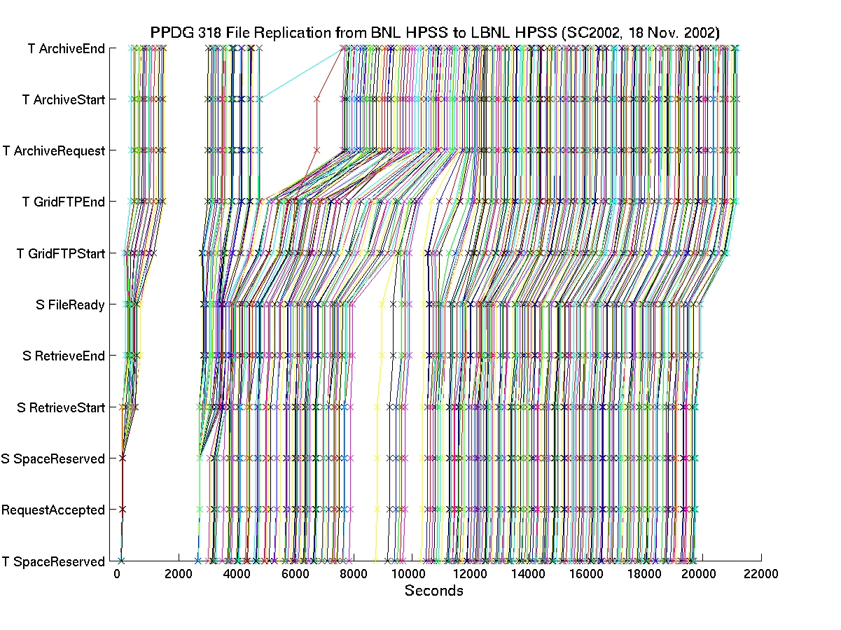
File Tracking Shows Recovery From Transient Failures
Total:
45 GBs
Notes:
Shows recovery from the machine problem and archiving HPSS down time

Slide 37

STAR Analysis scenario (1)
Client
Job submission
Remote sites
A site
dCache/SRM
Worker Nodes
Client Job
Gate Node
Disk
GridFTP server
Disk
Client Job
BeStMan/SRM
Disk
Disk
Client Job
Disk
DPM/SRM
Disk
Disk
Disk
Cache
DISK
CACHE
Client Job
BeStMan/SRM
Disk
Disk
Disk
Cache
Cache

Slide 38
STAR Analysis scenario (2)
SRM Job submission
Client
Client Job submission
Remote sites
A site
dCache/SRM
Worker Nodes
Client Job
Gate Node
Disk
GridFTP server
Disk
Client Job
BeStMan/SRM
Disk
Disk
Client Job
Disk
DPM/SRM
Disk
Disk
Disk
Cache
DISK
CACHE
Client Job
BeStMan/SRM
Disk
Disk
Disk
Cache
Cache
Notes:
Dynamic SRM instantiation
BeStMan can be run with host cert, service cert and even with user proxy

Slide 39
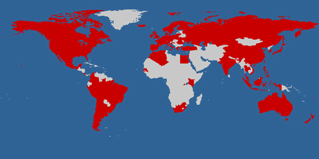
Earth System Grid
Main ESG portal
148.53 TB of data at four locations (NCAR, LBNL, ORNL, LANL)
965,551 files
Includes the past 7 years of joint DOE/NSF climate modeling experiments
4713 registered users from 28 countries
Downloads to date: 31TB/99,938 files
IPCC AR4 ESG portal
28 TB of data at one location
68,400 files
Model data from 11 countries
Generated by a modeling campaign coordinated by the Intergovernmental Panel on Climate Change (IPCC)
818 registered analysis projects from 58 countries
Downloads to date: 123TB/543,500 files, 300 GB/day on average
Courtesy: http://www.earthsystemgrid.org
Notes:
ESG main: Downloads to date: 31TB/99,938 files

Slide 40
SRMs in ESG
Client
Files Selection
And Request
SRM
@ LBNL
download
Disk
Disk
Cache
SRM
@ NCAR
Cache
Portal
SRM
@ LANL
Disk
Disk
Cache
Cache
SRM
@ LLNL
Disk
Disk
Disk
Cache
Cache
Cache
DISK
CACHE
NCAR
MSS
SRM
@ ORNL
Disk
Disk
Cache
Cache

Slide 41
SRM works in concert with other Grid components in ESG
LBNL
DISK
HPSS
ANL
GridFTP service
BeStMan/SRM
Storage Resource
Management
RLS
Globus Security infrastructure
GridFTP
server
NCAR
ESG Portal
RLS
ORNL
LLNL
BeStMan/SRM
Storage Resource
Management
DISK
IPCC Portal
User DB
XML
data
catalogs
ESG CA
GridFTP
server
XML data
catalogs
ESG Metadata DB
MyProxy
RLS
DISK
BeStMan/SRM
Storage Resource
Management
OPeNDAP-g
RLS
LAHFS
HPSS
GridFTP server
FTP server
GridFTP
server
BeStMan/SRM
Storage Resource
Management
ISI
LANL
DISK
MCS Metadata Cataloguing Services
RLS
RLS Replica Location Services
MSS
Mass
Torage
System
BeStMan/SRM
Storage Resource
Management
DISK
GridFTP
server
Monitoring Discovery ervices

Slide 42
Summary

Slide 43
Summary and Current Status
Storage Resource Management – essential for Grid
Multiple implementations interoperate
Permits special purpose implementations for unique storage
Permits interchanging one SRM implementation by another
Multiple SRM implementations exist and are in production use
Particle Physics Data Grids
WLCG, EGEE, OSG, …
Earth System Grid
More coming …
Combustion, Fusion applications
Medicine

Slide 44
Documents and Support
SRM Collaboration and SRM Specifications
http://sdm.lbl.gov/srm-wg
OGF mailing list : gsm-wg@ogf.org
SRM developer’s mailing list: srm-devel@fnal.gov
BeStMan (Berkeley Storage Manager): http://datagrid.lbl.gov/bestman
CASTOR (CERN Advanced STORage manager): http://www.cern.ch/castor
dCache: http://www.dcache.org
DPM (Disk Pool Manager): https://twiki.cern.ch/twiki/bin/view/LCG/DpmInformation
StoRM (Storage Resource Manager): http://storm.forge.cnaf.infn.it
SRM-SRB: http://lists.grid.sinica.edu.tw/apwiki/SRM-SRB
SRB: http://www.sdsc.edu/srb
BeStMan-XrootD: http://wt2.slac.stanford.edu/xrootdfs/bestman-xrootd.html
Other support info : srm@lbl.gov

Slide 45
Credits
Alex Sim <asim@lbl.gov>
Arie Shoshani <ashoshani@lbl.gov>

