Slide 1
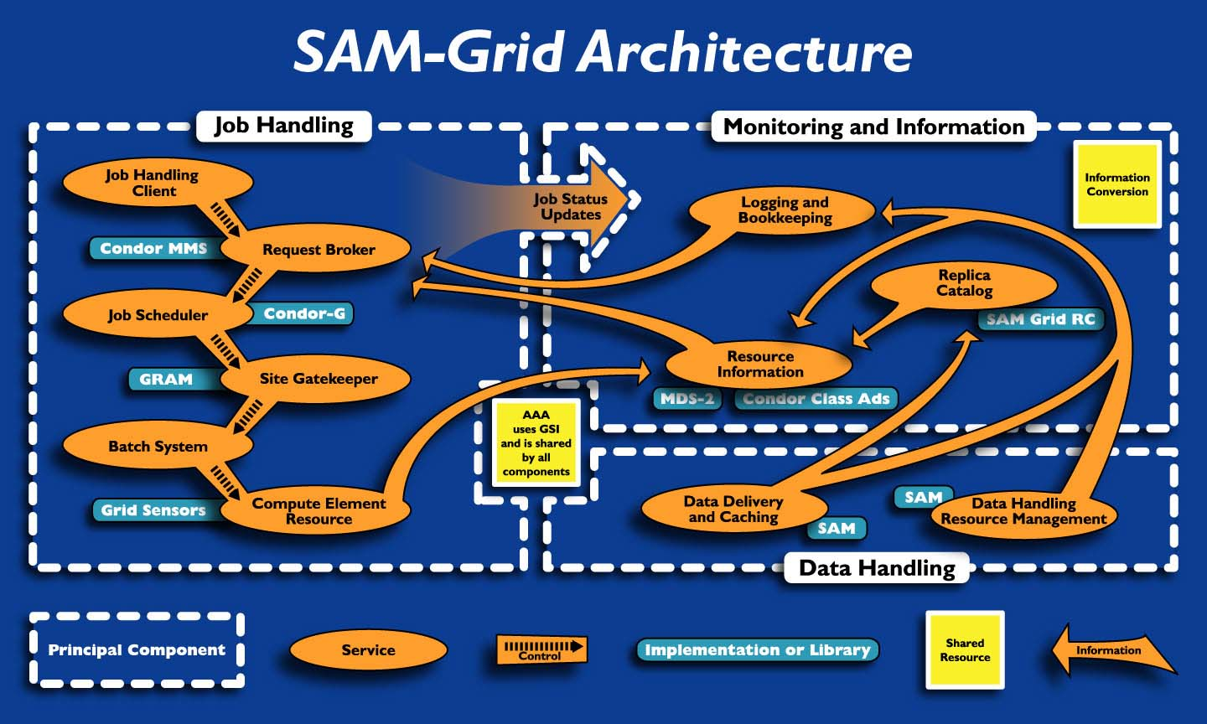

Slide 2

SAM-Grid Diagram
Flow of:
job
data
meta-data
User Interface
User Interface
User Interface
User Interface
Submission
Submission
Global Job Queue
Resource Selector
Grid Client
Match Making
Global DH Services
Info Gatherer
SAM Naming Server
Info Collector
SAM Log Server
Resource Optimizer
MSS
Cache
Site
SAM DB Server
Cluster
RC
MetaData Catalog
Data Handling
Local Job Handling
Bookkeeping Service
SAM Station
(+other servs)
Grid Gateway
Info Manager
Grid/Fabric
Interface
MDS
Web Serv
SAM Stager(s)
Info Providers
Grid Monitoring
JIM Advertise
XML DB server
User Tools
Dist.FS
Worker Nodes
Site Conf.
AAA
Glob/Loc JID map
Site
Site
Site
...

Slide 3
ReSS Architecture
Users express cluster requirements in the JDL
Jobs sit in the site batch system queue until execution
ReSS can be queried and info passed to VO matchmaker
VO / Grid Interface
ReSS
job
What Gate?
Info
Gatherer
classads
Condor
Match Maker
Condor
Scheduler
VO
Grid
Gate 3
job
classads
classads
classads
Grid / Site Interface
Site
Gate1
CEMon
Gate2
CEMon
Gate3
CEMon
jobs
info
jobs
info
jobs
info
CE
job-managers
GIP
CE
job-managers
GIP
CE
job-managers
GIP
job-managers
job-managers
job-managers
job-managers
job-managers
job-managers
CLUSTER
CLUSTER
CLUSTER

