Slide 1
National Heart Failure Training for Improved Patient Care N-HeFT
Notes:
National Heart Failure Training for Improved Patient Care N-HeFT

Slide 2
The Cardiovascular Continuum: Targeting Mechanisms and Mediators
Oxidative Stress/
Inflammation
Target Organ
Damage
Tissue Injury
(MI, Stroke)
Pathological
Remodeling
Vascular Disease
Target Organ
Dysfunction (CHF, Renal)
Vascular
Dysfunction
End-stage
Organ Failure
Risk Factors:
Diabetes
Hypertension
Death
Adapted from Dzau V, Braunwald E. Am Heart J. 1991.
Notes:
The Cardiovascular Continuum:Targeting Mechanisms and Mediators

Slide 3
Heart Failure
5 million Americans with heart failure
550,000 new cases each year and growing
Number one Medicare diagnosis
Costs are spiraling
Responsible for more hospitalizations than any other single diagnosis for the elderly
Newer therapies known to improve patient outcomes widely underutilized
Substantial and preventable morbidity and mortality
.
Notes:
Heart Failure
5 million Americans with heart failure
550,000 new cases each year and growing
Number one Medicare diagnosis
Costs are spiraling
Responsible for more hospitalizations than any other single diagnosis for the elderly
Newer therapies known to improve patient outcomes widely underutilized
Substantial and preventable morbidity and mortality

Slide 4
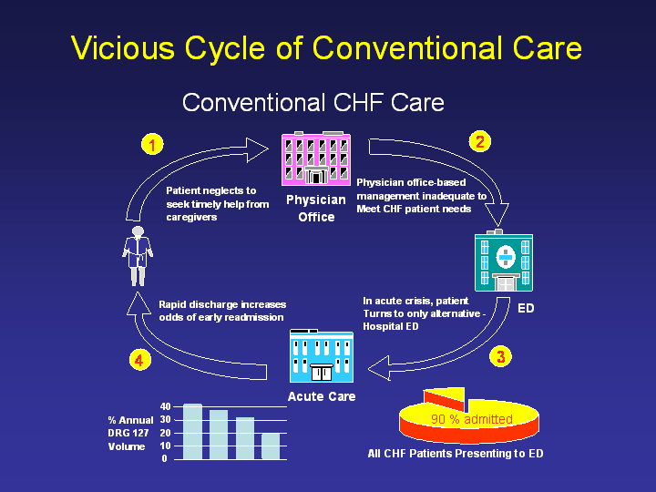
Notes:
Vicious Cycle of Conventional Care

Slide 5
N-HeFT Bridges the GAP
The treatment gap continues to widen between
evidence-based approaches to quality care
and the reality of practice across the continuum of care,
contributing to the increasing economic and social burden
of this chronic illness.
Notes:
N-HeFT Bridges the GAP
The treatment gap continues to widen between
evidence-based approaches to quality care
and the reality of practice across the continuum of care,
contributing to the increasing economic and social burden
of this chronic illness.

Slide 6
N-HeFT Overview
Began in 1994 at Temple University
Sponsored and administered by Case Western Reserve University since 1999
Customized accredited training
32 host sites: leading heart failure centers
Application to practice
Outcomes-driven mentoring
Notes:
N-HeFT Overview
Began in 1994 at Temple University
Sponsored and administered by Case Western Reserve University since 1999
Customized accredited training
32 host sites: leading heart failure centers
Application to practice
Outcomes-driven mentoring

Slide 7
Accreditation
AMA CME
Nursing CE
Pharmacy CEU
American Academy of Family Physicians CME
Notes:
Accreditation
AMA CME
Nursing CE
Pharmacy CEU
American Academy of Family Physicians CME

Slide 8
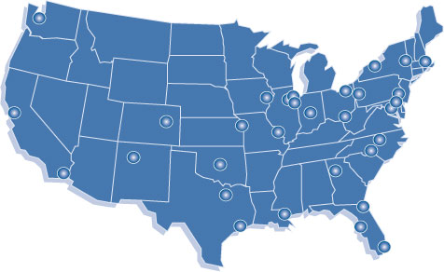
32 Centers of Excellence
Notes:
32 Centers of Excellence

Slide 9
PURPOSE OF THE NETWORK
Disseminate best practices to interdisciplinary medical teams who are eager to learn and enhance their care for HF patients
Continuously improve the quality of the program as an educational delivery system
Notes:
PURPOSE OF THE NETWORK
Disseminate best practices to interdisciplinary medical teams who are eager to learn and enhance their care for HF patients
Continuously improve the quality of the program as an educational delivery system

Slide 10
DESIRED OUTCOMES
Medical teams identify up to 3 changes they will make to improve patient care.
They rank their level of commitment to implementing identified changes.
Teams sign a “Commitment to Change Contract” and submit to N-HeFT for follow up.
Notes:
DESIRED OUTCOMES
Medical teams identify up to 3 changes they will make to improve patient care.
They rank their level of commitment to implementing identified changes.
Teams sign a “Commitment to Change Contract” and submit to N-HeFT for follow up.

Slide 11
Outcomes Follow up
3 mentoring opportunities for medical teams up to 6 months
Review “Commitment to Change Contract”
Discuss approaches to improve quality of care
Notes:
Outcomes Follow up
3 mentoring opportunities for medical teams up to 6 months
Review “Commitment to Change Contract”
Discuss approaches to improve quality of care

Slide 12
Notes:
N-HeFT Live

Slide 13
Organizational Structure
Executive
Committee
Notes:
Organizational Structure

Slide 14

Best Practice at All Points of Care
Notes:
Best Practice at All Points of Care

Slide 15
N-HeFT Online
Web site www.nheft.org
Online Curriculum
Cardiology Core
Primary Care Core
Allied Health Core
Electives
Faculty
Standard curriculum
Resources
Tools
Notes:
N-HeFT Online
Web site www.nheft.org
Online Curriculum
Cardiology Core
Primary Care Core
Allied Health Core
Electives
Faculty
Standard curriculum
Resources
Tools

Slide 16
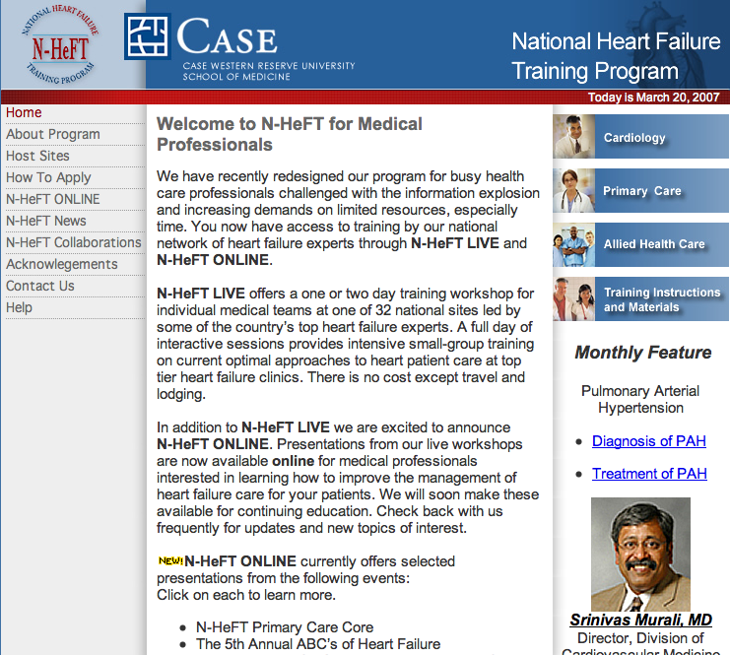
Notes:
Welcome to N-HeFT for Medical Professionals

Slide 17
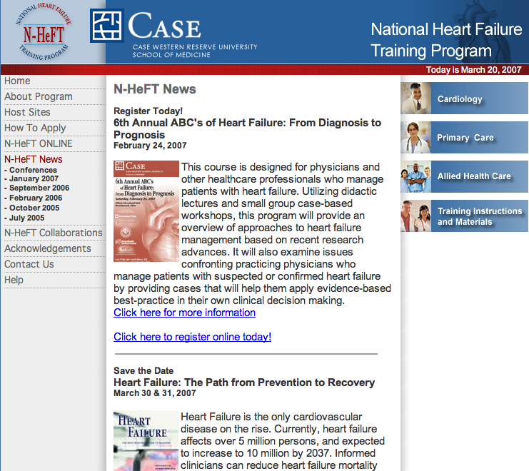
Notes:
N-HeFT News

Slide 18
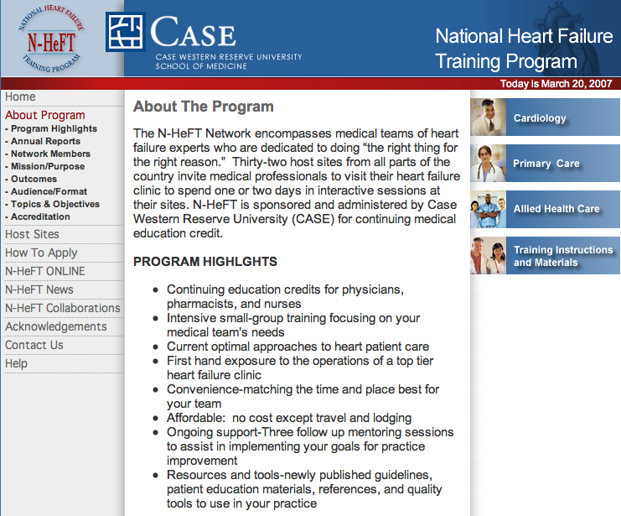
Notes:
About The Program

Slide 19
Standardization of Training
Curriculum
Developed and updated by network expert authors
Password-protected and posted on web for faculty
Accredited for physicians, nurses, pharmacists
Training Processes
Thorough application process
Coordinated through Case Western Reserve University
Standardized forms
Follow up mentoring
Notes:
Standardization of Training
Curriculum
Developed and updated by network expert authors
Password-protected and posted on web for faculty
Accredited for physicians, nurses, pharmacists
Training Processes
Thorough application process
Coordinated through Case Western Reserve University
Standardized forms
Follow up mentoring

Slide 20
Louis B. Stokes VA Medical Center
On site at the Lorain C-BOC
Staff: MD’s, Pharm D, RN, PA, MBA
Feb 6, 7
Morning Didactic Primary Care Core
Afternoon clinic with Dr. Ileana Pina and participants” patients-Faculty-guided visit
Notes:
Louis B. Stokes VA Medical Center
On site at the Lorain C-BOC
Staff: MD’s, Pharm D, RN, PA, MBA
Feb 6, 7
Morning Didactic Primary Care Core
Afternoon clinic with Dr. Ileana Pina and participants” patients-Faculty-guided visit

Slide 21
Visit Snapshot 07/05-present
95 trainings completed
11 applications pending
600+ participants completed training
64 Primary Care
31 Cardiology
Notes:
Visit Snapshot 07/05-present
95 trainings completed
11 applications pending
600+ participants completed training
64 Primary Care
31 Cardiology

Slide 22
Collaborations
Think Tank for Cardiovascular Research in Women
CHP: HF Advocate
Visiting Nurse Association
Ohio Coalition of HF
Hospice of the Western Reserve
Notes:
Collaborations
Think Tank for Cardiovascular Research in Women
CHP: HF Advocate
Visiting Nurse Association
Ohio Coalition of HF
Hospice of the Western Reserve

Slide 23



Think Tank
Need
Public health concerns resulting from disparities in management of cardiovascular diseases and related outcomes in women
Goal
To create multi-center prospective studies for women with cardiovascular diseases
Notes:
Think Tank
Need
Public health concerns resulting from disparities in management of cardiovascular diseases and related outcomes in women
Goal
To create multi-center prospective studies for women with cardiovascular diseases

Slide 24
Think Tank Purpose
Provide an interdisciplinary forum to discuss promising and novel approaches to management of cardiac disease and its risk factors
Identify promising new directions in related research
Notes:
Think Tank Purpose
Provide an interdisciplinary forum to discuss promising and novel approaches to management of cardiac disease and its risk factors
Identify promising new directions in related research

Slide 25
Think Tank
Participation:
National Heart Lung Blood Institute (NHLBI), Food and Drug Administration (FDA, ODE), Department of Health and Human Services (DHHS).
Meetings:
2/16/06: Bethesda Maryland; 7/13/06: Rockville, MD; 11/11/06 Chicago, 3/24/07: New Orleans, 9/07: Washington
Supporters:
Office of Women’s Health (US Public Health Service), N-HeFT
Notes:
Think Tank
Participation:
National Heart Lung Blood Institute (NHLBI), Food and Drug Administration (FDA, ODE), Department of Health and Human Services (DHHS).
Meetings:
2/16/06: Bethesda Maryland; 7/13/06: Rockville, MD; 11/11/06 Chicago, 3/24/07: New Orleans, 9/07: Washington
Supporters:
Office of Women’s Health (US Public Health Service), N-HeFT

Slide 26

Collaboration
VNA
N-HeFT
7 home care agencies in Ohio
Telemonitor and outcomes research
Standard education for all team members
Notes:
Collaboration
VNA
N-HeFT
7 home care agencies in Ohio
Telemonitor and outcomes research
Standard education for all team members

Slide 27
Chronic Care Model
Health System
Health Care Organization
Self- Delivery Decision Clinical
Management System Support Information
Support Design Systems
Community
Resources and Policies
Informed
Activated
patient
Prepared Practice Team
Productive Interactions
Improved Outcomes
Notes:
Chronic Care Model

Slide 28
Ohio Heart Failure Coalition
Emerged from the “Partnership for Quality” initiated within the Guidelines Assisting Practice Agency for Health Quality Research Grant started in 2004.
Started in 2005
Special projects
Notes:
Ohio Heart Failure Coalition
Emerged from the “Partnership for Quality” initiated within the Guidelines Assisting Practice Agency for Health Quality Research Grant started in 2004.
Started in 2005
Special projects

Slide 29
Mission Mission
To achieve transformational change across the continuum of heart failure care through innovative collaboration, dedicated to sharing best practices and resources
Goals
Increase awareness and knowledge of heart failure in Ohioans
Improve health-related quality of life for people living with heart failure
Improve timeliness, efficiency, and effectiveness of heart failure care
Notes:
Mission Mission
To achieve transformational change across the continuum of heart failure care through innovative collaboration, dedicated to sharing best practices and resources
Goals
Increase awareness and knowledge of heart failure in Ohioans
Improve health-related quality of life for people living with heart failure
Improve timeliness, efficiency, and effectiveness of heart failure care

Slide 30
N-HeFT Future Directions
Expand bridge between research and practice through education
Outcomes research
Develop new programs based on identified needs: ie-Nursing home, skilled nursing facility, hospice, emergency dept.
Develop new modules: diabetes, anemia
Develop CME for online
Expand collaborative network
Notes:
N-HeFT Future Directions
Expand bridge between research and practice through education
Outcomes research
Develop new programs based on identified needs: ie-Nursing home, skilled nursing facility, hospice, emergency dept.
Develop new modules: diabetes, anemia
Develop CME for online
Expand collaborative network

