Slide 1
Status and Plan of J-PARC
Shin’ya Sawada
KEK
(High Energy Accelerator Research Organization, Japan)
Quark Matter 2008
Jaipur, India
February 7, 2008
Notes:
First of all, I would like to thank the organizers for giving us an opportunity to have a presentation of our project.
My talk is on the J-PARC project, the Japan Proton Accelerator Research Complex. My name is Shin’ya Sawada from KEK, a national laboratory for accelerator science in Japan.

Slide 2
Overview
Accelerator Complex
Construction Status
Nuclear and Particle Physics Facility at J-PARC
Facility
PAC
Nuclear & Hadron Physics Experiments
Notes:
The first section of my talk is the overview of the facility.

Slide 3
Overview
Accelerator Complex
Construction Status
Nuclear and Particle Physics Facility at J-PARC
Notes:
The first section of my talk is the overview of the facility.

Slide 4
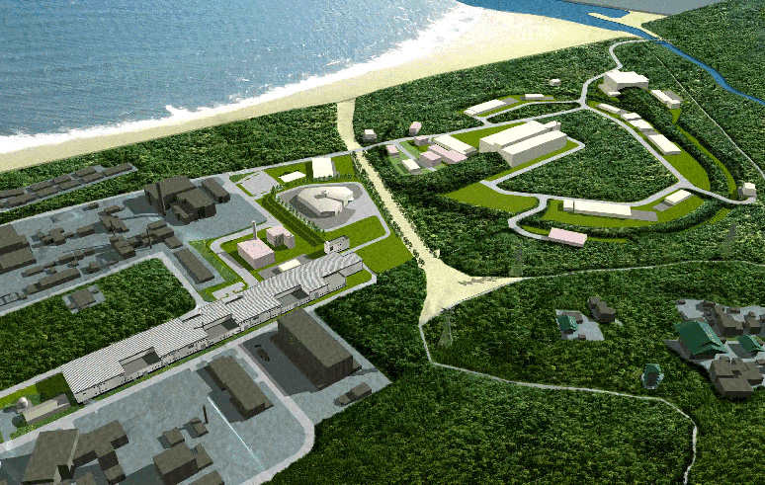
Accelerator Configuration
Nuclear & Particle Physics with pions, kaons, neutrinos, etc.
Cascaded Accelerator Complex:
Hadron Hall (Slow Extracted Beams)
3GeV Rapid Cycling (25Hz) Synchrotron
Neutrino Beamline to Super-Kamiokande
Linac
Materials and Life Science Facility
R&D for Acc. Driven Transmutation System
Matarials & Life Science with neutrons and muons
50GeV Synchrotron
Notes:
The facility is a cascaded accelerator complex. There are a linear accelerator as an injector, 3-GeV rapid cycling synchrotron, and 50-GeV main synchrotron.
We will have major experimental facilities, the materials and life science facility which uses 3-GeV beams and the nuclear and particle physics facility and the neutrino beamline which uses 50-GeV beams.

Slide 5
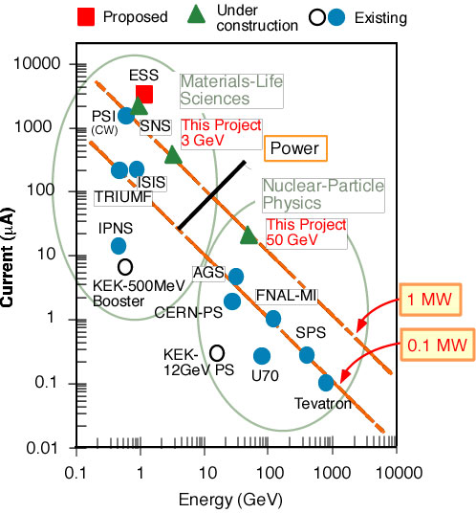
J-PARC:
the High Intensity Frontier
J-PARC aims for the high intensity frontier for
materials/life sciences (3GeV), and
nuclear/particle physics (50GeV)
High intensity proton beam leads to high intensity secondary (neutron, meson, …) beam.
The power (= Energy x Current) is a good measure.
Neutron: from 0.16MW (ISIS) to 1MW
K meson: 5 to 10 times more intense than existing BNL-AGS.
Notes:
What is the sales point of our new accelerator, J-PARC? In one sentence, J-PARC aims for the high intensity frontier in the world for materials and life sciences and nuclear-particle physics. High intensity proton beam leads to high intensity secondary beams, which are used for various experiments. The power, the product of the beam energy and the current, is a good measure of the intensity. This graph shows the beam power of the major proton accelerators in the world. J-PARC aims to build an accelerator complex with the beam power of about one order higher than the existing facilities. For example, at the neutron facility, the power will be from 0.16 MW at ISIS in England to 1 MW, and for K meson experiments, we will have 5 to 10 times more intense beam than the existing facilities such as BNL-AGS.

Slide 6
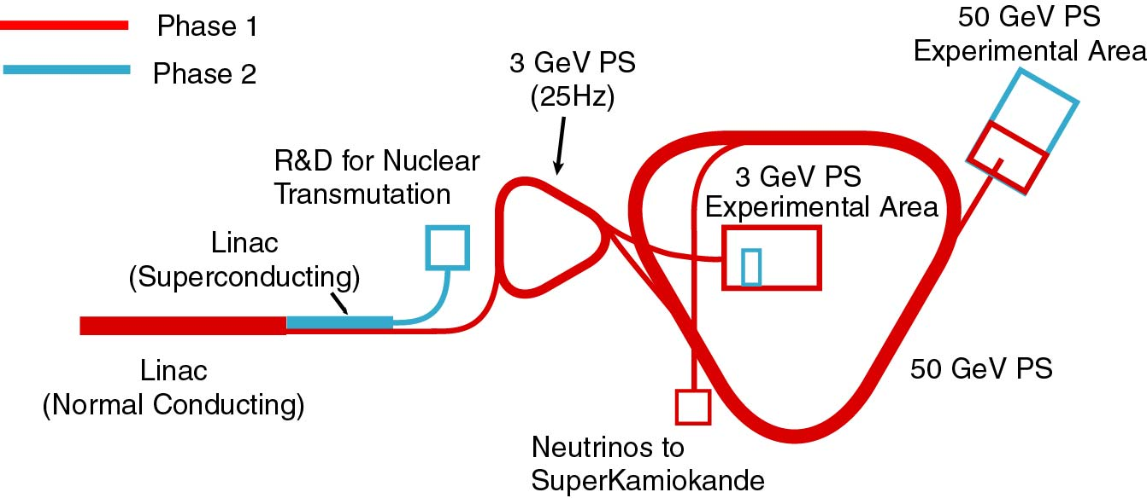
Phase 1 & 2
The budget for about 2/3 of the entire project has been approved by the Japanese government from JFY2001 as Phase 1.
Phase 1 (~151 billion Yen) consists of major accelerator components and a part of experimental facilities.

Slide 7
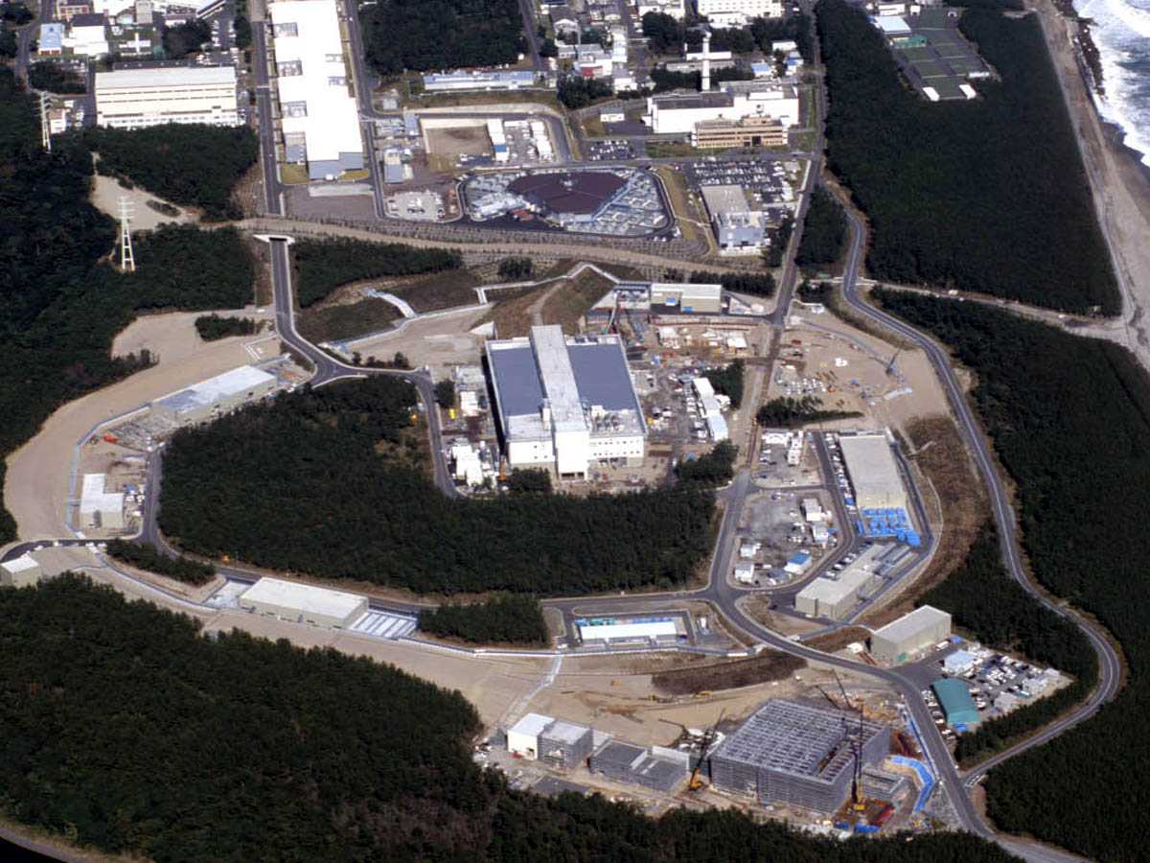
ＬＩＮＡＣ
RCS
ν
ＭＬＳＦ
50GeV-PS
Hd
Bird’s eye photo in Nov. 2006

Slide 8
Performance of the 50-GeV PS
Numbers in red are design values.
Numbers in parentheses are ones for the beginning of Phase 1. Energy recovery of the linac to 400 MeV is planned just after the completion of the Phase-1 construction in 2009.
Beam Energy： 50ＧｅＶ E_{Linac} = 400MeV
(30GeV for Slow Beam) E_{Linac} = (180MeV)
(30GeV for Fast Beam)
Repetition: 3.4 ~ 5-6s
Flat Top Width： 0.7 ~ 2-3s
Beam Intensity: 3.3x10¹⁴ppp, 15μA
(2×10¹⁴ppp, 9μA)
Beam Power: 750kW
(270kW)

Slide 9
Beam Commissioning of the Accelerators
December 2006: Beam commissioning of the Linac was started.
January 24, 2007: The Linac accelerated 181MeV=Design Energy protons with 0.25μA current.
Goal is 200μA.
From Fall 2007: Beam commissioning of the 3-GeV RCS was started.
From December 2007: Non-beam commissioning of the 50-GeV synchrotron was started.
From May 2008: Beam commissioning of the 50-GeV synchrotron will be started.

Slide 10
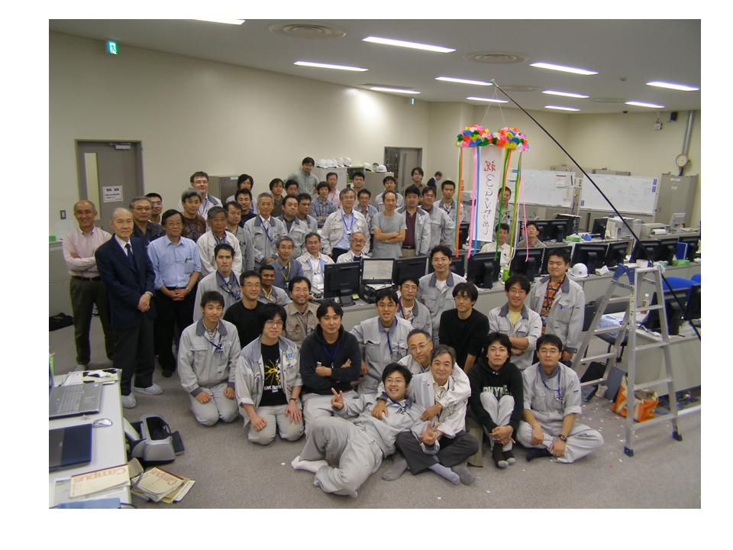
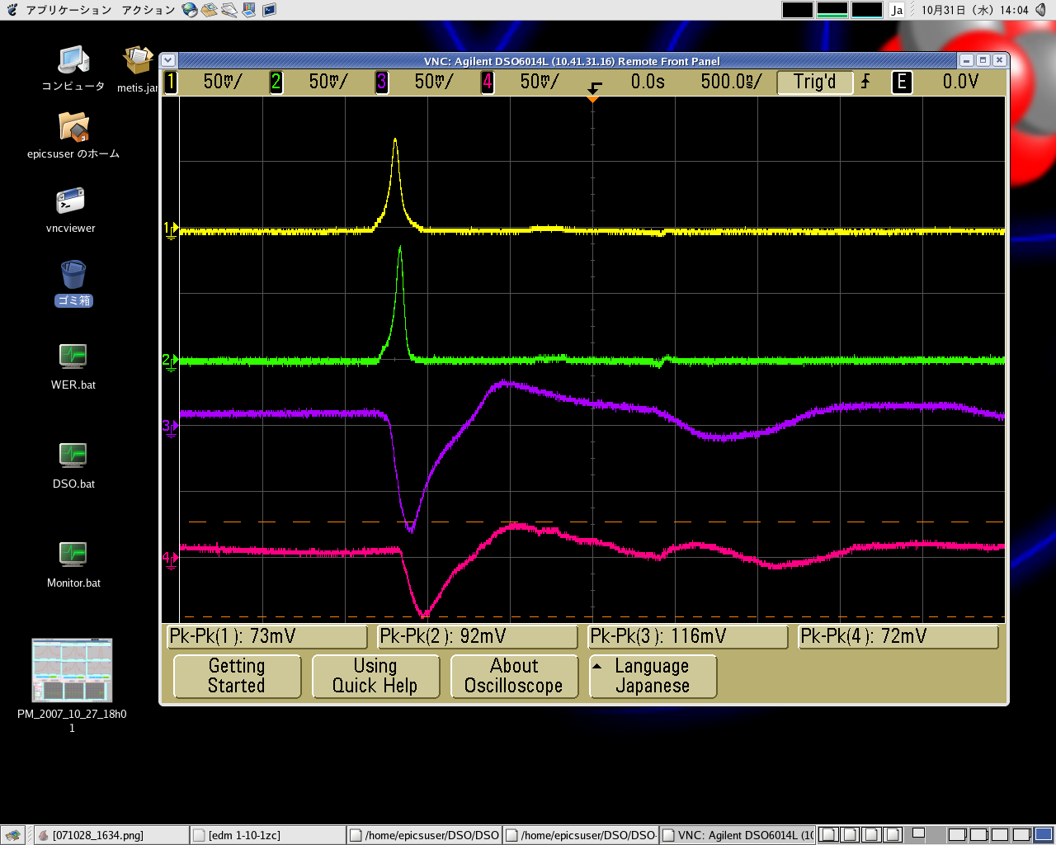
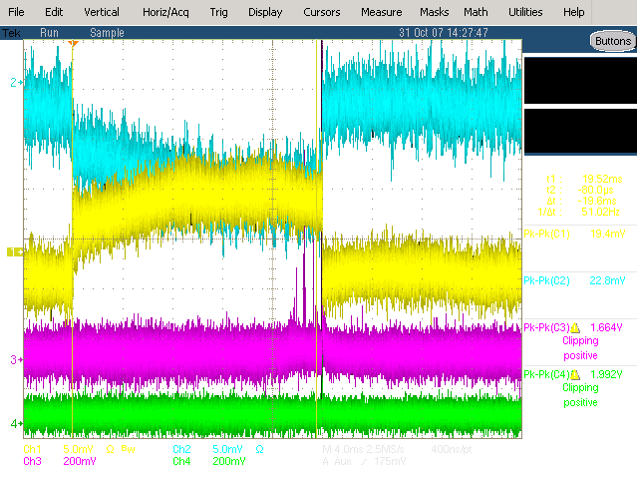
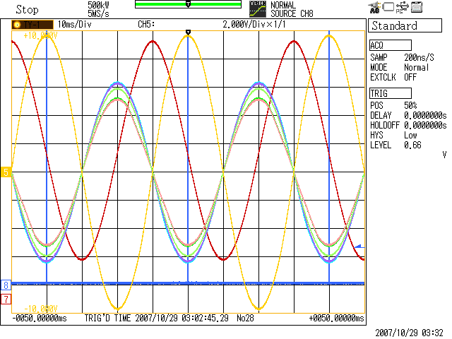
Acceleration and Extraction at 3 GeV
2007.10.31.14h03m23s
Beam Current inside the Ring
500ns
Beams remain inside the ring for 20 ms.
Current
Beam Loss
Time
Magnetic
Field
3GeV
3NBT Beam Current
（Extracted Beams)
Current
20 ms
Injection at the minimum field and the extraction at the maximum field
Beam Current Detected at 3NBT
Time
181MeV
Successful Acceleration and Extraction !!!
Acceleration
Injection
Extraction

Slide 11
Schedule of 50-GeV Facilities
May-June 2008: First beam commissioning of the 50-GeV accelerator.
July-Oct. 2008: Installation of slow extraction equipments (ES septum, septum magnets, etc.) and the rest of neutrino beamline equipments.
Dec. 2008: Resume beam commissioning.
Dec. 2008 – March 2009: First extraction to the Hadron facility with slow extraction.
April 2009: First extraction to the neutrino beamline with fast extraction.

Slide 12
Overview
Nuclear and Particle Physics Facility at J-PARC
Facility
PAC
Nuclear & Hadron Physics Experiments
Notes:
Here, we come to nuclear and particle physics at J-PARC.

Slide 13
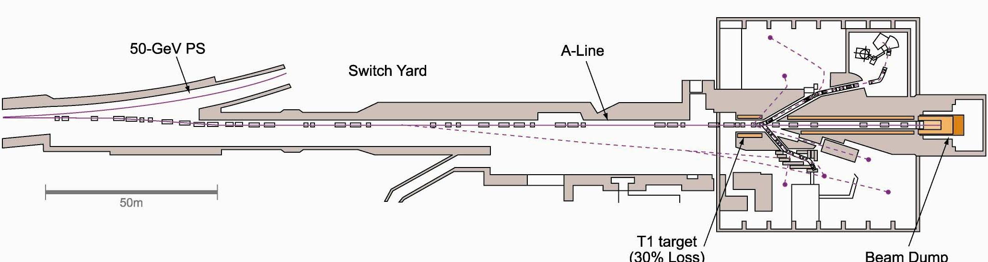
Slow Extraction Beamline (Phase 1)
Hadron HALL
56m(L)×60m(W)
50-GeV PS
A-Line
Switch Yard
Split Point
2% Loss
T1 Target
30% Loss
T0 Target
0.5% Loss
Beam Dump
750kW
Plan to extend the hall downstream (~50m) in the Phase 2.

Slide 14
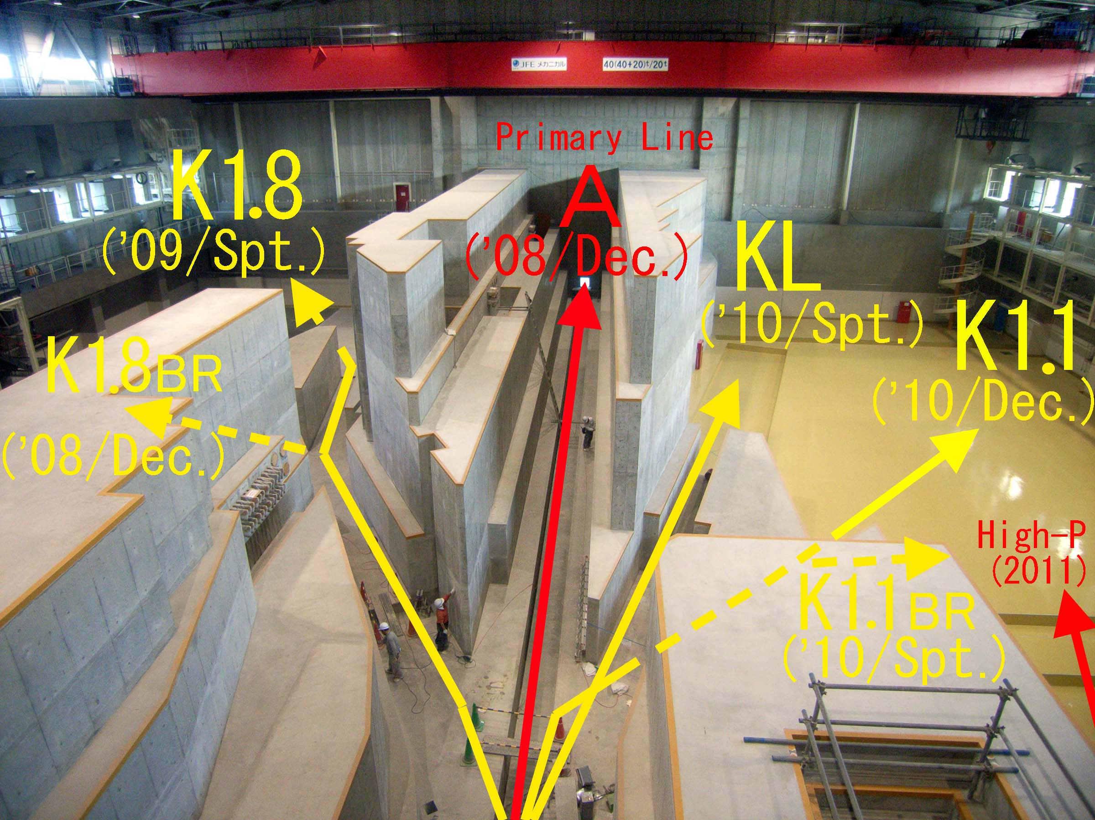
Beam Lines of the Hadron Hall

Slide 15
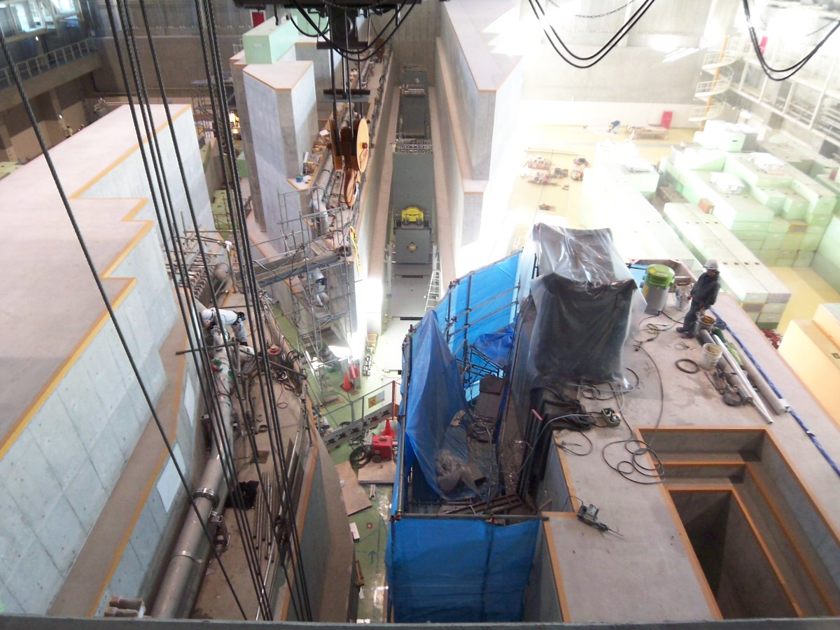
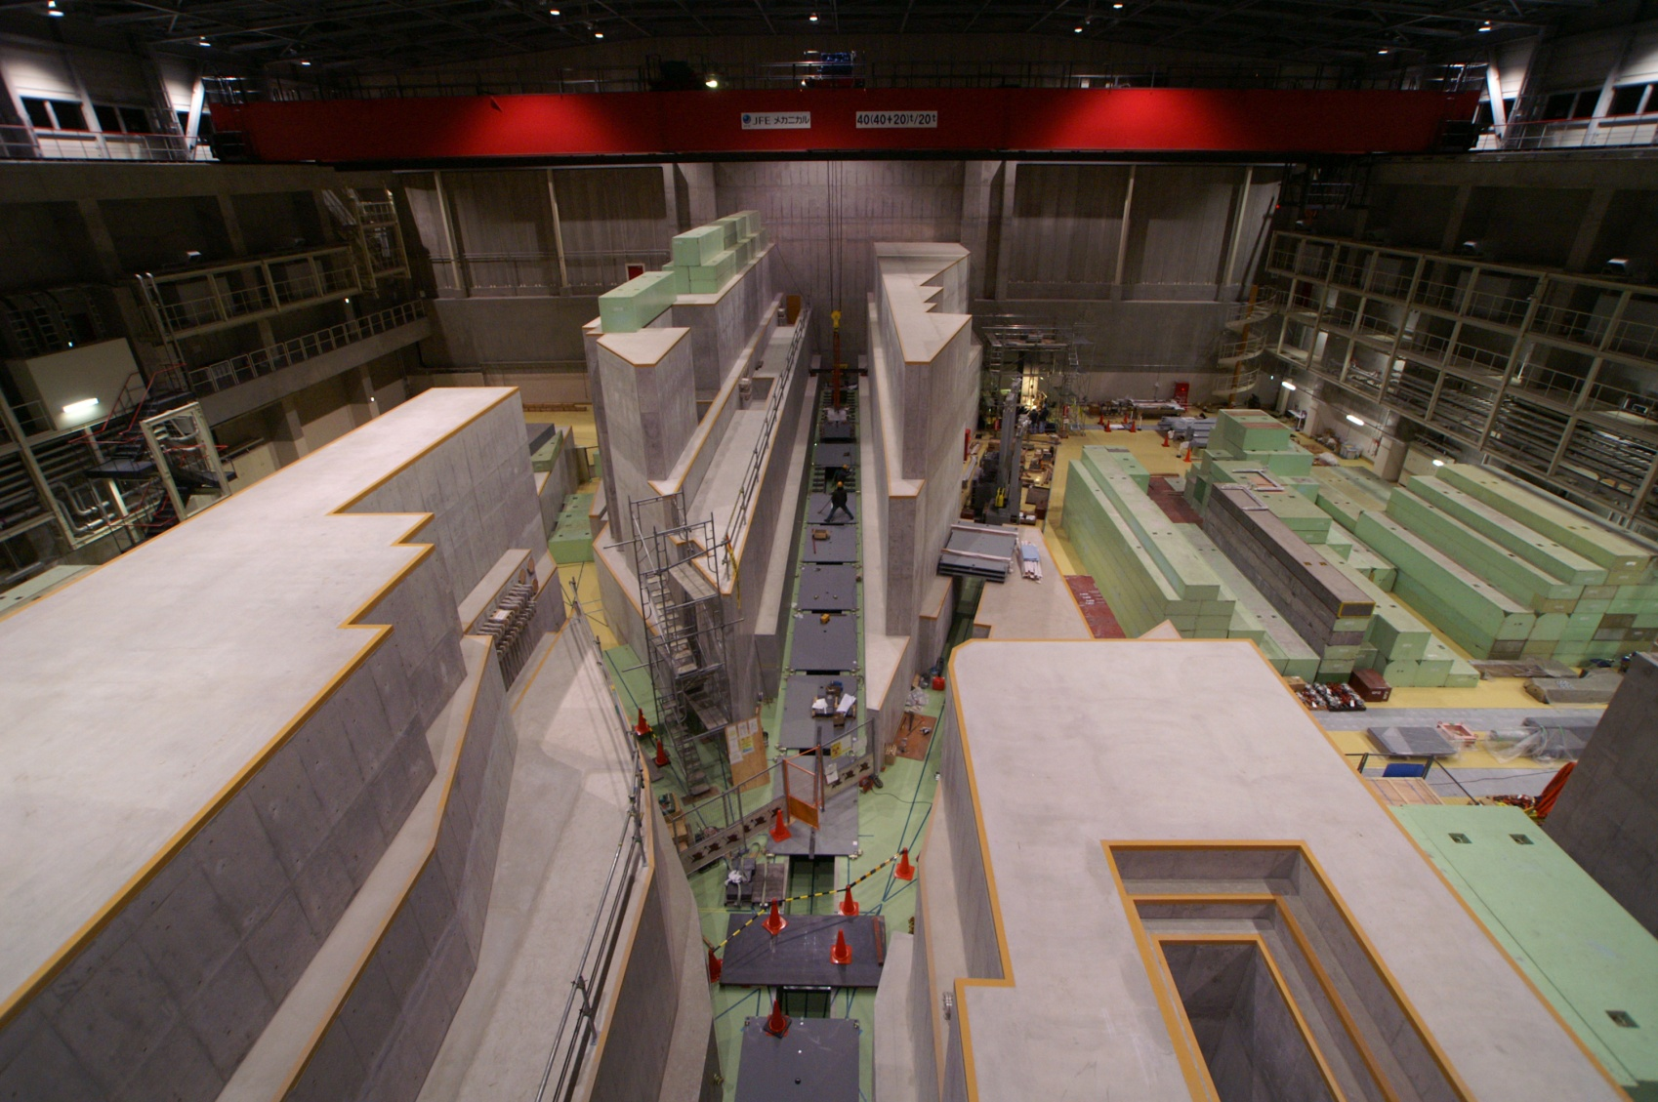
Current Construction
Last week
December, 2007

Slide 16
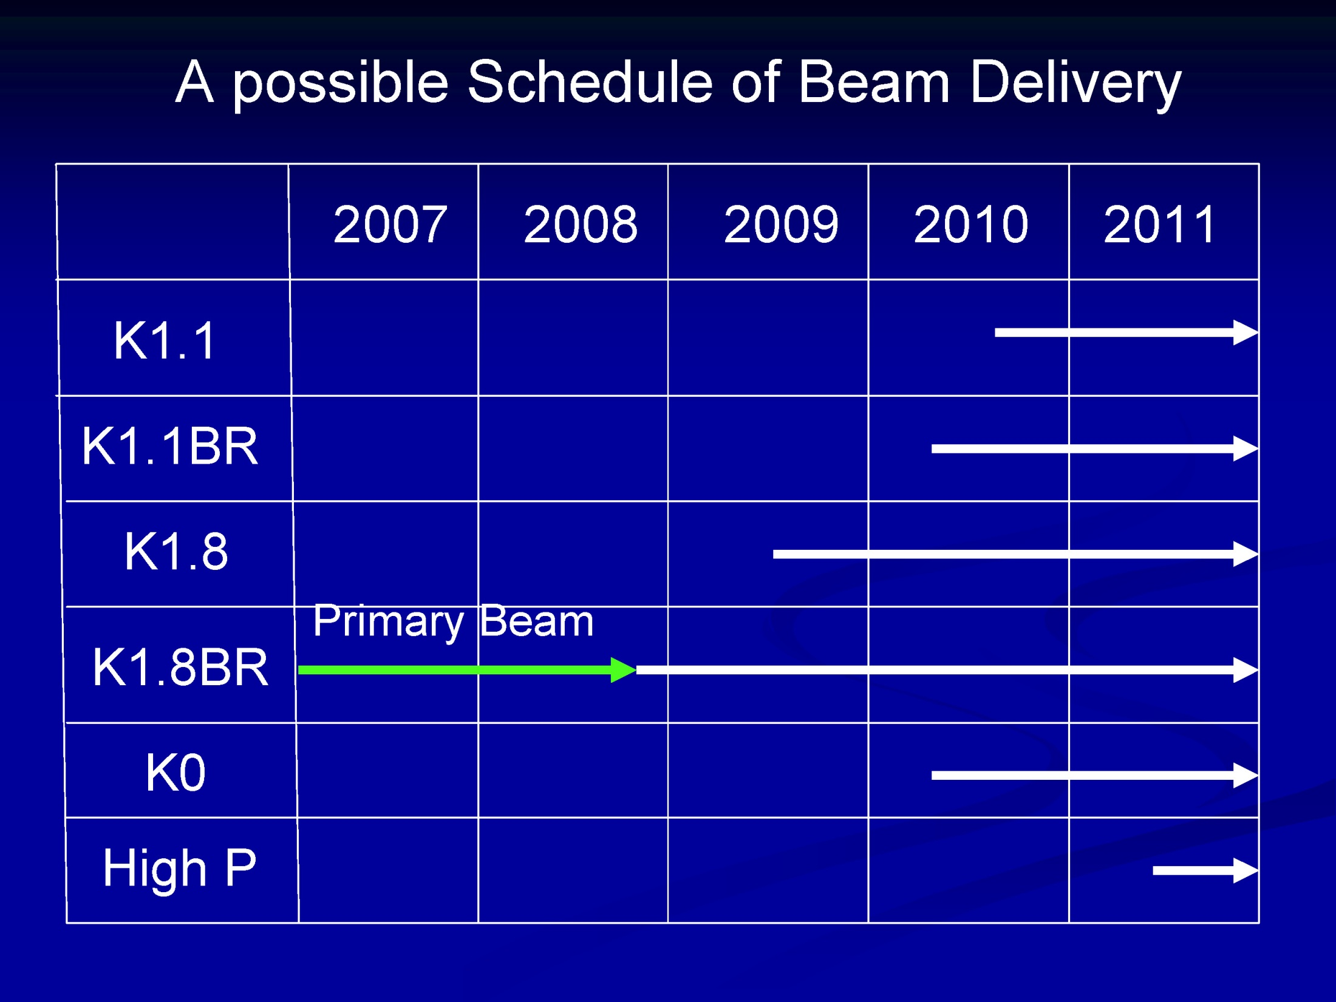
Oct.
Dec.
Neutrino

Slide 17
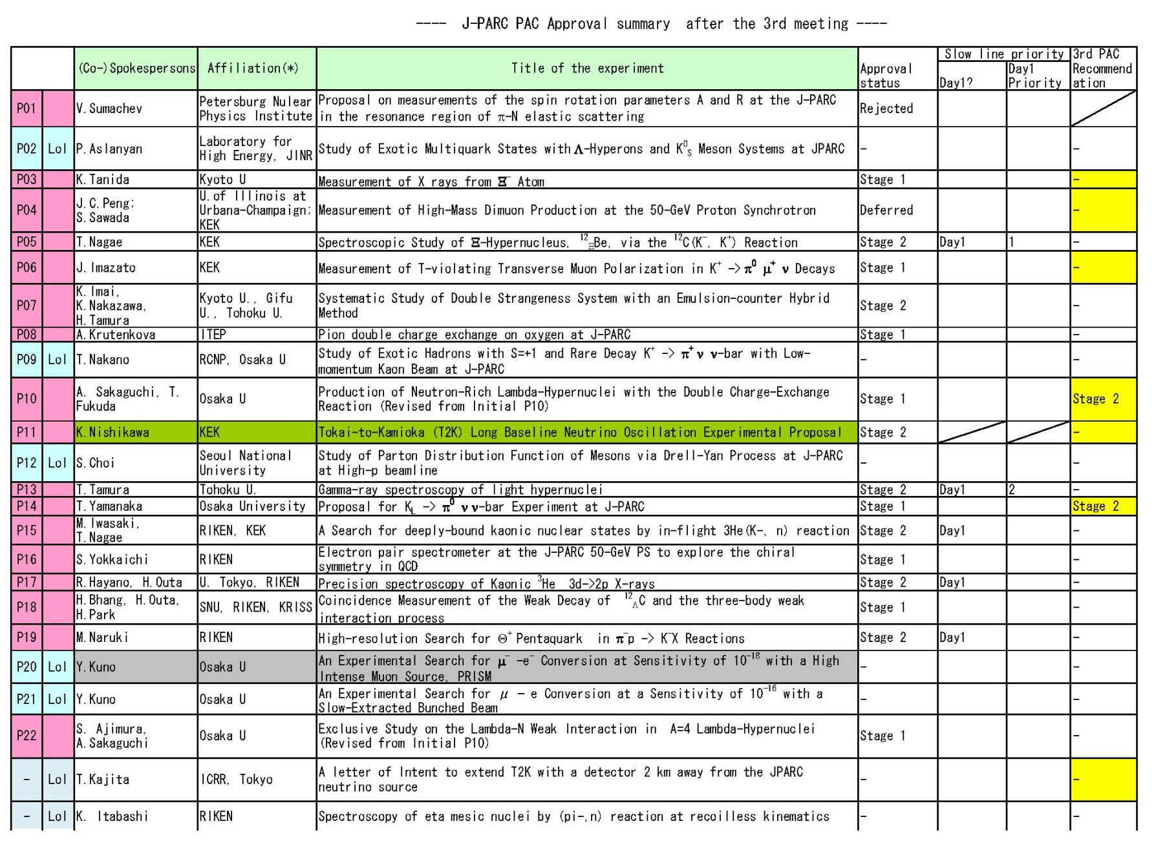
Results of the 3rd PAC (July 2007)

Slide 18
Plan of Hadron Physics at J-PARC
1st Experiments – Only One Secondary Beam Line
Strangeness Nuclear Physics
strangeness plays a key role in dense matter.
Information on hyperon interaction is indispensable to investigate high density matter.
Need Some Efforts – More Beam Lines, Energy Recovery to 50-GeV,…
Exotic hadrons
Hadrons in nuclear medium
Hard processes (50 GeV recovery)
After Major Upgrades (uncertain at present…)
Nucleon spin (proton polarization)
Quark-hadron matter (heavy ion beams)
Two Examples
Dimuon measurement
Dielectron measurement

Slide 19
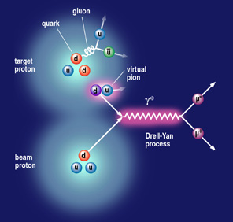
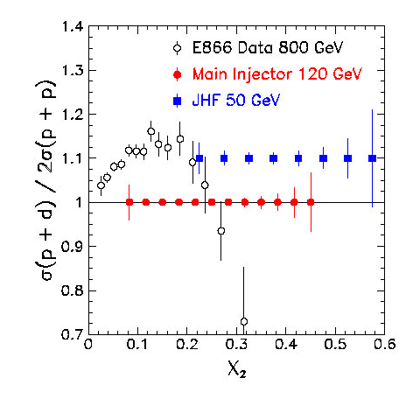
Dimuon Measurement with Proton Beams
Proton beams (30/50 GeV) +hydrogen/deuterium/A target+dimuon (← Drell-Yan process) spectrometer
dbar/ubar (flavor asymmetry) at large x
Nuclear dependence of the sea distribution
Quark energy loss in nuclei
Future: Drell-Yan and J/ψ with polarized beam
Similar experiment has been approved at Fermilab 120-GeV MI as E906.
Notes:
An example of hadron physics is parton distribution inside nucleons. This is a direct investigation of quark-gluon many body system. Proton beams and hydrogen and deuterium targets and a dimuon spectrometer, we can measure the flavor symmetry at large Bjorken x. The figure shows the existing data and expected statistics at the Main Injector and J-PARC. We can see that we can measure the distribution up to very large x.

Slide 20
Quark Energy Loss with D-Y at 50 GeV
Fractional energy loss is larger at 50 GeV
Possible to test the predicted L²-dependence from the A-dependence measurement
Garvey and Peng, PRL 90 (2003) 092302

Slide 21
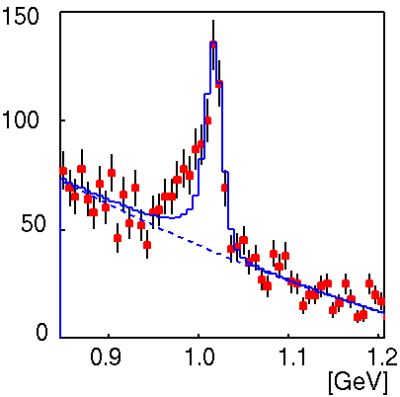
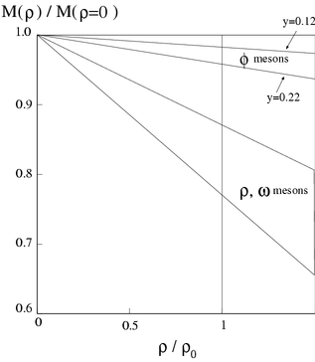
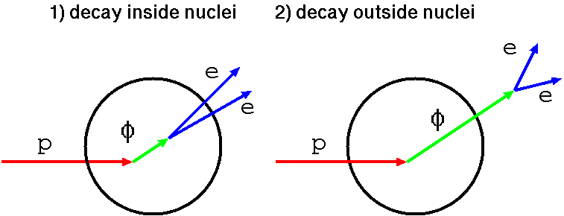
Dielectron: KEK-PS E325 Experiment
12GeV p+A → ρ/ω/φ +X ( ρ/ω/φ → e⁺e⁻ , φ → K⁺K⁻ )‏
consistent with the prediction
Hatsuda and Lee, PRC46(92)R34,PRC52(95)3364
linear dependence on density m*/m₀ = 1- k ρ/ρ₀
mass decreasing
- 16(±6)% for ρ/ω
- 0.15(±0.05)*y
=2~4% for φ
(for y=0.22)
at the normal nuclear density

Slide 22
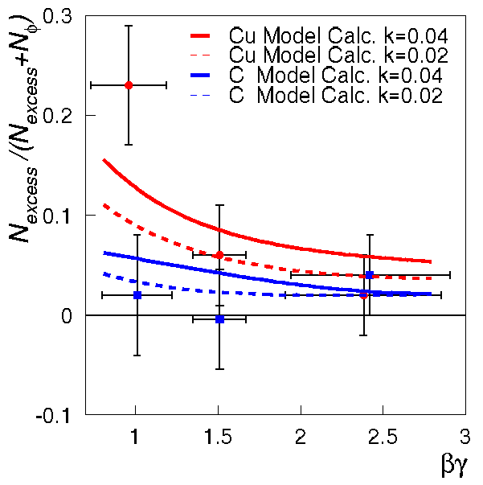
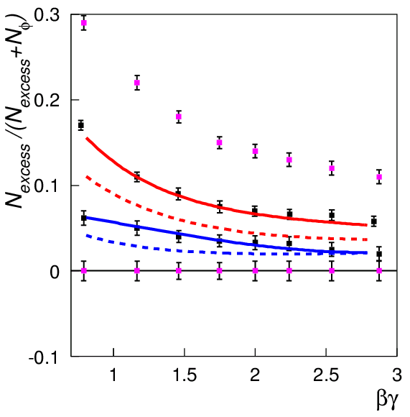
J-PARC Experiment: Much Higher statistics
Main goal : collect ~1x10⁵ φ → ee for each target in 5 weeks
100 times as large as E325
velocity dependence of 'modified' component / new nuclear targets
Pb
x 100 stat.
proton
error bars are shrunk and βγ bin can be divided

Slide 23
Summary
Facility
Status: construction going well. Acceleration up to 3 GeV has been achieved.
Near Term Plan: From May, 2008, beam commissioning at the 50-GeV synchrotron will be started, and the first 30-GeV beam is expected around the end of this year.
Long Term Plan: Major upgrades.
Physics
Day-1 experiments are mainly for strangeness nuclear physics (and neutrino experiment).
Other hadron physics experiments are also planned.
No heavy ion beams in the near term plan, but a lot of capabilities to study QCD matter from different directions of view.

Slide 24
Bakup slides

Slide 25
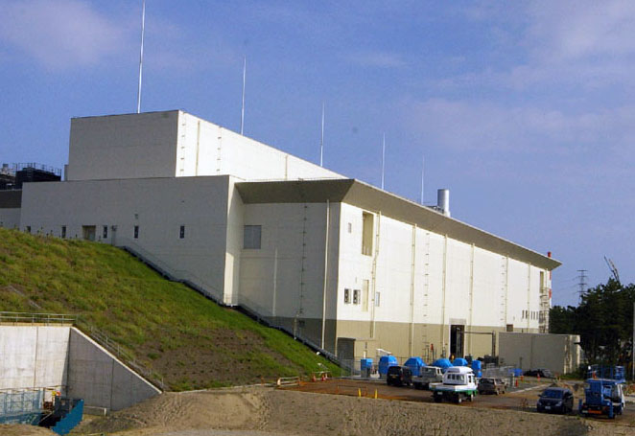
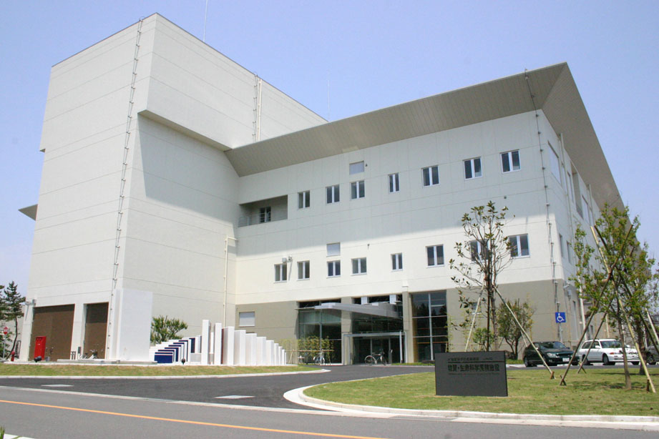
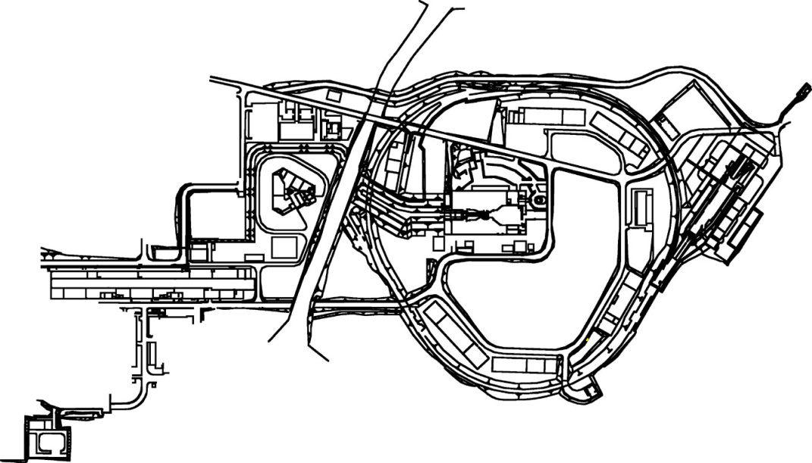
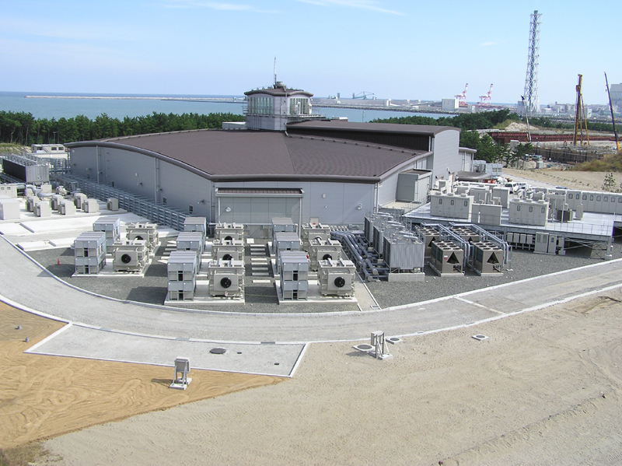
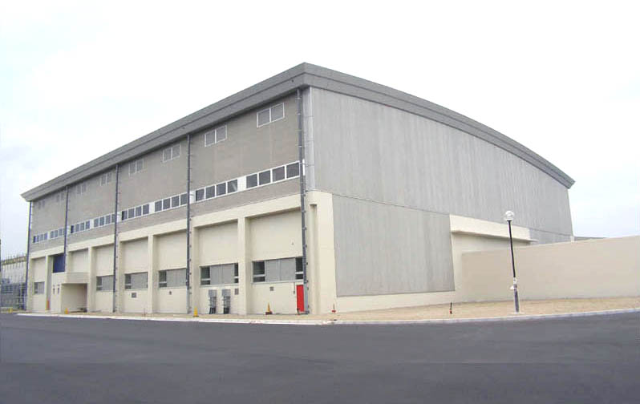
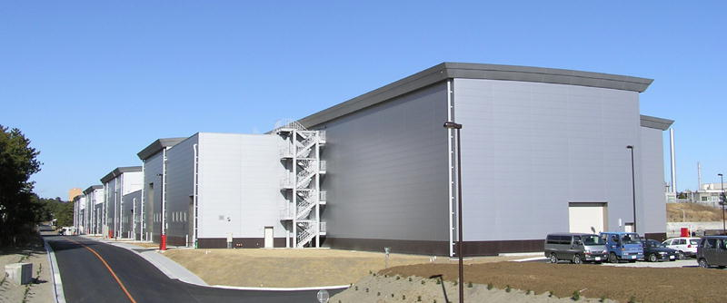
Materials & Life
Experimental Hall
Neutrino
Target
Area
3 GeV
Linac
Hadron Experimental Hall
Notes:
ニュートリノと変更した。
施設建設における苦労話（地下水対策、塩田発掘調査、オオタカ保護など）について触れた方がよい。

Slide 26
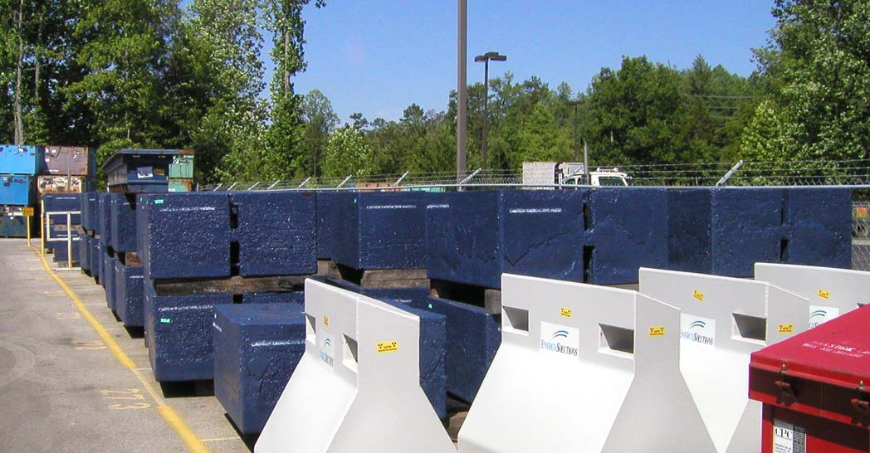
Use of “Recycled” Shielding Blocks
Iron blocks for radiation shield (fabricated by Energy Solutions Co. (previously called the Duratek))

Slide 27
Things afｔer Day-1
Linac Energy Recovery
181MeV → 400MeV
To get design intensity of the 3-GeV and thus also the 50-GeV accelerators. (0.6MW→1MW for the 3-GeV RCS)
Phase 2 items
Neutron
Muon
Transmutation
Hadron Hall Extension
Flying Wheel Generator for 50-GeV acceleration

Slide 28
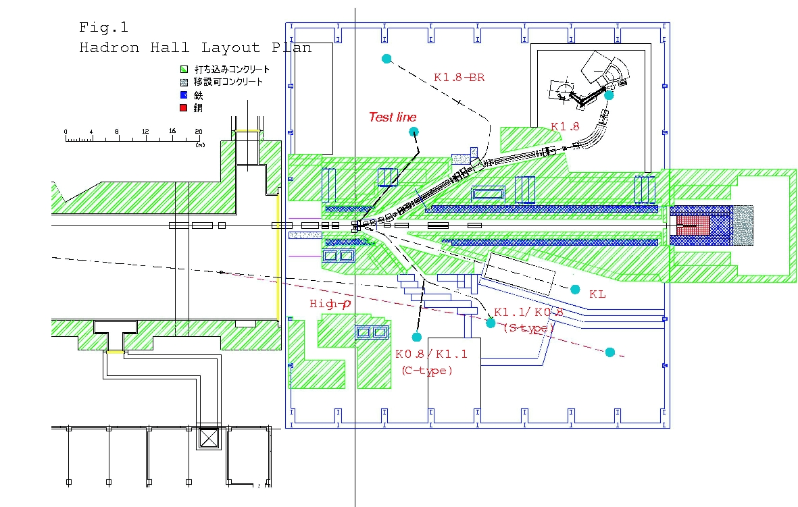
Phase-2 Items regarding the Hadron Hall
Gradual construction of the secondary beamlines at the Hadron Hall
Only K1.8 (or K1.8BR) can be completed at the Day 1.
K1.1, K0, High-p, …
Phase-2 construction
Extension of the Hadron Hall and related beamline construction
Continuous 50-GeV operation at the 50-GeV synchrotron with the flying wheel generator.
→ 100m
56m

Slide 29
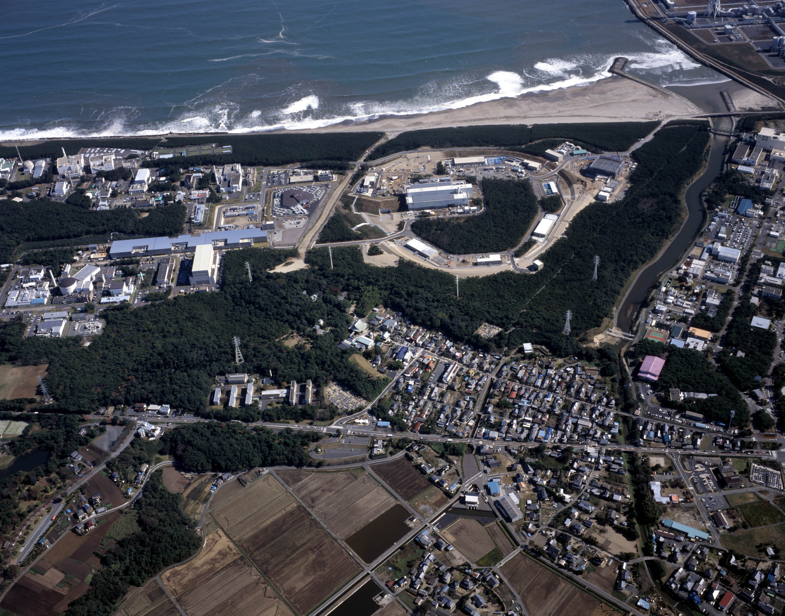
Scenes of Construction
Notes:
Let me introduce some scenes of the construction. This is a photograph of the J-PARC site this year. These are the linear accelerator, the 3-GeV Proton Synchrotron, and the 50-GeV PS.

Slide 30
Beamline Parameters
 | K1.8 |  |  | K1.8BR |  |  | K1.1 (S-Type)
Max. Mom. | ~2 GeV/c |  |  | 1.2 GeV/c |  |  | 1.1 GeV/c
Length | 45.694 m |  |  | 26.973 m |  |  | 27.05 m
Acceptance | 2.03 msr.% & |  |  | 4.5 msr.% & |  |  | 4.1msr.% \
Intensity (ppp)# | K⁻ (×10⁶) |  |  | K⁻ (×10⁶) |  |  | K⁻ (×10⁶) |  |  | K⁺ (×10⁶)
 | 50GeV15μA | 30GeV9μA |  | 50GeV15μA | 30GeV9μA |  | 50GeV15μA | 30GeV9μA |  | 50-15 |  | 30-9
1.8 GeV/c | 9.6 | 2.0
1.1 GeV/c | 0.6 | 0.1 |  | 10.7 | 2.3 |  | 9.1 | 2.0 |  | 81 |  | 11
0.8 GeV/c |  |  |  | 2.0 | 0.4 |  | 1.7 | 0.4 |  | 18 |  | 2.5
0.6 GeV/c |  |  |  | 0.3 | 0.05 |  | 0.2 | 0.05 |  | 2.6 |  | 0.4
DC-Separator | 750kV/10cm 6m×2 |  |  | 500kV/10cm 6m |  |  | 750kV/10cm 2m×2
K⁻/π^{− $} | 2.3 (1.8GeV/c) |  | 2.6 | 10 (1.1GeV/c) |  | 12 | 4.3(1.1GeV/c) |  | 4.7
X/Ysize @ FF | 16/8 mm(FWHM) |  |  | 38/7.4 mm(FWHM) |  |  | 10/6 mm(FWHM)
& MS1 opening: ±2mm, MS2 opening: -3.25mm,+2.75mm
\ MS1 opening: ±1mm, MS2: ±2mm
# using Sanford-Wang formula, assuming 1pulse=3.53s（0.7s flat top)
$ Cloud π are not taken into account.

Slide 31
PAC Members (June 2006)
Name | Affiliation | Remarks
Ishii, Tetsuro | JAEA | ○
Inoue, Kunio | Tohoku | ○
En’yo, Hideto | RIKEN | △
Oshima, Takayoshi | RIKEN | ○
Kishimoto, Tadashi | Osaka | ○
Sakai, Hideyuki | Tokyo | ○
Nakano, Takashi | Osaka | △
Hiyama, Emiko | Nara | ○
Bressani, Tullio | Torino | ○
Peng, Jen-Chieh | Illinois | △
Ceccuci, Augusto | CERN | △
Shaevits, Michael | Columbia | △
Hsiung, Yee-Bob | National Taiwan U. | ○
Tokushuku, Katsuo | KEK | △
Hagiwara, Kaoru | KEK | △
Term of Service: ○＝2006.6.1-2008.3.31, △=2006.6.1-2010.3.31

Slide 32
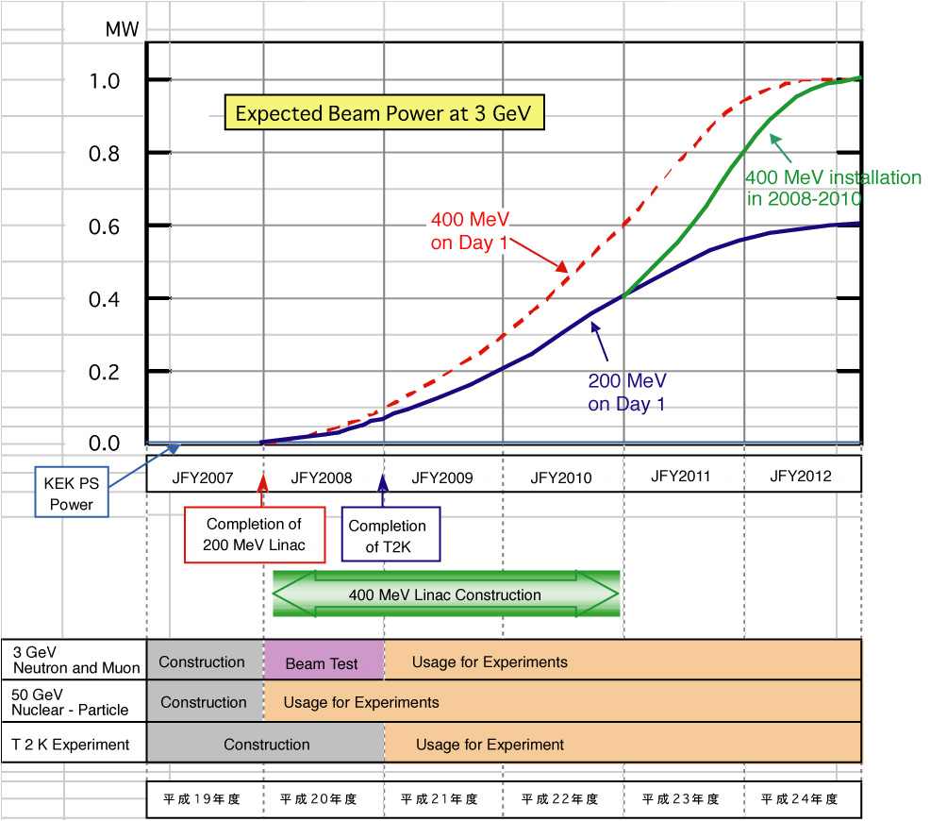
Linac Energy Recovery
The Committee recommended strongly to start the energy recovery immediately after the completion of Phase 1.
JFY2008 JFY2009 JFY2010 JFY2011 JFY2012 JFY2013
Phase 1
Completion

Slide 33
Proposals and PAC recommendation
 | (Co-)Spokespersons | Affiliation | Title | Stat
E03 | K. Tanida | Kyoto U. | Measurement of X rays from Ξ- Atom | S1
P04 | J.C. Peng/S. Sawada | U. Illinois/KEK | Measurement of High-Mass Dimuon Production at the 50-GeV Proton Synchrotron
E05 | T. Nagae | KEK | Spectroscopic Study of Ξ-Hypernucleus, 12ΞBe, via 12C(K-, K+) Reaction | S2,D1
E06 | J. Imazato | KEK | Measurement of T-Violating Transverse Muon Polarization in K+ -> pi0 mu+ nu Decays | S1
E07 | K. Imai/K. Nakazawa/H. Tamura | Kyoto U./Gifu U./Tohoku U. | Systematic Study of Double Strangeness System with an Emulsion-counter Hybrid Method | S2
E08 | A. Krutenkova | ITEP | Pion Double Charge Exchange on Oxygen at J-PARC | S1
E10 | A. Sakaguchi/T. Fukuda | Osaka U. | Production of Neutron-Rich Lambda-Hypernucleus with the Double Charge-Exchange Reaction | S1
E11 | K. Nishikawa | KEK | Tokai-to-Kamioka (T2K) Long Baseline Neutrino Oscillation Experiment Proposal | S2
E13 | T. Tamura | Tohoku U. | Gamma-ray Spectroscopy by Light Hypernuclei | S2,D1
E14 | T. Yamanaka | Osaka U. | Proposal for KL -> pi0 mu mu-bar Experiment at J-PARC | S2
E15 | M. Iwasaki/T. Nagae | RIKEN/KEK | A Search for deeply-bound kaonic nuclear states by in-flight 3HE(K-, n) Reaction | S2,D1
E16 | S. Yokkaichi | RIKEN | Electron Pair Spectrometer at the J-PARC 50-GeV PS to explore the chiral symmetry in QCD | S1
E17 | R. Hayano/H. Outa | U. Tokyo/RIKEN | Precision Spectroscopy of Kaonic 3He 3d -> 2p X-Rays | S2,D1
E18 | H. Bhang/H. Outa/H. Park | SNU/RIKEN/KRISS | Coincidence Measurement of the Weak Decay of 12ΛC and the three-body weak interaction process | S1
E19 | M. Naruki | KEK | High-Resolution Search for Θ+ Pentaquark in pi- p -> K- X Reaction | S2,D1
E22 | S. Ajimura/A. Sakaguchi | Osaka U | Exclusive Study on the Lambda-N Weak Ineteraction in A=4 Lambda-Hypernuclei | S1
S2: Stage-2 approval, S1: Stage-1 approval, D1: Assigned as Day-1

