Slide 1
Highlights from the spin PWG
Kensuke Okada (RBRC)
for the spin PWG
PHENIX collaboration meeting
July 18, 2008

Slide 2
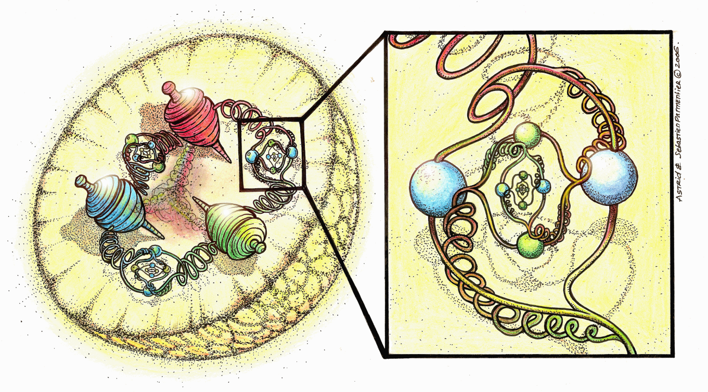
Topics covered by the SpinPWG
What is the spin structure of proton?
Longitudinal spin structure
Gluon polarization
(Anti-)quark flavor decomposition
Transverse spin structure
Transversity
Orbital angular momentum
Courtesy of A. Morreale
Method
The basic idea :
To see the spin effect, measure the difference between spin orientations.
A_LL, A_L, A_TT, A_N, …
D_LL, D_LS, …

Slide 3
PHENIX datasets
Longitudinally Polarized Runs
The program for gluon polarization (Δg)
Year | √s [GeV] | Recorded L | Pol [%] | FOM (P⁴L)
2003 (Run 3) | 200 | .35 pb⁻¹ | 27 | 1.9 nb⁻¹
2004 (Run 4) | 200 | .12 pb⁻¹ | 40 | 3.1 nb⁻¹
2005 (Run 5) | 200 | 3.4 pb⁻¹ | 49 | 200 nb⁻¹
2006 (Run 6) | 200 | 7.5 pb⁻¹ | 57 | 790 nb⁻¹
2006 (Run 6) | 62.4 | .08 pb^{-1 **} | 48 | 4.2 nb^{-1 **}
** initial estimate
(With the rotator on)
No data since Run6….
Notes:
From Ken’s talk at Spin Praha, add run8

Slide 4
PHENIX datasets
Transversely Polarized Runs
The program for transversity and orbital angular momentum.
Year | √s [GeV] | Recorded L | Pol [%] | FOM (P²L)
2001 (Run 2) | 200 | .15 pb⁻¹ | 15 | 3.4 nb⁻¹
2005 (Run 5) | 200 | .16 pb⁻¹ | 47 | 38 nb⁻¹
2006 (Run 6) | 200 | 2.7 pb⁻¹ | 57 | 880 nb⁻¹
2006 (Run 6) | 62.4 | .02 pb^{-1 **} | 48 | 4.6 nb^{-1 **}
2008 (Run8) | 200 | 5.2 pb^{-1 **} | 45 | 1100 nb^{-1 **}
** initial estimate
Vertically polarized (the natural direction)
Radially polarized (with the rotator on)

Slide 5
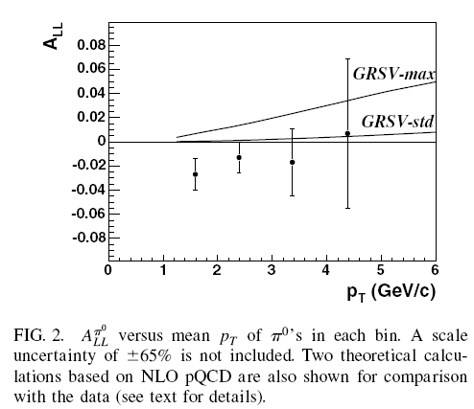
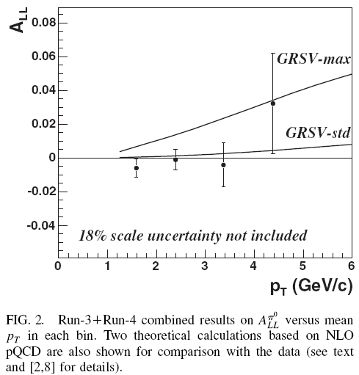
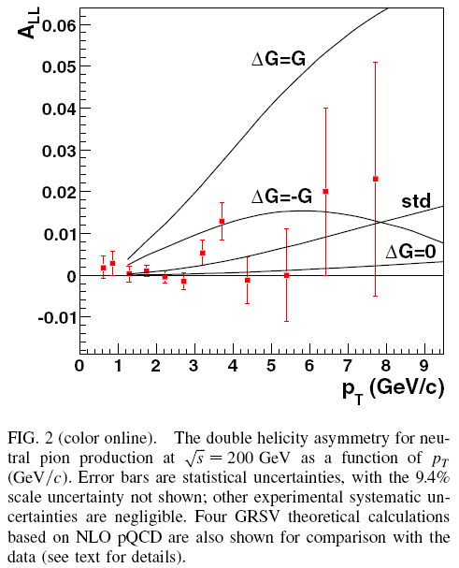
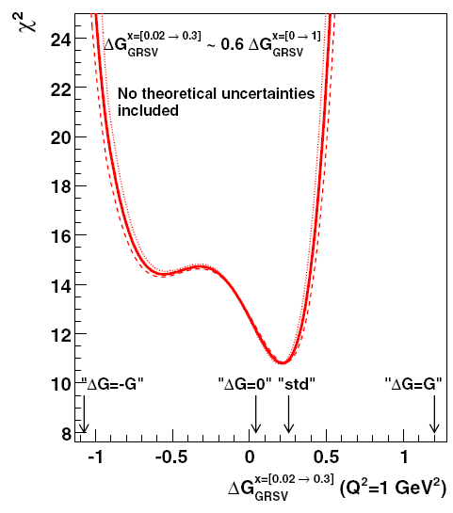
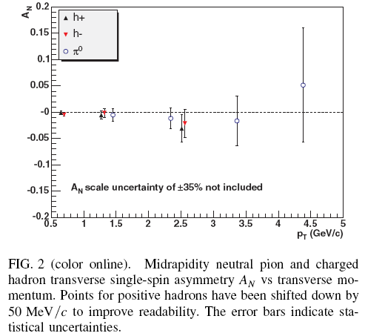
Published results
ppg31
PRL(2004)
Run3
ppg59
PRD(2006)
Run3+4
ppg63
PRD(2007)
Run5
π⁰ A_{LL}
ppg50
PRL(2005)
Run2
ΔG is small!
A_{N}
(central arm)
And
p+p cross section papers,
with other PWGs.
A_{N} is small!

Slide 6
(proto) ppgs
ppg
ppg87 (K. Aoki) π⁰ A_{LL} at √s=62.4GeV : The x_{g} range is different.
ppg89 (D. Fields) k_{T} asymmetry in Double-longitudinally polarized p+p : jet correlation
ppg91 (K. Boyle) π⁰ A_{LL} at √s=200GeV from Run6
ppg89
Proto-ppg
Multi-particle A_{LL} (K. Nakano) : “jet” analysis
A_{LL} of eta (F. Ellinghaus) :
Forward neutron cross section and A_{N} (M. Togawa) : neutrons are tagged by ZDC.
Forward neutron

Slide 7
Preliminaries
The list is from the last year.
The current status is
2008. 7
(Run5,6) Prompt mu A_LL, A_L
(Run3) Anti-Lambda (D_LL), D_LS, A_LL
ppg or proto-ppg,
Active,
Not active
2008.6
(Run6) IFF
+
2008.5
(Run6) Prompt mu A_N
-
IFF
2008.3
(Run6) Direct-gamma 62.4GeV (H/P)
(Run6) Charged pi A_LL
2007.12
(Run6) Eta A_LL
2007.11
(Run3) anti-Lambda D_LL
(Run5) single-e A_LL
2007.10
(Run5) direct photon A_LL
2007.7
(Run5) eta (H/P)
2007.6
(Run6) pi0 A_LL
2007.5
(Run6) pi0 62.4GeV (H/P)
(Run6) MPC pi0 62.4GeV A_N

Slide 8
Ongoing analysis
From PWG presentations the last year (before preliminary),
Run6 Central arm Sivers (Feng) :
a jet correlation analysis from the transversely polarized data.
Run6 Dimuon A_{TT} (Todd) :
towards the asymmetry of DY process. A direct access to the transversity.
Charged pion cross section study (Astrid):
It supports the A_{LL} result.
Access to low-x region with di-hadron using MPC (John):
A way from inclusive to exclusive probes
Electron (Central arm) and muon (muon arm) correlation study (Mikhail):
An idea to enhance the charm sample.
???
Anything comes with the spin orientation must be related to
the spin structure of the proton.
But what kind of probe is appropriate?

Slide 9
Key points
Basic data for the asymmetry measurement
Polarization of protons : Both absolute value and direction
Relative luminosity : It should be measured by a spin unbiased probe.
For the single azimuthal asymmetry, it can be bypassed.
Statistics and the signal to background ratio
The asymmetry signal is so tiny!
The understanding of spin averaged object
It needs to be collaborated with other PWGs.
Sometimes it is not very clear.

Slide 10
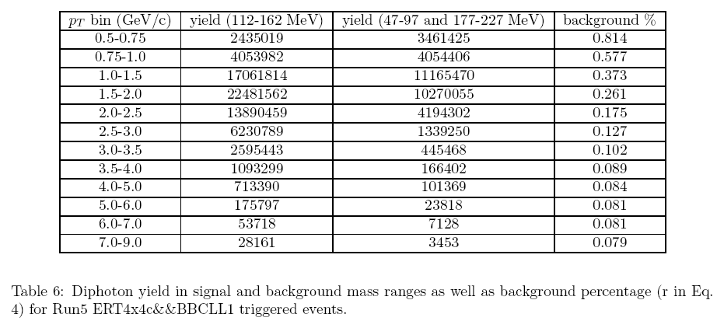
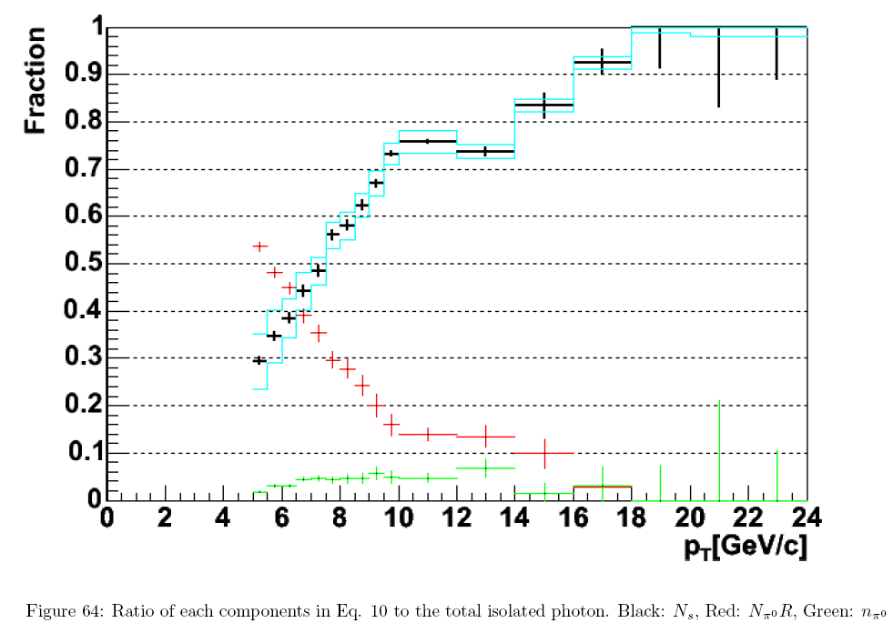
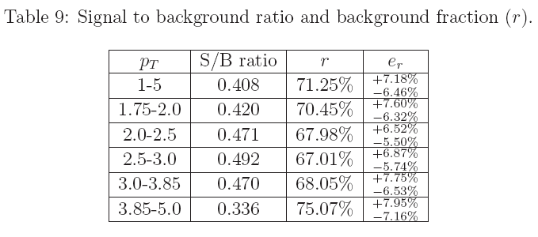
Fight for S/B
π⁰
r
The ideal case : We know B exactly (σ_{B}=0)
S/B is as important as
the integrated luminosity.
Prompt photon
(with an isolation cut)
Prompt muon
(1-r)

Slide 11
The understanding of spin averaged object
Multi-particles
Partial jet caught in PHENIX
2 (or more) fragmentation function
Charm, J/psi
How to connect the observables to the proton components?
What is the production mechanism?
kT asymmetry of longitudinally polarized protons (related to ppg89)
Is there centrality class in proton-proton collisions?
Hard/soft separation
The factorization scheme doesn’t work in the soft process.
(It’s an issue, especially when we see no asymmetry.)
Be as simple as possible!

Slide 12
The future

Slide 13
Integrated L goals:
From RHIC Spin Plan Report (June 9,2008)
Delivered ∫L
Recorded ~0.35X
Notes:
Run9 *1.3 with a new 9MHz RF.
In addition *2 with 200MHz strage system.
Run8 : 7.5/pb/week
Run9 : 14.5
Run10 : 21.6

Slide 14
Global fit with RHIC + DIS de Florian, Sassot, Stratmann, Vogelsang, arXiv:0804.0422
Now
50 pb⁻¹

Slide 15
W physics in √s=500 GeV
The parity violating process is to decompose the anti-quark flavor.
Observables : A_{L} of electrons and muons from the W decay.
W -> e (central arm)
W -> mu (muon arm)
How much is the QCD backgrounds?
Is the momentum resolution enough?
The MC estimations need to be confirmed by the real data.

Slide 16
Beyond Run9
The detector upgrades
VTX, FVTX, NCC, W-trigger
Heavy flavor tagging
Increase the acceptance → It helps determination of the kinematics
Drell-Yan transverse single spin asymmetry
Check fundamental QCD prediction of sign change in Sivers asymmetry
between Drell-Yan and semi-inclusive DIS

Slide 17
Outlook
Recorded Luminosity | Main physics Objective | Remarks
~50pb⁻¹ | Gluon polarization using di-jets and precision inclusive measurements | 200 GeV
~100pb⁻¹ | W production (Important consistency check to DIS results - Phase I) Gluon polarization (Di-Jets / Photon-Jets) | 500 GeV
~300pb⁻¹ | W production (Constrain antiquark polarization - Phase II) Gluon polarization (Di-Jets / Photon-Jets) | 500 GeV
~30pb⁻¹ | Transverse spin gamma-jet | 200 GeV
~250pb⁻¹ | Transverse spin Drell-Yan (Long term) | 200 GeV
(BNL PAC talk May 2008)
P=.7; running time is critical.

Slide 18
Spinfests
2005 at RIKEN (July 11- September 2)
2006 at BNL (July 24 – September 1)
2007 at BNL (March 19 – April 6) (analysis only)
2007 at RIKEN (June 11 – July 27)
2008 at BNL (July 21 – August 8)
2009 in Hawaii?
Goals
To integrate new people and get to know each other
Discussion (deeper than regular PWG meetings)
Theory lectures
Complete one’s analysis
Sponsored by RIKEN, LANL

Slide 19
Summary
Inclusive π⁰ has been the only probe of the gluon polarization published for now.
As the integrated luminosity is increased, other inclusive probes (π±, direct photon,
heavy quarks) get to be in the scope. In addition, di-jet (di-hadron) analysis
determines the kinematics. And the jet correlation itself can be a spin probe.
The field of transverse spin physics is still developing rapidly.
A number of inclusive A_{N} analyses from Runs 6 and 8 still need
people to work on them!
We need 30 times more integrated luminosity in √s=200GeV to meet
the original plan. (The A_{LL} of direct photon )
Another program with √s=500GeV is also exciting.
The spinPWG is actively working on Run5,6,8 data.

Slide 20
Backup slides

Slide 21
Published results
Double Helicity Asymmetry in Inclusive Mid-Rapidity neutral pion
Production for Polarized p+p Collisions at sqrt(s)=200 GeV
ppg31
Phys. Rev. Lett. 93, 202002 (2004)
Run3 pi0 A_LL
ppg50
Measurement of Transverse Single-Spin Asymmetries for Mid-rapidity
Production of Neutral Pions and Charged Hadrons in Polarized p+p
Collisions at sqrt(s) = 200 GeV
Phys. Rev. Lett. 95, 202001 (2005)
Run3 pi0, h A_N
ppg59
An Update on the Double Helicity Asymmetry in Inclusive Midrapidity
$\pi^{0}$ Production for Polarized $p+p$ Collisions at $\sqrt{s}=200$ GeV
Phys. Rev. D 73, 091102(R) (2006)
pi0 A_LL, update (Run3+Run4)
Inclusive cross section and double helicity asymmetry for pi^0 production
in p+p collisions at sqrt(s)=200 GeV:
Implications for the polarized gluon distribution in the proton
ppg63
Phys. Rev. D 76, 051106 (2007)
pi0 A_LL, update chi2 (Run5)

Slide 22
(proto) ppgs
2008b | Spin | M.Togawa;G. Bunce, S.White,Y.Goto,K.Tanida |  |  |  |  |  | 84 | 18-Apr-08 | 2008b | 5 | p+p | 200 GeV | A_N | forward neutron x-sect and A_N; M.Togawa
2007l | Spin | F. Ellinghaus; J.Seele,E.Kinney,C.Aidala |  |  |  |  |  | 210 | 14-Dec-07 | 2007l | 5,6 | p+p | 200 GeV | A_LL,eta | x-sect, A_LL eta, comp.to pi^0; F. Ellinghaus
2007k | Spin | K.Nakano;Y.Akiba,Y.Goto,J.Lajoie,T.-A.Shibata |  |  |  |  |  | 302 | 13-Sep-07 | 2007k | 6 | p+p | 200 GeV | A_LL | Event structure&A_Ll in part. cluster; K.Nakano
2007i | Spin | K.Boyle; A. Bazilevsky, G. Bunce, A. Deshpande |  |  |  |  |  | 332 | 14-Aug-07 | 2007i | 6 | p+p | 200 GeV | A_LL,pi^0 | delta G from pi^0 A_LL; K. Boyle
089 | Spin | hep-ex |  | wrk |  | PRL | PPG formed | 4 | 7-Jul-08 | 2007g | 5 | p+p | 200 GeV | di_h,crl | k_T asymmetry di-h correl.long.pol.;Doug Fields
PPG # | PWG | arXiv | IRC formed | w/us | w/jrn | jrn. | last action | days | last act'n | PPG # | Run(s) | CollSys | sqrt(sNN) |  | Description and PPG Head Name
087prd | Spin | hep-ex | 2-Jun-08 | int1 |  | prdR | first int. revue | 56 | 16-May-08 | 087prd | 6 | p+p | 62.4 GeV | A_LL,pi^0 | pi^0 incl. X-sect & A_LL; K. Aoki

Slide 23
Preliminaries
2008. 7
(Run5,6) Prompt mu A_LL, A_L
(Run3) Anti-Lambda (D_LL), D_LS, A_LL
2008.6
(Run6) IFF
2008.5
(Run6) Prompt mu A_N
2008.3
(Run6) Direct-gamma 62.4GeV (H/P)
(Run6) Charged pi A_LL
2007.12
(Run6) Eta A_LL
2007.11
(Run3) anti-Lambda D_LL
(Run5) single-e A_LL
2007.10
(Run5) direct photon A_LL
2007.7
(Run5) eta (H/P)
2007.6
(Run6) pi0 A_LL
2007.5
(Run6) pi0 62.4GeV (H/P)
(Run6) MPC pi0 62.4GeV A_N

Slide 24
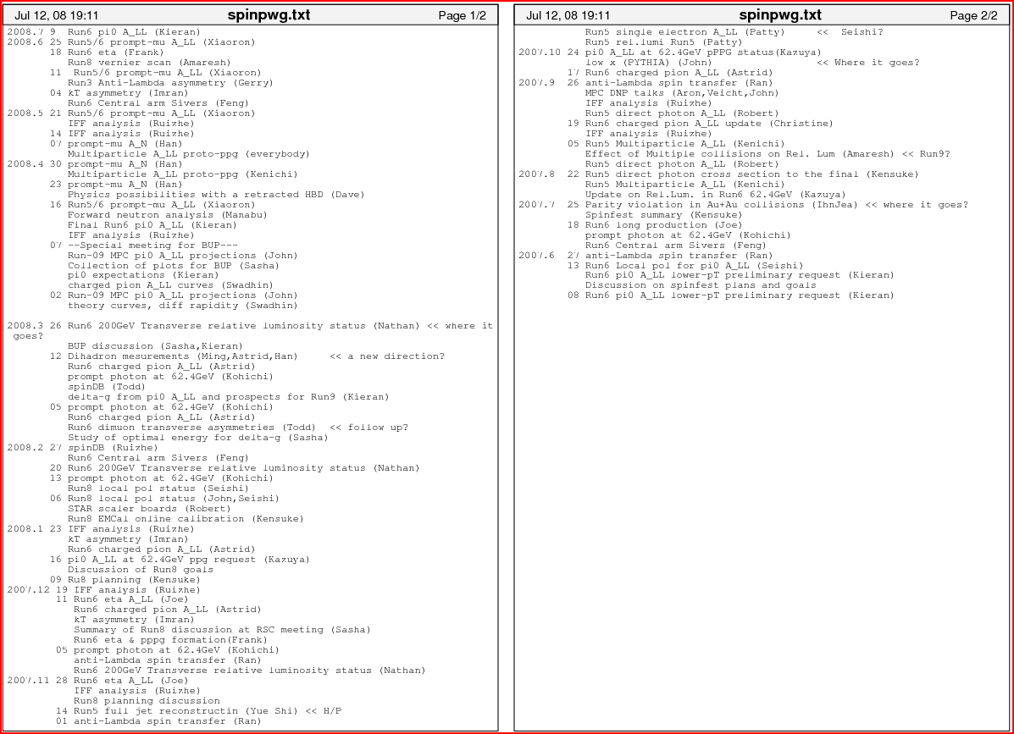
Recent activities
June 2007 ~ July 2008
Presentations at SpinPWG

