Slide 1
Direct Photons from RHIC to the LHC
Stefan Bathe
RBRC
Nuclear Physics Seminar
BNL, August 19, 2008
Notes:
Changed title

Slide 2
What I will do in this talk - a disclaimer -
I’ll talk little about RHIC physics
I’ll talk some about LHC physics
I’ll talk much about LHC calorimeters

Slide 3
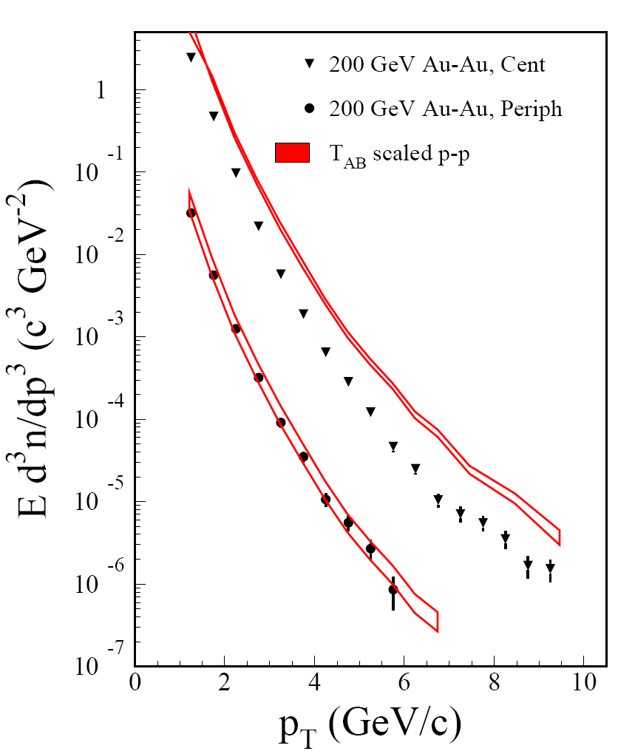
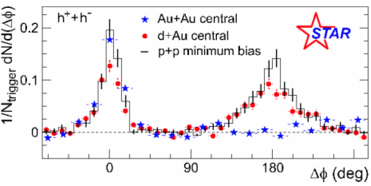
RHIC Key Physics Result
Nucl.Phys.A757:184-283,2005
PRL91(2003)072304
π⁰
High-pT hadron suppression
E loss of partons in medium

Slide 4
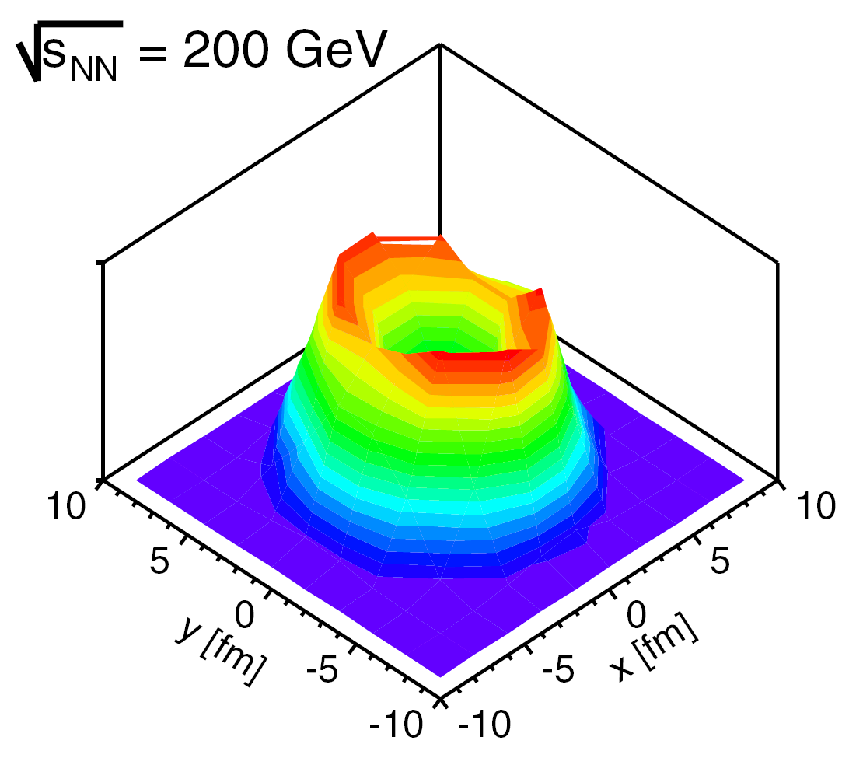
Surface Bias
Strong suppression (factor 5)
Dominated by surface emission (black probe)
Difficult to learn about suppression mechanism
Dainese et al., Eur. Phys. J. C 38, 461 (2005)
Origin of partons that produce 5 GeV hadrons in central Au+Au

Slide 5
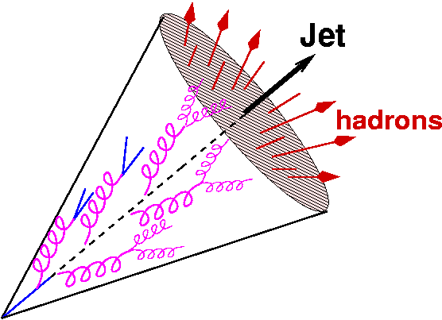
How can we learn more?
“[Almost] everything you want to know about jets can be found in 2-particle correlations.” Mike Tannenbaum
“Almost”: Shape of x_{E} distribution not sensitive to FF
Reason: trigger bias
Trigger bias can be overcome by
γ-h correlations (also overcomes surface bias!)
Full jet reconstruction (difficult, but higher rate)
So what does γ-jet help vs. γ-h?
Jet angle easy to measure
Expect multiple scattering in medium even w/o E loss
γ

Slide 6
Jet Measurements in HI Collisions
Challenge: background!
In cone of
there is
dE_{T}/dη in central Au+Au at RHIC is 600 GeV*
→E= 300 GeV in cone with R=1
75 GeV in cone with R=0.5
Compare to maximum jet energy: 100 GeV
* Phys. Rev. C 71, 034908 (2005)
Jet measurement in HI at RHIC difficult!

Slide 7
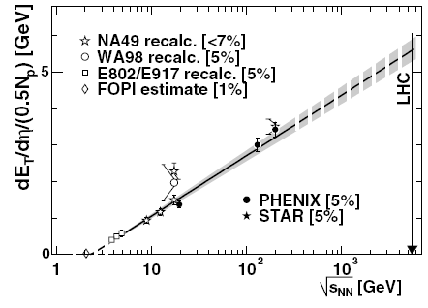
Jet Measurements at LHC
*Logarithmic extrapolation of √s dependence
of (dE_{T}/dη) /(N_{part}/2) from SIS to LHC
Jet measurement in HI at LHC still challenging
eliminate b fluctuations (large acceptance)
S. Milov, Jour.Phy.: Conf.Ser. 5 (2005) 17
dE_{T}/dη in central Pb+Pb at LHC ≈ 1200 GeV*
→E= 600 GeV in cone with R=1
150 GeV in cone with R=0.5
Compare to: - maximum jet energy: 2750 GeV
- typical jet energy: 100-200 GeV

Slide 8
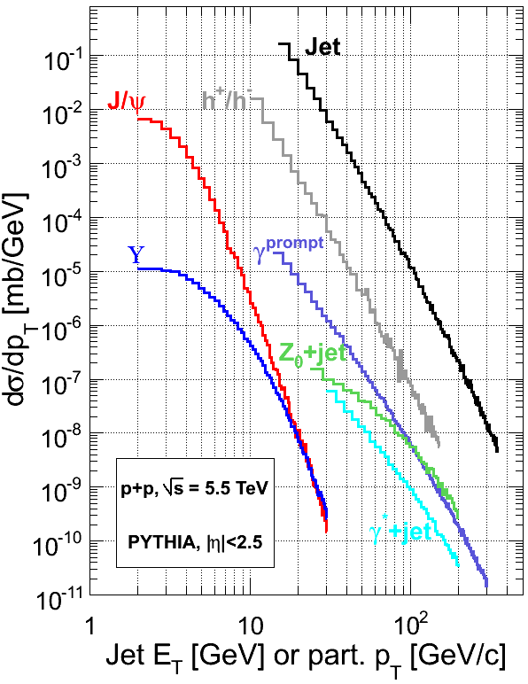
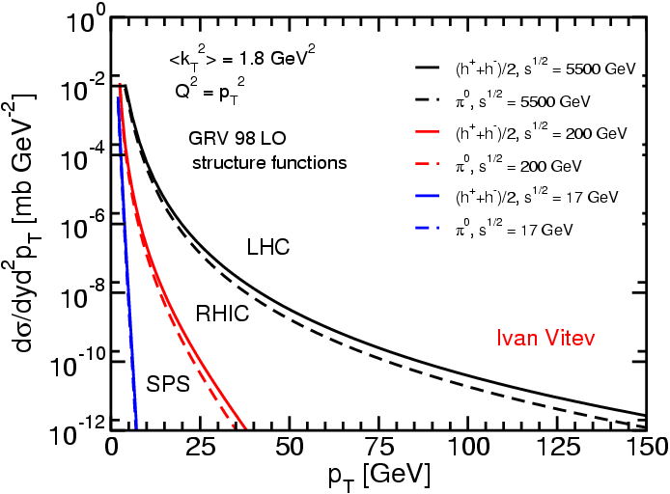
RHIC to LHC
Pb+Pb design lumi:
One Jet with 150 GeV/s
√s: 0.2 TeV → 5.5 TeV (x 27.5)
Relative rates (e.g. γ/π⁰) ~ scale with x_{T}
e.g. γ fraction = 10%: 3 GeV at RHIC
90 GeV at LHC
σ_{hard} increases by orders of magnitude
Accessible p_{T} range ~ 20-200 GeV (x10)
New probes available
Jets, direct γ-jet correlations
Experimental limit at RHIC
G. Roland, Hard Probes 2008
Detailed study of hard scattering

Slide 9
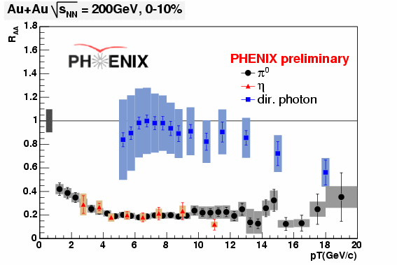
Caveat
Direct γ R_{AA} with measured
p+p reference data
γ
η π⁰
“If energy loss is low-p_{T} phenomenon, LHC will have nothing to measure.” (Mike Tannenbaum)

Slide 10
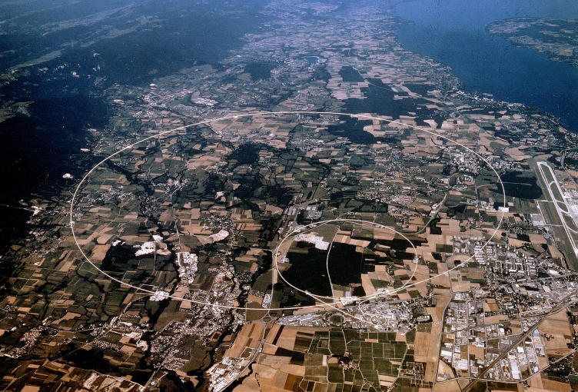
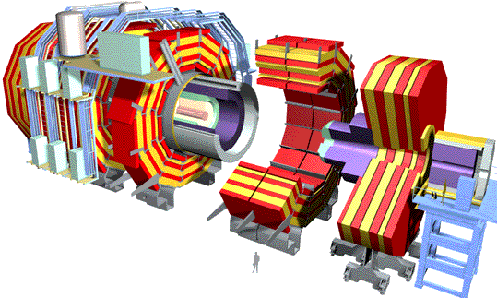
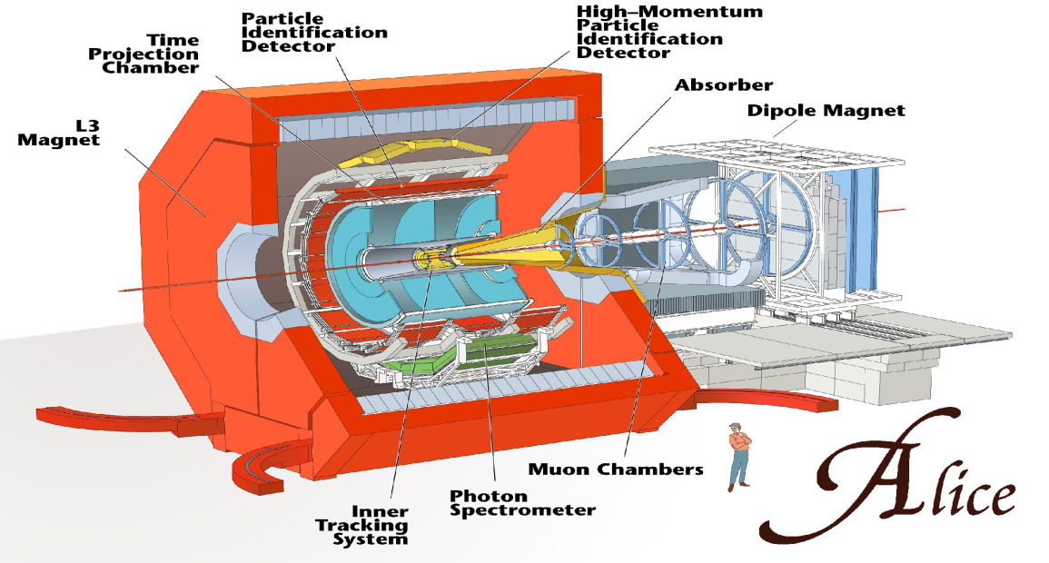
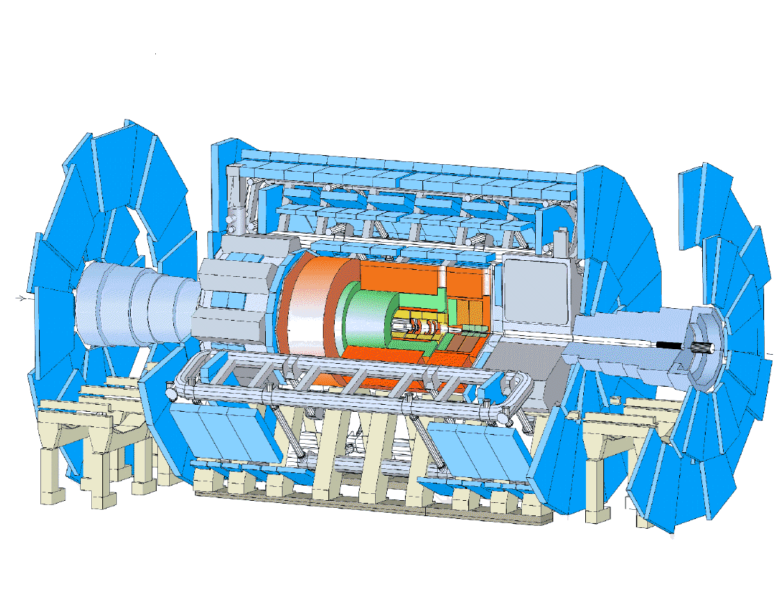
Experiments at the LHC
ALICE
ATLAS
CMS

Slide 11
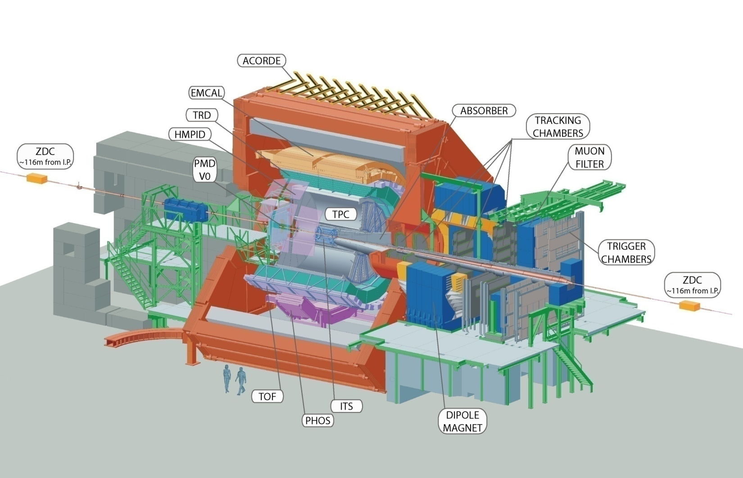
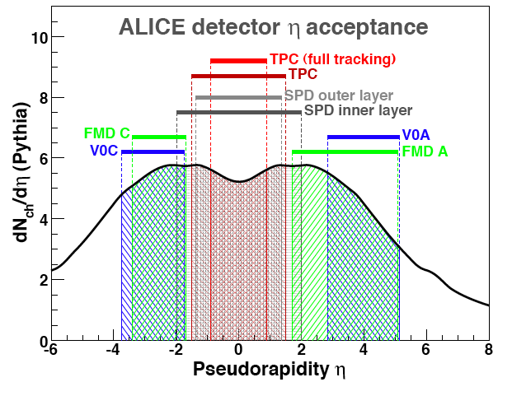
The ALICE Detector: dedicated to HI
Capabilities
Hadrons: 2π * 1.8 units η (dE/dx + ToF)
Leptons (dE/dx, TOF, transition radiation)
Photons (high resolution EM calorimetry, conversions)
Tracking and PID p_{T} range: 100 MeV/c -100 GeV/c

Slide 12
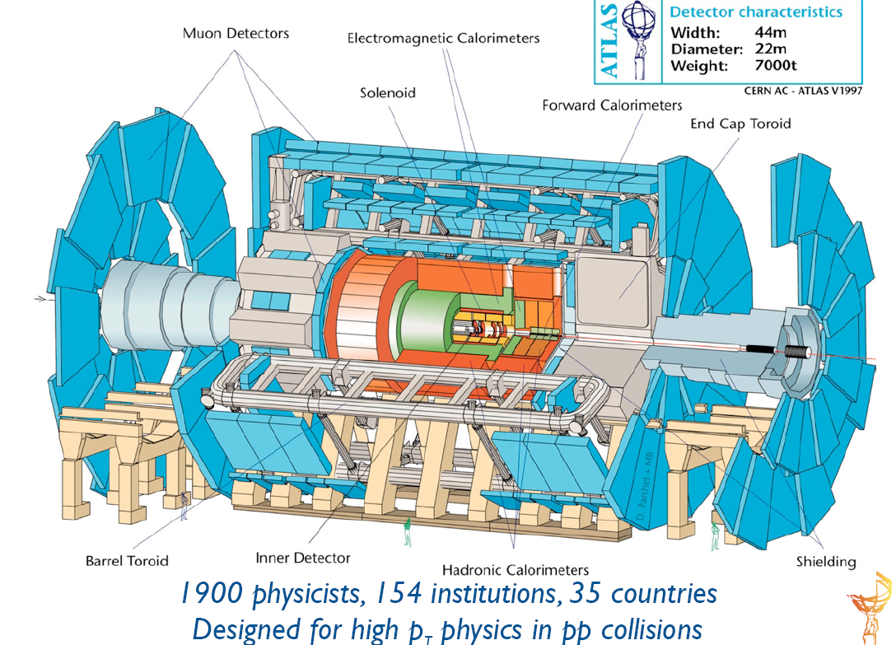
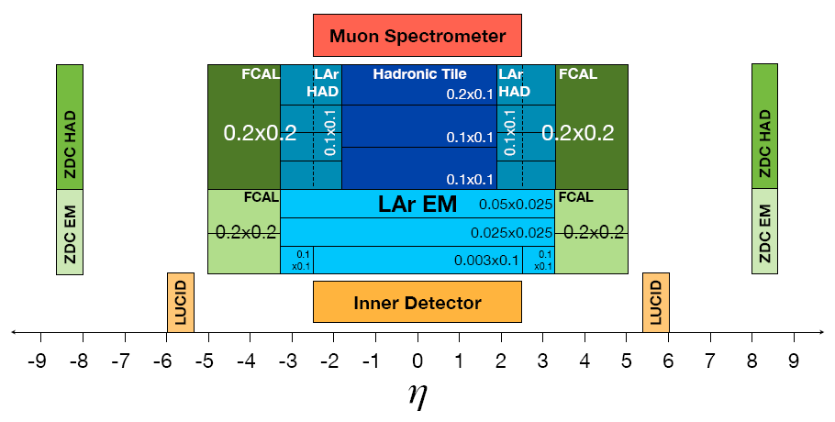
The ATLAS Detector
Inner tracking
EM and Hadronic calorimeters
External muon spectrometers
Full azimuthal acceptance in all detectors
Large pseudorapidity coverage
Δη = 10 for Calorimetry
Capabilities
High-precision tracking |η| < 2.5
Muon identification |η| < 2.5
Highly segmented calorimetry |η| < 5
Forward coverage
Large bandwidth: DAQ + Trigger
2π
Δη = 5 for tracking

Slide 13
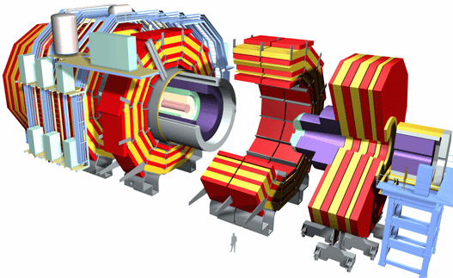
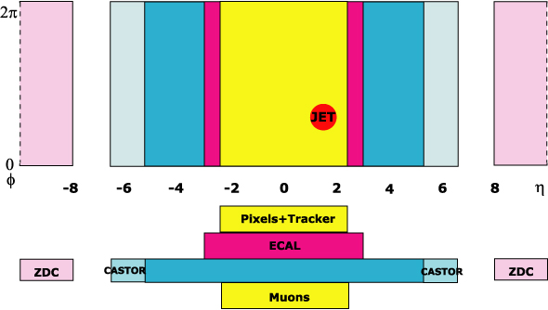
The CMS Detector
Δη = 10 for Calorimetry
Δη = 5 for Si tracker
2π
Capabilities
High-precision tracking over |η| < 2.5
Muon identification over |η| < 2.5
High resolution calorimetry over |η| < 5
Forward coverage
Large bandwidth: DAQ + Trigger
Large (mid-rapidity) acceptance (tracker and calorimetry)‏
DAQ+HLT will inspect every single Pb+Pb event
Large statistics for rare probes
Very well suited for HI environment
J.Phys.G34:2307-2455,2007

Slide 14
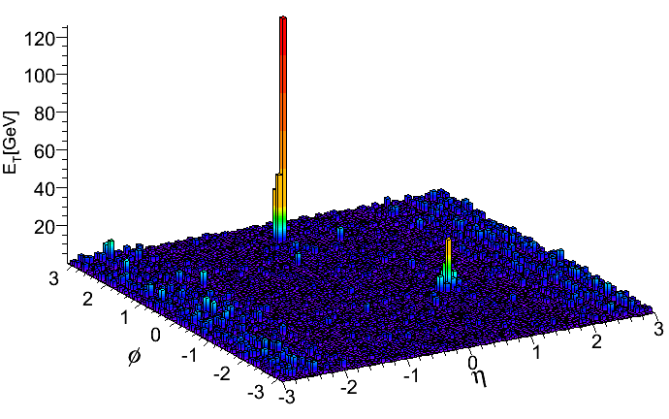
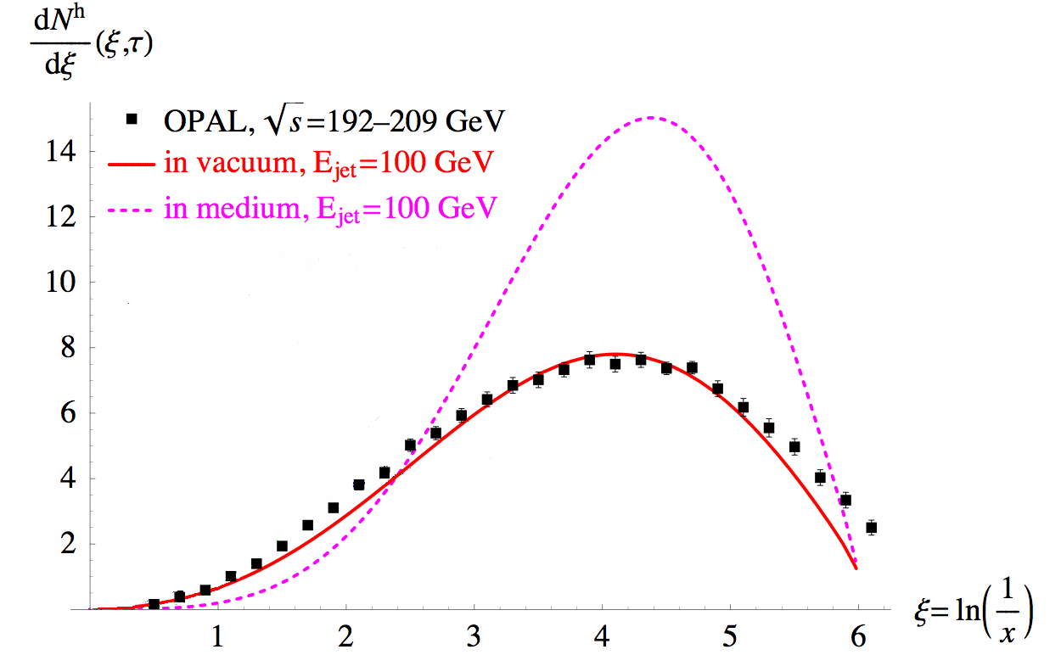
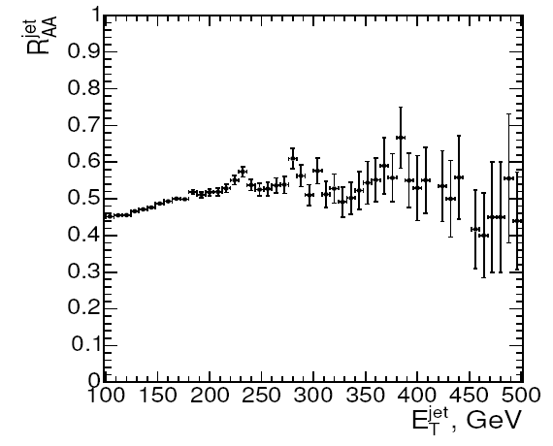
Measuring γ-Jet Correlations
Jet
3) Jet axis provides parton direction
Hadrons
1) Multiplicity, <p_{T}> and flow measurements characterize density, path length
4) Charged hadron tracks used to calculate
z = p_{T(track)}/E_{T}^{γ}
q,g
q,g
q,g
Photon
dN/dξ
Radiation inside jet cone
2) Photon energy tags parton energy E_{T}
Lokhtin et al.
Adapted from hep-ph/0506218
Radiation outside jet cone
Collisional/non-perturbative
vs. radiative E loss
ξ=log(E_{T}/p_{T})‏

Slide 15
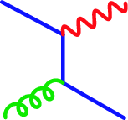
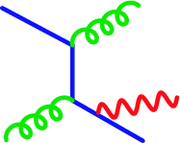
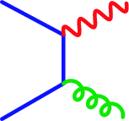
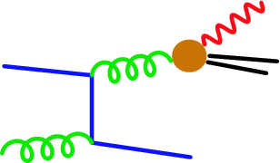
Photon Energy Tag
Compton
Bremsstrahlung
Annihilation
Fragmentation
Use photon to tag parton energy
Goal: Best correlation of photon and parton energy
Ideal: Use leading order photons
In practice: Isolated photons to select events with
good correlation of photon and parton energy
Background photons usually associated with jets
Remove using isolation cuts in data analysis and calculations

Slide 16
RHIC Calorimeters

Slide 17
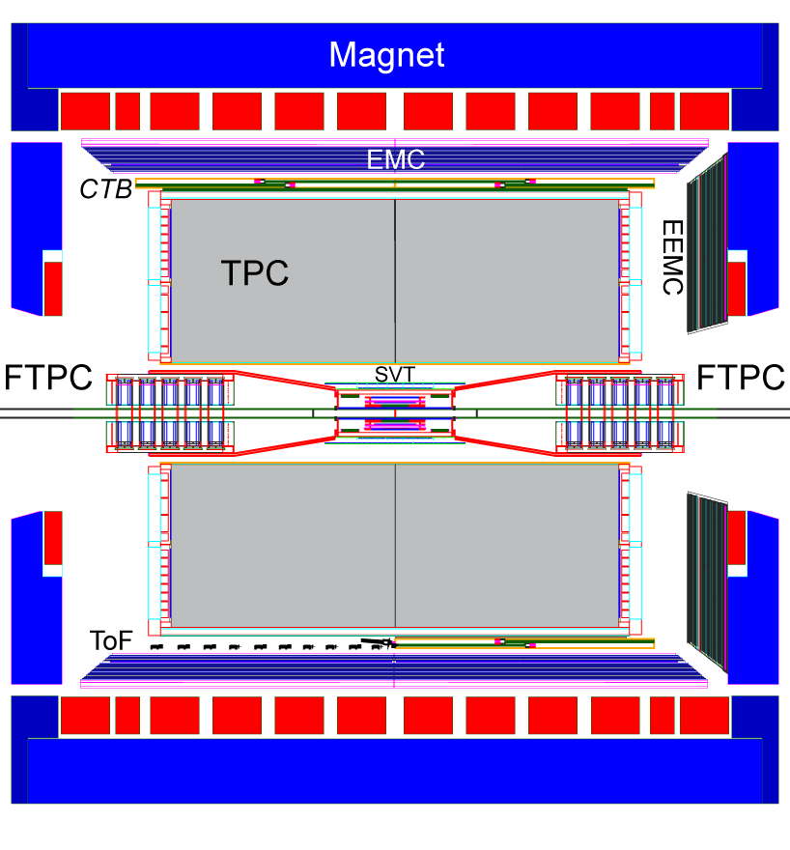
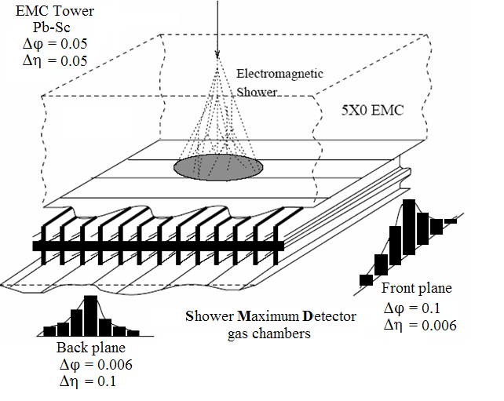
STAR Calorimeter
Similar to LHC calorimeters
large coverage
high resolution in Shower Max for neutral hadron rejection
lower resolution in Towers for π⁰ measurement

Slide 18
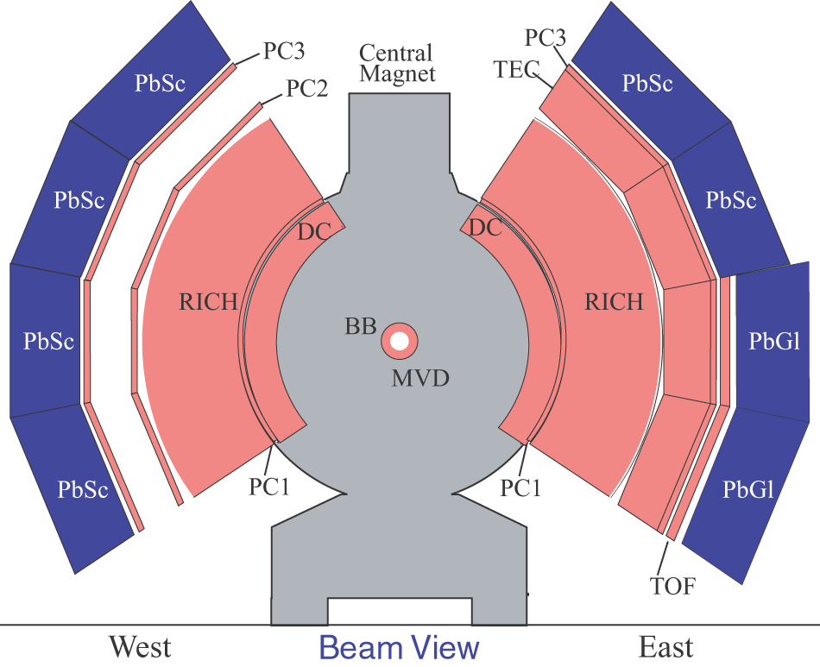
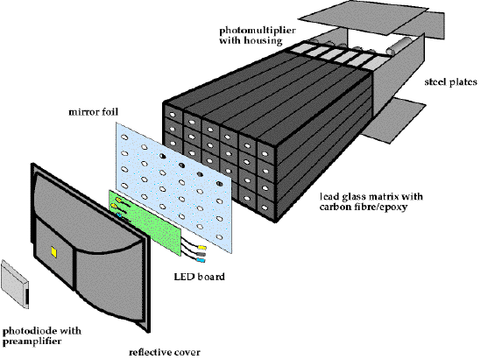
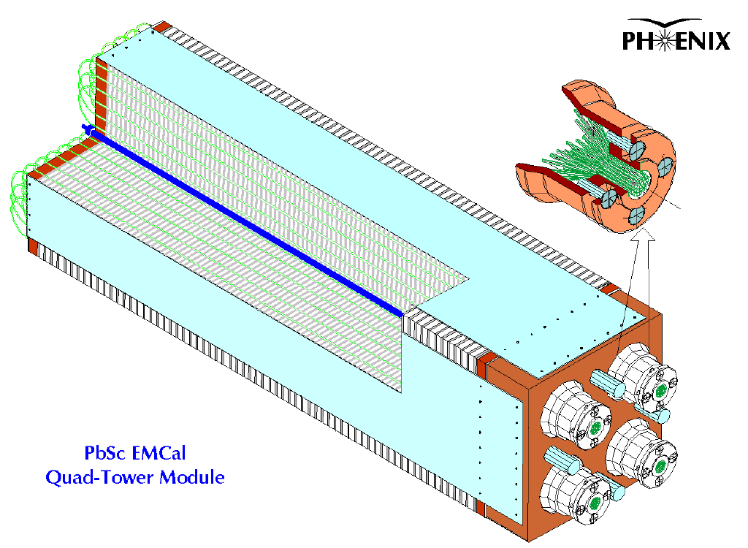
PHENIX Calorimeter
γ
π⁰
γ
Two calorimeters: PbSc (sampling); PbGl (homogenous)
Spatial resolution: ΔηxΔϕ = 0.01x0.01
Energy resolution: σ(E)/E = [1-2]% ⊕ [6-8]%/√E
Virtually complete background rejection for p_{T}< 25 GeV through reconstruction of neutral hadrons

Slide 19
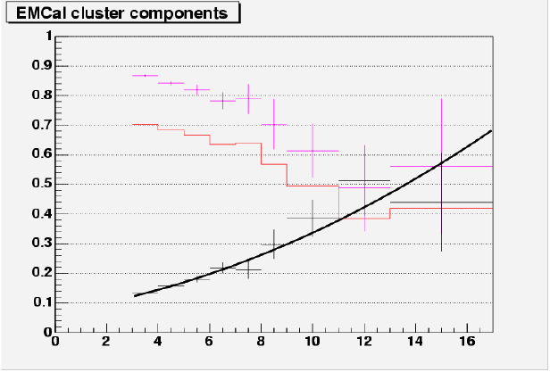
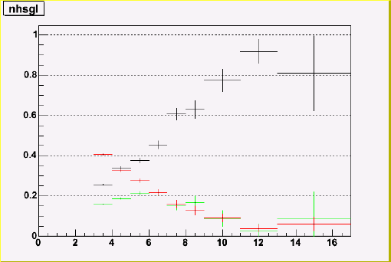
PHENIX Isolation Cut in p+p
Uncorrected for cluster merging
w/o iso
w/ iso
bckgrd fraction
Signal fraction
p_{T}
Why does isolation cut only suppresses background by factor 5 at 10 GeV?
Small acceptance?---Small effect.
More likely due to underlying event

Slide 20

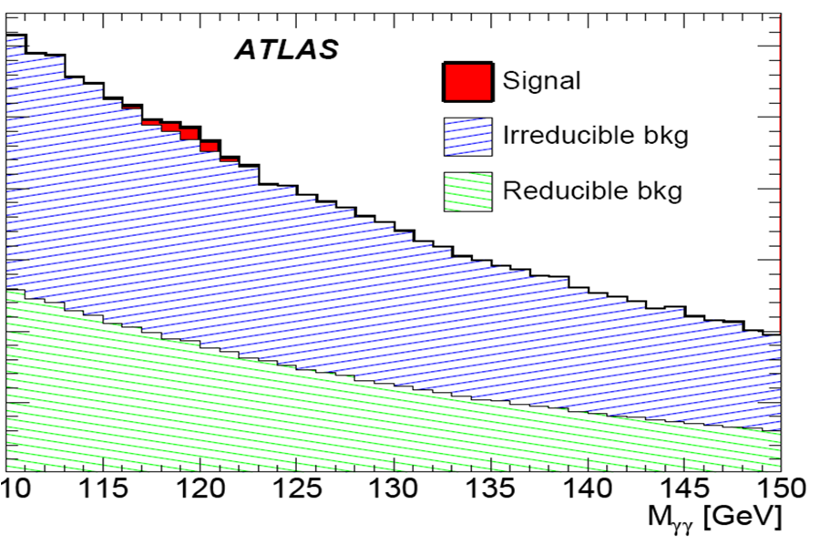

The Higgs: driving the design of LHC calorimetry
Arbitrary scale
H→γγ
Higgs capabilities depend on
Rejection (ATLAS: lateral, longitudinal segmentation)
E Resolution (CMS: crystal)

Slide 21
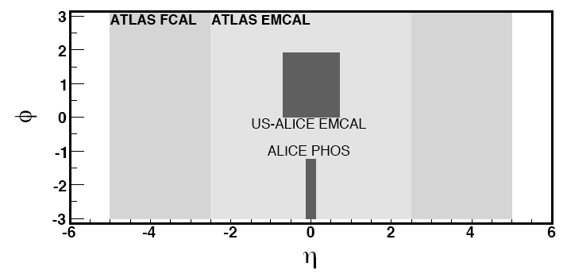
Coverage and Other Differences
From 2010
ALICE: 1000 scientists, 1000 HI
ATLAS: 2500 scientists, ~35+ HI (11 inst.), photon experts
CMS: 2600 scientists, ~100 HI (25 inst.)

Slide 22
Photon Detectors at LHC
Exp. | ATLAS |  | CMS |  | ALICE
Name | LAr Barrel | LArEndCap | ECAL(EB) | ECAL(EE) | PHOS | EMCal | Barrel
Structure | Liquid Argon |  | PWO+APD |  | PWO+APD | Pb+APD | TPC+ITS+ TRD+TOF
Coverage | 0<|η|<1.4 2π | 1.4<|η|<3.2 2π | 0<|η|<1.5 2π | 1.5<|η|<3. 2π | 0<|η|<0.12 0.6π | 0<|η|<0.7 0.6π | (0<|η|<0.9 2π)∗ 7% X/X₀
Granularity Δη xΔφ | 0.003x0.100 0.025x0.025 0.025x0.050 | 0.003x0.100 0.025x0.025 0.025x0.050 | 0.017x0.017 | 0.017x0.017 to 0.05x0.05 | 0.004x0.004 | 0.014x0.014 | 3.10⁻⁴x 2.10⁻⁴ (resolution)
Resolution | 10%/√E ⊕ 0.5% | 10%/√E ⊕ 0.5% | 2.7%/√E ⊕ 0.55% | 5.7%/√E ⊕ 0.55% | 3.3%/√E ⊕ 1.1% | 7%/√E ⊕ 1.5% | 2% low p _{T} 5% high p _{T}
A. Marin, Hard Probes 2008

Slide 23

ALICE

Slide 24
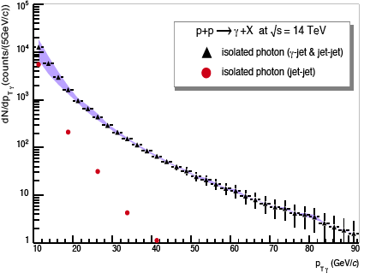
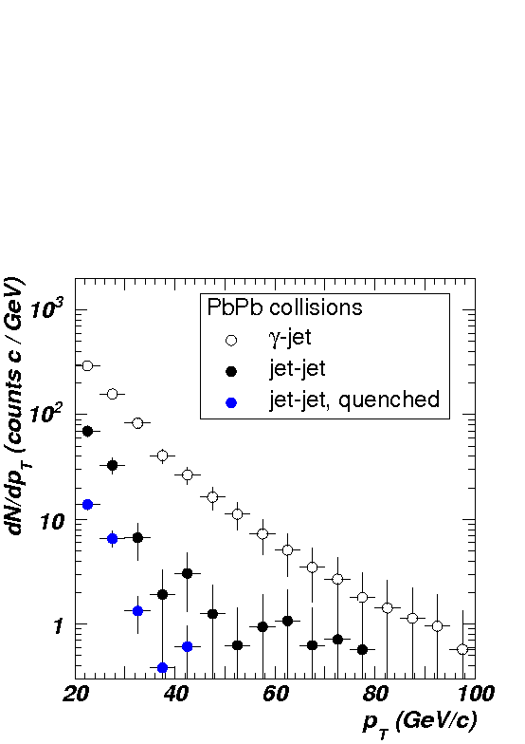
Identifying prompt γ in ALICE (PHOS)
Y. Mao, Poster QM2008,
ALICE-INT-2007-021
p+p
R = 0.3, Σp_{T} < 2 GeV/c
Efficiency: 69%
Background rejection: 1/170
First year (10 pb⁻¹)
3000 γ (Eγ > 20 GeV)
Pb+Pb
R = 0.2, p_{T}^{thresh} = 2 GeV/c
Efficiency: 50%
Background rejection: 1/14
One month of running
2000 γ (E_{γ} > 20 GeV)
signal
× 5
Why S/B so good (100)?
G. Conesa et al., NIM A 580(2007) 1446,
NIM A 585(2008) 28

Slide 25
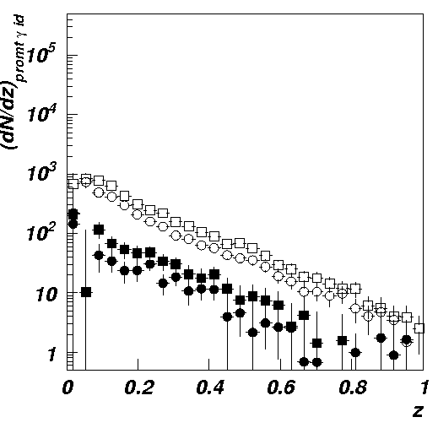
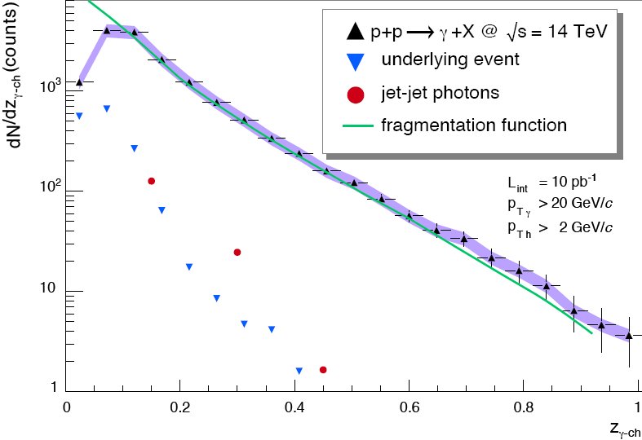
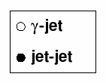
ALICE: Photon-Tag Jets Fragmentation Function
Y. Mao, Poster QM2008, ALICE-INT-2007-021
G. Conesa et al., NIM A 580(2007) 1446,
NIM A 585(2008) 28
pp
p+p
PbPb
Pb+Pb
Imbalance distribution
Isolated photons and
background subtracted

Slide 26
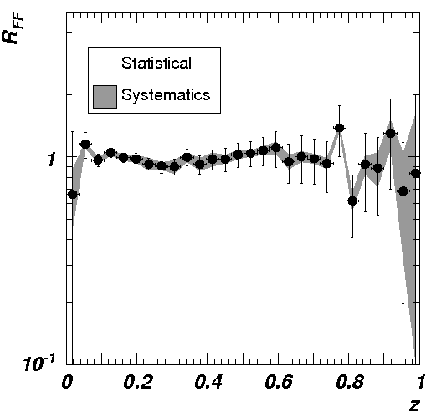
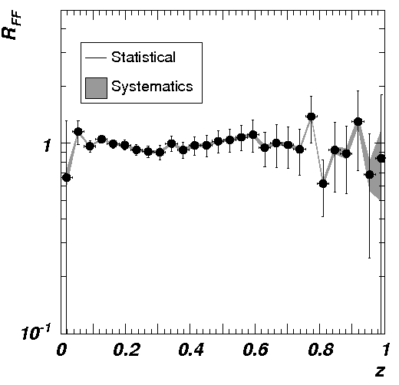
ALICE: γ-tagged FF R_{AA}
Systematic errors due
to jet(π⁰)-jet background
G. Conesa et al., NIM A 580(2007) 1446,
NIM A 585(2008) 28
Charged + EM
With error quenched π⁰
Sensitive to medium modifications at low z
if larger than ~5%.

Slide 27

ATLAS

Slide 28
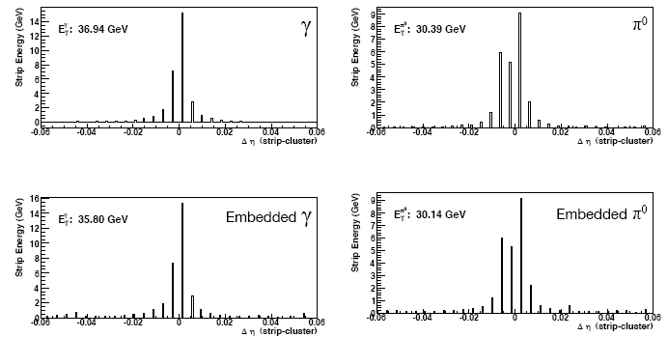
Lateral Segmentation
Single particle
Single particle
Central Pb+Pb
Central Pb+Pb
First EMCal layer has high separation in η
Low occupancy even in central Pb+Pb
π⁰ rejection for E_{T} ≤ 70 GeV

Slide 29
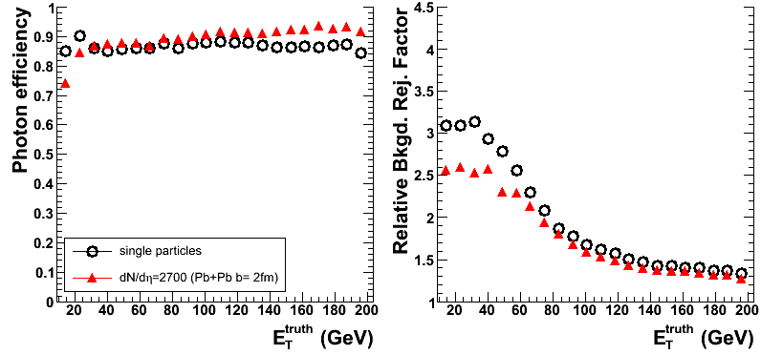
Photon ID: Loose Cuts
unquenched
Relative rejection of 2 at 85% efficiency with loose photon ID cuts below ~ 50 GeV

Slide 30
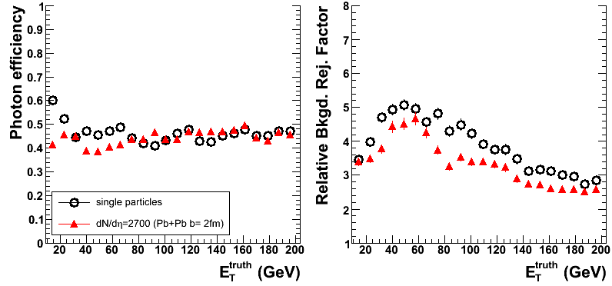
Photon ID: Tight Cuts
unquenched
Relative rejection of 1.5-2.2 at ~50% efficiency with tight photon ID cuts

Slide 31
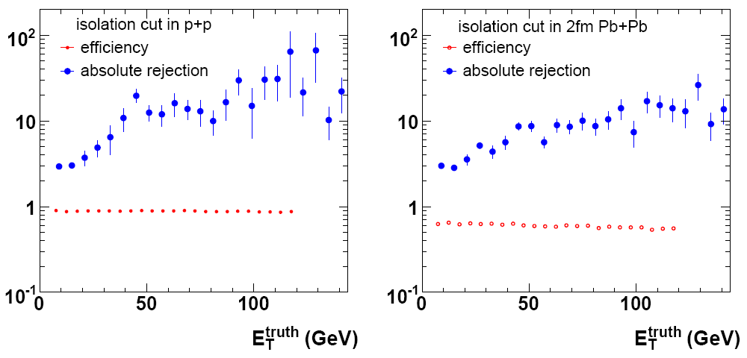
Isolation Cut
Relative rejection of 5 at ~60% efficiency in unquenched Pb+Pb

Slide 32
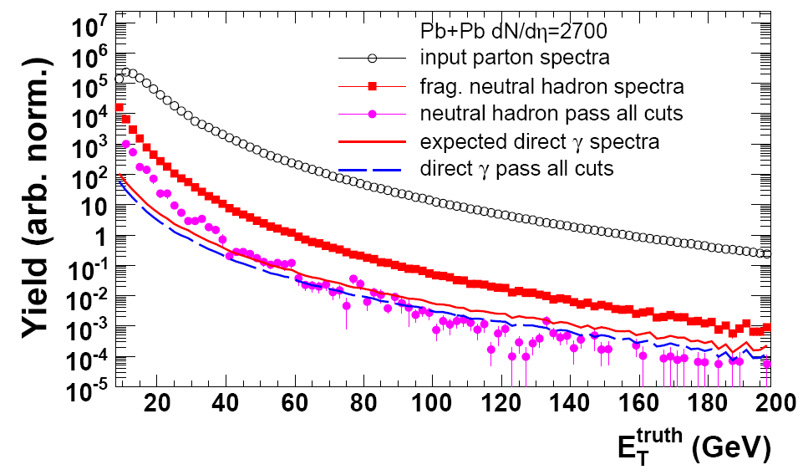
Photon Spectrum
S/B > 1 for E_{T} > 70 GeV in unquenched central Pb+Pb
Relative rejection factor ~ 15

Slide 33
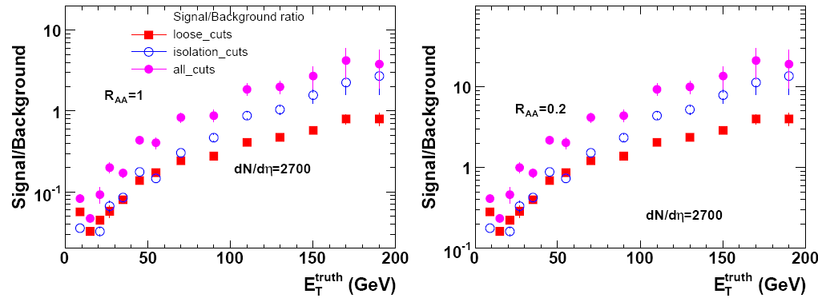
S/B
S/B = 1 at E_{T} = 70 GeV for unquenched Pb+Pb
S/B ~ 4 at E_{T} = 70 GeV for quenched Pb+Pb

Slide 34
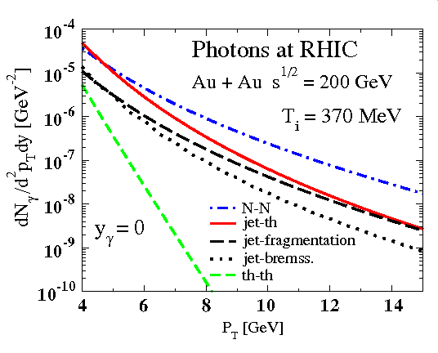
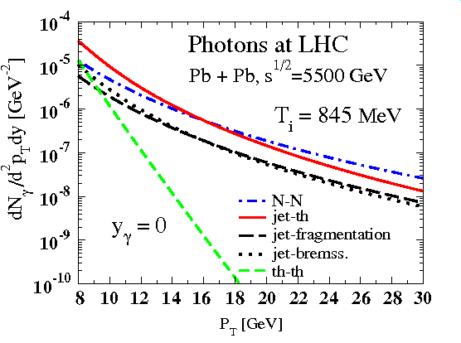
Medium Photons
Turbide, Gale, Jeon, and Moore
PRC (2004) 014906
Photons are abundantly produced at LHC
Jet-photon conversion in the plasma dominates 8<p_{T}<14 GeV
Prompt hard NN scattering dominant for p _{T}>20GeV at LHC
ATLAS better suited than CMS

Slide 35

CMS

Slide 36
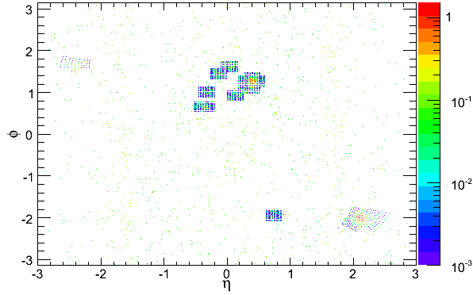



ECAL Response in p+p and Pb+Pb
Pb+Pb
dN/dη ~ 2400
p+p (selective readout)
ECAL clusters
p+p after seed threshold (0.5/0.18 GeV)
Pb+Pb after seed threshold (0.5/0.18 GeV)

Slide 37




Photon Selection
*
Selection variables
Cluster shape in ECAL
HCAL/ECAL energy ratios
Track isolation
21 variables total
Linear discriminant analysis to select optimal cuts
Large acceptance essential for effective cuts w/o loss of signal
Prompt
photon
π⁰
ECAL
ECAL
HCAL
HCAL

Slide 38

Photon identification performance
WP
Set working point to 60% signal efficiency
Leads to 96.5% background rejection
Training is done on unquenched samples only
p+p
Pb+Pb
Notes:
38
19/08/2008
So here is the obtained photon id performance, given as signal efficiency vs background rejection. Obviously one would like to have 100% signal and 100% background rejection. For pp as you can see we get close to this. For Pb+Pb we set our working point to 60% sig eff, which corresponds to about 96.5% background rejection.

Slide 39


Photon Selection Performance
PYQUEN/quenched Pb+Pb
Before cuts:
S/B=0.3
After cuts:
S/B=4.5
C. Loizides nucl-ex/0804.3679v1
Photon isolation/shape cuts improve S/B by factor ~15
(at 60% signal acceptance, 97% background rejection)

Slide 40
Photon Selection Performance
Before cuts:
S/B=0.3

Slide 41
Photon Selection Performance
Before cuts:
S/B=0.3
π⁰
Main background: high-z neutral hadrons
Why γ/π⁰ flat (and not rising)?

Slide 42


Fragmentation function ratio
Reco quenched Pb+Pb / MC unquenched p+p
E_{T}^{γ} >70GeV
E_{T}^{γ} >100GeV
Medium modification of fragmentation functions can be measured
High significance for 0.2 < ξ < 5 for both, E_{T}^{γ} >70GeV and E_{T}^{γ} >100GeV
Notes:
Still the overall systematic errors are small compared to the effect we are after. Here you see the ratio of the reconstructed fragmentation function in Pb+Pb quenched case to the MC truth unquenched case for gamma et cut of 70 GeV left and 100 GeV right.
In comparison with the horizontal line indicating no modification, it is obvious that for xi between 0.2 and 5 modified fragmentation functions will be measurable.

Slide 43



Discrepancy in p+p
CMS: factor 200 background rejection
S/B = 10 after cuts
ATLAS: factor 15 rejection
S/B = 1 after cuts at (70 GeV)

Slide 44
Summary
LHC gives access to new regime of HI physics
High rates for hard scattering
New observables: jets, direct photon-jet
One dedicated HI experiment (ALICE)
Two large-acceptance HEP experiments (ATLAS, CMS) with excellent HI capabilities
ATLAS and CMS calorimeters ideally suited for jet measurement

Slide 45

ATLAS Calorimeter I

Slide 46

ATLAS Calorimeter II

