Slide 1
“MuCyc” Update
Kevin Paul
Tech-X Corporation
Don Summers
University of Mississippi

Slide 2
Introduction to MuCyc
Tech-X was awarded a Phase I in July 2008
“MuCyc: Inverse Cyclotrons for Intense Muon Beams”
Investigating most unexplored (“risky”) aspects of the inverse cyclotron for intense muon beam cooling:
Strength of “realistic” fields required to trap 2×10¹² muons
Beam properties of muons after ejection from the core
Effects of matter in the core (muonium formation, muon capture, ionization)
Simulations done with the VORPAL EM-PIC code
Preparation for full end-to-end simulations

Slide 3
MuCyc Tasks
Task 1: Implement one-body radioactive decay in the EM-PIC code VORPAL
VORPAL never had to worry about this before!
Implementation assumes V-A “decay” of a muon to an electron (no neutrinos need be simulated)
Task 2: Vacuum simulations of muon extraction from the core of the inverse cyclotron
Studying field strengths for different configurations
Considering simple traps (Penning) without injection
TIME PERMITTING: Paul Trap (demanding!)
COMPLETE
COMPLETE

Slide 4
MuCyc Tasks (continued)
Task 3: Muon beam ejection from the core of the inverse cyclotron with matter present
Considering muonium formation (μ⁺) and muon atomic capture (μ⁻) along with ionization of H and He
Studying energy and matter density dependence
Task 4: Investigate improved algorithms for low-energy muon cooling
This is the fun “catch-all”!
Involves thinking about how to extend this work to make possible full end-to-end simulations
IN PROGRESS
IN PROGRESS

Slide 5
Summary of this Update
Summary of vacuum simulation results
Pierce-Penning Trap (ideal quadrupole fields)
Open-Cylindrical Penning Trap
100 ns ramping time for “kicker”
Summary of matter effects
Ionization effects on confinement and ejection
Cross sections for muonium formation and muon atomic capture in H and/or He
Pessimistic losses in matter at various energies and at various densities

Slide 6
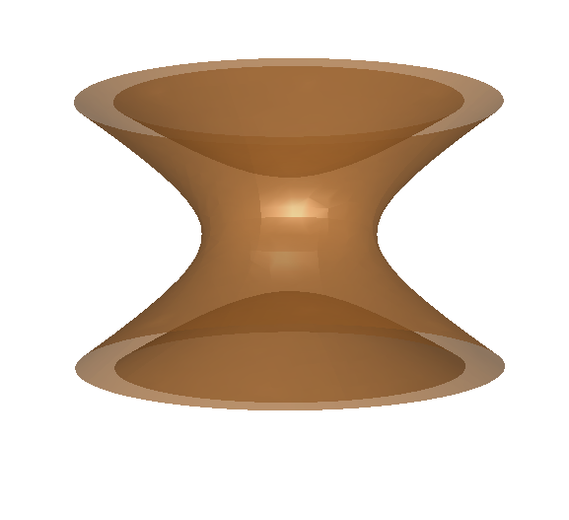
Vacuum CASE 1: The Pierce-Penning Trap
Assuming positive muons and a ramp time of 100 ns…
+60 kV ➔ -60 kV
Upper/Lower End-caps:
B_{z} = 1 T
-60 kV ➔ 0 V
Cylindrical Ring:
+60 kV

Slide 7
Vacuum CASE 2: The Open-Cylindrical Penning Trap
30 cm
Assuming positive muons and a ramp time of 100 ns…
12 cm
+120 kV ➔ -120 kV
2 cm
12 cm
-120 kV ➔ 0 V
B_{z} = 1 T
2 cm
12 cm
+120 kV

Slide 8
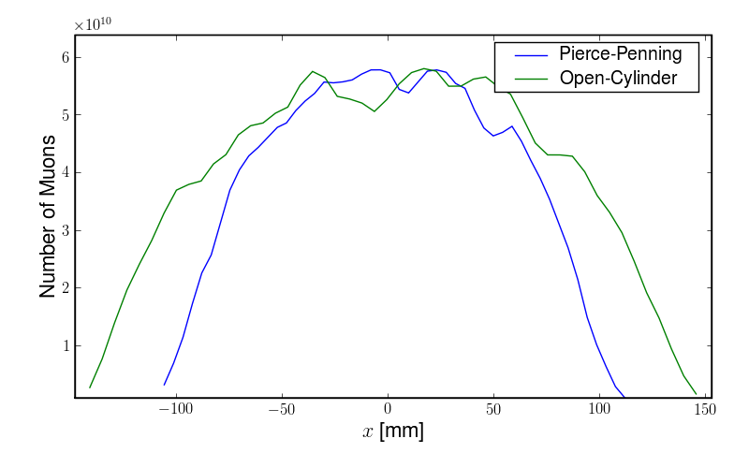
VACUUM: Radial Spacial Distributions before Ejection

Slide 9
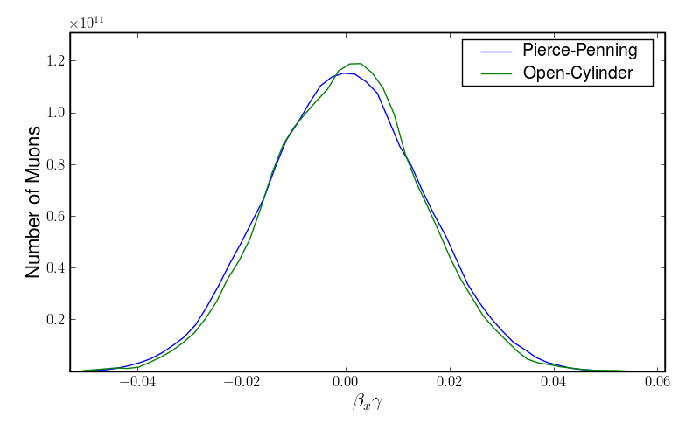
VACUUM: Radial Momentum Distributions before Ejection

Slide 10
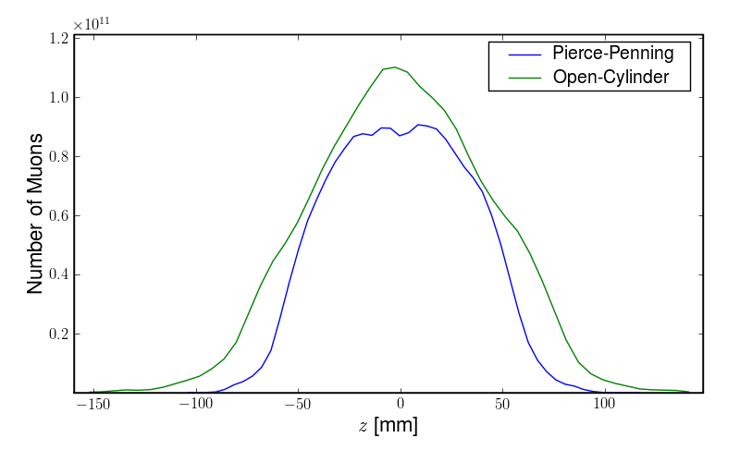
VACUUM: Axial Spacial Distributions before Ejection

Slide 11
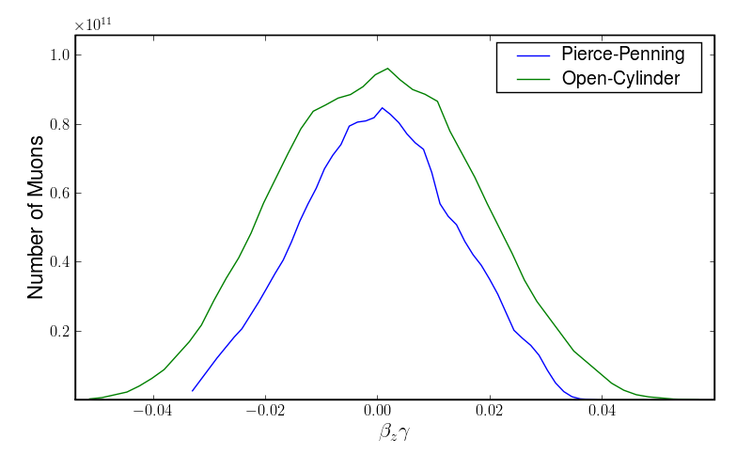
VACUUM: Axial Momentum Distributions before Ejection

Slide 12
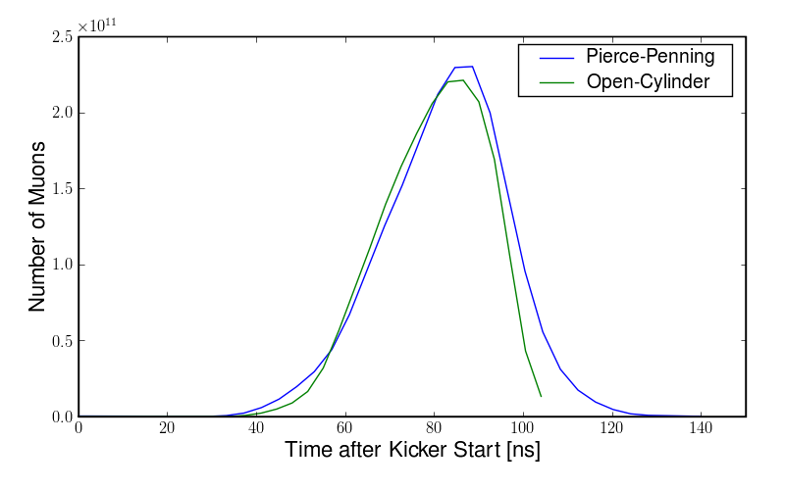
VACUUM: Temporal Distributions after Ejection

Slide 13
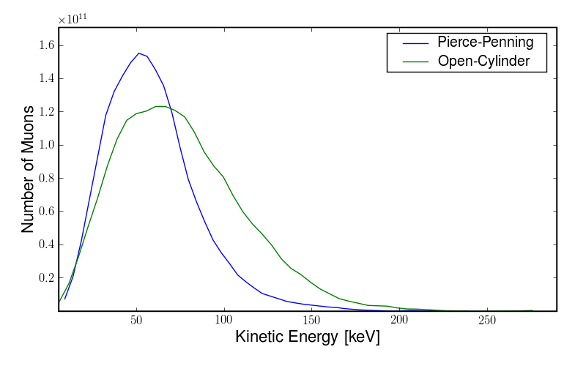
VACUUM: Axial Momentum Distributions after Ejection

Slide 14
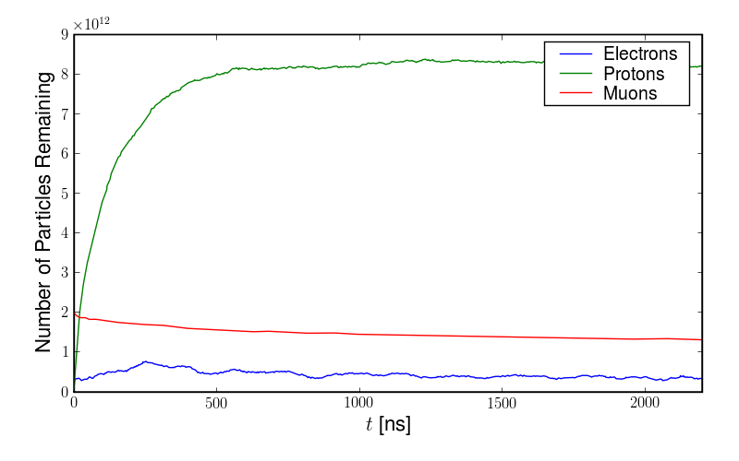
Trapping Ionization Effects: Pierce-Penning with 10⁻⁴ atm H
10 keV muon temperature
Electrons are quickly lost, leaving positive charge to build up in the core!
This leads to muon losses, about 30% over 1 muon lifetime.

Slide 15
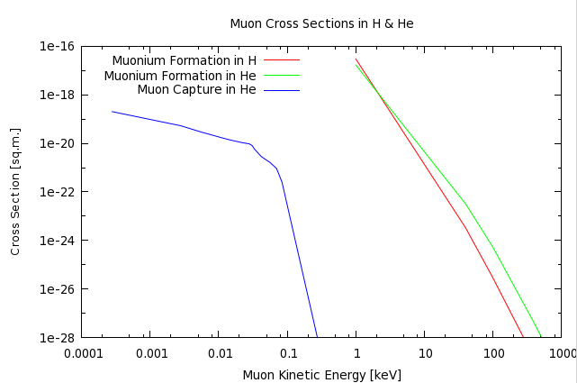
Cross Sections for Muonium Formation and Muon Capture
Optimal Energy Range
Belkic and Janev, J. Phys. B, 6 (1973).
Recombination & Muon Capture neglected!

Slide 16
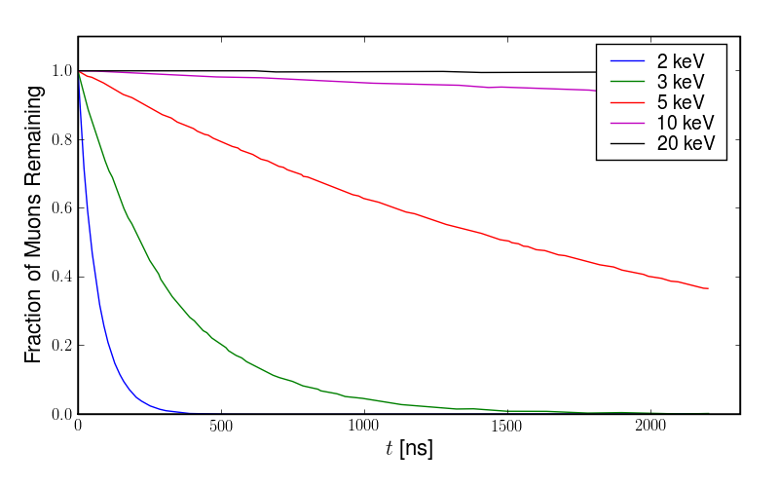
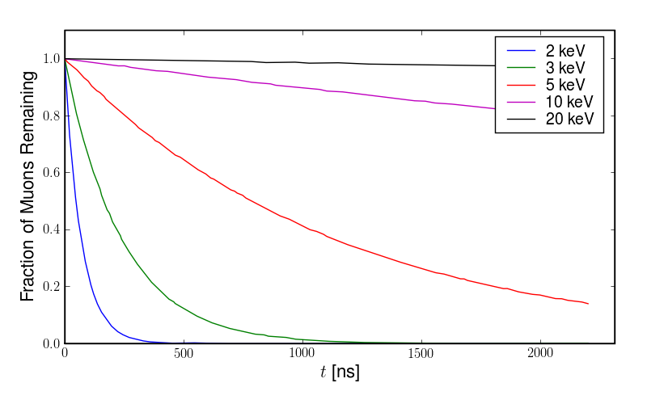
Muonium Formation in H & He (10⁻⁶ atm) vs Muon Energy
H
Lifetime @ 5 keV: 2.2 μs
Fraction of Muon Remaining
He
Lifetime @ 5 keV: 1.1 μs

Slide 17
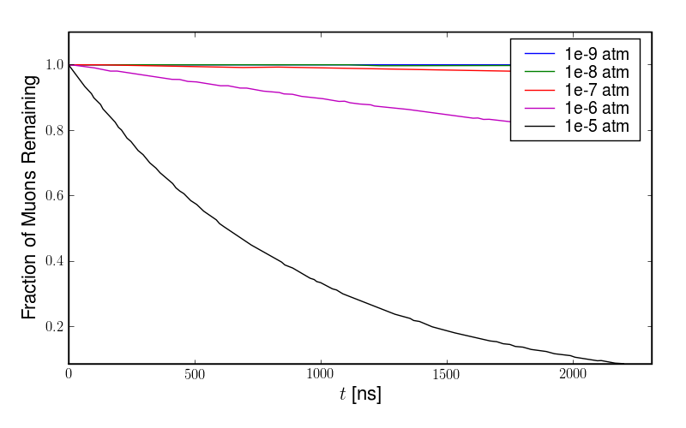
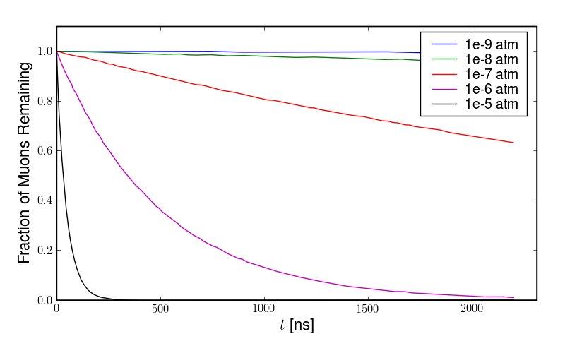
Muonium Formation in H & He (10 keV) vs Gas Pressure
Lifetime @ 10⁻⁵ atm: 0.9 μs
H
Fraction of Muon Remaining
He
Lifetime @ 10⁻⁶ atm: 0.5 μs

Slide 18
Conclusions
Vacuum simulation results:
Pierce-Penning design “feasible” with 120 kV
Open-Cylindrical design “feasible” with 2x voltages!
Transverse emittance determined by B
Longitudinal emittance determined by kicker
Matter effects:
H-Ionization with >10-4 atm could be a problem
Muon atomic capture may be negligible (>1 keV)
Muonium formation problematic (<5 keV & >10⁻⁶ atm)

Slide 19
Work to Do
Vacuum simulations:
Paul Trap (demanding computationally)
Matter effects:
He-Ionization in the trap
Full ejection simulations with H & He gas
Write the Phase II proposal (March) to move toward full end-to-end simulations

