Slide 1
caBench-to-Bedside (caB2B)
A caGrid client to facilitate
translation research
Mukesh Sharma
Washington University in St. Louis
Developers
Washington University
Persistent Systems Limited

Slide 2
Overview
Brief Description
caB2B is a tool designed to integrate and analyze diverse biomedical datasets seamlessly. It has been developed to facilitate individual steps of cancer research analyses and reduce the bench-to-bedside barrier.
caB2B is a caGrid client that permits bench scientists, translational researchers, and clinicians to leverage data and analytical services developed under caBIGTM through a graphical user interface. Its metadata-based query interface enables end users to search virtually any caGrid data service.
Primary User Groups/Beneficiaries:
bench scientists, translational researchers, and clinicians

Slide 3
Key Features
Novel use of metadata infrastructure allows query enabling searches of any available data service (e.g. caArray or caTissue Core) thus promoting interoperability among disparate data sources.
Semantically aware query interface that seamlessly creates distributed queries (e.g. across two or more applications such as caFE and GeneConnect).
Saving and filtering data acquired as a result of a query.
Basic data visualization windows.

Slide 4
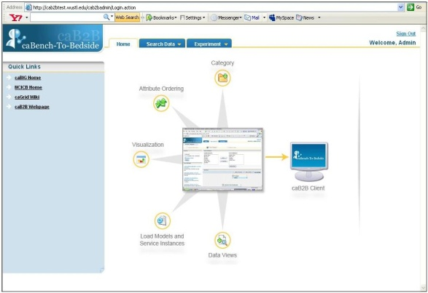
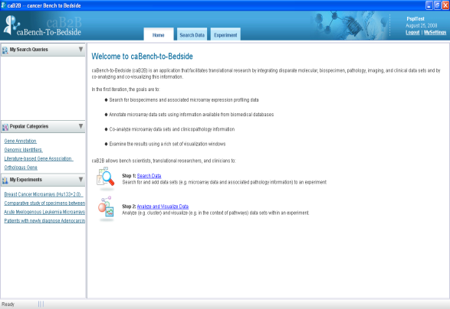
Components
caB2B Server
Caches metadata (concept codes, class and attribute descriptions, and permissible values) from caDSR and service instances to query
Persists query results and downstream analyses
caB2B Administrative Module
Permits caB2B server customization by the Administrator
Allows for model metadata caching and service instance selection
Permits Administrator to curate models in order to facilitate end user queries
caB2B Client
Allows end users to query virtually any caGrid data service, persist salient results, and examine this information using visualization windows

Slide 5
caB2B Administrative Module

Slide 6
Administrative module features
Web based administration.
UI to search caDSR, retrieve models and load into MDR.
Discover services dynamically.
Curate frequently used paths to speedup query building.
Create categories to bridge gap between end user’s view of data and real object oriented representation.
Define intermodel joins based on CDE, DEC match and manual override to connect underspecified models.
Automatic cache update between administrative module and caB2B server.
Ability to reconfigure the previously configured service instances.
Notes:
Automatic cache update between administrative module and caB2B server. Previously any update by admin requires JBOSS restart.

Slide 7
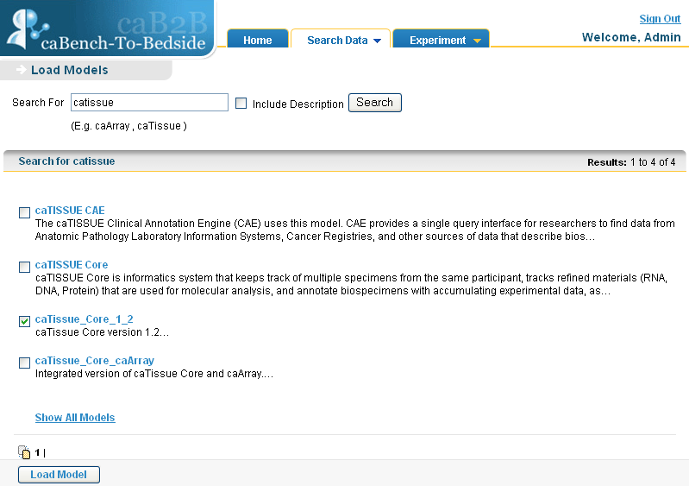

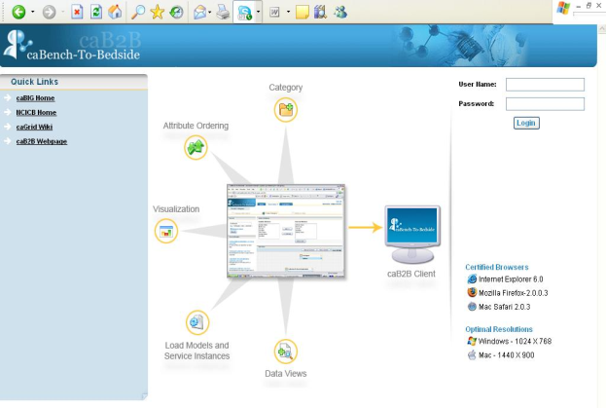

Load Models from caDSR
caB2B
MDR
Select models to load
Fetch selected model
Get all Model names
Administrative interface

Slide 8
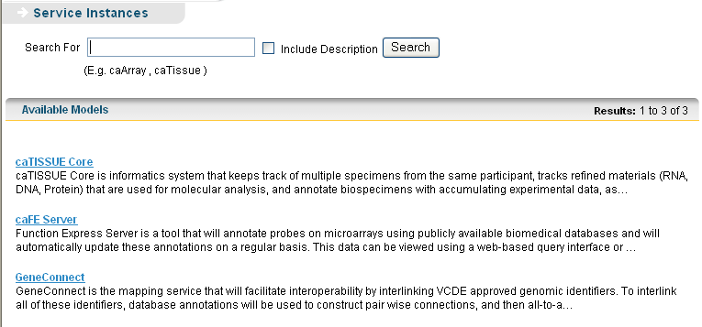
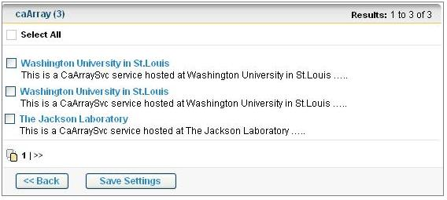



Discover Services Dynamically
Select models to discover services
Select service instances
Discover data services by domain model
Get loaded Models
caB2B
MDR

Slide 9
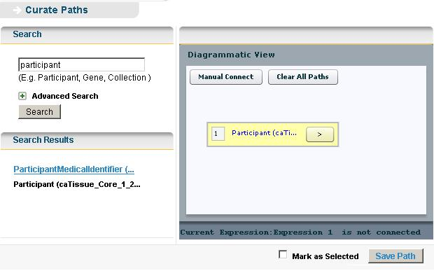
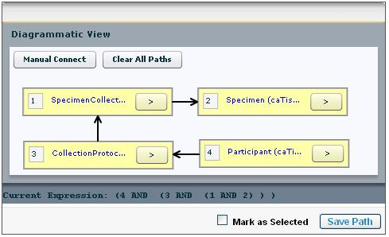
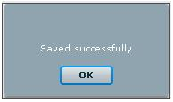
Curating frequently used paths for connecting classes
Identifying the most relevant paths between a
classes and storing them.

Slide 10
caB2B Category
A UML Class is a collection of attributes that makes sense technically to developers and bioinformaticians, but may not be intuitive to researchers and clinicians.
Data elements for patient demographics are present across three classes
* Example from caTissue Core

Slide 11
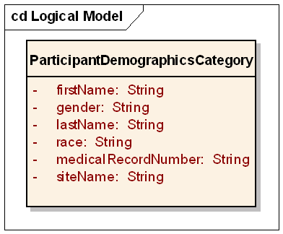
caB2B Category
An example caB2B category
A caB2B Category
Is a collection of attributes that makes logical sense to researchers and clinicians
Can contain attributes from any class, even across models, as long as a valid path exists among all classes
UML Class is a type of Category
Usage
Each caB2B administrator will create categories
Categories may be shared across caB2B server instances

Slide 12
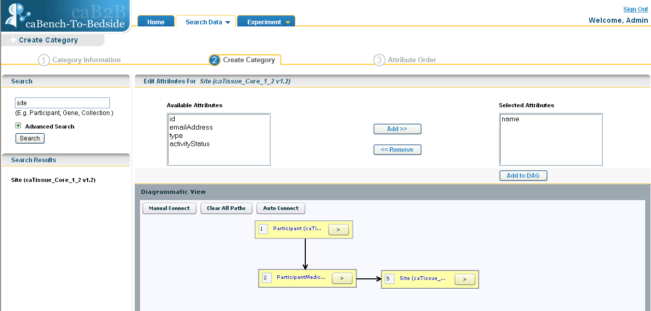
Create Category
Notes:
–look up steps

Slide 13
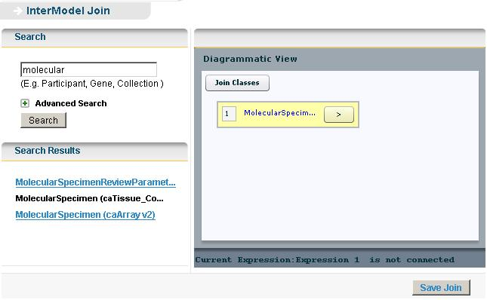
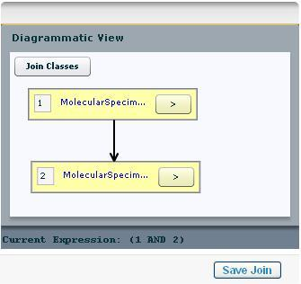
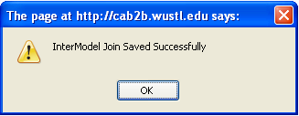
Defining intermodel joins using semantic metadata and manual override to consider underspecified models
Connecting two models using the common bridging
attributes between them.
Notes:
Show intermodel join between caBIO and grid PIR. One screen shot is missing where you get the CDE mappings.

Slide 14
caB2B End User Client

Slide 15
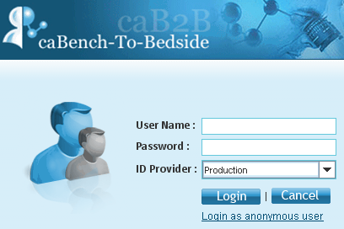
caB2B Client Features
The end user client is a Java application that enables end users to query for and persist data available on the caGrid. The end user client offers the following features:
caGrid based authentication of users.
Anonymous login for users without grid account.
The query component consists of a diagrammatic view.
The diagrammatic viewer allows the user to create a directed acyclic graph of the query that is to be executed and also helps the user to connect two or more classes to be searched.
User based access control for experiments and saved queries. The experiments and queries saved by user will only be visible to the user and not to anyone else. "My Experiments" and "My Search Queries" menus on home page dashboard are available for easy access to user's experiments and queries.

Slide 16
caB2B Client Features
Category popularity to display most used categories. "Popular Categories" menu on the home page dashboard now displays categories searched by all caB2B users in descending order of popularity.
User override of administrator defined services instances. The user can change the service instances configured by the administrator without using the administrative module. The user can achieve this through "MySetting" link at the Home page dashboard or from the third step of search data wizard.
User to view DCQLs in read only way. The DCQL that will be executed for a particular query is available for review from the third step of search data wizard.
Grouping of query results by service instances. The results obtained for a query can be narrowed down to view results obtained from a particular service instance.

Slide 17
caB2B Client Features
Queries generated/executed can be saved.
The data obtained from the query may be saved as a ‘virtual experiment’ and analyzed further.
Saved data may be filtered to generate a custom data view.
The end user may also visualize data in the experiment by using various graphical components.

Slide 18
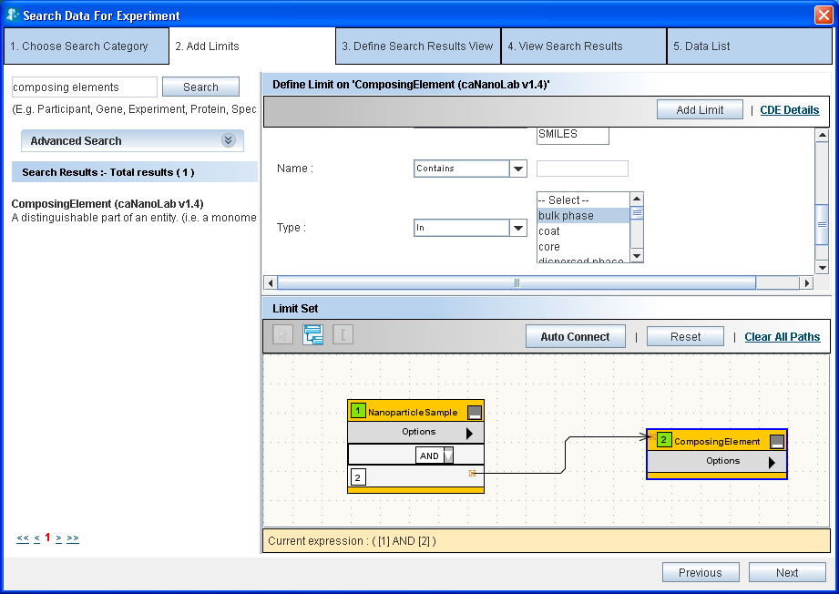
Diagrammatic viewer

Slide 19
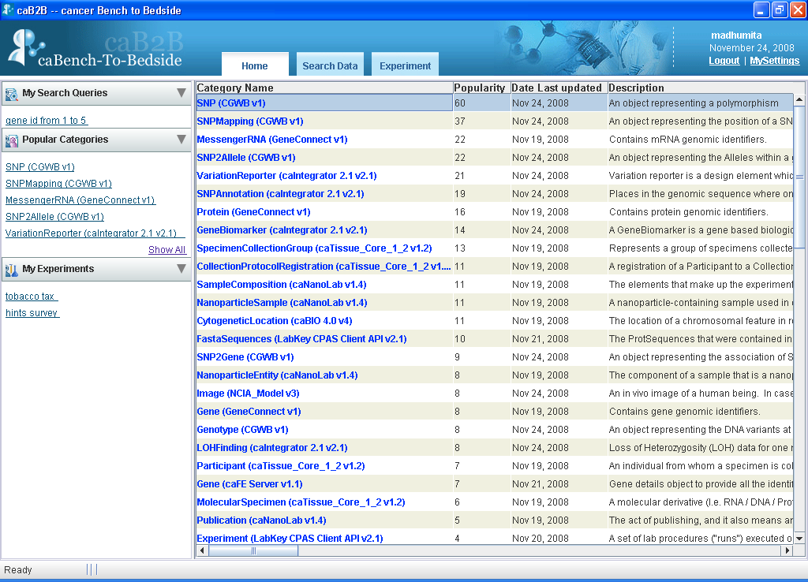
My Search Queries, Popular categories and My Experiments menus on home page for easy access

Slide 20
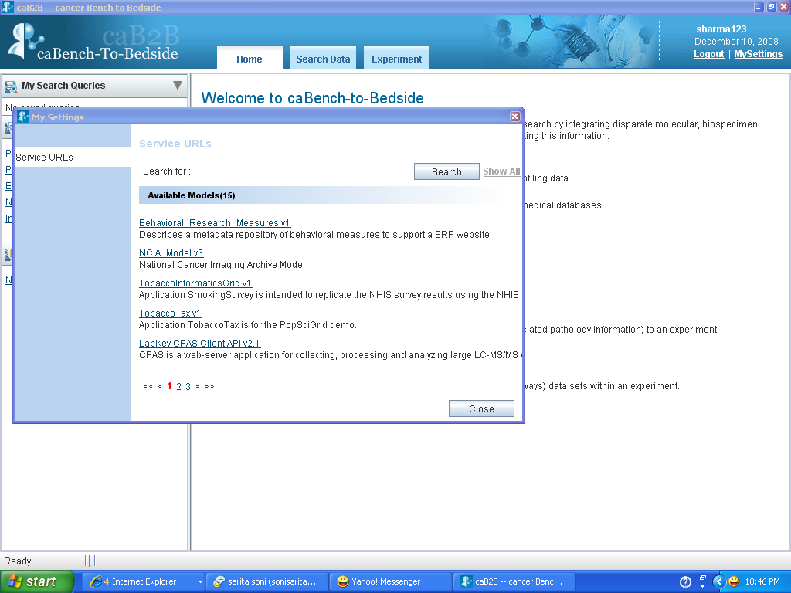
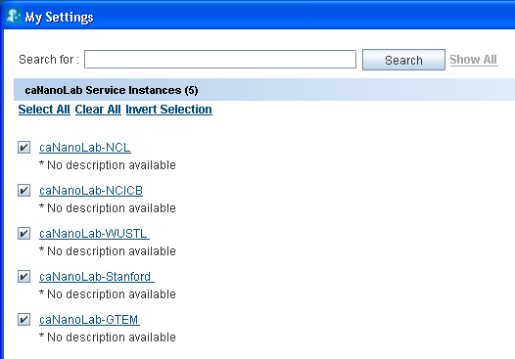
User can override administrator defined services instances from “My Settings” or from the third step of query

Slide 21
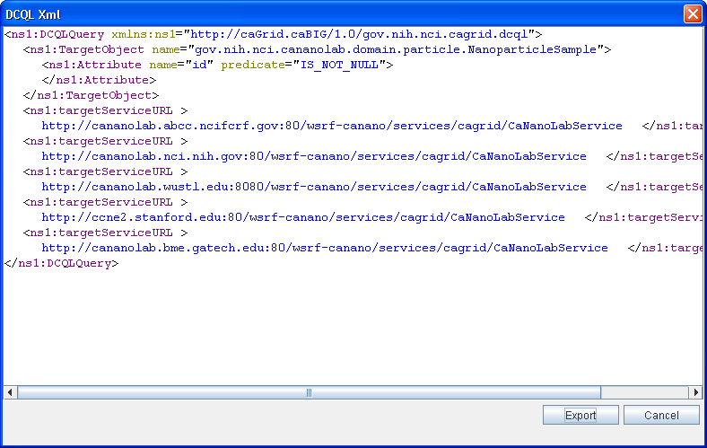
The DCQL that will be executed for a particular query can be viewed

Slide 22
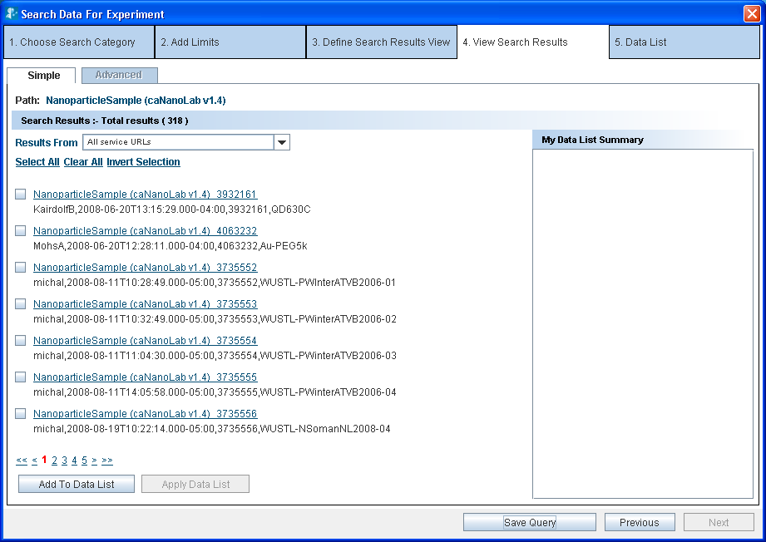
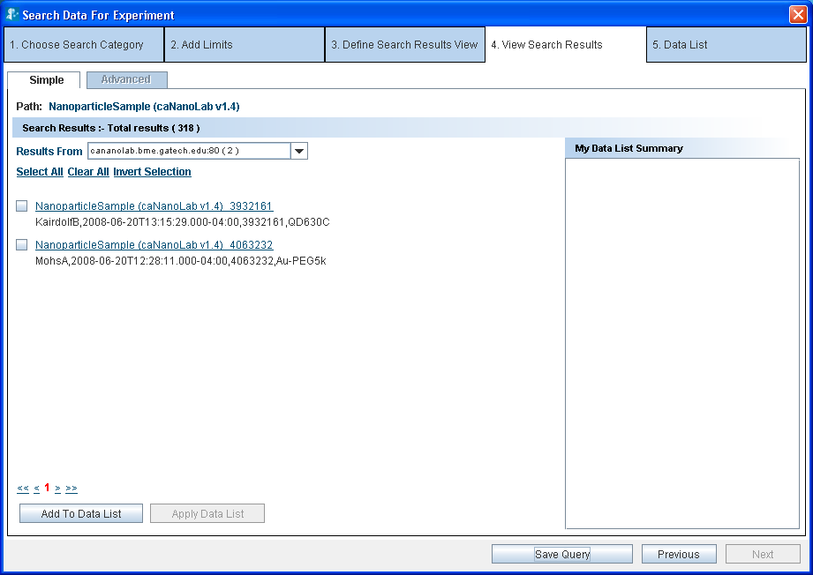
Grouping of query results by service instances.
Available results can be grouped based to instances to view results from the service of interest.
348 Samples filtered to view only the results from caNanoLab-GME instance

Slide 23
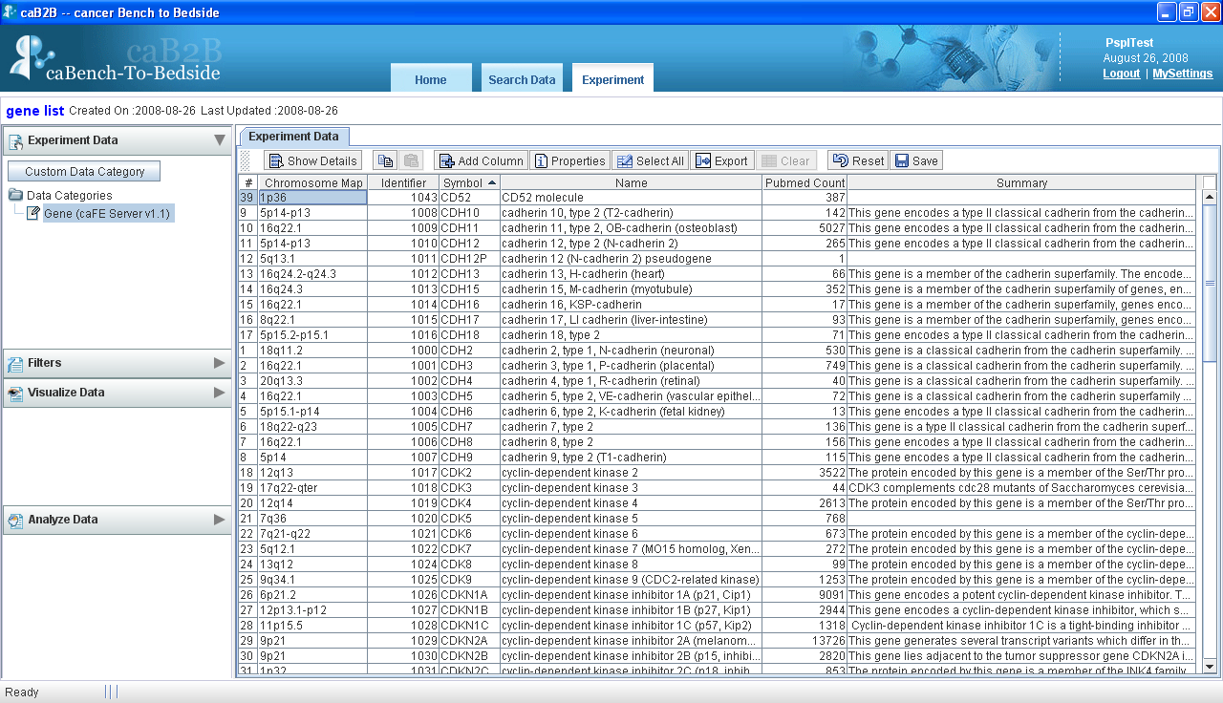
Spreadsheet component displaying experiment details

Slide 24
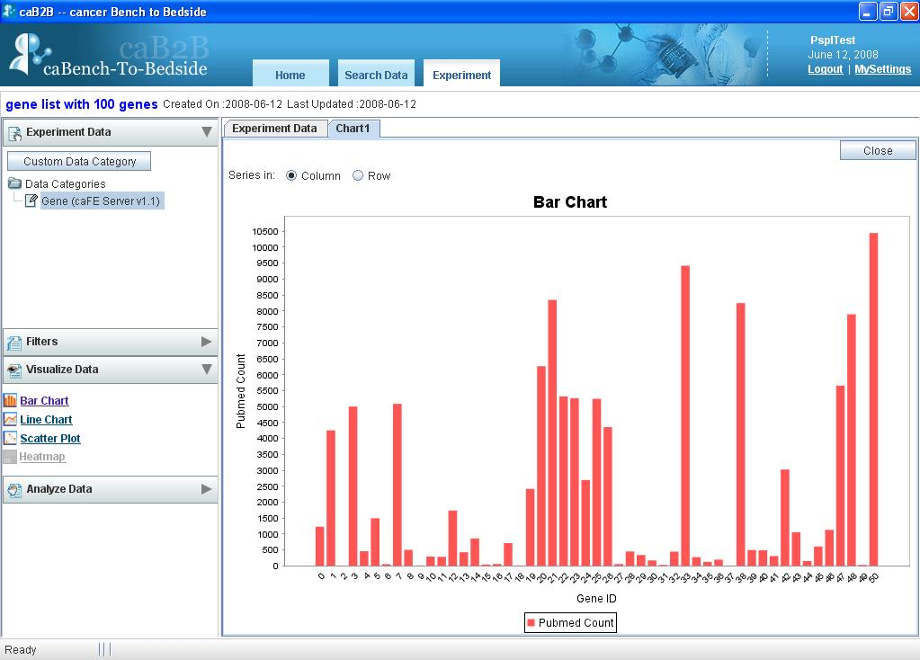
Visualization of data using Bar Chart

Slide 25
Example Queries:
User can search for a particular gene based on the EntrezGeneID and its related information e.g. messenger RNA and protein information from GeneConnect.
User can query for all pre-cancerous biospecimens from various caTissue instances like those at WUSM, UPENN etc.
User can find out if a sample used in an expression profiling experiment is available for a SNP analysis experiment. This query can be performed by querying across caTissue and caArray using caB2B.
Notes:
Show intermodel join movie

Slide 26
Intermodel search movie
play

Slide 27
Future releases
Release date March 09, 2009
Asynchronous execution of queries and saving of data lists.
Intermodel joins for a particular group, i.e., defining a join for a single institution like for WUSM’s caArray and caTissue only.
Intermodel joins with multiple attributes.
Advanced result view or the tree based view.
User to configure service instances for saved query.

Slide 28
Future releases
Release date June 16, 2009
Metadata that has been searched for should be highlighted in the Add Limit panel.
Search for the children values while specifying the limits on the parent value within an ontology tree.
Expansion of categories to create category across different applications.
Support basic analytical services including the services developed at WUSM as part of ICR tools adoption project and the required viewers for them.
Support for getting probe intensity data from caArray to run any analytical service on the microarray data. For CEL/DTT files there should be no need to bring data back to caB2B server.
Experiments with multiple datalists, edit experiments to add datalist with a way to re-query to modify the experiments.

Slide 29
Learn More…
GForge Site: http://gforge.nci.nih.gov/projects/cab2b
caB2B wiki : http://www.cagrid.org/mwiki/index.php?
title=CaB2B
caBIGTM Tools Site: https://cabig.nci.nih.gov/tools/caB2B
Production caB2B URL: http://cab2b.wustl.edu
‘Bleeding Edge’ caB2B URL: http://cab2btest.wustl.edu
Support: cab2b@bmi.wustl.edu

Slide 30
Acknowledgments
Washington University
Burr Fontaine
Rakesh Nagarajan
Jackie Payton
Mark Watson
NCI-CBIIT
Ian Fore
Juli Klemm
Avinash Shanbhag
Anand Basu
Chris Piepenbring
Stephen A. Goldstein
Persistent Systems
Srikanth Adiga
Madhurima Bhattacharjee
Lalit Chand
Leena D’Almeida
Atul Jawale
Srinath Krishnamurthy
Ashwini Patil
Chetan Patil
Hrishikesh Rajpathak
Jasbir Sachdeva
Deepak Shingan
Madhumita Shrikande
Sarita Soni
Chandrakant Talele
Rajesh Vyas

Slide 31
Thanks!

