Slide 1
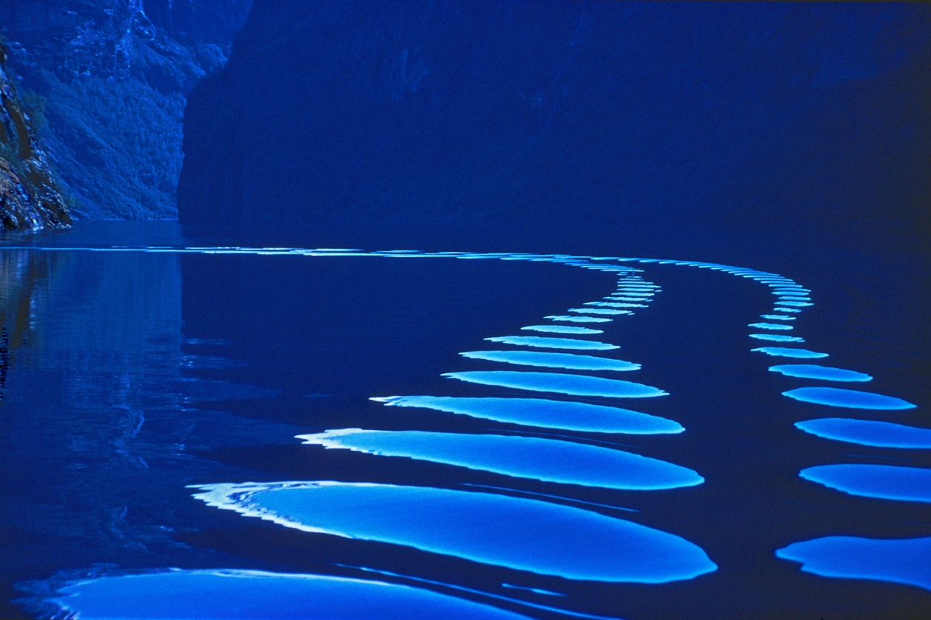
BOAT WAKE © Pete Turner
Sampling Theory and Practice: 50 Ways to Sample your Signal
Martin Vetterli EPFL & UC Berkeley

Slide 2

Acknowledgements
Sponsors and supporters
NSF Switzerland: thank you!
Conference organizers, Akihiko Sugiyama in particular!
My japanese friends, in particular Prof. Masaaki Ikehara ☺
Co-authors and collaborators
Thierry Blu, CUHK
Yue Lu, Harvard
Amina Chebira, EPFL
Ali Hormati, EPFL
Yann Barbotin, EPFL
Jury Rarienri, EPFL
Discussions and Interactions
V. Goyal, MIT
M. Unser, EPFL

Slide 3
Outline
1. Introduction
The world is analog but computation is digital!
2. Sampling: The linear case
Classic results and generalizations: Known locations
3. Application: Sampling physics
The plenacoustic function and sampling wave fields
4. Sampling: The non-linear case
Finite rate of innovation sampling
Compressed sensing
5. Applications: The non-linear case
Diffusion equation
Multichannel sampling
Super-resolution imaging
6. Conclusions

Slide 4
The situation
The world is analog
Computation is digital
How to go between these representations?
Ex: Audio, sensing, imaging, computer graphics, simulations etc
Processing
Analog World
Analog World

Slide 5
The situation (bis)
The world is analog, computation is digital, and
You want an analysis
You want a synthesis
Processing
For analysis
Analog World
Decision
Processing
For synthesis
Digital World
Analog output

Slide 6
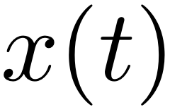
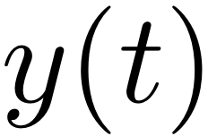
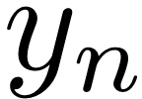

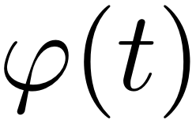
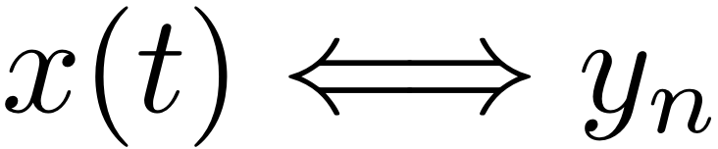
The Question:
Given a class of objects, like a class of functions (e.g. bandlimited)
And given a sampling device, as usual to acquire the real world
Smoothing kernel or lowpass filter
Regular, uniform sampling
That is, the workhorse of sampling!
Obvious question: When does a minimum number of samples
uniquely specify the function?
sampling kernel

Slide 7
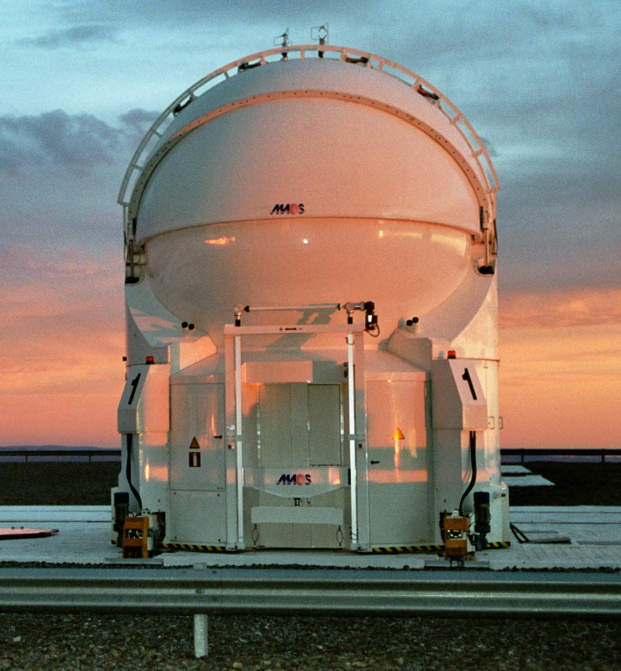
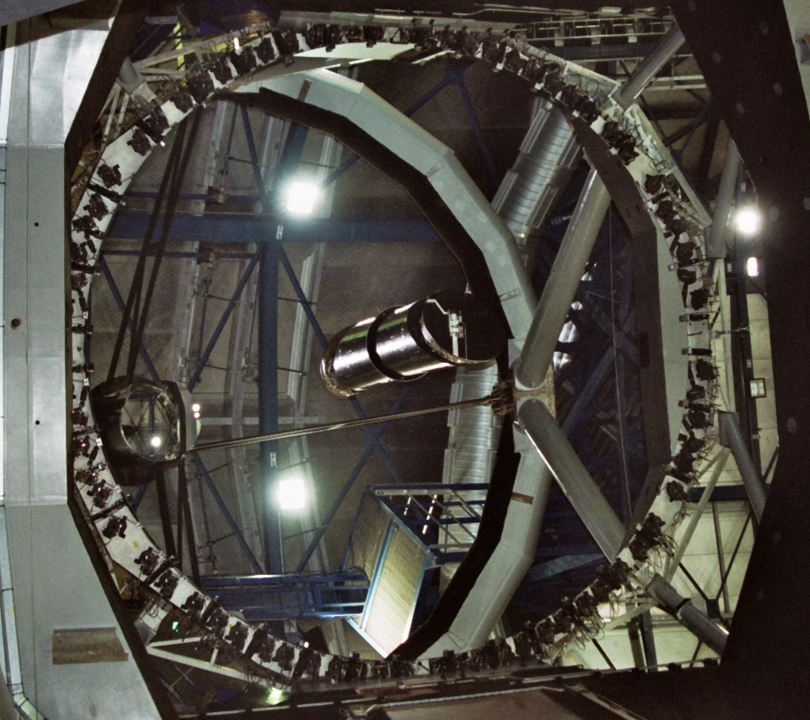
Kernel and sampling rate
1. About the observation kernel:
Given by nature
Diffusion equation, Green function Ex: sensor networks
Given by the set up
Designed by somebody else, it is out there Ex: Hubble telescope
Given by design
Pick the best kernel Ex: engineered systems, but constraints
2. About the sampling rate:
Given by problem
Ex: sensor networks
Given by design
Usually, as low as possible (UWB)
ESO, Chile

Slide 8
A Variation: Compressed Sensing
Finite dimensional problem: K sparse vector in N dimensional space
x: Input in R^{N} but only K non zero elements
y: Output in R^{M}, where M < N
F: Frame sensing matrix M by N
Ill posed inverse problem….
Key: K < M << N
Questions
Can this be inverted
What sizes K, M, N are possible
What if approximate sparsity
What algorithms
Problem is non-linear in the location of non-zero entries of x!
Measurement Matrix

Slide 9
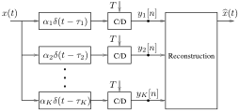
Variation: Multichannel Sampling
Signal is observed in K different channels
Sampling rate can be diminished by at most K
Shifts, however, are unknown
Some redundancy needed to find the unknown shifts
Problem is non-linear in the shifts!

Slide 10
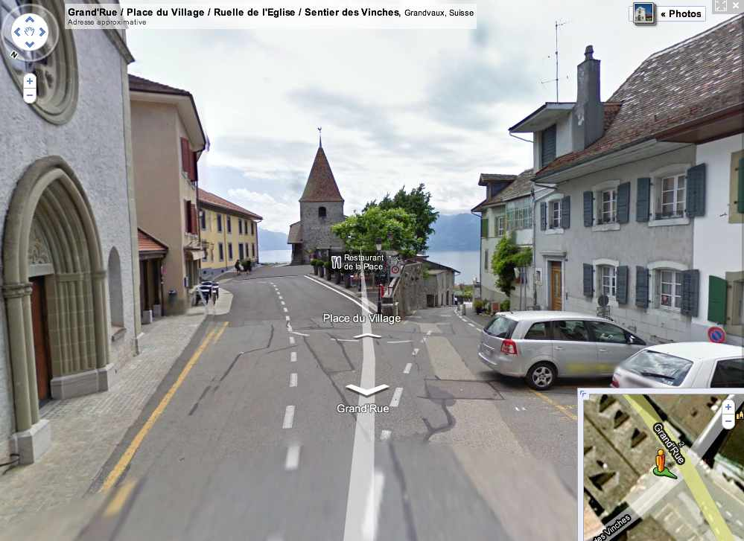
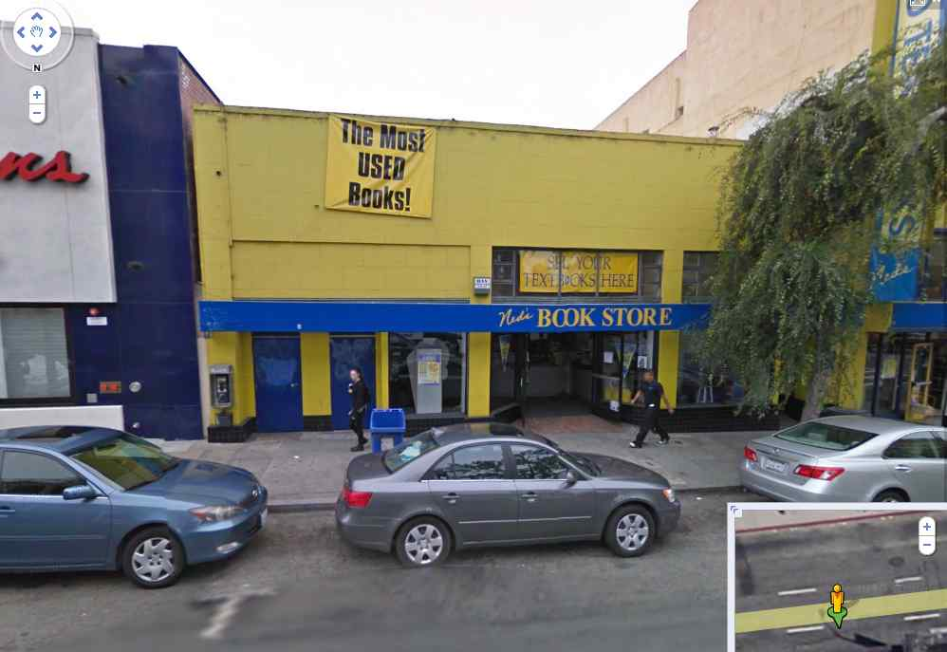
Are these real problems? (1)
Google Street view as a popular example
How many images per second to reconstruct the real world
What resolution images to give a precise view of the world

Slide 11
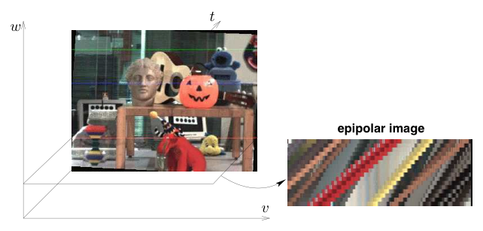
Plenoptic sampling
Epipolar geometry
Points map to lines
Approximate sampling theorem

Slide 12
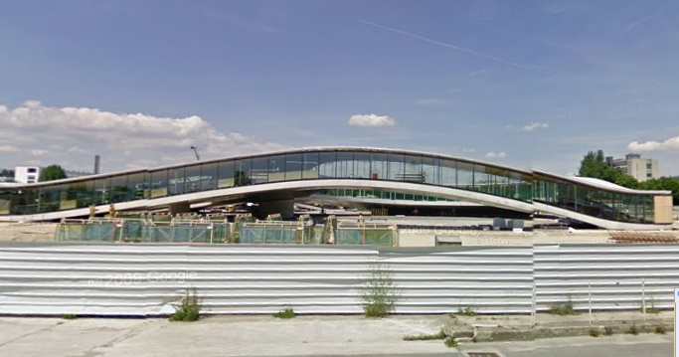
When there are problems….
Rolex Learning Center at EPFL
SANAA Architects ( Kazuyo Sejima, Ryue Nishizawa)

Slide 13
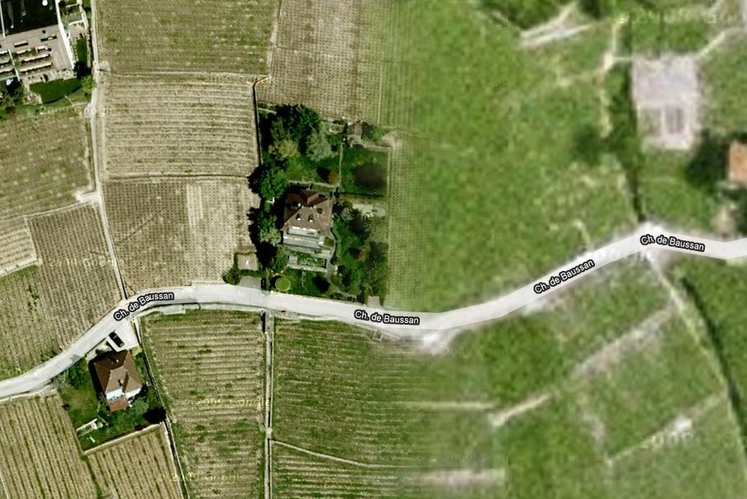
Are these real problems?
Google maps as another popular example
How to register images
What resolution images to give an adequate view of the world

Slide 14
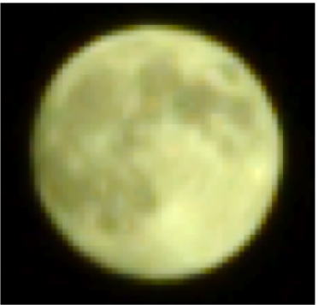
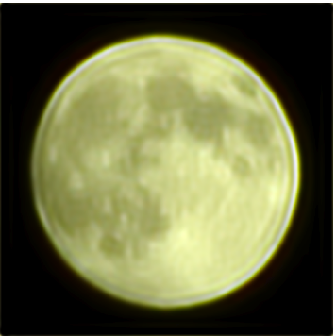
Super-resolution
Actual acquisition with a digital camera (Nikon D70)
registration using FRI with psf and moments
captured image: 60 images of 48 by 48 pixels
super-resolved image 480 by 480 pixel
[Dragotti et al, 2008]

Slide 15
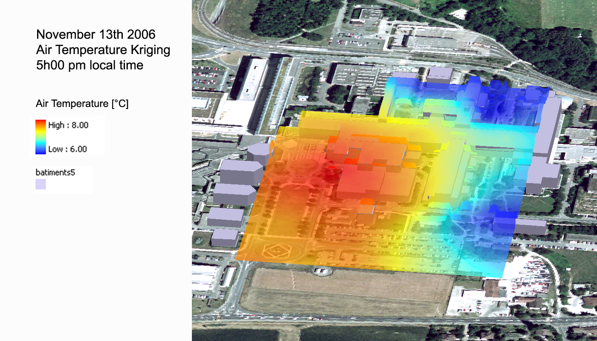
Are these real problems?
Sensor networks as another relevant example
How many sensors
How to reconstruct

Slide 16
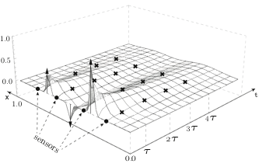
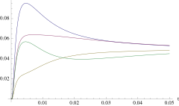
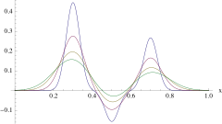
Diffusion equation and inversion
Point sources
Observation by sensors
Ex: Process over (x,t)
3 point sources
4 sensors
Over space
Over time

Slide 17
Outline
1. Introduction
2. Sampling: The linear case
Shannon sampling
Subspace sampling
Irregular sampling with known locations
3. Application: Sampling physics
4. Sampling: The non-linear case
5. Applications: The non-linear case
6. Conclusions

Slide 18
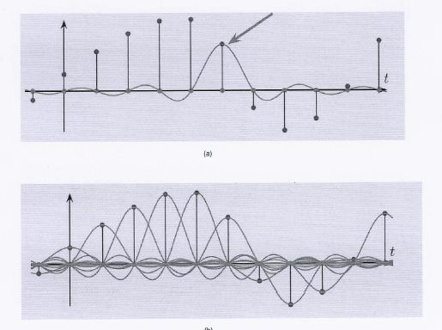
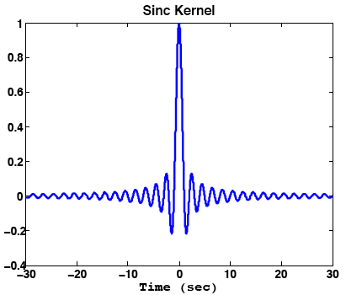

Classic Sampling Case [WNKWRGSS, 1915-1949]
If a function x(t) contains no frequencies higher than W cps, it is completely determined by giving its ordinates at a series of points spaced 1/(2W) seconds apart. [if approx. T long, W wide, 2TW numbers specify the function]
It is a representation theorem:
sinc(t-n) is an orthobasis for BL[-π,π]
x(t) ∈ BL[-π,π] can be written as
Notes:
x(t) = \sum_{n=-\infty}^{\infty}x[n]\mathrm{sinc} \bigg( \frac{t-nT_s}{T_s}\bigg)

Slide 19
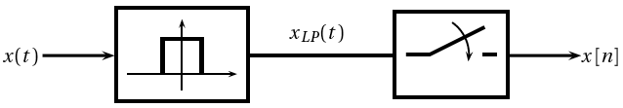
Classic Sampling Case (cont.)
What if not bandlimited?
Project onto BL[-π,π]
Use sampling theorem
Space of bandlimited functions
Linear subspace
Shift-invariant
Notes:
Slow convergence of the sinc series
Shannon-Bandwidth and information rate
Bandlimited is sufficient, not necessary! (e.g. bandpass sampling)

Slide 20
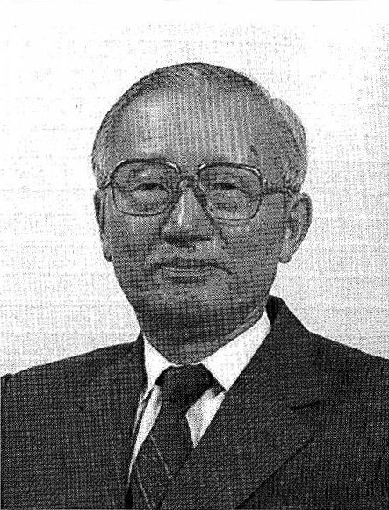
Shannon’s Theorem… a bit of History
Whittaker 1915
Nyquist 1928
Kotelnikov 1933
Whittaker 1935
Raabe 1938
Gabor 1946
Shannon 1948
Isao Someya 1949

Slide 21
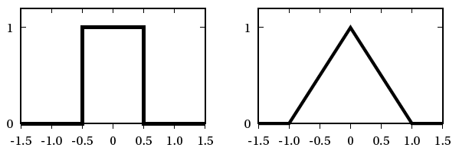
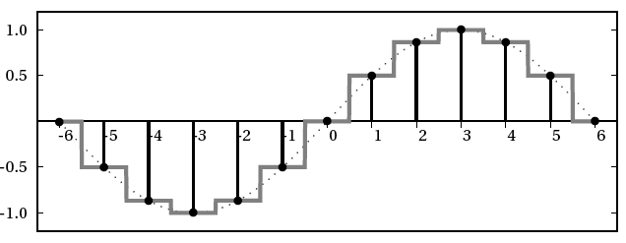
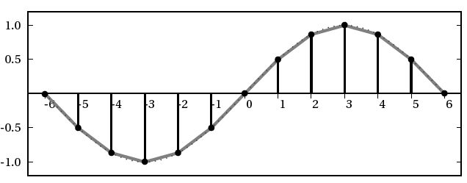
Shannon’s Theorem: Variations on the subspace theme
Non uniform
Kadec 1/4 theorem
Derivative sampling
Sample signal and derivative… … at half the rate
Stochastic
Power spectrum is good enough
Shift-invariant subspaces
Generalize from sinc to other shift-invariant Riesz bases (ortho. and biorthogonal)
Structurally, it is the same thing!
Multichannel sampling
Known shift: easy
Unknown shift: interesting (super-resolution imaging)
Spring-09 - 21

Slide 22
Outline
1. Introduction
2. Sampling: The linear case
3. Application: Sampling physics
Microphone and loudspeaker arrays
The plenacoustic function
A sampling theorem for wave fields
4. Sampling: The non-linear case
5. Applications: The non-linear case
6. Conclusions

Slide 23
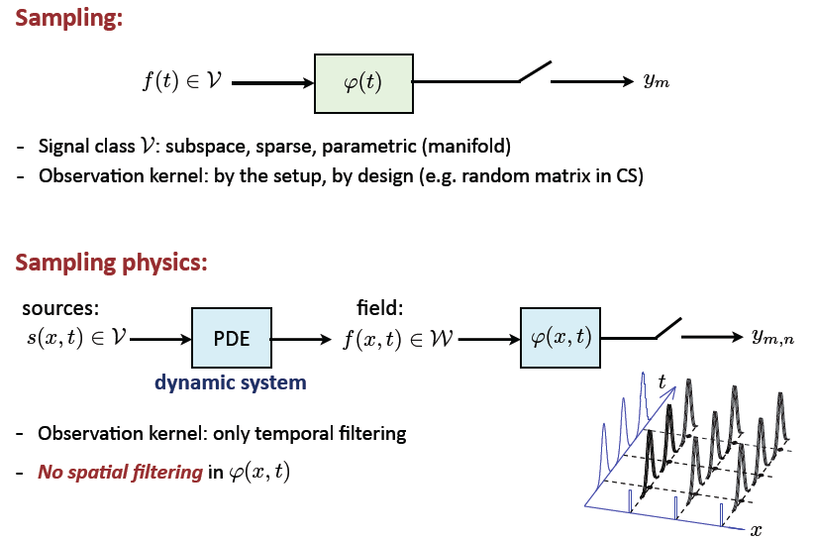
Sampling versus sampling physics

Slide 24

Sampling and interpolating acoustic fields
Wave fields governed by the wave equation
Space-time distribution
Constrained by wave equation
Not arbitrary, but smoothed
What can we say about sampling/interpolation?
Spatio-temporal Nyquist rate
Perfect reconstruction
Aliasing
Space-time processing
How do we sample and interpolate?
Wave equation
Space-time
acoustic
wave field
Analog sources

Slide 25
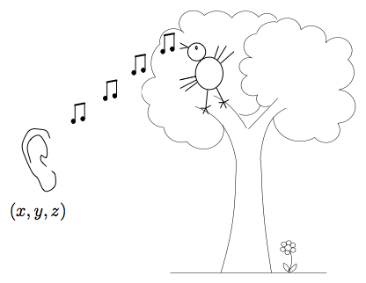
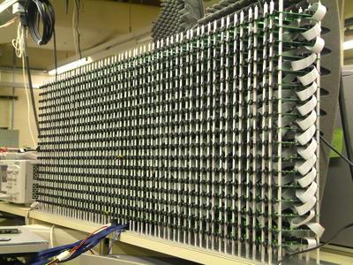
Many microphones and loudspeakers
Multiple microphones/loudspeakers
physical world (e.g. free field, room)
distributed signal acquisition of sound with “many” microphones
sound rendering with many loudspeakers (wavefield synthesis)
This is for real!
sound recording
special effects
movie theaters (wavefield synthesis)
MP3 surround etc
MIT1020 mics

Slide 26
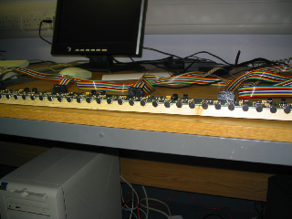
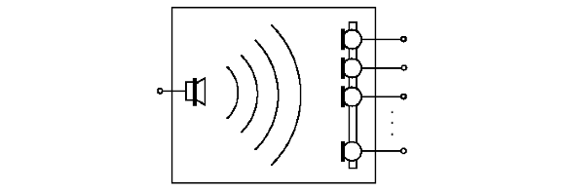
The plenacoustic function and its sampling
Setup
Questions:
Sample with “few” microphones and hear any location?
Solve the wave equation? In general, it is much simpler to sample the plenacoustic function
Dual question also of interest for synthesis (moving sources)
Implication on acoustic localization problems
Application for acoustic cancellation

Slide 27
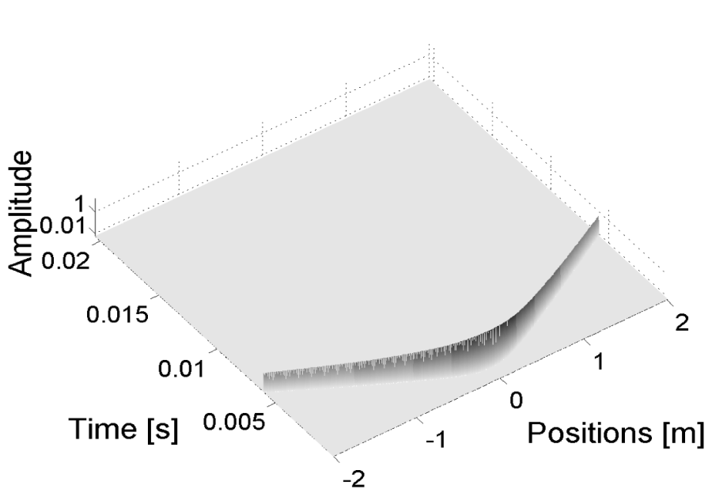
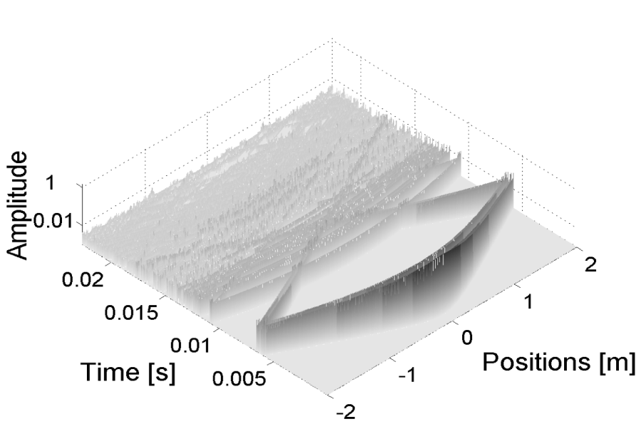
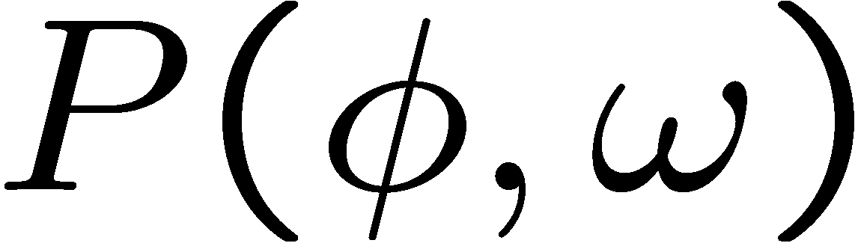
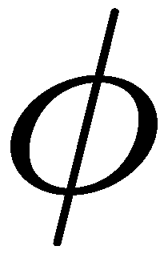

The plenacoustic function and its sampling
PAF in free field and in a room for a given point source
We plot: p(x,t), that is, the spatio-temporal impulse response
The key question for sampling is: , that is, the Fourier transform
A precise characterization of for large and will allow sampling and reconstruction error analysis

Slide 28
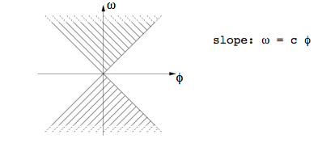
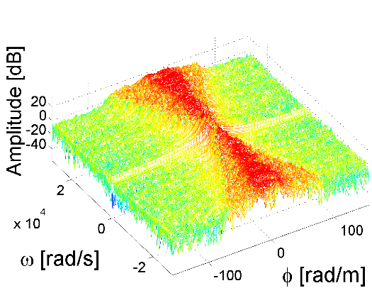
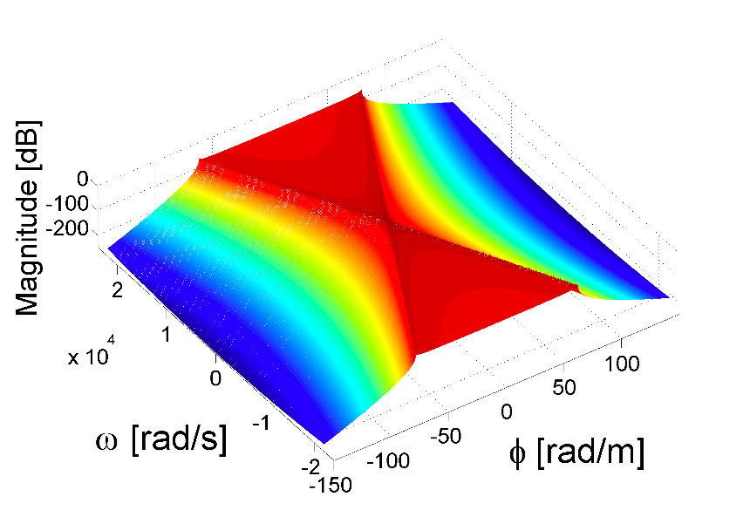
The plenacoustic function in Fourier space
ω: temporal frequency
Φ: spatial frequency

Slide 29
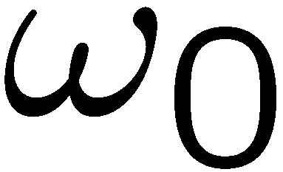
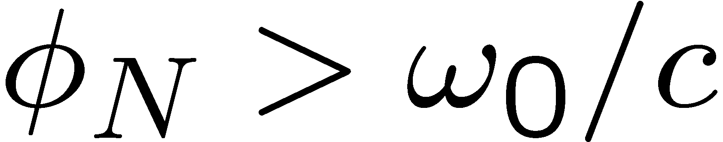
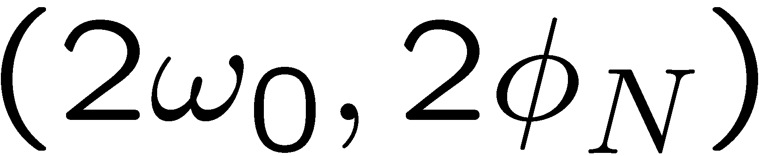
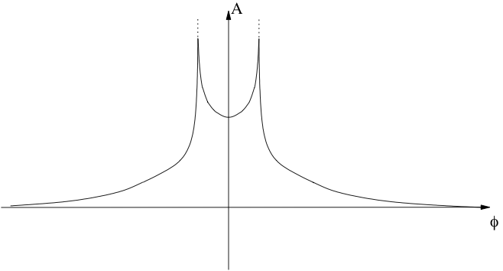
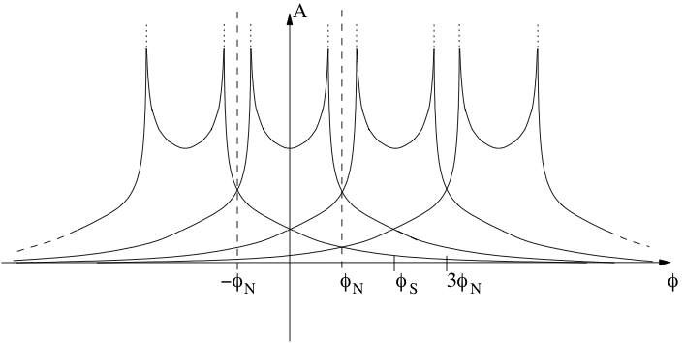
A Sampling Theorem for Acoustic Fields
Theorem [ASV:06]:
Assume a max temporal frequency
Pick a spatial sampling frequency
Spatio-temporal signal interpolated from samples taken at
Argument:
Take a cut through PAF
Use exp. decay away from central triangle to bound aliasing
Improvement using quincunx lattice

Slide 30
Visual proof ☺

Slide 31
Outline
1. Introduction
2. Sampling: The linear case
3. Application: Sampling physics
4. Sampling: The non-linear case
Position information
Finite rate of innovation
Sparse sampling
Compressed sensing
5. Applications: The non-linear case
6. Conclusions

Slide 32
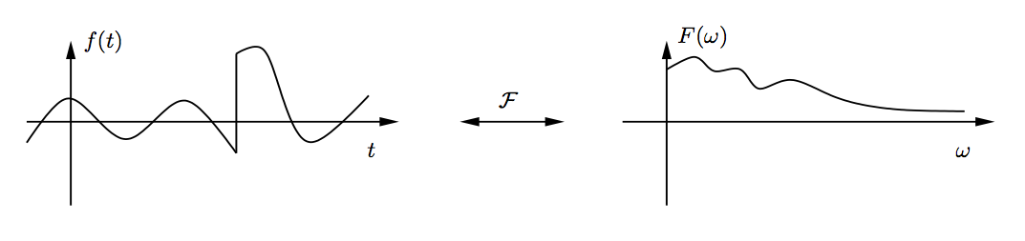
Classic Case: Subspaces
Shannon bandlimited case
or 1/T degrees of freedom per unit time
But: a single discontinuity, and no more sampling theorem…
Are there other signals with finite number of degrees of freedom per unit of time that allow exact sampling results?
Notes:
Latex:
x(t) = \sum_{n\in Z}x(nT)\mathrm{sinc}(t/T-n)

Slide 33
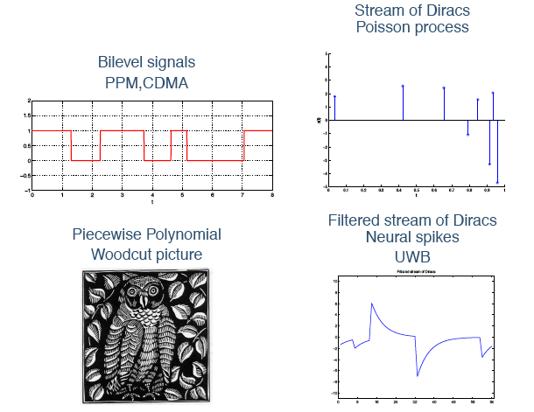
Examples of non-bandlimited signals

Slide 34
Classic Case and Beyond…
Is there a sampling theory beyond Shannon?
Shannon: bandlimitedness is sufficient but not necessary
Shannon bandwidth: dimension of subspace
Shift-invariant subspaces: Similar dimension of subspace
Is there a sampling theory beyond subspaces?
Finite rate of innovation: Similar to Shannon rate of information
Non-linear set up
Thus, develop a sampling theory for classes of non-bandlimited but sparse signals!
x(t)
x_{N-1}
x₀
t₁
…
t₀
t
t_{N-1}
x₁
Generic, continuous-time sparse signal

Slide 35
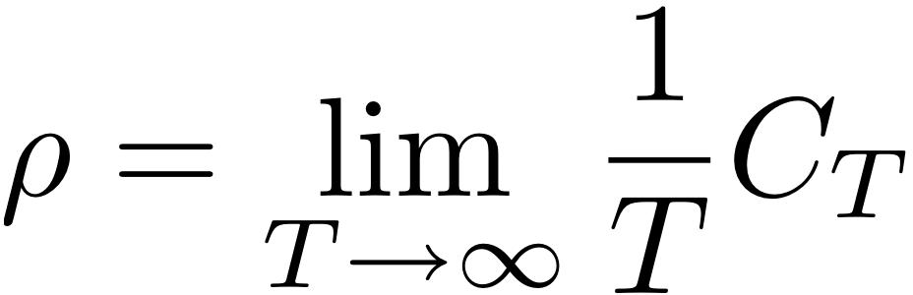
Sparsity and Signals with Finite Rate of Innovation
Sparsity:
CT: parametric class, with degrees of freedom (e.g. K diracs, or 2K degrees of freedom)
DT: N dimensional vector x, and its l₀ norm K = ||x||₀. Then K/N indicates sparsity
ρ : Rate of innovation or degrees of freedom per unit of time
Call C_{T} the number of degrees of freedom in the interval [-T/2,T/2], then
Note: Compressibility:
Object expressed in an ortho-basis has fast decaying NLA For ex., decay of ordered wavelet coefficients in O(k^{-a}), a > 1.

Slide 36
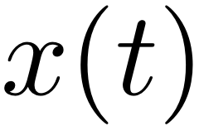
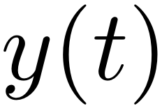
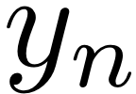


Signals with Finite Rate of Innovation
The set up:
For a sparse input, like a weighted sum of Diracs
One-to-one map y_{n} ⇔ x(t)?
Efficient algorithm?
Stable reconstruction?
Robustness to noise?
Optimality of recovery?
sampling kernel

Slide 37


A simple exercise in Fourier series
Periodic set of K Dirac pulses
Is not bandlimited!
Has a Fourier series
Fourier integral leads to
K complex exponentials
Exponents depends on location
Weight depends on
If we can identify the exponents
Diracs can be recovered
Weights are a linear problem (given the locations)
Notes:
X_m & = & \int_0^1 x(t) \; e^{-j 2\pi m t } dt\\
& = & \int_0^1 (\sum_{k=0}^{K-1} \alpha_k \delta(t-t_k) ) \; e^{-j 2\pi m t } dt \\
& = & \sum_{k=0}^{K-1} \alpha_k e^{-j 2\pi m t_k }
x(t) = \sum_{m=Z} X_m \; e^{-j 2\pi m t }

Slide 38



A Representation Theorem [VMB:02]
Theorem
Given x(t), a periodic set of K Diracs, of period τ, weights {x_{k}} and locations {t_{k}}.
Take a Dirichlet sampling kernel of bandwidth B, with Bτ an odd integer > 2K
Then the N samples, N > Bτ, T = τ/Ν ,
are a sufficient characterization of x(t).
Notes:
x(t) = \sum_{k=1}^{K} \sum_{k' \in Z} x_k \delta (t-t_k-k'\tau)
\varphi (t) = \sum_{k' \in Z} \mathrm{sinc} \big( B(t-k'\tau) \big) = \frac{\sin(\pi Bt)}{B\tau \sin(\pi t / \tau)}
y_n = \sum_{k=1}^K x_k \varphi (nT-t_k)

Slide 39
Linear versus non-linear problem
This is not a subspace problem!
Problem is non-linear in t_{k}, and linear in x_{k} given t_{k}
Given two such streams of K Diracs, and weights and locations {x_{k},t_{k}} and {x’_{k},t’_{k}}.
The sum is a stream with 2K Diracs.
But, given a set of locations {t_{k}} then the problem is linear in {x_{k}}!
The key to the solution: Separability of non-linear from linear problem
Note: Finding locations is a key task in estimation/retrieval of sparse signals, but also in spectral estimation, error location in coding, in registration, feature detection etc

Slide 40



Sketch of Proof
The signal is periodic, so consider its Fourier series
The samples y_{n} are a sufficient characterization of the central 2K+1 Fourier series coefficients (Sampling Thm. for BL FS).
The Fourier series is a linear combination of K complex exponentials. These can be killed using an annihilation filter

Slide 41




Sketch of Proof (cont.)
3. To find the coefficients of the annihilating filter, we need to solve a convolution equation, which leads to a K by K Toeplitz system
4. Given the coefficients {1, h₁, h₂, … h_{K}}, we get the {t_{k}}’s by factorization of
5. To find the coefficients {x_{k}}, we have a linear problem, since given the {t_{k}}’s or {u_{k}}’s, the Fourier series is given by
This is a Vandermonde linear system, proving 2K+1 samples are sufficient!

Slide 42
Notes on Proof
The procedure is constructive, and leads to an algorithm:
Take 2K+1 samples y_{n} from Dirichlet kernel output
Compute the DFT to obtain Fourier series coefficients -K..K
Solve Toeplitz system of size K by K to get H(z)
Find roots of H(z) by factorization, to get u_{k} and t_{k}
Solve Vandermonde system of size K by K to get x_{k}.
The complexity is:
Analog to digital converter
K Log K
K²
K³ (can be accelerated)
K²
Or polynomial in K!
Note 1: For size N vector, with K Diracs, O(K³) complexity, noiseless
Note 2: Method similar to sinusoidal retrieval in spectral estimation and

Slide 43

Generalizations [VMB:02]
For the class of periodic FRI signals which includes
Sequences of Diracs
Non-uniform or free knot splines
Piecewise polynomials
There are sampling schemes with sampling at the rate of innovation with perfect recovery and polynomial complexity
Variations: finite length, 2D, local kernels etc

Slide 44

Generalizations [DVB:07]
Strang-Fix condition on sampling kernel:
Local, polynomial complexity reconstruction, for diracs and piecewise polynomials
Pure discrete-time processing!

Slide 45




Generalizations 2D extensions [MV:06]
Note: true 2D processing!

Slide 46







The real, noisy case…
Acquisition in the noisy case:
where ‘’analog’’ noise is before acquisition (e.g. communication noise on a channel) and digital noise is due to acquisition (ADC, etc)
Example: Ultrawide band (UWB) communication….
analog noice
digital noice
sampling kernel

Slide 47






The real, noisy case…
Total Least Squares:
Annihilation equation: can only be approximately satisfied.
Instead:
using SVD of a rectangular system
Cadzow denoising:
When very noisy: TLS can fail…
Use longer filter L > K, but use fact that noiseless matrix A is Toeplitz of rank K
Iterate between the two conditions
Algorithm:
Cadzow
yes
too
noisy?
no
Annihilating
Filter method
FTT
Linear system

Slide 48


Example
7 Diracs in 5dB SNR, 71 samples
Original and noisy version Original and retrieved Diracs

Slide 49


The real world: -5dB Experiment
Find [x_{k},t_{k}] from noisy
samples [y₁,y₂, … y₂₉₀]

Slide 50

Compressed sensing
Consider a discrete-time, finite dimensional set up in R^{N}:
Model:
World is discrete, finite dimensional of size N
x ∈ R^{N}, but |x|₀ = K << N , that is vector is K-sparse
Alternatively, K sparse in a basis Φ
Method:
Take M measurements, where K < M << N
Measurement matrix F: a fat matrix of size M x N
Measurement Matrix
Sparsity
Basis

Slide 51





Geometry of the problem
Vastly under-determined system…
Infinite number of solutions…
F is a frame matrix, of size M by N, M << N
Each set of K possible entries defines M by K matrix F_{k}
There are matrices F_{k}
Calculate projection of y onto range of F_{k},
If , possible solution
In general, choose k such that
Note: this is hopeless in general
Necessary conditions (for most inputs, or prob. 1)
M > K
all F_{k} must have rank K
all ranges of F_{k} must be different
It requires completely different attacks!
Notes:
\binom{n}{k}
\hat{y}_k = F_k (F_k^* F_k)^{-1} F^*_ky

Slide 52

Example: Fourier matrix
Vandermonde matrices satisfy the geometric conditions
All submatrices F_{k} of rank K
All subspaces spanned by columns of F_{k} are different
Fourier case: Discrete finite rate of innovation matrix
Conditioning can be an issue
As N grows, K subsequent columns are ‘’almost’’ co-linear
Necessary to take M measurements that grows faster than N
Notes:
F_{2K \times n} = \begin{pmatrix} 1 && 1 && \dots && 1 \\ 1 && W && \dots && W^{N-1} \\ \vdots && \vdots && && \vdots \\ 1 && W^{2K-1} && \dots && W^{(2K-1)(N-1)} \end{pmatrix}

Slide 53


CS: The power of random matrices!
Flurry of activity on efficient solutions Donoho, Candes et al
Set up: x ∈ R^{N}, but |x|₀ = K << N : K sparse, F of size M by N
Measurement matrix with random entries (gaussian, bernoulli)
Pick M = O(K log N/K)
With high probability, this matrix is good!
Condition on matrix F
Uniform uncertainty principle or restricted isometry property All K-sparse vectors x satisfy an approx. norm conservation
Reconstruction Method:
Solve linear program under constraint
Strong result: l₁ minimization finds, with high probability, sparse solution, or l₀ and l₁ problems have the same solution!
Notes:
(1-\delta_K) \|x\|^2_2 \le \|Fx\|^2_2 \le (1+\delta_K)\|x\|^2_2
\min_{\hat{x}\in R^N}\|\hat{x}\|_1
y=F\hat{x}

Slide 54
Sparse sampling and compressed sensing
Sparse sampling of signal innovations
Continuous or discrete, infinite or finite dimensional
Lower bounds (CRB) provably optimal reconstruction
Close to “real” sampling, deterministic
Not universal, designer matrices
Compressed sensing
Universal and more general
Probabilistic, can be complex
Discrete, redundant
Not continuous time
The real game: In the space of frame measurements matrices F
Best matrix? (constrained grassmanian manifold)
Tradeoff for M: 2K, KlogN, Klog²N
Complexity (measurement, reconstruction)

Slide 55
Outline
1. Introduction
2. Sampling: The linear case
3. Application: Sampling physics
4. Sampling: The non-linear case
5. Applications: The non-linear case
Joint sparsity estimation in distributed settings
Multichannel sampling
Super-resolution imaging
Other applications
6. Conclusions

Slide 56

Applications: Joint Sparsity Estimation
Two non-sparse signals, but related by sparse convolution
Often encountered in practice
Distributed sensing
Room impulse measurement
Question: What is the sampling rate region?
Similar to Slepian-Wolf problem in information theory

Slide 57




Applications: Joint Sparsity Estimation
Sampling rate region:
Universal (all signals): no gain!
Almost surely (undecodable signals of measure zero)
Universal recovery
Annihilating filter method
Almost sure
recovery
Notes:
M_1 & \ge & \min \{ K+r,N \} \\M_2 & \ge & \min \{ K+r,N \} \\M_1 + M_2 & \ge & \min \{ N+K+r,2N \}
M_1 & \ge & \min \{ 2K+1,N \} \\M_2 & \ge & \min \{ 2K+1,N \} \\M_1 + M_2 & \ge & \min \{ N+2K+1,2N \}

Slide 58


Applications: Joint Sparsity Estimation
Ranging, room impulse response, UWB:
Know signal x₁, low rate acquisition of x₂

Slide 59


Applications: Joint Sparsity Estimation
Experiment
Known signal x₁,
Low rate acquisition of x₂,
Various sparsity levels for acquisition of x₂

Slide 60


Super-resolution imaging
1. What is super-resolution?
Registration: Non-linear… Reconstruction: Linear!
2. Multi-channel sampling
Unknown shifts, unknown weights
3. Rank condition
Correct shifts lead to a low rank solution
4. A new algorithm
Efficient rank minimization

Slide 61



1. Registration and Reconstruction
Δ x, Δ y

Slide 62

1. Registration and Reconstruction
Δ x’, Δ y’

Slide 63
1. Registration and Reconstruction
1. Registration
Is a non-linear problem
Exhaustive search is possible but not computable…
Need for efficient and precise registration
Rank testing is a possibility
2. Reconstruction
Is a linear problem
Solution lives on a subspace
It amounts to solving a linear system of equations

Slide 64

2. Multichannel Sampling
Input: bandlimited to
Unknown gains and offsets
Sub-Nyquist sampling: aliasing!

Slide 65





Subsampling and Aliasing
Depending on sampling rate, 3 different cases

Slide 66


3. Rank Condition
Time:
Frequency:
Discrete-time FT:
Periodic
A finite number of frequency segments folding on top of each other

Slide 67

3. Rank Condition (cont.)

Slide 68

Example

Slide 69

From Theorems to Patents to Products…
Theorem 1 -> Patent 1
{Patents 1..N} -> Patent troll? No!
Real technology transfer!

Slide 70
Conclusions: Sampling is Alive and Well!
Classic sampling
It is a linear problem
Nice applications in sampling of physics
Sampling of sparse signals
It is a non-linear problem
Separation of location and value
Different possible algorithms
Many actual and potential applications
Fit the model (needs some work)
Apply the ‘’right’’ algorithm
Still a number of good questions open, from the fundamental to the algorithmic and the applications
Non-linear problems
Regularization of the inverse problem
Faster algorithms
Designer matrices

Slide 71

Publications
Special issue on Compressive Sampling:
R.Baraniuk, E.Candes, R.Nowak and M.Vetterli (Eds.)IEEE Signal Processing Magazine, March 2008. 10 papers overviewing the theory and practice of Sparse Sampling, Compressed Sensing and Compressive Sampling (CS).
Basic paper:
M.Vetterli, P. Marziliano and T. Blu, “Sampling Signals with Finite Rate of Innovation,” IEEE Transactions on Signal Processing, June 2002.
Main paper, with comprehensive review:
T.Blu, P.L.Dragotti, M.Vetterli, P.Marziliano, and L.Coulot,“Sparse Sampling of Signal Innovations: Theory, Algorithms and Performance Bounds,” IEEE Signal Processing Magazine, Special issue on Compressive Sampling, March 2008.
Spring-09 - 71

Slide 72
Publications
For more details:
P.L. Dragotti, M. Vetterli and T. Blu, “Sampling Moments and Reconstructing Signals of Finite Rate of Innovation: Shannon Meets Strang-Fix,” IEEE Transactions on Signal Processing, May 2007.
P. Marziliano, M. Vetterli and T. Blu, Sampling and exact reconstruction of bandlimited signals with shot noise, IEEE Transactions on Information Theory, Vol. 52, Nr. 5, pp. 2230-2233, 2006.
I. Maravic and M. Vetterli, Sampling and Reconstruction of Signals with Finite Rate of Innovation in the Presence of Noise, IEEE Transactions on Signal Processing, Aug. 2005.
A. Hormati, O. Roy, Y.M. Lu and M. Vetterli, Distributed Sampling of Signals Linked by Sparse Filtering: Theory and Applications, IEEE Transactions on Signal Processing, Vol. 58, Nr. 3, pp. 1095 - 1109, 2010.
Y.Lu and M.Vetterli, Multichannel sampling with unknown gains and offsets: A fast reconstruction algorithm, Allerton 2010.
A. Hormati, I. Jovanovic, O. Roy, and M. Vetterli, "Robust ray-based reconstruction in ultrasound tomography", SPIE Medical Imaging, 2010.

Slide 73

Thank you for your attention !
Lausanne, November 6th, 2009
Any questions ?

