Slide 1
Exposing the University of Economics‘ academic bibliography database as linked data
Jitka Hladká,
University of Economics, Prague
Jindřich Mynarz,
National Technical Library, Prague
Vilém Sklenák,
University of Economics, Prague

Slide 2
All about…
converting bibliographic records
to RDF-based data

Slide 3
Presentation Outline
Academic bibliography database at the beginning
Linked data
Transformation process
Linked data user interface
Design issues
Future challenges and possibilities

Slide 4
At the beginning…
Academic bibliography database:
Bibliographic information
Project / research & development information added
All provided in :
MARC standard format for bibliographic description
Notes:
Rejstřík informací o výsledcích RIV, Součást Informačního systému výzkumu, vývoje a inovací – část záznamů zasílána

Slide 5
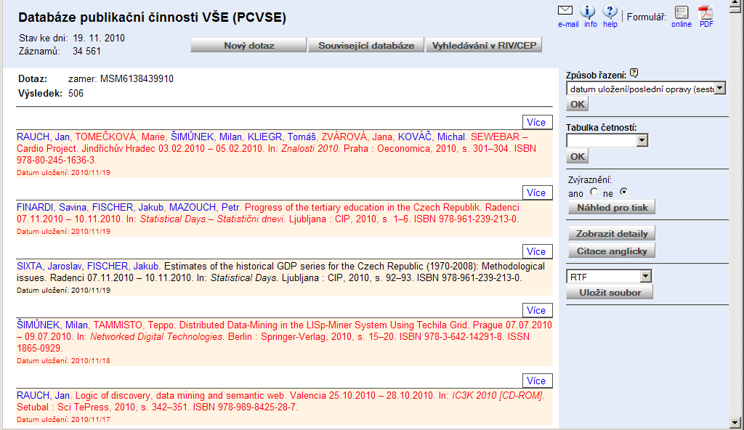

Slide 6
Academic bibliography database
Publishing activities of the academic staff of the University of Economics, Prague
journal articles, conference papers, lecture notes, monographs and monograph chapters
Interesting resource of scientific research and development activities
…but is it ready to the Web environment?

Slide 7
Linked data
= „best practices for publishing and connecting structured data on the Web“
Using URIs to identify things
HTTP protocol
RDF is a graph-based data model for representing structure and linking data about things

Slide 8
Linked data benefits
linking the pieces of data, information, knowledge on the Web from disparate resources
Machine processable information ready to use by web applications
Improved retrieval and discovery services

Slide 9
What about our bibliographic data?
RDF is familiar to people outside the library community
Integration of bibliographic information into the Web
Sharing scientific and research outputs information and its visibility increase

Slide 10
Transformation process
Data preparation
Data modelling
Interlinking
…our experiences, comments and suggested problems' solutions to share

Slide 11
Problems of original data
Bibliographic format - MARC
„Library data“ made by „non-librarians“
No cataloguing standard used
No established classification scheme used
No controlled vocabulary used: names used in many variations, translations and abbreviations

Slide 12
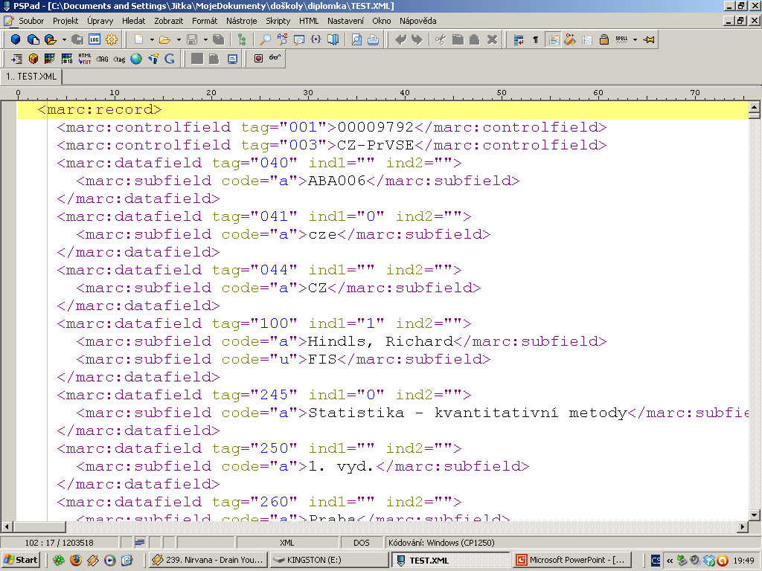

Slide 13
Publisher names
synsets
= all variant names of a single publisher in a group
preferred form of the name selected according to the Publishers’ Directory maintained by the National Library of the Czech republic

Slide 14
Synsets
Vysoká škola ekonomická
University of Economics, Prague
VŠE
VŠE v Praze
Univ. of Economics
University of Economics
University of economics
Univerzita Karlova
Charles University
Karlova universita
Universita Karlova v Praze
Universita Karlova
UK
Univerzita Karlova v Praze
Springer
Springer Verlag
Springer-Verlag

Slide 15
Information to transform
All the information captured in MARC format ?
not required and not necessary considering today‘s retrieval on the web
we need to select the most essential and widely used information

Slide 16
Selection tools
Tags' frequency analysis of MARC fields/subfields used
Final list of the most frequent fields and subfields
= the most essential bibliographic data pieces that we would like to use in the further transformation

Slide 17
Data modelling
Transformation into the RDF data model:
Entity types specification
2. Find the most appropriate rdf:type for the specified entities
…in available RDF vocabularies
and domain ontologies

Slide 18






Resource types
Concept (skos:Concept)
Document (bibo:Document)
Organization (foaf:Organization)
Person (foaf:Person)
Project (arpfo:Project)
Record (irw:InformationResource)
Notes:
The Identity of Resources on the Web ontology (IRW). It describes identification of resources on the Web, through the definition of relationships between resources and their representations on the Web.

Slide 19
Example MARC fields‘ RDF representation
Field | Subfield
100 | a
245 | a
040 | a
653 | a
773 | t
Subject | Predicate | Object
bibo:document | dc:creator | foaf:Person
bibo:document | dc:title | xsd:string
irw:InformationResource | dc:creator | foaf:Organization
bibo:document | dc:subject | skos:Concept, xsd:string
bibo:document | dcterms:isPartOf, bibo:DocumentPart, dc:title | xsd:string

Slide 20
Selection criteria
popularity of vocabulary (ontology)
Well established and the most popular
vocabularies are preferred.
2. concept description match
The description or meaning of the concept
should match as closely as possible
to MARC bibliographic data element meaning.

Slide 21

Looking for the best concept…
Vocabularies and domain ontologies:
representing bibliographic information
common vocabularies providing domain agnostic terms widely used
specialized on scientific research, academic environment and project's description
We felt free to combine various vocabularies to find the most appropriate descriptions for our data.

Slide 22
Vocabularies and domain ontologies used
Bibliographic Ontology (bibo) http://purl.org/ontology/bibo/
Dublin Core (dc) http://purl.org/dc/elements/1.1/
Friend of a Friend (foaf) http://xmlns.com/foaf/0.1/
Identity of Resources on the Web (irw) http://ontologydesignpatterns.org/ont/web/irw.owl
Simple Knowledge Organization System (skos) http://www.w3.org/TR/skos-reference/skos.html
…

Slide 23
…Not found?
Vocabularies
currently not available
PlaceOfPublication problem –appropriate property
dc:coverage, dc:spatial?

Slide 24

Project information modelling
bibliographic data are enriched by information about the projects related to the described documents
ARPFO, Academic Research Project Funding Ontology – describing the project funding structure of academic research
SWRC, Semantic Web for Research Communities – modelling entities of research communities.

Slide 25
FRBRization?
Functional Requirements for Bibliographic Records (FRBR) abstract data model
= „framework for relating the data in bibliographic records and defining the basic level of functionality for records created by national bibliographic agencies“ ⁽¹⁾
Expression of Core FRBR Concepts in RDF vocabulary describing basic concepts and relations http://vocab.org/frbr/core.html

Slide 26
FRBRization?
classical library catalogue: framework for relating the data in bibliographic records, collocation of multiple variations, versions, formats or editions of a single work to improve retrieval and displaying of bibliographic information
Academic bibliography database ≠ classical library data
Multiple versions, formats or editions of works occurring only rarely, if so
Work, expression, manifestation, item
not very suitable for our data

Slide 27
Interlinking
Deterministic – exact matches
Country codes, languages
Non-deterministic – probabilistic matching
Authors, documents
With manual revisions

Slide 28
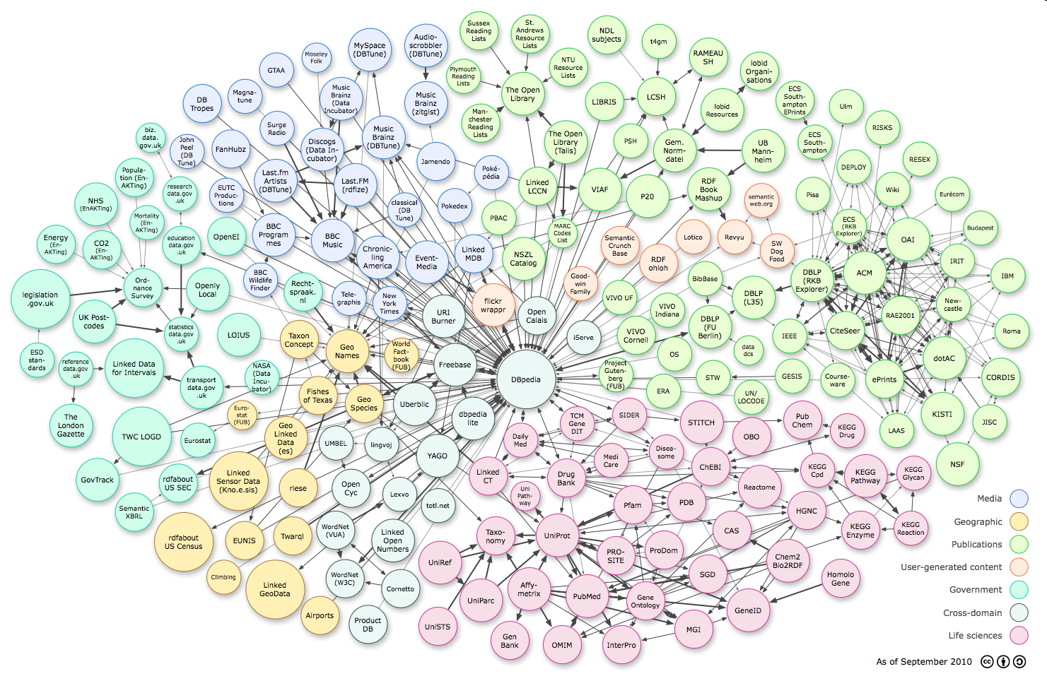
Interlinking
MARC Codes
Geonames
VIAF
DBLP
KEG web

Slide 29
Linked data user interface
{3. principle} “When someone looks up a URI, provide useful information, using the standards (RDF, SPARQL).” ⁽²⁾
Various representations of a resource
HTML, RDF/XML, RDF/Turtle
Various access mechanisms
SPARQL, search interface

Slide 30
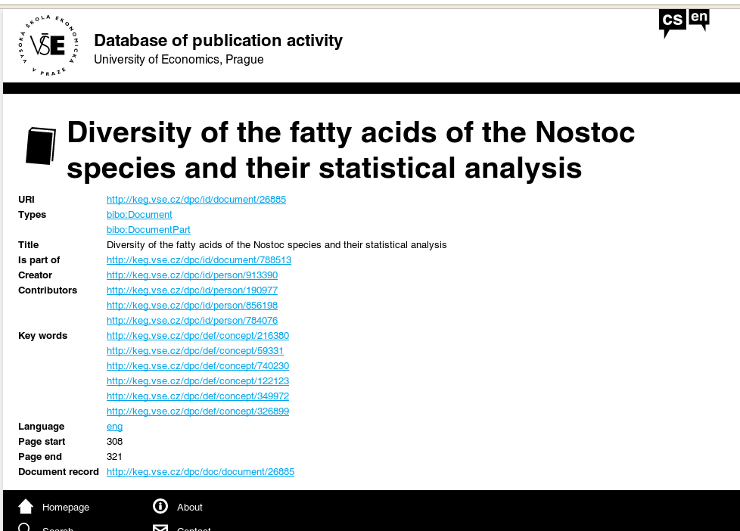

Slide 31
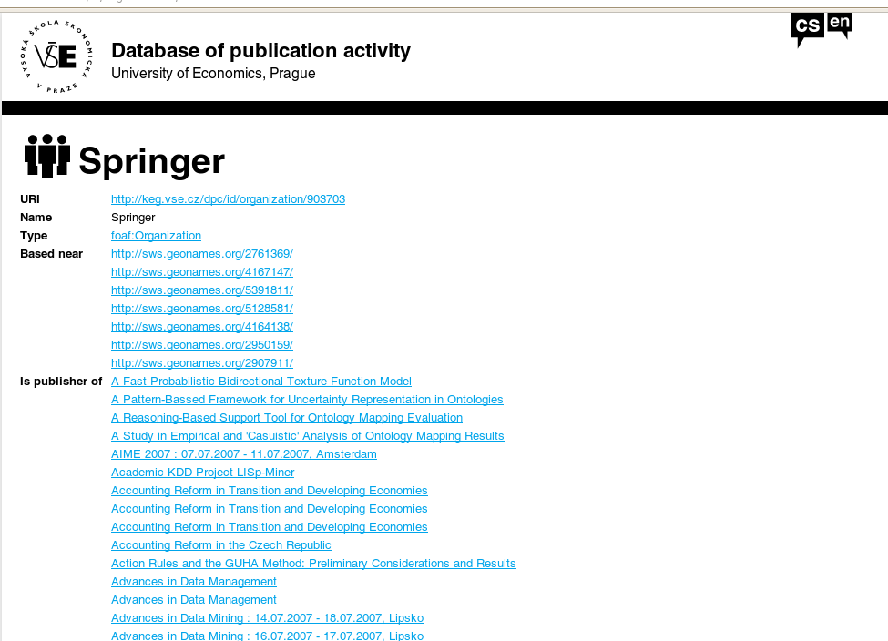

Slide 32
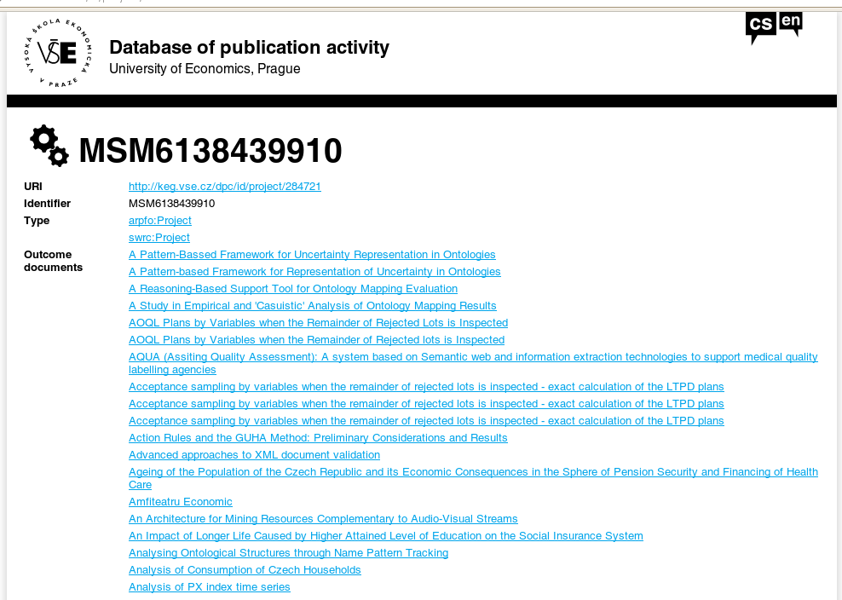

Slide 33
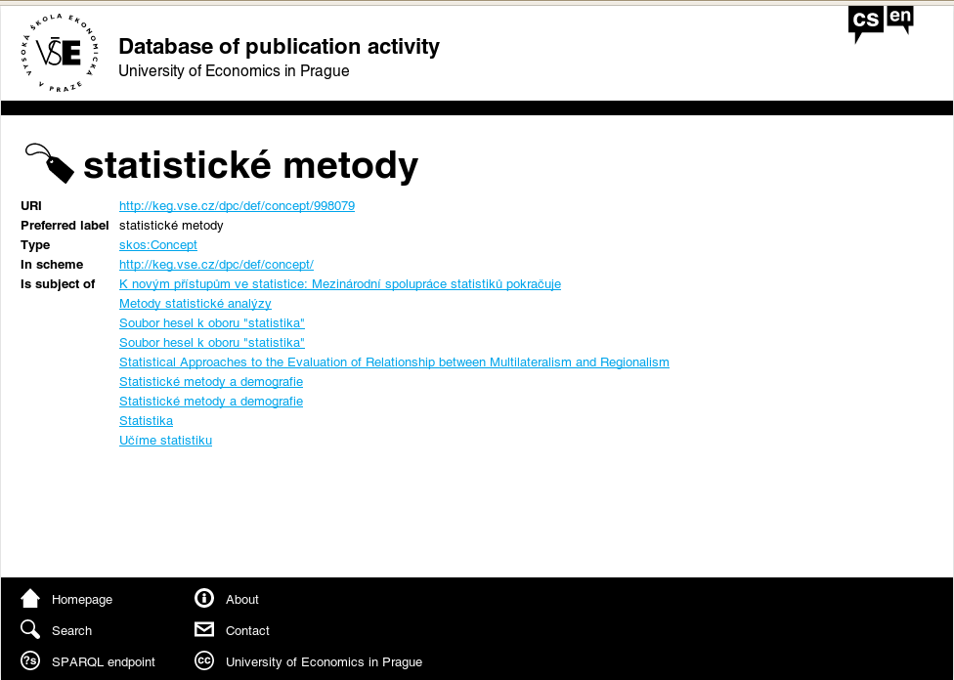

Slide 34
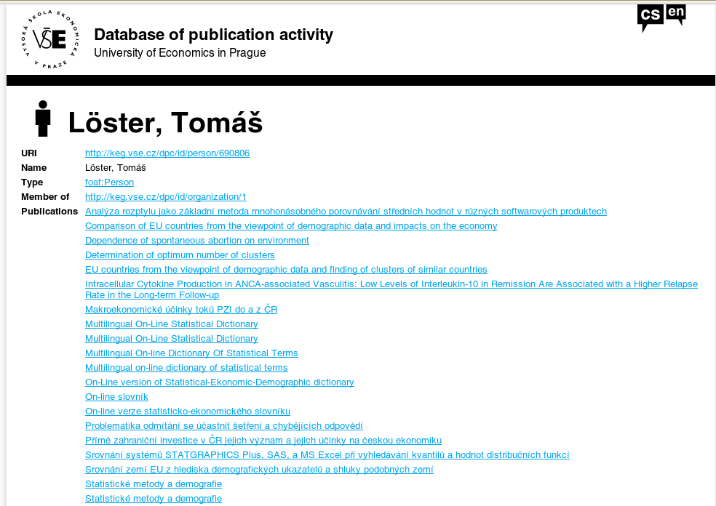

Slide 35
Design issues
Individual page for each resource
Content negotiation (HTTP 303 redirects)
Providing labels (title, name) instead of URIs for resources.
Performance of SPARQL queries (caching is needed)
Specific templates for distinct RDF types

Slide 36
URI patterns
URI pattern for each resource type
/id/{resource type}/{resource ID}.{format}
e.g., /id/person/123, /def/concept/456.rdf
Hierarchical pattern
Neutral identifiers

Slide 37
Connecting with applications
Data can be easily repurposed by other applications
Added metadata
COinS (Context Objects in Spans)
OpenURL resolvers (SFX)
Citation managers (Zotero)
RDFa

Slide 38

Future challenges and possibilities
Further interlinking
Data cleaning
Synchronization with the original dataset
Better user interface (visualizations)
…

Slide 39
References
1)IFLA. Functional Requirements for Bibliographic Records – Final report 1998 [online]. Latest revision: 11 April 2010. Available from WWW: http://archive.ifla.org/VII/s13/frbr/frbr1.htm
2)BERNERS-LEE, Tim. Linked data [online]. W3C, Last change 2009/06/18. Available from WWW: http://www.w3.org/DesignIssues/LinkedData.html

Slide 40

Thank you for your attention.
…any questions?

