Slide 1


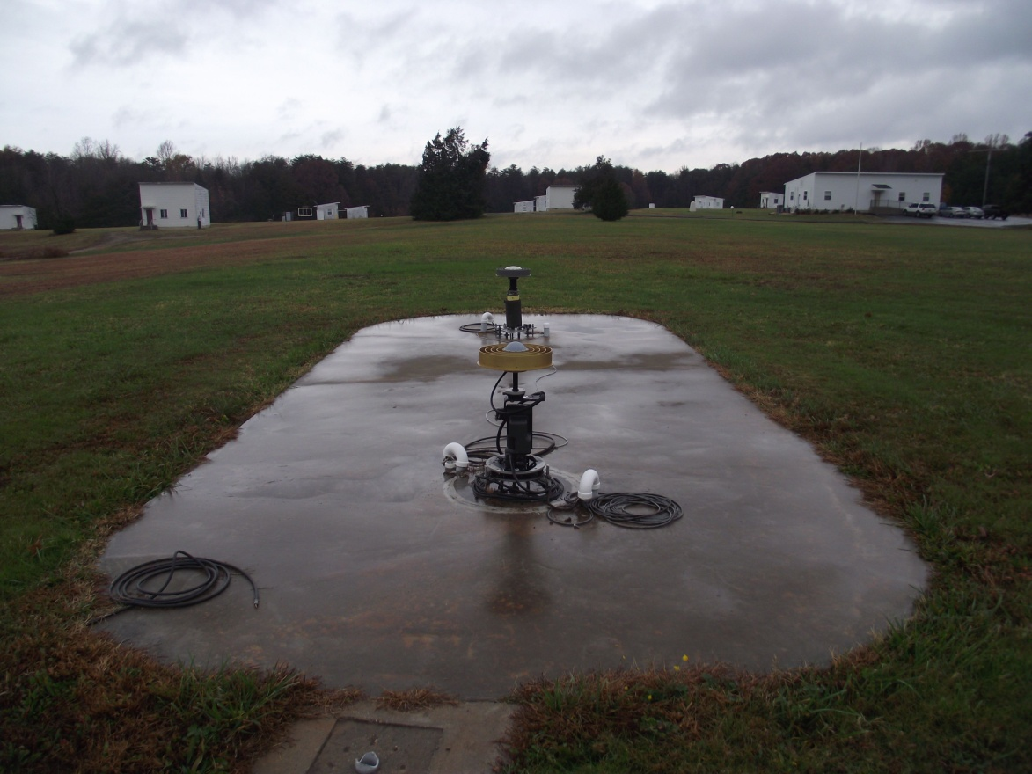
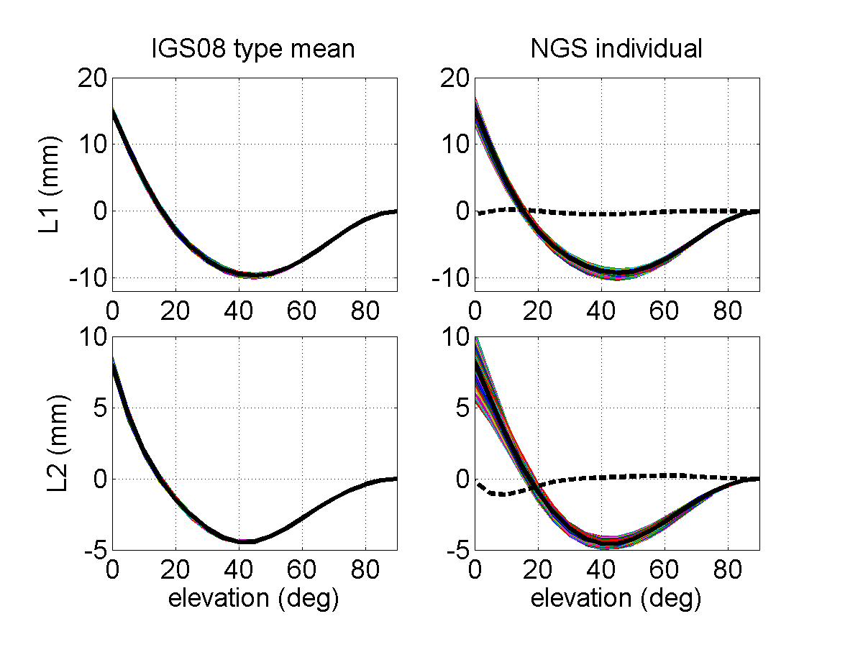
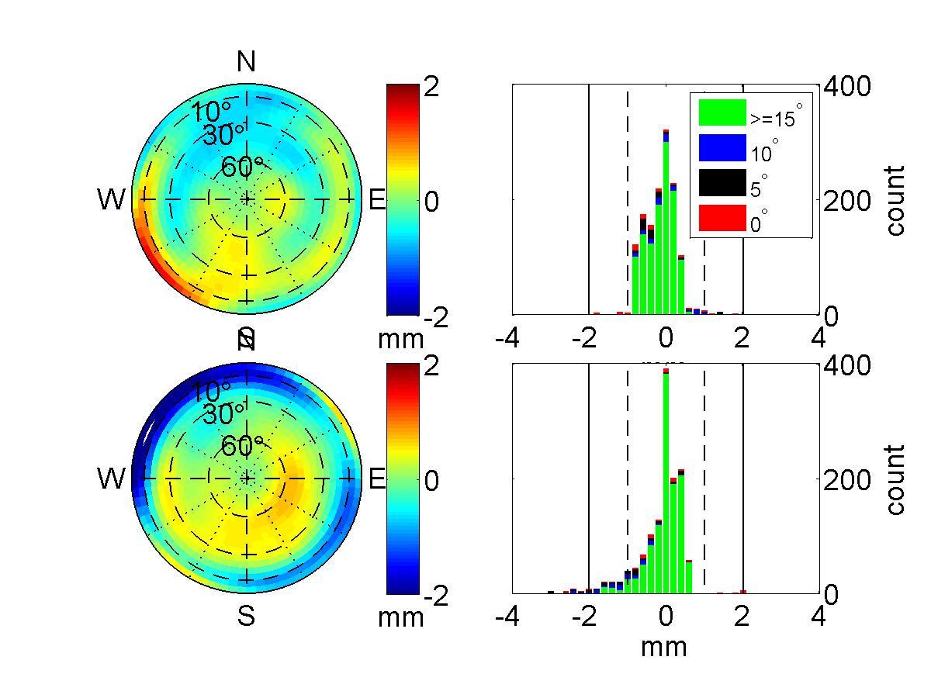
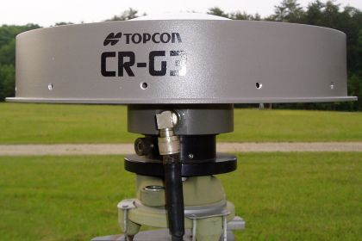
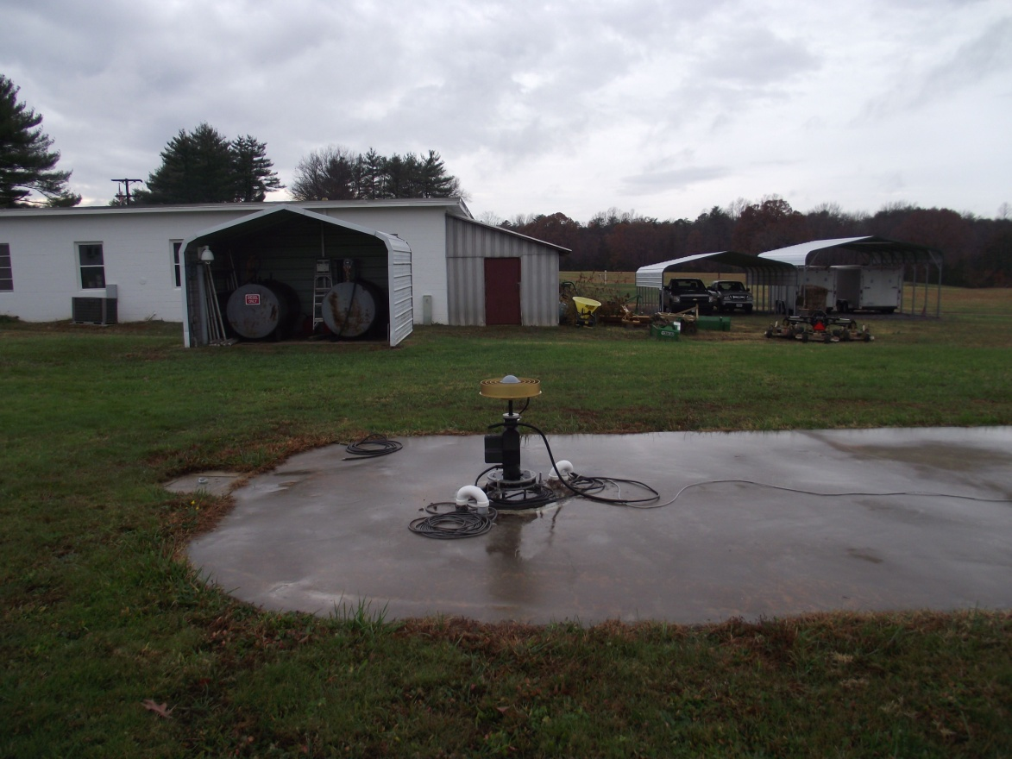
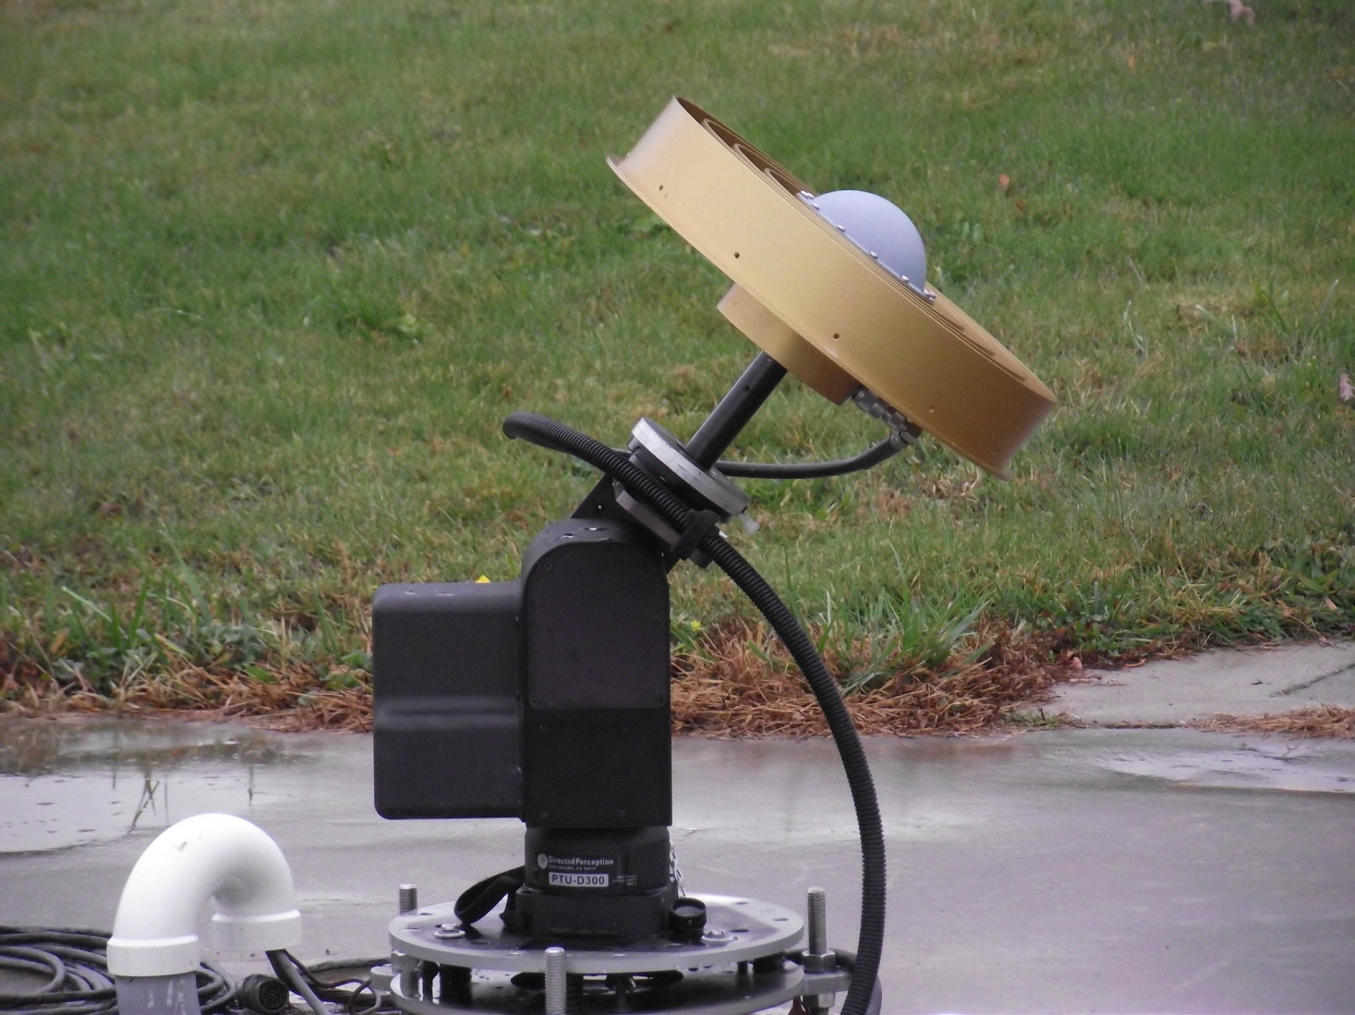
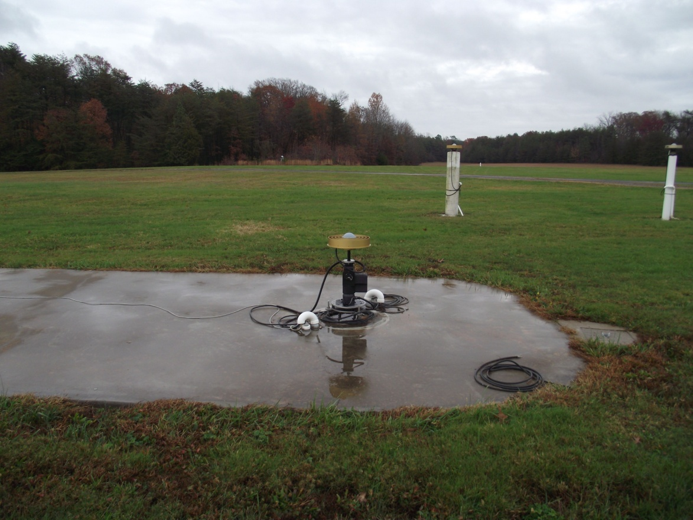
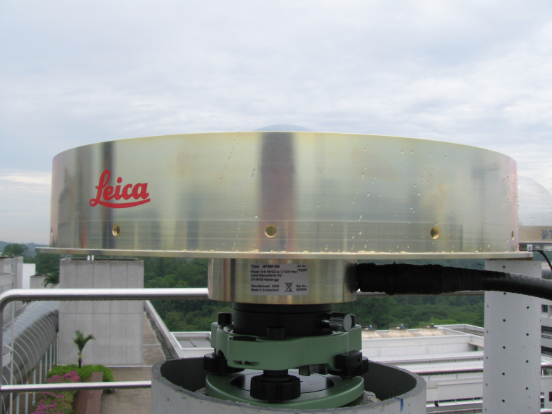
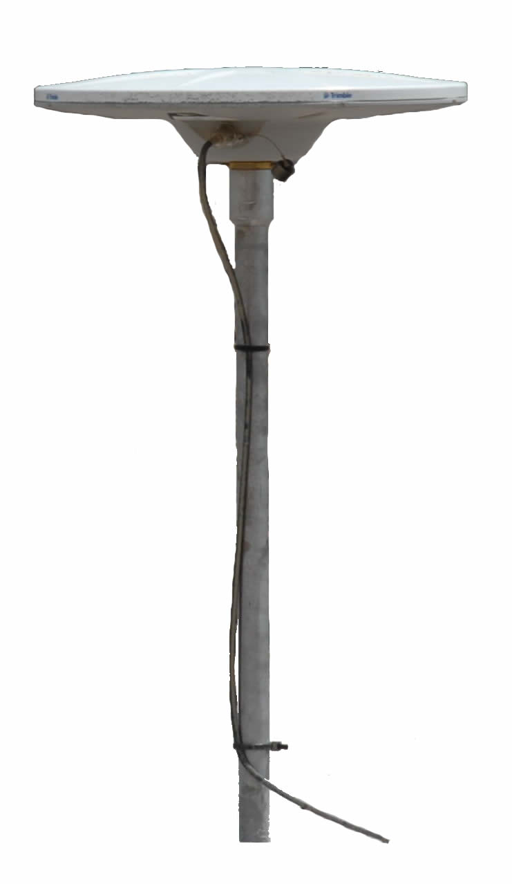
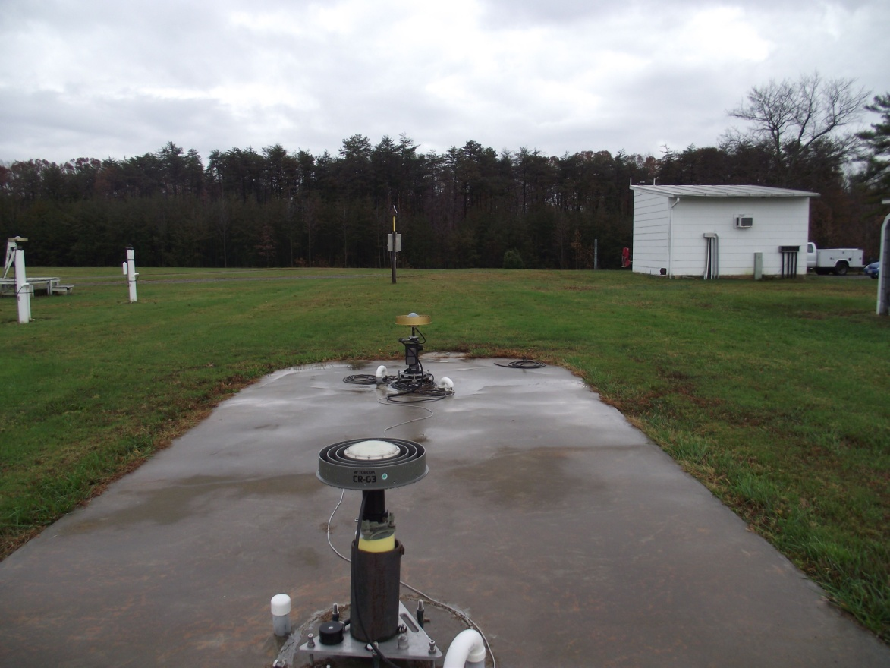
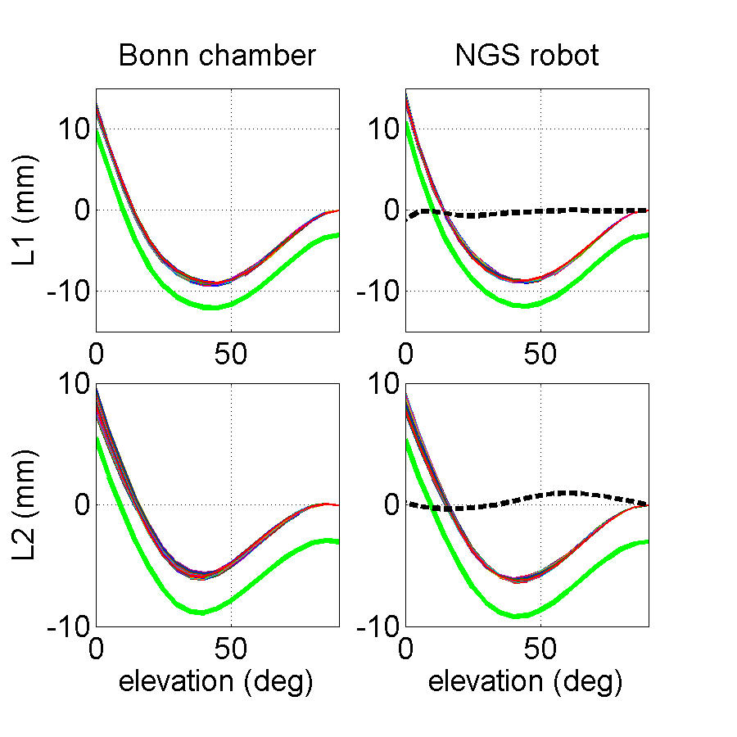
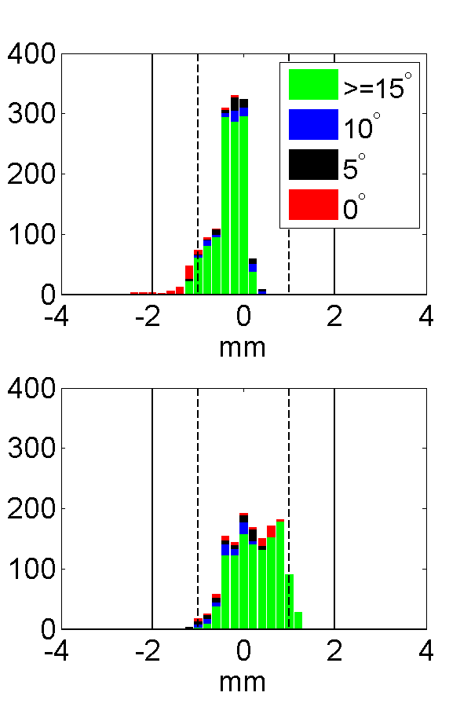
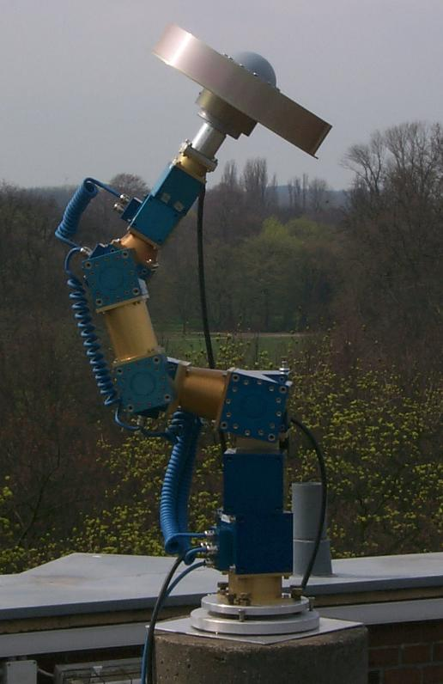
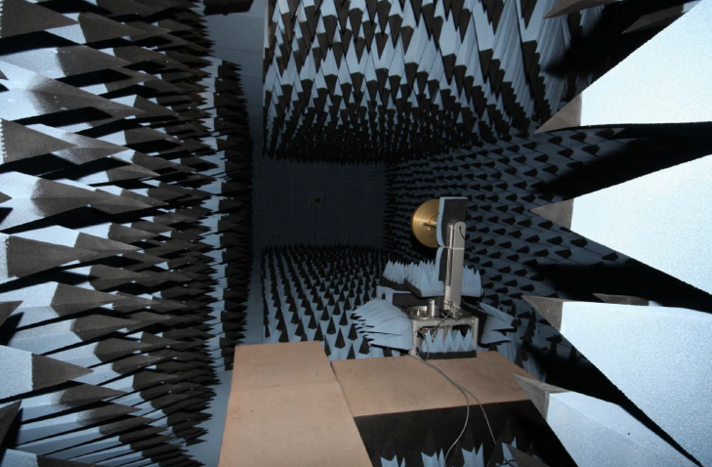
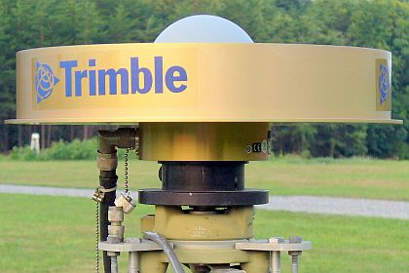
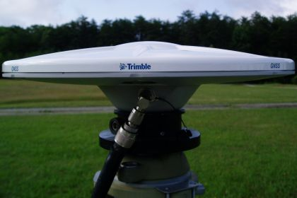
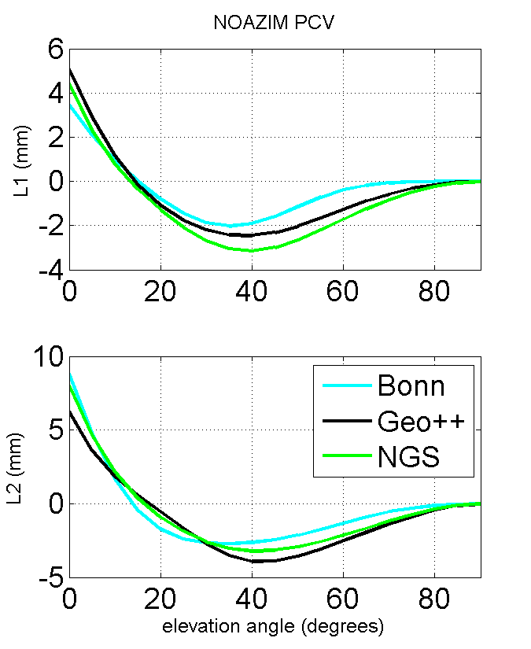
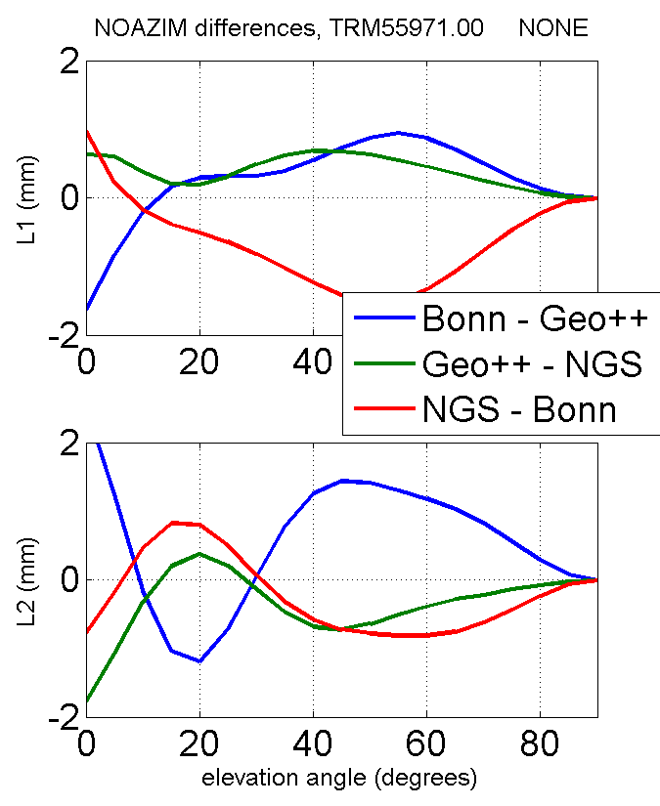
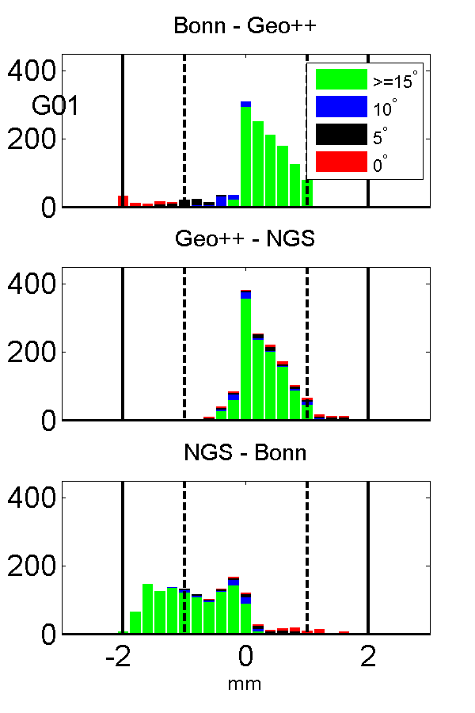
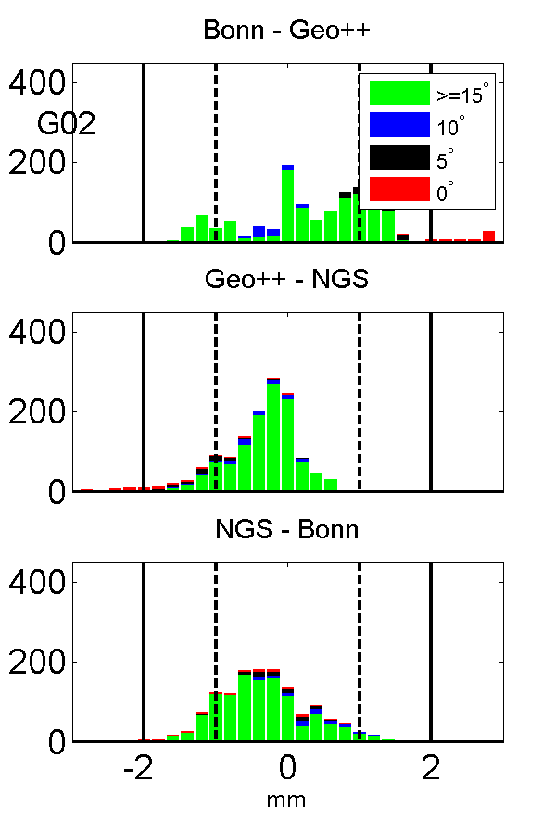
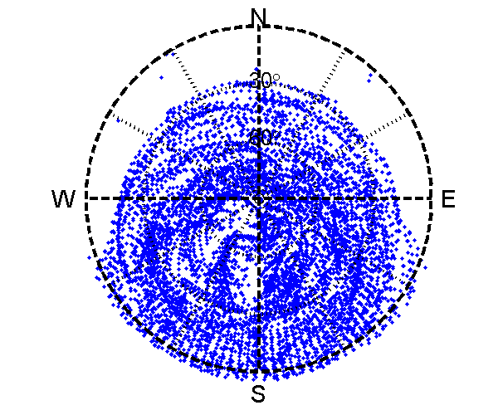
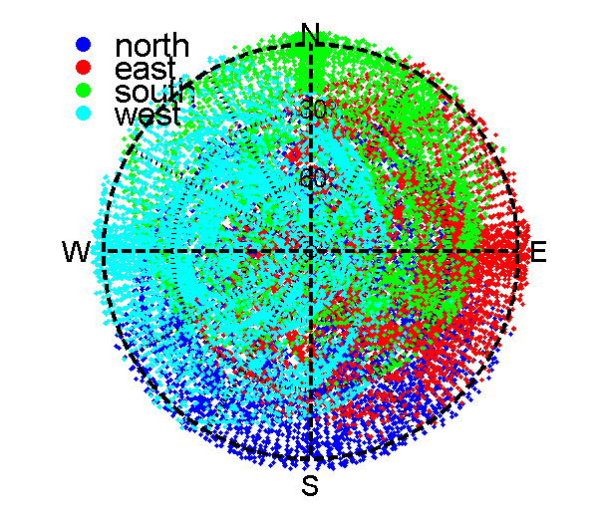
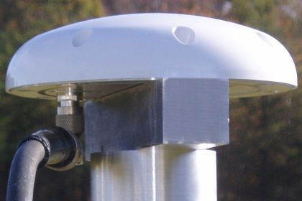
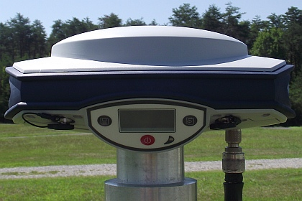
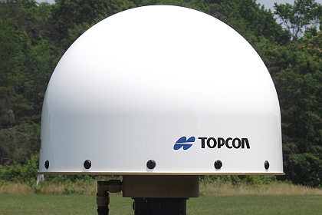
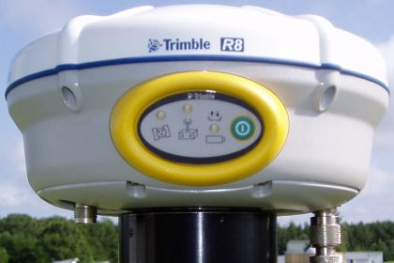
GNSS Absolute Antenna Calibration at the National Geodetic Survey
Gerald L Mader² , Andria L Bilich¹, Charles Geoghegan³ ¹National Geodetic Survey, NOAA/NOS, Boulder CO; corresponding author: andria.bilich@noaa.gov
¹National Geodetic Survey, NOAA/NOS, Silver Spring, MD
³National Geodetic Survey, NOAA/NOS, Corbin VA
Background
Method
Results
… compared to IGS type mean
What is GNSS Antenna Calibration?
Why Do I Need Antenna Calibration?
Calibration
Setup
Antenna ARP ~ 50 cm above concrete pad (zero tilt)
10 cm Sokkia extension used to separate test antenna from robot
PCO
PCV
residuals
statistics
N E U [mm]
IGS08 -0.17 0.30 88.41
NGS -0.23 1.50 87.76
100% < 1mm @ >10°
100% < 2mm @ ≤10°
Antenna calibration = measurement of the antenna phase center (the apparent point of phase signal reception for a GNSS antenna)
Antenna phase center:
Differs between antenna models and manufacturers
Is affected by antenna radome and antenna mount
To account for range errors introduced by the antenna element and hardware
Calibrations are a required input for many GNSS data processing packages
Omitting calibrations leads to estimation errors:
Long baselines
Combining multiple antenna models
Height errors
The NGS calibration facility is located in Corbin, VA.
N
Topcon CR-G3
TPSCR.G3
s/n 0152
97% < 1mm @ >10°
84% < 2mm @ ≤10°
N E U [mm]
IGS08 0.28 -0.04 119.40
NGS 0.26 0.83 118.20
W
E
We provide NGS PCO values from the individual calibration of the serial number shown on the photo, to demonstrate the NGS method’s ability to correctly recover PCO. However, all further comparison (plots to right) are after shifting NGS values to use the published IGS PCO.
Colored lines are azimuthal lines through full PCV pattern every 5°. Heavy black line is the NOAZIM elevation-only profile.
NGS solution is shifted to use IGS PCO. Dashed black line is the NOAZIM difference between IGS and NGS values..
IGS minus NGS residuals, shown with respect to azimuth and elevation angle (lefthand circular plots) and as a histogram (righthand). Vertical bars in histogram denote 1mm and 2mm bounds for IGS AWG approval.
Percentage of NGS-IGS residuals which fall within 1mm and 2mm bounds.
A full calibration is the sum of two different components:
PCO (phase center offset)
Point in space relative to physical, easily ID’ed and accessible ARP
Given as NEU in antenna frame
PCV (phase center variations)
Relative to PCO
Depends on direction of incoming satellite signal
Flat field & concrete pad = well-behaved multipath environment
5 meter baseline (N-S orientation)
precise baseline from survey
baseline orientation used to fix robot reference frame
Robot
2-axis pan and tilt unit
rotation arm = 10.77 cm
coincident origins for pan and tilt systems
arm length and pan/tilt axis origin precisely measured with Total Station observations over range of robot pan/tilt angles
Calibration values are given relative to a reference surface, typically the ARP
Members of the IGS Antenna Working Group (AWG) are conducting “ring calibrations”, that is, calibrating individual antennas with different systems and environments to test consistency between methods.
… compared to other absolute calibration methods
S
Trimble D/M GNSS
TRM59800.00
L1
N E U
0.93 1.08 91.42 1.35 -0.17 91.94
0.29 1.20 121.91
0.69 -0.74 123.19
ARP (antenna reference point)
Typically antenna mount point
Defined by calibration facility
L2
L1
0.77 0.88 91.51 -0.64 0.33 91.60
1.12 0.62 121.79 -0.58 -0.24 123.16
The 2-axis robot lacks the third degree of freedom necessary to fully sample the PCV pattern. Collecting data with the antenna in 4 different orientations on the robot circumvents this limitation.
Data Reduction and Solution
PCO values for three different serial numbers of TRM59800.00 antennas, Bonn in red and NGS in black.
L2
Relative vs. Absolute Calibration?
Geo++: field calibration with 3-axis robot and Kalman filtering
Bonn: anechoic chamber calibration with signal simulator and 2-axis robot
L1
0.84 1.46 91.56 0.00 1.15 91.63 0.52 0.40 121.93 -1.00 -0.81 122.55
Colored lines are azimuthal lines through full PCV pattern every 5°, for the first serial number. Heavy green line is the NOAZIM elevation-only profile, offset by -3 mm for clarity. The heavy dashed black line is the difference between Bonn and NGS NOAZIM values.
Full PCV residuals, Bonn minus NGS .Vertical bars in histogram denote 1mm and 2mm bounds for IGS AWG approval.
Advantages of absolute calibrations:
Better/fuller description of phase behavior
Depends only on calibrated antenna (reference-free)
Includes 0-10° elevation coverage
Captures azimuthal variations
Multipath removed/negated
The way of the future
International GNSS Service (IGS) standard
Used in OPUS and CORS multiyear
Compatible with absolute calibrations from any IGS-sanctioned facility
 | Relative | Absolute
Calibration values | Relative to a reference antenna (at NGS, use JPL chokering D/M_T) | Independent of reference antenna
Method | Stationary antennas | Test antenna moves
Advantages | Straightforward math | Sample full hemisphere and low elevation angles; independent of source
Limitations | Cannot sample full pattern; source-dependent | Requires robot and rigorous accounting of angles & rotations
L2
Pre-Edit Phase
Geometric range
Single Difference Phase
Cycle slip editing
Time Difference of Single Difference Phase Pairs
Phase windup
PTU tilt arm
Satellite XYZ/velocity calcs (for windup)
Form / Solve Normal Equations
PCO (east, north, up components)
PCV (elevation and azimuth angle)
Calculation of Angles
Angles in local frame
Angles in antenna frame
Data Collection (all 4 directions)
Trimble Zephyr 2
TRM55971.00
Samples collected with antenna mounted in north orientation
s/n 30213962
Because this antenna model does not have chokerings, we expect results to be more sensitive to environmental effects such as multipath. Even with this expectation, the different methods have excellent PCO agreement and PCVs agree at < 2mm level.
[mm] N E U
Bonn 0.71 0.27 67.70
Geo++ 1.01 -0.27 67.70
NGS 1.25 -0.31 67.46
N E U
Bonn -0.03 0.50 58.89
Geo++ -0.25 -0.19 58.34
NGS -0.12 -0.17 59.74
Composite sampling after all four directions
(left) NOAZIM elevation-only PCV profile. (right) differences between solution pairs. All results have been shifted to use common PCO values.
Histogram of full (azimuth and elevation-dependent) PCV differences between solution pairs. Black vertical bars in histogram denote 1mm and 2mm bounds.
Do not combine relative and absolute calibrations!
NGS Absolute Calibration
Motivation and Goals
Serve high precision needs of U.S. surveying and geodesy communities
Multi-frequency, multi-GNSS calibrations
2-D (elevation, azimuth) phase center patterns
Free calibration service (antenna providers pay shipping)
Calibration values publicly distributed via Internet http://www.ngs.noaa.gov/ANTCAL/
Compatible with IGS ANTEX values
Conclusions
Next Steps
References &
Acknowledgements
Favorable individual comparison to IGS published values and other calibration institutions is demonstrated
Solid methodology and testing facility are in place
Able to compute type means from 3-5 samples (not shown)
Small discrepancies remain for some antenna models = area of active research
Finalize IGS Antenna Working Group approval
3-method comparison with Bonn chamber and Geo++ robot is ongoing
final results to be presented at IGS Workshop in July 2012
Set permanent piers for calibration baseline
Add capabilities to software
Integrated antenna + receiver units
GLONASS
Bilich A and GL Mader, GNSS Antenna Calibration at the National Geodetic Survey, Proceedings of ION GNSS 2010, Portland, OR, September 2010, pp. 1369-1377.
The authors thank many people at NGS (Steven Breidenbach, Hong Chen, Kendall Fancher, David Geitka, Heeyul Han, Dennis Lokken, Frank Marion, Jaya Neti, Giovanni Sella, Bruce Tran, Jarir Saleh, and Mark Schenewerk) and the IGS Antenna Working Group (Ralf Schmidt, Phillip Zeimetz, Martin Schmitz for contributions to this project.
Please see our website at http://www.ngs.noaa.gov/ANTCAL for more information
The robot moves the test antenna between two closely spaced times. During that time interval the satellite has moved a negligible amount. Therefore multipath and PCO/PCV at the reference antenna are unchanged, and drop out when observations at the two times are differenced.
Fixed reference antenna
Test antenna

