Slide 1
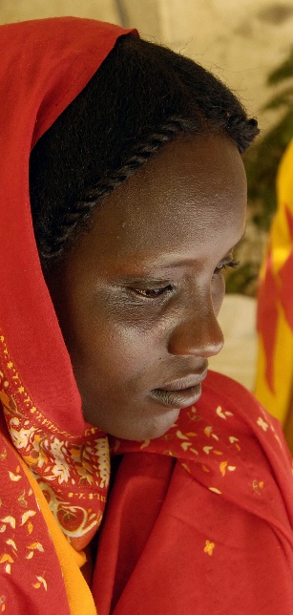


MEETING A GLOBAL PROMISE THE MOUNTING EVIDENCE OF MDG ACHIEVEMENT
OLAV KJØRVEN
DIRECTOR
BUREAU FOR DEVELOPMENT POLICY
UNITED NATIONS DEVELOPMENT PROGRAMME
8 MARCH 2010
Notes:
1

Slide 2
THE PROMISE OF MDG ACHIEVEMENT IN REACH
With less than 6 years to the MDG achievement target date – a global promise appears to be within reach
Major successes on the MDGs have been achieved over the past years globally:
Between 1990 and 2005, the number of people living on less than $1.25 a day declined from 1.8 billion to 1.4 billion.
Remarkable progress towards achieving universal primary education in developing countries since 2000, with many countries having crossed the 90 per cent enrolment threshold.
Child mortality rate in the developing world has shrunk from 103 to 74 per 1,000 live births over 1990-2007.
And the world is well on its way to meeting the safe drinking water target.

Slide 3
KEEPING THE PROMISE IN A NEW CONTEXT
Yet meeting this global promise is becoming increasingly daunting as a measure of current challenges and crises
Because progress on the MDGs was already highly mixed across and within countries and goals;
Because inequality kept on the rise - even where progress on MDGs seems to be on track globally, regionally or nationally, there are gaps and discrepancies in achievements.

Slide 4

KEEPING THE PROMISE IN A NEW CONTEXT
Because new challenges such as food, fuel and economic crises have dealt real blows to MDG progress, and threaten to slow or even reverse gains made. Climate crisis threatens to set back MDGs.
Because the evidence base needs to be bolstered - moving beyond the just actions required to identifying the actions and approaches which have worked, and which would need to be scaled up and replicated in the remaining five years to achieve the MDGs.
And because the global partnership has to be renewed and deliver better – predictable financial resources, innovative partnerships, renewed commitment and building on success.

Slide 5
GLIMPSE INTO THE MOUNTING EVIDENCE – WHAT WORKS
The cases presented here today are just 4 glimpses of evidence across the MDGs; we are also deepening the evidence base (based on MDG Country Reports)
They demonstrate using concrete examples that the MDGs are achievable & inspire renewed action to accelerate progress.
That new answers are needed, such as improving the quality of scaled-up services or reaching marginalized segments of society and particular pockets of deprivation, calling for continued efforts through the ‘last leg’ of MDG achievement in all countries.

Slide 6
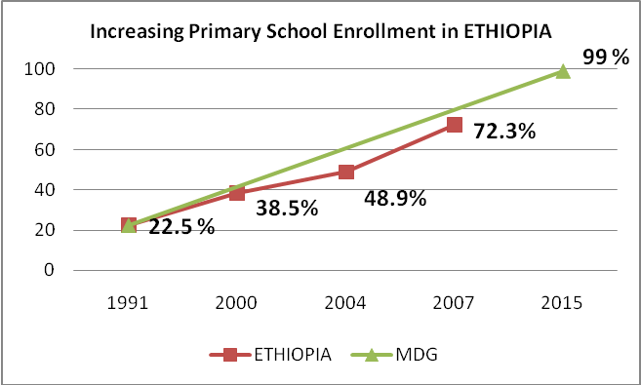
CASE OF ACCELERATED PROGRESS ON EDUCATION
Remarkable progress in increasing enrolment in primary education is possible – e.g Ethiopia (and Tanzania) – by:

Slide 7
EDUCATION ACTIONS AND APPROACHES THAT WORKED
Abolishing school fees
Introducing double shifts to accommodate the large, rapid enrolment increases and engaging in scaled-up infrastructure development and teacher recruitment (Tanzania)
School construction in rural areas, decentralization, curriculum reform and text book distribution in 22 local languages - Ethiopia
Increased public spending on education - growing from 3.6% of GNP to 6% in Ethiopia and to 5% in Tanzania.
Adopting and implementing education SWAp and increased donor support – in both countries.

Slide 8
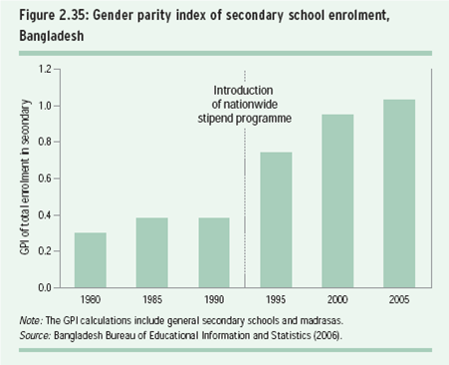
CASE OF ACCELERATED PROGRESS ON GENDER EQUALITY
Bangladesh has already achieved gender parity in education within a decade from a low starting point, for example, 0.35 in the 1990s. (Source: EFA, 2009)

Slide 9
ACTION AND APPROACHES THAT WORKED FOR
GENDER EQUALITY AND MORE …
Employed financial incentives to target girls from poor families to attend secondary school
Similarly, the Food for Education programme, providing grain rations to disadvantaged families conditional on their children attending primary school, further investments included:
improving the learning environment and school infrastructure, including sanitation facilities,
and affirmative action in recruiting female teachers.
International aid played a central role in stipend programmes in Bangladesh and the government adopted a sector-wide approach with 11 development partners.
Equally important, the action and approaches catalyzed improvement across nutrition, income and health

Slide 10
CASE OF ACCELERATED PROGRESS ON CHILD MORTALITY
The under-five mortality rate has fallen by 40 % or more since 1990 E.G. in Eritrea, Ethiopia, Malawi, Mozambique and Niger – countries with per capita GNI below US$350 a year.
Eritrea’s under-5 child mortality rate was more than halved from 147 per 100,000 live births in 1990 to 70 in 2007.

Slide 11
HEALTH ACTION AND APPROACHES THAT WORKED
Implemented the Community Integrated Management of Childhood Illness (C-IMCI) at the village level in 2005, complemented in 2006 by community-based therapeutic feeding and community outreach activities and a further scale-up of the C-IMCI initiative in 2007.
A neo-natal component was also added.
Vitamin A supplementation programme reaching all children aged 6 to 59 months old.
Measles vaccination and a hand-washing campaign in schools.
A catch-up campaign to increase routine child vaccination to at least 80% and increase coverage of 2 doses of tetanus toxoid vaccine among pregnant women to at least 50 per cent.
Broader government’s action to improve its healthcare system.

Slide 12
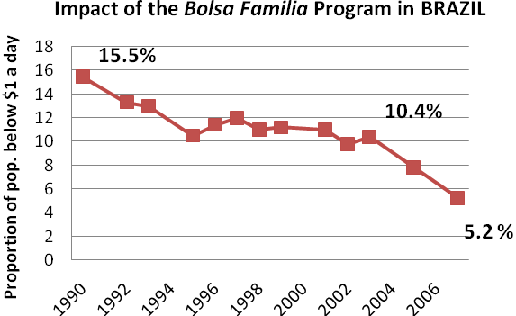
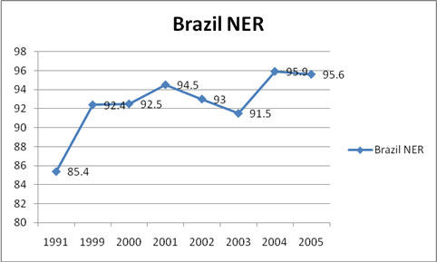
CASE OF ACCELERATED PROGRESS ACROSS
A NUMBER OF MDGs

Slide 13
ACTIONS AND APPROACHES THAT ACCELERATED
PROGRESS ACROSS A NUMBER OF MDGs
Brazil’s introduced the Bolsa Família (“Family Stipend”) Programme - a conditional cash transfer (CCT) program.
The programme reaches now cover a quarter of the populaton (approx. 50 million)
CCTs targets poor households to supplement household income conditional on meeting children’s education attendance and health service utilization.
Dramatic drop in income poverty
And catalyzing MDG achievement across - children’s education and nutritional levels.

Slide 14
EMERGING COMMON SUCCESS FACTORS
It is possible to draw common success factors across all successful examples:
Government leadership that facilitates national ownership of development strategies is critical;
Not just effective policies and strategies but meeting the implementation challenge:
Actions and approaches which are multi-sectoral address different dimensions and needs of the poor are critical to success of a number of MDGs;
Finally, good governance by donors and recipients, which involves timely and predictable delivery of aid by donors; enhanced state and societal capacity of recipient countries to manage scaled-up resource flows transparently and with accountability.

Slide 15
MEETING THE PROMISE
Together these successes also demonstrate that Yes We Can meet the promise of achieving the MDGs
That what is needed is Business Unusual now that brings together a Global Action Agenda in September 2010 for the next 5 years
That the Action Agenda is based on renewed commitment to a global partnership, promotes innovative actions and approaches to scale-up and replicate success, new and broader partnerships and the required resources;
UNDP’s role in the 2010 Review

