Slide 1
NCBO-I2B2 Collaboration Overview and Use Cases
Nigam Shah
nigam@stanford.edu

Slide 2
NCBO: Key activities
We create and maintain a library of biomedical ontologies.
We build tools and Web services to enable the use of ontologies and their derivatives.
We collaborate with scientific communities that develop and use ontologies.

Slide 3
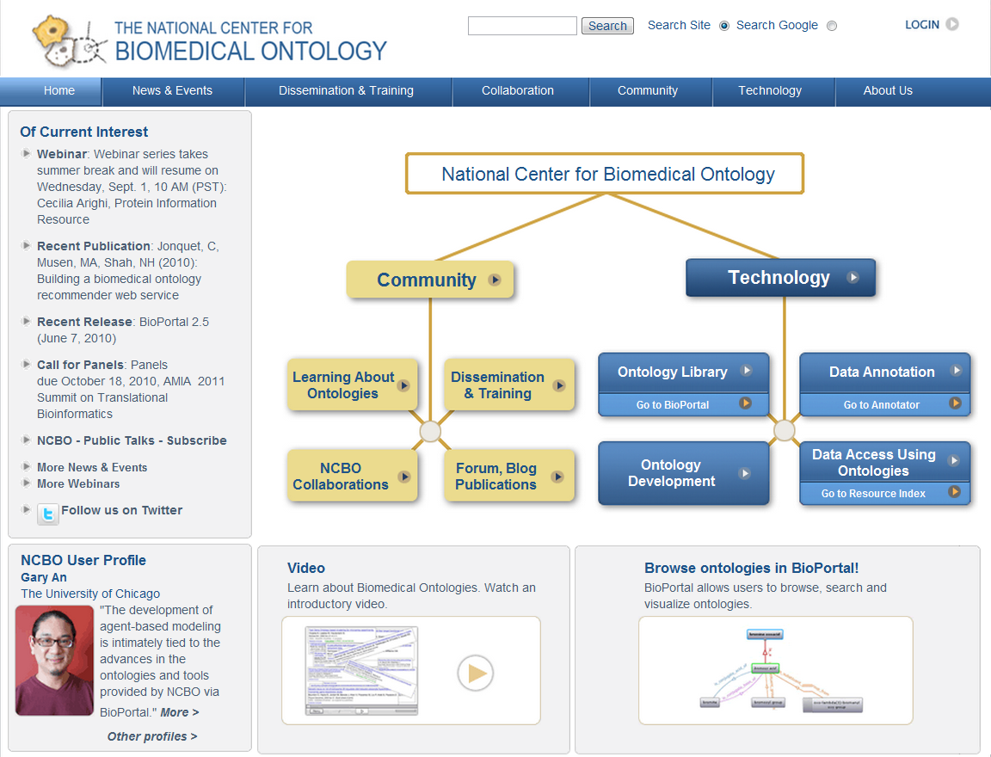
www.bioontology.org

Slide 4
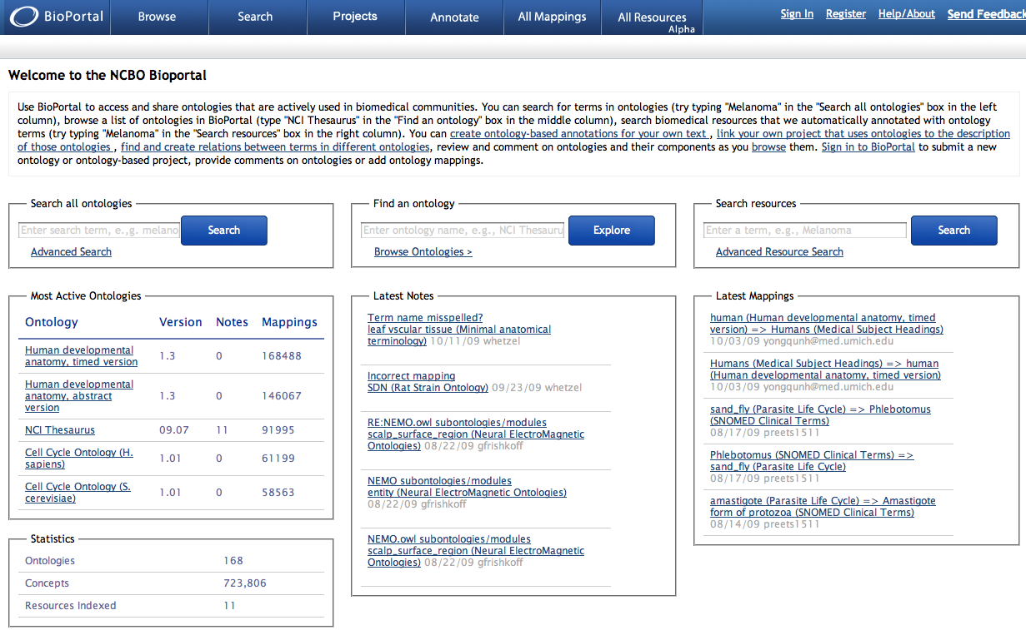
Ontology Services
Download
Traverse
Search
Comment
Aim 1: Integrate NCBO services to support the i2b2 ontology platform
Views
Create
Download
Upload
Aim 2: Employ NCBO mappings to enable efficient query translation in cross-institutional tools
Mapping Services
http://rest.bioontology.org
Tree-view
Auto-complete
Graph-view
Widgets
Annotation Services
Concept recognition
Data Services
Fetch “data” annotated with a given concept
http://bioportal.bioontology.org

Slide 5
Aim 1
Preliminary results:
Prototype code to export any ontology stored in BioPortal into the format used by i2b2’s ontology cell
Future Work:
Make the export code available as a service
Embed the extraction code into the i2b2 Ontology Cell to “pull” content
Ensure we have the latest versions of ontologies used by i2b2 users

Slide 6
Aim 2
Preliminary result:
“on-paper” draft of using mappings for query translation
Detailed discussions with the HOM and OpenMDR groups to define use-case and elicit requirements
Future work:
Use BioPortal as the shared repository for inter terminology mappings
Tackle access, IP, performance, and institutional issues
Key features
Import outside mappings
Update mappings when versions change
Mechanism to curate mappings
Support proprietary curation and content

Slide 7
Detailed slides – if needed

Slide 8
Ontology services
Accessing, browsing, searching and traversing ontologies in Your application

Slide 9
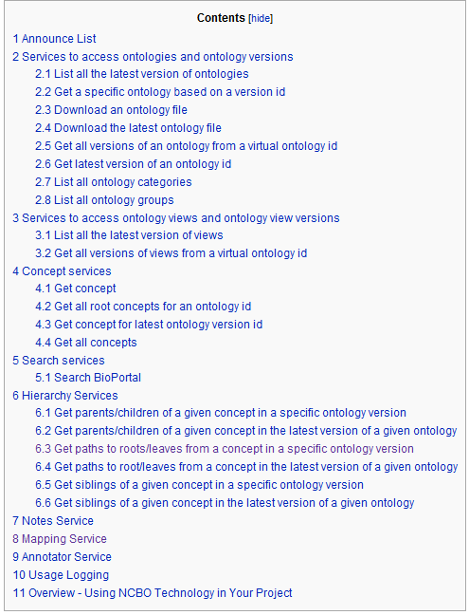
www.bioontology.org/wiki/index.php/NCBO_REST_services

Slide 10
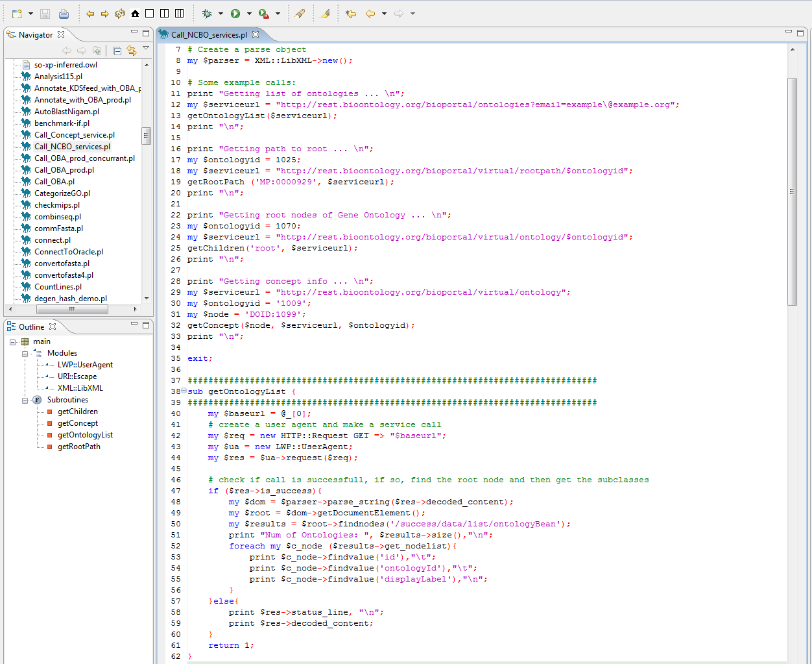
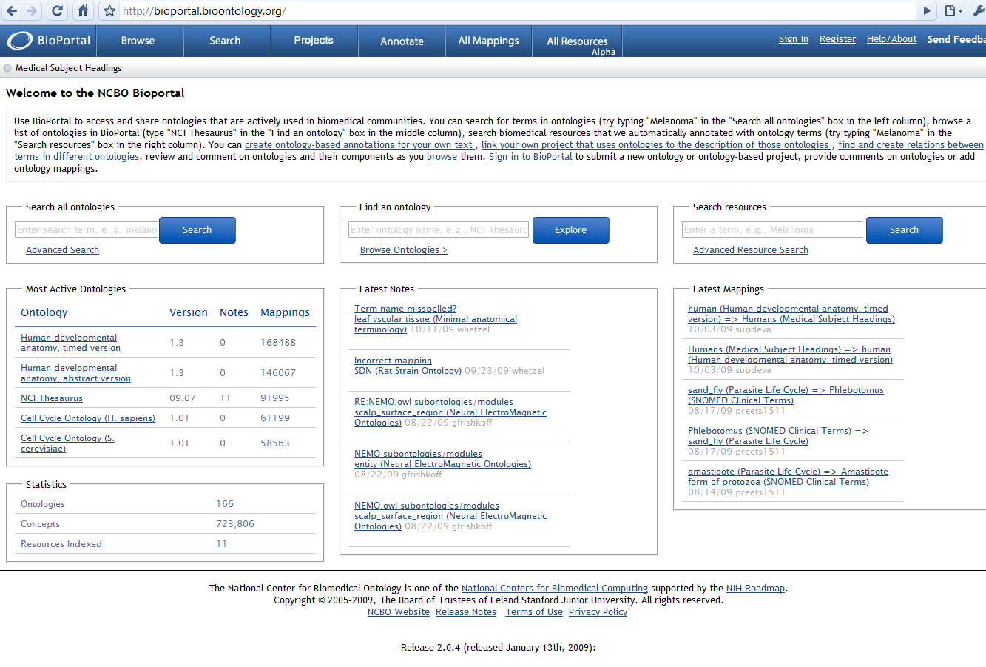
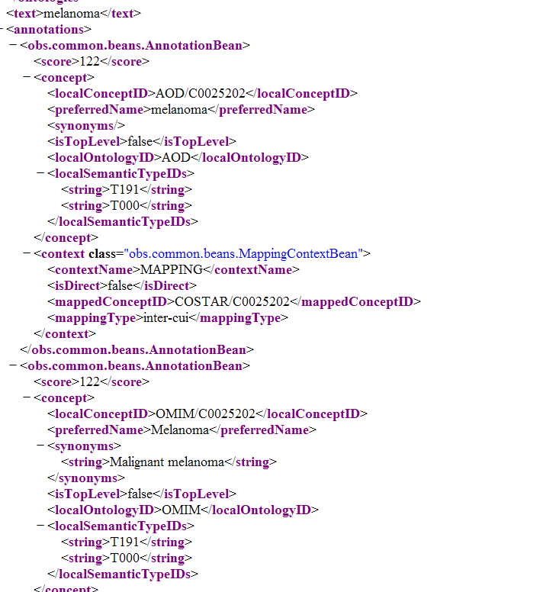
Code
Specific UI
http://rest.bioontology.org/<SERVICE>

Slide 11
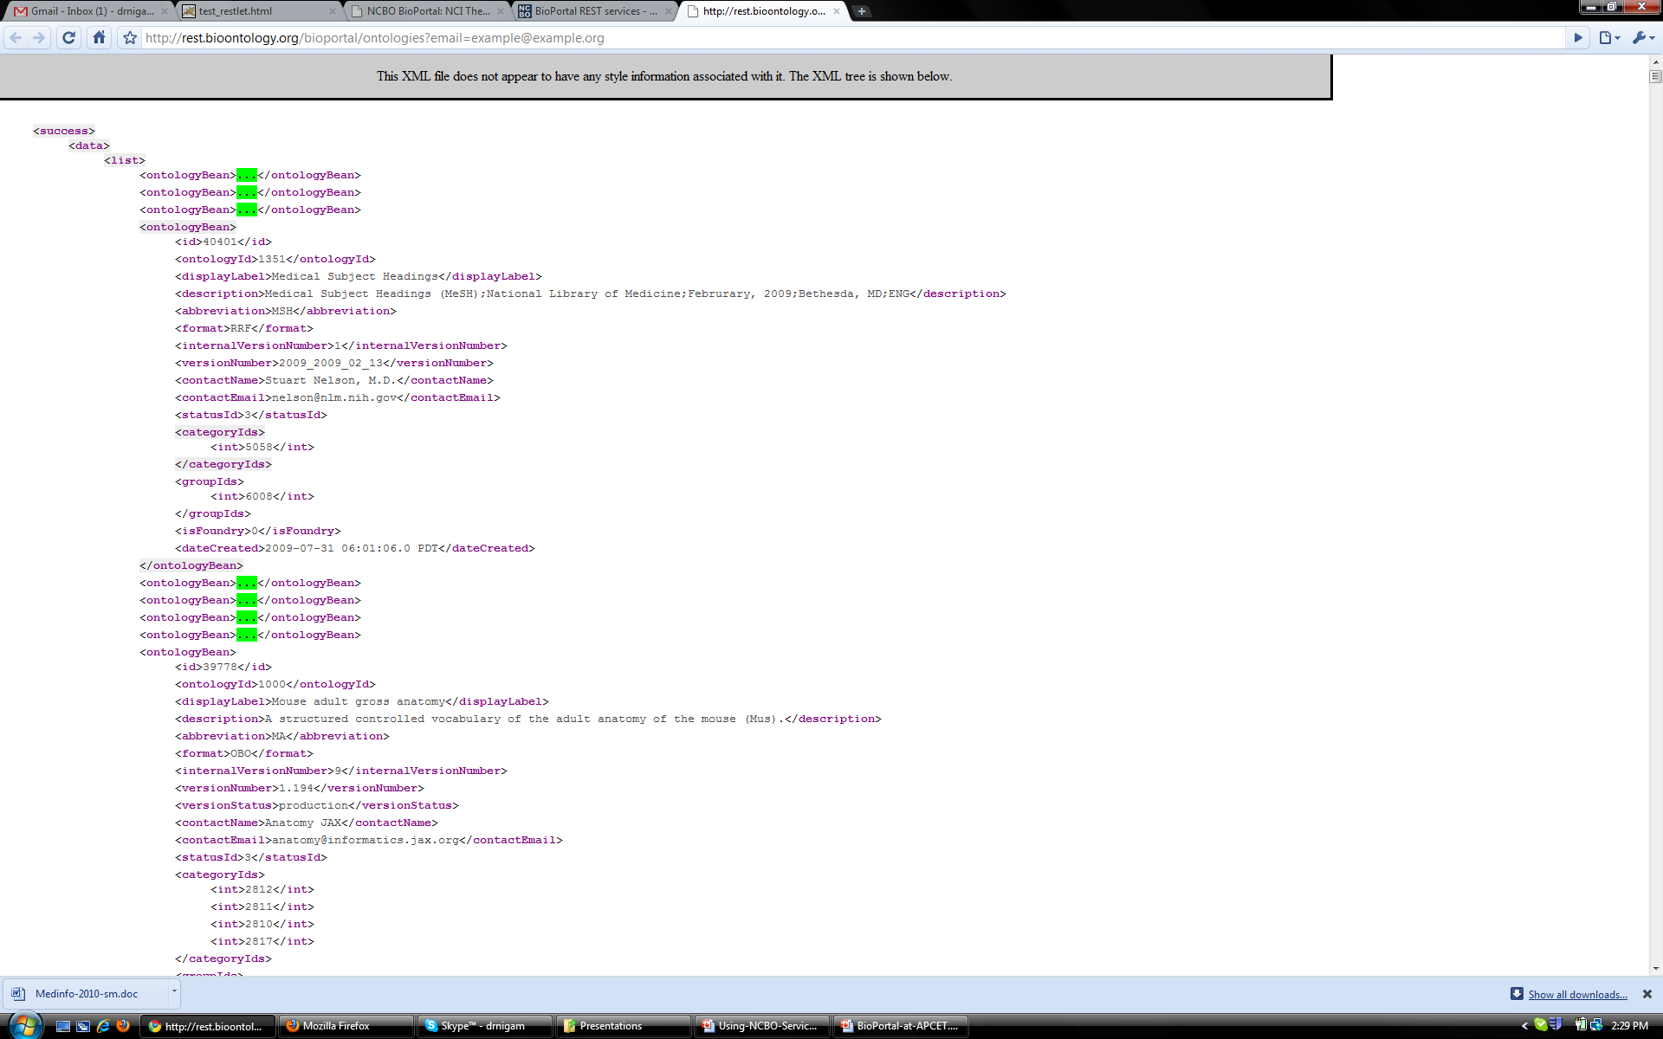
http://rest.bioontology.org/bioportal/ontologies

Slide 12
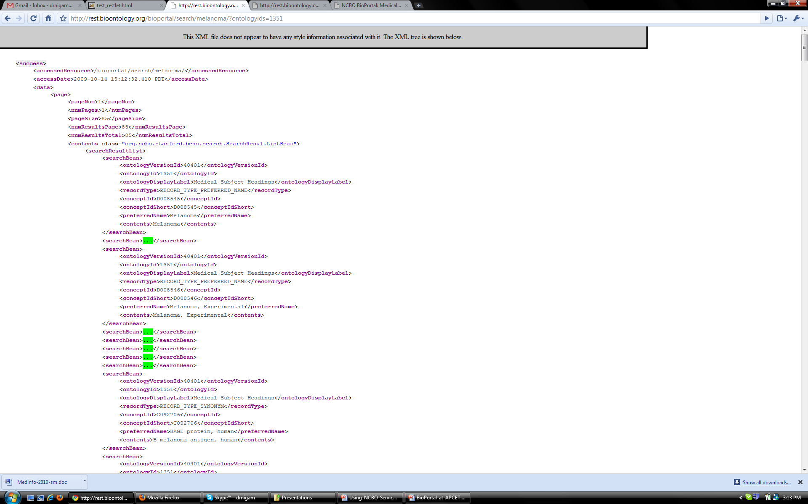
http://rest.bioontology.org/bioportal/search/melanoma/?ontologyids=1351

Slide 13
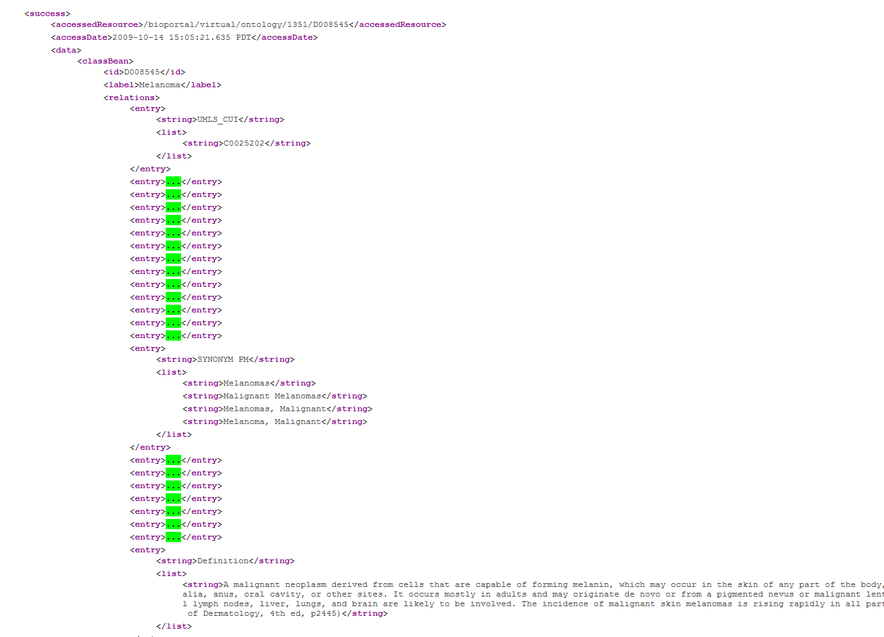
http://rest.bioontology.org/bioportal/virtual/ontology/1351/D008545

Slide 14
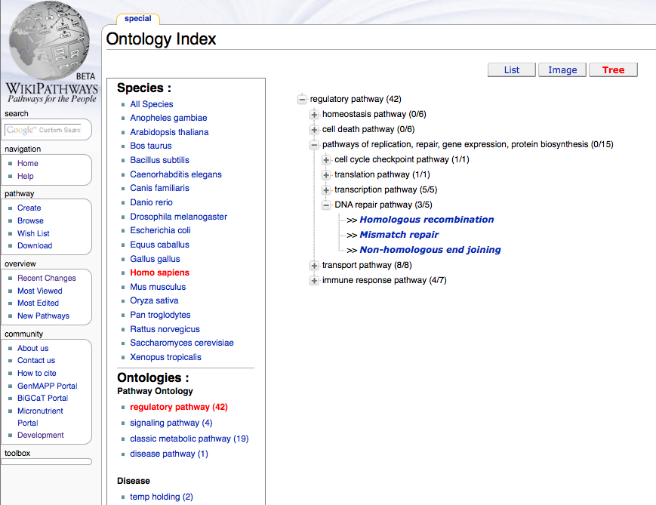
Wikipathways uses Ontology Services

Slide 15
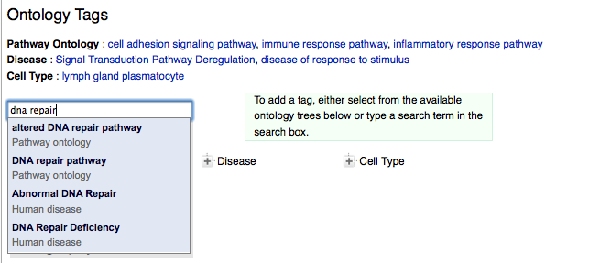
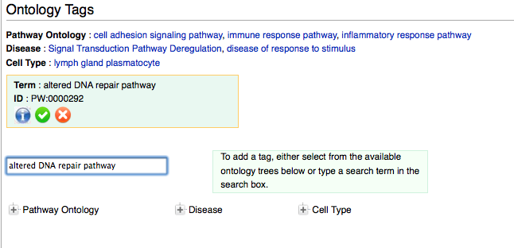

Slide 16
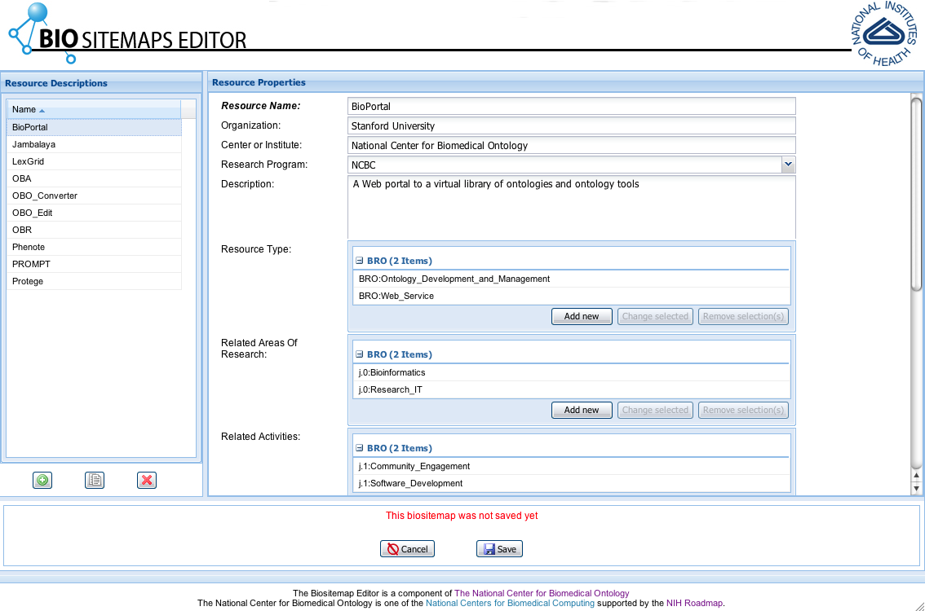
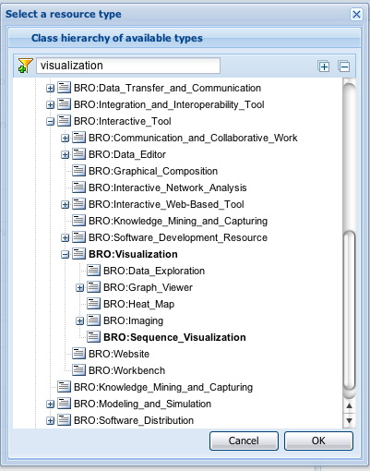
Biositemaps Editor
Notes:
16

Slide 17
Views
Custom subsets of large ontologies

Slide 18
Views and Value Sets
Users can contribute their derivatives of BioPortal ontologies,
which become first-class objects in BioPortal and can be used as all other ontologies are (e.g., as value sets)
Recently added: a view-extractor service
Enables users to extract a subtree of an ontology in OWL

Slide 19
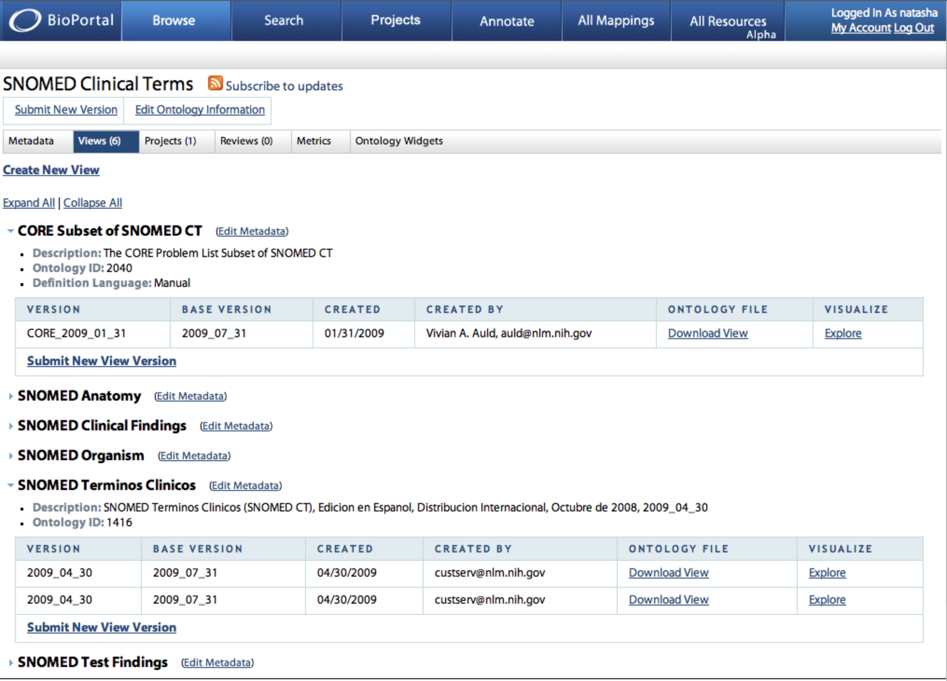
Views in BioPortal

Slide 20
Mappings
Using NCBO technology to integrate terminologies and ontologies

Slide 21
Mappings
Something

Slide 22
Widgets
Using NCBO technology on your web pages

Slide 23
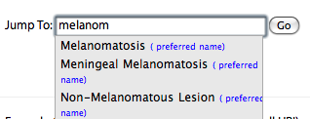
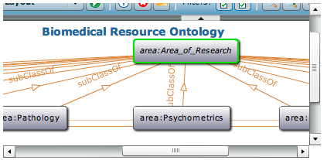
Ontology Widgets
UI components with “BioPortal inside”:
term-selection widget for a specific ontology
form fields with auto-complete from a specific BioPortal ontology
RSS feed for an ontology
Visualization widget
Tree widget

Slide 24
Annotator Service
Using Ontologies to Annotate Your Data

Slide 25
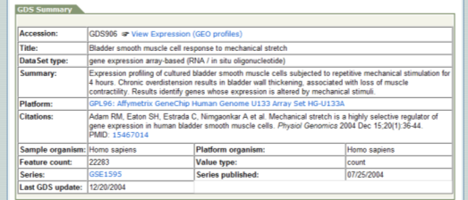
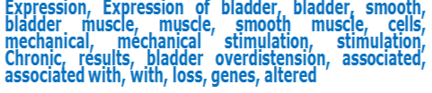
Annotation as a Web service
Process textual metadata to automatically tag text with as many ontology terms as possible.
Notes:
We want to process the text and assign “tags” to each element in public repositories.

Slide 26
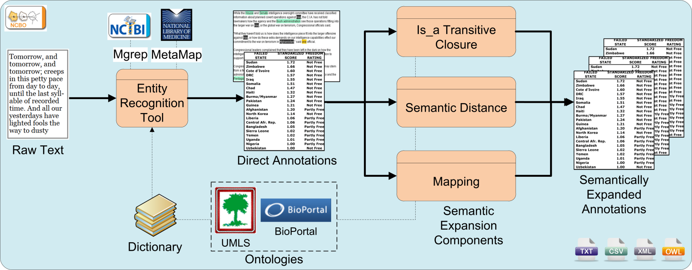
Annotator: workflow
“Melanoma is a malignant tumor of melanocytes which are found predominantly in skin but also in the bowel and the eye”.
39228/DOID:1909, Melanoma in Human Disease
Transitive closure
39228/DOID:191, Melanocytic neoplasm, direct parent of Melanoma in Human Disease
39228/DOID:0000818, cell proliferation disease, grand parent of Melanoma in Human Disease

Slide 27
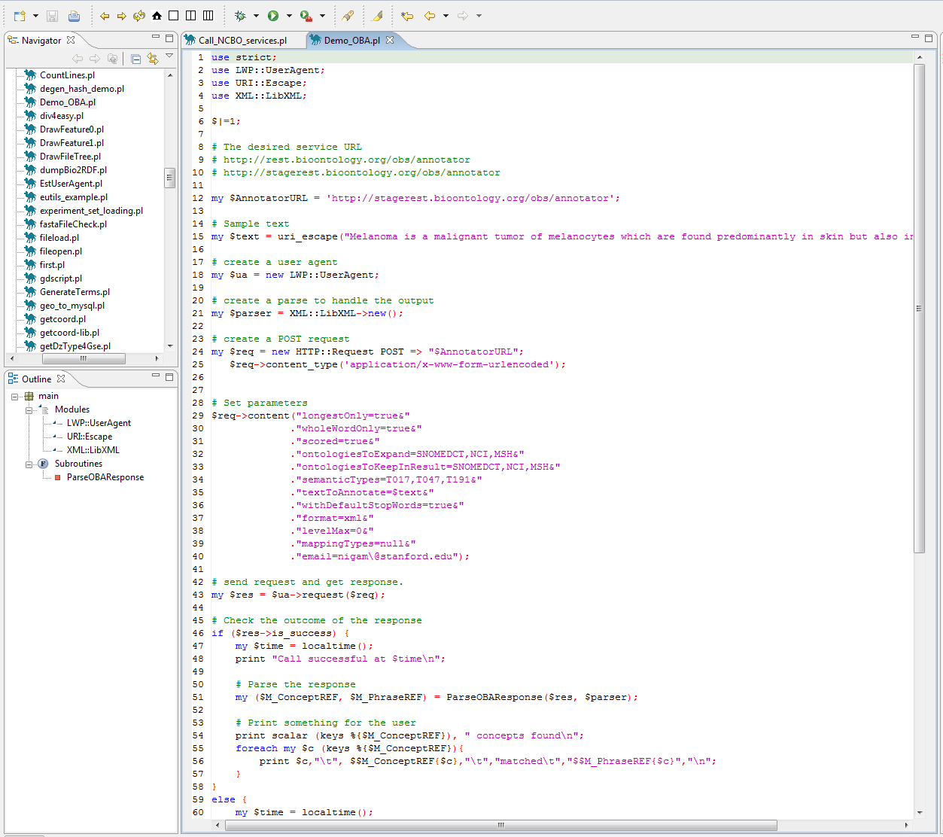
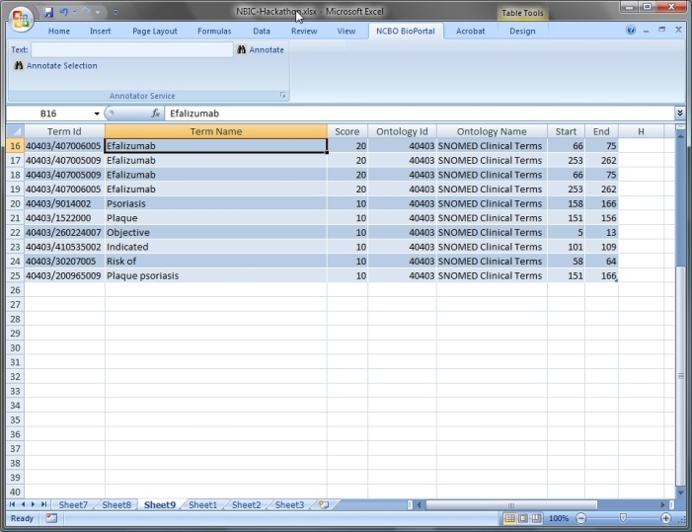
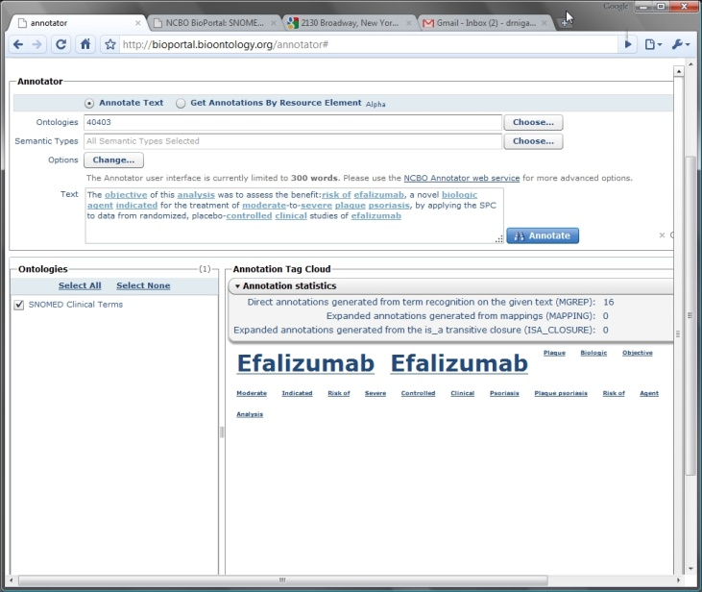
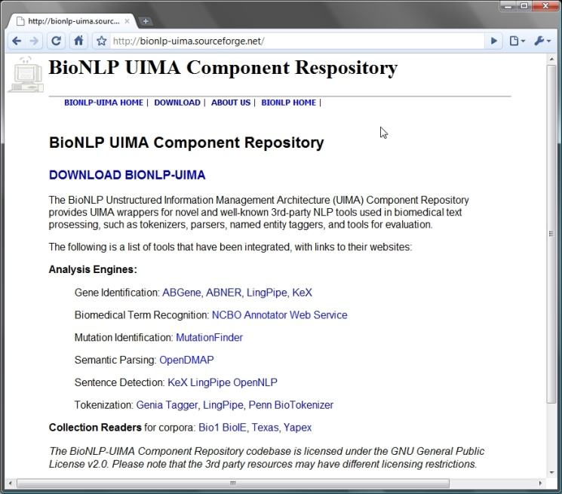
Multiple ways to access
Code
Excel
Word Add-in to call the Annotator Service
?
UIMA platform
Specific UI
Selected @ AMIA-TBI, Year in review
Annotator service
Notes:
Elsevier SciVerse
Karen Dowell, Jackson Lab
Shai-shen Orr, Mark Davis’s lab
Sean Mooney’s group
Ida Sim, UCSF
Simon Twigger, Medical college of Wisconsin
Nathan Baker, Washington Univ.
Amit Seth, Wright State Univ.
Neil Sarkar, University of Vermont
Larry Hunter, University of Colorado, Denver

Slide 28
Data Service
Using Ontologies to Access Public Data
Notes:
The screen shots I was showing you are the UI for a project called OBR at the NCBO. The Goal of the OBR project is to enable the use of ontologies to access public data at multiple levels of abstraction.

Slide 29
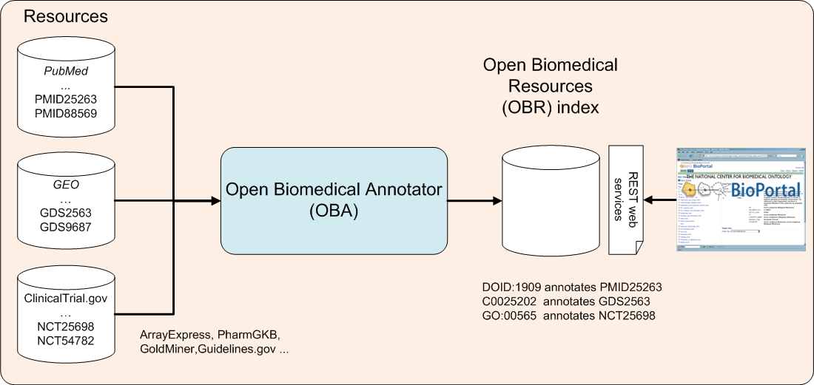
Resource index: The Basic Idea
The index can be used for:
Search
Data mining
Notes:
Search:
GEO has > 13 datasets on retroperitoneal tumors, none show up without an ontology based search!
- Did you know that GEO contains more public datasets on drug – gene expression information that Connectivity map?
Data mining:
- Extraction of Conditional Probabilities of the Relationships between Drugs, Diseases, and Genes from PubMed guided by relationships in PharmGKB in AMIA spring translational bioinformatics 2009.

Slide 30
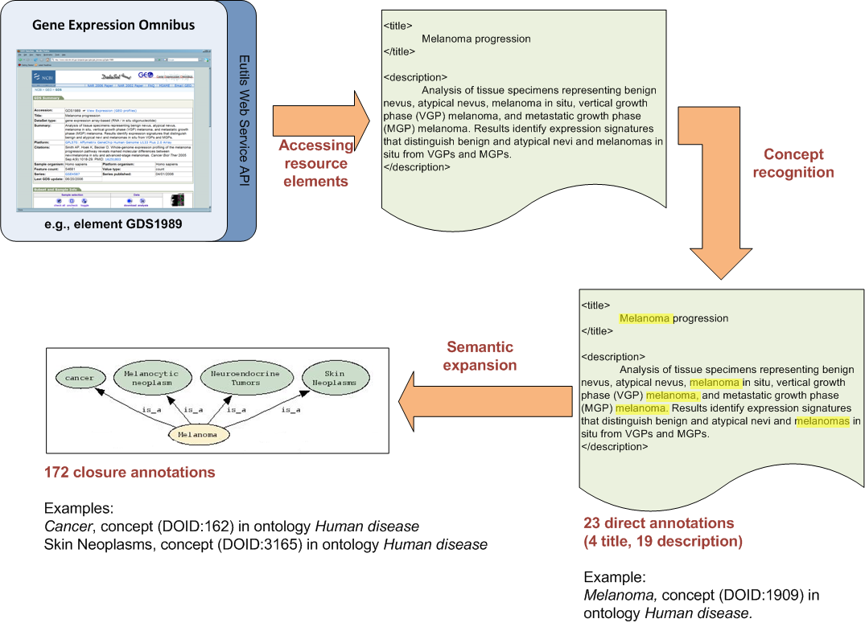

Resources index: Example
Notes:
Indexing an element from GEO. The GEO element GDS1989 is annotated according to its title and its description, as well as by the ontology elements that comprise the transitive closure over the parent–child relationships subsumed by the direct annotations.

Slide 31
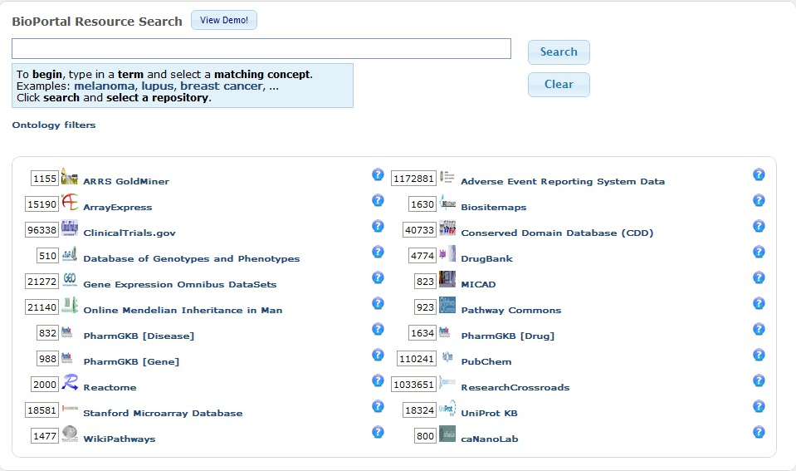
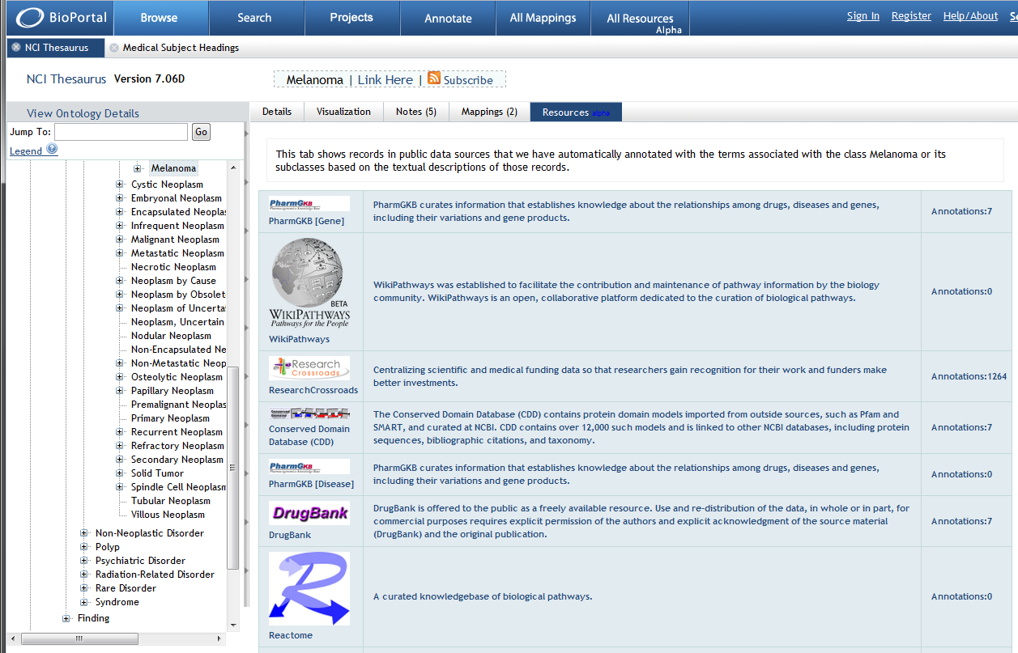
Multiple ways to access
Code
Resources annotated = 22
Total records = 3.5 million
Direct annotations = … million
After transitive closure = 16.4 Billion
Specific UI
Resource Tab
Resource Index

Slide 32

Credits
Mark Musen, PI
The team @ www.bioontology.org/project-team
NIH Roadmap grant U54 HG004028

