Slide 1


The Intersection of Game Engines & GPUs: Current & Future
2.5
Johan Andersson
Rendering Architect

Slide 2
Agenda
Goal
Share and discuss current & future graphics use cases in our games and implications for graphics hardware
Areas
Engine overview
Shaders
Parallelization
Texturing
Raytracing
GPU compute
Conclusions
Q & A
Notes:
Very big topic!
The last time I talked about these topics was with one of the IHVs and that lasted 12 hours straight, I will try to keep keep this a little bit shorter ☺
Coffe break aftwards, so the reprocussions for me rambling on for too long shouldn’t be too bad
Parallelization, multi-core dispatch

Slide 3


Frostbite
DICE proprietary engine
Xbox 360
PS3
Windows (Direct3D 10)
Focus
Large outdoor environments
Singleplayer & multiplayer
Destruction!
New: Content workflows
Notes:
Started developing in 2004 as a way to transition to the next-generation consoles, Xbox 360 and PS3.
BFBC pilot project. Release next week

Slide 4

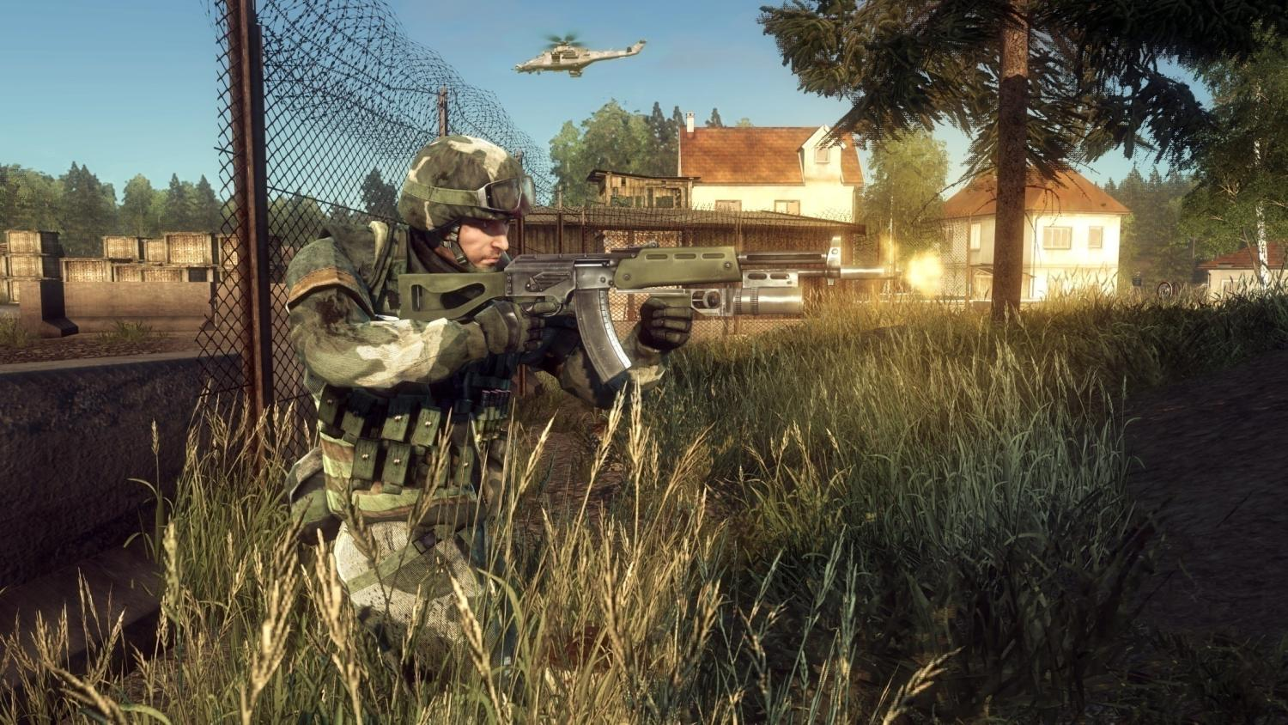
BFBC screenshot

Slide 5
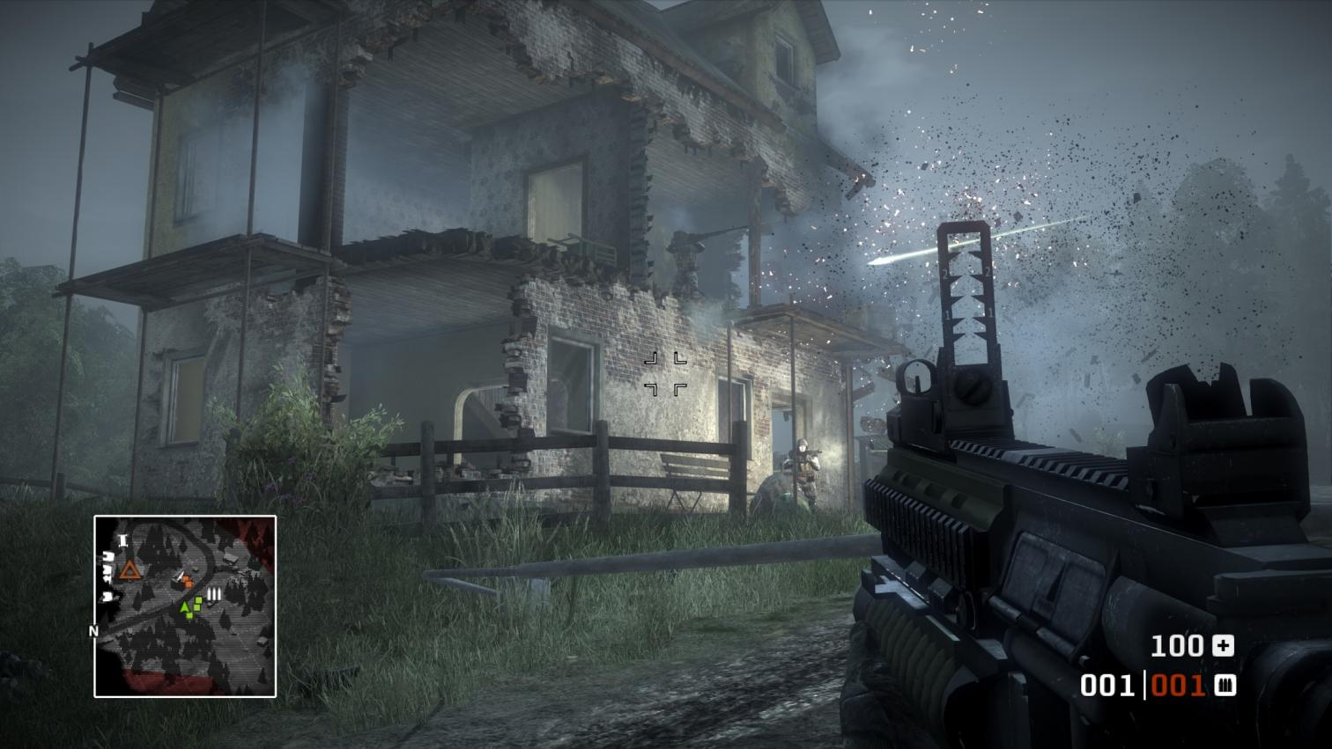
BFBC screenshot

Slide 6


Slide 7
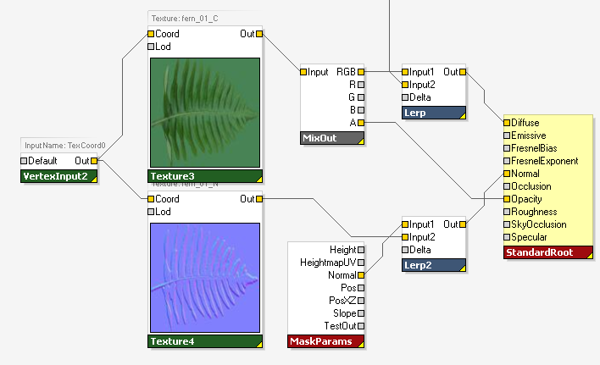
Graph-based surface shaders
Rich high-level shading framework
Used by all content & systems
Artist-friendly
Easy to create, tweak & manage
Flexible
Programmers & artists can extend & expose features
Data-centric
Encapsulates resources
Transformable
Notes:
Independent of lighting & environment
Rich data-centric control flow
No need to manually specialize shaders to enable/disable features
Calculations can be done on any level
Per-pixel, per-vertex, per-object, per-frame
Split to multiple passes

Slide 8
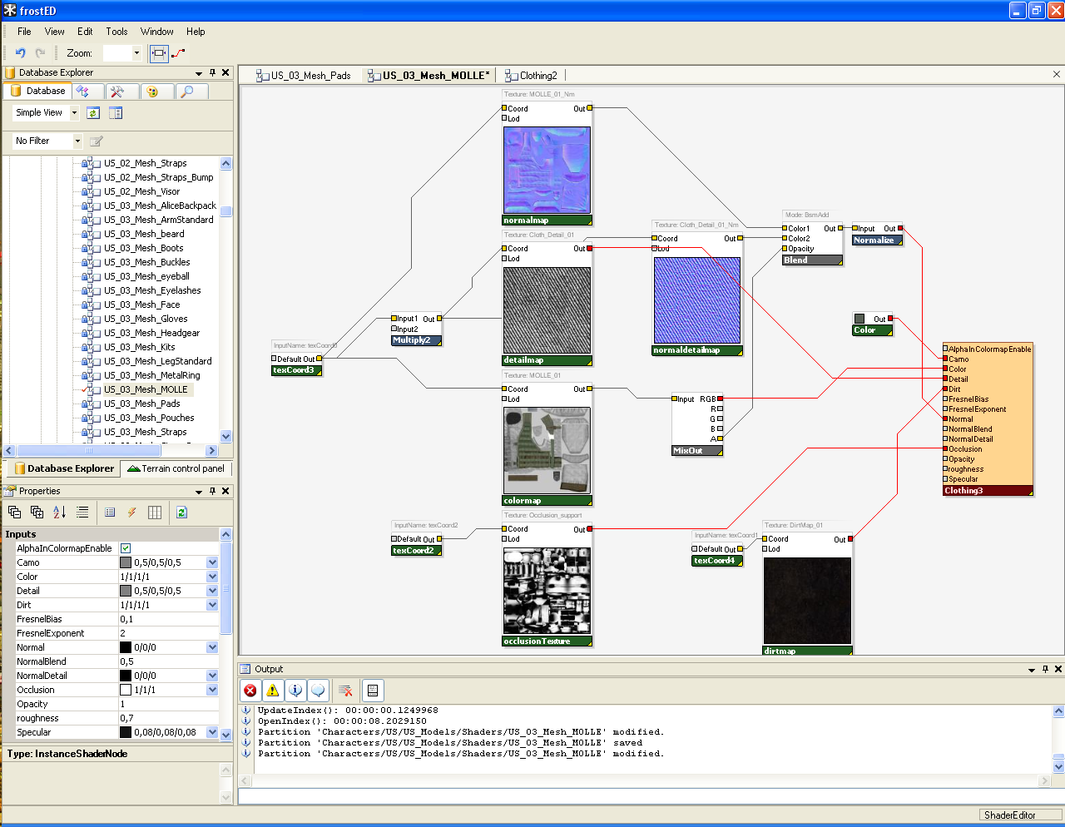

Slide 9
Shader permutations
Generate shader permutations
For each used combination of features/data
HLSL vertex & pixel shaders
Many features = permutation explosion
Shader graphs, lighting, geometry
Balance perf. vs permutations vs features
Dynamic branching
Live with many permutations

Slide 10
Shader subroutines
Next step: Static subroutine linking
Inline in all subroutines at call site
Similar to a switch statement
Reduces # permutations
Implementation moved to driver or GPU
Doesn’t work with instancing
Future step: Dynamic subroutines
Control function pointers inside shader
Problem solved, but coherency important
Notes:
Static:
Virtual call to evaluateLighting
Select linking of shader before draw call
Seperate fog and lighting permutations
Dynamic subroutines:
Direct connection with our instanced shader graph
Good coherency for good performance
Use cases: Vary per instance, texel, and more.

Slide 11
Rendering & Parallelization
Notes:
Waterfall:
Client game -> cull -> visible entity -> render primitive -> system -> shader backend

Slide 12
Jobs
Must utilize multi-core
6 HW threads on Xbox 360
6 SPUs on PS3
2-8 cores on PC
Job definition
Fully independent stateless function
PS3 SPU requirement
Graph dependencies
Task-parallel and data-parallel
Notes:
Better code structure!
Gustafson’s Law
Fixed 33 ms/f

Slide 13
Rendering jobs
Refactor rendering systems to jobs
Most will move to GPU
Eventually
One-way data flow
Compute shaders & stream output
Jobs
Decal projection
Particle simulation
Terrain geometry processing
Undergrowth generation [2]
Frustum culling
Occlusion culling
Command buffer generation
PS3: Triangle culling
Notes:
Divided up all the different rendering systems into individual parallelizable jobs
Jobs: functions, standalone
One-way data flow, CPU to GPU and not back.
Decal projection GS & stream out

Slide 14
Parallel command buffer recording
Dispatch draw calls and state to multiple command buffers in parallel
Scales linearly with # cores
1500-4000 draw calls per frame
Super-important for all platforms, used on:
Xbox 360
PS3 (SPU-based)
No support in DX10!
Notes:
One of the first optimizations for multi-core that we did was to move all rendering dispatch to a seperate thread. This includes all the draw calls and states that we set to D3D.
This helps a lot but it doesn’t scale that well as we only utilize a single extra core.
Gather

Slide 15
DX10 parallel command buffer rec.
Single most important DX10 issue
For us and many others (in the future)
Until future API support
Reduce draw calls with instancing
Trade GPU performance for CPU performance
Reduce state & constant updates
Slow dynamic constant path ☹
Manual software command buffers
Difficult to update dynamic resources efficiently in parallel due to API
Notes:
20 ms DX10 dispatch for 2000 draw calls
Semi-static constant buffer pain
Constant buffer as resource

Slide 16
PS3 geometry processing (1/2)
Slow GPU triangle & vertex setup
Unique situation with ”free” processors
Not fully utilized
Solution: SPU triangle culling
Trade SPU time for GPU performance
Cull back faces, micro-triangles, frustum
Sony PS3 EDGE library
5 jobs processes frame geometry in parallel
Output is new index buffer for each draw call
Notes:
Only visible triangles

Slide 17
PS3 geometry processing (2/2)
Great flexibility and programmability!
Custom processing
Partition bounding box culling
Triangle part culling
Clip plane triangle trivial accept & reject
Triangle cull volumes (inverse clip planes)
Future: No vertex & geometry shaders
DIY compute shaders with fixed-func tesselation and triangle setup units
Output buffer streaming still important
Notes:
Initially very skeptical
Intrinsics problematic

Slide 18
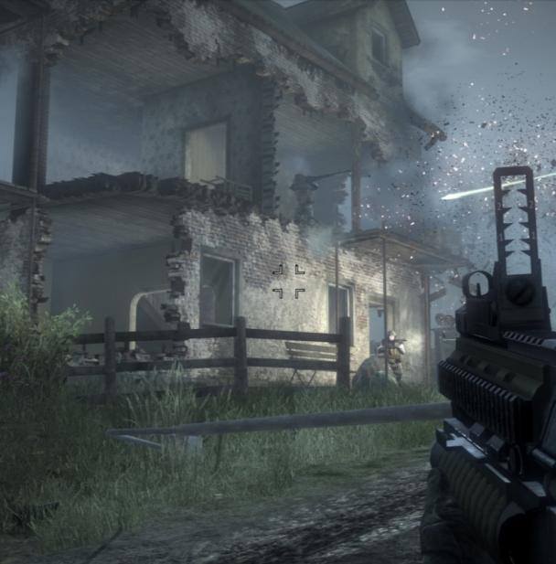
Occlusion culling
Buildings occlude objects
Tons of objects
Difficult to implement
Building destruction
Dynamic occludees
Heavy GPU occlusion queries
Invisible objects still have to
Update logic & animations
Generate command buffer
Processed on CPU & GPU

Slide 19
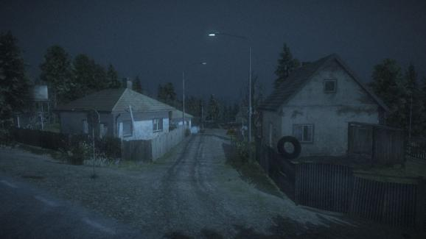
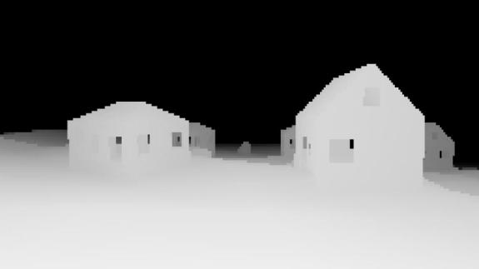
Software occlusion culling
Solution: Rasterize course zbuffer on SPU/CPU
Low-poly occluder meshes
100m view distance
Max 10000 vertices/frame
Manually conservative
256x114 float z-buffer
Created for PS3, now on all
Cull all objects against zbuffer
Before passed to all other systems = big savings
Screen-space bbox test
Notes:
Conservative

Slide 20
GPU occlusion culling
Want GPU rasterization & testing, but:
Occlusion queries introduces overhead & latency
Can be manageable, not ideal
Conditional rendering only helps GPU
Not CPU, frame memory or draw calls
Future1: Low-latency extra GPU exec context
Rasterization and testing done on GPU
Lockstep with CPU
Future2: Move entire cull & rendering to GPU
Scene graph, cull, systems, dispatch. End goal.
Notes:
Want to rasterize on GPU, not CPU ☺
CPU ⇔ GPU job dependencies

Slide 21
Texturing

Slide 22

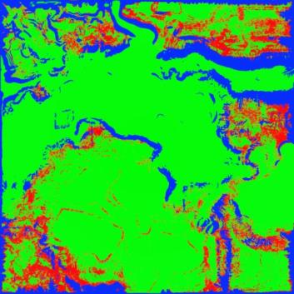
Texture formats
Using
DXT1/5 color maps, sRGB
BC5 (3Dc) normal maps
BC4 (DXT5A) for grayscale masks
sRGB support for BC4/5 would be nice
DXT1 replacement needed
Low quality
565 color bleeding
RG/RGB masks compresses badly
HDR envmaps & lightmaps
DXT color bleed
RGB DXT1 mask
Notes:
BC4/5 sRGB for orthogonality and grayscale colormaps
Color bleeding on upsampling, lowres colormaps
Transcode BC7 to DXT1 on low-spec
HDR format, BC6?
Not using RGBE yet

Slide 23

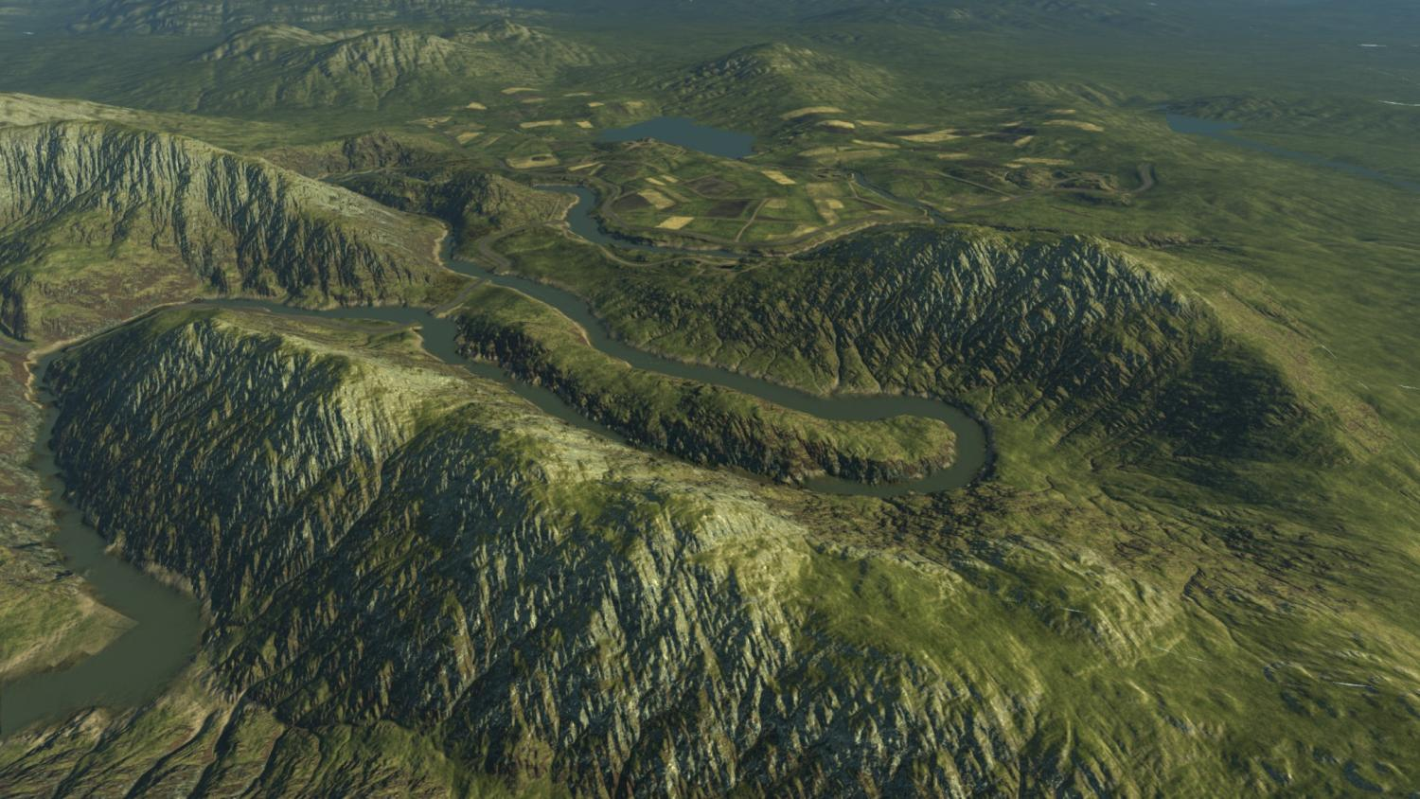

Slide 24
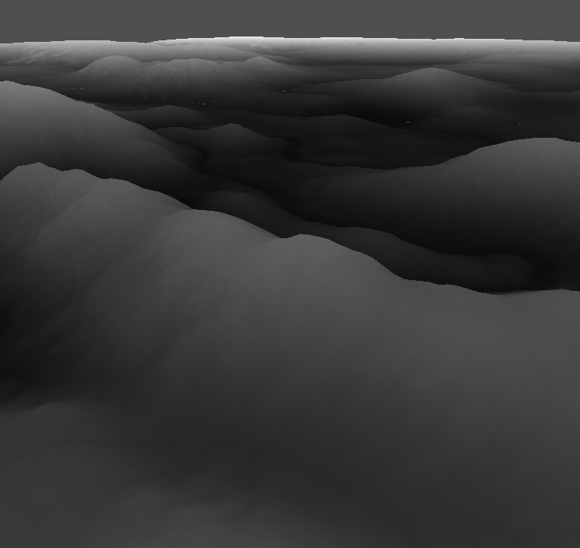
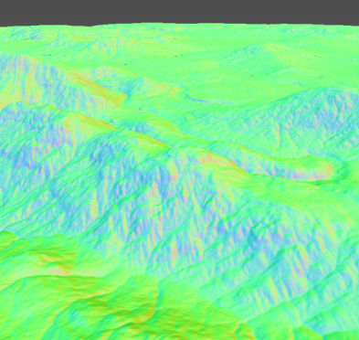
Future texture sampling
Texture sampling derivatives
1st order texel derivatives
2nd order as well?
Implement in sampler unit
Bad performance or quality with shader sampling
Artifacts with ddx/ddy technique
Replace normalmaps with easily compressed bumpmaps
Bicubic upsampling
Terrain masks
Terrain heightmap
Derived normals [2]
Notes:
When it comes to the texture samplers on the GPUs, that is one fixed function unit that I would actually want to extend some more.
The terrain geometry in Frostbite is represented as an 16-bit integer heightfield to be able to easily support destruction, where we can just render into to heightfield.
To light the terrain correctly we
C1 continuity
Shader sampling vs sampler HW: What matters to us is performance

Slide 26
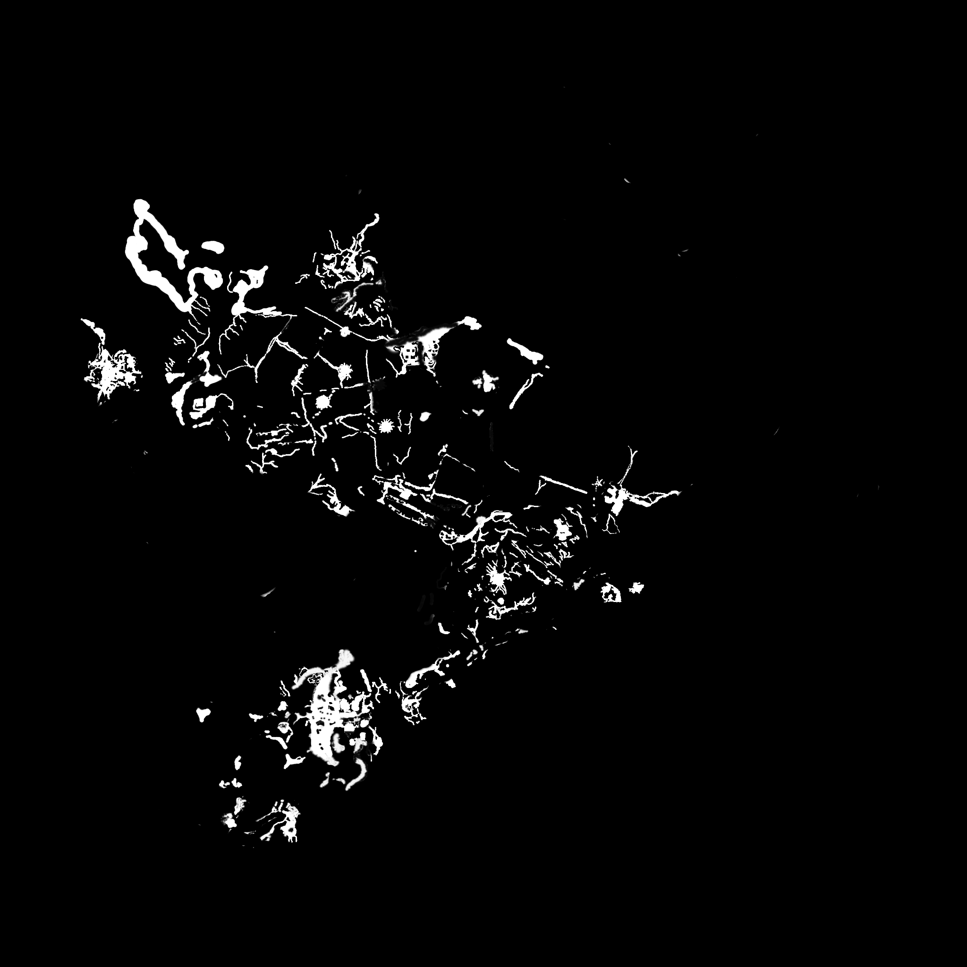
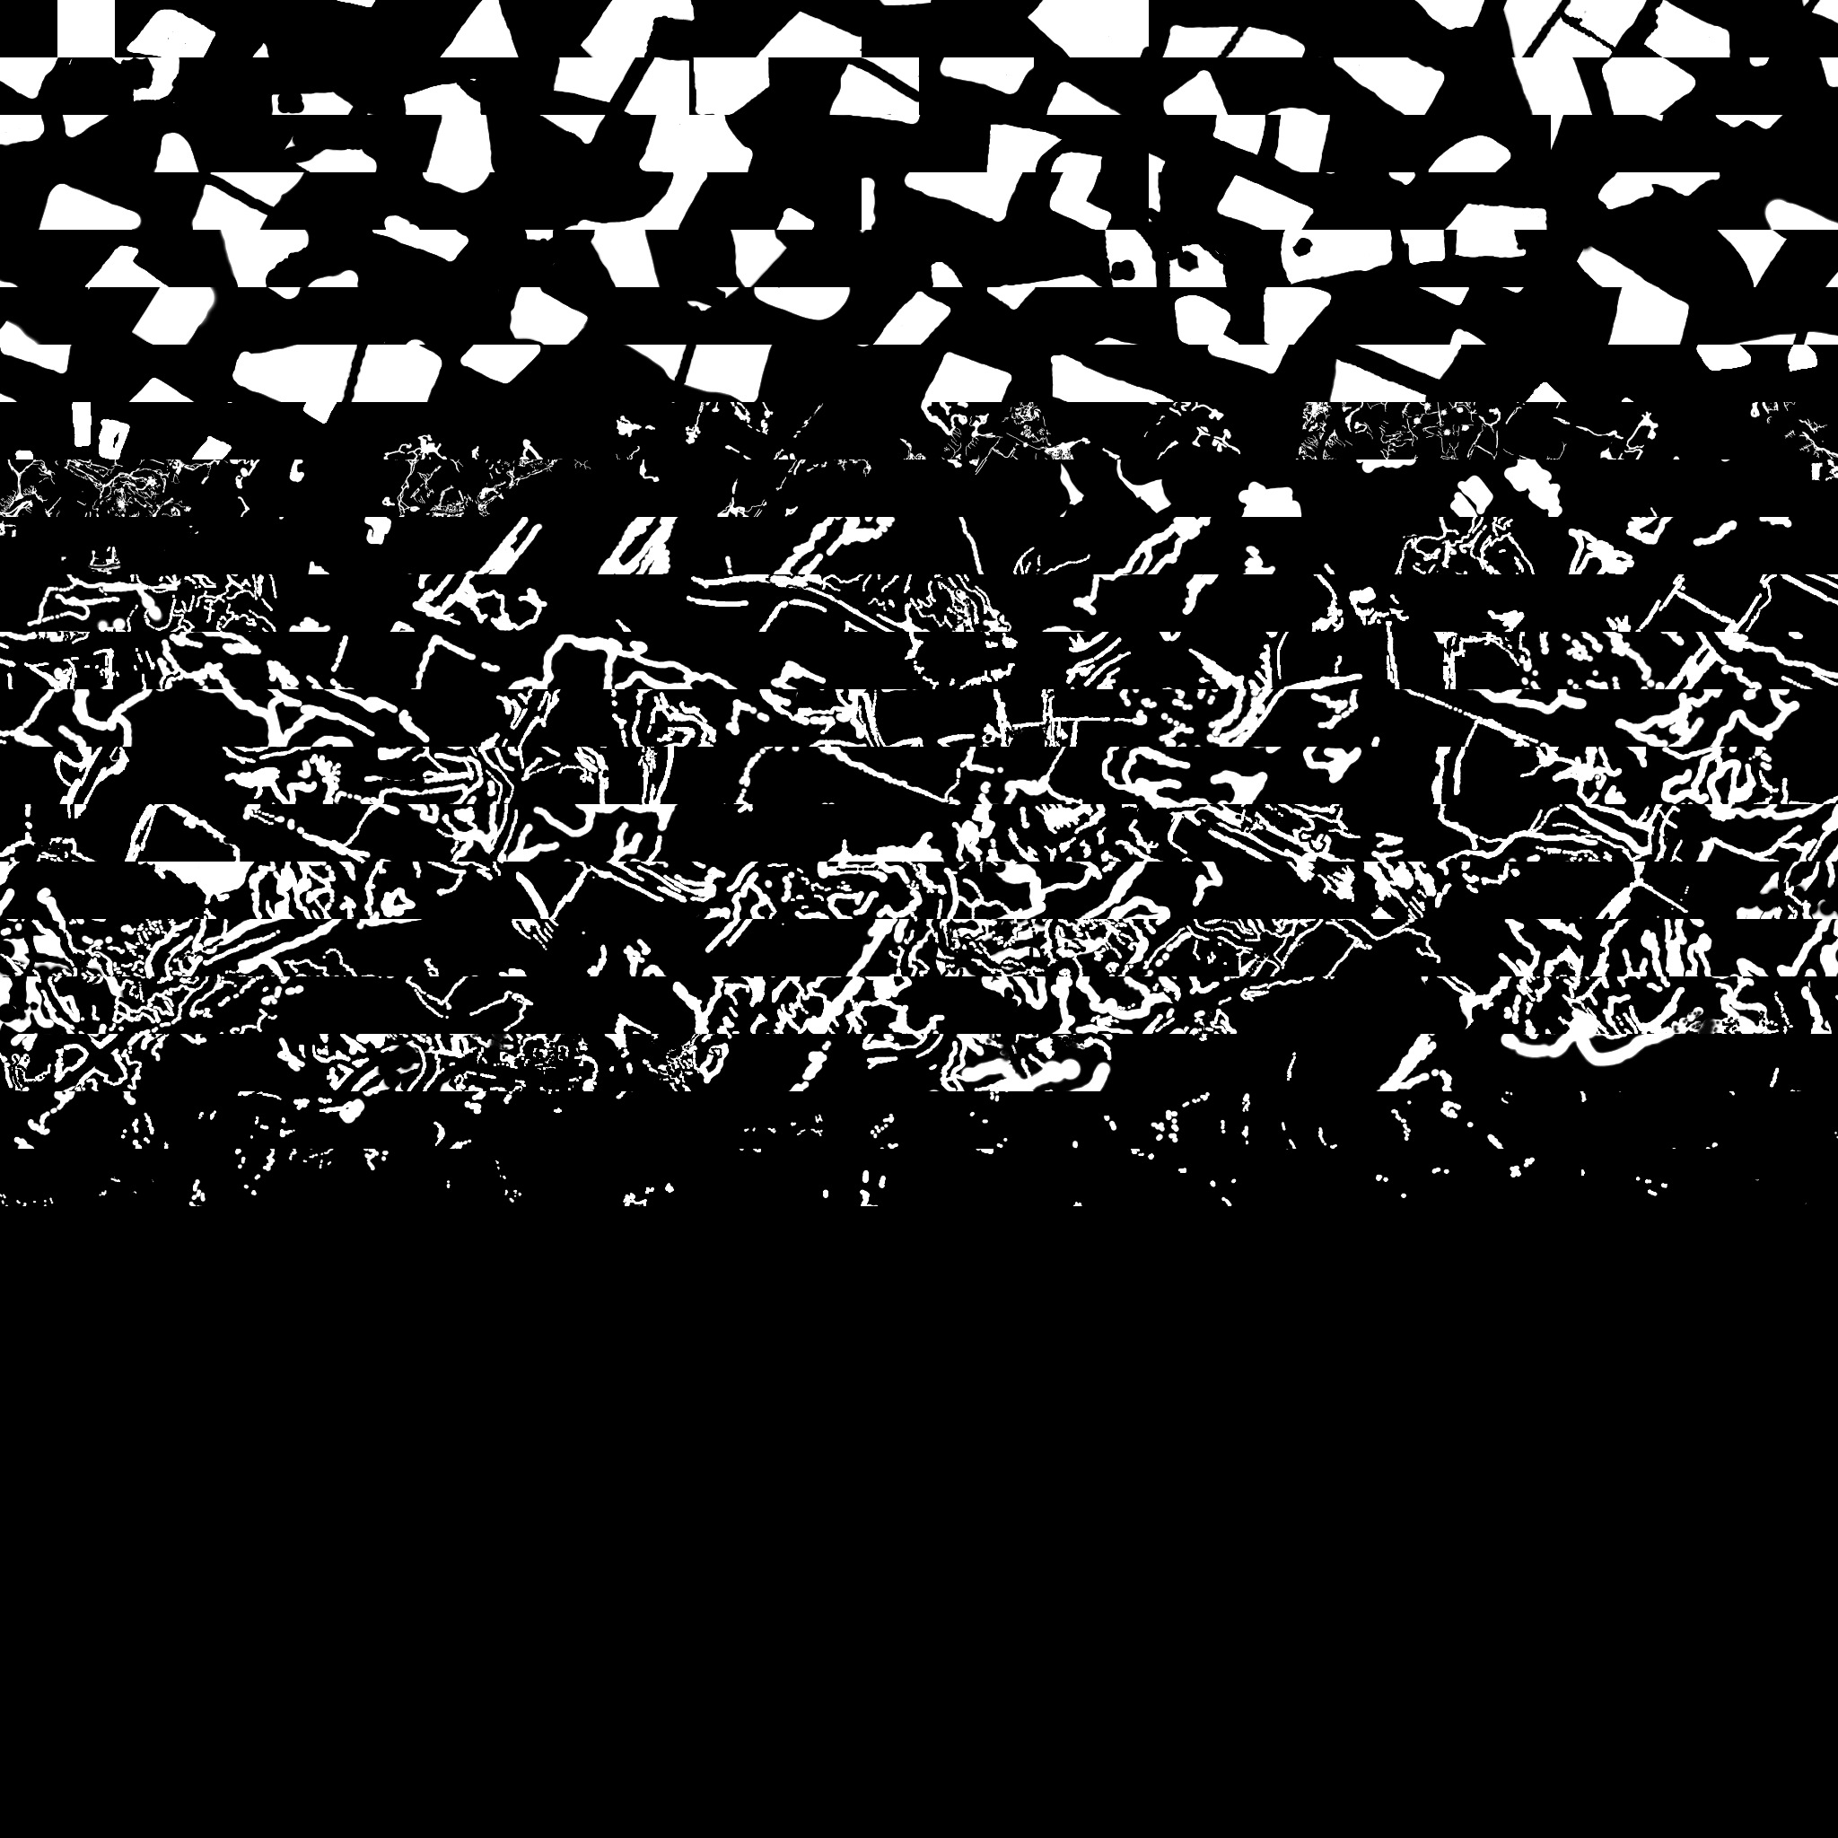
Current sparse textures
Save memory for terrain
Static quadtree mask texture
Dynamic sparse destruction mask
Implementation
Indirection texture lookup in atlas
Arrays too small, want 8192 slices
Correct bilinear filtering by borders
Siggraph’07 course for details [2]
Source mask
Atlas texture
Notes:
Atlas, texture arrays to small

Slide 27
HW sparse textures
Virtual texture
HW texture filtering & mipmapping
Fallback on non-resident tile access
Lower mipmap, default value or shader bool
At least 32k x 32k, fp issues with larger?
Application-controlled tile commit/free
~128 x 128 tiles
Feedback mechanism for referenced tiles
Easy view-dependent allocation
Future: Latency-free allocation & generation
Alt1. CPU thread callback & block
Alt2. Keep everything on GPU. ”Command” shader?
Notes:
GPU control = No frame latency

Slide 28
Cached Procedural Unique Texturing
Unique dynamic sparse texture on all objects
Defined by texture shader graph
Combine procedurals, compositing, streaming and uv-space geometry
Dynamically commit & render visible tiles
Highly complex compositing
Thanks to high frame-to-frame coherency
Upsample and refine
New dynamic effects made possible
Affect every surface
Notes:
Motivation
Superset of Megatexture
Affect surfaces with destruction, decals, paint in uv-space

Slide 29
Raytracing

Slide 30
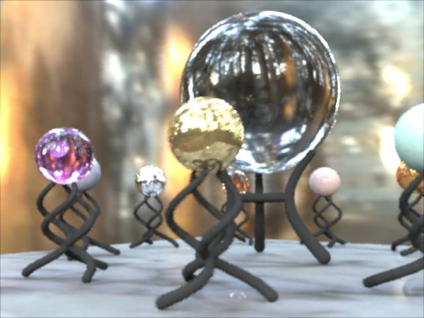
Raytracing
Much recent debate & interest in RTRT
What we are interested in:
Performance!!
Rasterization for primary rays
Deterministic
Easy integration into engines
Just another method for certain effects & objects
Not replace whole pipeline
Efficient dynamic geometry
Procedural & manual animation (foliage, characters)
Destruction (foliage, buildings, objects)
Notes:
Middleware?
Going in the direction of having more and more dynamic geometry.

Slide 31

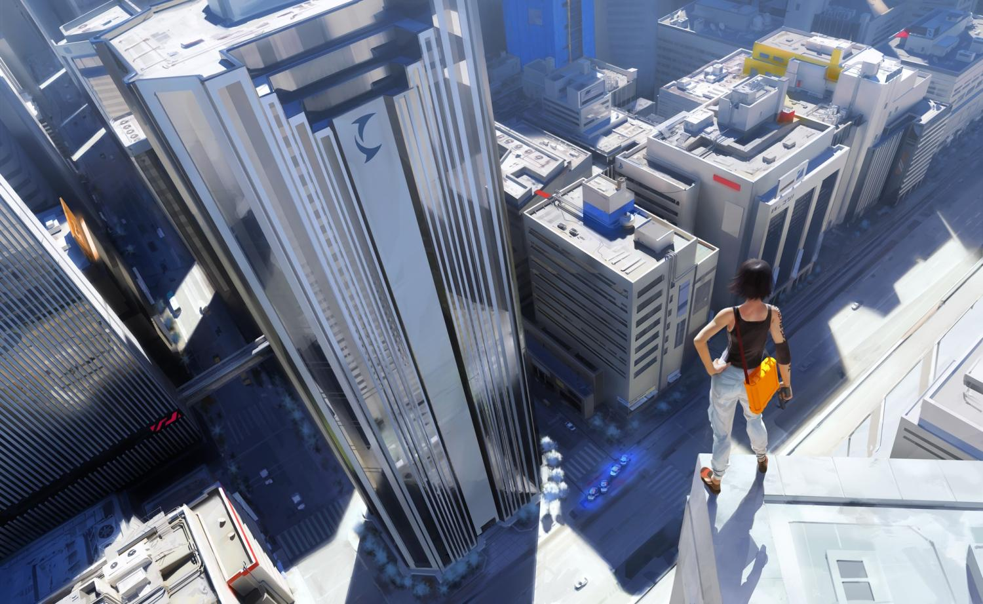
Mirror’s Edge

Slide 32
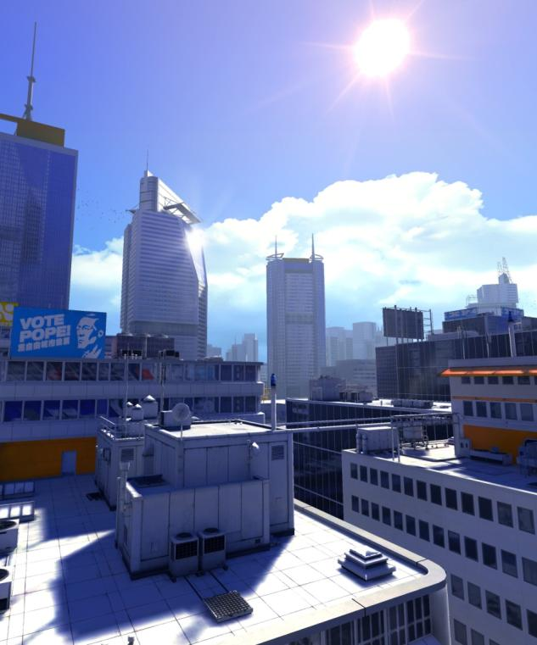
Raytraced reflections wanted
Glass & metal
Mostly planar surfaces
Reflection locality
Correct reflections for important objects
Main character
Simplified world geometry & shading for rest
Common for games
Brickmaps? [3]
Notes:
Cars not so important
Ratatouiie

Slide 33
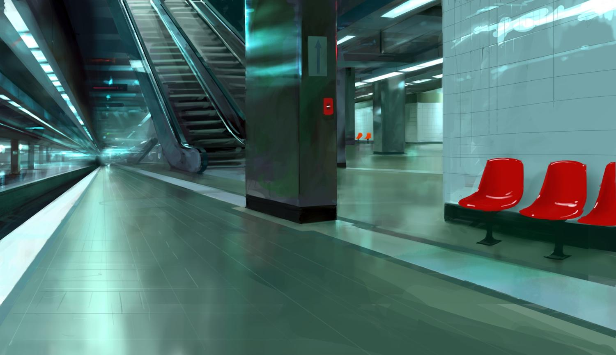
Mirror’s Edge
Soft reflections
Notes:
Soft reflections for floors & metal surfaces
Generally more useful than sharp reflections

Slide 34
GPGPU

Slide 35
GPGPU uses
Effect physics
Particle vs world soft collision
AI pathfinding
AI visibility
View rasterization. Obstruction from smoke & foliage
Procedural animation
Trees, undergrowth, hair
Post-processing

Slide 36
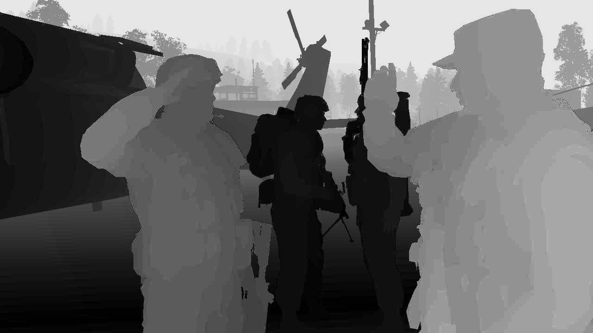
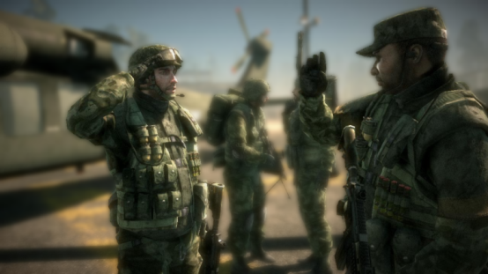
CUDA DOF post-process filter
Thesis work at DICE [4]
Test CUDA and performance
Poisson disc blur
Multi-passed diffusion
Seperable diffusion
Good:
Easy to learn (C)
Map complex algorithms
Thread & memory control
Bad:
Performance vs shaders
Beta interop
Vendor-specific
Circle of confusion map
Output

Slide 37
GPU Compute programming model
Wanted:
Easy & efficient Direct3D 10 interop
Low-latency Compute tasks
Vendor-independent base interface
OpenCL?
Efficient CPU multi-core backend
Server, older GPUs, debugging
MCUDA [5]
Eventually platform-independent
Future consoles
Notes:
Mipmapping?

Slide 38
Conclusions
Shader subroutines
More software-controlled pipeline
More texture sampler functionality
Limited-case raytracing
GPU compute for games

Slide 39
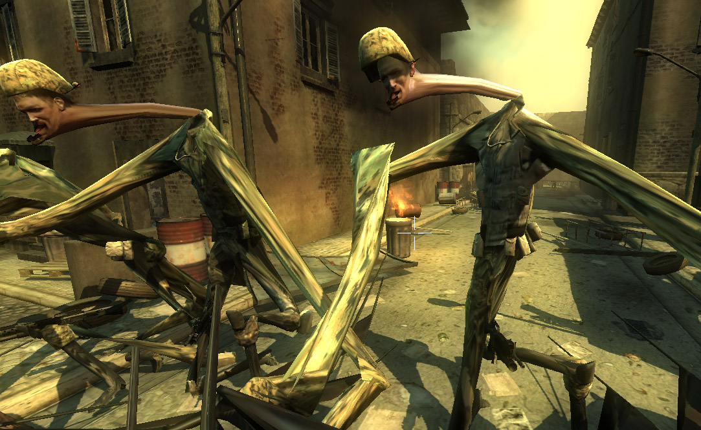
Questions?
Contact: johan.andersson@dice.se

Slide 40
References
[1] Tartarchuk, Natasha & Andersson, Johan. ”Rendering Architecture and Real-time Procedural Shading & Texturing Techniques”. GDC 2007. Link
[2] Andersson, Johan. ”Terrain Rendering in Frostbite using Procedural Shader Splatting”. Siggraph 2007. Link
[3] Christensen, Per H. & Batali, Dana. "An Irradiance Atlas for Global Illumination in Complex Production Scenes“. Eurographics Symposium on Rendering 2004. Link
[4] Lonroth, Per & Unger, Mattias. ”Advanced Real-time Post-Processing using GPGPU techniques”. Master thesis, 2008.
[5] John Stratton, Sam Stone, Wen-mei Hwu. "MCUDA: An Efficient Implementation of CUDA Kernels on Multi-cores". Technical report, University of Illinois at Urbana-Champaign, IMPACT-08-01, March, 2008.

Slide 41
Bonus slides

Slide 42
Real-time REYES
Very interesting
Displacement mapping & procedurals
Stochastic sampling
Potentially more efficient & general
Compared to maxed out rasterization & tessellation on everything = pixel-sized triangles
But
No experience
More research & experimentation needed

Slide 43
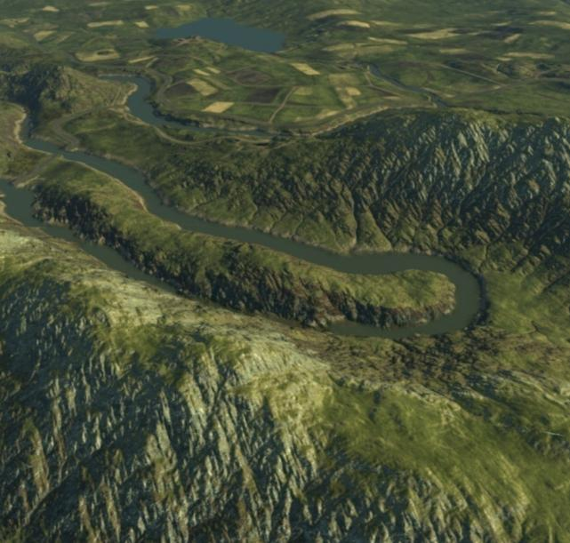
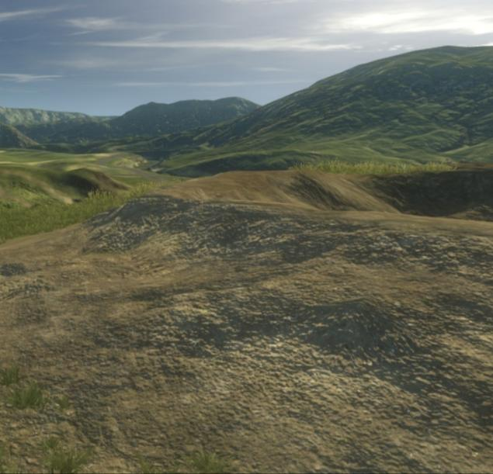
Terrain detail
Deriving normal from heightfield good in distance
Future: HW tessellation & procedural displacement shaders for up close ground detail

Slide 44
Texture arrays
Use cases:
Everything!
Rich parameterized shaders
Vary slice index per instance, triangle or texel
Instancing without comprimising on variation or perf.
Cascaded shadow maps
HW PCF only in DX 10.1 ☹
Stable Cascaded Bounding Box Shadow Maps
Sparse textures
More slices plz
For tile pools. 64x64x8192
Notes:
Tiling
Merge shaders, single brdf

Slide 45
Other raytracing uses
Global Illumination & Ambient Occlusion
Incremental Photon Mapping?
Async collision raycasts
AI pathfinding, gameplay, sound obstruction
Seperate collision world from visual world
CPU job-based now
Notes:
Semi-static environment with destruction

