Slide 1

China-North America Collaboration on Chinese Rare Book Digitization and Metadata Sharing:
East Asian Libraries in North America
Annual Meeting of the Council on East Asian Libraries Hawaii, March 30, 2011
Franklin Odo, Ph.D.
Chief
Asian Division, Library of Congress
202-707-5919, fodo@loc.gov
Anchi Hoh, Ph.D.
Assistant Chief
Asian Division, Library of Congress
202-707-5673, adia@loc.gov
†††eScience @ LoC Team (eST)
The Library of Congress
Washington, D.C.
1
Notes:
1

Slide 2
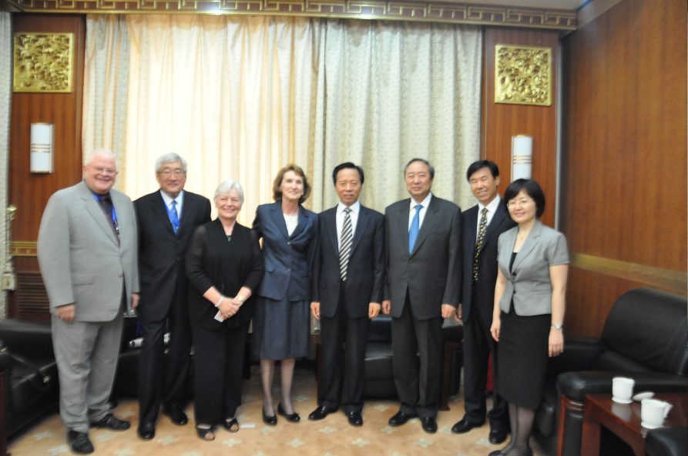
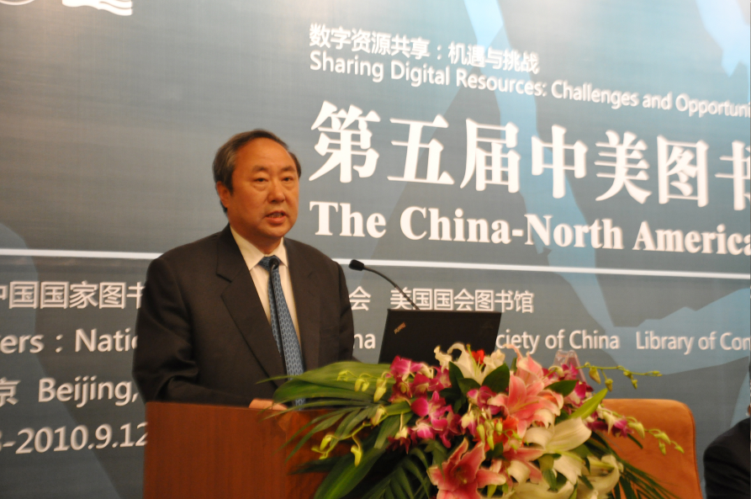
China-North America Library Conference
The Fifth China-North America Library Conference in Beijing, China, September 2010, aimed to identify post-conference initiatives that are mutually beneficial.
2

Slide 3
Current North America Organizing Committee
Members
Deanna Marcum
Associate Librarian for Library Services
Library of Congress
James K. M. Cheng
Librarian
Harvard-Yenching Library of the Harvard College Library
Harvard University
Sayeed Choudhury
Associate Dean for Library Digital Programs and Hodson Director of the Digital Research and Curation Center
Eisenhower Libraries
Johns Hopkins University
Jay Jordan
President and Chief Executive Officer
OCLC
Haipeng Li
University Librarian
Au Shue Hung Memorial Library
Hong Kong Baptist University
Ingrid T. Parent
University Librarian
Office of the University Librarian
University of British Columbia
Gary E. Strong
University Librarian
University of California, Los Angeles

Slide 4
Current North America Organizing Committee
Members (Cont’d)
Betsy Wilson
Dean of University Libraries
University of Washington Libraries
Peter R. Young
Former Director, National Agricultural Library
Former Chief, Asian Division
Library of Congress
Sha Li Zhang
Assistant Dean for Collections and Technical Services
University of North Carolina at Greensboro
Ethan Zuckerman
Berkman Fellow & Technologist
Global Voices
Senior Advisors
Franklin Odo
Chief, Asian Division, Library of Congress
Anchi Hoh
Assistant Chief
Asian Division
Library of Congress

Slide 5
PURPOSE
The China and North America Organizing Committees jointly identified a post-conference initiative:
“China-North America Collaboration on Chinese Rare Book Digitization and Metadata Sharing.”

Slide 6
PROJECT PROPOSAL
Project Goal:
- Through the assistance and collaboration of rare book subject experts and repository technology experts in China and North America, to create a national digital repository of the comprehensive holdings of Chinese rare books among the East Asian libraries in North America.
6

Slide 7
COLLABORATION
To achieve this goal, this project calls for a broad collaboration among the East Asian libraries in North America.
7

Slide 8
INVITATIONS TO 13 EAST ASIAN LIBRARIES IN NORTH AMERICA
Harvard-Yenching Library at Harvard University
Asian Division at the Library of Congress in Washington, D.C.
Gest Oriental Collection and East Asian Library at Princeton University
East Asian Library at the University of British Columbia
University of California, Berkeley
Columbia University
University of Toronto
Yale University
Cornell University
New York Public Library
University of Chicago
University of Washington
University of California, Los Angeles
Stanford University
other East Asian collections in North America that also hold Chinese rare books

Slide 9
DRAFT PROPOSAL
Initial progressive implementation plan that consists of at least the following two phases:
Phase I
Conducting an online survey of the holdings of Chinese rare books among the thirteen East Asian collections in North America.
This survey will be able to inform the number of Chinese rare book titles that need cataloging and call for the assistance of subject experts in China.
9

Slide 10
DRAFT PROPOSAL
Phase II –
Identify a number of East Asian partnering libraries to convene an initial meeting and discuss collaboration. Discussion topics should include best practices, collaboration model, funding resources, cataloging solutions, metadata standards sharing, and other potential partners, etc.
This core group (library directors and key curators) will be invited by Dr. Marcum to convene a Steering Committee.

Slide 11
Steering Committee
Role and Responsibilities
Report to the North America Organizing Committee
Hold regular teleconferences to explore collaboration model and ensure steady progress; communicate via email and meetings
Using the current proposal, create project management documents, including scope, collaboration model, budget, funding, measures of success, roles and responsibilities, milestones, deliverables, risk assessment, work breakdown structure, communication plan, etc.
Design detailed implementation plans and involve all participating libraries in order to pursue the successful completion of the project.

Slide 12
NEXT STEPS
Undoubtedly, such broad-extent undertaking of the digital preservation of Asian cultural heritage across North America is unprecedented and requires extremely thorough planning and tireless pursuit. A number of institutions (including Cornell, OCLC, and UBC) have expressed their strong interest and support.
This project will be mutually beneficial not only for the East Asian libraries in North America and participating academic/research libraries in China, but also for the scholarly communities everywhere.
12

Slide 13
CONTACTS
Franklin Odo, Ph.D.
Chief
Asian Division, Library of Congress
202-707-5919, fodo@loc.gov
Anchi Hoh, Ph.D.
Assistant Chief
Asian Division, Library of Congress
202-707-5673, adia@loc.gov

Slide 14
Questions and Answers
Thank you.

