Slide 1
Cross-Site Scripting (XSS) Vulnerabilities
#hew08xss
Presented by
Paul Gilzow Web Communications
University of Missouri

Slide 2
SafeWEB
Division of IT initiative to increase awareness of the need to improve overall security for applications utilized at the University of Missouri-Columbia, with an emphasis on Web development and the systems upon which those applications reside or depend.
BPPM Chapter 13 Section 120
http://doit.missouri.edu/security/safeweb/

Slide 3
Data Classifications
The MU Data Classification System (DCS) consists of four levels with corresponding security requirements for each level
Level 1 : Public
Level 2 : Confidential
Level 3 : Restricted
Level 4 : National Security Interest

Slide 4
Application Registration
Application owners, developers and system administrators must register their custom and vended applications and ensure such systems meet the security requirements of the MU DCS.
The Division of IT uses the Application Registry to schedule applications for initial and ongoing security inspections.
https://doit.missouri.edu/security/applications/registry/

Slide 5
Security Audits
Really aren't that bad!
New Security Audit tool coming soon (2-3 weeks)
Code audit tool coming Q1 ’08
Contact Mike Morrison or anyone else at ISAM if you have questions

Slide 6
What is XSS
An Injection attack, usually in the form of
HTML Code
<img src=“javascript:attacker.site.js” />
Client-side scripts
<script src= “attacker.site.js” />
Exploits the trust a user has for a site
Usually an indication of a much larger problem

Slide 7
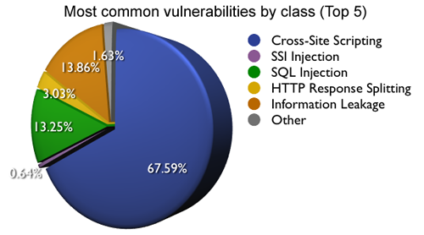
How Prevalent Is XSS? 2006
2006 Statistics (January 1 – December 31)
http://webappsec.org/projects/statistics/

Slide 8
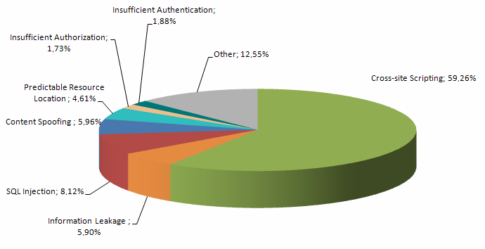
How Prevalent is XSS? 2007
The overall statistics includes analysis results of 32,717 sites and 69,476 vulnerabilities
2007 Statistics (January 1 – December 31)
http://webappsec.org/projects/statistics/

Slide 9
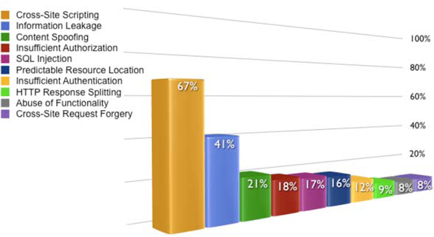

Slide 10
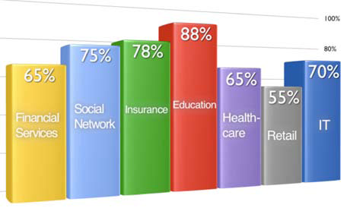
How prevalent is XSS in EDUCATION?
Percentage of websites with an URGENT, CRITICAL or HIGH severity vulnerability
http://www.whitehatsec.com/home/assets/WPstats0808.pdf

Slide 11
The Dangers of XSS
XSS is usually just the first step in a larger attack
Platform independent
Can spread much faster than traditional viruses/malware
Defacement
Phishing
Spam
CSRF
Identity Theft
URI / JAR Exploit
Whatever your devious little mind can imagine

Slide 12
Why is XSS so Dangerous to Higher Education?
People trust edu sites

Slide 13
A recent report from North Carolina State University showed that most internet users are unable to tell the difference between genuine and fake pop-up messages.
Despite being told some of the messages were fake, people hit the OK button 63% of the time.
http://news.ncsu.edu/news/2008/09/wmswogalterfakemessage.php

Slide 14
Three Types of XSS
Non-Persistent/Reflective
Most common
Relies on Social Engineering
Persistent/Stored
Web Forums, Social Sites, etc.
Local
Less likely, but still dangerous

Slide 15
Example of Reflective
Applicants have to register at OAPA, and save sensitive data with their account
OAPA is susceptible to a reflective XSS injection
Sean sends Jane a spoofed email that contains a URL to OAPA (social engineering)
Embedded in the URL is the payload script. If Jane visits the URL while already logged into OAPA, the script is able to run within the context of OAPA (bypassing the Same Origin Policy) and can send her data (session ID, etc.) back to Sean

Slide 16
Example of Persistent
OAPA has a web forum that is susceptible to XSS injection
Sean posts a thread to the forum that contains an injection
Jane views this thread and the injection is able to run within the context of the page (bypassing the Same Origin Policy) and can send back her information to Sean
Everyone that views the thread is affected – no need for social engineering

Slide 17
Example of LOCAL-based
Jane visits a compromised site
Malicious JavaScript on the page launches an HTML file on Jane’s computer that also contains malicious JavaScript
That JavaScript can now run with the same privileges that Jane’s user account has on that computer

Slide 18
Examples of XSS
Reflective demo
Persistent demo

Slide 19
So, What Can We Do To Protect Our Applications???

Slide 20
Put on your tinfoil hats
Be paranoid, be very paranoid
Trust no one
Layers, layers, layers

Slide 21
How do we protect our apps?
Input Filtering
Input Validation
Output Encoding
Intrusion Detection System (IDS)
PHPIDS (http://php-ids.org/)
Tidy the output
HTML Purifier (http://htmlpurifier.org/)
AntiSamy (http://www.owasp.org/index.php/AntiSamy/)

Slide 22
Questions/Discussion

