Slide 1
DuraCloud Pilot Program
Experiences, Use Cases, and Lessons Learned

Slide 2
DuraCloud Team
Michele Kimpton
Carissa Smith
Andrew Woods
Bill Branan

Slide 3
Presenters
New York Public Library
Barbara Taranto
Biodiversity Heritage Library
Chris Freeland - Missouri Botanical Garden
Tom Garnett - Smithsonian
WGBH Educational Foundation
Peter Pinch
Notes:
Questions after each partner presentation

Slide 4
Pilot Timeline
Release 0.1 Cloud Storage Mediation
11/2009
Release 0.3
Security & File Synchronization
05/2010
Release 0.5 Open Source
Release
07/2010
Public Beta Release
02/2011
10/2009
Initial Pilot Program Begins
02/2010
Release 0.2
Cloud-based Service Infrastructure
06/2010
Release 0.4
Media Streaming
09/2010
ExpandedPilot Program Begins

Slide 5
Reasons for the Pilot Programs
DuraSpace
Real use cases
Real data at scale
Real users testing the software
Help in discovery of opportunities and obstacles
Opportunity to engage with potential customers
Pilot Partners
Gain a better understanding of the capabilities and limitations of the cloud
Help to shape the DuraCloud offering into something truly useful
Discover how to meet real business needs

Slide 6
DuraCloud Pilot Program: New York Public Library Pilot Partner Report
Barbara Taranto
Managing Director, NYPL Labs
Office of Strategic Planning
NDIIP 2010 Partners Meeting
July 21, 2010

Slide 7
New York Public Library
NYPL Repository
What Prompted Our initial interest in DuraCloud
NYPL Pilot program – 2009 Use Cases
Outcome
Where we are now – 2010 Use Cases

Slide 8
New York Public Library
Real data at scale
60 TB of mostly image files
40 TB of multimedia files waiting to be loaded
In final stages of implementing Fedora repository
Migrating from SAN to Isilon storage cluster
New workflows in development
Digital Gallery – Primary front end application (700,000 metadata records)

Slide 9
What Prompted Our initial interest in DuraCloud
Possibility of buying licensing, services that we didn’t need to develop, host, support or upgrade ourselves
Belonging to a larger community of libraries, museums and cultural organizations working in concert on a common problem
Need to address some serious issues with the creation, support and web delivery of large zoom-able files
Streamline workflow
Tie delivery directly to repository workflow

Slide 10
NYPL DuraCloud Pilot Goals
Preservation
Migration of service files from an unsupported format to a supported format – Mr. Sid to JP2000
Data integrity checking of new format
Ingest of new data streams associated with existing objects in Fedora Repository
Access
Reduce number of service files
Reduce number of services used in delivering service files
Provide reliable and dependable service and access to those service files

Slide 11
Key Advantages Cloud provides NYPL
Reliability

Slide 12
NYPL Preservation services utilizing DuraCloud
Digital Repository Storage System
Local NYPL
Fedora Repository
Preservation file
JP2000 service file
checksum
NYPL DuraCloud Instance
Amazon
EMC
RackSpace

Slide 13




NYPL Access Services utilizing DuraCloud
Local NYPL
Fedora Repository
Service Request
Image Service
Yeah !!
NYPL DuraCloud Instance
Access file in cloud
Amazon
EMC
RackSpace

Slide 14
Outcomes
Loaded 10 TBs of TIFFS to cloud
Were able to view, convert, and serve a subset of those files via Adore Djatoka image service
We were able to download and verify end products of conversion process with the DuraCloud API and JHOVE
We were able to demo the process of chunking and storing multi-gigabyte media files with the DuraCloud sync tool
Delays in hardware did not allow for provisioning additional services from DuraCloud

Slide 15
Lessons Learned
Constraints are at many levels
Policy favors public service over preservation needs
IT does not support dedicated, segregated bandwidth
Restricted funds (restrictions on use of capital funds)
Flexible storage is needed at many points in the NYPL workflow – loading content up to the cloud requires local storage as well
Quickly reached the limitations of single thread processing. Image conversion.
Local processing is quicker because there is no latency due to the I/O with moving files.
Flexibility, scalability, Elasticity of the cloud are important to NYPL at the beginning of the process

Slide 16

Use Case – 2010 Collaborative Evaluation and Processing Space
Detached media
Donor Content
Vendor Produced Content
NYPL DuraCloud Instance
Storage and Processing
Amazon
EMC
RackSpace
accessioning
Local NYPL
Fedora Repository

Slide 17
Questions?

Slide 18



BHL in the cloud
A Pilot Project
Tom Garnett, BHL Executive Director
Chris Freeland, BHL Technical Director
http://www.biodiversitylibrary.org

Slide 19
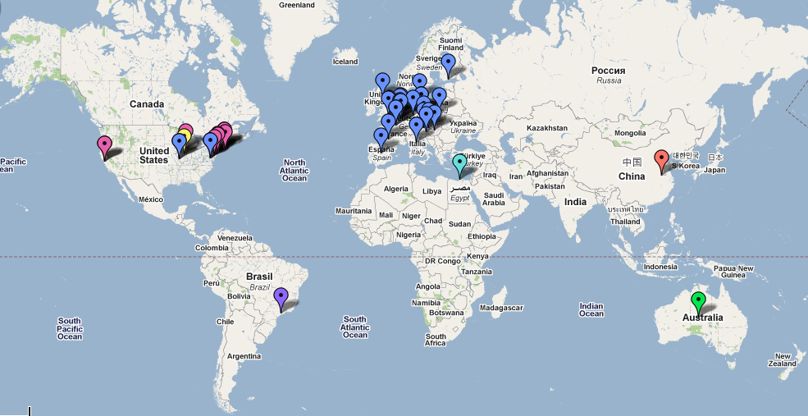
The Biodiversity Heritage Library (BHL) is a global community of natural history libraries and research institutions who have formed a partnership to digitize and make available the world's biodiversity literature.
Now Online:
82,000 volumes
31 million pages
BHL Partners
http://www.biodiversitylibrary.org

Slide 20
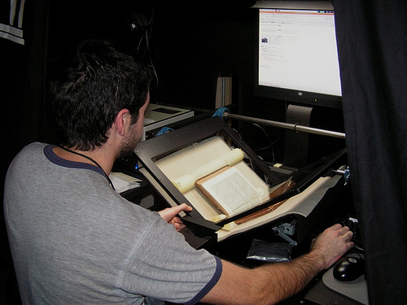
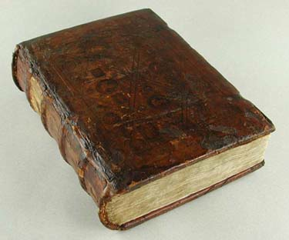
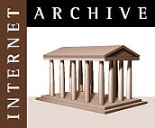
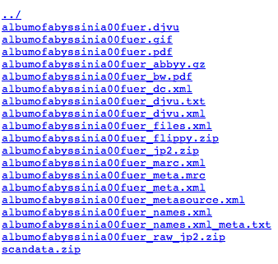
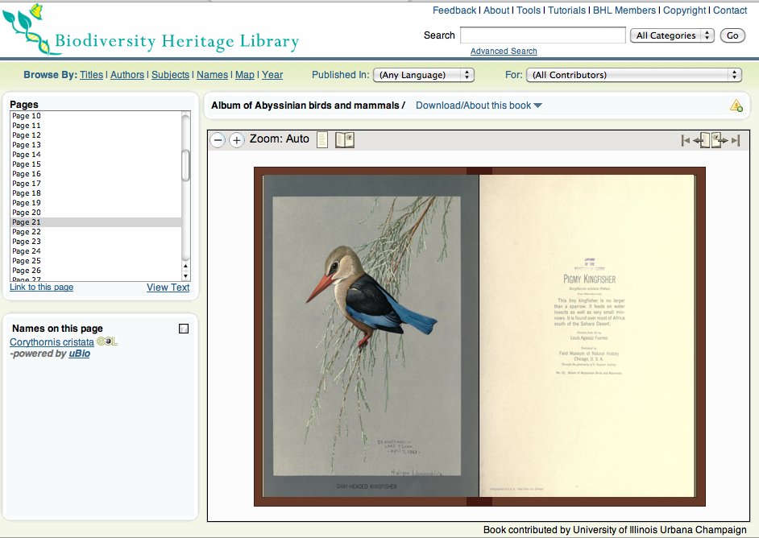
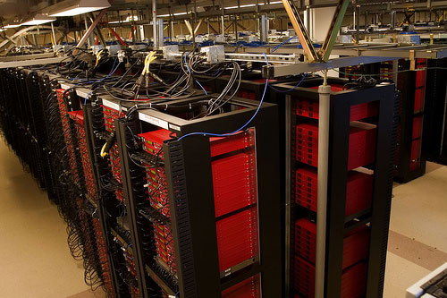

Slide 21
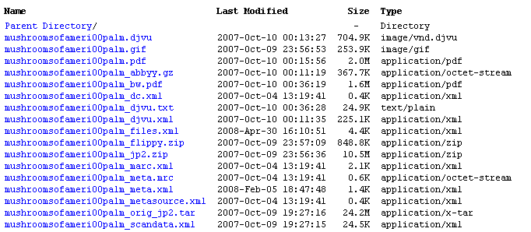
BHL by the Book
One 380 pg (avg) volume = multiple files, varying sizes, relationships among them
PDF
OCR
JP2
XML
> 70TB, growing every day…

Slide 22
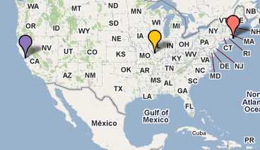
Current distributed infrastructure
MBL:
Redundant cluster
Content
Metadata
MOBOT:
Database & web application
Internet Archive:
Digitized content / files

Slide 23
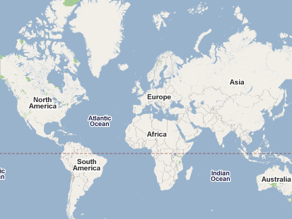
BHL Vision: Global Infrastructure
Preservation System – multiple redundant copies of all digitized content.
Access System – files, metadata & services needed to deliver content.
Replicate
Data Ingest
Sync
Data Ingest
Data Ingest

Slide 24
Motivation for joining pilot
Community interest in cloud storage
(Funding organizations, too!)
Wanted to evaluate applicability of cloud storage for large-scale digitization activities
Solutions for efficient transfer of 10-100s TB data
Lower cost alternatives to maintaining large data centers

Slide 25
BHL as a research space
BHL nodes are autonomous centers serving the digitized texts under their applications in response to users.
But the BHL corpus as whole is a data set of biodiversity data in its own right. Embedded in it are:
Predator/prey relationships
Habitat/distribution data
Host/parasite data
Pathogen/disease vector data
Third party researchers and projects are interested in mining the BHL texts for multiple research needs.
One site for serving/accessing/downloading digital texts AND for data mining is messy. Separate out and put a version of the corpus in a public-like cloud space.

Slide 26
BHL Policy Challenges
Money - At present in the US, one BHL member library (MBL) is willing to provide essentially free redundant hosting. This is a very attractive financial offer. Since the MBL is BHL member it provides a level of administrative commitment. If this changes, DuraCloud becomes very attractive.
Skill level - Multiple global partners needing all or some of the current holdings - have varying levels of technical skills. For some shipping hard drives might be easier. For some uploading to and downloading from DuraCloud might be preferable.
Timing – at the time of the closing of the pilot our partners, while very close are not quite ready for the initial large data transfer. As they get their marbles lined up, we can evaluate DuraCloud as a transfer mechanism on a node-by-node basis.
Control – in cultural-scientific digital projects no clear models using DuraCloud. Early-adopter paranoia.

Slide 27
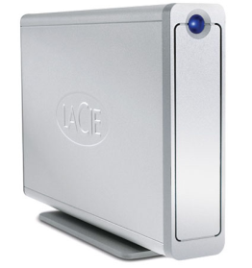
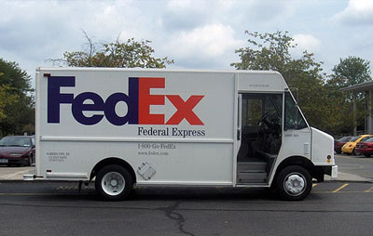
Data Transfer Methods & Limitations
NodeA
NodeB
Problems: Hardware failure, data loss, shipping fees
vs
NodeA
NodeB
Problems: Available bandwidth, upload/download fees

Slide 28
Data transfer: Cloud vs. Cluster
Inventory & audit lists
Checksums for data integrity
Heavy lifting at BHL scale, regardless of endpoint
weeks->months, not minutes->days
Differences
In cluster environment, have to be intimately involved in hardware decisions, maintenance, troubleshooting
In cloud environment, those worries are part of your fee

Slide 29
Challenges for adopting cloud storage
BHL is embedded in longstanding institutions with megainfrastructure.
Already support data storage & maintenance at BHL scale
Little funding for alternative infrastructure / storage
Current storage is (really, truly) free through Internet Archive
Costs associated with download / use of content
BHL is a global resource for a broad community
User community wants to “do things” with data

Slide 30
Lessons Learned
Cloud infrastructure & applicability to BHL are no longer a mystery
Nothing is free
Except when it is
Cloud storage provides ability to quickly scale infrastructure
No lost time procuring & configuring hardware
Useful for the right kinds of datasets
It’s not the size of the corpus, it’s the size of the files
Huge files are problematic

Slide 31
Outcomes
10-13TB transferred from Internet Archive to DuraCloud over wire
Simple, without bandwidth limitations
Became intimately familiar with our data
Larger files in corpus than expected (GB+ files)
Issues with “checksums”
Need to know your data to efficiently manage it
Spent less time moving data than checking / verifying data

Slide 32
Perceptions about cloud infrastructure after pilot participation
More possibilities than expected:
Features
Movement
Support available from commercial providers.
Increasing menus of choices
There is no silver bullet
Cloud is just a different endpoint for file storage
It doesn’t solve all problems related to repository management

Slide 33
Future opportunities for cloud infrastructure & BHL
Depending on BHL partner needs/abilities use DuraCloud to transfer/synch files
Seek research grants for data mining and include line items for DuraCloud hosting of BHL “research space” for multiple informatics projects.
If “free” turns into “not so free” use DuraCloud as ongoing redundant preservation storage.
As we explore synchronization across projects, is DuraCloud an alternative?

Slide 34
BHL in the cloud
A Pilot Project
Tom Garnett, BHL Executive Director
Chris Freeland, BHL Technical Director
http://www.biodiversitylibrary.org

Slide 35
WGBH DuraCloud Pilot
Audio and video in the cloud
Digital Preservation Partners Meeting
Wednesday, July 21, 2010
Peter Pinch
Director of Technology for Interactive
Notes:
15m

Slide 36
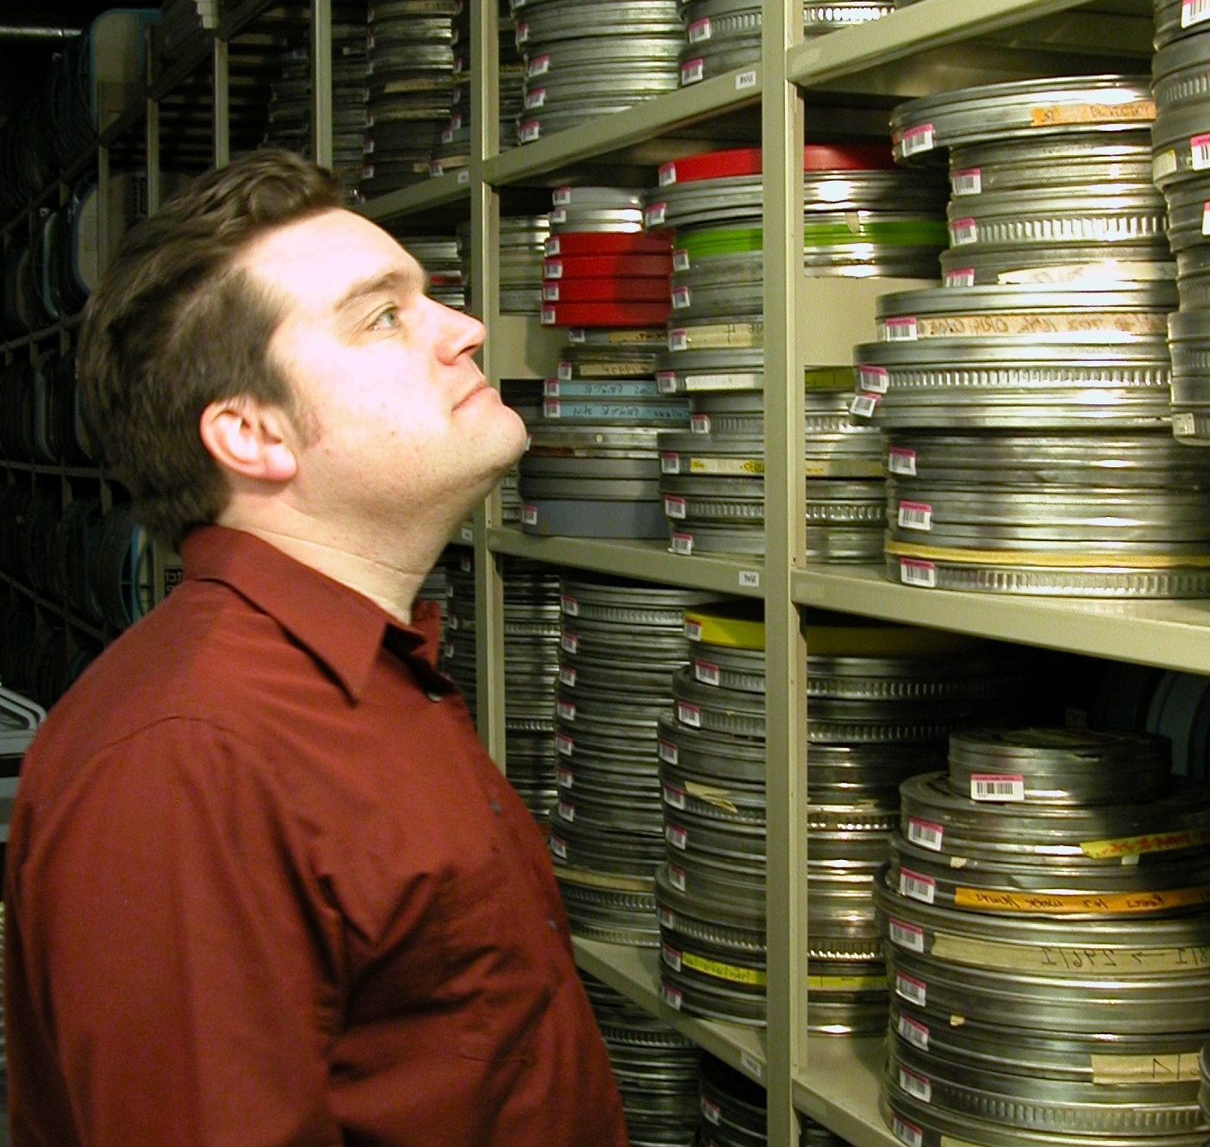
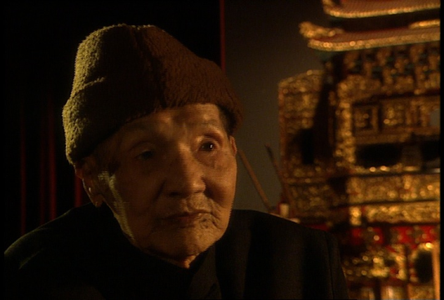
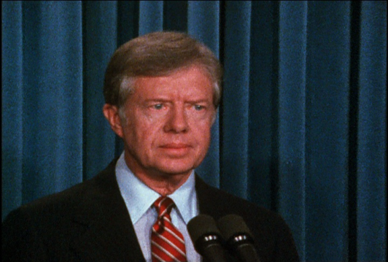
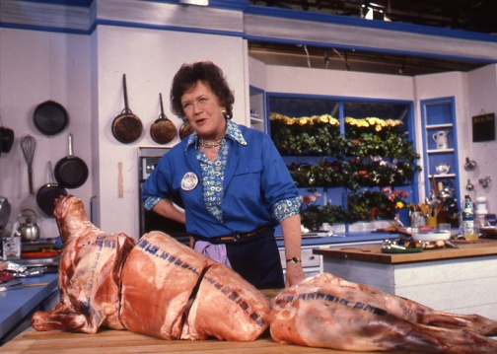
WGBH Media Library and Archives
Notes:
Our interest in DuraCloud is related to our work increasing access to our archives
CM: Assets to 1951, founded 1970s
Nearly 700,000 Finished films + elements
Interviews, stock footage, programs, variety of formats; open to scholars. Existing asset databases from productions
Formats: film, video, digital video, audio tape, digital audio, still images as slides, prints, negatives, documentation on paper, disks, you name it.

Slide 37
DuraCloud Pilot Goals
37
Access
Streaming video
Integration with http://openvault.wgbh.org
Cost savings?
Improved sustainability?
Preservation
Uncompressed audio and video storage
Cost Savings?
Improved reliability?
Future Services
© 2010 WGBH
Notes:
What were perceptions going in? How has that changed?
- I presumed delivery by drive would be necessary, but by wire was not as slow as I feared
The cloud is complicated

Slide 38
DuraCloud Use Case: American Archive Pilot
38
CPB pilot project, 20 stations including WGBH
civil rights era and World War II
Stations responsible for preservation & hosting
Preservation
110 hrs of video, 8.5 TB
120 hrs of audio, 150 GB
Access (streaming)
12GB of H.264 video
4GB of mp3 audio
© 2010 WGBH

Slide 39

Preservation using DuraCloud
Digital access management system
DAM
Open Vault
Fedora Repository
Preservation file
Ingest
Preservation file
File sync
WGBH DuraCloud Instance
Preservation support:
File validation
Replication management
Administrative access
Error checking
File migration/transformation
Monitoring
Amazon
EMC
RackSpace

Slide 40

Access using DuraCloud
40
Digital Access Management system
Open Vault
Fedora Repository
Ingest
Access file
Access file streaming
Access services:
Streaming
File format transformation
File access
collaboration
WGBH DuraCloud Instance
Amazon
EMC
RackSpace
© 2010 WGBH

Slide 41
Lessons Learned

Slide 42
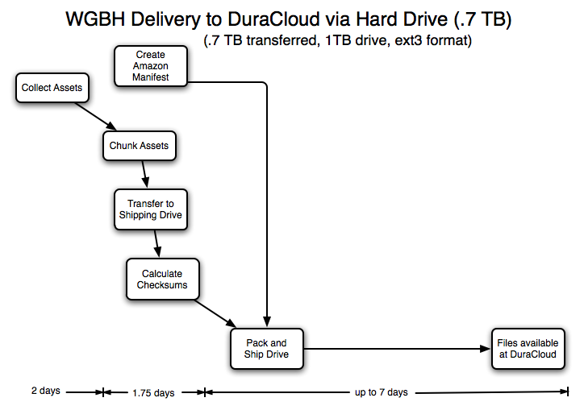
Sending disks to the cloud
42
Notes:
Some unexpected slowdowns
gathering the assets
chunking assets -- AWS file size limit
drive format issues -- at least for us, as a Mac shop

Slide 43
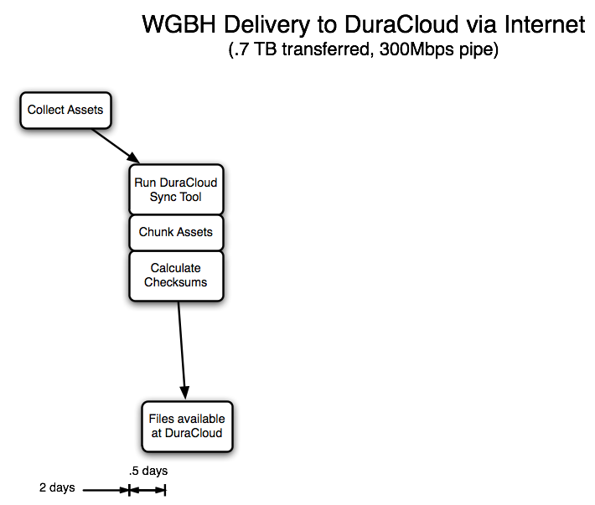
Using tubes and wires
43
Notes:
Need to move Files available box to left

Slide 44
Costs
44
Gathering data
Sunk costs
DAM (including hierarchical storage
Bandwidth (to the cloud)
Incremental costs
Off-line storage
Cloud storage
Streaming bandwidth (+1 for cloud)
© 2010 WGBH
Notes:
Sunk Costs
DAM maintenance; HSM maintenance
20TB of spinning disk; room for 2.4 petabytes near line
bandwidth is symmetrical, but our outbound use much less than inbound
Incremental costs:
backup is 8.8 cents/GB
cloud storage is 15 cents/GB/month ?
streaming bandwidth is 17 cents/GB transferred?
current cost is $1/GB transferred
Digital preservation costs
-- not a fair comparison. Neither is “trusted digital repository”
--- DAM: fully loaded storage, cost of backup tape
---- tape is $35/.8TB or $.04375/GB
--- Cloud: storage costs of ???
Access costs:
-- current incremental streaming cost is $1/GB

Slide 45
Cost Comparisons
45
 | In-house | Cloud
Bandwidth to storage | n/a | “free”
Bandwidth for access | $1 per GB transferred | 17¢ per GB transferred
Storage | 8.8¢ per GB | 15¢ per GB per month
© 2010 WGBH
Notes:
Sunk Costs
DAM maintenance; HSM maintenance
20TB of spinning disk; room for 2.4 petabytes near line
bandwidth is symmetrical, but our outbound use much less than inbound
Incremental costs:
backup is 8.8 cents/GB
cloud storage is 15 cents/GB/month ?
streaming bandwidth is 17 cents/GB transferred?
current cost is $1/GB transferred
Digital preservation costs
-- not a fair comparison. Neither is “trusted digital repository”
--- DAM: fully loaded storage, cost of backup tape
---- tape is $35/.8TB or $.04375/GB
--- Cloud: storage costs of ???
Access costs:
-- current incremental streaming cost is $1/GB
in-house DuraCloud
Storage
Bandwidth
Streaming Bandwidth

Slide 46
Outcomes
46
5.5 TB of audio & video uploaded
Preservation and access files
Still working with sync tool
Streaming service works
But still need to integrate with Open Vault web site (for access)
© 2010 WGBH
Notes:
Sunk Costs
DAM maintenance; HSM maintenance
30TB of spinning disk; near line is LTO tapes
bandwidth is symmetrical, but our outbound use much less than inbound
Incremental costs:
backup is 4.4 cents/GB
cloud storage is 15 cents/GB ?
streaming bandwidth is 20 cents/GB transferred?
current cost is $1/GB transferred
Digital preservation costs
-- not a fair comparison. Neither is “trusted digital repository”
--- DAM: fully loaded storage, cost of backup tape
---- tape is $35/.8TB or $.04375/GB
--- Cloud: storage costs of ???
Access costs:
-- current incremental streaming cost is $1/GB

Slide 47
The Future
47
Complete integration with Open Vault site
Dealing with file size limits
Editing (clipping)
Transcode services?
Proposal with NCSA
Speech to text?
Transcript alignment
Recommend for American Archive when it moves to preservation phase of project
© 2010 WGBH
Notes:
Next up: integration

Slide 48
Questions? http://openvault.wgbh.org peter_pinch@wgbh.org

Slide 49
Achievements during Initial Pilot
Demonstrated large scale data transfer
30 TB moved into the cloud
Demonstrated feasibility of large scale data processing in the cloud
Image format conversion
Demonstrated cloud capabilities for content access
Media streaming
Image display

Slide 50
Lessons Learned
Initial content load requires time and effort
Preparing content for transfer is often non-trivial
Transfer over http: simpler, faster, and cheaper than disks
Time to load content: determined by bandwidth available at the source location
Client-side utilities can help ease burden
Tool development is required to overcome or mitigate cloud provider limitations
Latency due to transfer over the web can be an issue for applications
Minimize transactions across the wire
Keep data close to compute
Must allow for “eventual consistency”
Adds to latency if existence guarantees are required

Slide 51
Lessons Learned
Cloud market is still developing
New capabilities becoming available frequently
Sun and EMC have both exited the market in the past year
Storage capabilities more mature than Compute
Cloud storage provides robust performance
Storage APIs beginning to converge
Compute services and capabilities vary widely
Each vendor is seeking ways to differentiate offerings
Amazon way out in front
Building only to lowest-common-denominator equals missed opportunities to leverage provider offerings

Slide 52
Expanded Pilot Partners
University | Use Case | Repository
Rice U | Preservation | DSpace, meta archive
Hamilton College | Access/international collaboration | Fedora
Northwestern U | Preservation books, audio, image | Fedora
U of PEI | Image viewing/hosting | Fedora/Islandora
Cornell U | Data stream access and preservation | Fedora
ICPSR | Access and Preservation | Fedora
SUNY Buffalo | Preservation | DSpace
IUPUI | Preservation | DSpace
Rhodes College | Image Access | DSpace
North Carolina State U | Preservation | DSpace
CARL | Preservation and Services | Fedora
Orbis Cascade Alliance | Preservation and Services | DSpace
MIT | Preservation, OAIS compliance | Dspace
NYPL | Preservation and Services | Fedora
WGBH | Access and Preservation | DAM

Slide 53
Thank You! http://www.duracloud.org https://wiki.duraspace.org/display/duracloud

