Slide 1
Private Schools, Earthquakes: What we know from Pakistan (with insights for Haiti)
Jishnu Das (World Bank)
Tahir Andrabi (Pomona College)
(with inputs from Natalie Bau and Erum Haider, World Bank)

Slide 2
What could Pakistan and Haiti have in common?
Poor countries
Poor investments in education
Poor educational outcomes
Private school presence
Large and growing in Pakistan (NOT madrassas, which account for 1-1.5% of enrollment)
Much larger in Haiti
Pakistan has much better information on private schools (LEAPS and APPEAR projects)
Argue that this provides valuable insights for Haiti
 | Haiti¹ |  | Pakistan²
GDP/Capita (PPP in 2005 US dollars) | 1,088 |  | 2,444
 | Primary | Secondary | Primary | Secondary
Net enrollment (% of relevant age group) | 76 | 22³ | 66 | 32
Private School enrollment (% of total enrollment) | 75 | 82 | 34 | ??
1 – Wolff, 2008 2 – 2007 figures, World Bank

Slide 3
Outline
Facts about Pakistani private schools
Growth
Costs
Quality
Recovery after earthquakes
Location patterns and what they mean
Key message
In Pakistan private schools provide a cheap, higher quality alternative to public schools but they do not arise everywhere
due to supply constraints in the availability of teachers
Argue that we can reexamine Haitian education in the light of these data

Slide 4
Pakistani private schools
Secular, “mom and pop” schools
Mostly unregistered
No regulation (even on curriculum)
Recipe for disaster?

Slide 5
What we know from existing work

Slide 6
Private School Growth
Enrollment shares in private schools increased dramatically, from less than 5% in 1990 to 35% in 2007 in Pakistan
Large portion of the growth has come in rural regions
Not specific to Pakistan—identical patterns in India
Enrollment shares increased even as the government poured money into public schools
Click here to see pictures

Slide 7
Private School Costs
Private schools are (very) cheap
The median fee in a private school is still less than a dime a day
Fees represent 1.7% of average household expenditure in rural areas
Cost per student in a private school is ½ of that in a public school (lower bound estimate: other estimates suggest 1/6)
Click here to see the table of fees in Pakistani provinces

Slide 8
Why are private schools so cheap?
Private schools hire
Mostly female, local teachers with
Only secondary education and no training whom they
Pay very low wages ($15 a month)
Teachers in public schools make 5 times as much as those in private

Slide 9
But inputs are NOT outputs!
“Better” civic values
Far better test-score outcomes
1/3rd TIMSS standard-deviation
Effect of Private on Educational Outcomes Controlling for Age, Gender, and District
 | All Enrollees | R Squared | All Girls | R Squared | All Boys | R Squared | All Enrollees With Village Fixed Effects | R Squared
English Score | 0.801*** | 0.234 | 0.609*** | 0.151 | 1.003*** | 0.288 | 0.840*** | 0.374
 | (0.075) |  | (0.089) |  | (0.103) |  | (0.084)
Urdu Score | 0.628*** | 0.154 | 0.588*** | 0.129 | 0.679*** | 0.168 | 0.742*** | 0.314
 | (0.082) |  | (0.100) |  | (0.125) |  | (0.081)
Math Score | 0.690*** | 0.147 | 0.772*** | 0.141 | 0.620*** | 0.155 | 0.787*** | 0.312
 | (0.089) |  | (0.123) |  | (0.126) |  | (0.095)
TIMSS Adjusted Math Score | 55.790*** | 0.133 | 60.489*** | 0.125 | 52.188*** | 0.137 | 62.921*** | 0.297
 | (7.857) |  | (11.023) |  | (11.228) |  | (8.220)
All Ideology Related Questions | 0.277*** | 0.041 | 0.338*** | 0.051 | 0.235** | 0.033 | 0.310*** | 0.157
 | (0.081) |  | (0.112) |  | (0.116) |  | (0.089)
Pro Government Index | 0.215** | 0.027 | 0.196 | 0.029 | 0.246** | 0.028 | 0.201** | 0.147
 | (0.083) |  | (0.123) |  | (0.115) |  | (0.093)
Pakistan Knowledge | 0.292*** | 0.035 | 0.415*** | 0.059 | 0.192 | 0.023 | 0.331*** | 0.151
 | (0.084) |  | (0.110) |  | (0.117) |  | (0.094)
Male Bias | -0.123* | 0.060 | -0.039 | 0.027 | -0.197 | 0.008 | -0.200** | 0.206
 | (0.072) |  | (0.086) |  | (0.119) |  | (0.085)

Slide 10
Causality?
In two different papers, we show that the results that children in private schools report higher test-scores and better civic values are causal
- Using children who switch from one type of school to another over time
- Using instrumental variables
Message? Test-scores and civic outcomes are better in totally decentralized, unregulated private schools relative to public schools. Unqualified teachers in private schools produce (far) better outcomes than qualified teachers in government schools—and at less than half the price.

Slide 11
Schooling and the Pakistani Earthquake of 2005: New work

Slide 12
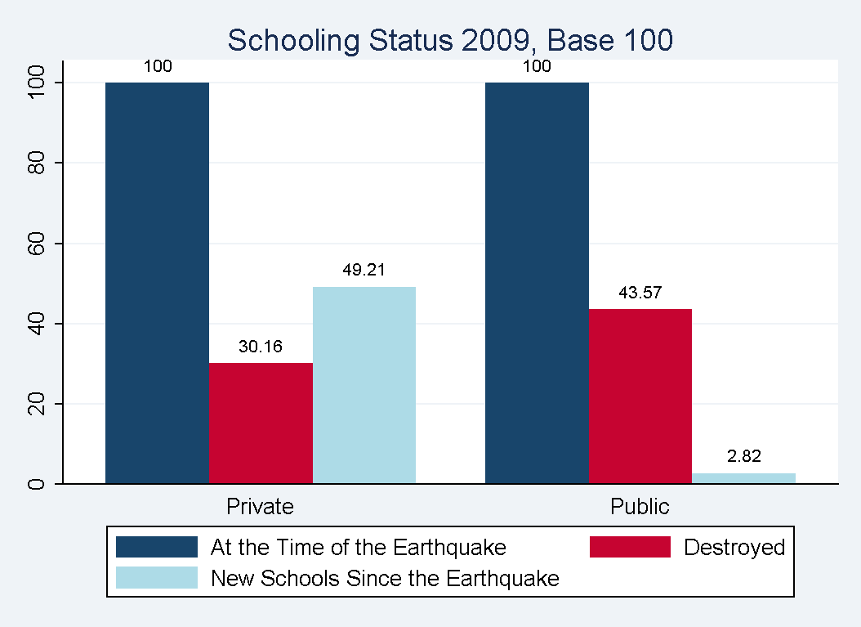
School Destruction in the Earthquake

Slide 13
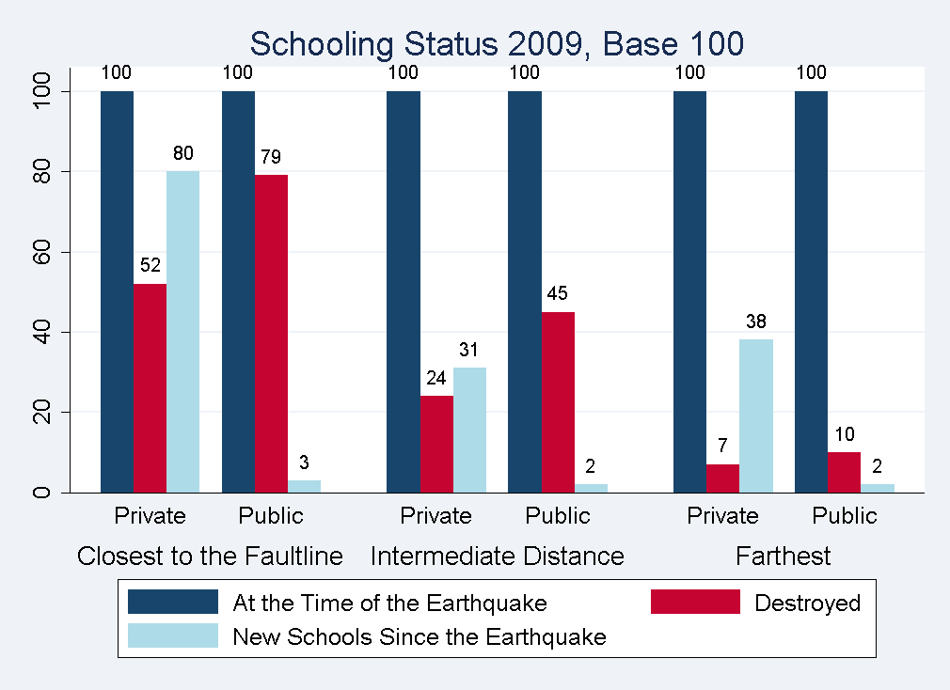
Recovery from the Pakistani Earthquake

Slide 14
Perhaps because of this
New household survey in 2009 that compares households close to fault-line with those further away suggests (TBC!):
No impact of earthquake on 2009 enrollment
No impact of earthquake on 2009 test-scores
Even though disruption was higher closer to the fault-line
Could reflect pre-existing baseline differences (unlikely)
Could reflect survivorship bias (work underway)

Slide 15
So why not only private schools?

Slide 16
Key problems are on the supply-side
Across villages, private schools are overwhelmingly in richer and larger villages

Slide 17
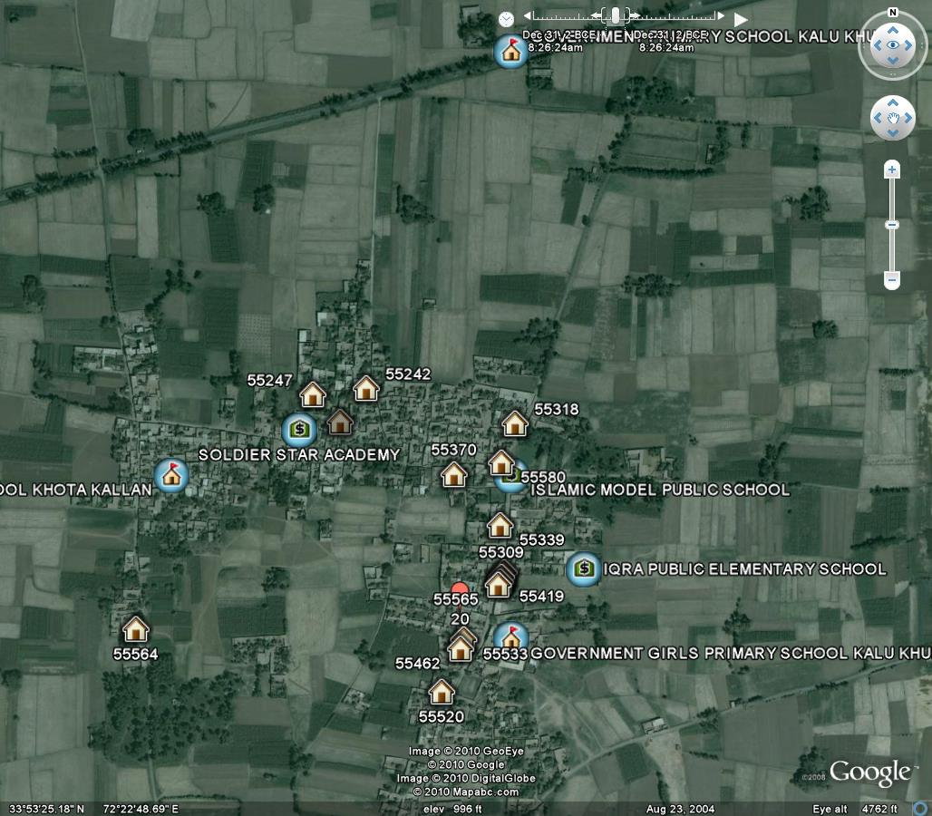
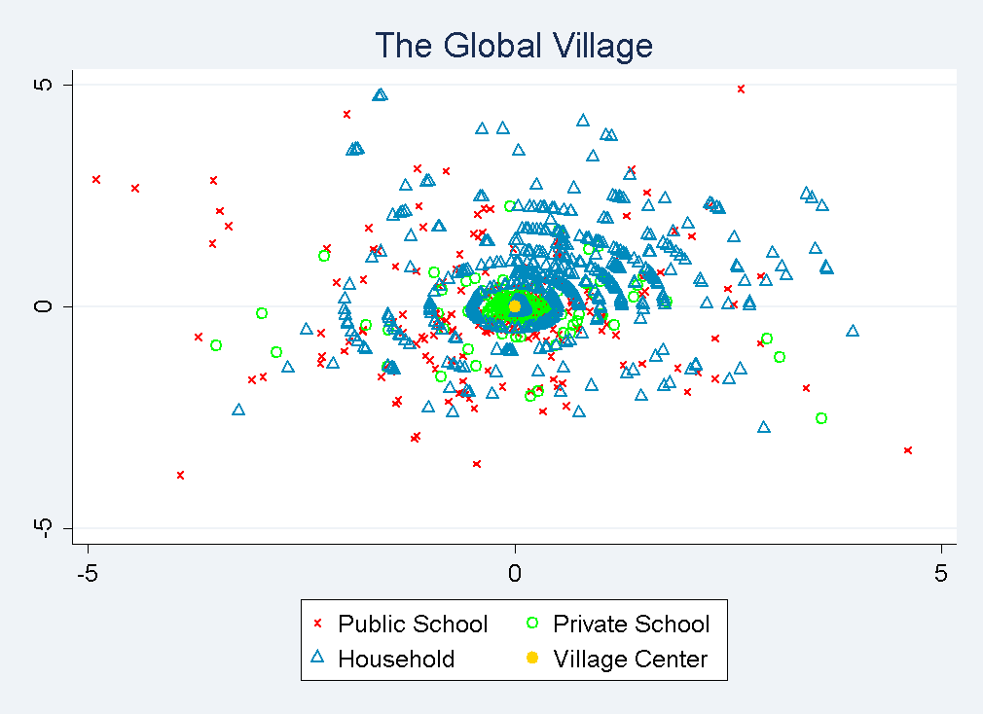
Supply-side issues: A typical village in Punjab, Pakistan
Within villages, private schools are overwhelmingly in the centre

Slide 18
Centrally related to the availability of teachers
Private schools are causally 300 percent more likely to locate in villages with a government secondary school—the students of today are the teachers of tomorrow
Therefore, for private schools to arise at low costs and operate without subsidies require initial subsidies for secondary education!
Click here to see picture

Slide 19
Back to Haiti
Current Thinking
Educational outcomes are poor
Costs are high with most kids in private schools
Private schools are poor because inputs are poor
Therefore, we require free government education
Reevaluate in the context of Pakistan

Slide 20
Educational outcomes again: Is enrollment worse than other similar-income countries?
Are Haitian outcomes abnormally bad relative to its income level?
1 – Most recent enrollment figures: Haiti – Wolff (2008); Nigeria – World Bank, 2006; rest – World Bank, 2007
2 – World Bank, 2008 figures

Slide 21
Costs of schooling: comparing Haiti and Pakistan, all numbers are converted to 2005 PPP adjusted dollars using UN Stats on PPP
 |  | Haiti |  |  | Pakistan⁵
 |  | Percentage of enrolled primary school students ¹ | Fees ($ per year) ² | Total cost per Student ($ per year) ³ | Percentage of enrolled primary school students | Fees ($ per year) | Total cost per Student ($ per year)
Private Schools | Religious affiliated schools | 75 | ~167* | 46.65 | 1.3 | N/A | N/A
 | Commercial (for-profit) Schools |  |  | 64.05 | 34 | 46 | 60
 | NGO/Community Schools |  |  |  | <1 | N/A | N/A
Public Schools |  | 25 | 4.11⁴ | ? | 64 | 0 | 82-247
1- Salmi, J. (2000) “Equity and Quality in Private Education: the Haitian Paradox,” Compare, 30:2, pp163-178
2- World Bank, (2007) Project Appraisal Report: Grant to Haiti for Education for All Project (internal document). Washington, DC
3- Salmi, op cit.
4- Reported fees (World Bank 2007, citing 2005 DHS). Because of the shortage of public schools, only children who attend expensive private pre-primary schools that teach reading and writing secure a place. Public schools are also prone to rent-seeking, or requiring parents to pay part of school costs (Salmi, 2000)
5- LEAPS Report, 2007 * The 2005 DHS calculated average school fees across the Haiti education system. Since the private sector makes up most of the education system, this average serves a s an approximation on average private school fees.

Slide 22
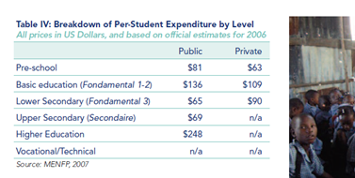
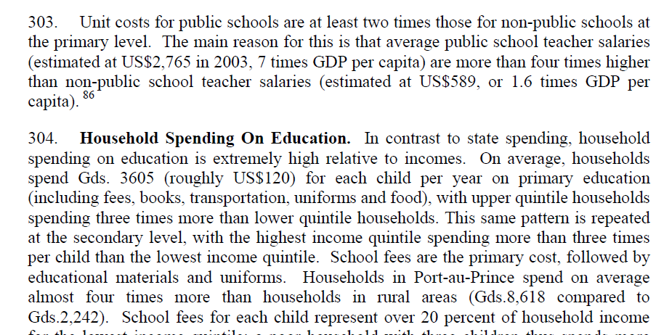
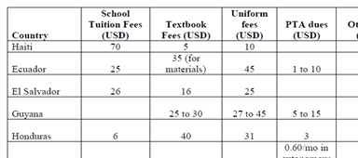
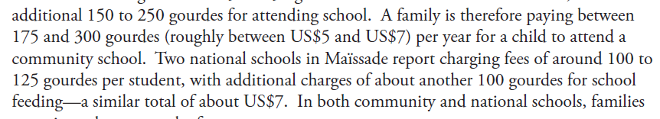
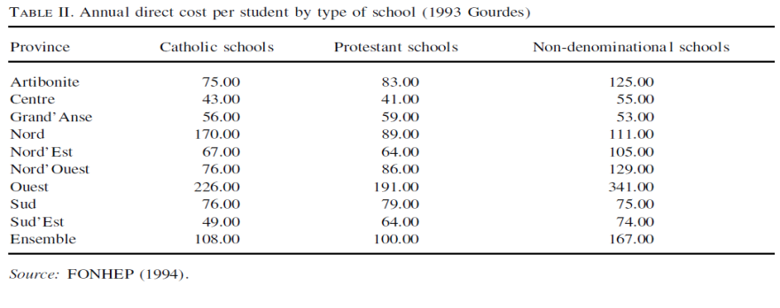
Source | School Fees/ Expenditures (PPP Adjust 2005 US$)
Wolff, Laurence. 2008. Education in Haiti: The Way Forward. Washington, DC: PREAL | Private Total Expenditures: 181 Public Total Expenditures: 226
World Bank, (2006) “Haiti: Options and Opportunities for Inclusive Growth Country Economic Memorandum” Washington, DC | Direct cost: 251
Kattan, Raja Bentaout, (2006) “Implementation of Free Basic Education Policy,” World Bank, Washington DC | Direct cost: 178
World Bank (2007) “Project Appraisal Document of a Proposed Grant To The Republic Of Haiti – Education for All Project,” Washington DC | Overall Average Tuition: 167 Public School Fee: 4
USAID, (2007) “Working Paper: School Effectiveness in Maïssade, Haiti,” Washington DC | Average Tuition: 10 – 15 for Community Schools (highly subsidized)
Salmi, J. (2000) “Equity and Quality in Private Education: the Haitian Paradox,” Compare, 30:2, pp163-178 | Average Direct Cost: 58

Slide 23
Haiti and Pakistan: Making sense of it all (if the numbers are correct!)

Slide 24
The derived demand for private schooling: Case 1 is fees are high
Moving from Pakistani equilibrium to Haitian equilibrium consistent with
Far higher demand in Haiti
Supply may be worse or better
Notes:
Need a curve for haitian demand

Slide 25
Derived demand for private schooling: Case 2 is Fees are not high
Moving from Pakistani equilibrium to Haitian equilibrium consistent with
Better supply in Haiti
Demand probably higher
Notes:
Need a curve for haitian demand
25

Slide 26
Pakistan and Haiti: Putting it together
From Pakistan we know that
Educational outcomes at these levels more to do with time on educational instruction and ability to monitor, hire, fire and reward teachers rather than wages and qualifications
Fixed cost of setting up a school is very small, but finding teachers in rural areas is hard

Slide 27
Pakistan and Haiti: Putting it together
Three possibilities
The data are wrong and private schools in Haiti are fairly “good”
OR, the problem is spatially localized
With severe constraints on labor market mobility (esp. rural to rural). Are their security/safety issues?
& Very low secondary school penetration: no teachers available locally
AND/OR Government schools are rationed (not the case in Pakistan) so private schools also represent very low demand for certain types of children
Plausible, but still hard to explain higher prices and lower quality
There are enormous regulatory and bribery costs in setting up even “illegal” unregistered schools

Slide 28
If we believe all this
Problem in Haiti is a spatial distribution issue
Private schools are geographically highly concentrated (?)
Two types of rural areas
Areas with government and private schools
Areas without government schools
Here private schools are non-existent or very low quality (& price)

Slide 29
Question is what institutions will work
Always possible to setup very high cost, well functioning boutique schools. Some of this in Pakistan
Partially useful
If the problem is supply, fix supply by increasing availability of government secondary education
Longer term solution that can yield large benefits
In the short-run, tent schools set up in Pakistan spontaneously within a month of the quake
But pinning down the prices and spatial distribution is key to figuring out future policy
Right now, there are 2 totally different potential views of what is going on.
At least with regard to schooling, that is the real Haitian Paradox

Slide 30
Supplementary Slides

Slide 31
Private School Growth
Pakistan: Private School Enrollment Incidence in the 1990s
India: Private School Enrollment Incidence in the 1990s
The figures show the growth rate of private school enrollment shares for every PCE decile and grouped by urban and rural areas
Private Schools dramatically increased their share of the educational market even as governments poured money into the public sector. Most of the growth was in rural areas
Click here to return to main presentation

Slide 32
Private School Costs
Private schools are (very) cheap: currently, they still cost less than a dime a day
Note: $1=60 PKR
Click here to return to main presentation

Slide 33
Centrally related to the availability of teachers
Private schools are causally 300 percent more likely to locate in villages with a government secondary school—the students of today are the teachers of tomorrow
Click here to return to main presentation

