Slide 1
Cloud Computing: Recent Trends, Challenges and Open Problems
Kaustubh Joshi, H. Andrés Lagar-Cavilla
{kaustubh,andres}@research.att.com
AT&T Labs – Research

Slide 2
Tutorial?
Our assumptions about this audience
You’re in research
You can code
(or once upon a time, you could code)
Therefore, you can google and follow a tutorial
You’re not interested in “how to”s
You’re interested in the issues

Slide 3
Outline
Historical overview
IaaS, PaaS
Research Directions
Users: scaling, elasticity, persistence, availability
Providers: provisioning, elasticity, diagnosis
Open Challenges
Security, privacy

Slide 4
The Alphabet Soup
IaaS, PaaS, CaaS, SaaS
What are all these aaSes?
Let’s answer a different question
What was the tipping point?

Slide 5
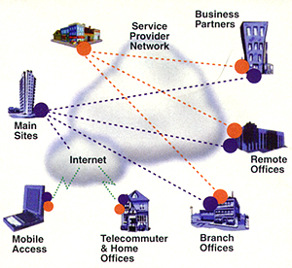
Before
A “cloud” meant the Internet/the network

Slide 6
August 2006
Amazon Elastic Compute Cloud, EC2
Successfully articulated IaaS offering
IaaS == Infrastructure as a Service
Swipe your credit card, and spin up your VM
Why VM?
Easy to maintain (black box)
User can be root (forego sys admin)
Isolation, security

Slide 7
IaaS can only go so far
A VM is an x86 container
Your least common denominator is assembly
Elastic Block Store (EBS)
Your least common denominator is a byte
Rackspace, Mosho, GoGrid, etc

Slide 8
Evolution into PaaS
Platform as a Service is higher level
SimpleDB (Relational tables)
Simple Queue Service
Elastic Load Balancing
Flexible Payment Service
Beanstalk (upload your JAR)

Slide 9
PaaS diversity (and lock-in)
Microsoft Azure
.NET, SQL
Google App Engine
Python, Java, GQL, memcached
Heroku
Ruby
Joyent
Node.js and JavaScript

Slide 10
Our Focus
Infrastructure
and Platform
as a Service
(not Gmail)
x86
JAR
Key
Value
Byte

Slide 11
What Is So Different?
Hardware-centric vs. API-centric
Never care about drivers again
Or sys-admins, or power bills
You can scale if you have the money
You can deploy on two continents
And ten thousand servers
And 2TB of storage
Do you know how to do that?

Slide 12
Your New Concerns
User
How will I horizontally scale my application
How will my application deal with distribution
Latency, partitioning, concurrency
How will I guarantee availability
Failures will happen. Dependencies are unknown.
Provider
How will I maximize multiplexing?
Can I scale *and* provide SLAs?
How can I diagnose infrastructure problems?

Slide 13
Thesis Statement from User POV
Cloud is an IP layer
It provides a best-effort substrate
Cost-effective
On-demand
Compute, storage
But you have to build your own TCP
Fault tolerance!
Availability, durability, QoS

Slide 14
Let’s Take the Example of Storage

Slide 15
Horizontal Scaling in Web Services
X servers -> f(X) throughput
X load -> f(X) servers
Web and app servers are mostly SIMD
Process requests in parallel, independently
But down there, there is a data store
Consistent
Reliable
Usually relational
DB defines your horizontal scaling capacity

Slide 16
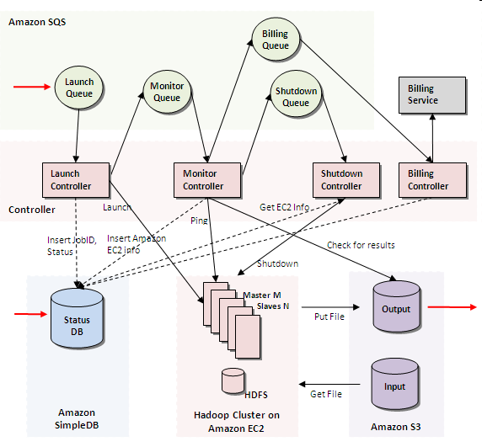
Data Stores Drive System Design
Alexa GrepTheWeb Case Study
Storage APIs changing how applications are built
Elasticity of demand means elasticity of storage QoS

Slide 17
Cloud SQL
Traditional Relational DBs
If you don’t want to build your relational TCP
Azure
Amazon RDS
Google Query Language (GQL)
You can always bundle MySQL in your VM
Remember: Best effort. Might not suit your needs

Slide 18
Key Value Stores
Two primitives: PUT and GET
Simple -> highly replicated and available
One or more of
No range queries
No secondary keys
No transactions
Eventual consistency
Are you missing MySQL already?

Slide 19
Scalable Data Stores: Elasticity via Consistent Hashes
E.g.: Dynamo, Cassandra key-stores
Each nodes mapped to k pseudo-random angles on circle
Each key hashed to a point on the circle
Object assigned to next w nodes on circle
Permanent Node removal:
Objects dispersed uniformly among remaining nodes (for large k)
Node addition:
Steals data from k random nodes
Node temporarily unavailable?
Sloppy quorums
Choose new node
Invoke consistency mechanisms on rejoin
3 nodes, w=3, r=1
Object key hash
Store object at next k nodes
Notes:
Elasticity aspect of cloud is something new not in the past. Consistent hashing is something all elastic data stores need: efficient add/removal in the face of unpredictable and frequent changes in demand/availability of replicas

Slide 20
Eventual Consistency
Clients A and B concurrently write to same key
Network partitioned
Or, too far apart: USA – Europe
Later, client C reads key
Conflicting vector (A, B)
Timestamp-based tie-breaker: Cassandra [LADIS 09], SimpleDB, S3
Poor!
Application-level conflict solver: Dynamo [SOSP 09], Amazon shopping carts
(K=X, V=Y)
Client A
(K=X, V=A)
Client B
(K=X, V=B)
Client C Reads K=X
V = <A,B>
(or even V = <A,B,Y>)!

Slide 21
KV Store Key Properties
Very simple: PUT & GET
Simplicity -> replication & availability
Consistent hashing -> elasticity, scalability
Replication & availability -> eventual consistency

Slide 22
EC2 Key Value Stores
Amazon Simple Storage Service (S3)
“Classical” KV store
“Classically” eventual consistent
<K,V1>
Write <K,V2>
Read K -> V1!
Read your Writes consistency
Read K -> V2 (phew!)
Timestamp-based tie-breaking

Slide 23
EC2 Key Value Stores
Amazon SimpleDB
Is it really a KV store?
It certainly isn’t a relational DB
Tables and selects
No joins, no transactions
Eventually consistent
Timestamp tie-breaking
Optional Consistent Reads
Costly! Reconcile all copies
Conditional Put for “transactions”

Slide 24
Pick your poison
Perhaps the most obvious instance of
“BUILD YOUR OWN TCP”
Do you want scalability?
Consistency?
Survivability?

Slide 25
EC2 Storage Options: TPC-W Performance
Flavor | Throughput (WIPS) | Cost High Load ($/WIPS)
MySQL in your own VM (EBS underneath) | 477 | 0.005
RDS (MySQL aaS) | 462 | 0.005
SimpleDB (non-relational DB, range queries) | 128 | 0.005
S3 (B-trees, update queues on top of KV store) | 1100 | 0.009
Kossman et al, [SIGMOD 10,08]

Slide 26
Durability use case: Disaster Recovery
Disaster Recovery (DR) typically too expensive
Dedicated infrastructure
“mirror” datacenter
Cloud: not anymore!
Infrastructure is a Service
But cloud storage SLAs become key
Do you feel confident about backing up to a single cloud?

Slide 27
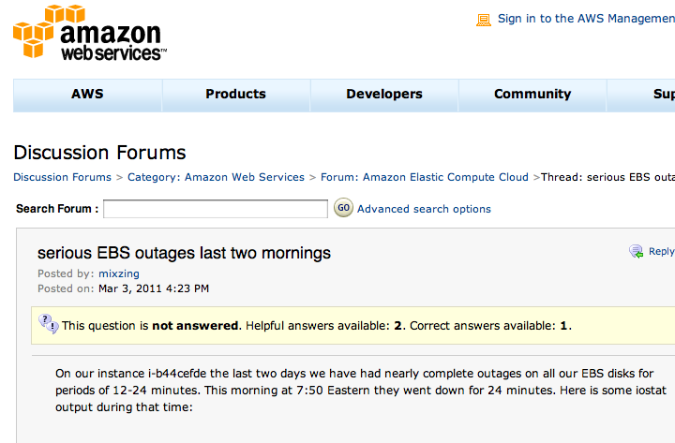
Will My Data Be Available?
Maybe ….

Slide 28
Availability Under Uncertainty
DepSky [Eurosys 11], Skute [SOCC 10]
Write-many, read-any (availability)
Increased latency on writes
By distributing, we can get more properties “for free”
Confidentiality?
Privacy?

Slide 29
Availability Under Uncertainty
DepSky [Eurosys 11], Skute [SOCC 10]
Confidentiality. Privacy.
Write 2f+1, read f+1
Information Dispersal Algorithms
Need f+1 parts to reconstruct item
Secret sharing -> need f+1 key fragments
Erasure Codes -> need f+1 data chunks
Increased latency

Slide 30
How to Deal with Latency
It is a problem, but also an opportunity
Multiple Clouds!
“Regions” in EC2
Minimize client RTT
Client in the East, should server be in the West
Nature is tyrannical
But, CAP will bite you

Slide 31
Wide-area Data Stores: CAP Theorem
Brewer, PODC 04 keynote
Pick 2: Consistency, Availability, Partition-Tolerance
C
A
C
A
C
A
P
P
P
Role of A and P interchangeable for multi-site ACID guarantees possible, but can’t have system available when there is a network partition Traditional DBs: MySQL, Oracle But what about latency? Latency-consistency tradeoff is fundamental | “Eventual consistency” e.g., Dynamo, Cassandra Must be able to resolve conflicts Suitable for cross-DC replication

Slide 32
Build Your Own NoSQL
Netflix Use Case Scenario
Cassandra, MongoDB, Riak, Translattice
Multiple “Clouds”
EC2 availability zones
Do you automatically replicate?
How are reads/writes satisfied in the normal case?
Partitioned behavior
Write availability? Consistency?

Slide 33
Build Your Own NoSQL
The (r,w) parameter for n replicas
Read succeeds after contacting r ≤ n replicas
Write succeeds after contacting w ≤ n replicas
(r+w) > n: quorum, clients resolve inconsitencies
(r+w) ≤ n: sloppy quorum, transient inconsistency
Fixed (r=1, w=n/2 + 1) -> e.g. MongoDB
Write availability lost on one side of a partition
Configurable (r,w) -> e.g. Cassandra
Always write available

Slide 34
Remember
Cloud is IP
Key value stores are not as feature-full as MySQL
Things fail
You need to build your own TCP
Throughput in horizontal scalable stores
Data durability by writing to multiple clouds
Consistency in the event of partitions

Slide 35
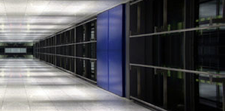

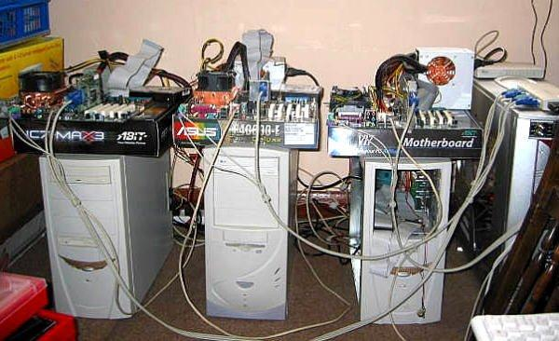

Provider Point of View
Cloud
User
?
Cloud
Provider

Slide 36
Provider Concerns
Lets focus on VMs
Better multiplexing means more money
But less isolation
Less security
More performance interference
The trick
Isolate namespaces
Share resources
Manage performance interference

Slide 37
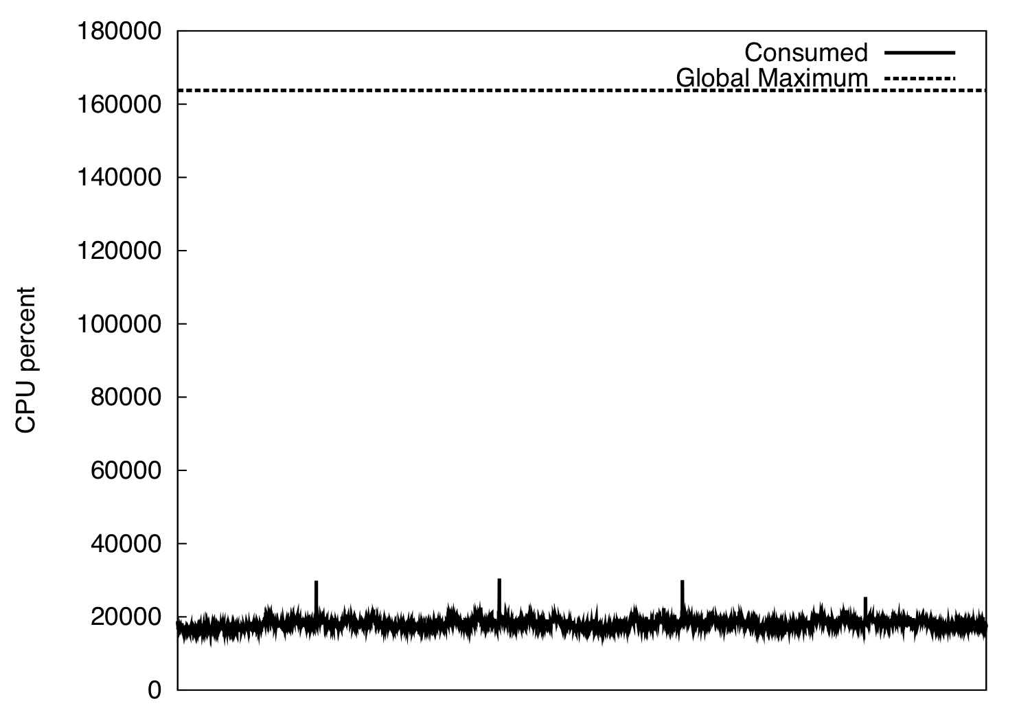
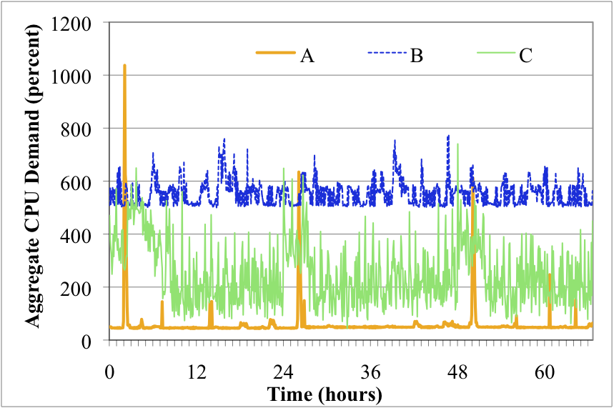
Multiplexing: The Good News…
Data from a static data center hosting business
Several customers
Massive over-provisioning
Large opportunity to increase efficiency
How do we get there?

Slide 38
Multiplexing: The Bad News…
CPU usage is too elastic…
Median lifetime < 10min
What does this imply for VM lifecycle operations?
But memory is not…
< 2x of peak usage
Notes:
Median, 8 minutes. Most, <10minutes, Most servers created last 4 minutes

Slide 39
The Elasticity Challenge
Make efficient use of memory
Memory oversubscription
De-duplication
Make VM instantiation fast and cheap
VM granularity
Cached resume/cloning
Allow dynamic reallocation of resources
VM migration and resizing
Efficient bin-packing

Slide 40
How do VMs Isolate Memory?
Shadow Page Tables: another level of indirection
a
Page Tables (virtual to physical)
CPU
Process 1
Machine Address
a
Physical Address
1
b
+
c
2
1
Process 2
c
1
Shadow page tables
Process 1
2
3
Hypervisor
a
b
4
Physical Address
Machine Address
c
5
Process 2
1
1
100
FREE
2
200
Physical to
Machine map
VM
3
300
4
400
5
500

Slide 41

Memory Oversubscription
Populate on demand: only works one way
Hypervisor paging
To disk: IO-bound
Network memory: Overdriver [VEE’11]
Ballooning [Waldspurger’02]
Respect guest OS paging policies
Allocates memory to free memory
When to stop? Handle with care
VM
VM
Guest OS
VMM
Guest OS
OS
paging
Release
pages to
VMM
Balloon
driver
Inflating the
Balloon
Allocate
pinned
pages
Balloon
driver

Slide 42
Memory Consolidation
Trade computation for memory
Memory Buddies [VEE’09]
Bloom filters to compare cross-machine similarity and find migration targets
VMM
P2M
Map
VMM
P2M
Map
Physical RAM
Physical RAM
A
A
FREE
D
D
A
FREE
A
B
B
D
D
D
VM 2 Page Table
D
VM 2 Page Table
FREE
B
FREE
B
A
A
A
A
B
B
B
C
B
C
C
VM 1 Page Table
C
VM 1 Page Table
Page Sharing [OSDI’02]
VMM fingerprints pages
Maps matching pages COW
33% savings
Difference Engine [OSDI’08]
Identify similar pages
Delta compression
Up to 75% savings

Slide 43
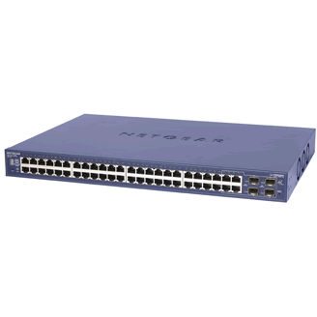
Page-granular VMs
Cloning
Logical replicas
State copied on demand
Allocated on demand
Fast VM Instantiation
Parent VM:
Disk, OS, Processes
Clone
Private
State
On-demand fetches
VM Descriptor
VM Descriptor
VM Descriptor
Metadata, Page tables, GDT, vcpu
~1MB for 1GB VM

Slide 44
Fast VM Instantiation?
A full VM is, well, full … and big
Spin up new VMs
Swap in VM (IO-bound copy)
Boot
80 seconds → 220 seconds → 10 minutes

Slide 45
Clone Time
Milliseconds
Clones
Scalable Cloning: Roughly Constant
Notes:
Multicast + start clones

Slide 46
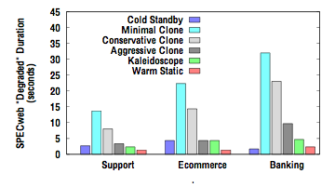

Memory Coloring
Network demand fetch has poor performance
Prefetch!?
Semantically related regions are interwoven
Introspective coloring
code/data/process/kernel
Different policy by region
Prefetch, page sharing

Slide 47
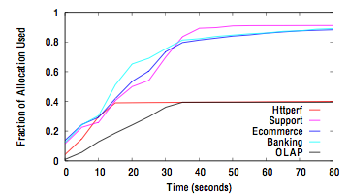
Clone Memory Footprints
For scientific computing jobs (compute)
99.9% footprint reduction (40MB instead of 32GB)
For server workloads
More modest
0%-60% reduction
Transient VMs improve efficiency of approach

Slide 48
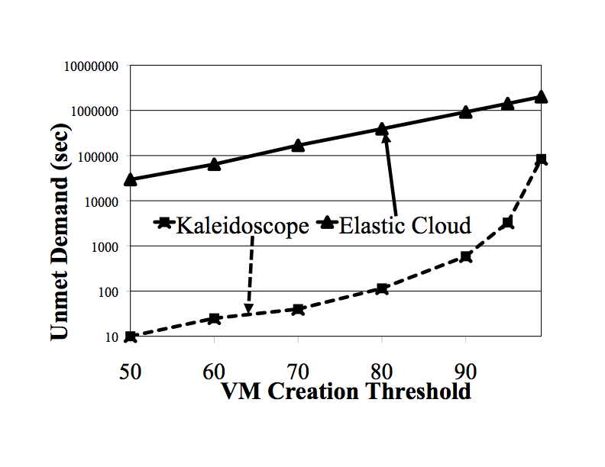
Implications for Data Centers
vs. Today’s clouds
30% smaller datacenters possible
With better QoS
98% fewer overloads

Slide 49
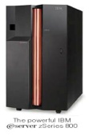
Dynamic Resource Reallocation
Monitor:
demand, utilization, performance
Decide:
Are there any bottlenecks?
Who is affected?
How much more do they need?
Act:
Adjust VM sizes
Migrate VMs
Add/remove VM replicas
Add/remove capacity
Decide
Act/Adapt
Monitor.
Shared Resource Pool with Applications
Notes:
Challenges:
Multi-tier applications
Preserve end-to-end performance
Minimize power usage/cost
Continuous reconfiguration is never free

Slide 50
Blackbox Techniques
Hotspot Detection [NSDI’07]
Application agnostic profiles
CPU, network, disk – can monitor in VMM
Migrate VM when high utilization
e.g., Volume = 1/(1-CPU)*1/(1-Net)*1/(1-Disk)
Pick migrations to maximize volume per byte moved
Drawbacks
What is a good high utilization watermark?
Detect problems only after they’ve happened
No predictive capability – how much more is needed?
Dependencies between VMs?

Slide 51
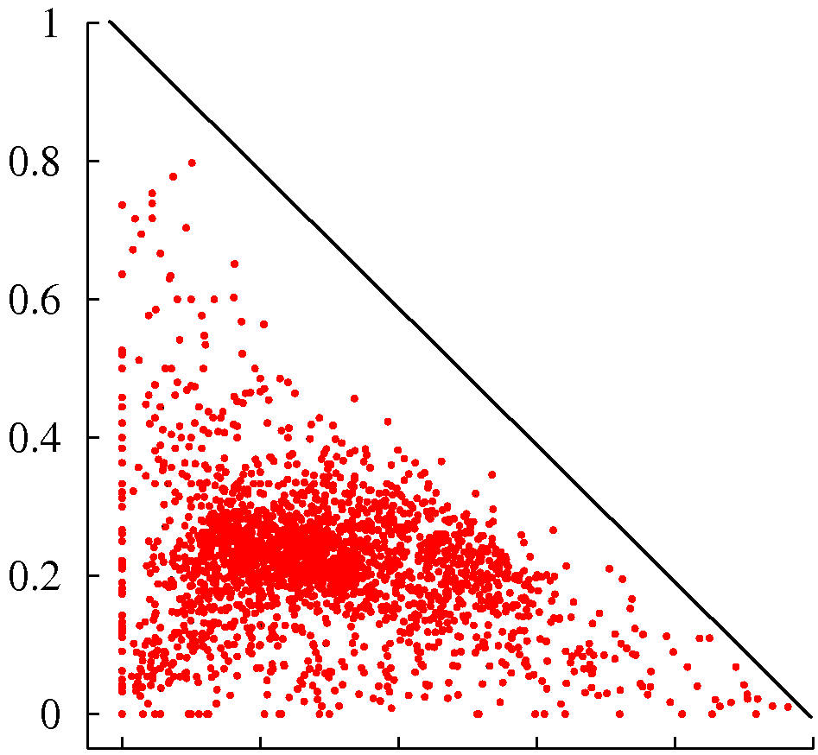
Up the Stack: Graybox Techniques
Queuing models
Response time
Predictive
Dependencies
Fraction of 2nd Most Popular Transaction
Learn models on the fly
Exploit non-stationarity
Online regression [NSDI’07]
Graybox
Fraction of Most Popular Transaction

Slide 52
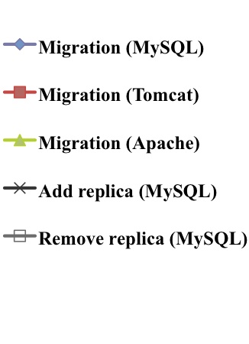
Comparative Analysis of Actions
Different actions, costs, outcomes
Change VM allocations
VM migrations, add/remove VM clones
Add or remove physical capacity
Response time Penalty
Energy Penalty

Slide 53
Acting to Balance Cost vs. Benefit
Adaptation costs are immediate, benefits accrued over time
Pick actions to maximize benefit after recouping costs
unknown window W of benefit accrual (forecasting)
adaptation
starts
Time
adaptation
completed
time to recoup costs
known adaptation duration
U = (W - ∑ da^{k}) ∑ (ΔPerf+ΔResources) −∑ (da^{k} ∑ Perf_{a}+Resources)
a^{k}∈A
s∈S
a^{k}∈A
s∈S
Benefit
Adaptation Cost

Slide 54
Conjoint Sequential Optimization
Perf. Model
Reconf. Model
Pwr. Model
Adjust VM quotas
Add VM replicas
Remove VM replicas
Migrate VMs
Remove capacity
Add capacity
Controller
Current config
Stop reconf.
(benefit)
c_{max}
Reconf. Actions
(costs)
Final reconf.
c_{new1}
c_{new2}
c_{new3}
…….
c_{new}n
c_{new1}
c_{new2}
c_{new3}
…….
c_{new}n
……
Ideal configuration
DB Server
Adapt. Action
Demand
Optimize performance, infrastructure use, adaptation penalties
Infrastructure
Web Server
App. Server
DB Server
Domain-0
DB Server
App. Server
Domain-0
OS
Image
VM
VM
VM
VM
VM
VM
Storage
Hypervisor
Hypervisor
Active Hosts

Slide 55
Let’s talk about failures

Slide 56
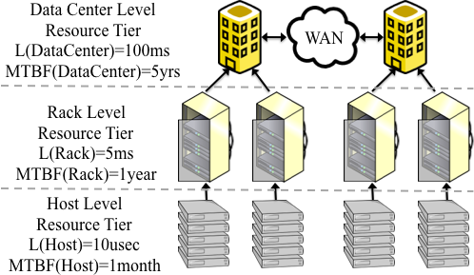
Assume Anything can Fail
But can it fail all at once?
How to avoid single failure points?
EC2 availability zones
Independent DCs, close proximity
March outage was across zones
EBS control plane dependency across zones
Ease of use/efficiency/independence tradeoff
What about racks, switches, power circuits?
Fine-grained availability control
Without exposing proprietary information?
Notes:
Reference: deep analysis of EC2 outage
EC2 places VMs from a single user on different hosts

Slide 57
Peeking over the Wall
Users provide VM-level HA groups [DCDV’11]
Application-level constraints
e.g., primary and backup VMs
Provider places HA group to avoid common risk factors
Users provide desired MTBF for HA groups [DSN’10]
Providers use infrastructure dependencies and MTBF values to guide placement
Optimization problem: capacity, availability, performance

Slide 58
Data Center Diagnosis
Whose problem is it?
Application? Host? Network?
Who detects it?
Cloud users don’t know topology
Providers don’t know applications
[NSDI’11]
Lightweight, application independent monitors

Slide 59
Network Security
Every VM gets private/public IP
VMs can choose access policy by IP/groups
IP firewalls ensure isolation
Good enough?

Slide 60
Information Leakage
Is your target on in a cloud?
Traceroute
Network triangulation
Are you on the same machine?
IP addresses
Latency checks
Side channels (cache interference)
Can you get on the same machine?
Pigeon-hole principle
Placement locality
Notes:
Hey you – get off my cloud (Ristenpart)

Slide 61
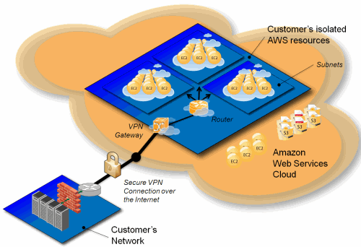
Network Security Evolved
Virtual private clouds
Amazon, AT&T, Verizon
MPLS VPN connection to cloud gateway
Internal VLANs within cloud
Virtual gateways, firewalls
Remove external addressability
Doesn’t protect external facing assets
Source: Amazon AWS

Slide 62
Security: Trusted Computing Bases
Isolation is the fundamental property of IaaS
That’s why we have VMs … and not a cloud OS
Narrower interfaces
Smaller TCBs
Really?

Slide 63
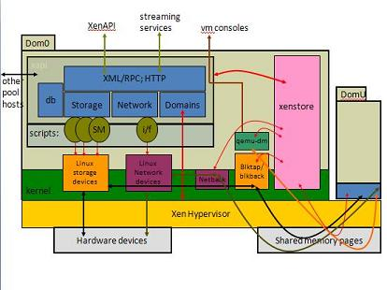
The Xen TCB
Hypervisor
Domain0
Linux Kernel
Linux distribution
Network services
Shell
Control stack
VM mgmt tools
Boot-loader
Checkpointing

Slide 64
Smaller TCBs
Dom0 disaggregation, Nova
No TCB? Homomorphic encryption!

Slide 65
Remember
Moving up the stack helps
Multiplexing
Resource allocation
Design for availability
Diagnosability
Moving down the stack helps
Security
Privacy

Slide 66
Learn From a Use Case: Netflix
Transcoding Farm
It does not hold customer sensitive data
It has a clean failure model: restart
You can horizontally scale this at will

Slide 67
Learn From a Use Case: Netflix
Search Engine
It does not hold customer sensitive data
It has a clean failure model: no updates
You can horizontally scale this at will
It can tolerate eventual consistency

Slide 68
Learn From a Use Case: Netflix
Recommendation Engine
It does not hold customer sensitive data
It has a clean failure model: global index
You can horizontally scale this at will
It can tolerate eventual consistency

Slide 69
Learn From a Use Case: Netflix
“Learn with real scale, not toy models”
Why not? It costs you ten bucks
Chaos Monkey
Why not? Things will fail eventually
Nothing is fast, everything is independent

Slide 70
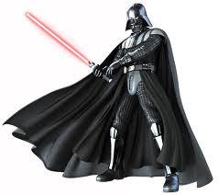
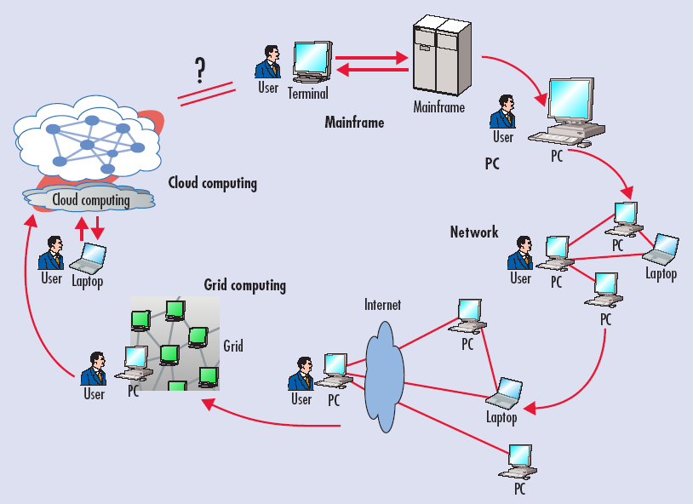

The circle is now complete…
Source: Voas, Jeffrey; Zhang, Jia. Cloud Computing: New Wine or Just a New Bottle? In IT Professional, March 2009, Volume 11, Issue 2, pp 15-17.

Slide 71
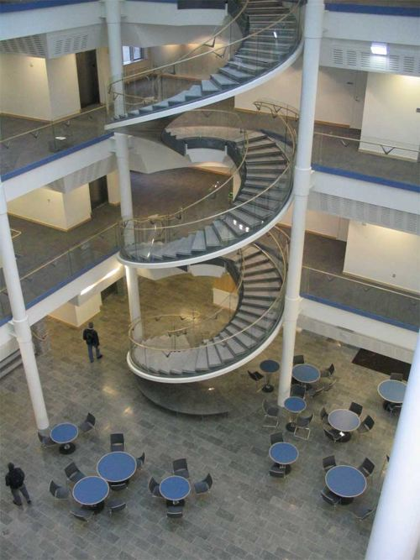
…or is it?
Tradeoffs driven by application rather than technology needs
Scale, global reach
Mobility of users, servers
Increasing democratization
Questions?

