Slide 1
NLP and ML in Scala with Breeze
David Hall
UC Berkeley
9/18/2012
dlwh@cs.berkeley.edu

Slide 2

What Is Breeze?

Slide 3
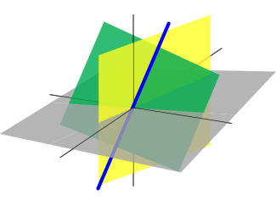
What Is Breeze?
≥
Dense Vectors, Matrices, Sparse Vectors,
Counters, Decompositions, Graphing, Numerics

Slide 4
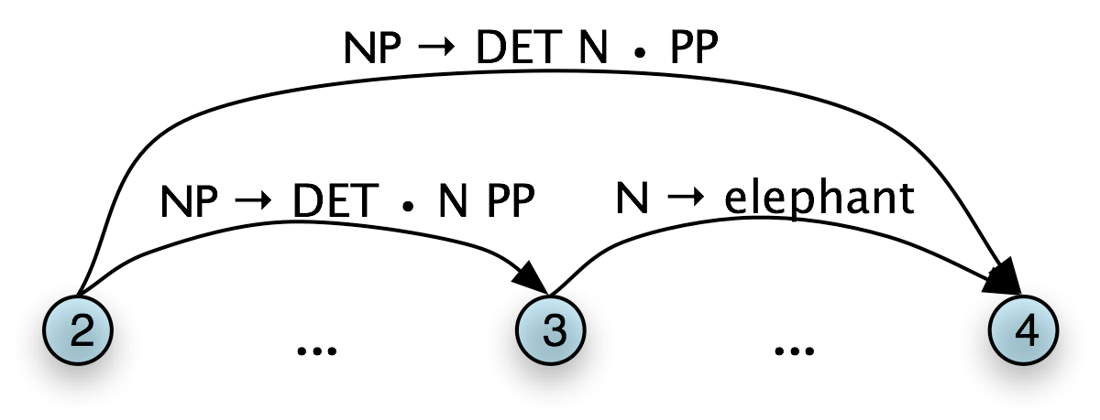
What Is Breeze?
≥
Stemming, Segmentation,
Part of Speech Tagging, Parsing (Soon)

Slide 5
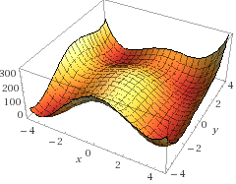
What Is Breeze?
≥
Nonlinear Optimization,
Logistic Regression, SVMs,
Probability Distributions

Slide 6
What Is Breeze?
Scalala
≥
+
ScalaNLP/Core

Slide 7
What are Breeze’s goals?
Build a powerful library that is as flexible as Matlab, but is still well-suited to building large scale software projects.
Build a community of Machine Learning and NLP practitioners to provide building blocks for both research and industrial code.

Slide 8
This talk
Quick overview of Scala
Tour of some of the highlights:
Linear Algebra
Optimization
Machine Learning
Some basic NLP
A simple sentiment classifier

Slide 9


Slide 10
Static vs. Dynamic languages
Java
Python
Type Checking
High(ish) performance
IDE Support
Fewer tests
Concise
Flexible
Interpreter/REPL
“Duck Typing”

Slide 11
Scala
Type Checking
High(ish) performance
IDE Support
Fewer tests
Concise
Flexible
Interpreter/REPL
“Duck Typing”

Slide 12
=
Concise

Slide 13
Concise: Type inference
val myList = List(3,4,5)
val pi = 3.14159

Slide 14
Concise: Type inference
val myList = List(3,4,5)
val pi = 3.14159
var myList2 = myList

Slide 15
Concise: Type inference
val myList = List(3,4,5)
val pi = 3.14159
var myList2 = myList
myList2 = List(4,5,6) // ok

Slide 16
Concise: Type inference
val myList = List(3,4,5)
val pi = 3.14159
var myList2 = myList
myList2 = List(4,5,6) // ok
myList2 = List(“Test!”) // error!

Slide 17
Verbose: Manual Loops
// Java ☹
ArrayList<Integer> plus1List = new
ArrayList<Integer>();
for(int i: myList) {
plus1List.add(i+1);
}

Slide 18
Concise, More Expressive
val myList = List(1,2,3)
def plus1(x: Int) = x + 1
val plus1List = myList.map(plus1)

Slide 19
Concise, More Expressive
val myList = List(1,2,3)
val plus1List = myList.map(_ + 1)
Gapped Phrases!

Slide 20
Verbose, Less Expressive
// Java ☹
int sum = 0
for(int i: myList) {
sum += i;
}

Slide 21
Concise, More Expressive
val sum = myList.reduce(_ + _)

Slide 22
Concise, More Expressive
val sum = myList.reduce(_ + _)
val alsoSum = myList.sum

Slide 23
Concise, More Expressive
val sum = myList.par.reduce(_ + _)
Parallelized!

Slide 24

Title
Body
Location
: String
: String
: URL
Notes:
http://www.elitetranslingo.com/css/css/images/doc.png

Slide 25
Verbose, Less Expressive
// Java
public final class Document {
private String title;
private String body;
private URL location;
public Document(String title, String body, URL location) {
this.title = title;
this.body = body;
this.locaiton = location;
}
public String getTitle() { return title; }
public String getBody() {return body; }
public String getURL() { return location; }
@Override
public boolean equals(Object other) {
if(!(other instanceof Document)) return false;
Document that = (Document) other;
return getTitle() == that.getTitle()
&& getBody() == that.getBody()
&& getURL() == that.getURL();
}
public int hashCode() {
int code = 0;
code = code * 37 + getTitle().hashCode();
code = code * 37 + getBody().hashCode();
code = code * 37 + getURL().hashCode();
return code;
}
}

Slide 26
Concise, More Expressive
// Scala
case class Document(
title: String,
body: String,
url: URL)

Slide 27
Scala: Ugly Python
# Python
def foo(size, value):
[ i + value for i in range(size)]

Slide 28
Scala: Ugly Python
# Python
def foo(size, value):
[ i + value for i in range(size)]
// Scala
def foo(size: Int, value: Int) = {
for(i <- 0 until size)
yield i + value
}

Slide 29
Scala: Ugly Python
// Scala
class MyClass(arg1: Int, arg2: T) {
def foo(bar: Int, baz: Int) = {
…
}
def equals(other: Any) = {
// …
}
}

Slide 30
Scala: Ugly Python?
# Python
class MyClass:
def __init__(self, arg1, arg2):
self.arg1 = arg1
self.arg2 = arg2
def foo(self, bar, baz):
# …
def __eq__(self, other):
# …

Slide 31
Scala: Ugly Python
Pretty
# Python
class MyClass:
def __init__(self, arg1, arg2):
self.arg1 = arg1
self.arg2 = arg2
def foo(self, bar, baz):
# …
def __eq__(self, other):
# …

Slide 32
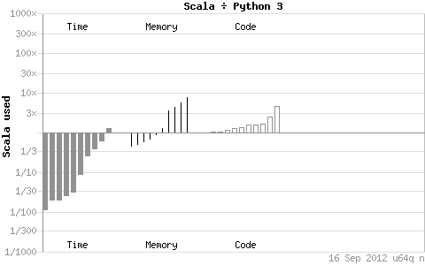
Scala: Fast Pretty Python

Slide 33
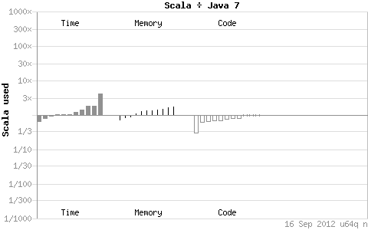
Scala: Fast Pretty Python

Slide 34
Scala: Performant, Concise, Fun
Usually within 10% of Java for ~1/2 the code.
Usually 20-30x faster than Python, for ± the same code.
Tight inner loops can be written as fast as Java
Great for NLP’s dynamic programs
Typically pretty ugly, though
Outer loops can be written idiomatically
aka more slowly, but prettier

Slide 35
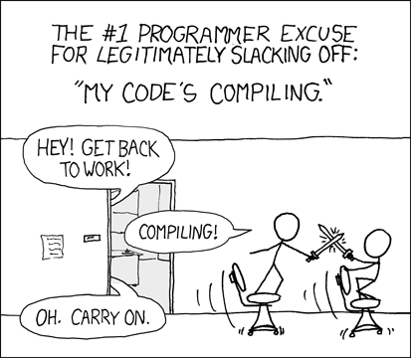
Scala: Some Downsides
IDE support isn’t as strong as for Java.
Getting better all the time
Compiler is much slower.

Slide 36
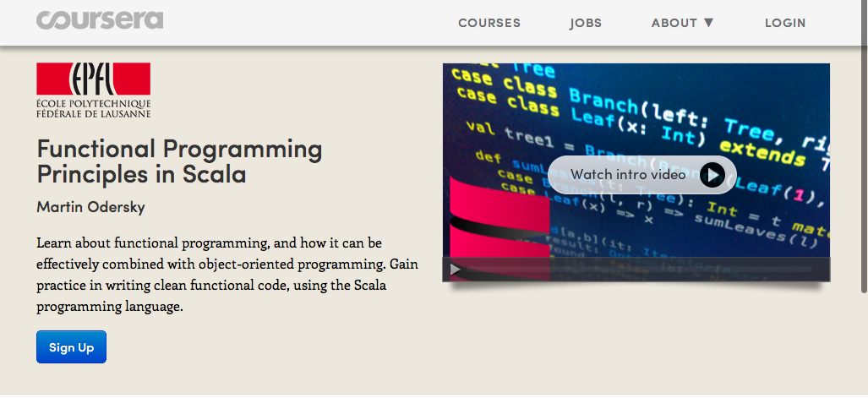
Learn more about Scala
https://www.coursera.org/course/progfun
Starts today!

Slide 38
Getting started
libraryDependencies ++= Seq(
// other dependencies here
// pick and choose:
"org.scalanlp" %% "breeze-math" % "0.1",
"org.scalanlp" %% "breeze-learn" % "0.1",
"org.scalanlp" %% "breeze-process" % "0.1",
"org.scalanlp" %% "breeze-viz" % "0.1"
)
resolvers ++= Seq(
// other resolvers here
// Snapshots: use this. (0.2-SNAPSHOT)
"Sonatype Snapshots" at "https://oss.sonatype.org/content/repositories/snapshots/"
)
scalaVersion := "2.9.2"

Slide 39
Breeze-Math

Slide 40
Linear Algebra
import breeze.linalg._
val x = DenseVector.zeros[Int](5)
// DenseVector(0, 0, 0, 0, 0)
val m = DenseMatrix.zeros[Int](5,5)
val r = DenseMatrix.rand(5,5)
m.t // transpose
x + x // addition
m * x // multiplication by vector
m * 3 // by scalar
m * m // by matrix
m :* m // element wise mult, Matlab .*

Slide 41
Linear Algebra: Return type selection
scala> val dv = DenseVector.rand(2)
dv: breeze.linalg.DenseVector[Double] = DenseVector(0.42808779630213867, 0.6902430375224726)
scala> val sv = SparseVector.zeros[Double](2)
sv: breeze.linalg.SparseVector[Double] = SparseVector()
scala> dv + sv
res3: breeze.linalg.DenseVector[Double] = DenseVector(0.42808779630213867, 0.6902430375224726)
scala> (dv: Vector[Double]) + (sv: Vector[Double])
res4: breeze.linalg.Vector[Double] = DenseVector(0.42808779630213867, 0.6902430375224726)
scala> (sv: Vector[Double]) + (sv: Vector[Double])
res5: breeze.linalg.Vector[Double] = SparseVector()
Dense
Static: Vector
Dynamic: Dense
Static: Vector
Dynamic: Sparse

Slide 42
Linear Algebra: Slices
m(::,1) // slice a column
//→ DenseVector(0, 0, 0, 0, 0)
m(4,::) // slice a row
m(4,::) := DenseVector(1,2,3,4,5).t
m.toString:
0 0 0 0 0
0 0 0 0 0
0 0 0 0 0
0 0 0 0 0
1 2 3 4 5

Slide 43
Linear Algebra: Slices
m(0 to 1, 3 to 4).toString
//0 0
//2 3
m(IndexedSeq(3,1,4,2),IndexedSeq(4,4,3,1))
//0 0 0 0
//0 0 0 0
//5 5 4 2
//0 0 0 0

Slide 44
UFuncs
import breeze.numerics._
log(DenseVector(1.0, 2.0, 3.0, 4.0))
// DenseVector(0.0, 0.6931471805599453,
// 1.0986122886681098, 1.3862943611198906)
exp(DenseMatrix( (1.0, 2.0), (3.0, 4.0)))
sin(Array(2.0, 3.0, 4.0, 42.))
// also sin, cos, sqrt, asin, floor, round, digamma, trigamma

Slide 45
UFuncs: Implementation
trait Ufunc[-V, +V2] {
def apply(v: V):V2
def apply[T,U](t: T)(implicit cmv:
CanMapValues[T, V, V2, U]):U = {
cmv.map(t, apply _)
}
}
// elsewhere:
val exp = UFunc(scala.math.exp _)

Slide 46
UFuncs: Implementation
new CanMapValues[DenseVector[V], V, V2, DenseVector[V2]] {
def map(from: DenseVector[V], fn: (V) => V2) = {
val arr = new Array[V2](from.length)
val d = from.data
val stride = from.stride
var i = 0
var j = from.offset
while(i < arr.length) {
arr(i) = fn(d(j))
i += 1
j += stride
}
new DenseVector[V2](arr)
}
}

Slide 47
URFuncs
val r = DenseMatrix.rand(5,5)
// sum all elements
sum(r):Double
// mean of each row into a single column
mean(r, Axis._1): DenseVector[Double]
// sum of each column into a single row
sum(r, Axis._0): DenseMatrix[Double]
// also have variance, normalize

Slide 48
URFuncs: the magic
trait URFunc[A, +B] {
def apply(cc: TraversableOnce[A]):B
def apply[T](c: T)(implicit urable: UReduceable[T, A]):B = {
urable(c, this)
}
def apply(arr: Array[A]):B = apply(arr, arr.length)
def apply(arr: Array[A], length: Int):B = apply(arr, 0, 1, length, {_ => true})
def apply(arr: Array[A], offset: Int, stride: Int, length: Int, isUsed: Int=>Boolean):B = {
apply((0 until length).filter(isUsed).map(i => arr(offset + i * stride)))
}
def apply(as: A*):B = apply(as)
def apply[T2, Axis, TA, R](
c: T2,
axis: Axis)
(implicit collapse: CanCollapseAxis[T2, Axis, TA, B, R],
ured: UReduceable[TA, A]): R = {
collapse(c,axis)(ta => this.apply[TA](ta))
}
}
Optional Specialized Impls
How Axis stuff works

Slide 49
URFuncs: the magic
trait Tensor[K, V] {
// …
def ureduce[A](f: URFunc[V, A]) = {
f(this.valuesIterator)
}
}
trait DenseVector[E] … {
override def ureduce[A](f: URFunc[E, A]) = {
if(offset == 0 && stride == 1)
f(data, length)
else
f(data, offset, stride, length, {(_:Int) => true})
}
}

Slide 50
Breeze-Viz

Slide 51
Breeze-Viz
VERY ALPHA API
2-d plotting, via JFreeChart
import breeze.plot._

Slide 52
Plotting
val f = Figure()
val p = f.subplot(0)
val x = linspace(0.0,1.0)
p += plot(x, x :^ 2.0)
p += plot(x, x :^ 3.0, '.')
p.xlabel = "x axis"
p.ylabel = "y axis"
f.saveas("lines.png") // also pdf, eps

Slide 53
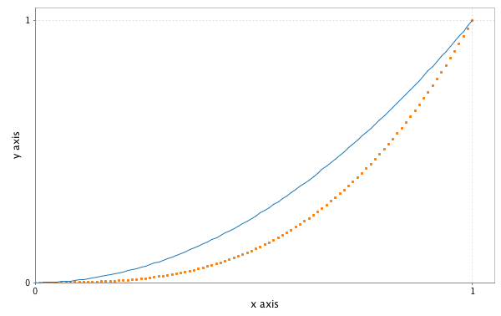
Plotting

Slide 54
Plotting
val p2 = f.subplot(2,1,1)
val g = Gaussian(0,1)
p2 += hist(g.sample(100000),100)
p2.title = "A normal distribution”

Slide 55
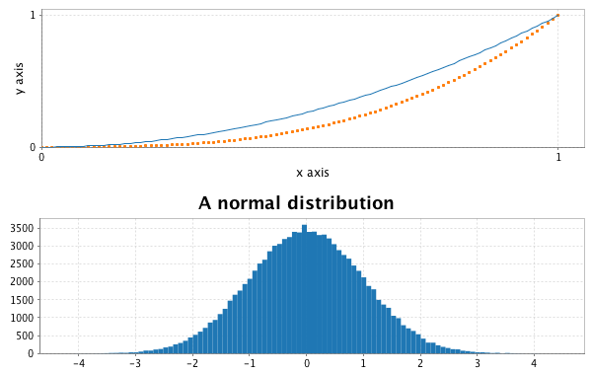
Plotting

Slide 56
Breeze-Learn

Slide 57
Breeze-Learn
Optimization
Machine Learning
Probability Distributions

Slide 58
Breeze-Learn
Optimization
Convex Optimization: LBFGS, OWLQN
Stochastic Gradient Descent: Adaptive Gradient Descent
Linear Program DSL, solver
Bipartite Matching

Slide 59
Optimize

Slide 60
Optimize
trait DiffFunction[T] extends (T=>Double) {
/** Calculates both the value and the gradient at a point */
def calculate(x:T):(Double,T);
}

Slide 61
Optimize
val df = new DiffFunction[DV[Double]] {
def calculate(values: DV[Double]) = {
val gradient = DV.zeros[Double](2)
val (x,y) = (values(0),values(1))
val value = pow(x* x + y - 11, 2) +
pow(x + y * y - 7, 2)
gradient(0) = 4 * x * (x * x + y - 11) +
2 * (x + y * y - 7)
gradient(1) = 2 * (x * x + y - 11) +
4 * y * (x + y * y - 7)
(value, gradient)
}
}

Slide 62
Optimize
val lbfgs = new LBFGS[DenseVector[Double]]
lbfgs.minimize(df, DenseVector.rand(2))
// DenseVector(2.999983, 2.000046)

Slide 63
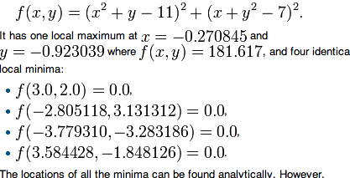
Optimize
val lbfgs = new LBFGS[DenseVector[Double]]
lbfgs.minimize(df, DenseVector.rand(2))
// DenseVector(2.999983, 2.000046)

Slide 64
Breeze-Learn
Classify
Logistic Classifier
SVM
Naïve Bayes
Perceptron

Slide 65
Breeze-Learn
val trainingData = Array (
Example("cat", Counter.count("fuzzy","claws","small")),
Example("bear",
Counter.count("fuzzy","claws","big”)),
Example("cat",
Counter.count("claws","medium”))
)
val testData = Array(
Example("????", Counter.count("claws","small”))
)

Slide 66
Breeze-Learn
new LogisticClassifier
.Trainer[L,Counter[T,Double]]()
val classifier = trainer.train(trainingData)
classifier(Counter.count(“fuzzy”, “small”)) == “cat”

Slide 67
Breeze-Learn
Distributions
Poisson, Gamma, Gaussian, Multinomial, Von Mises…
Sampling, PDF, Mean, Variance, Maximum Likelihood Estimation

Slide 68
Breeze-Learn
val poi = new Poisson(3.0)
val samples = poi.sample(1000)
meanAndVariance(samples.map(_.toDouble))
// (2.989999999999995,3.0009009009009)
(poi.mean, poi.variance)
// (Double, Double) = (3.0,3.0)

Slide 69
Let’s build something…
Sentiment Classification
Given a movie review, predict whether it is positive or negative.
Dataset:
Bo Pang, Lillian Lee, and Shivakumar Vaithyanathan, Thumbs up? Sentiment Classification using Machine Learning Techniques, EMNLP 2002
http://www.cs.cornell.edu/people/pabo/movie-review-data/

Slide 70


Anatomy of a Classifier
+
x

Slide 71
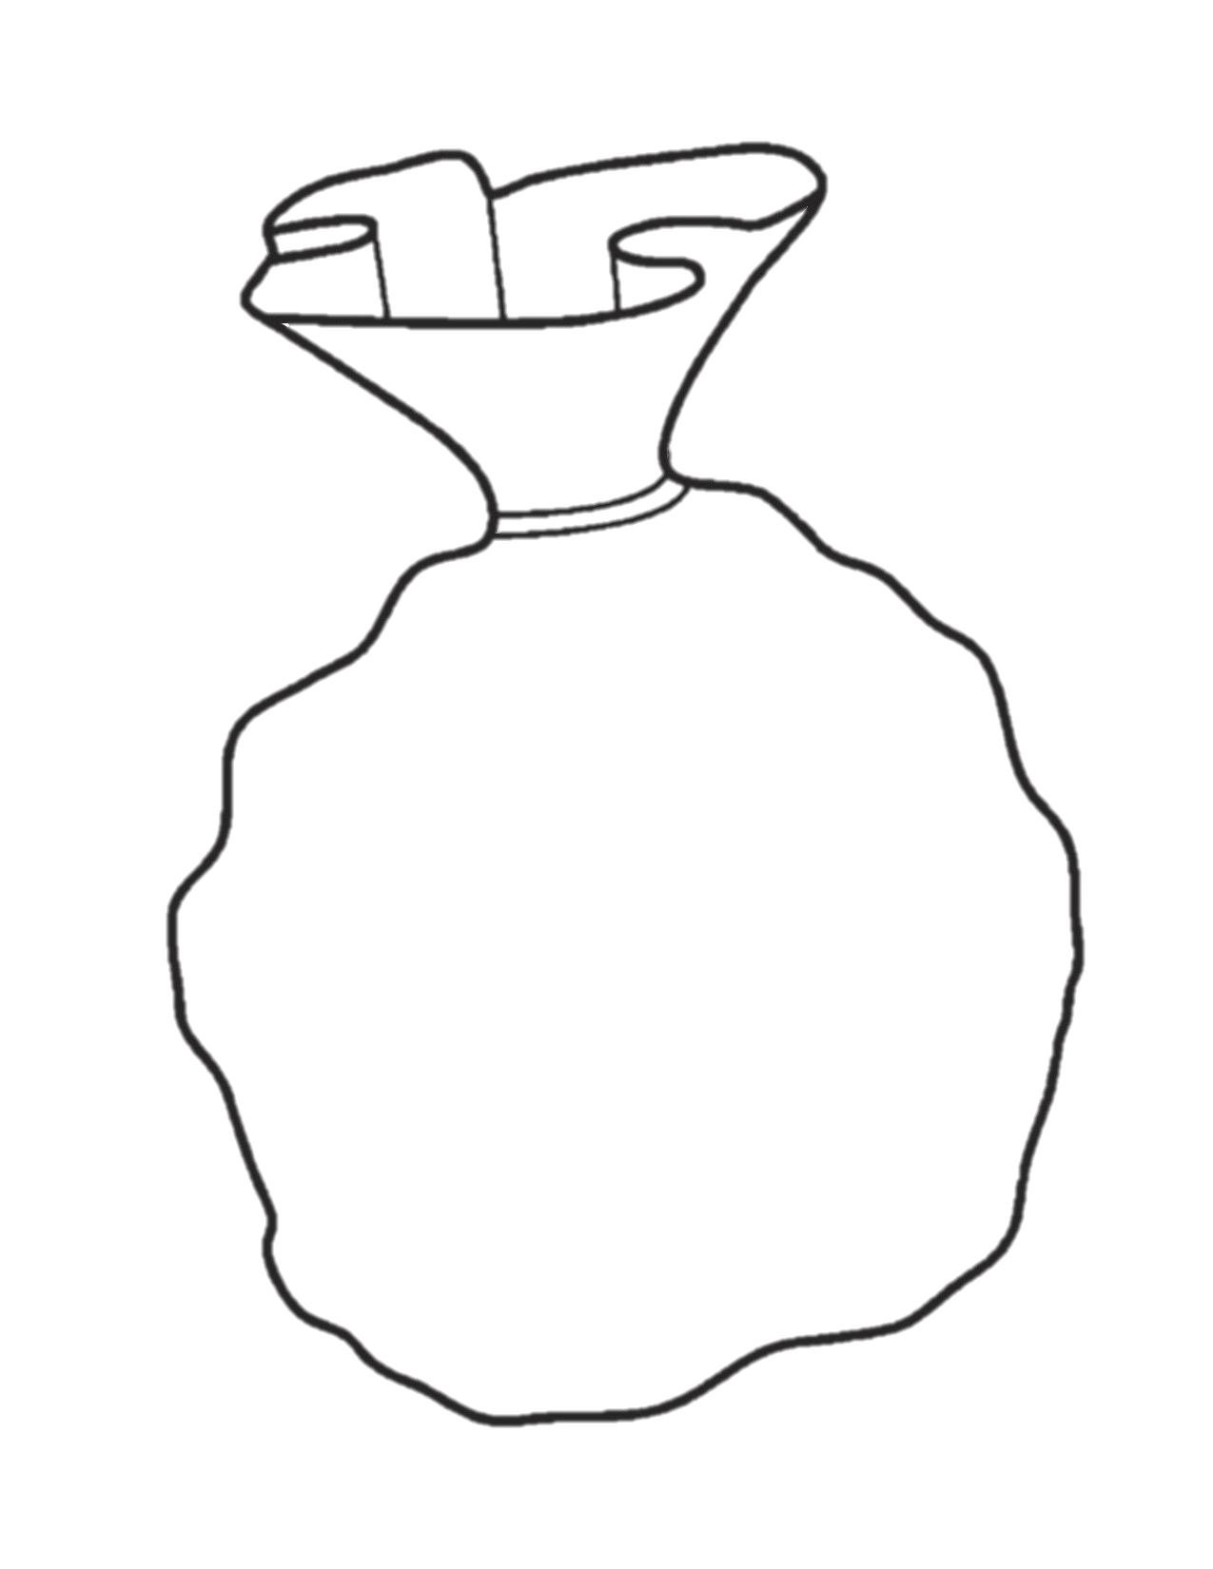

Anatomy of a Classifier
+
wonderful
wonder-
+
a
see-
seen
epic
Notes:
http://etc.usf.edu/clipart/41200/41273/bag_41273_lg.gif

Slide 72
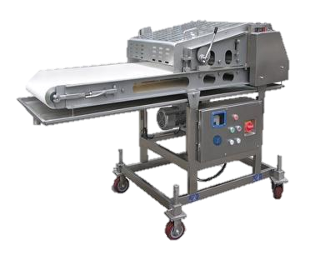
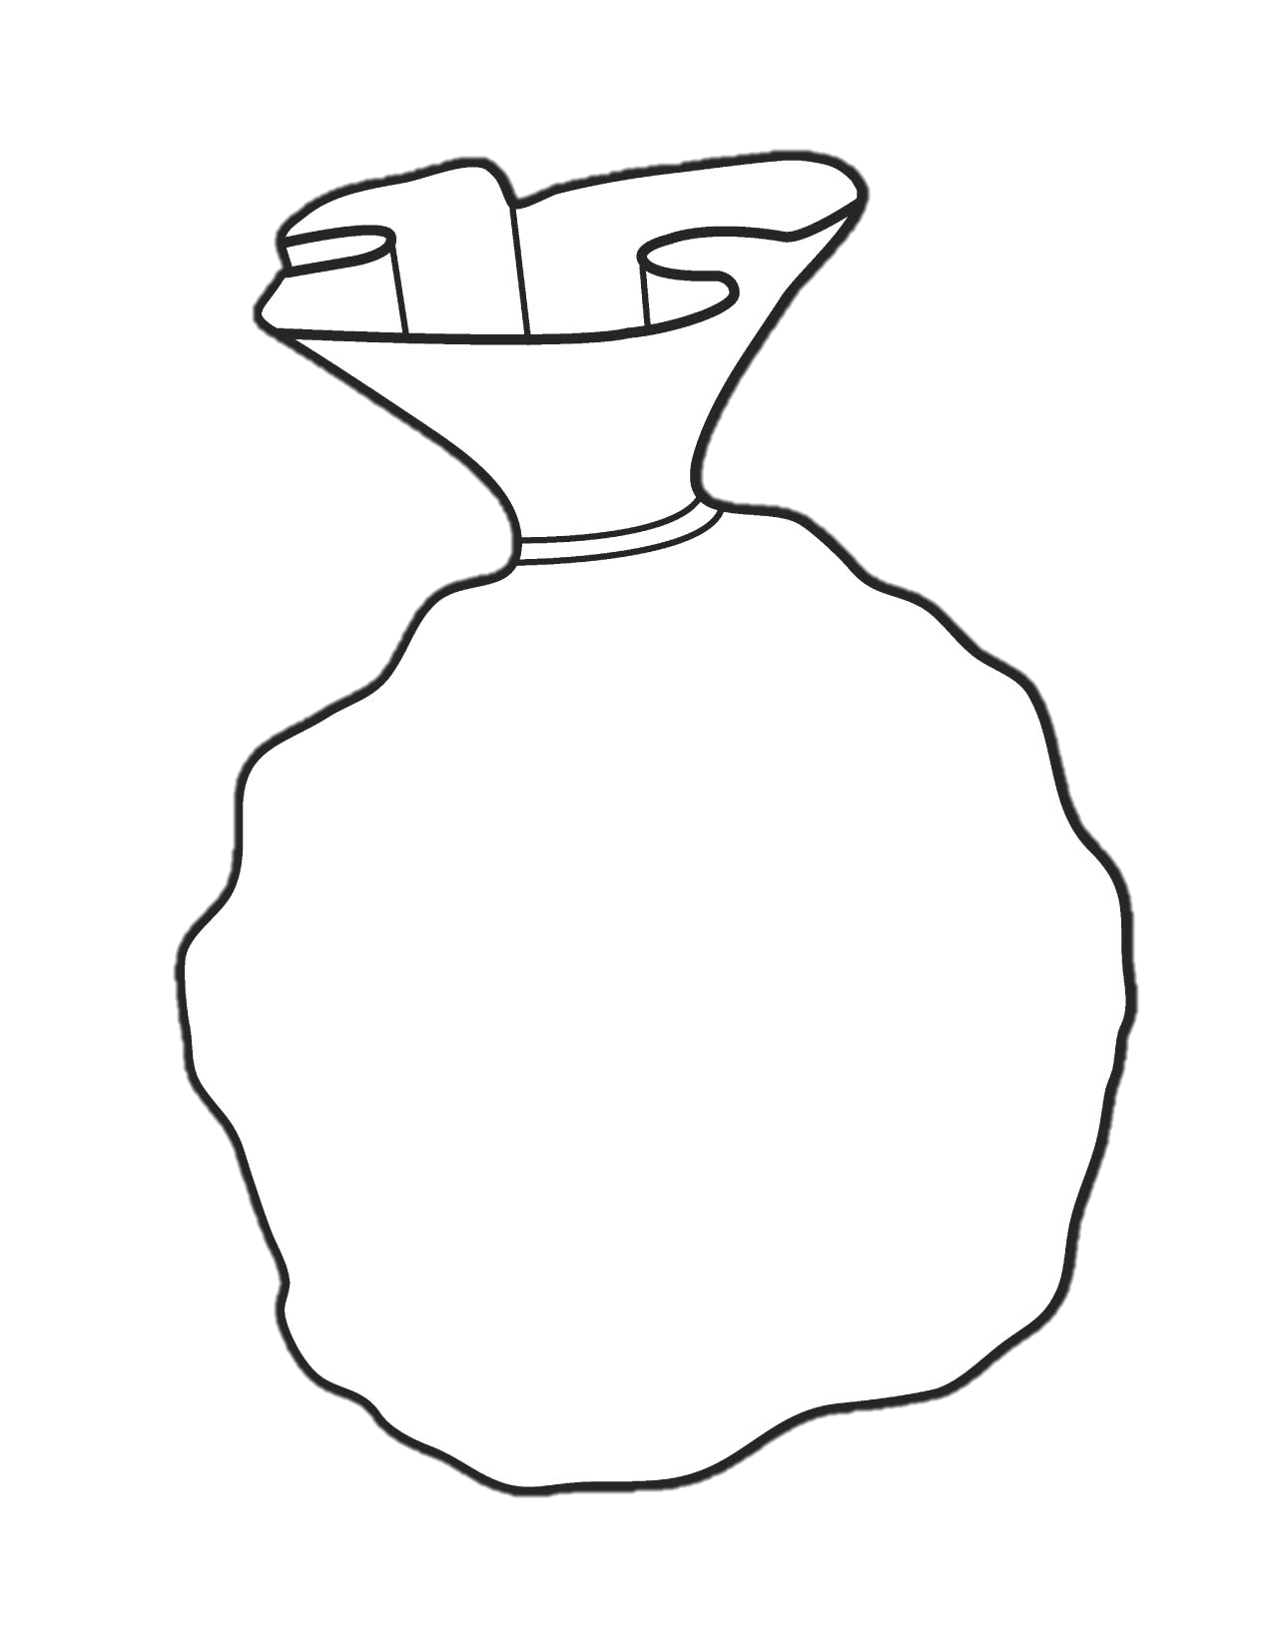
Anatomy of a Classifier
+
wonderful
wonder-
a
see-
seen
epic
Index[Feature]
Notes:
http://etc.usf.edu/clipart/41200/41273/bag_41273_lg.gif

Slide 73

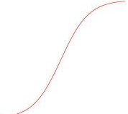
Anatomy of a Classifier
f(x)

Slide 74
Let’s build something…
object SentimentClassifier {
case class Params(
@Help(text="Path to txt_sentoken in the dataset.")
train:File,
help: Boolean = false)
// …

Slide 75
Parsing command line options
def main(args: Array[String]) {
// Read in parameters, ensure they're right and dump help if necessary
val (config,seqArgs) = CommandLineParser.parseArguments(args)
val params = config.readIn[Params](“”)
if(params.help) {
println(GenerateHelp[Params](config))
sys.exit(1)
}

Slide 76
Reading in data
val tokenizer = breeze.text.LanguagePack.English
val data: Array[Example[Int, IndexedSeq[String]]] = {
for {
dir <- params.train.listFiles();
f <- dir.listFiles()
} yield {
val slurped = Source.fromFile(f).mkString
val text = tokenizer(slurped).toIndexedSeq
// data is in pos/ and neg/ directories
val label = if(dir.getName =="pos") 1 else 0
Example(label, text, id = f.getName)
}
}

Slide 77
Some useful processing stuff:
val langData = breeze.text.LanguagePack.English
// Porter Stemmer
val stemmer = langData.stemmer.get

Slide 78
Porter stemmer examples
scala> PorterStemmer(”waste")
res15: String = wast
scala> PorterStemmer(”wastes")
res16: String = wast
scala> PorterStemmer(”wasting")
res17: String = wast
scala> PorterStemmer(”wastetastic")
res18: String = wastetast

Slide 79
Some features
sealed trait Feature
case class WordFeature(w: String) extends Feature
case class StemFeature(w: String) extends Feature
// We're going to use SparseVector representations
// of documents.
// An Index maps Features to Ints and back again.
val featureIndex = Index[Feature]()

Slide 80
Extract features for each example
def extractFeatures(ex: Example[Int, ISeq[String]]) = {
ex.map { words =>
val builder = new SparseVector.Builder[Double](Int.MaxValue)
for(w <- words) {
val fi = featureIndex.index(WordFeature(w))
val s = stemmer(w)
val si = featureIndex.index(StemFeature(s))
builder.add(fi, 1.0)
builder.add(si, 1.0)
}
builder
}
}

Slide 81
Extract features for each example
val extractedData = (
data
map(extractFeatures)
map { ex =>
ex.map{ builder =>
builder.dim = featureIndex.size
builder.result()
}
}
)

Slide 82
Build the classifier!
val (train, test) = splitData(extractedData)
val opt = OptParams(maxIterations=60,
useStochastic=false,
useL1=true) // L1 regularization gives a sparse model
val classifier = new LogisticClassifier.Trainer[Int, SparseVector[Double]](opt).train(train)
val stats = ContingencyStats(classifier, test)
println(stats)

Slide 83
Top weights
StemFeature(bad) 0.22554878
WordFeature(bad) 0.22435212
StemFeature(wast) 0.1472285
StemFeature(look) 0.14148404
WordFeature(worst) 0.138328
StemFeature(worst) 0.138328
StemFeature(attempt) 0.13563
StemFeature(bore) 0.1226431
WordFeature(only) 0.116272
StemFeature(onli) 0.116272
StemFeature(plot) 0.1162459
WordFeature(unfortunately)
StemFeature(see) -0.11374918
WordFeature(nothing) 0.1134
StemFeature(noth) 0.113431
WordFeature(seen) -0.11184
StemFeature(seen) -0.1118435
WordFeature(great) -0.10769
StemFeature(suppos) 0.10752
StemFeature(great) -0.107476

Slide 84

Breeze: What’s Next?
Improved tokenization, segmentation
Cross-lingual stuff
GPU matrices (via JavaCL or JCUDA)
More powerful/customizable classification routines
Epic: platform for “real NLP”
Parsing, Named Entity Recognition, POS Tagging, etc.
Hall and Klein (2012)

Slide 85
Thanks!
https://github.com/dlwh/breeze
http://scalanlp.org

Slide 86

No really, who is Breeze?

