Slide 1

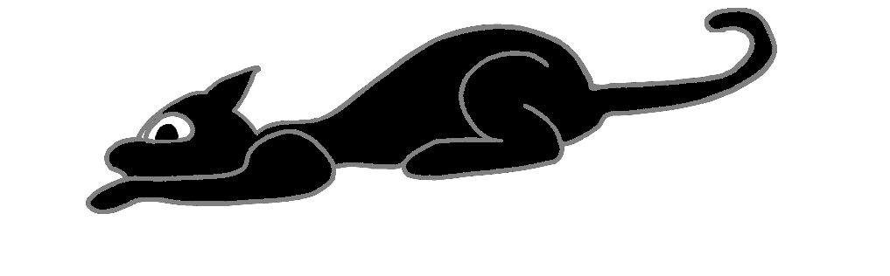
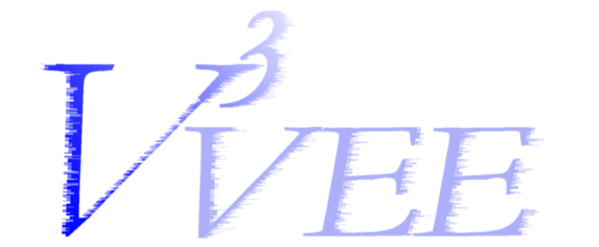


SymCall: Symbiotic Virtualization Through VMM-to-Guest Upcalls
John R. Lange and Peter Dinda
University of Pittsburgh (CS)
Northwestern University (EECS)
March 11th, 2011

Slide 2
Summary
Virtualization can scale
Near native performance for optimized VMM/guest (within 3%)
VMM needs to know about guest internals
Should modify behavior for each guest environment
Example: Paging method to use depends on guest
Black Box inference is not desirable in HPC environment
Unacceptable performance overhead
Convergence time
Mistakes have large consequences
Need guest cooperation
Guest and VMM relationship should be symbiotic

Slide 3
Outline
Semantic Gap
VM introspection is hard
Symbiotic Virtualization
Specifically design VMM/OS to maximize information sharing
SymCall
Synchronous upcalls into a running VM
SwapBypass
Transparently increase guest memory space

Slide 4
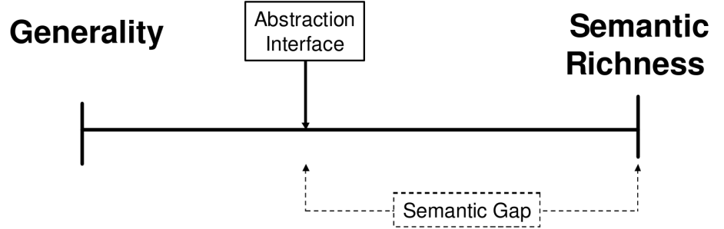
Semantic Gap
VMM architectures are designed as black boxes
Explicit OS interface (hardware or paravirtual)
Internal OS state is not exposed to the VMM
Many uses for internal state
Performance, security, etc...
VMM must recreate that state
“Bridging the Semantic Gap”
[Chen: HotOS 2001]
Two existing approaches: Black Box and Gray Box
Black Box: Monitor external guest interactions
Gray Box: Reverse engineer internal guest state
Examples
Virtuoso Project
Lycosid, Antfarm, Geiger, IBMon, many others

Slide 5
Example: Swapping
Disk storage for expanding physical memory
Application Memory Working Set
Swapped
Memory
Physical Memory
Guest
VMM
Swap Disk
Only basic knowledge without internal state

Slide 6
Symbiotic Virtualization
Bridging the semantic gap is hard
Can we design a virtual machine interface with no gap?
Symbiotic Virtualization
Design both guest OS and VMM to minimize semantic gap
2 components
Guest OS provides internal state to VMM
Guest OS services requests from VMM
Interfaces are optional

Slide 7
Symbiotic Interfaces
SymSpy Passive Interface
Internal state already exists but it is hidden
Asynchronous bi-directional communication
via shared memory
Structured state information that is easily parsed
Semantically rich
SymCall Functional Interface
Synchronous upcalls into guest during exit handling
API
Function call in VMM
System call in Guest
Brand new interface construct

Slide 8
Symbiotic Discovery
A symbiotic OS must run on real hardware
Interface must be based on hardware features
CPUID
Detection of Symbiotic VMM
MSRs
Configuration of Symbiotic interfaces

Slide 9
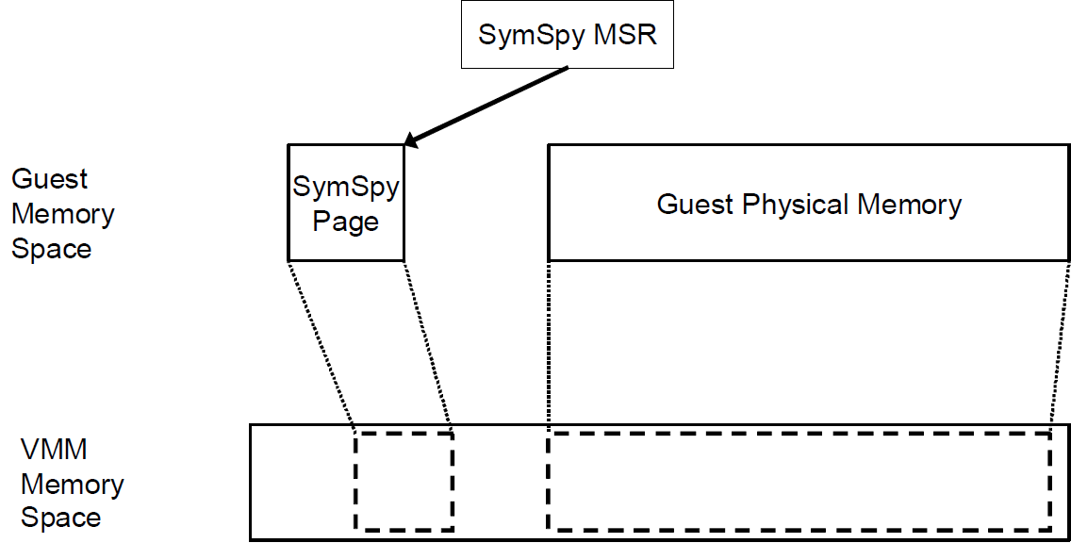
SymSpy
Shared memory page between OS and VMM
OS uses MSR to map into address space
Standardized data structures
Shared state information
Read and write without exits

Slide 10
SymCall (Symbiotic Upcalls)
Conceptually similar to System Calls
System Calls: Application requests OS services
Symbiotic Upcalls: VMM requests OS services
Designed to be architecturally similar
Virtual hardware interface
Superset of System Call MSRs
Internal OS implementation
Share same system call data structures and basic operations
Guest OS configures a special execution context
VMM instantiates that context to execute synchronous upcall
Symcalls exit via a dedicated hypercall

Slide 11
SymCall environment
Specified in virtual SYMCALL MSRs
Based on System Call MSRs
VMM copies values into hardware control registers
SYMCALL MSRs
SYMCALL_RIP
Global code entry point for all symcalls
SYMCALL_RSP
Stack frame used by SymCall
SYMCALL_CS (+SS)
Code segment and Stack segment used for SymCall
Enables kernel mode execution
SYMCALL_GS and SYMCALL_FS
Special segments that point to per CPU data structures

Slide 12
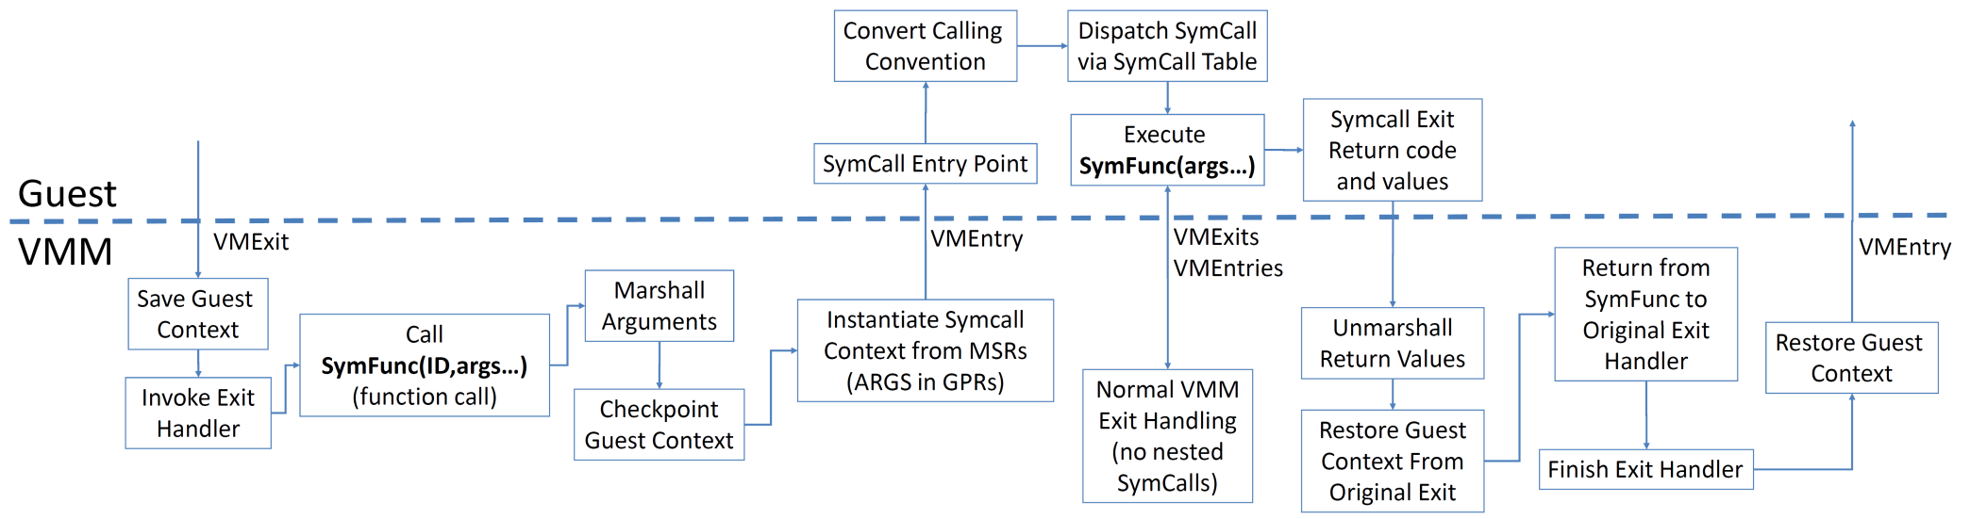
SymCall Control Flow
Handle exit

Slide 13
Existing Implementation
Symbiotic Linux guest OS
Exports SymSpy and SymCall interfaces
Palacios
Fairly significant modifications to enable nested VM entries
Re-entrant exit handlers
Serialize subset of guest state out of global hardware structures

Slide 14
Restrictions
Currently designed for short queries
Narrow focus allows behavioral guarantees
Restrictions:
Only 1 symcall active at a time
Symcalls run to completion
No blocking
Blocking would allow asynchronous behavior
No context switches
No injected exceptions or interrupts
Symcalls cannot wait on locks
Waiting would make deadlocks possible

Slide 15
Example: SwapBypass
Purpose: prevent thrashing situations
Temporarily expand guest memory
Completely bypass the Linux swap subsystem
Enabled by SymCall
Not feasible without symbiotic interfaces
VMM detects guest thrashing
Shadow page tables used to prevent it

Slide 16
Symbiotic Shadow Page tables
Guest Page Tables
Shadow Page Tables
PDE
PTE
PDE
PTE
Physical
Memory
Physical
Memory
Swap
Disk
Cache
Swapped out page
Swap Bypass Page

Slide 17
SwapBypass Concept
Application Working Set
Guest 2
Guest 3
Swapped
Memory
Guest Physical Memory
Swap Disk
VMM
physical
Memory
Global Swap
Disk Cache
Guest 3
Guest 2
Guest 1
Swap Disk

Slide 18
Necessary SymCall: query_vaddr()
Get current process ID
get_current(); (Internal Linux API)
Determine presence in Linux swap cache
find_get_page(); (Internal Linux API)
Determine page permissions for virtual address
find_vma(); (Internal Linux API)
Information extremely hard to get otherwise

Slide 19
Evaluation
Memory system microbenchmarks
Stream, GUPS, ECT Memperf
Configured to overcommit anonymous memory
Cause thrashing in the guest OS
Overhead isolated to swap subsystem
Ideal swap device implemented as RAM disk
IO occurs at main memory speeds
Provides lower bound for performance gains

Slide 20
Stream Runtime
Ideal swap cache improvement
Working set size

Slide 21
Conclusion
Palacios:
http://www.v3vee.org/palacios
V3VEE Project:
http://www.v3vee.org

Slide 22
System Calls
Entry points into Kernel
Provides privileged services for applications
Device IO, address space modifications, etc…
Extensive hardware support
Fast entry to preconfigured execution state
Switch from user mode to kernel mode
Kernel specifies execution environment to hardware
Model Specific Registers (MSRs)
Special instructions for kernel entry/exit
SYSENTER and SYSEXIT
SYSCALL and SYSRET

