Slide 1
Modular Chronic Disease Registries for QI and Comparative Effectiveness Research
Keith Marsolo, PhD
Assistant Professor
Division of Biomedical Informatics
October 13, 2010

Slide 2
Purpose & Proposal
Purpose & Proposal
Purpose:
Enhance electronic clinical capability of an existing registry:
Create and analyze valid data for comparative effectiveness research
Enhance ability to monitor and advance quality improvement of clinical care.
Proposal:
“We propose to achieve vision of a learning healthcare system by using open-source informatics tools to enhance an existing registry for children with inflammatory bowel disease (IBD) to enable better standardization and customization of care and CE research to create new knowledge about what care is best for which patients.”
Notes:
2

Slide 3
Specific Aims
Aim 1: Enhance an existing registry to support a learning healthcare system for pediatric IBD by capturing needed data directly from electronic health records, improving the quality of collected data, and facilitating interventions to improve the quality of care for children. (Informatics)
Aim 2: Use QI methods to implement enhanced IBD-registry features to enable management of IBD care center patient populations and to increase patient participation in care. (Quality Improvement)
Aim 3: Use data from the enhanced registry to compare the effectiveness of alternative treatment strategies for pediatric Crohn’s disease (CD) patients, with a special focus on timing of biologic agents. (Comparative Effectiveness)
Aim 4: Develop governance structures for the network that engages patients and provides oversight of privacy, confidentiality, and data access, as well as scientific and technical concerns. (Governance)

Slide 4
Existing Registry/Network
ImproveCareNow – pediatric IBD
Practice-based Research & Improvement Network: Measure, standardize and improve care delivery and outcomes
Started in 2007 with 10 sites, now 27 (soon 30)
Mix of public & private, urban & rural
Collect data on patient, disease status and care provided during each encounter
Capture on structured forms
Re-enter in web-based registry (Clinipace)
Provide each site with monthly reports
Process and outcome measures
Remission rates
Population management
Notes:
4

Slide 5
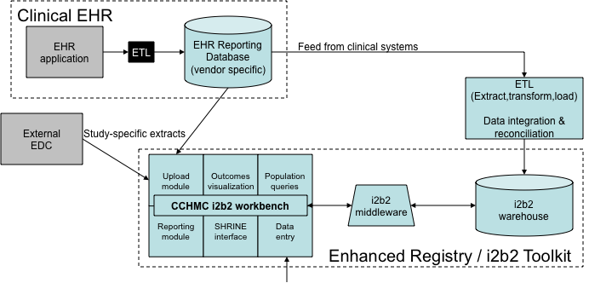
Aim 1 – i2b2 toolkit
Data in once – collect directly in EHR
Direct feed (ETL)
File upload
Direct data entry
Error-checking & exception reports
Population management & QI reports
SHRINE linkage

Slide 6
Aim 1 - Implementation
Phase 1:
All sites adopt “same” EHR build
Data is uploaded/entered into central ICN i2b2
Phase 2:
Three sites implement local i2b2s (CCHMC, Denver, CHOP)
Remaining sites upload/enter data into ICN i2b2
Phase 3:
Three additional sites implement local i2b2s (Nemours, UNC, Nationwide) – six local i2b2s total
Remaining sites upload/enter data into ICN i2b2
Communication in Phases 2 & 3 occurs via SHRINE

Slide 7
Challenges
EHR vs. registry “visit”
“Static” variables may have multiple entries (race, date of diagnosis)
Data is stored all over the EHR record, complicating extraction/classification
Simplify extracts – ease stress on reporting teams
Piece together data in ETL – upstream from i2b2
Data issues
Completeness
Quality
Correctness
Multi-site challenges
Standardizing EHR build(s)
Aims of network vs. aims of single site
Definition of outcomes
Ability to make changes to EHR
Support of technologies

Slide 8
Web-based forms

Slide 9
Auto-suggest & XML filtering

Slide 10
Chart Review

Slide 11
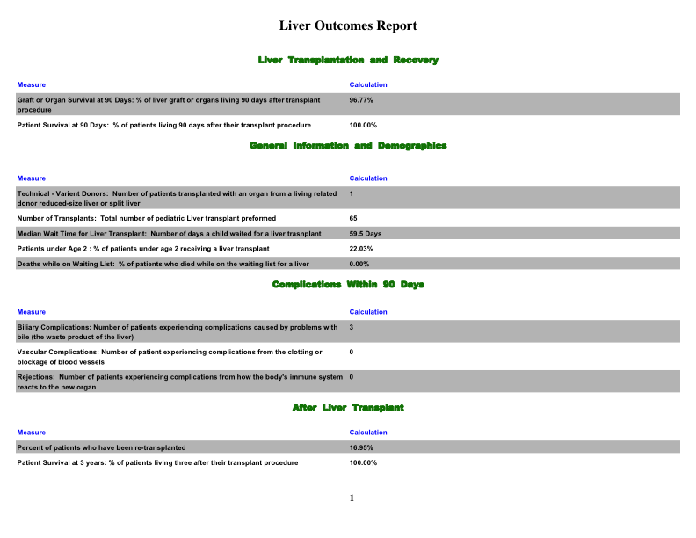
Reports

Slide 12
Collaborators*
Collaborators*
Cincinnati Children’s John Hutton, MD (PI); Peter Margolis, MD; PhD, Keith Marsolo, PhD; Eileen King, PhD
Children’s Hospital of Philadelphia, U Penn Christopher Forrest, MD, PhD; Marshall Joffe, MD, PhD
Nationwide Children’s, UNC, Nemours, Denver Children’s Kelly Kelleher, MD, MPH; Michael Kappelman, MD, MPH; David Milov, MD; Michael Kahn, MD, PhD
Children’s Hospital Boston Bill Simmons; Ken Mandl, MD, MPH; Zac Kohane, MD, PhD
Creative Commons (Science) John Wilbanks
Recombinant Data
* a partial list

Slide 13
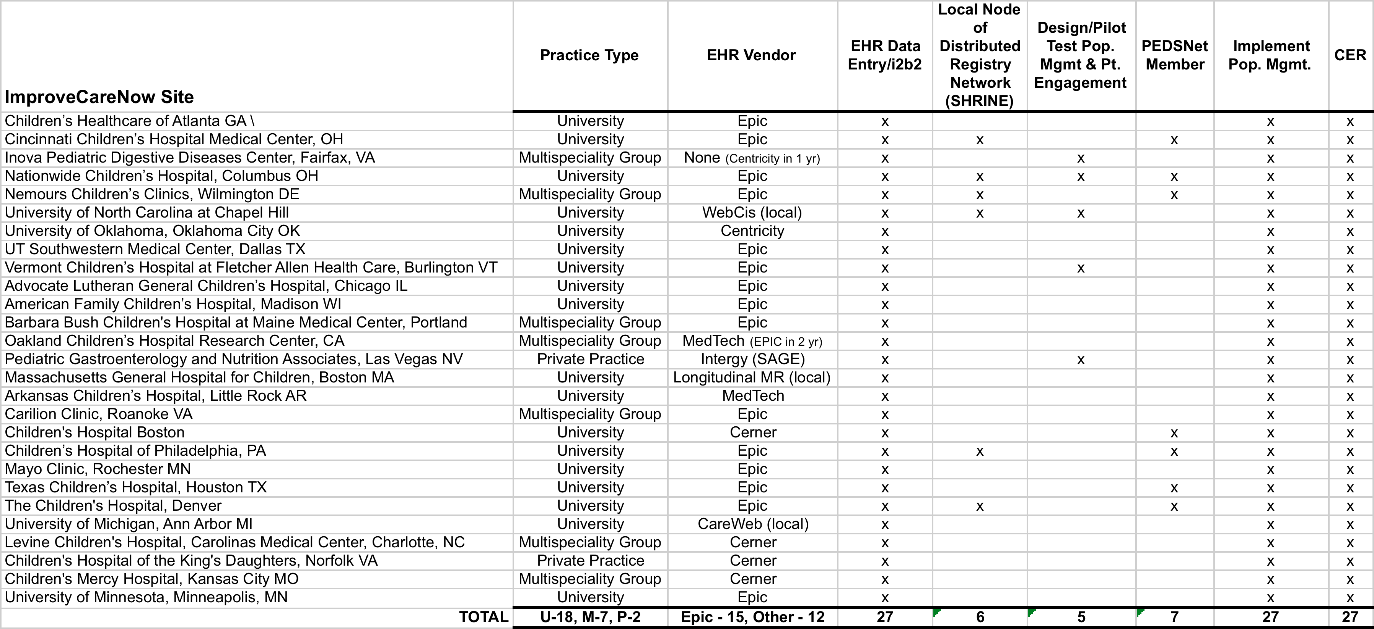
ICN Site List

Slide 14
Questions?
For more information: http://i2b2.cchmc.org
keith.marsolo@cchmc.org

