Slide 1
HDF Project Update
Mike Folk, Kent Yang, Elena Pourmal
The HDF Group
April 5, 2010

Slide 2
GMQS activities
GMQS:
General Maintenance, QA, and Support

Slide 3
Helpdesk Statistics

Slide 4
HDF4 and HDF5 issues by years

Slide 5
HDF4 issues by categories
Number of issues
Categories

Slide 6
HDF5 issues by categories
Number of issues
Categories

Slide 7
HDF issues resolution time
Percentage of all issues
Resolution time

Slide 8
HDF4 opened and closed issues
H4mapping Project
Number of issues
Years

Slide 9
HDF5 opened and closed issues
Number of issues
Years

Slide 10
Issues and their Priorities
Must Fix
Data corruption
Portability
Backward and Forward Compatibility
Funded Request
Fix after “Must Fix”
Power User Request
Tools
Library issues
Build Infrastructure
When resources permit
Wrappers
HL Libraries
Other
Need your input on priorities!

Slide 11
HDF Releases

Slide 12
Maintenance Releases 2010 - 2011
Product
June 2010
August2010
H4toH5
Java Products
Nov 2011
Jun 2011
May 2011
Feb 2011
2.2
HDF5 1.8
HDF4
4.2.6
1.8.5
1.8.5-patch1
1.8.7
1.8.8
2.7
Time Frame and versions of the products
1.8.6
Future releases

Slide 13
HDF Libraries Releases Highlights

Slide 14
HDF 4.2.6
Delayed (should be in February 2010)
New features
New functions to support H4 mapping project
Support for JPEG 7&8
CMake support for Windows and Linux 32- and 64-bit
Misc. minor bug fixes and documentation improvements

Slide 15
HDF5 1.6.*
NO SUPPORT
Dropped in November 2010 with the last release of HDF5 1.6.10
Stopped Daily Testing in February 2011

Slide 16
HDF5 1.8.5 and patch1
Support for CMake on Windows and Linux 32- and 64-bit systems
Fixed a possible data corruption issue when non-default offset and length sizes were specified
Fixed memory leaks
Testing daily for memory leaks now
Fixed a problem with a higher level of optimizations with the latest versions of the GNU C compiler
Many improvements to tools:
Support for packed bits in h5dump
Symbolic links handling in h5diff

Slide 17
HDF5 1.8.6
Delayed due to the problems with MPI I/O and parallel HDF5 library
Critical: Fixed a possible corruption problem with the scale-offset filter.
Datasets written on a big-endian machine were not readable on a little-endian machine
Datasets created with libraries prior to 1.8.6 ARE NOT READABLE by the later versions
Workaround: Use old h5repack to remove the filter
Does NASA have any data compressed with scale-offset filter?
Fixed a bug that prevented applications (IDL 7.0) to read files created by 1.8.* libraries.

Slide 18
HDF5 1.8.6
Added support for thread safety using Windows thread-safe library (vs. POSIX one)
Improved performance for partial I/O. The library can now detect situations where a memory selection has the same shape and size as a selection in a dataset in the file.

Slide 19
HDF5 1.8.7
Scheduled for May 15, 2011 (back on schedule)
Performance improvements when working with external links
Improvements to tools
Performance issues for h5repack
Misc. bug fixes for h5dump, h5ls
Improved binary packaging using CMake

Slide 20
Platform support issues

Slide 21
HDF4 Platforms Supported
Systems
AIX 6.1
Linux 2.6 (CentOS-5)
Linux 2.6 x86_64
Solaris 5.10
SGI Altix
32/64bit Windows XP, Vista, 7 and Cygwin
Mac OS Intel 10.6.* 32/64-bit
FreeBSD 6.3-stable 32/64-bit
Compilers
IBM C and Fortran cmp
GNU C and Fortran up to 4.4.5, g95 (4.0.3)
Intel C and Fortran v12
PGI C and Fortran v10
Sun C 5.10 and Fortran 95 8.4
VS 2008 Intel Fortran 10
VS 2010 Intel Fortran 10

Slide 22
HDF5 Platforms Supported
Systems
As for HDF4
Open VMS 8.3
Compilers
As for HDF4
HP C, Fortran and C++ compilers

Slide 23
HDF4 and 5 Platforms to drop
Systems
?
Compilers
VS2005 with Intel 11

Slide 24
HDF4 and 5 Platforms to add
Systems
?
Compilers
?
We are using virtualization very successfully.
Can add any Linux or Windows flavors.
Just let us know!

Slide 25
HDF Binaries Distribution

Slide 26
HDF4 and HDF5 Binaries
We distribute zlib and szip libraries with the binaries
Drastically reduced the number of questions to the Help Desk
Resolved CRTL issues when building Windows binaries
Have been looking into CMake packaging for Windows, Linux and Mac OS X
Problems remaining:
Shared libraries for Mac OS X
How important are shared libraries to NASA?

Slide 27
HDView Binaries Downloads
Platform | Number of downloads
Linux (32/64, shared/static) | 3,132
Windows (XP, Vista, 32/64) | 13,131
Mac Intel (32/64) | 920

Slide 28
Download stats for HDF5 Binaries
Platform | Number of downloads
Linux (32/64, shared/static) | 4,324
Windows (XP, Vista, 32/64) | 4,777
Mac Intel (32/64) | 676
FreeBSD | 117
AIX | 77
Other platforms are on the order of 1 - 10 downloads

Slide 29
Download stats for HDF4 Source and Binaries
Other platforms are on the order of 1 - 10 downloads
Platform | Number of downloads
Source | 1,339
Linux (32/64, shared/static) | 534
Windows (XP, Vista, 32/64) | 674

Slide 30
Methodology and more statistics
ftp access stats obtained by Google Analytics
Stats on HDF4 source code downloads, not HDF5
543 pages were viewed
46,279 unique ftp accesses in 2010
Average Time on Page 4 minutes

Slide 31
h4toh5 and h5toh4 technologies
Notes:
31

Slide 32
H4H5 tools and library
H4toH5 conversion library and utility
Template to be used in converting HDF4 to HDF5
Convert HDF4 to HDF5
Convert HDF-EOS2 to HDF-EOS5
H5toH4 conversion utility
Convert some HDF5 to HDF4
Useful when data stored in HDF5 is used by an HDF4-based application (e.g., visualization tool)
If important to NASA, there are a number of improvements that could be made to these tools

Slide 33
Current Support Plan
In maintenance mode unless requests from NASA
Continue the daily tests on the current platforms
Fix bugs
Keep documentation up to date
Release with every new HDF4 release
Next release in June 2011
Based on HDF4r2.6 and HDF5-1.8.7*
Current release based on HDF4.2.5 and HDF5-1.8.5
Support CMake on Windows and Linux 32- and 64-bit
How important this tool is for NASA?
(See next slide.)

Slide 34
Recent contacts about the package
MODAPS asked general questions about both H4toH5 and H5toH4 tools.
A researcher at Univ. of Edinburgh used H4toH5 tool to convert CERES HDF4 files to HDF5 in order to use R to visualize the data
Sweden's Meteorological and Hydrological Institute contacted us about using the H4toH5 tool
Helpdesk and hdf-forum
Three users have asked questions or reported bugs at the hdf-forum in the past 10 months
HDF HelpDesk has received 6 messages per year in the last 6 years

Slide 35
Discussion
How important are the h4toh5/h5toh4 tools to NASA?

Slide 36
HDF5 Backward/Forward Compatibility and Interoperability with other Libraries

Slide 37
Backward/Forward Compatibility
Continued testing files from FTP sites with command line utilities for backward and forward file format compatibility
OMI Level 2 files
ftp://aurapar2u.ecs.nasa.gov
OMI Level2G, MLS and HIRDL files
ftp://acdisc.gsfc.nasa.gov
TOM files
ftp://acdisc.sci.gsfc.nasa.gov
TES files
ftp://l4ftl01.larc.nasa.gov
NPOESS MiniIDPS
ftp://nppsds.nascom.nasa.gov/MiniIDPS_1.5.00.48/
NOAA’s GRAVITE
Notes:
Elena said:
They u8se unknown SW to generate files.
We are using current tools to assure we can always read those files.
Then we test whether we can read them with old utilities.
Go to wiki: testing EOS big data files.

Slide 38
HDF5/netCDF-4 Interoperability Issues
netCDF-4 cannot modify files that do not have creation order tracking enabled
netCDF-4 fails to open HDF5 files with datasets of reference types (NPOESS files)
netCDF-4 fails to open HDF5 files with multi-dimensional attributes (NPOESS files)
Concurrent opening of HDF5 files by both libraries fails due to conflicting file close properties used
On Ed’s to-do list, but no time frame

Slide 39
HDF5 Code Improvements with Valgrind and Coverity

Slide 40
Code analysis
Valgrind used in a daily testing to check for memory leaks
Developers work on the Coverity issues on a regular basis
Coverity runs as requested to assure that we address old issues and do not introduce new ones

Slide 41
Coverity
Coverity Prevent v1 found 549 defects – 538 were addressed
Coverity Prevent v2 found 1558 defects in first run – 44 have been addressed
Currently down to 1385 defects

Slide 42
Java Product Highlights 2010-2011
Notes:
42

Slide 43

HDF Java Products Highlights
HDF-Java 2.7 released in February 2011
V2.7 was built on HDF 4.2.5 and HDF5 1.8.6
Support for HDF5 1.8 features
24 bug fixes and 5 enhancements since March 2010
Notes:
43
43
Need clarification from Peter.

Slide 44
Major Improvements in HDF-Java
New HDFView features
Ability to move objects within the same file
Import/export for binary data
HDFView issues resolved
Ability to copy/past large datasets
Ability do display unsigned 64-bit integers in compound data fields
Crash when displaying attributes or compound fields with variable length strings.
Made all java classes the same for all platforms
Notes:
44
44
Need clarification from Peter.

Slide 45
HDF-EOS Plugin
Tested HDFView 2.7 with the latest HDF-EOS plugin (2.6)
Changed HDFView so that no code change is needed to compile the latest HDF-EOS plugin

Slide 46
Support for HDF5 1.8 Features
Changes to Java HDF5 Interface(JHI5) include
Support added for HDF5 1.8.
Added support for compatibility between HDF5 1.6 and 1.8.
Added unit tests for all new methods in JHI5.

Slide 47
Support for HDF5 1.8 Features
Added to the Java HDF Object package
Set the bounds of library versions
Set link storage type
Set link creation order
Show group contents in creation order
Show attributes in creation order
Create soft and external links
Retrieve link information

Slide 48
Support for HDF5 1.8 Features
Features added to HDFView include:
Set the bounds of library versions of an open file
Show the bounds of library versions of an open file
Set link creation order in groups
Set link storage type when creating a group
Create soft and external links
Show link information

Slide 49
Future work for HDF-Java
Planned work:
CMake to compile and install hdf-java products
Automatic GUI testing for HDFView (prototype)
Bug fixes and minor enhancements
HDF-Java 2.8 release with HDF 4.2.6 and HDF5 1.8.8
On the wish list:
Write variable length datasets in hdf-java
Import/export Geo Tiff images in HDFView
Implement buffering in HDFView to handle large datasets and images
Notes:
49
49

Slide 50
Tools Activities
Notes:
50

Slide 51
Major Bugs Fixed for HDF5 Tools
h5dump :
A bug when h5dump "-y -o output_file" options were used
Problem on skipping array indices every certain number
Incorrect information on datatype of elements for object references
A bug for generating XML with -u and -m options
A bug to export data pointed by a region references
h5diff
Problem on compound datasets with fixed length and variable length strings
Low performance on compound datasts (7 or more times faster now)
Inability to traverse groups recursively when comparing objects in groups
h5repack
Cannot convert a layout to COMPACT
Loses attributes for datasets of type H5T_REFERENCE
Cannot handle references to groups as an element of a dataset
h5copy
Cannot copy objects into the same HDF5 file
Cannot handle dangling links correctly
h5ls
Cannot manipulate special characters , e.g. tabs, in object names
Wrong exit code when non-existent file is to be compared

Slide 52
New Options Added to HDF5 Tools
'-exclude-path' option to h5diff to ignore object(s) in comparison
Example: Exclude datasets with metadata in HDF-EOS files
'-follow-symlinks' option to h5diff and h5ls to follow soft and external links
‘--enable-error-stack’ option in h5dump to show error information
Notes:
HDF-EOS5 files use datasets to store file metadata. Each dataset of file metadata contains very long strings. The output from h5diff is very hard to read when two such datasts are compared because each characters are compared by h5diff. This scirpt is provided for users to easily compare two HDF-EOS5 files by two steps: 1) Use h5diff to compare objects of two files except the datasets of file metadata 2) Use h5dump to get the content of the datasets of file metadata and use diff to compare the results from h5dump =====================

Slide 53
In Progress
h5edit Beta Version (Details in NPOESS report)
Create or Delete Attributes of an existing datasets or groups
Support only Basic datatypes like integers, floats and strings
H5Ocompare API
A function that compares two HDF5 objects or files
RFC will be out in April or May 2011
An independent tool may follow after the API development

Slide 54
Designs and Guidelines on HDF5 tools
HDF5 File and Object Comparison
Guidelines for Naming HDF5 Tool Options
RFC: Reserved Characters for HDF5 Applications
https://www.hdfgroup.uiuc.edu/RFC/HDF5/tools

Slide 55
Outreach

Slide 56
hdf-forum@hdfgroup.org
Started in Summer 2007
Monitored by the members of the HDF group
Very active
1605 emails from March 2010
Most discussed topics:
Parallel HDF5
.NET APIs
CMake issues
Search in HDF5
Domain specific usage of HDF5 (e.g., data streaming, climate modeling applications)
Some bugs were reported

Slide 57
hdf-forum@hdfgroup.org
Members of the FORUM help with
Releases testing on a regular basis
Maintaining CMake build systems on platforms beyond Windows
Answering questions
The HDF Group’s HelpDesk focuses on working with ESDIS and other paid customers while referring users to FORUM for difficult topics that require domain knowledge or very specific HDF5 usage
Securing funding for The HDF Group especially in domain of parallel HDF5

Slide 58
Earth Science Related Outreach
ESIP Federation Summer meeting, July 2010
Hosted a session about the support to easy access NASA HDF data
Presented four presentations and two posters
An article about the new HDF-EOS website, August 2010
Worked with ESDIS managers on this article
Published at “The Earth Observer”
2010 Unidata NetCDF Workshop, October 2010
Gave a presentation on “HDF5 for netCDF developers”
9th NASA ESDSWG conference, October 2010
Invited for two presentations about HDF5 and data interoperability
Helped Decadal Survey teams: SMAP and ICESat-2
American Geophysical Union Fall meeting, December 2010
Presented two posters about the HDF OPeNDAP work and the comprehensive tool examples at the HDF-EOS website
ESIP Federation Winter meeting, January 2011
Presented a poster about the support of easy access of the HDF data

Slide 59
HDF-EOS Workshop XIV
Tutorials
Introduction to HDF5 Data and Programming Models
Advanced HDF5 Features
Tutorial on HDF tools
Usage of NCL, IDL and Matlab to access NASA
HDF4/HDFEOS2/HDF-EOS5 data
Usage of OPeNDAP to access NASA HDF4/HDF-EOS2/HDF-EOS5 data
Parallel HDF5
Keynotes and Discussions
The HDF Group – Past, Present and Future
Discussions about data interoperability

Slide 60
HDF-EOS Workshop XIV
Status
HDF Status and Developments
Update on HDF Tools
HDF Group Support for NPP/NPOESS/JPSS
Applications and Posters
HDF OPeNDAP Project Update and Demo
Independent HDF4 mapping project update
Exploiting HDF5 Technologies to Represent Geo-Information
-An Example with Complex Terrain Data
HDF5 high performance

Slide 61
netCDF Support

Slide 62
NetCDF4 support
Help Unidata netCDF-4 developers
Frequent communications with netCDF-4 developers
Test netCDF-4 daily with the HDF5 development code
Add more features to the HDF-EOS5 augmentation tool
Harmonizing HDF5 with netCDF-4 – to be covered in JPSS/NPOESS session

Slide 63
EOS Support

Slide 64
EOS Support
EOS2 and EOS5 are tested daily with HDF4 and HDF5 development code
HDF-EOS website
Actively maintain the new website
Add codes and plots to access NASA HDF and HDF-EOS data via MATLAB, IDL and NCL
More information in a separate talk

Slide 65
OPeNDAP

Slide 66
OPeNDAP – current status
HDF5-OPeNDAP handler
Served OMI,MLS,HIRDLS,TES and MEaSUREs GSSTF data
HDF4-OPeNDAP handler
Re-engineered to support many NASA HDF-EOS2 and HDF4 products
HDF-EOS2: MODIS, AIRS, MISR,AMSR
HDF4: TRMM, CERES, OBPG, AVHRR
More information in a separate talk

Slide 67
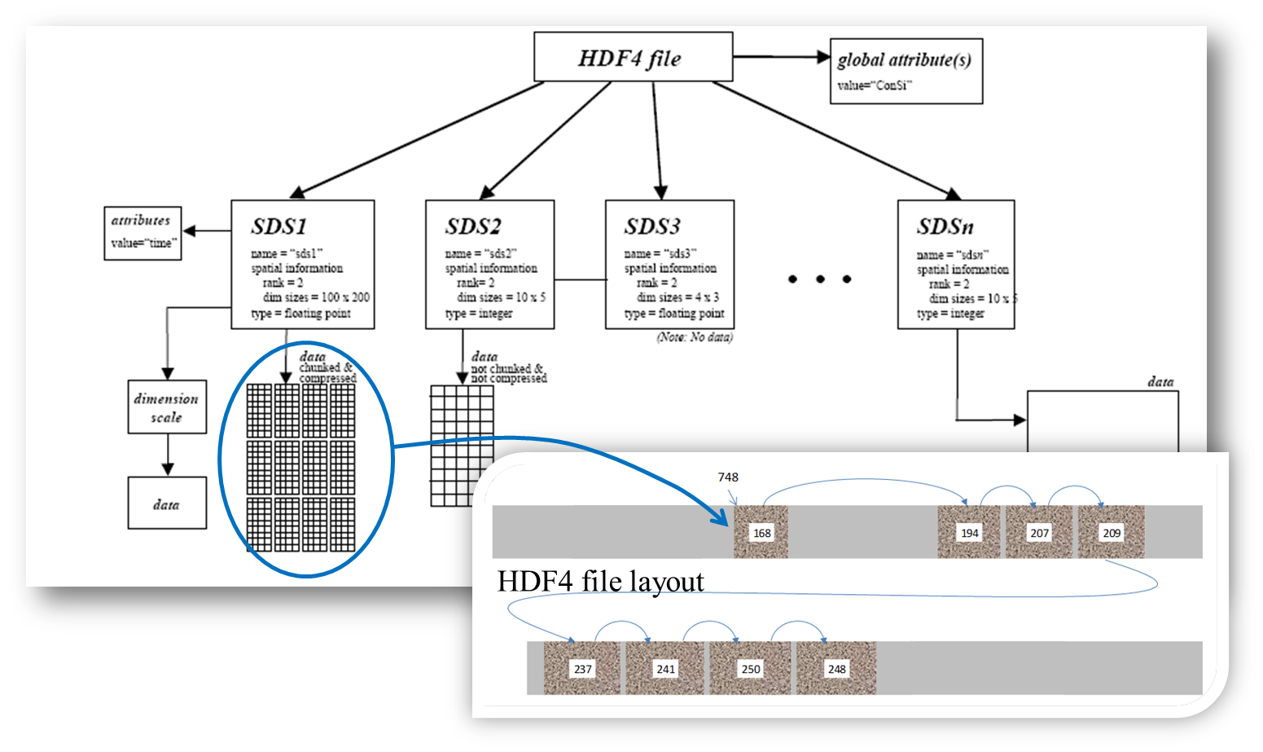
HDF4 Layout Maps (Discussed later)

Slide 68
Thank You!

Slide 69
Acknowledgements
This work was supported by cooperative agreement number NNX08AO77A from the National Aeronautics and Space Administration (NASA).
Any opinions, findings, conclusions, or recommendations expressed in this material are those of the author[s] and do not necessarily reflect the views of the National Aeronautics and Space Administration.

