Slide 1

Convergence of HPC, Databases, and Analytics
Tirthankar Lahiri
Senior Director, Oracle TimesTen In-Memory Database

Slide 2

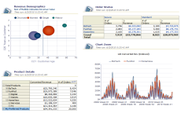

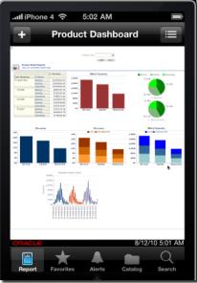



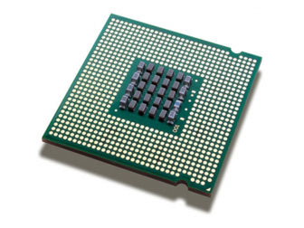
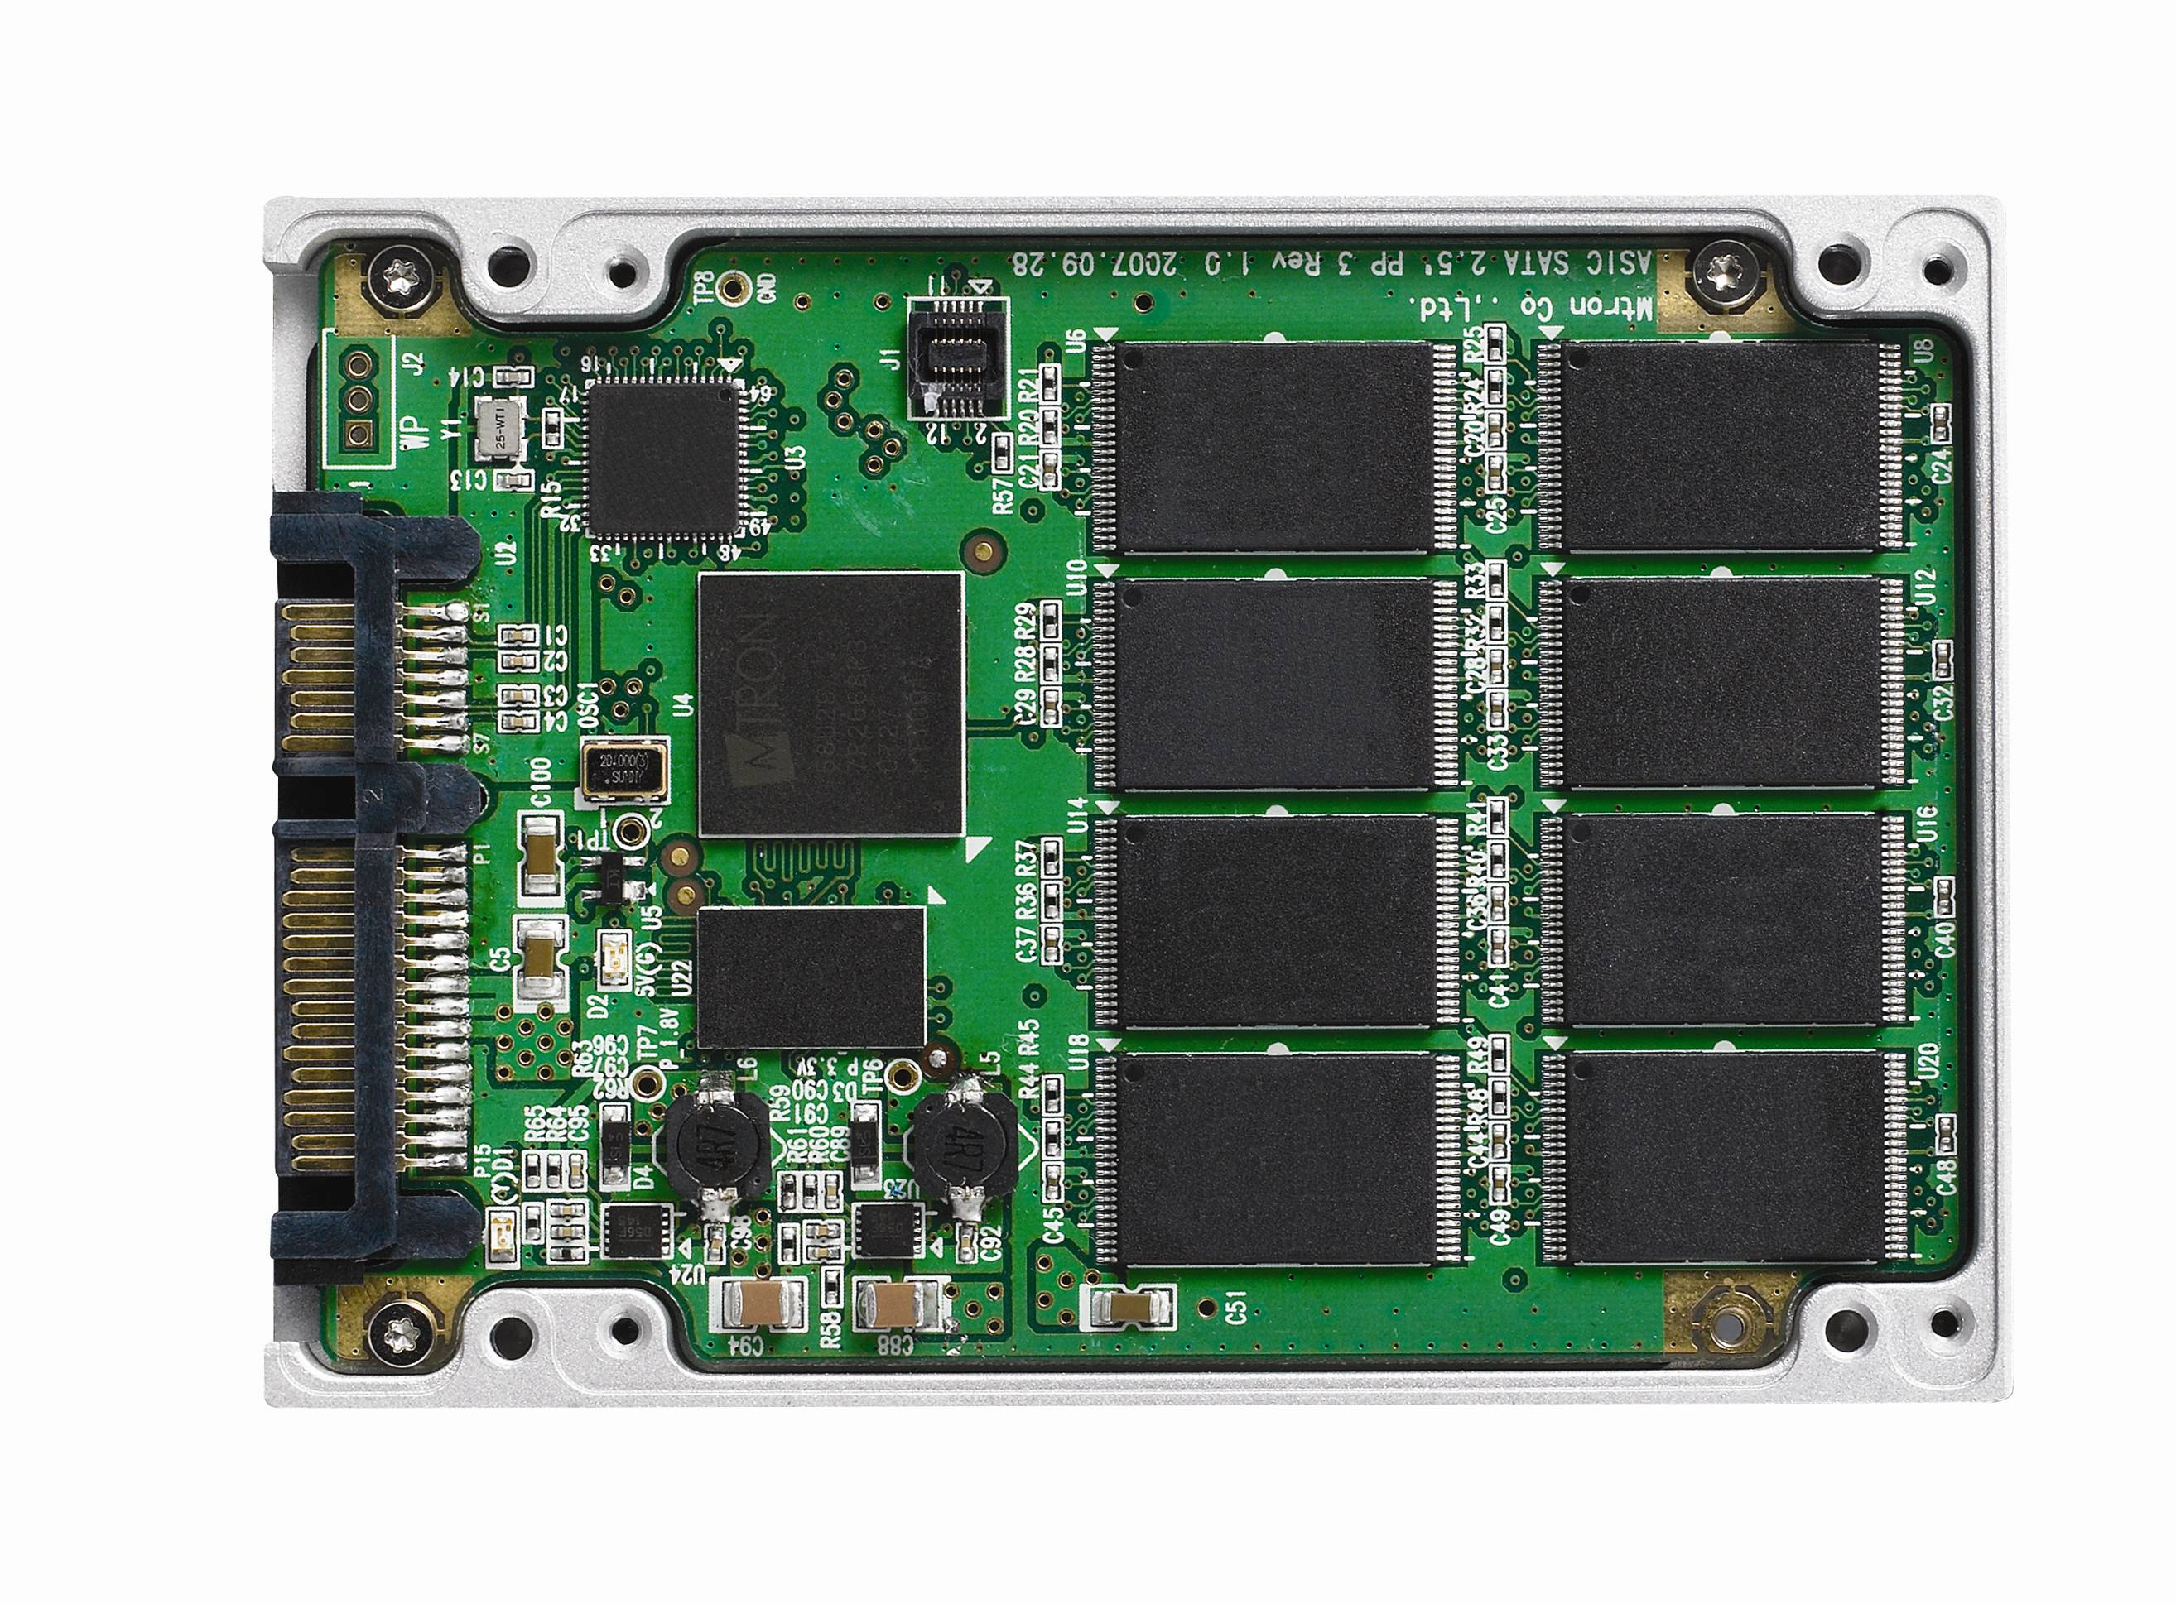
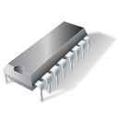
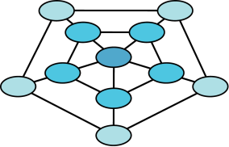
Enabling The Real-Time World
Financial Services
Social Media
Real-Time Analytics
Telecommunications
eCommerce
Next Generation DBMSs
Multicore
64-bit
Processors
High-Speed
Networks
Massive DRAM capacity
SSD/Persistent
Memory

Slide 3
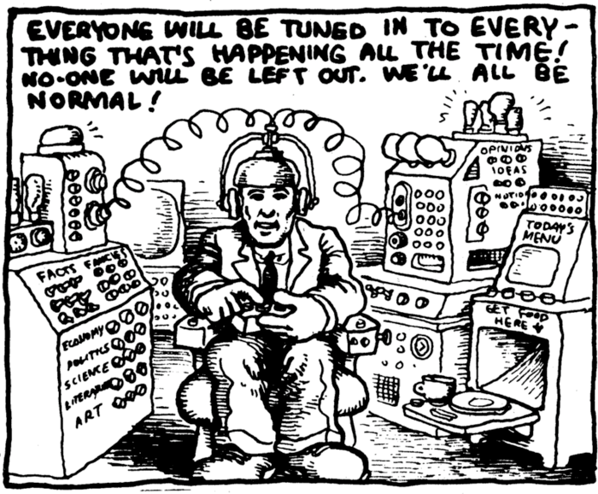
Analytics Requirements
Intuitive interfaces
Instantaneous response time
Real-time reporting
Structured / Unstructured data
Extreme concurrency

Slide 4

Hardware Trends
Processor throughput
Cores per socket: 5x in last 5 years
Clock frequency: Flat in last 2 years
Memory capacity 2x every 2 years
High-speed networking: Infiniband, RapidIO, 10GigE, etc.
Persistent memory technologies
Flash replacing disks for online storage
PC-RAM, MRAM : extension of RAM, or superfast disks for hot data

Slide 5

Database Design Trends
Integrated Appliances
Emerging Industry Trend
Exadata, Exalytics, Big-Data Appliance
Balanced Compute/Capacity/Power
Co-developed components
Built-in scale up, scale out
Built-in interoperability
Pushdown functionality into hardware
Exadata Smart Storage

Slide 6


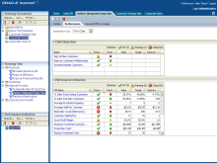



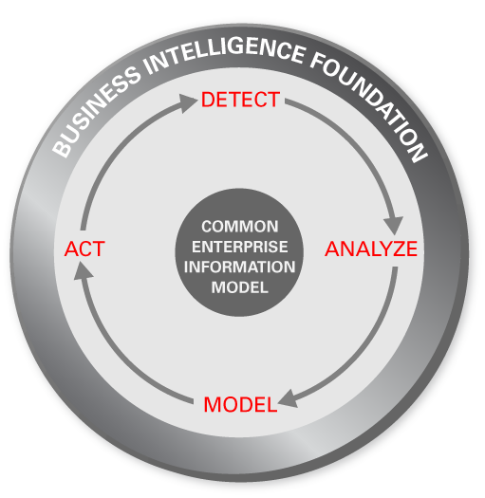
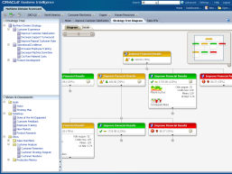
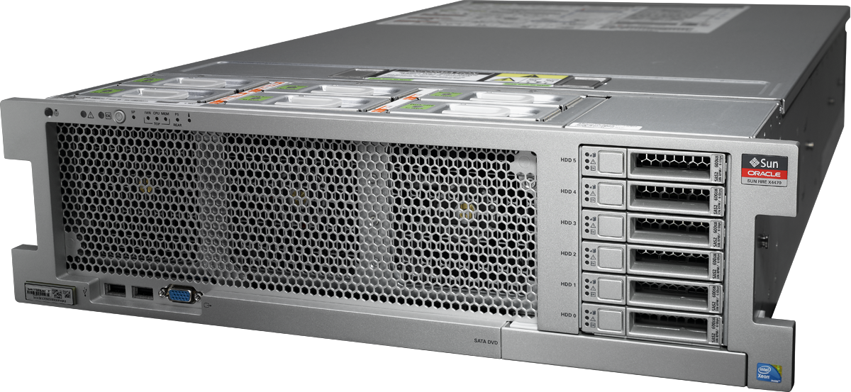

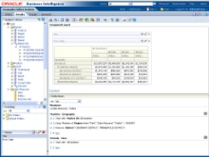



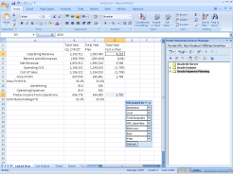


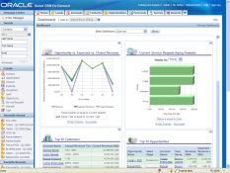
Example: Oracle Exalytics In-Memory Machine
TimesTen for Exalytics
1 TB RAM
40 Processing Cores
High Speed Networking
Memory Optimized Essbase
Adaptive In-Memory Tools
Optimized Oracle Business Intelligence Foundation Suite
In-Memory Analytics Software
In-Memory Analytics Hardware

Slide 7
Database Design Trends
Parallelism Everywhere
CPU core performance is flat
Parallelize (don’t paralyze)
Coarse-grained parallelism
Exploit workload parallelism
Parallelize query execution
Parallelize maintenance operations (backup/restore)
Exploit high speed communication primitives (e.g. Infiniband RDS)
Fine-grained parallelism
Vector execution
Multi-threading of low-level primitives

Slide 8
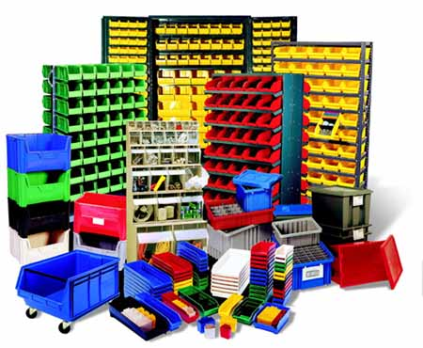
Database Design Trends
Storage Management
Use all the available tools:
In-memory storage when applicable
Column storage for sequential accesses
Row storage for random accesses
Advanced compression techniques
More bang for your storage buck
!! Beware of NUMA !!
NUMA locality awareness
Lock free or well partitioned data structures
Avoid global updates to shared memory

Slide 9

Database Design Trends
Where’s that %^@#$ plan??
Query Optimization
Enhance for analytics
Analytic functions, data mining models, graph models, etc
Cache-friendly access methods
Sequential scans better than random access
Cost modeling for modern hardware
Disk IOs are no longer the dominant cost
Cache Misses / Memory References
CPU cycles, execution time

Slide 10



