Slide 1

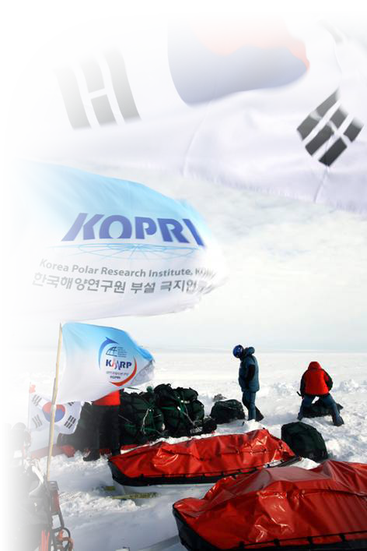
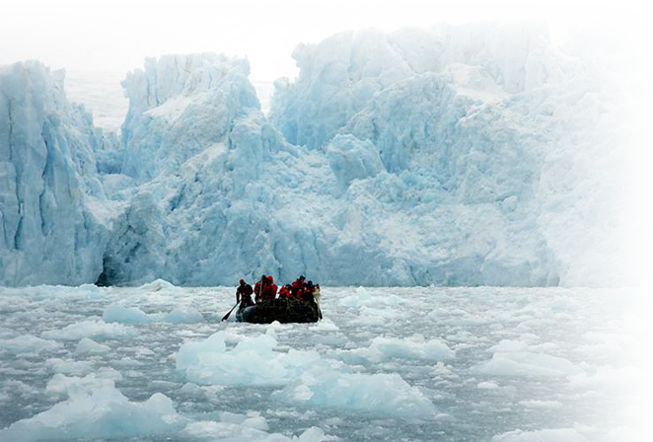
Korean Icebreaker – ARAON -
December, 2009
KOPRI

Slide 2




_
_
_
_

Slide 3

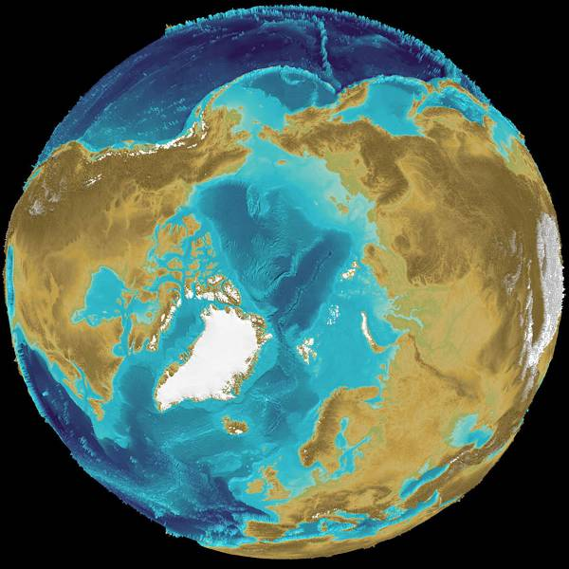
Korean Icebreaker ARAON
2

Slide 4
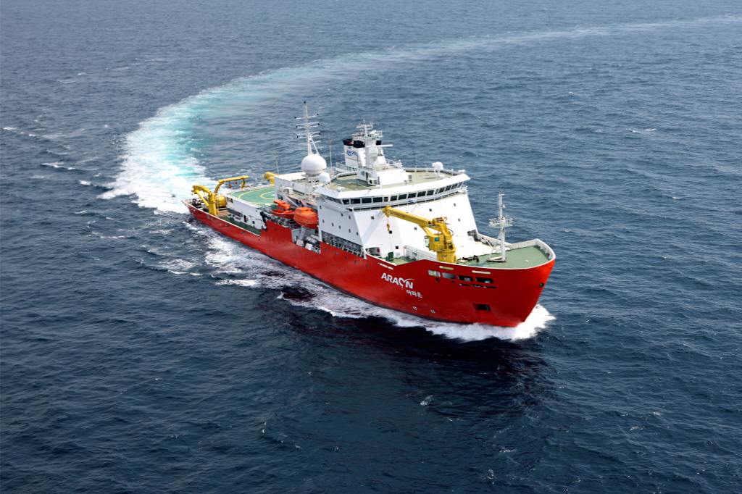

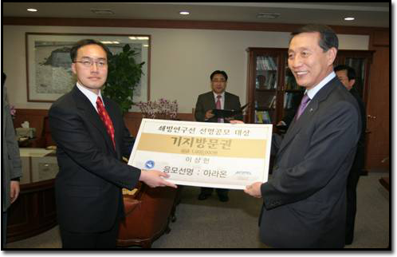
Period : 2004~2009 (6 yrs)
Budget : 100 mil USD
‘Ara’ (sea) + ‘On’ (all) = All the sea
Purpose
- To execute multidisciplinary research survey
in the both polar regions
- Logistics support for the Antarctic station

Slide 5

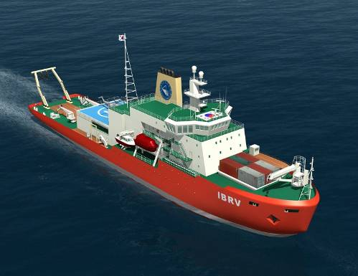
Korean Icebreaker, ‘ARAON’ - 1
Helicopter
Container: 31 TEU
25ton Crane
Barge
Work Boat
Breadth: 19 m
Length: 111 m
Tonnage : 7,847 GRT
Manning : 85 persons (25+60)
Service Speed : 12 knot
Endurance : 20,000 nm (70 days)
Classification : KR PL-10
(1 m depth icebreaking in 3 knot, Dnv Polar 10)
Propulsion : Azimuth Thruster
- Diesel electric plant : 10 MW (5 MW x 2)
DP-2 System
Notes:
그림 적절히 수정 및 재배치

Slide 6
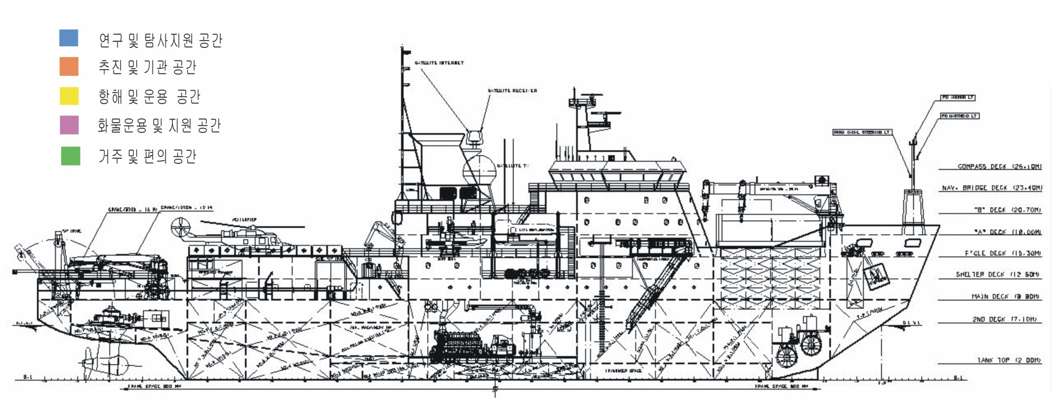
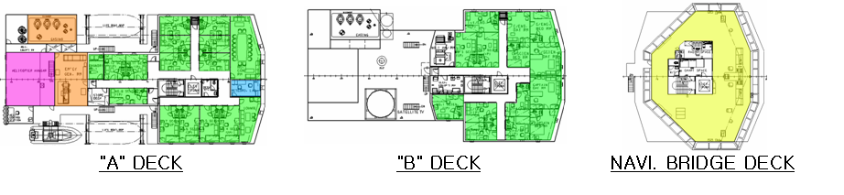
Korean Icebreaker, ‘ARAON’ - 2

Slide 7
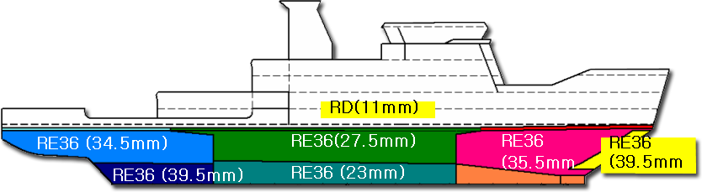
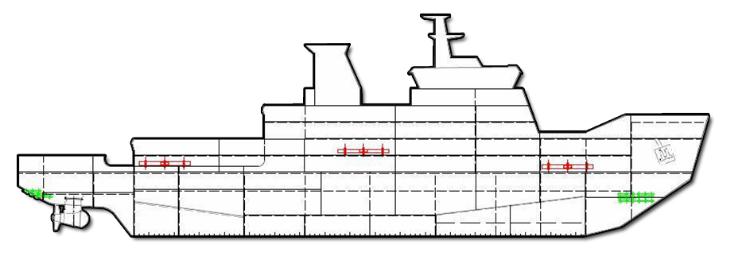
Korean Icebreaker, ‘ARAON’ - 3
Higher Tensile Steel
- Ice strengthening area and transverse structural members
- Thickness : 39.5 mm in max.
- Material (RE 36, - 40 ℃) : normalized steel or TMCP steel
Hull Stress & Ice Load Monitoring System
- Realtime monitoring and alert while ice breaking
- Keeping ice load data on cruising route

Slide 8

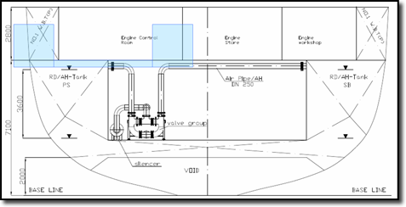
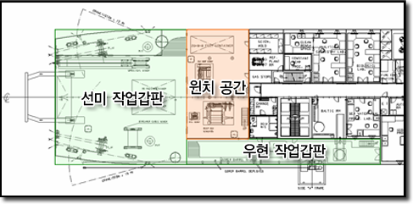
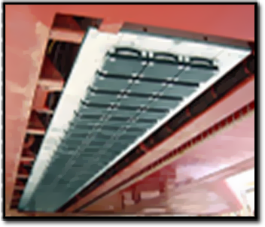
Korean Icebreaker, ‘ARAON’ - 4
Heeling System
- Air-blow type
- 7 °heeling from port to starboard
during 3 minutes
Working Deck
- Wooden deck
- Close for winches
- Room for controlling & monitoring
Sensors fitted on Hull Bottom
- Compact and no interferance
- Ice protection of bottom sensors from ice load

Slide 9
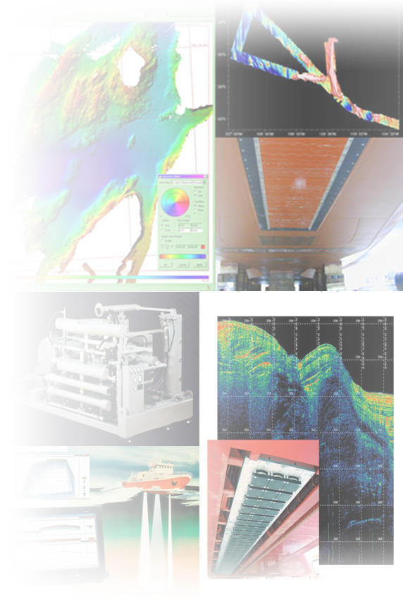

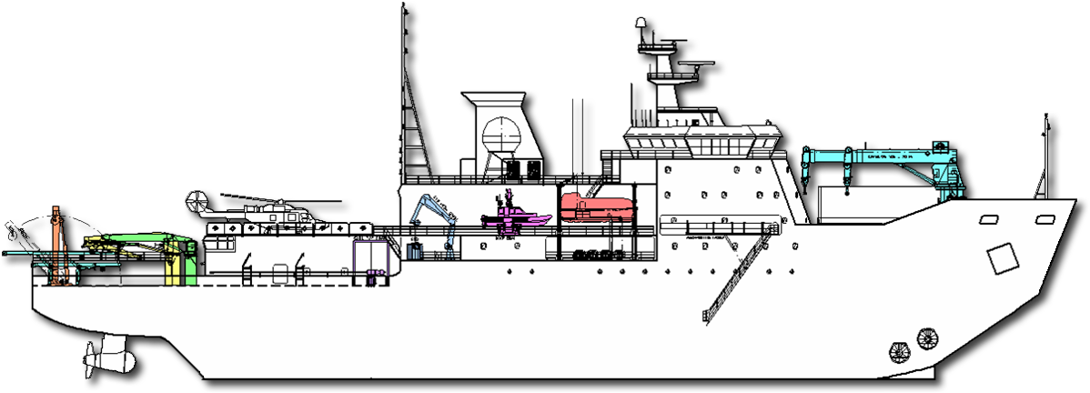
Korean Icebreaker, ‘ARAON’ - 5
Oceanography : CTD with water sampler, etc.
Geophysics : Multi-channel seismic system, etc.
Marine Geology : Multi-beam echo sounder, etc.
Biology : MOCNESS, Sea soar, etc.
Monitoring, Analyzing equipment : Weather Station, etc.
A-Frame
A-Frame
CTD Crane
25t crane
10t Crane
Hatch Cover
3t Crane
Seismic Z-Frame
Working Boat (6 prn)
Safety Boat (85 prn)
Cargo Space

Slide 10
Korean Icebreaker, ‘ARAON’ - 6
Equipment | Specification | Equipment | Specification
ADCP/LADCP | Freq:38kHz | Salinometer | Measurement Range: 0.0001:1.15 Conductivity Ratio 0.004 to 76mS/cm 0.005 to 42 Equivalent Practical PSU
Scientific Fish Finder | Freq:38,120,200kHz | Acoustic Synchronizer System | Synchronizing up to 12 acoustic system Better than 1 msec timing resolution
Low Fre. Omni-Directional Fishery Sonar | Freq:24/26/28kHz | Marine Gravity Meter | Resolution:0.01mGal Static Repeatability:0.05mGal Accuracy at Sea:1.00mGal
Multi-Beam Echo Sounder in cluding Sub-Bottom Profiler) | Freq:12kHz Freq:2.5kHz ~ 7kHz | Marine Magnetometer | Absolute accuracy:0.2nT Sensitivity:0.01nT Resolution:0.001nT
Precision Depth Recorder | Freq:12/38kHz | Wavemeter | Significant Wave Height - Range:0~5m, Accuracy:0.25~0.5m - Range:Above 5m, Accuracy:10%
Compressor System | GA90W / Air Receiver / CT | Underwater Undulating Instrument System | Towing speed:0.5 ~ 10knot Operating Depth:0 ~ 400m
Aerosol Sizing Instrument | Heating Control:0~300 ℃ | Multi-Channel Seismic System | Streamer CH:120 Air Gun Vol:1200 cu in
LIDAR | Range:12km (Less than) wavelength:532nm | TV Grab | working depth:~6000m Grab size:2 X 2ft

Slide 11
Korean Icebreaker, ‘ARAON’ - 7
Equipment | Specification | Equipment | Specification
Attitude and Positioning System | Heading Accuracy:0.02 ℃ Roll/Pitch Accuracy:0.02 ℃ Heave Accuracy:5cm or 5% | MOCNESS | Net size:333 micron mesh No of Net:9 Length of Net:6.0m
LAN system | Master/Slave Server/Ship's Signal Interface Unit/ | Satellite Receiver | Radome attenuation:~0.15dB L-Band Input Freq:1680~1710Mhz S-Band Input Freq:2207~2267Mhz
CTD | Temperature:-5 ~ 35℃ Conductivity:0 ~ 7 S/m Pressure:0 ~ 10500 meter | Sea Water Analyze | Take 120 sample cups up to 5mL Fiber optic detector for Nutrient
Weather station |  | Data cable
Sub-bottom profiler |  | pCo2 System
ITRAC Core Scanner(Second Generation) |  | Thermo-Salinograph
Streamer Winch |  | Umblilical Winch
Magnetometer Winch |  | Gun Array
Deep Sea Winch |  | Electro-Optic Cable Winch
Small Empty Winch |  | Small Coaxial Cable Winch
CTD Winch |  | CTD Crane
Stern A-Frame |  | CTD Handling System
Winch Monitoring System |  | Uncontaminater Seawater System

Slide 12


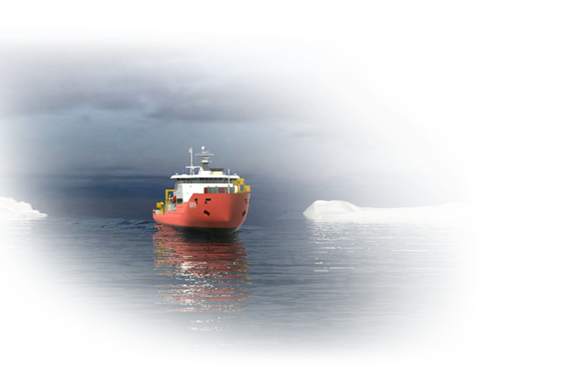

Korean Icebreaker, ‘ARAON’ - 8
2003 : Feasibility Study
2004 ~ 2005 : Concept & Basic Design
2007 : Shipbuilding Start
KOPRI/HANJIN/KMS
Jan. 2008 : Steel Cutting
May 2008 : Keel Laying
Jun. 2009 : Launching
Oct. 2009 : Delivery
Jan ~ Feb. 2010 : Ice trial
Notes:
연도순이 위아래로 지그재그 배치되어 아주 어지러운데… 한쪽으로 배치 요망!

Slide 13

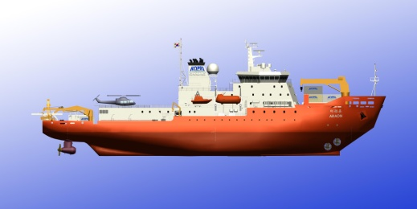
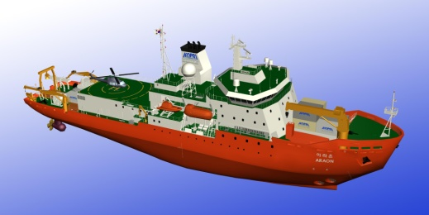
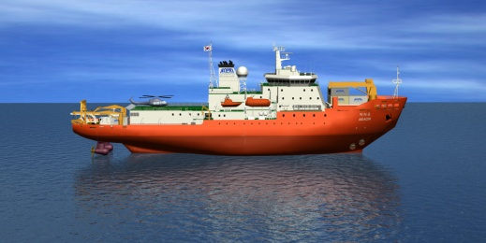
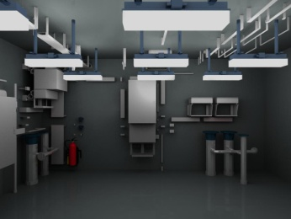
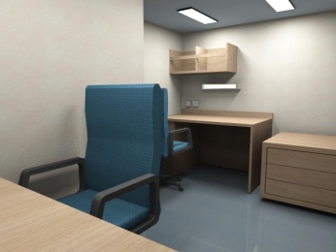
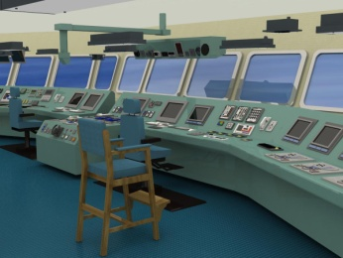
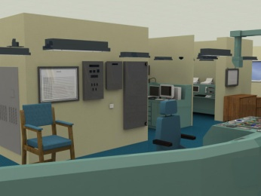
Korean Icebreaker, ‘ARAON’ - 9

Slide 14
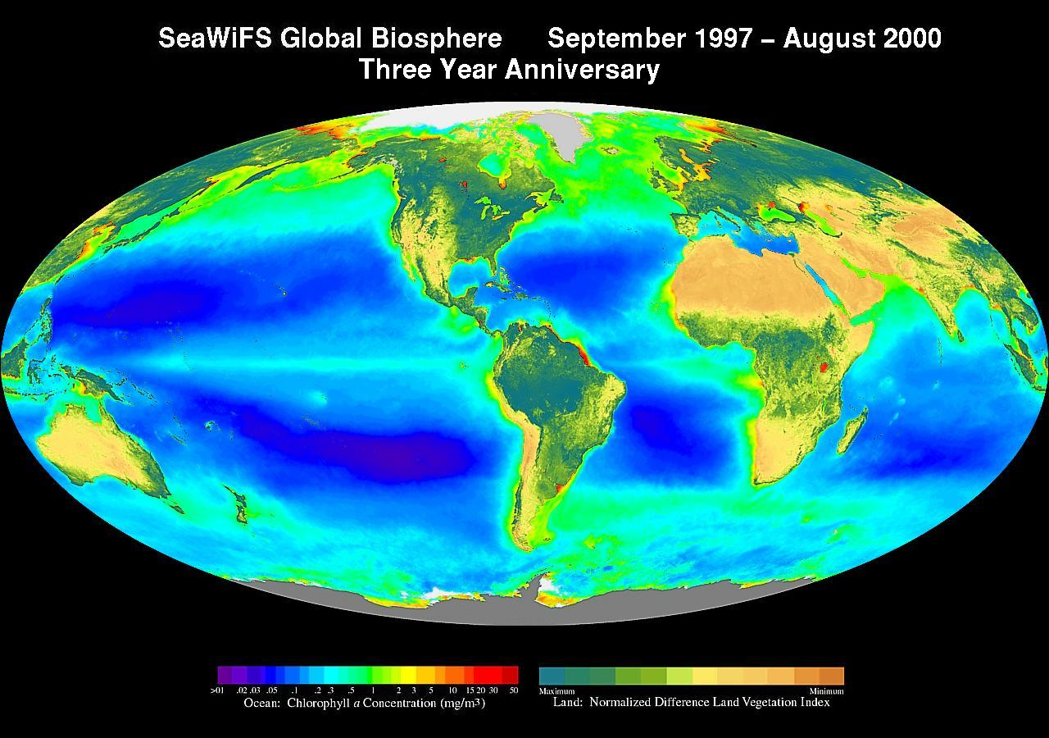
“in each area international
cooperation is actively sought”
Major Research Field(draft)
Monitoring in the Arctic ocean
Bering sea, Arctic sea (abt. 40 days)
Pacific meridional transect program
Antarctic marine ecosystem survey
Shetland islands (abt. 20 days)
Multidisciplinart survey on pacific-Antarctic ridge
Bransfield strait (abt. 20 days)
Environmental changes of Antarctic penn. Ice shelves
Weddell sea (abt. 20 days)
Greenhouse gas control,
Antarctic bathymetry & sea-bottom mapping
Bellingshousen sea (abt. 20 days)
Changing roles of Antarctic sea ice in global changes
Amundsen sea (abt. 20 days)

Slide 15
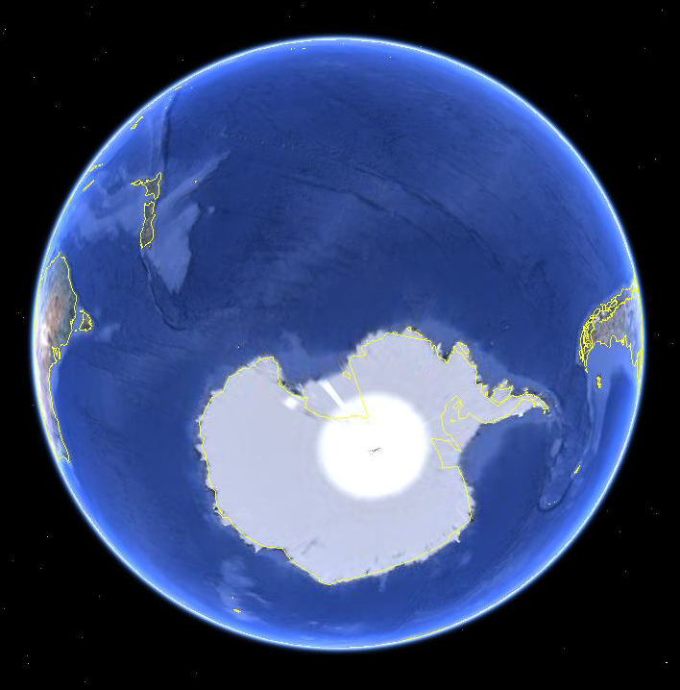


Korean Icebreaker, ‘ARAON’ - 11
Main duty
conduct Ice trial & assist site survey
Time plan | Activities
19th, Dec ~ 7th, Jan | Incheon → Christ Church
8th, Jan ~ 11th, Jan | Christ Church
12th, Jan ~ 23rd, Jan | Christ Church → Cape Burks
24th, Jan ~ 2nd, Feb | Ice trial and site survey
3rd, Feb ~ 12th, Feb | Cape Burks → Christ Church
13th, Feb ~ 15th, Feb | Christ Church
16th, Feb ~ 7th, Mar | Christ Church → Incheon
Joint point : ARAON
and AK
CHCH(12th, Jan)
5 days
10 days
10 days
CB (24th, Jan ~ 2nd, Feb)
- Conduct ice trial
& assist site survey

Slide 16
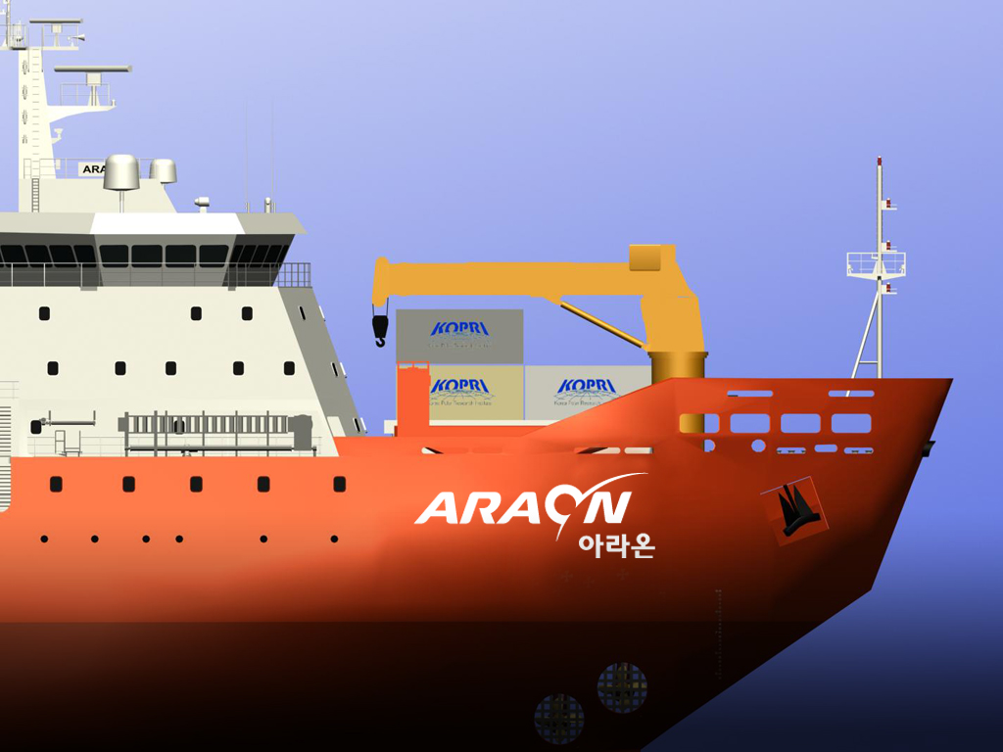
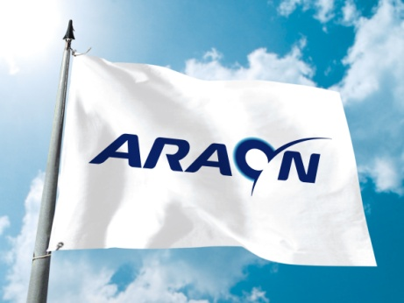
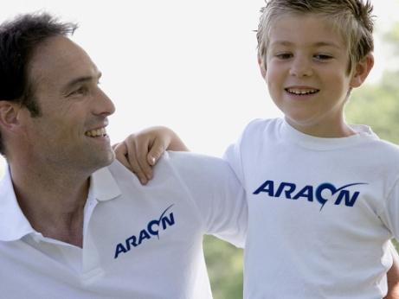
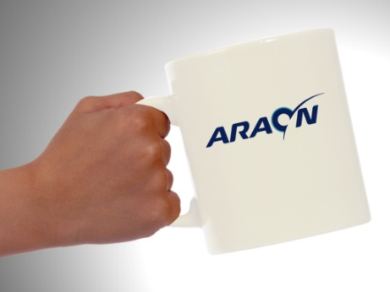
Korean Icebreaker, ‘ARAON’ - 12
‘The Light of Pole’ means global dynamics, the future of polar research and the hope of polar research

Slide 17

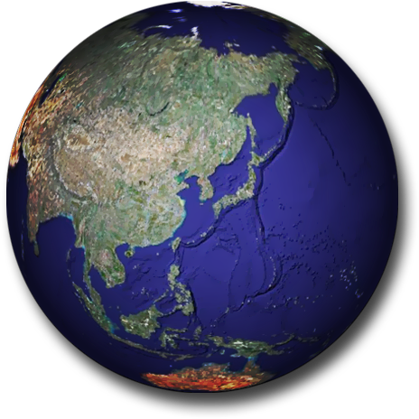
Thank you
Thank you

