Slide 1
Study of effectiveness of Mifepristone for Glioma cell line growth suppression
Mr R Ramaswamy, Mrs K Ashton, Dr R Lea, Dr P Roberts, Mr A Golash, Mr C H Davis, Dr T Dawson
Departments of Neurosurgery and Neuropathology, Royal Preston Hospital, Preston UK and University of Central Lancashire, Preston, UK
Acknowledgements: Prof J Darling, University of Wolverhampton, UK

Slide 2
Malignant Glioma is the most common malignant primary brain tumour
It is a significant burden to society- social and financial
Life span for a patient with malignant glioma is still few weeks to few months
There is presently no cure to malignant Gliomas
Most treatment strategies aim to increase life span by few weeks to months

Slide 3
Lot of research being undertaken to improve treatment of malignant Gliomas
Most research has only produced very modest improvement in prognosis
Any addition to existing treatment that can improve prognosis is beneficial
Present research was aimed at assessing the effectiveness of Mifepristone, an antiprogestogen, in suppressing growth of glioma cell lines in the laboratory.

Slide 4
Progesterone is a steroid hormone produced in the body
It has many physiological roles in the body
It is being increasingly found to be relevant to both normal physiological and pathological processes in the CNS
In fact progesterone is produced in the CNS
It is well known that certain tumours like meningiomas increase in size during states of relative abundance of progesterone like pregnancy

Slide 5
Progesterone causes its effects via progesterone receptors (PR)
There are 2 types of PRs→ PR-A and PR-B
PR-A (94kD) is a shorter form of PR-B (114 kD)
Both synthesised from same Gene
Many CNS tumours express progesterone receptors
PR-A is found to be the predominant type in meningiomas and PR-B is predominant in gliomas
Some authors have reported PR positivity proportional to the grade of glioma
Does progesterone have any role in glioma growth and does antiprogestogens have any role in treatment of gliomas?

Slide 6
Use of anti hormonal agent is well established→ Tamoxifen in breast ca
Can the same be done in gliomas?
Mifepristone is an antiprogesterone that is commonly used in obstetrics
Mifepristone has been used on 3 different malignant Glioma cell lines in literature with good growth suppression
Are these results reproducible? if yes it would increase the chances of the drug being effective in Glioma treatment.

Slide 7
Materials and Methods
Cell lines including IN1265, IN859, IN077, U257/7 (courtesy Prof J Darling, University of Wolverhampton, UK) and U373 (Sigma Aldrich, ECACC collection) were used in our experiments
Each cell line was initially grown in a flask with media (Nutrient mixture F10 Ham, Sigma N2147 + 10% Fetal Calf Serum (FCS)) until confluent growth was observed.
Cells were then trypsinised and cell numbers were counted using a Coulter counter. Cell solution was diluted to achieve 1500 cells/200 micl concentration

Slide 8
200 micltrs of this solution was plated into multiwell plates
Cells allowed to settle for 24 hrs in an incubator
After 24 hrs the media from the wells were emptied and replaced with new media either by itself or media with Mifepristone (4, 2, 1, 0.25, 0.5 micrograms/ml) or Dexamethasone (39ng/ml, 3.9ng/ml and 0.39ng/ml) or Progesterone (31ng/ml, 3.1ng/ml and 0.31ng/ml) in 3 different dilutions
Plates were returned to the incubator
4 plates were prepared each to be assayed every 24 hrs till 96 hrs

Slide 9
ATP assays were carried out to assess number of living cells and to calculate the effect of various drugs
ATP assay used principle of bioluminescence (Cell titre Glo Luminescent Cell viability assay)
Reagent contains Luciferin which when added to enzyme Luciferace in the presence of ATP and oxygen is mono-oxygenated and light is generated as a result.
This generated light is measured as “Relative Light Units” (RLU) to quantify the amount of ATP in cell solution.
Amount of ATP present in the solution is proportional to the number of living cells
Immunostaining done to look for PRs in cell lines

Slide 10
Results
Of the 5 cell lines used only 2 of the cell lines showed growth suppression with Mifepristone
IN1265 and U257/7 showed statistically significant growth suppression
Median growth suppression of U257/7 = 33% (P<0.05)
Mean growth suppression of IN1265 = 12% (P<0.05)
effect was mainly seen with drug concentration 4 times above therapeutic level with IN1265 and was seen in all dose concentrations in U257/7 cell line.

Slide 11
Growth suppression was most pronounced on days 3 and 4.
Growth suppression was highest with the highest dose of Mifepristone and gradually decreased with decreasing drug dose
Although there was a dose response demonstrated in U257/7 the lowest concentration of Mifepristone (X/4) showed higher growth suppression than the preceding 3 higher doses of Mifepristone hence falling out of the dose response pattern. This pattern was not explicable

Slide 12
Cell line | Growth supression
U373 | Not significant
U257/7 | 33%
IN1265 | 12%
IN077 | Not significant
IN859 | Not significant

Slide 13
Figure 1: Growth curve showing growth suppression of Mifepristone at 4X dose on IN1265 cell line.

Slide 14
Figure 2: Effect of 5 different doses of Mifepristone on growth of U257/7 cell line over 96 hrs. 4X= 4 times therapeutic concentration of Mifepristone, 1X (T) = Therapeutic concentration of Mifepritsone, T/2 and T/4= half and ¼ concentration of Mifepristone.

Slide 15
Figure 3: Graph representing dose responses of U257/7 after 96 hrs of exposure to Mifepristone.

Slide 16
Effects of Progesterone and dexamethasone as growth stimulants were analysed on various cell lines
There was no statistically significant growth stimulation with Progesterone in any of the cell lines.
There was some growth stimulation with Dexamethasone in U257/7 on day 1 with all 3 doses of Dexamethasone.
This was statistically significant but did not show an expected dose response pattern or was not sustained after day 1.
On immunostaining none of the cell lines showed significant PR positivity including U257/7 and IN1265.

Slide 18
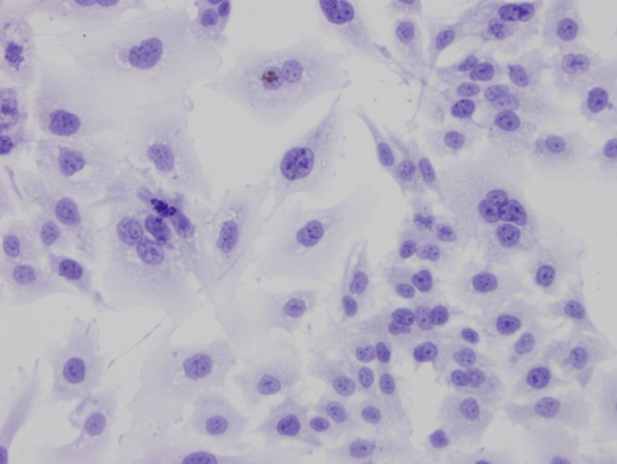
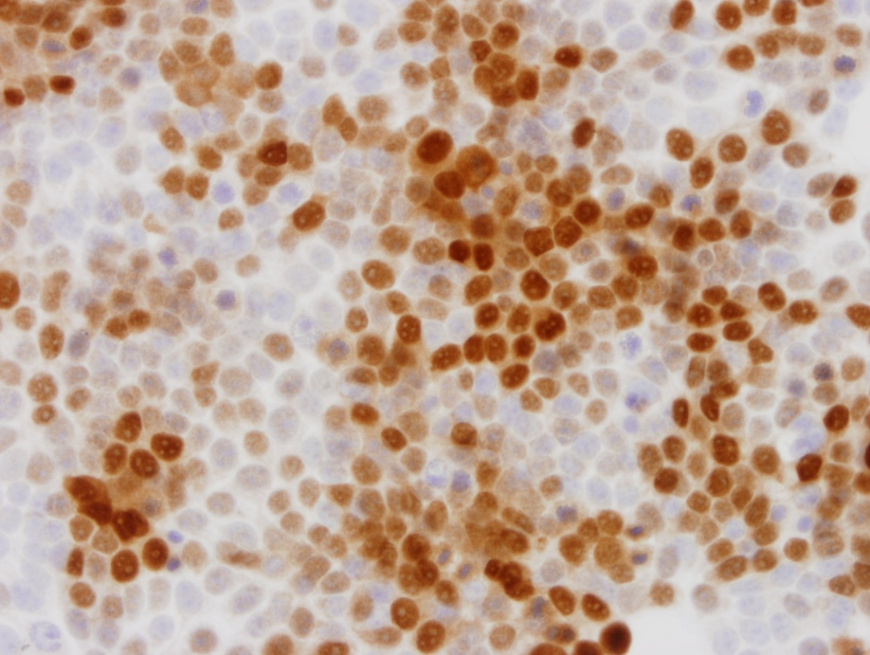
U257/7 and MCF (Control endometrial cell line on the right shows strong PR positivity) PR staining

Slide 19
Discussion
Considering the significant morbidity and mortality associated with malignant gliomas and the limited effective modalities available to treat these tumours, it becomes necessary to test any logical treatment option possible to improve treatment outcomes in these devastating tumours
Mifepristone has been successfully used in various trials to control meningioma growth in patients with either in-operable or recurrent meningiomas (26, 27, 28)
Pinsky et al demonstrated in their in vivo and in vitro experiments, a growth suppression of > 50% with Mifepristone.
They showed that Mifepristone suppressed tumour growth even when used without growth stimulants like progesterone or dexmethasone

Slide 20
Similar experiment done by Gonzalez-Aguero et al using 2 cell lines showed growth suppressive potential of Mifepristone.
They also showed that Progesterone increased the “S” phase of glioma cell cycle and Mifepristone blocked that effect of Progesterone.
Used alone in the absence of Progesterone, Mifepristone did not seem to affect the cell cycle, indicating possibly a different mechanism of action.
They also found growth suppressive effects from day 2 onwards when Mifepristone was used alone

Slide 21
In our experiments, we have been successful in demonstrating the growth suppressive effects of Mifepristone on glioma cell lines.
We were however not able to demonstrate growth stimulation by either Progesterone or Dexamethasone to any significant degree.
Also, we found that effect of Mifepristone was most pronounced on days 3 and 4 rather than from day 2.
None of the cell lines used by us showed significant PR receptor positivity.
It is known that receptor expression diminishes significantly in tumours grown in cultures (25). This could explain why immunostaining did not reveal PR positivity in our experiment.
This could also explain the lack of predictability of expected response to various doses of drugs. This may also be the reason why we have not been able to demonstrate growth stimulation by either progesterone or dexamethasone.
It is also possible why higher doses showed better response than lower doses.

Slide 22
If however our cell lines were truly PR deficient, then the growth suppression by Mifepristone in the absence of growth stimulation by either progesterone or dexamethasone, may indicate a different mechanism of action which we are not able to explain
This does increase the therapeutic potential of Mifepristone in Gliomas as not all malignant gliomas are PR positive
Conclusion:
Our experiments confirm the growth suppressive potential of Mifepristone on malignant glioma cell lines grown in the laboratory.
Our results are in keeping with other reports in literature with a few differences.
This raises the possibility of use of Mifepristone in treatment of GBMs but needs further investigating possibly in the form of use of the drug first on primary glioma cultures or in vivo studies before Mifepristone can become a treatment modality in humans.
But our and few other experiments have certainly opened an interesting and potentially useful treatment option for a so far incurable and devastating disease.

Slide 23
References:
1) Inhibition of Growth of the Human Malignant Glioma Cell Line (U87MG) by the Steroid Hormone Antagonist RU486*
Jacek Pinski, Gabor Halmos, Yutaka Shirahige, James Wittliff, and Andrew V. Schally
Journal of Clinical Endocrinology and Metabolism, Vol. 77 (5), 1388-93
2) Progesterone effects on cell growth of U373 and D54 human astrocytoma cell lines.
González-Agüero G, Gutiérrez AA, González-Espinosa D, Solano JD, Morales R, González-Arenas A, Cabrera-Muñoz E, Camacho-Arroyo I
Endocrine. 2007 Oct;32(2):129-35. Epub 2007 Nov 15.
3) Recurrences of meningiomas: predictive value of pathological features and hormonal and growth factors.
Maiuri F, De Caro Mdel B, Esposito F, Cappabianca P, Strazzullo V, Pettinato G, de Divitiis E.
J Neurooncol. 2007 Mar;82(1):63-8. Epub 2007 Jan 17.
4) Progesterone and estrogen receptors in meningiomas: prognostic considerations.
Hsu DW, Efird JT, Hedley-Whyte ET
J Neurosurg. 1997 Jan;86(1):113-20.
5) Schwann cells from human neurofibromas show increased proliferation rates under the influence of progesterone.
Overdiek A, Winner U, Mayatepek E, Rosenbaum T
Pediatr Res. 2008 Mar 19

Slide 24
6) The Antiprogestogen Mifepristone: A Review
Pramila W Ashok, Prabath T Wagaarachchi and Allan Templeton
Curr. Med. Chem- Immun, Endoc & Metab Agents, 2002, 2, 71-90
7) Do hormonal contraceptives stimulate growth of neurofibromas? A survey on 59 NF1 patients.
Lammert M, Mautner VF, Kluwe L
BMC Cancer. 2005 Feb 9;5:16.
8) ProTECT: a randomized clinical trial of progesterone for acute traumatic brain injury.
Wright DW, Kellermann AL, Hertzberg VS, Clark PL, Frankel M, Goldstein FC, Salomone JP, Dent LL, Harris OA, Ander DS, Lowery DW, Patel MM, Denson DD, Gordon AB, Wald MM, Gupta S, Hoffman SW, Stein DG.
Ann Emerg Med. 2007 Apr;49(4):391-402, 402.e1-2. Epub 2006 Sep 29.
9) Progesterone differentially regulates pro- and anti-apoptotic gene expression in cerebral cortex following traumatic brain injury in rats.
Yao XL, Liu J, Lee E, Ling GS, McCabe JT
J Neurotrauma. 2005 Jun;22(6):656-68.
10) Effects of progesterone on neurologic and morphologic outcome following diffuse traumatic brain injury in rats.
O'Connor CA, Cernak I, Johnson F, Vink R.
Exp Neurol. 2007 May;205(1):145-53. Epub 2007 Feb 12.
11) Biosynthesis and organizing action of neurosteroids in the developing Purkinje cell.
Tsutsui K.
Cerebellum. 2006;5(2):89-96.
12) Does progesterone have neuroprotective properties?
Stein DG, Wright DW, Kellermann AL
Ann Emerg Med. 2008 Feb;51(2):164-72. Epub 2007 Jun 22.

Slide 25
13) The neuroprotective effect of progesterone after traumatic brain injury in male mice is independent of both the inflammatory response and growth factor expression.
Jones NC, Constantin D, Prior MJ, Morris PG, Marsden CA, Murphy S
Eur J Neurosci. 2005 Mar;21(6):1547-54.
14) Regulation of sex differences in progesterone receptor expression in the medial preoptic nucleus of postnatal rats.
Quadros PS, Goldstein AY, De Vries GJ, Wagner CK.
J Neuroendocrinol. 2002 Oct;14(10):761-7.
15) Progesterone receptor isoforms expression pattern in human astrocytomas.
González-Agüero G, Ondarza R, Gamboa-Domínguez A, Cerbón MA, Camacho-Arroyo I.
Brain Res Bull. 2001 Sep 1;56(1):43-8.
16) Correlation of expression of progesterone receptors with histopathological type and grade of malignancy of cerebral neoplasms
Och W, Mariak Z, Kopeć J, Smółka M, Koziorowski M
Neurol Neurochir Pol. 2001;35 Suppl 5:110-8.
17) Progesterone and estrogen receptors: opposing prognostic indicators in meningiomas.
Pravdenkova S, Al-Mefty O, Sawyer J, Husain M.
J Neurosurg. 2006 Aug;105(2):163-73.
18) Specific genes expressed in association with progesterone receptors in meningioma.
Claus EB, Park PJ, Carroll R, Chan J, Black PM.
Cancer Res. 2008 Jan 1;68(1):314-22.
19) Progesterone receptor isoform expression in human meningiomas.
Verheijen FM, Sprong M, Jacobs HM, Donker GH, Amelink GJ, Thijssen JH, Blankenstein MA.
Eur J Cancer. 2001 Aug;37(12):1488-95.

Slide 26
20) Enhancement of glioblastoma cell killing by combination treatment with temozolomide and tamoxifen or hypericin.
Gupta V, Su YS, Wang W, Kardosh A, Liebes LF, Hofman FM, Schönthal AH, Chen TC.
Neurosurg Focus. 2006 Apr 15;20(4):E20.
21) Sodium phenylacetate (NaPa) improves the TAM effect on glioblastoma experimental tumors by inducing cell growth arrest and apoptosis.
Wei MX, Liu JM, Gadal F, Yi P, Liu J, Crepin M.
Anticancer Res. 2007 Mar-Apr;27(2):953-8.
22) The influence of tamoxifen on the secretion of transforming growth factor-beta2 (TGF-beta2) in glioblastomas: in vitro and in vivo findings.
Puchner MJ, Köppen JA, Zapf S, Knabbe C, Westphal M.
Anticancer Res. 2002 Jan-Feb;22(1A):45-51.
23) A phase I study of high-dose tamoxifen for the treatment of refractory malignant gliomas of childhood.
Pollack IF, DaRosso RC, Robertson PL, Jakacki RL, Mirro JR Jr, Blatt J, Nicholson S, Packer RJ, Allen JC, Cisneros A, Jordan VC.
Clin Cancer Res. 1997 Jul;3(7):1109-15.
24) Progesterone Production and Actions in the Human Central Nervous System and Neurogenic Tumors
Tsukasa Inoue, Jun-Ichi Akahira, Takashi Suzuki, Adrew D. Darnel, Chika Kaneko,
Kazuhiro Takahashi, Masahito Hatori, Reizo Shirane, Toshihiro Kumabe,Yshimochi Kurokawa, Susumu Satomi, and Hironobu Sasano
The Journal of Clinical Endocrinology & Metabolism 87(11):5325–5331
25) Occurrence, regulation, and significance of progesterone receptors in human meningioma.
Blankenstein MA, Verheijen FM, Jacobs JM, Donker TH, van Duijnhoven MW, Thijssen JH.
Steroids. 2000 Oct-Nov;65(10-11):795-800.
26) Long-term administration of mifepristone (RU486): clinical tolerance during extended treatment of meningioma.
Grunberg SM, Weiss MH, Russell CA, Spitz IM, Ahmadi J, Sadun A, Sitruk-Ware R
Cancer Invest. 2006 Dec;24(8):727-33.
27) Treatment of unresectable meningiomas with the antiprogesterone agent mifepristone.
Grunberg SM, Weiss MH, Spitz IM, Ahmadi J, Sadun A, Russell CA, Lucci L, Stevenson LL.
J Neurosurg. 1991 Jun;74(6):861-6.
28) Mifepristone (RU 486) treatment of meningiomas.
S W Lamberts, H L Tanghe, C J Avezaat, R Braakman, R Wijngaarde, J W Koper, and H de Jong
J Neurol Neurosurg Psychiatry. 1992 June; 55(6): 486–490.

